Slide 1
Compliance Order on Consent Update
Doug Hintze
Manager
Environmental Management Los Alamos Field Office
November 29, 2018

Slide 2
Presentation Outline
Background
Consent Order Overview
Campaign Approach
Appendix C: Consent Order Campaigns
Appendix B: FY 2018 Enforceable Milestones

Slide 3
Background
2002: Litigation between DOE, NMED, and the Regents of the University of California (LANS’ predecessor)
2005: NMED, DOE and the Regents of the University of California entered into a “Compliance Order on Consent” (2005 Consent Order)
2012: NMED and DOE entered into a non-binding agreement, called the Framework Agreement
2016: Consent Order signed by NMED and DOE in June of 2016. Supersedes the 2005 Consent Order

Slide 4
Consent Order Overview
Appendix A: Solid Waste Management Unit/Area of Concern List
Appendix C: Future Campaigns
Appendix B: Milestones and Targets
Process for updating Appendix B
Current FY, FY+1, & FY+2, with milestones and targets
Updated annually
Review includes changed conditions, priorities, & funding
Revised Appendix B posted on NMED's website
Public meeting held to present changes to Appendix B
Dynamic process allows for revision during the year due to upward or downward adjustments in funding

Slide 5
Campaign Approach
EM-LA Lifecycle Cost Estimate (LCE) is based on a campaign approach
LCE is integrated with the 2016 Consent Order
17 Soil and Water campaigns identified in Appendix C
Legacy waste is a standalone campaign driven by DOE radiological authority (rather than the Consent Order)
Campaigns are worked in the prioritized order listed in Appendix C
Multiple campaigns underway simultaneously
Safe, efficient and transparent execution

Slide 6
Appendix C: Consent Order Campaigns
Item # | Campaign Title | SWMUs/AOCs | Estimated Completion | Estimated Cost (M)
1 | Chromium Interim Measure | 1 | 2020 – 2022 | $38.9 - $50.6
2 | Historic Properties Completion | 84 | 2019 – 2020 | $5.3 - $6.4
3 | Royal Demolition Explosives (RDX) Characterization | 2 | 2022 – 2024 | $1.6 - $2.1
4 | Supplemental Investigations Reports | 222 | 2019 – 2019 | $0 - $1.0
5 | TA-21 D&D and Cleanup | 41 | 2020 – 2022 | $45.8 - $54.9
6 | RDX Remedy | 0 | 2024 – 2025 | $22.3 - $26.8
7 | Known Cleanup Sites | 20 | 2027 - 2028 | $34.8 - $41.8
8 | Material Disposal Area (MDAs) A & T Remedy | 30 | 2028 – 2031 | $92.1 - $124.3
9 | Chromium Final Remedy | 0 | 2026 – 2028 | $100.3 - $130.0
10 | Southern External Boundary | 60 | 2025 – 2026 | $10.0 - $12.0
11 | MDA C Remedy | 1 | 2024 – 2026 | $34.6 - $48.7
12 | Sandia Canyon Watershed | 49 | 2024 – 2025 | $6.3 - $7.6
13 | Pajarito Watershed | 167 | 2028 – 2030 | $20.7 - $24.9
14 | Upper Water Watershed | 253 | 2030 – 2031 | $33.5 - $40.2
15 | MDA AB Remedy | 12 | 2027 – 2030 | $41.8 - $50.2
16 | MDA H Remedy | 1 | 2029 – 2030 | $15.3 - $18.3
17 | MDA G & L Remedy / D&D | 12 | 2035 – 2040 | $237.9 - $356.9
Highlighted rows indicate campaigns currently underway

Slide 7
Appendix B: FY 2018 Enforceable Milestones
Campaign | Consent Order Milestone | Target Date | Forecast | Actual (M/NM)
Chromium IM & Characterization | Technical Report Package for Chromium Plume Center Characteristics | Mar 30, 2018 | Mar 28, 2018 | Met
Chromium IM & Characterization | Letter Report to NMED-HWB documenting integrated operation of Chromium Extraction Well 4 (CrEX-4) into the existing IM System | Mar 30, 2018 | Mar 22, 2018 | Met
Chromium IM & Characterization | Summary Report (Completion or Progress) Phase I Pilot Amendment Test Results | Jul 31, 2018 | Jul 31, 2018 | Met
Chromium IM & Characterization | Phase II Pilot Amendment Test Work Plan | Sep 28, 2018 | Sep 28, 2018 | Renegotiated
Chromium IM & Characterization | Annual Progress Report on Chromium Plume Control IM Performance | Sep 28, 2018 | Sep 28, 2018 | Met
RDX Characterization | Technical Report Package related to Deep Groundwater Investigation | Mar 30, 2018 | Mar 30, 2018 | Met
RDX Characterization | R-69 Field Completion | Sep 28, 2018 | Sep 28, 2018 | Renegotiated
RDX Characterization | First Annual Long-Term Monitoring Report following completion of Surface CMI and approval of Long-Term Monitoring Plan | Sep 28, 2018 | Sep 28, 2018 | Met

Slide 8
Appendix B: FY 2018 Enforceable Milestones (Continued)
Campaign | Consent Order Milestone | Target Date | Forecast | Actual (M/NM)
Historical Properties Upper LA Canyon | Upper LA Canyon Phase II IR Submitted to NMED | Sept 28, 2018 | Sept 28, 2018 | Met
Historical Properties Middle LA Canyon | Middle LA Canyon Phase II IR Submitted to NMED | Sept 28, 2018 | Sept 28, 2018 | Met
TA-21 D&D and Cleanup | Investigation Report for DP sites Aggregate Area at DP East at TA-21 | Jun 29, 2018 | Jun 29, 2018 | Met
Known Cleanup Sites | Field Completion for Aggregate Area Known Cleanup Sites | Sep 28, 2018 | Sep 28, 2018
Sandia Canyon Watershed | Sandia Canyon Wetland Performance Report for Period April 2017-December 2017 | Apr 30, 2018 | Apr 30, 2018 | Met
N/A | Annual Monitoring Report for the completed FY17 and Plan for the upcoming FY18 LA/Pueblo Watershed Sediment Transport Mitigation Project | Apr 30, 2018 | Apr 28, 2018 | Met
N/A | Annual Update to the Interim Facility-Wide Groundwater Monitoring Plan | May 30, 2018 | May 30, 2018 | Met

Slide 10
Compliance Order on Consent Appendix B Milestones for Fiscal Year 2019
Arturo Duran, Designated Agency Manager
Environmental Management Los Alamos Field Office
November 29, 2018

Slide 11
Appendix B Milestones
Section VIII.C Annual Planning Process
The annual planning process is the process the Parties will use to update Appendix A, Appendix B, and Appendix C, as appropriate.
Prior to the end of the first quarter of each FY, DOE will provide a revision of Appendix A and Appendix C to NMED indicating proposed changes.
DOE shall update the milestones and targets in Appendix B on an annual basis, accounting for such factors as, actual work progress, changed conditions, and changes in anticipated funding levels.

Slide 12
Appendix B Milestones
Campaign Approach
Corrective action activities required by the Consent Order will be organized into campaigns, generally based upon a risk-based approach to grouping, prioritizing, and accomplishing corrective action activities at SWMUs and AOCs.
A campaign may consist of one or more projects; campaigns and projects consist of one or more tasks and deliverables.

Slide 13
Appendix B Milestones
Campaigns in Fiscal Year 2019
Chromium Interim Measure and Characterization
Historical Properties Completion
Royal Demolition Explosives (RDX) Characterization
Supplemental Investigation Reports
Technical Area 21 D&D and Cleanup
Known Cleanup Sites (Above SSLs)
Material Disposal Areas A and T Remedy
Southern External Boundary
Multi-Campaigns

Slide 14
Appendix B Milestones
Chromium Interim Measure and Characterization Campaign
Includes the installation and operation of wells and associated equipment necessary to meet three primary objectives:
provide interim measures to prevent migration of the plume beyond the Laboratory boundary;
perform scientific studies and aquifer testing to obtain data necessary to conduct a corrective measures evaluation; and
conduct a corrective measures evaluation.

Slide 15
Appendix B Milestones
Chromium Interim Measure & Characterization Campaign
Milestone # | Milestone | Milestone Description | Milestone Date
5 | Sandia Canyon Wetland Performance Report for Period Jan 2018 - Dec 2018 | Report on results of monitoring necessary to document efficacy of wetland stabilization efforts. | 4/30/2019
2, 16 | Semiannual Performance Monitoring Progress Reports of the Chromium Plume Control Interim Measure (July 2018 to December 2018) and (January 2019 to June 2019) | These progress reports will include summaries of the data collected from performance monitoring wells, operational activities, and analysis of performance of the IM with respect to the plume control objective. Modeling may be included as necessary to support the analysis. The reports may also include recommendations for the subsequent operating year. | 3/29/2019 & 9/30/2019
9 | Completion Report for Conversion of CrIN-6 to CrEX-5 and Integration into Chromium IM System | This report will include information associated with conversion of CrIN-6 to an extraction well (CrEX-5) in accordance with an NMED-approved work plan. The report will also include as-built information for CrEX-5. | 6/28/2019
8 | Letter Report Documenting Completion of R-70 and Collection of First Samples | R-70 will be located down gradient of CrIN-6 and will monitor performance of IM activities, specifically associated with the northeastern portion of the plume. | 5/31/2019
10 | Phase 2 Pilot Amendment Testing Work Plan | The work plan will provide the description of the test design and data collection needs to meet the work plan objectives. | 6/28/2019

Slide 16
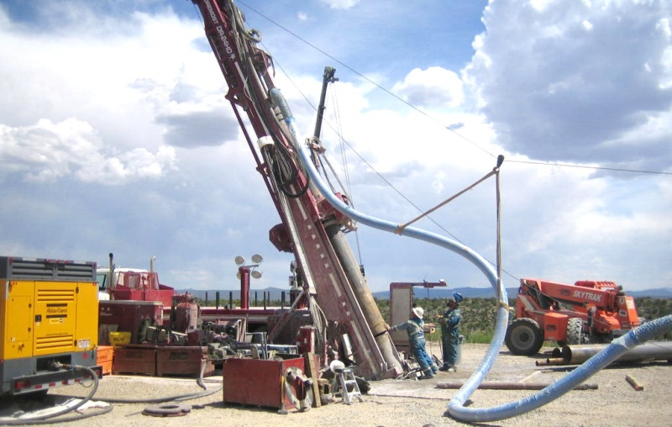
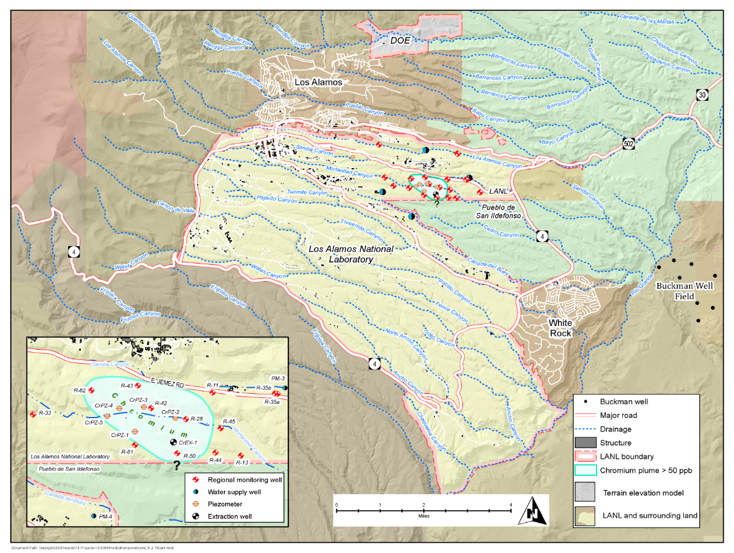
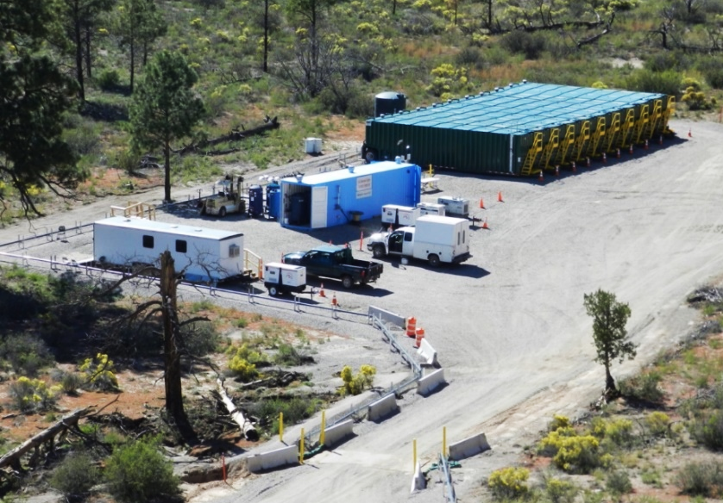
Appendix B Milestones
Chromium Interim Measure & Characterization Campaign
Drilling angled injection well for Interim Measure
Location of the Chromium Campaign
Chromium central treatment area

Slide 17
Appendix B Milestones
Historical Properties Completion Campaign
Includes additional investigation and remediation as necessary for:
sites located in the historical location of the Laboratory; and
sites located on former Laboratory properties that were transferred and are private properties or that require access through private property.
Aggregate Areas in campaign:
Guaje/Barrancas/Rendija Canyons Canyon Aggregate Area
Pueblo Canyon Aggregate Area
Upper Los Alamos Canyon Aggregate Area
Middle Los Alamos Canyon Aggregate Area

Slide 18
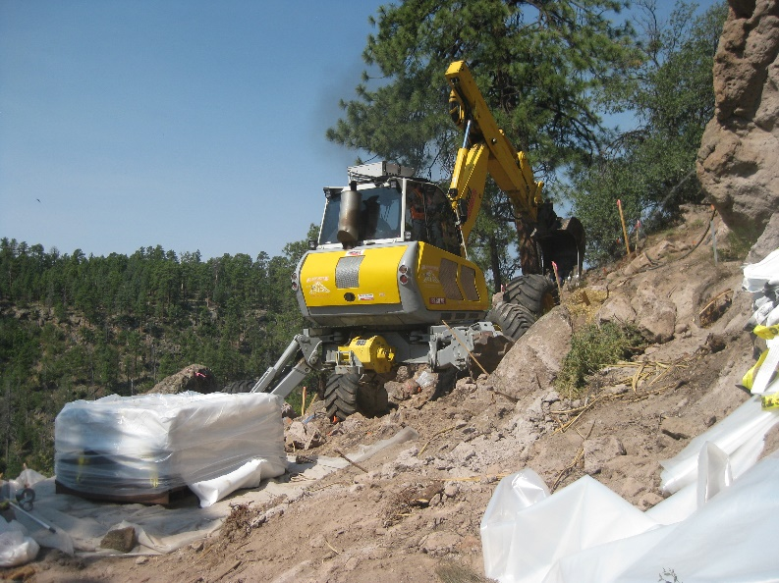
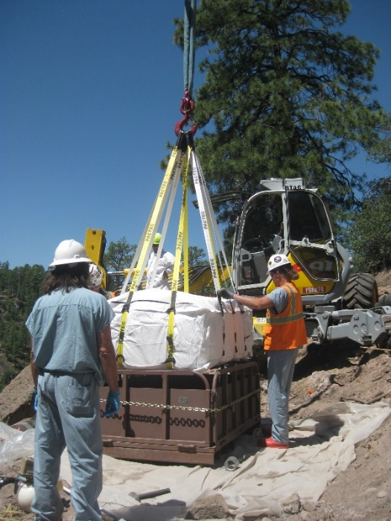
Appendix B Milestones
Historical Properties Completion Campaign
Milestone # | Milestone | Milestone Description | Milestone Date
6 | Addendum to the Middle Los Alamos Canyon Aggregate Area Phase II Investigation Report for SWMU 02-014 | Addendum to the Phase II Investigation Report that documents investigation activities at SWMU 02-014. This SWMU consists of three former electrical transformer stations that served buildings in Technical Area 2. | 4/30/2019
Excavation using a spider excavator at SWMU 01-001(d3)
Waste-packaging at SWMU 01-001(d3)

Slide 19
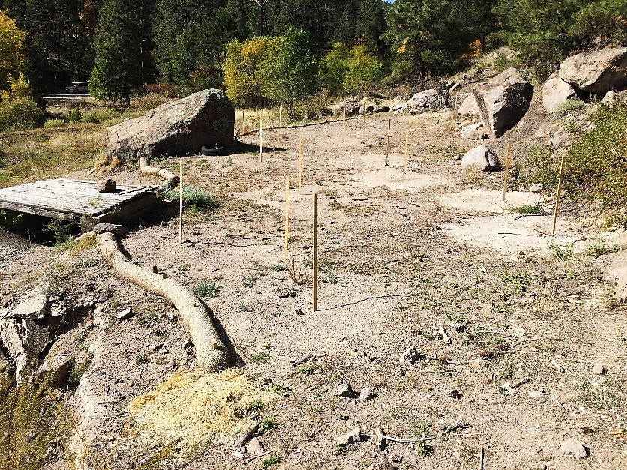
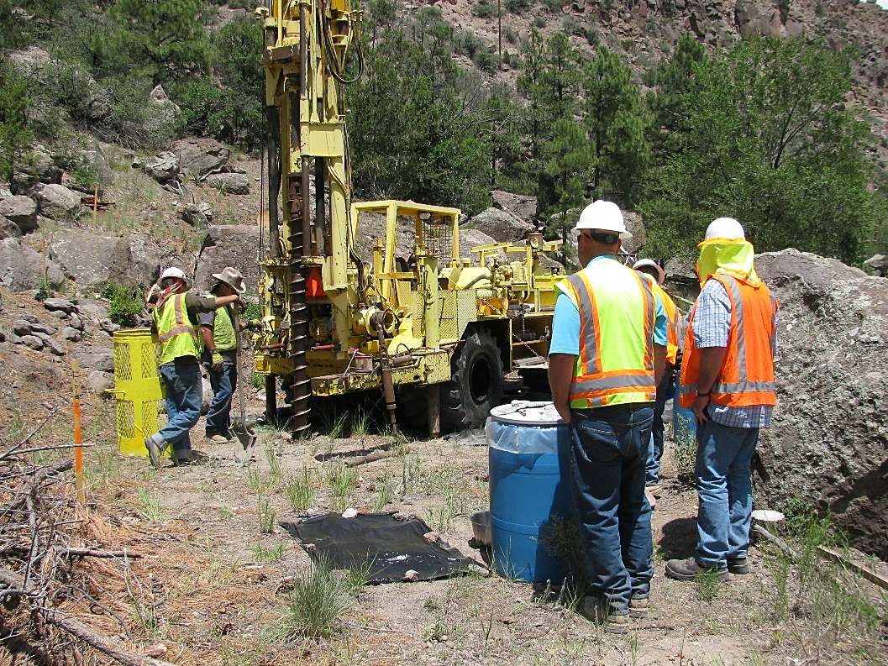
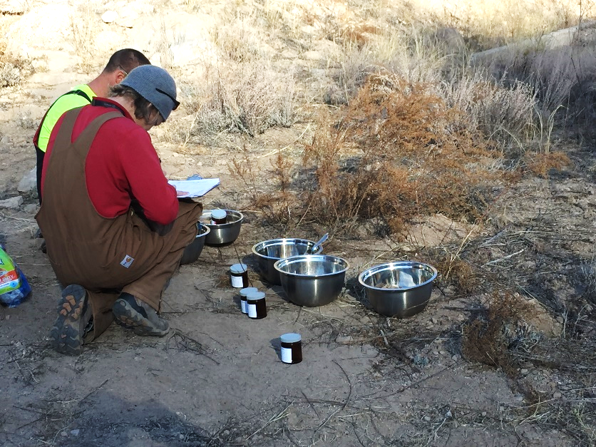
Appendix B Milestones
Historical Properties Completion Campaign
Drilling and sampling activities were conducted at SWMU 02-014 in 2017/2018. This is a newly identified SWMU that is associated with three former electrical transformer stations that served buildings in Technical Area 2. Remediation at this site started in November 2018.

Slide 20
Appendix B Milestones
Royal Demolition Explosives (RDX) Characterization Campaign
Includes potential interim measures or surface activities to prevent further migration of RDX, and characterization of the intermediate/regional groundwater, through well installation, tracer studies, and other evaluations necessary to complete the investigation of nature and extent and determine the need for a corrective measures evaluation (CME).

Slide 21
Appendix B Milestones
Royal Demolition Explosives (RDX) Characterization Campaign
Milestone # | Milestone | Milestone Description | Milestone Date
1 | R-69 Field Completion | Letter report documenting field completion of the well and first samples completed. This is a campaign level milestone because data from R-69 is necessary to address important conceptual model questions for the Investigation Report for Deep Groundwater. | 12/14/2019
15 | Investigation Report for Deep Groundwater | Investigation report that culminates results of investigation activities associated with deep groundwater and includes a groundwater risk assessment. Follows completion and multiple rounds of data collection at R-69. | 8/30/2019
17 | Annual Long-Term Monitoring Report of Results following Surface RDX Corrective Measures Implementation Completion | Executes the reporting required in the Remedy Completion Report for Corrective Measures Implementation at Consolidated Unit 16-021(c)-99 for long-term monitoring and inspections. | 9/30/2019

Slide 22
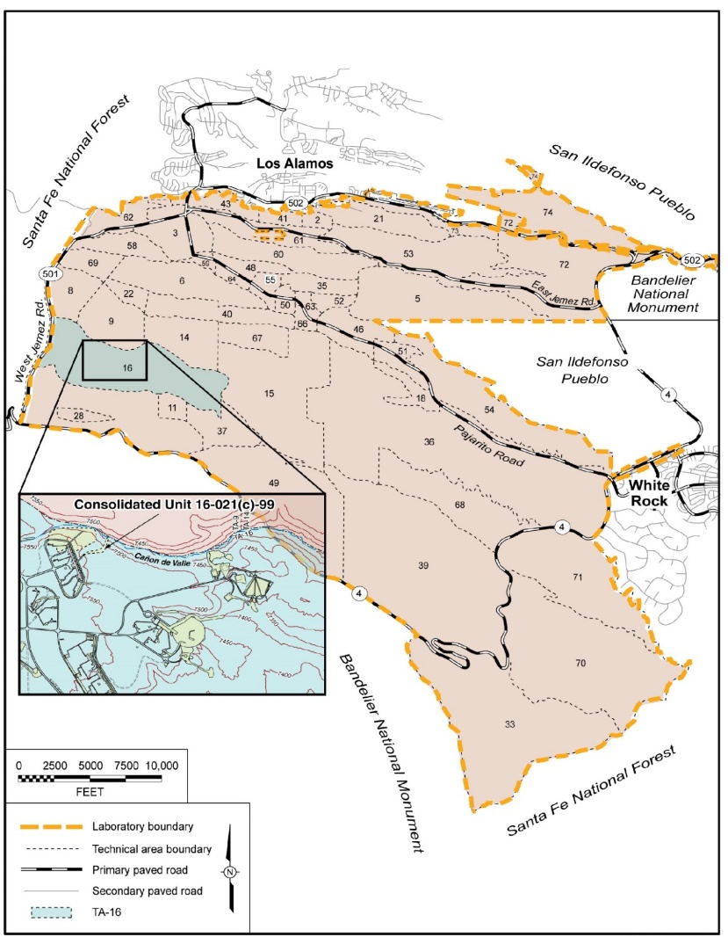
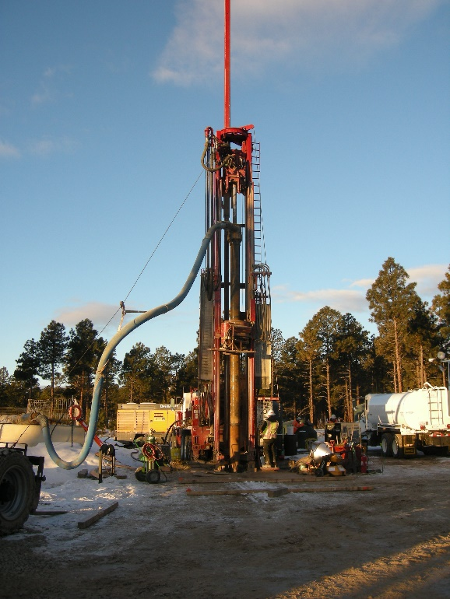
Appendix B Milestones
RDX Characterization Campaign
Location of RDX Campaign with respect to Laboratory TAs
Regional well R-68 under construction

Slide 23
Appendix B Milestones
Supplemental Investigation Reports Campaign
Includes the submission of ten aggregate area supplemental investigation reports that reevaluate the nature and extent of contamination and risk to human health and the environment. All SIRs have been submitted and two have been approved by NMED. The remaining SIRs are under review by NMED and comments will be addressed and revisions submitted.
Aggregate Areas in campaign:
S-Site Aggregate Area • Potrillo/Fence Canyons Aggregate Areas
Cañon de Valle TA-14 • North Ancho Canyon Aggregate Area
Threemile Canyon Aggregate Area • Lower Sandia Canyon Aggregate Area
TA-49 Inside the NES Boundary • Upper Cañada del Buey Aggregate Area
TA-49 Outside the NES Boundary • Upper Mortandad Canyon Aggregate Area

Slide 24
Appendix B Milestones
Supplemental Investigation Reports Campaign
Milestone # | Milestone | Milestone Description | Milestone Date
7 | Supplemental Investigation Report (SIR) for S-Site Canyon Aggregate Area, Revision 1 | Resolve NMED comments, incorporate changes, and submit Revision 1 to the SIR | 4/30/2019
13 | Supplemental Investigation Report (SIR) for Potrillo/Fence Canyons Aggregate Area, Revision 1 | Resolve NMED comments, incorporate changes, and submit Revision 1 to the SIR | 7/31/2019
The Threemile Canyon Aggregate Area SIR, Revision 1, was approved by NMED in August 2018. The SIR recommends corrective action complete without controls for 20 sites. Five other sites require additional sampling for extent, and two of those sites are recommended for cleanup.

Slide 25
Appendix B Milestones
Technical Area 21 D&D and Cleanup Campaign
Includes investigations of SWMUs and AOCs after removal and remediation of buried waste lines and contaminated soils associated with demolition of facilities and slabs (not part of the Consent Order) at DP West and the Radiological Liquid Waste Treatment Facility (RLWTF), building 21-257. Also includes the investigation of sites located outside the Nuclear Environmental Site (NES) boundary at Material Disposal Area (MDA) T.
Aggregate Area in campaign:
DP Site Aggregate Area

Slide 26
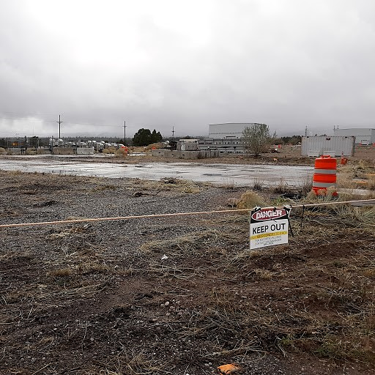
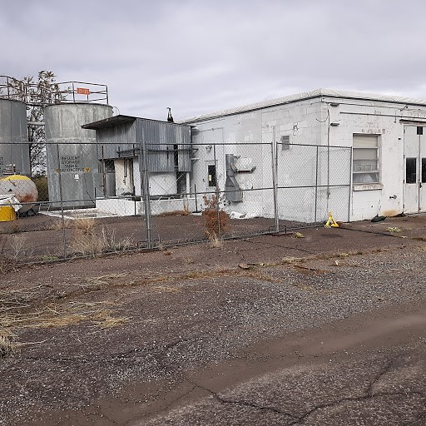
Appendix B Milestones
TA-21 D&D and Cleanup Campaign
Milestone # | Milestone | Milestone Description | Milestone Date
18 | TA-21 Delta Prime (DP) West Investigations Letter Report | Letter report that summarizes the initiation of investigation activities after the removal of waste lines at DP West. | 9/30/2019
Remaining slabs at DP West at Technical Area 21 will be removed and sumps and waste lines investigated.
Building 21-257 at Technical Area 21 will be decontaminated and demolished and associated SWMUs/AOCs will be investigated.

Slide 27
Appendix B Milestones
Known Cleanup Sites (Above SSLs) Campaign
Includes soil removal from six sites that previous investigations identified have hazardous contaminants at concentration that exceed the target risk levels of 10⁻⁵ lifetime excess cancer risk for carcinogenic contaminants and a hazard index (HI) of 1 for non-carcinogenic contaminants. Accelerates cleanups in advance of finalizing remaining aggregate area site investigations.
Aggregate Areas in campaign:
North Ancho Canyon Aggregate Area
Upper Mortandad Canyon Aggregate Area
Upper Cañada del Buey Aggregate Area
Threemile Canyon Aggregate Area

Slide 28
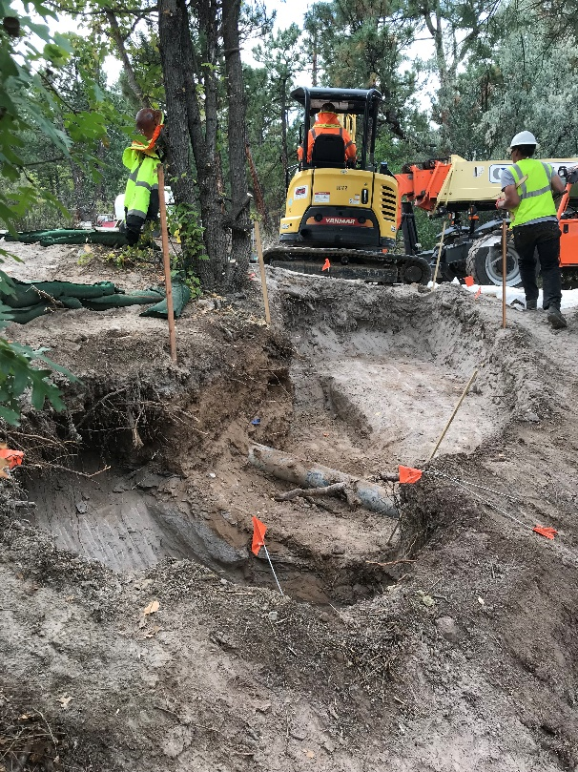
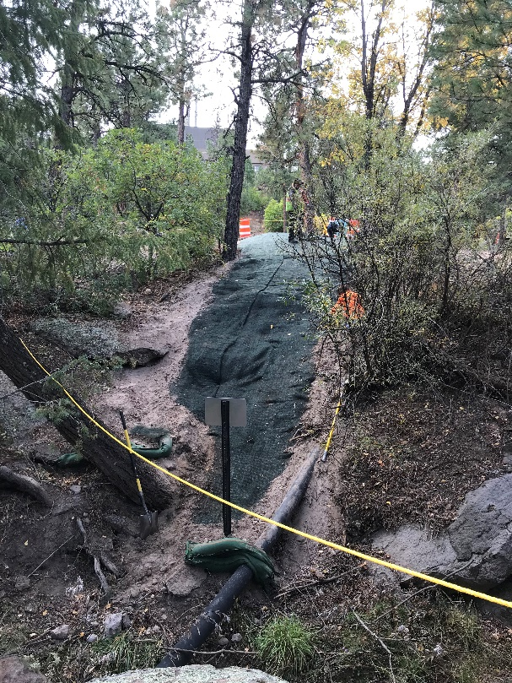
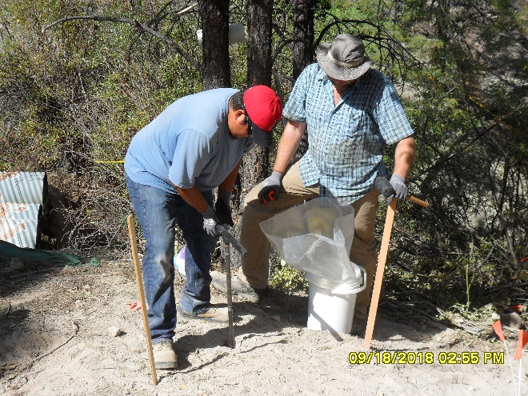
Appendix B Milestones
Known Cleanup Sites (Above SSLs) Campaign
Milestone # | Milestone | Milestone Description | Milestone Date
19 | Field Completion Letter Report for Aggregate Area Known Cleanup Sites; SWMU 39-002(a), SWMU 46-004(q), SWMU 15-008(b), and SWMU 15-007(c) | Letter report documenting field completion of cleanups of remaining four sites currently known to exceed soil screening levels. Sites to be addressed are; SWMU 39-002(a), SWMU 46-004(q), SWMU 15-008(b), and SWMU 15-007(c). | 9/30/2019
Sampling and cleanup of contaminated soil at a former outfall in TA-50, SWMU 50-006(d), and site stabilization after cleanup.

Slide 29
Appendix B Milestones
Material Disposal Areas A and T Remedy Campaign
Includes completion of additional characterization activities at MDAs A and T and installation of a moisture monitoring network at MDA T. These CMEs will result in NMED’s statements of basis and selections of a remedy, and then the campaign will implement the remedies.

Slide 30
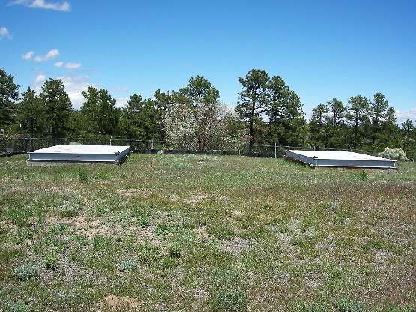
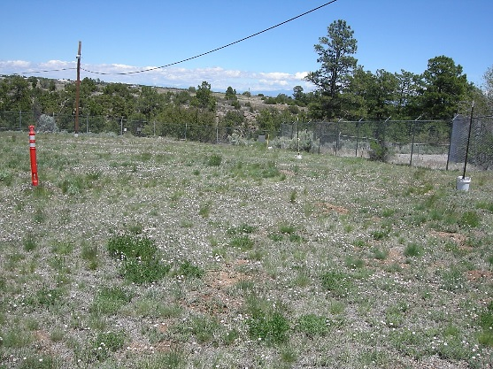
Appendix B Milestones
Material Disposal Areas A and T Remedy Campaign
Milestone # | Milestone | Milestone Description | Milestone Date
11 | Submit Revised Work Plan for Vadose Zone Moisture Monitoring at MDA T within the NES | The revised work plan will include proposed drilling, characterization activities, and installation and instrumentation of a vadose zone moisture monitoring system at MDA T within the NES. | 6/28/2019
Material Disposal Area A
Material Disposal Area T

Slide 31
Appendix B Milestones
Southern External Boundary Campaign
Includes initial investigations, remediation of media above soil screening levels, and risk assessments, for five aggregate areas. These aggregate areas are located in the border area between the Laboratory, Bandelier, and White Rock populated areas.
Aggregate Areas in campaign:
Chaquehui Canyon Aggregate Area (initial investigation)
South Ancho Canyon Aggregate Area (initial investigation)
Lower Water Canyon Aggregate Area (initial investigation)
North Ancho Canyon Aggregate Area (Phase II)
Potrillo/Fence Canyon Aggregate Area (Phase II)

Slide 32
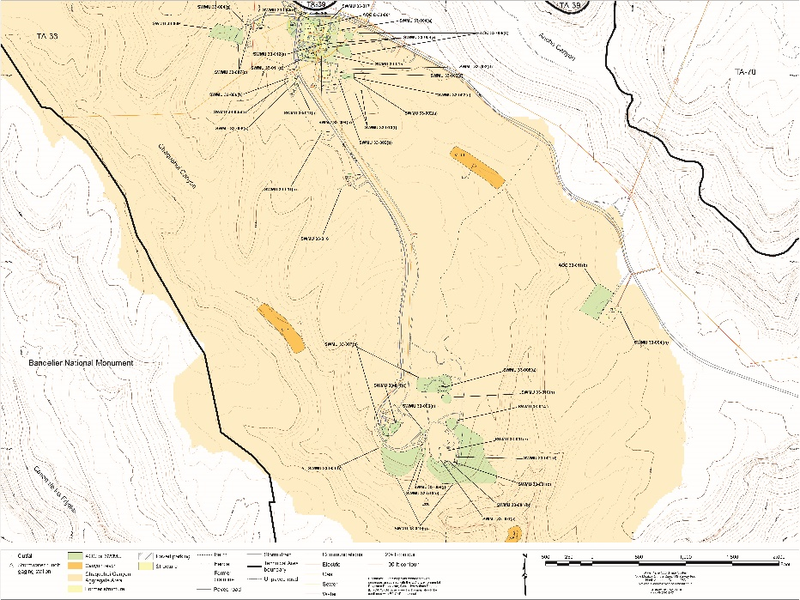
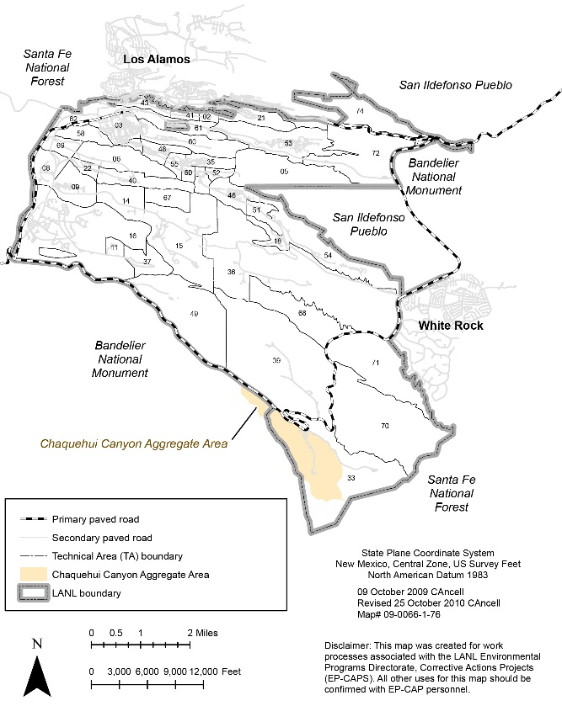
Appendix B Milestones
Southern External Boundary Campaign
Milestone # | Milestone | Milestone Description | Milestone Date
20 | Chaquehui Canyon Aggregate Area Letter Report | Letter report that summarizes the fieldwork implementation and status of site investigations in Chaquehui Canyon Aggregate Area. | 9/30/2019
Sites to be investigated in Chaquehui Canyon Aggregate Area
Location of Chaquehui Canyon Aggregate Area with respect to Laboratory TAs

Slide 33
Appendix B Milestones
Multi-Campaign Milestones
Includes activities not attributed to a single campaign but attributed with multiple campaigns, including;
Chromium Interim Measures and Characterization
Historical Properties Completion
Royal Demolition Explosives (RDX) Characterization
TA-21 D&D and Cleanup
Material Disposal Areas A and T Remedy
Material Disposal Area C Remedy
Material Disposal Area H Remedy
Material Disposal Areas G and L Remedy

Slide 34
Appendix B Milestones
Multi-Campaign Milestones
Milestone # | Milestone | Milestone Description | Milestone Date
12 | Annual Update to the Interim Facility-Wide Groundwater Monitoring Plan (IFGMP) for MY2020 (October 2019-September 2020) | Annual update to the groundwater monitoring program baseline document with adjustments to sampling, monitoring groups, analytes, and frequencies based on previous results. | 6/30/2019
14 | Westbay Wells Reconfiguration Completion Report for R-5, R-7, R-8, R-9i, R-19, R-25, and R-31 | This report will include a summary of field activities and as-built information associated with reconfiguration of R-5, R-7, R-8, R-9i, R-19, and R-31, and plugging and abandonment of R-25 which requires removal of the Westbay system. | 8/30/2019
3 | Annual Monitoring Report for the Los Alamos/Pueblo Watershed Sediment Transport Mitigation Project | Annual report of last year's results that addresses the performance of stormwater controls installed in the LA/Pueblo watershed. | 4/30/2019
4 | Annual Monitoring Plan for the Los Alamos/Pueblo Watershed Sediment Transport Mitigation Project | Annual plan for the upcoming year that addresses the performance of stormwater controls installed in the LA/Pueblo watershed. | 4/30/2019

Slide 35
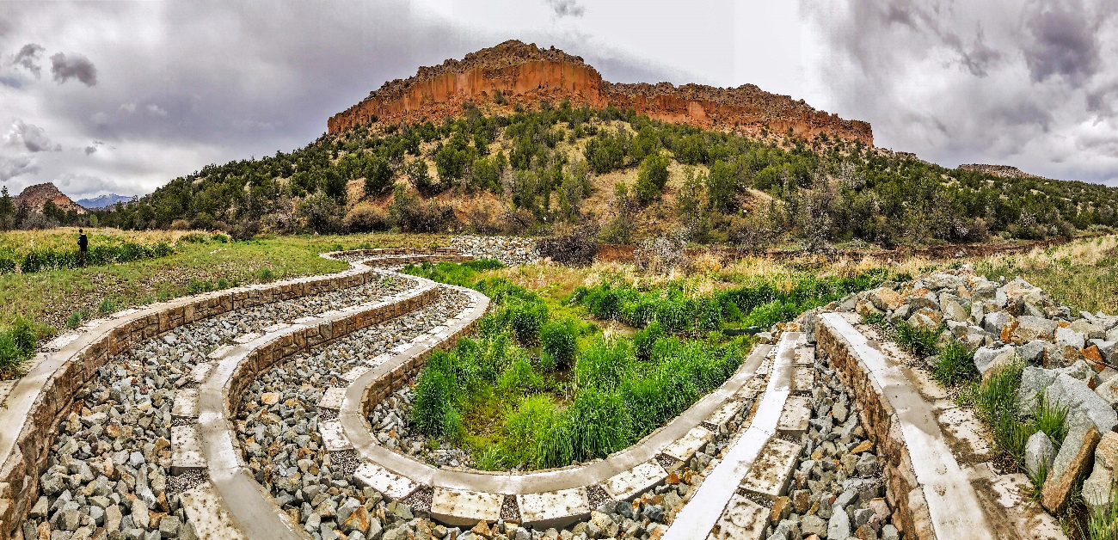
Appendix B Milestones
Redi-Rock wetland stabilization structure in Pueblo Canyon

