Slide 1
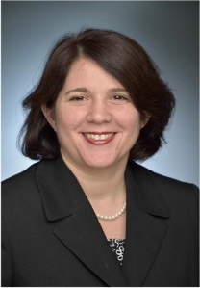
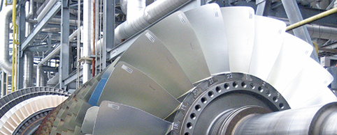
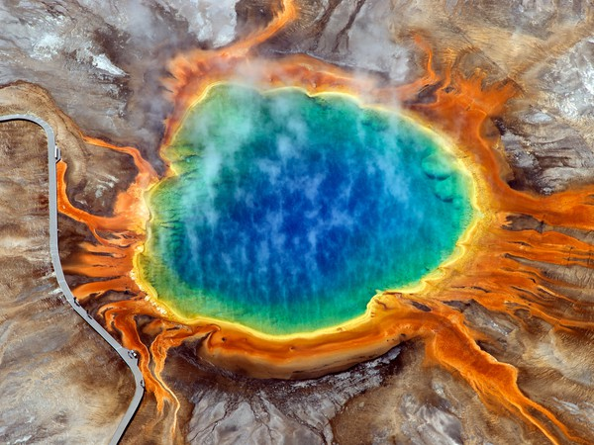
Geothermal Technologies Office
GRC 2018 Briefing
Dr. Susan Hamm, Director
Image: Calpine

Slide 2
GTO Budget
Dollars in Thousands USD (‘000) | FY 2016 Enacted | FY 2017 Enacted | FY 2018 Enacted | FY 2019 Enacted
Geothermal Technologies Office | 71,500 | 69,500 | 80,910 | 84,000
- Enhanced Geothermal Systems | 45,000 | 42,700 | 50,790 | 53,000
- Hydrothermal | 13,850 | 14,150 | 18,420 | 15,000
- Low Temperature & Coproduced Resources | 8,000 | 8,000 | 8,000 | 10,000
- Systems Analysis | 3,700 | 3,700 | 3,700 | 6,000

Slide 3
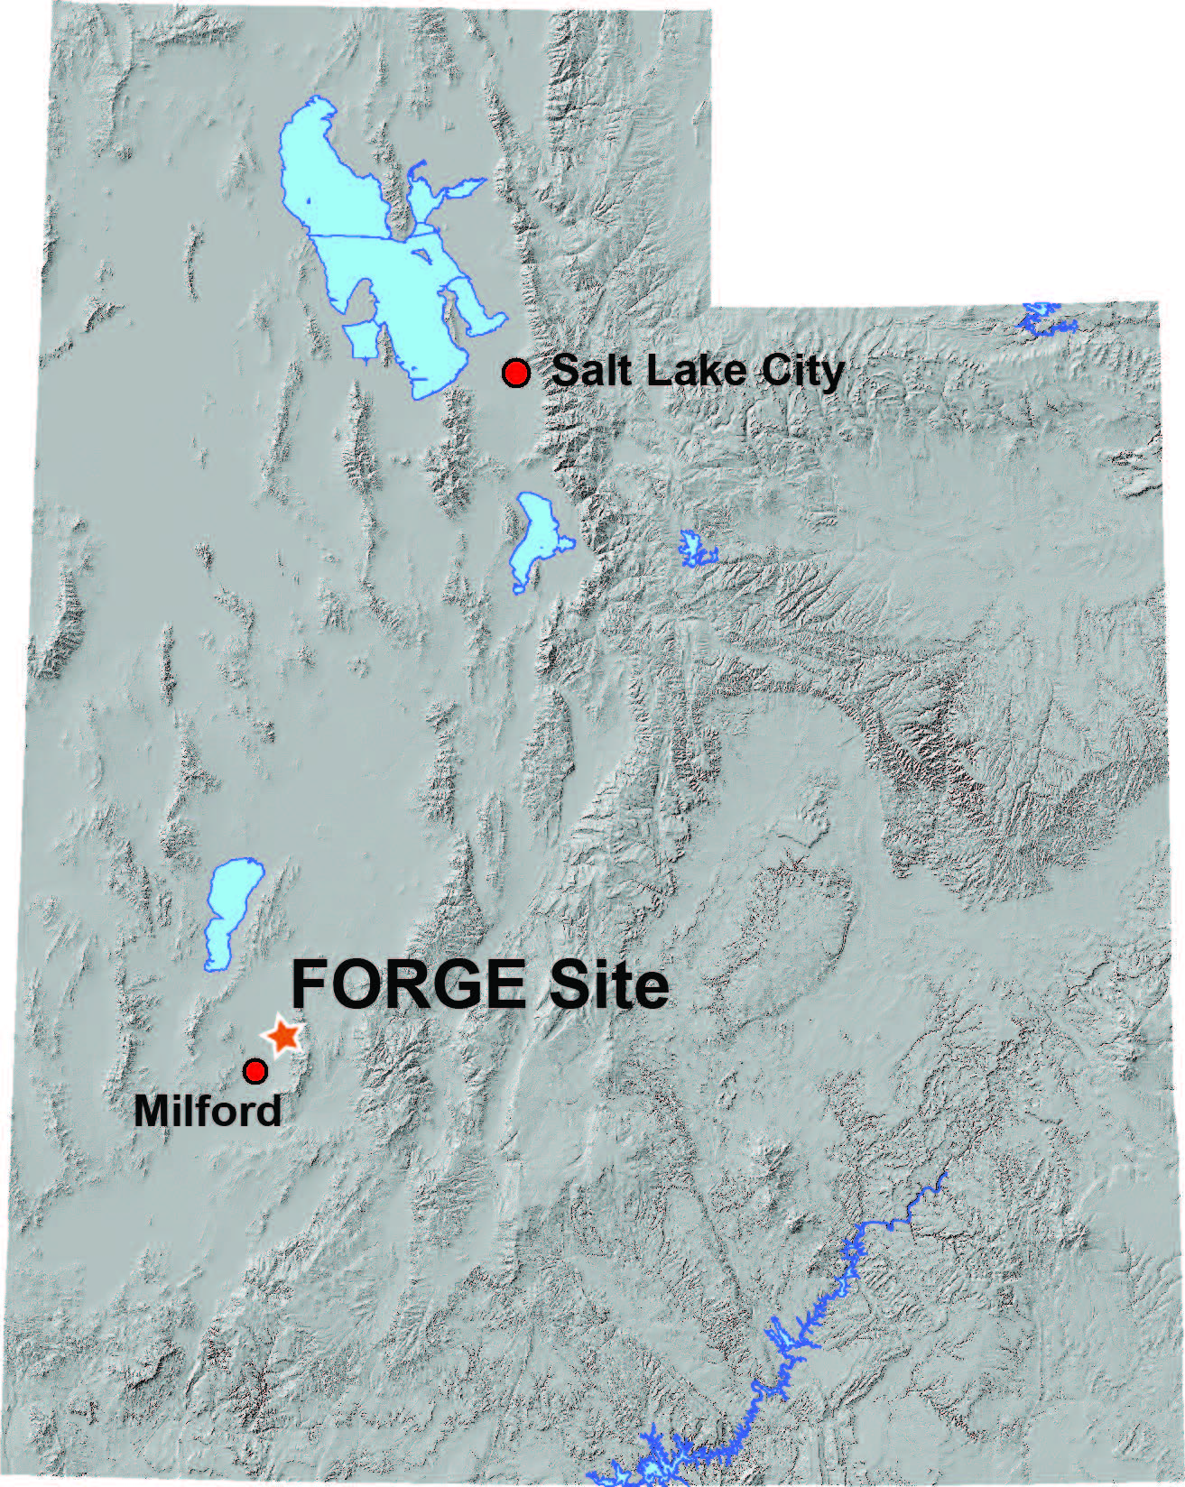
FORGE
FORGE is GTO’s flagship initiative to design and test a breakthrough approach to developing large-scale, economically sustainable EGS reservoirs.
Photo: Joseph Moore

Slide 4
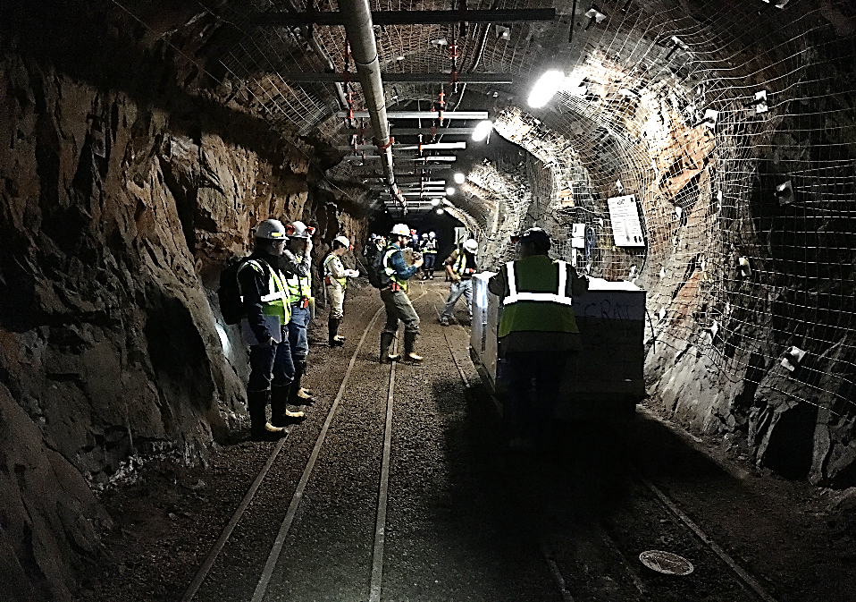
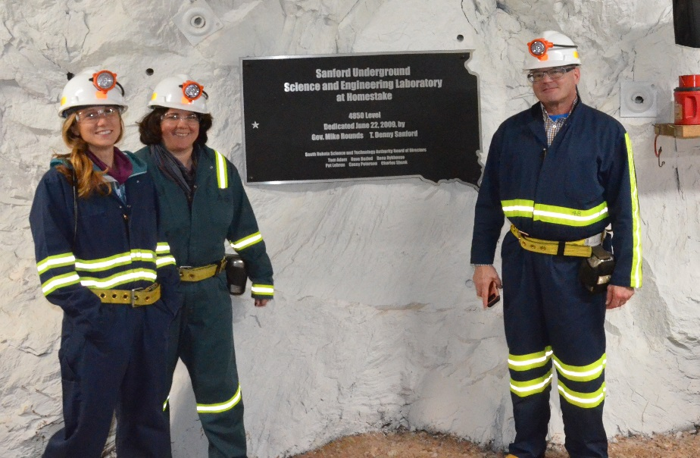
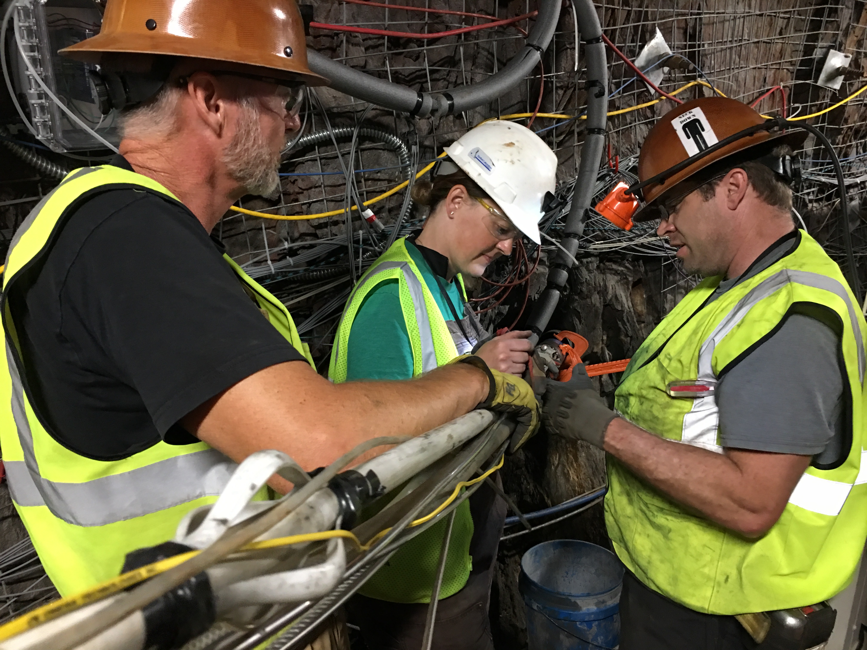
EGS Collab
Insight into reservoir creation and sustainability gained from EGS Collab directly supports FORGE research.
Experiment 1 is ongoing at a depth of 4,850 feet.
This first experiment focuses on hydraulic fracturing models and stimulation using LBNL’s SIMFIP tool.
Photo: Mark White

Slide 5
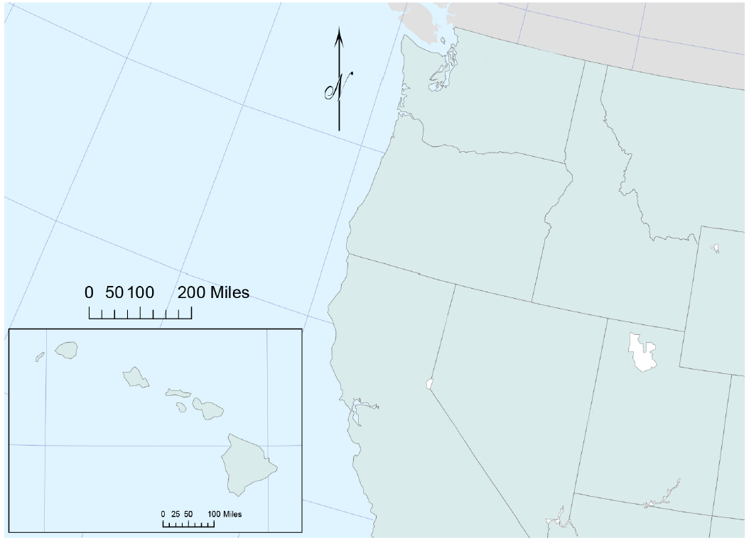
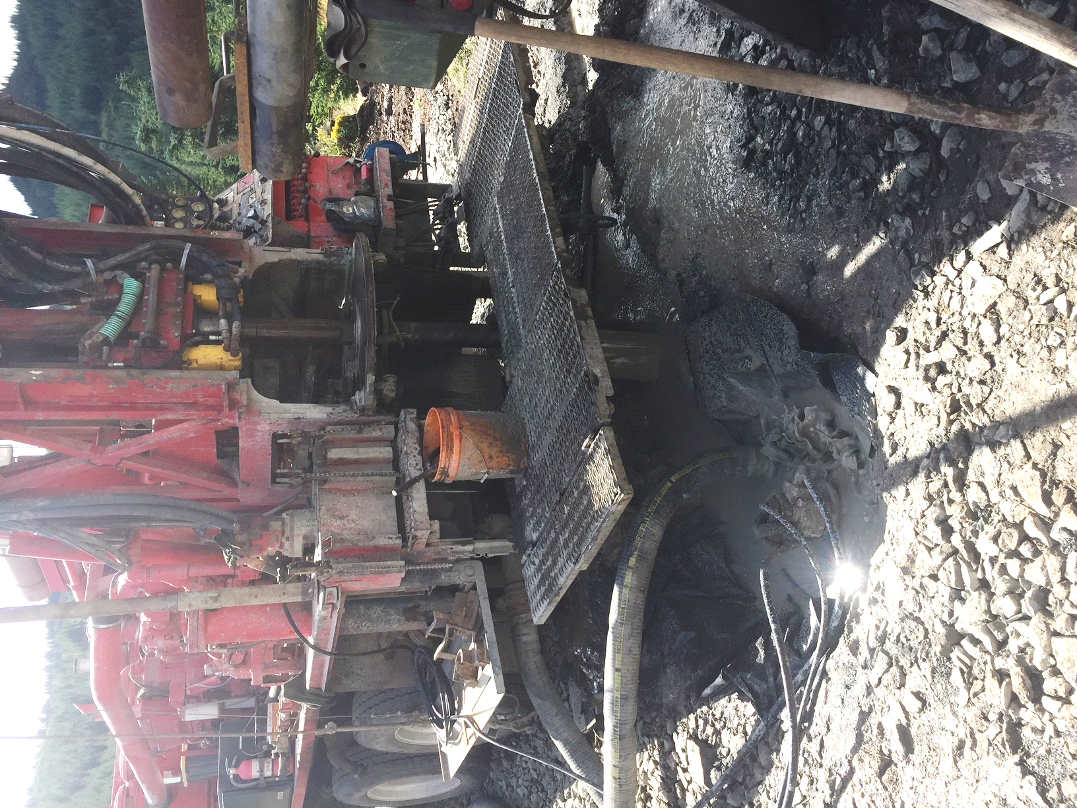
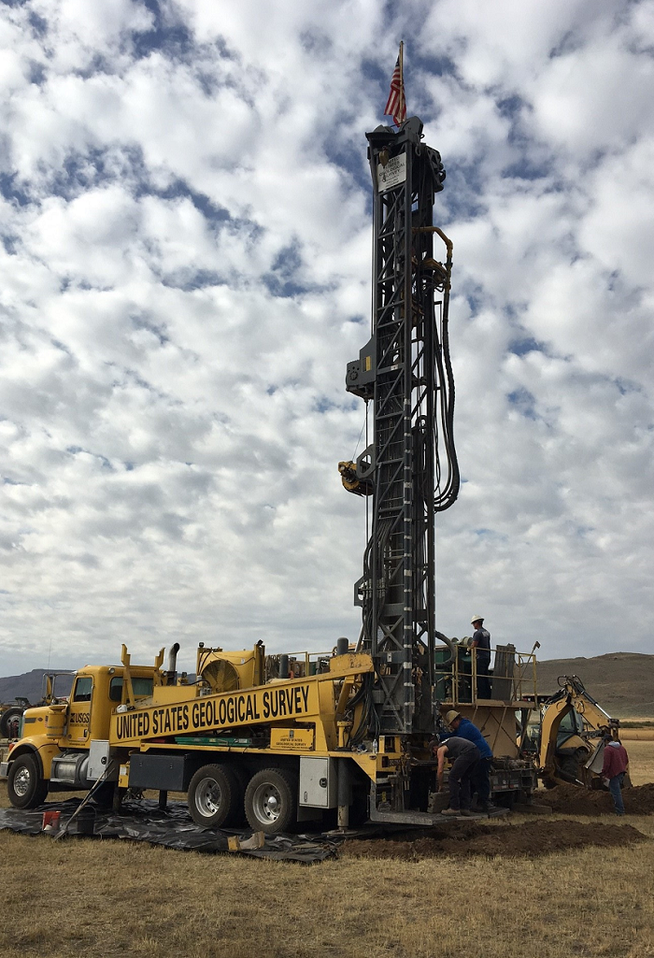
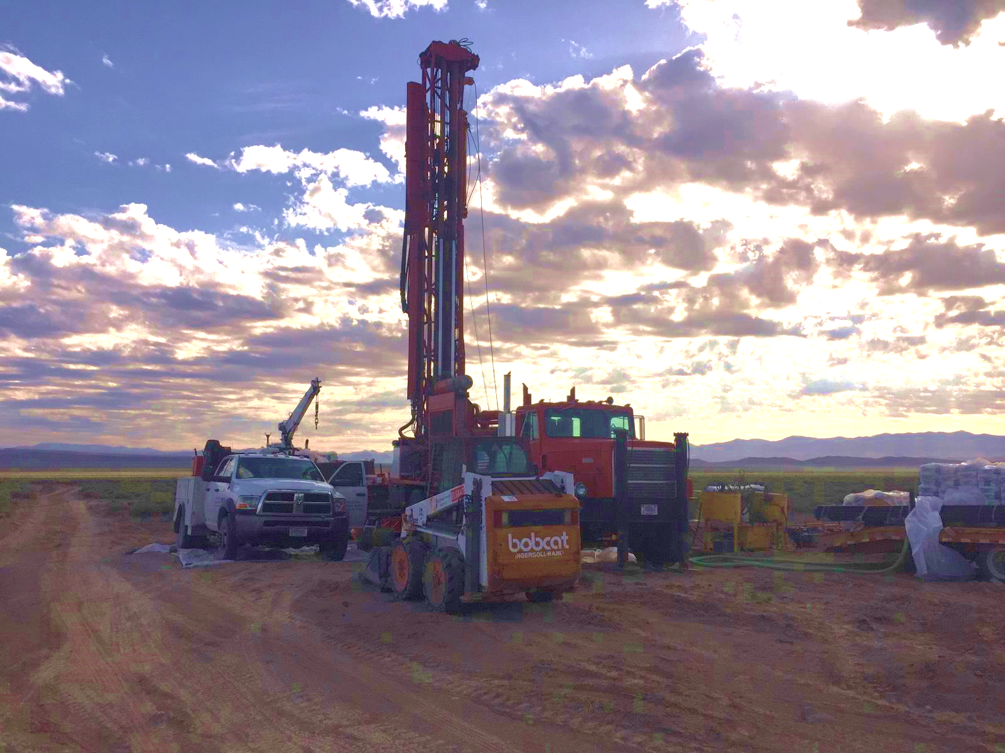
Play Fairway Analysis
Drilling Site | Status
Gabbs Valley, NV | Completed
Mount St. Helens, WA | Underway
Camas Prairie, ID | Underway
Dog Valley, UT | Fall 2018
Cove Fort, UT | Fall 2018
Granite Springs, NV | Fall 2018
Lanai, HI | January 2019
Mt Baker, WA | Spring 2019
Mt Baker
Mt St. Helens
Camas Prairie
Granite Springs
Lanai
Gabbs Valley
Dog Valley
Cove Fort

Slide 6
Deep Direct-Use
Six research teams are currently assessing DDU feasibility
Appalachian Basin – WV and NY sites
Wassuk Range – Hawthorne, NV
Columbia River Basalt – Portland, OR
Cotton Valley – East Texas
Illinois Basin – Champaign-Urbana, IL
WVU Facilities Management
West Virginia Geological & Economic Survey
Lawrence Berkeley National Laboratory
Cornell University
U.S. Navy Geothermal Program
Power Engineers, Inc.
University of Nevada-Reno
AltaRock Energy
City of Portland
Oregon Health & Science University
U.S. Geological Survey
University of Wisconsin-Madison
Loudon Technical Services
U.S. Army CER Laboratory
MEP Associates
Illinois Geothermal Engineering, Inc.
Trimeric
Southern Methodist University
Eastman Chemical
TAS Energy
Electric Power Research Institute

Slide 7
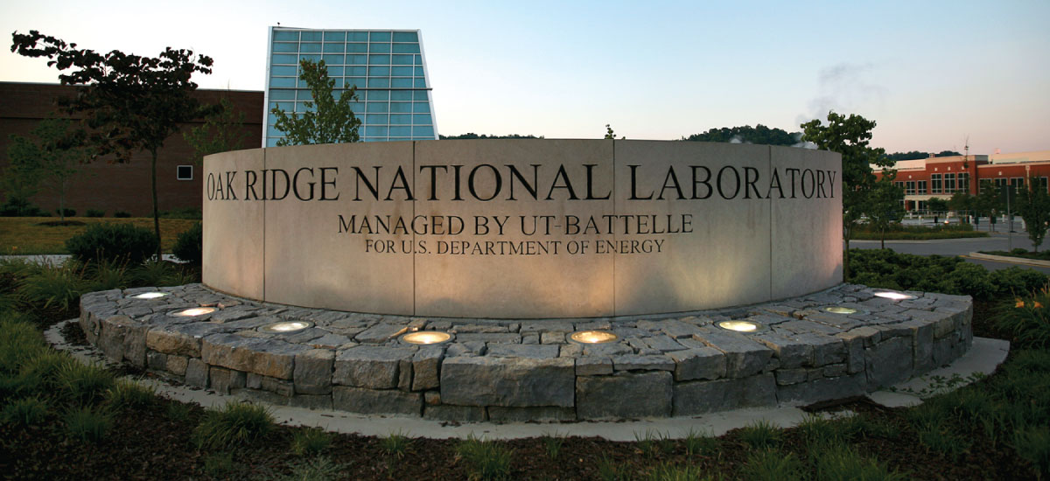
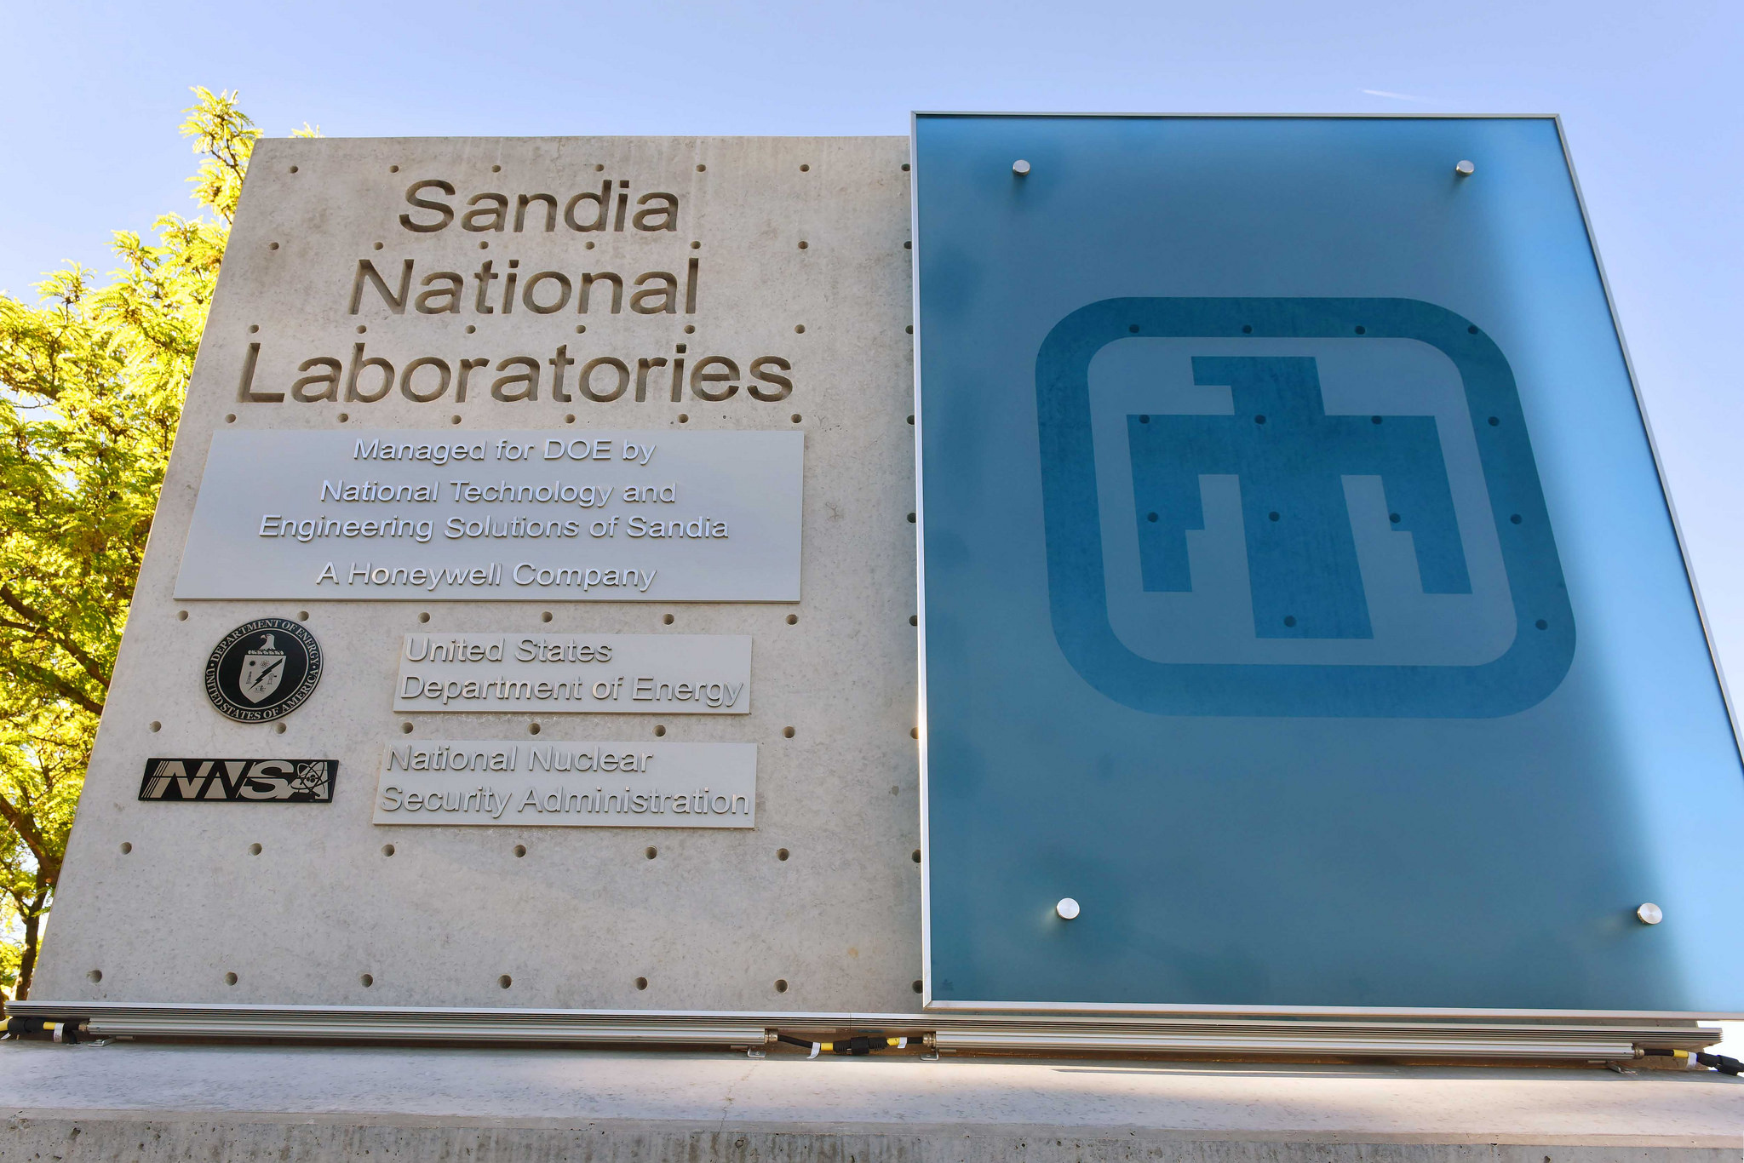
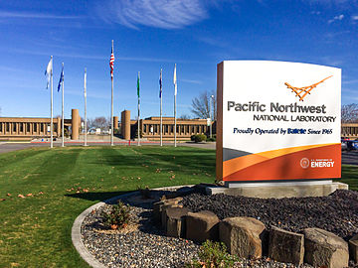
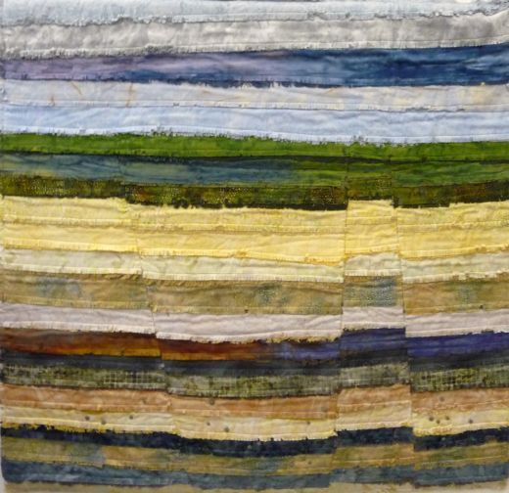
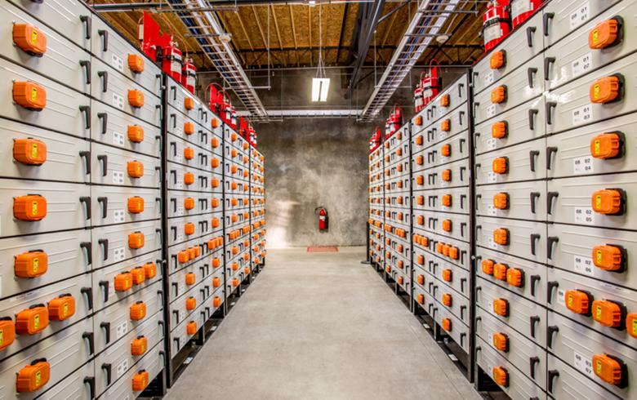
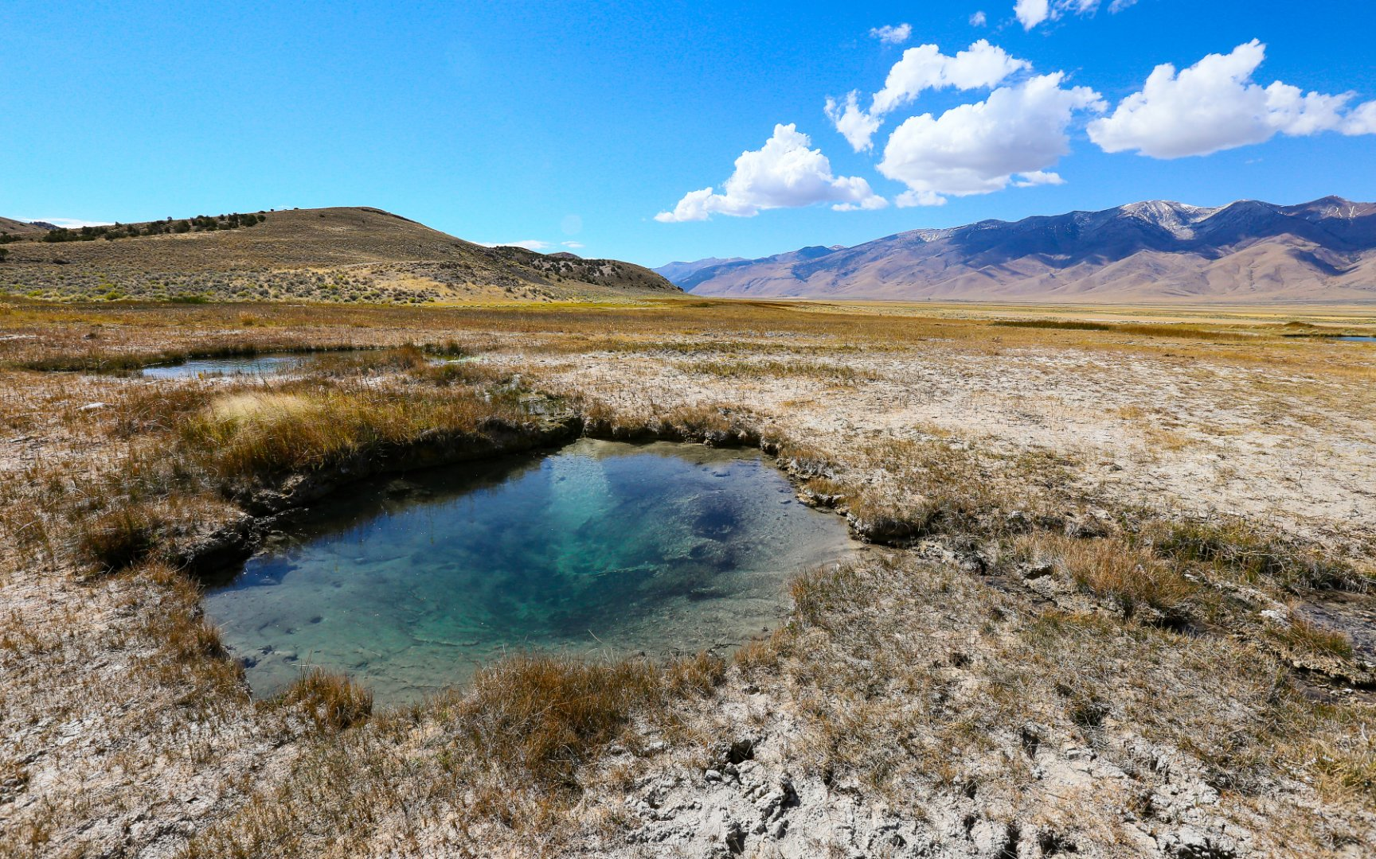
2018: A Strong Push in Research Investment
ORNL SNL PNNL
Zonal Isolation
Waterless Stimulation
C-Crete Technologies
Fervo Energy
Hotrock (HERO)
Welltec Inc.
Beyond Batteries
BNL
INL
LBNL
NREL
ORNL
Machine Learning
ANL
SNL
General Electric
Oklahoma State
Texas A&M
U of Oklahoma
Selections announced early 2019
EDGE

Slide 8
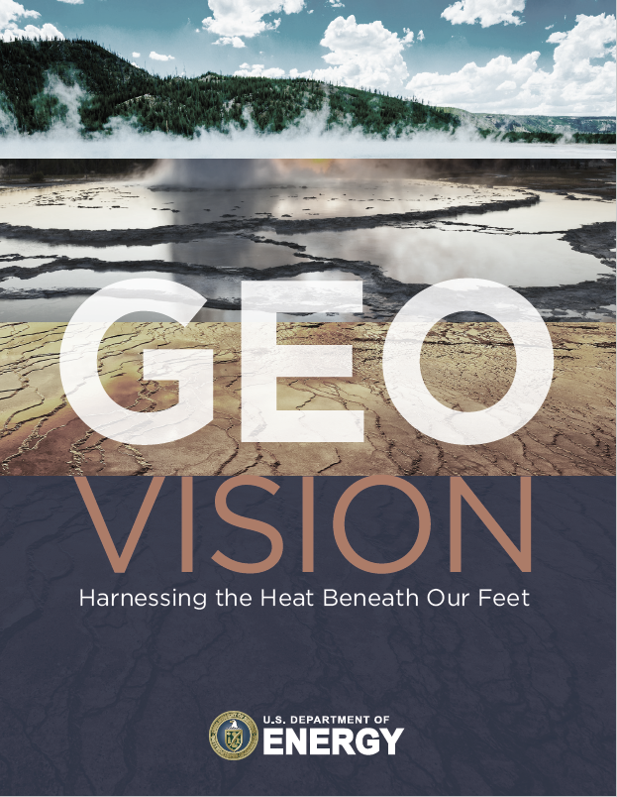
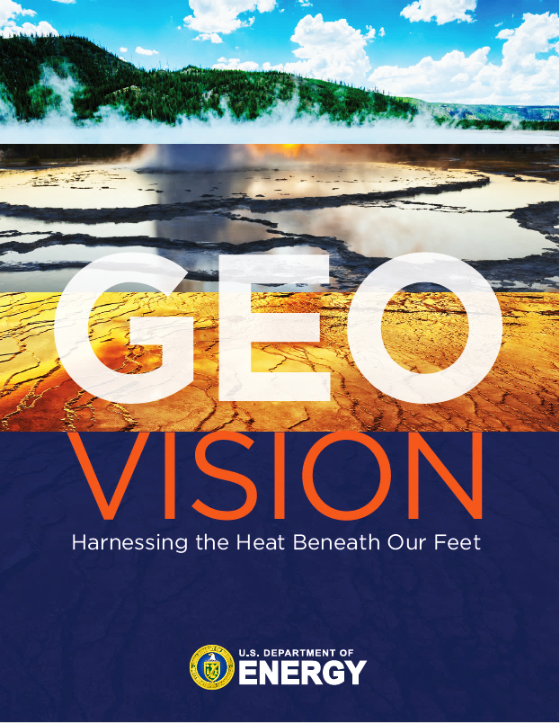
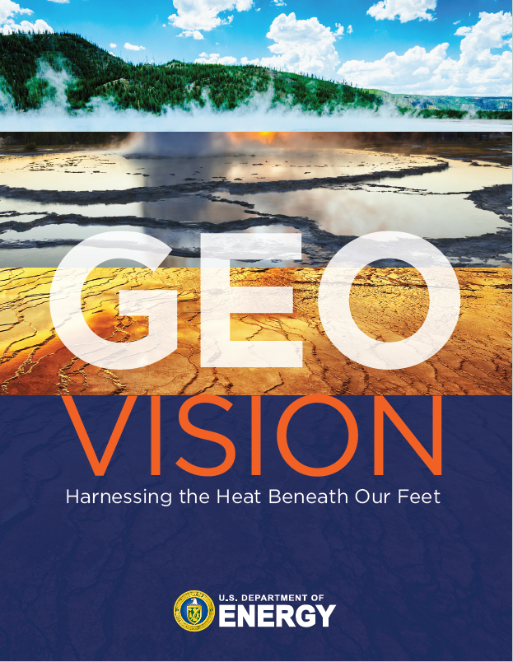
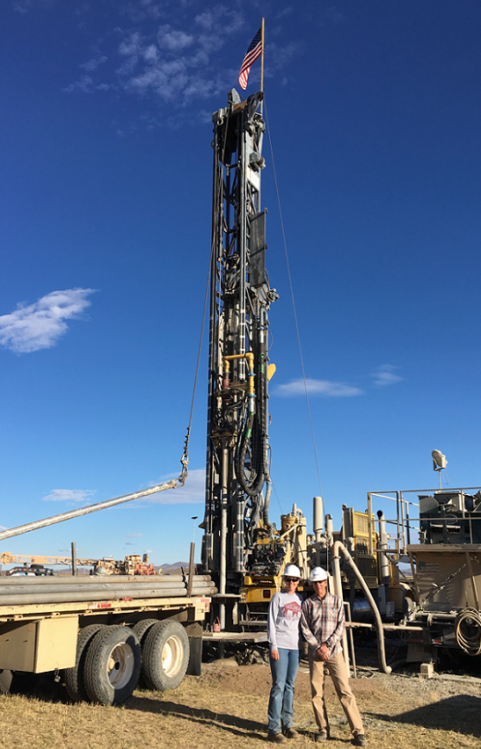
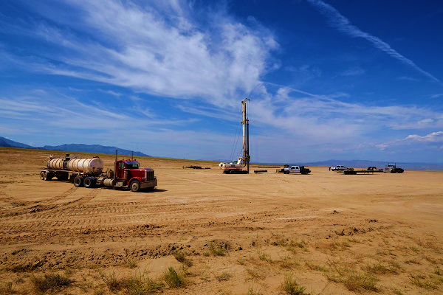
A Glimpse Ahead
Play Fairway Analysis drilling will continue in 2019
2019
Drilling at the FORGE site near Milford, Utah

Slide 9
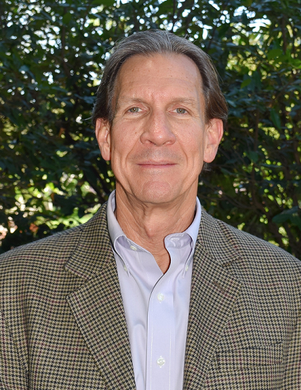
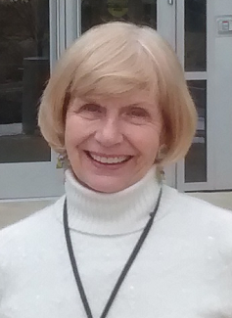
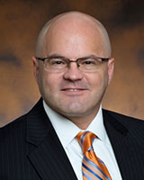
Personnel Changes
Congratulations to Eric Hass and Holly Thomas on their retirements from GTO – thank you for your devoted service to geothermal research and development!
After many years of outstanding service, Dr. Timothy Unruh has moved on from Deputy Assistant Secretary for Renewable Power to pursue a new role with NAESCO.

Slide 10
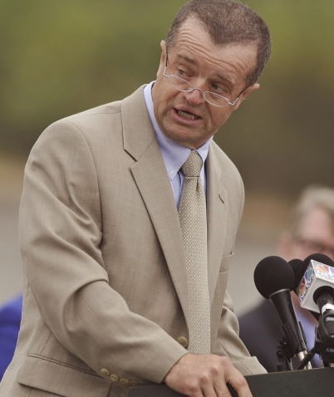
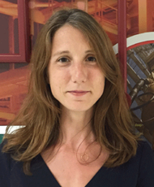
Personnel Changes
Steve Chalk, Deputy Assistant Secretary for Sustainable Transportation, steps into Tim’s role as acting DAS-RP. Steve is a former acting head of EERE.
Lauren Boyd takes on an expanded role as both Program Manager for Enhanced Geothermal Systems and acting Program Manager for Hydrothermal Resources.

Slide 11
Thank You! Visit us at Booth 218

