Slide 1
WOMEN FROM BETO

Slide 2
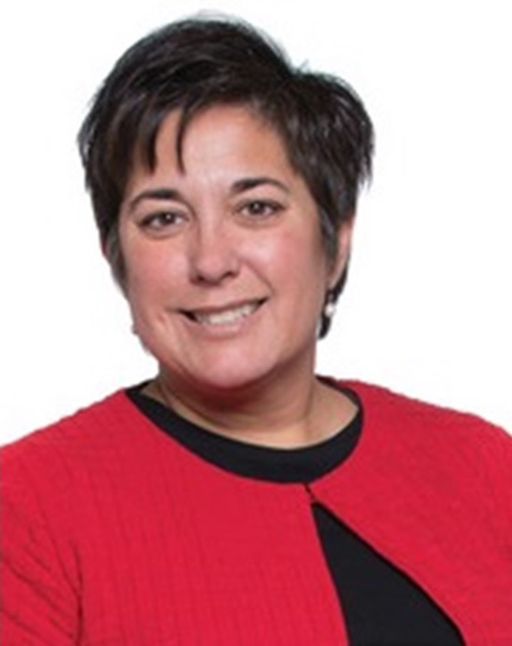
Women from BETO - Valerie Sarisky-Reed
Acting Director
Valerie manages efforts to improve performance, lower costs and accelerate market entry of bioenergy technologies. She assists in overseeing strategic planning to meet aggressive goals covered by the BETO R&D budget of approximately $250M annually, working with DOE’s national laboratories, academia, and industry.

Slide 3
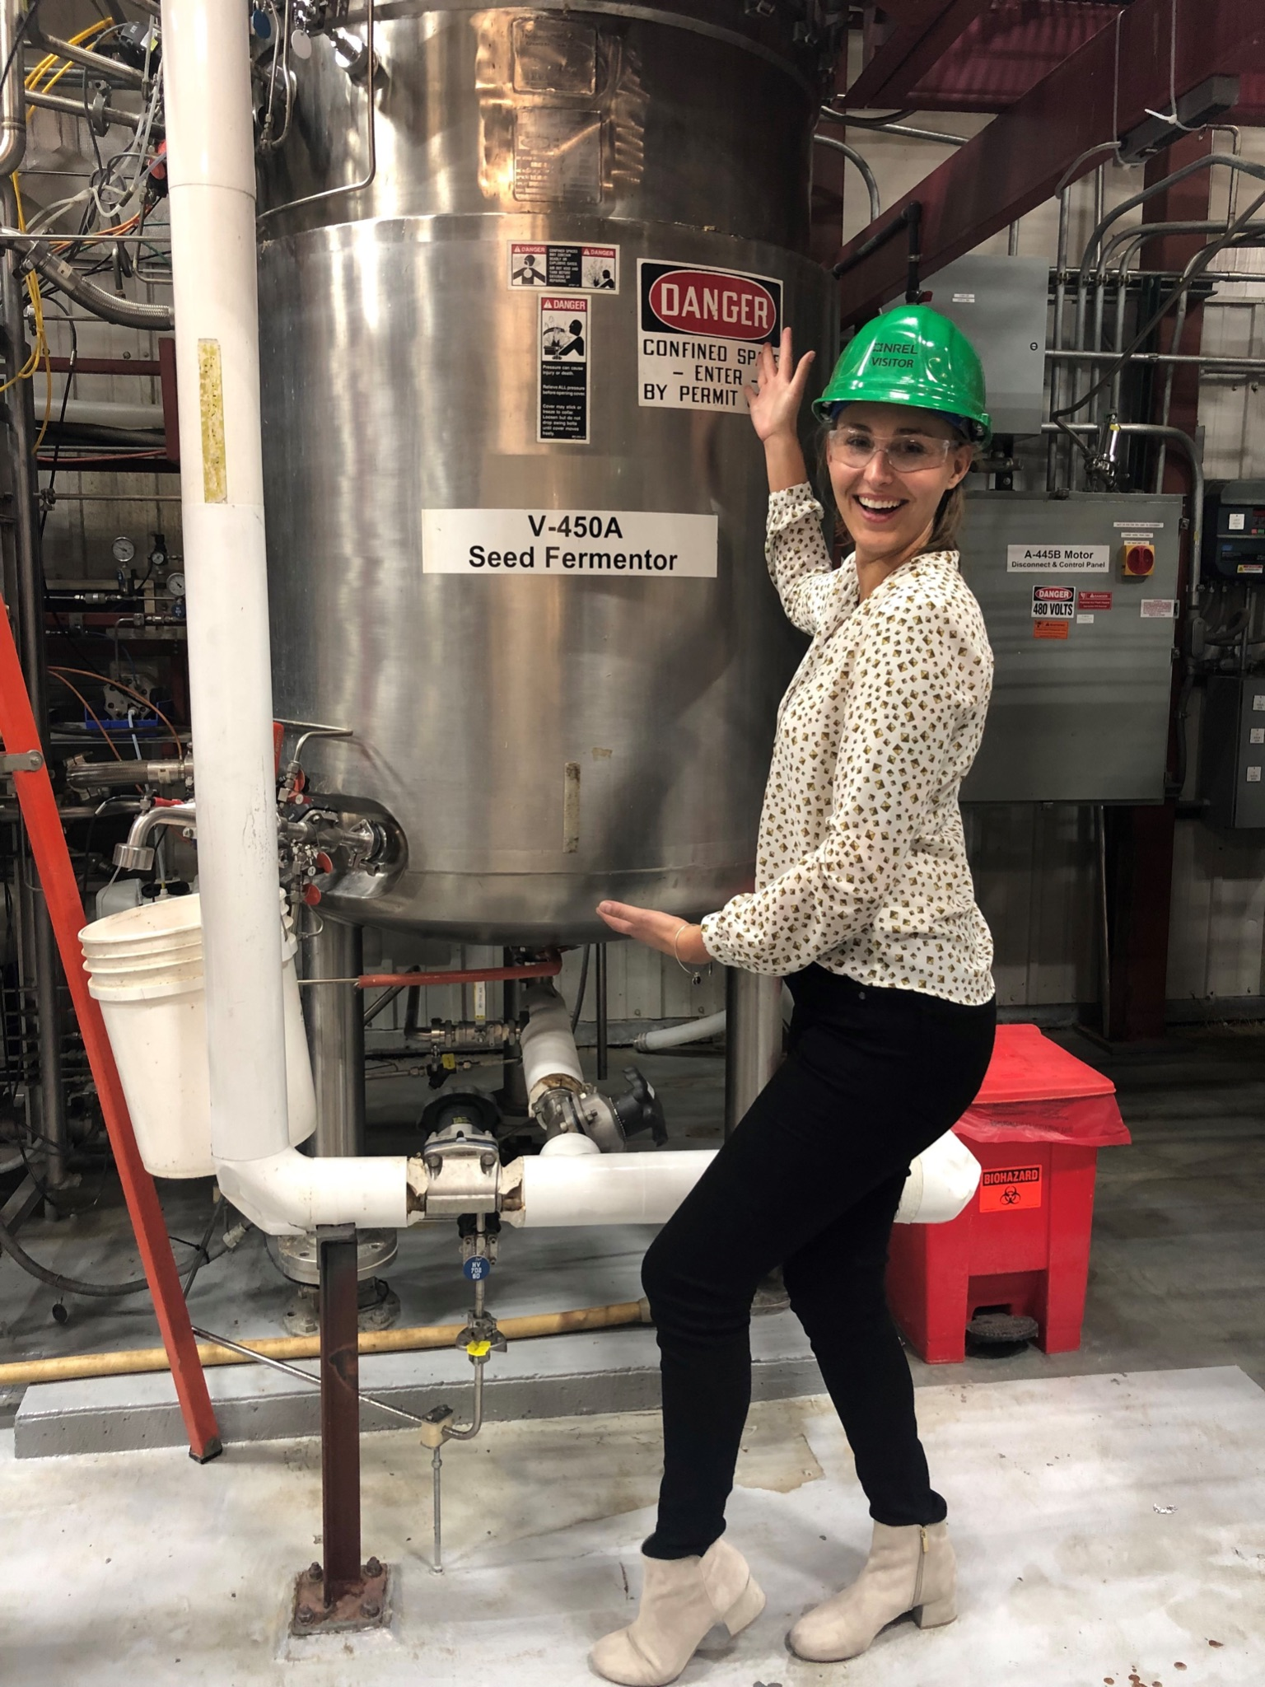
Women from BETO - Gayle Bentley
Technology Manager, Conversion
Gayle’s work helps support the development of new biological pathways to produce renewable fuels and chemicals, with significant greenhouse gas savings compared to routes from fossil. Biology has provided us with a rich resource to rethink our economy and limit the impact of climate change.
NO IMAGE AVAILABLE

Slide 4
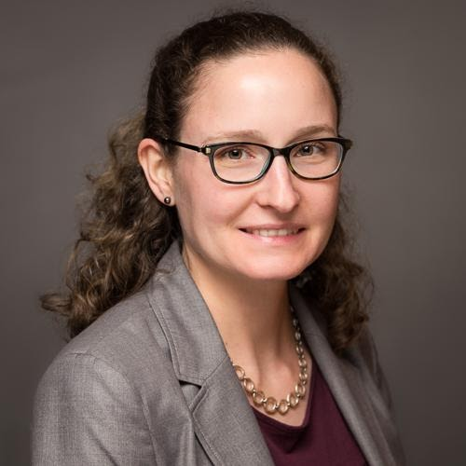
Women from BETO - Liz Burrows
Technology Manager, Feedstock Supply and Logistics
Liz works within the Feedstock Technologies R&D Program overseeing projects in R&D areas of feedstock production and supply, sustainable energy crops, feedstock preprocessing for conversion, waste stream valorization, and value-added coproducts. Liz is also the SBIR coordinator for BETO and is currently leading a Funding Opportunity Announcement on municipal solid waste characterization. Liz also has a special interest in data sharing and recently led BETO’s workshop titled, “Leveraging Existing Bioenergy Data.”

Slide 5
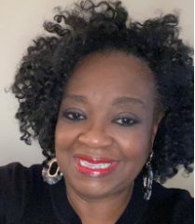
Women from BETO - Sheila Dillard
Communications Lead
Sheila manages the development and execution of BETO’s traditional and digital media, stakeholder engagement, media relations, and executive visibility. She manages BETO’s Biocomms collaboration with DOE’s national laboratory communications leaders and laboratory relationship managers in addition to the organization’s education and workforce development portfolio.

Slide 6
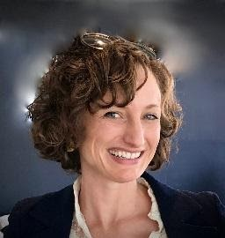
Women from BETO - Nichole Fitzgerald
Program Manager, Advanced Algal Systems and Feedstock Technologies
Nichole oversees $80M in annual appropriations aimed at advancing the state of technology for algal biofuels production and feedstock supply and logistics. She is passionate about finding ways to get renewable carbon into the materials we use daily and has pioneered several bioproduct and functional replacement initiatives for BETO.

Slide 7
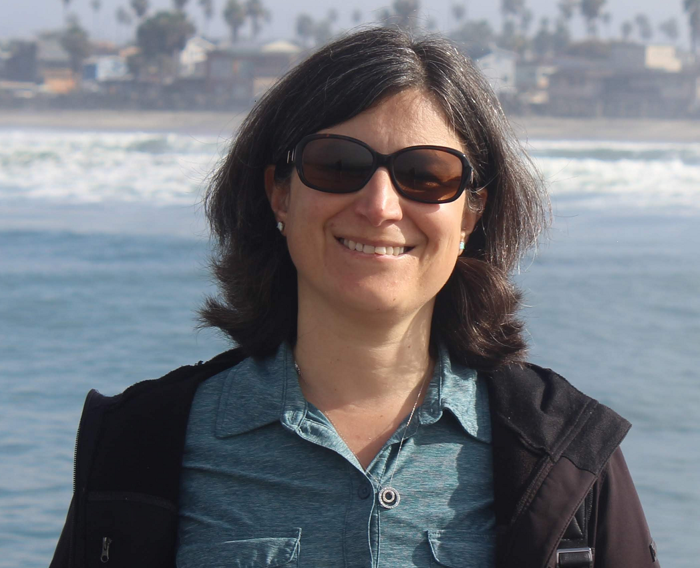
Women from BETO - Sonia Hammache
Technology Manager, Conversion
Sonia uses her decades of experience in energy research to ensure that the technology behind the DOE-supported projects involving the sustainability of energy production are based on scientific principles. She oversees several projects involving the reduction of greenhouse gases as it pertains to biomass. She is very involved in climate action outside of work.

Slide 8
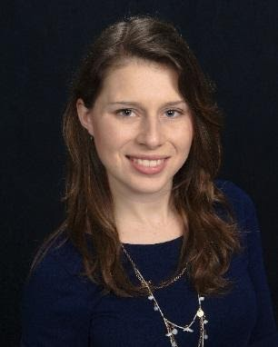
Women from BETO - Devinn Lambert
Technology Manager, Advanced Algal Systems
Devinn oversees research grants amounting to over $35 million annually. She established the Advanced Aviation Fuels Interagency Working Group, which brings together seven agencies to coordinate research from the microliter scale all the way up to biorefineries that process thousands of tons of biomass per day.

Slide 9
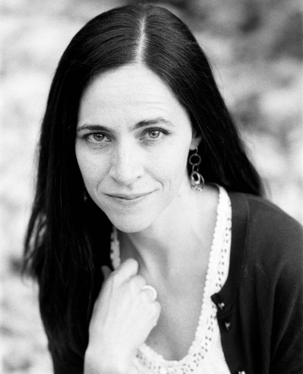
Women from BETO - Alicia Lindauer
Technology Manager, Data, Modeling and Analysis
Alicia manages strategic analysis and bioenergy sustainability activities. She also co-leads the Co-Optimization of Fuels and Engines initiative, a joint effort with the Vehicle Technologies Office focused on improving vehicle engine efficiency, performance and emissions. Alicia is passionate about addressing climate change and improving the environmental sustainability of biofuels and bioproducts.
NO IMAGE AVAILABLE

Slide 10
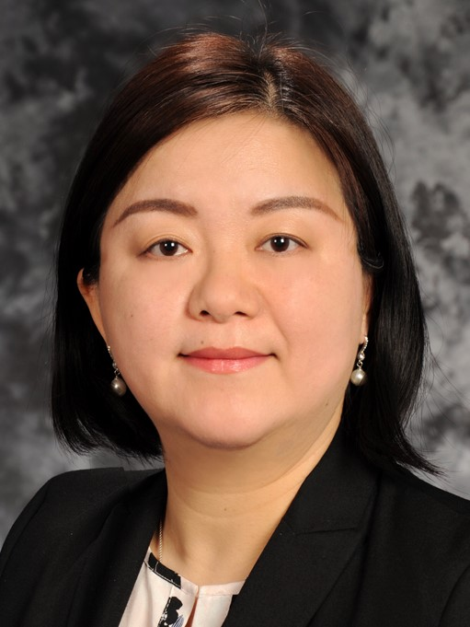
Women from BETO - Chenlin Li
Technology Manager, Feedstock Technologies
Chenlin works within the Feedstock Technologies R&D Program overseeing projects in R&D areas of feedstock production and supply, sustainable energy crops, feedstock preprocessing for conversion, waste stream valorization, and value-added coproducts. She is a co-chair of Feedstock Logistics Interagency Working Group under the Biomass R&D Board, which is a collaborated federal effort among agencies including DOE, USDA, DOI, DOD, EPA, and NSF. In addition to her technical management duties at BETO, currently Chenlin also serves as an Officer for the DOE’s Asian American Pacific Islander Network.

Slide 11
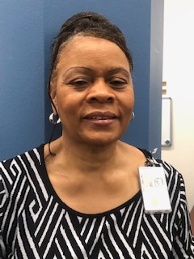
Women from BETO - Linda Malloy
Executive Administrative Assistant
Linda manages congressional items, travel, time and attendance, and onboards new employees.

Slide 12
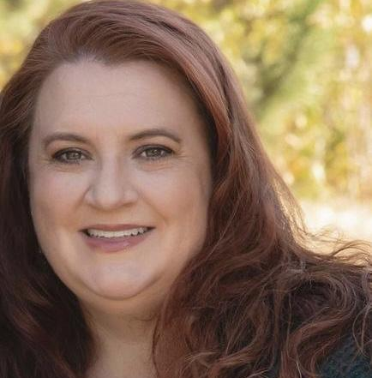
Women from BETO - Liz Moore
Technology Manager and Technical Project Officer, Systems Development and Integration
Liz works on all aspects of program and project management from budget planning and execution to all phases of project management. Additionally, Liz manages cross-cutting efforts in the Feedstock Technologies and Conversion areas.

Slide 13
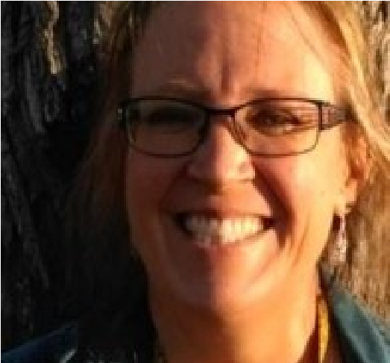
Women from BETO - Christy Sterner
Technology Manager, Advanced Algal Systems
Christy implements the federal budget for the Program’s algae research and development activities. She manages a portfolio of research/development and demonstration projects, supports and leads Funding Opportunity Announcements, and provides technical support to the Program.

