Slide 1


national water reuse
action plan
Water Security Grand Challenge Webinar Series
November 7, 2019

Slide 2
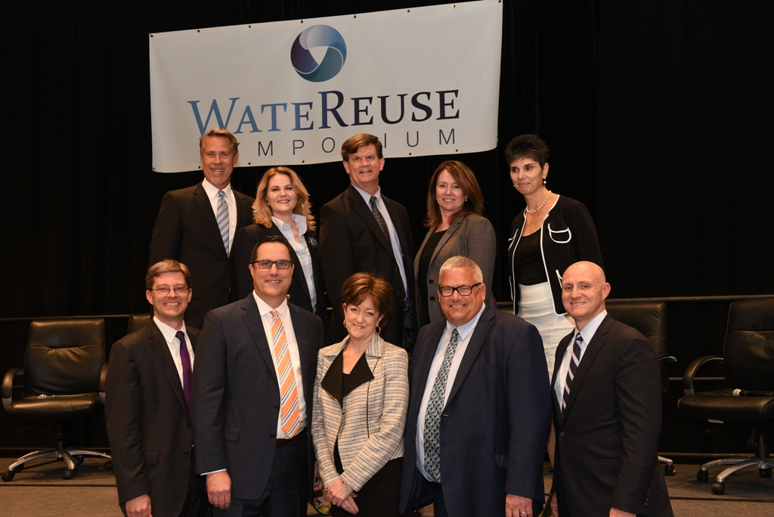
Agenda
Overview and background
Strategic objectives
WSGC and water reuse
Public commitment period
Envisioning implementation
Photo courtesy of WateReuse Association
Draft Action Plan announcement with federal partners at the WateReuse Symposium, September 10, 2019.

Slide 3
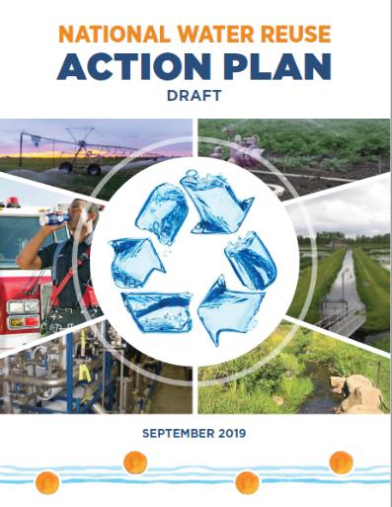
Content Overview
Call to Action
Section 1
  The business case
Section 2
  10 strategic objectives
  46 proposed actions
Section 3
  Looking forward
Released Sept. 10, 2019
~45 pages
9 appendices
Notes:
The draft National Water Reuse Action Plan is approximately 45 pages in length and supported by extensive information in nine Appendices. Section 1 of the draft Action Plan frames the business case for water reuse including: key definitions; summary of the primary drivers, opportunities and challenges for water reuse; the potential sources and applications for water reuse; and guiding principles and the methodology for development of the draft Action Plan.

Slide 4
Source Materials
Analysis and summary of literature (over 155 sources)
Outreach with an ~2,300 participants (>20 forums)
Public input from the docket (55 commenters)
WateReuse Association expert convening report (spring 2019)
Review of international experiences (Israel, Singapore, Australia, South Africa, Namibia)
Reuse case studies for facilities in the United States
Current federal agency roles

Slide 5

Drivers, Opportunities, and Challenges for Water Reuse
1.1
Water security: The capacity of a population to safeguard sustainable access to adequate quantities of acceptable quality water for sustaining livelihoods, human well-being, and socioeconomic development.
Water sustainability: Ensuring an adequate and continual supply of clean water for human uses and ecosystems.
Water resilience: The ability of a community water system or an asset of a community water system to adapt to or withstand the effects of rapid hydrologic change or a natural disaster.
Notes:
Inset 5 directly points to DOE WSGC as a driver

Slide 6
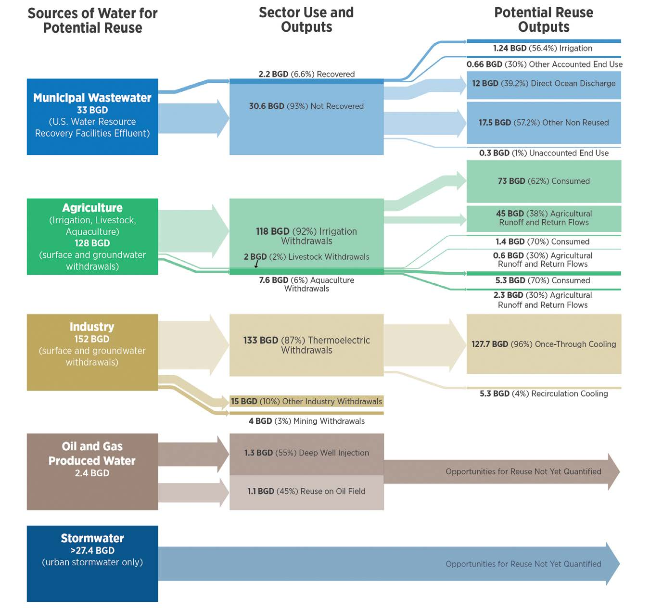
Sources of Water and Potential Applications for Water Reuse
1.2
Clear potential to reclaim more of nation’s water
  Nearly 350 BGD sources of water discharged
  Over 280 BGD potentially available for reuse
Sources* of water for potential reuse:
  33 BGD - Municipal wastewater
  128 BGD - Agriculture
  152 BGD - Industry
  2.4 BGD - Oil and gas produced water
  >27.4 BGD – Stormwater
* Graphic and estimates from draft Action Plan, page 6

Slide 7
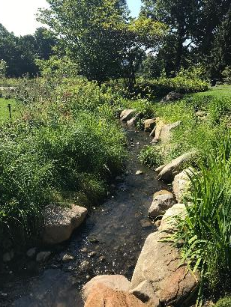
Enable Consideration of Water Reuse with Integrated and Collaborative Action at the Watershed Scale
2.1
“The Action Plan will be a critical step toward advancement of Integrated Planning across regulatory boundaries and for promoting more resilient water management across the United States.”
−New York City Department of Environmental Protection
Vegetation along a stream at the Brooklyn Botanic Garden in New York filters water collected on the garden grounds as part of their treatment and recirculation infrastructure, reducing the garden’s freshwater consumption.

Slide 8
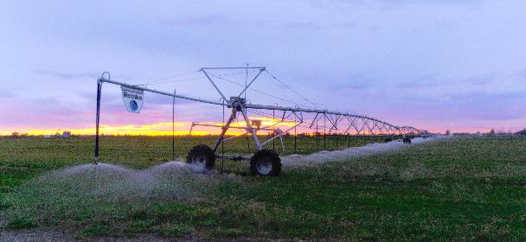
Coordinate and Integrate Federal, State, Tribal, and Local Water Reuse Programs and Policies
2.2
“Going forward, perhaps the most important action EPA can undertake is to maintain its stature as an honest broker for water reuse policy. As our nation’s lead regulator for water policy, the Agency is in a unique position, one that allows the Agency to backstop sound local and state decision making.”
−American Water Works Association (AWWA)
A farm in Idaho applies treated, reclaimed wastewater to a potato field.

Slide 9

Compile and Refine Fit-for-Purpose Specifications
2.3
“The academic and professional communities in the United States are embracing a ‘One Water’ approach that recognizes that water sources that were once thought to be unfit for consumption (e.g., treated wastewater, urban runoff, agricultural runoff) can now potentially be made safe for human consumption with appropriate treatment technologies.”
−ReNUWIt
The Heyburn reuse site in Benewah County, Idaho, reuses treated wastewater to irrigate a 20.5-acre native forested site during the growing season.

Slide 10
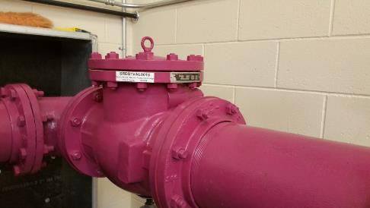
Promote Technology Development, Deployment, and Validation
2.4
“Establishing a national framework for reuse water quality, dictated by the source and end use, would promote reuse technology development and provide a greater economy of scale for manufacturers of equipment and engineered solutions.”
− The U.S. Chamber of Commerce Business Task Force on Water Policy
Purple pipes in the City of Meridian, Idaho, which has begun installing water reuse infrastructure with a goal to "recycle and/or reuse 80 percent of the waste stream" by 2030.

Slide 11
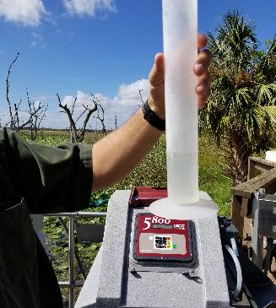
Improve Availability of Water Information
2.5
“Sharing information in a sector-specific context can help build awareness of the benefits of reuse and encourage stakeholders not yet engaged in reuse to consider options for implementation.”
−WateReuse Association Convening Report
Final effluent leaving constructed wetlands in Orlando. In-field water quality monitoring of reclaimed ensures fit-for-purpose specifications are being met.

Slide 12
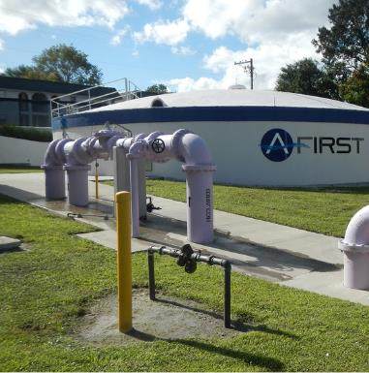
Facilitate Financial Support for Water Reuse
2.6
“EPA should clarify that water reuse projects are eligible expenses for State Revolving Funds (SRF) and which SRF, clean water or drinking water, should fund which pieces of a project.”
−ACWA and ASDWA
A storage facility with purple pipe distribution in Altamonte Springs, Florida.

Slide 13
Integrate and Coordinate Research on Water Reuse
2.7
“Federal leadership is sorely needed to help assure that, as we go forward with utilizing this critically important resource, we make sound, scientifically based decisions that work to prepare our country for the successful utilization of all alternate water sources.”
−Plumbing Industry Leadership Coalition
The private Hidden Springs sewage treatment facility provides treated wastewater to be reused for irrigation on public and small-scale crops.

Slide 14
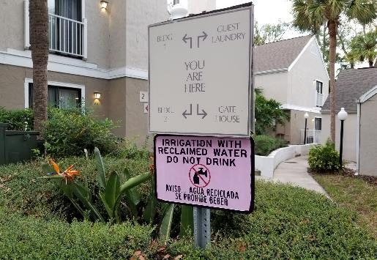
Improve Outreach and Communication on Water Reuse
2.8
“More messaging on a national level of the benefits and successes [of water reuse] in tandem with discussion of the public health and environmental protection safeguards and benefits is necessary.”
−NACWA
Bilingual signage about the use of reclaimed water for landscaping is protective of the entire community at one Florida hotel complex.

Slide 15
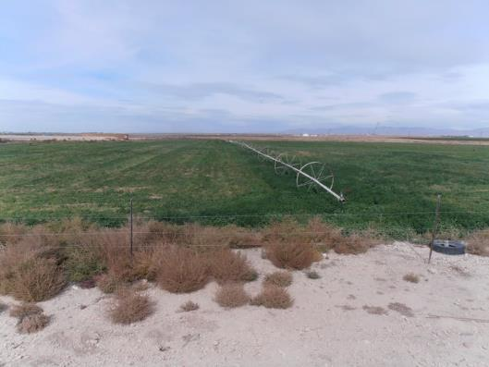
Support a Talented and Dynamic Workforce
2.9
“With increasingly complex systems, particularly in the case of direct potable reuse, there are skills, knowledge and abilities that go beyond traditional operator certification requirements. ACWA and ASDWA recognize and respect the States’ autonomy in implementing their operator certification programs, however water reuse represents a unique opportunity for EPA to partner with states to identify key knowledge and skills needed by water system operators who are presiding over these water reuse projects.”
−ACWA and ASDWA
A large wheel line sprinkler system in Idaho.

Slide 16
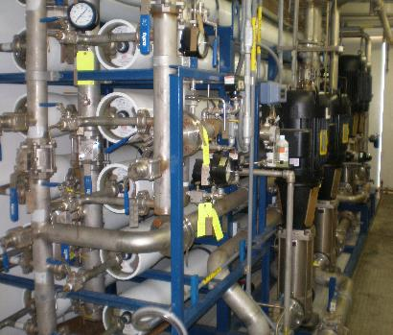
Develop Water Reuse Metrics that Support Goals and Measure Progress
2.10
“According to the 2017 Reuse Inventory Report, Florida reused approximately 813 MGD (over 161 billion gallons per year) of potable quality water while serving to add 252 MGD (approximately 92 billion gallons per year) back to available water supplies.”
−Florida DEP
The Don van Rasfeldt Power Plant in Santa Clara, California, takes high-salt water (750 mg/L total dissolved solids) and runs it through reverse osmosis. The resulting reclaimed water is fed into the power plant boilers.

Slide 17
Water Security Grand Challenge and Reuse
Goal Two
“Transform the energy sector’s produced water from waste to resource”
Complete the EPA Study of Oil and Gas Extraction Wastewater Management
2.2.3
Identify and Fill Science and Technology Gaps and Needs Inhibiting Greater Consideration of Off-Field Use of Treated Produced Water
2.4.2
Inset 9. Produced Water Report: Regulations, Current Practices, and Research Needs
In June 2019, the Ground Water Protection Council (GWPC) completed a comprehensive report on oil and gas produced water. The
report engaged geologists, engineers, lawyers, toxicologists, soil experts, public health experts, the petroleum industry, and regulators. From this group, the GWPC sought ideas and advice on the report’s content and conclusions. Relevant highlights considered in development of the draft Action Plan are excerpted below.
Notes:
Reuse fits into three of the five WSGC for achievement by 2030. Goal Four includes Clean water that can be reused for agricultural, industrial, and potable purposes.

Slide 18
Water Security Grand Challenge and Reuse
Goal Three
“Achieve near-zero water impact for new thermoelectric power plants, and significantly lower freshwater use intensity within the existing fleet”
Goal Four
“Double resource recovery from municipal wastewater”
Notes:
Reuse fits into three of the five WSGC for achievement by 2030. Goal Four includes Clean water that can be reused for agricultural, industrial, and potable purposes.

Slide 19
Action Together
Leverage the U.S. Department of Energy’s Water Security Grand Challenge
2.4.3
Use the DOE’s Water Security Grand Challenge to develop challenges that promote specific technological advancements
in support of water reuse, including:
A modular reuse challenge focused on the design of a “plug and play” system to be employed in rural communities, during emergency response, or at a building interested in implementing onsite reuse.
A multi-phase challenge for the development and testing of sensor technology that promotes the implementation of water reuse, to include prototype testing and complete International Organization for Standardization certification.
Innovative brine management (e.g., reclamation) approaches and treatment technologies that do not require a discharge.
Notes:
The draft National Water Reuse Action Plan specifics an entire action about leveraging DOE’s WSGC.

Slide 20
90-Day Public Commitment Period
Commenters are encouraged to:
Identify the most important proposed actions they feel should be taken in the near term;
Identify the specific attributes and outcomes of proposed actions that will achieve success;
Identify implementation steps and milestones necessary to implement the proposed actions;
Commit to lead or collaborate with others on implementing any of the proposed actions; and
Inform revisions and recommendations to the proposed 46 actions.
Comments on the draft plan may be submitted and viewed through regulations.gov
(EPA-HQ-OW-2019-0174) on or before December 16, 2019.

Slide 21
Envisioning Implementation
Goal: issue a National Water Reuse Implementation Plan, available online and updated in real-time, which includes clear commitments and milestones for actions.
Attributes of action scoping and implementation plans may include:
Background/Context/Framing
Problems to be Solved/Opportunities to be Gained
Entities and Organizations with Equities and Interests
Steps to Implement the Action
Key Contacts/Discussants
We look forward to your comments and continued engagement.

Slide 22
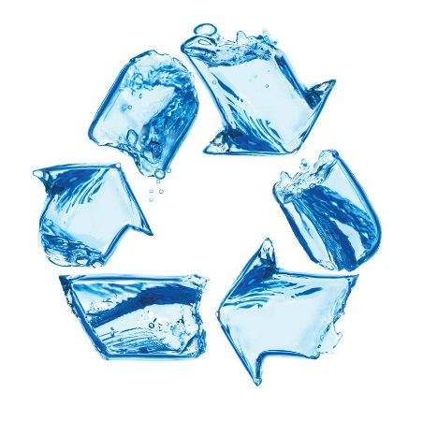
Thank you!
Sharon Nappier, Microbiologist
EPA Office of Water
Office of Science and Technology
Nappier.Sharon@epa.gov
https://www.epa.gov/waterreuse/water-reuse-action-plan
Aliza Furneaux, ORISE Fellow
EPA Office of Water
Office of Science and Technology
Furneaux.aliza@epa.gov

