Slide 1
Technologist in Residence Program
Webinar for interested parties
6.6.2018
Eli Levine, Program Manager, AMO

Slide 2
Introduction
TIR Opportunity Statement:
Intro to Advanced Manufacturing Office
Technologist in Residence Overview
Review of TIR Program To-Date
How to Apply
Review Criteria
Questions and Answers

Slide 3
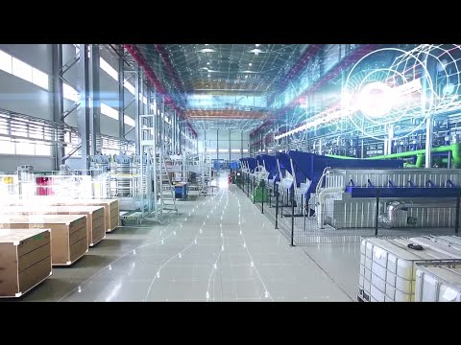
Advanced Manufacturing Office
Focus on Early Stage Applied Research and Development
Technology Areas with Knowledge Gaps Applicable to
Manufacturing and Energy
Merit-based R&D at National Laboratories, Universities,
Companies (for profit and not for profit) and Consortia
Partner with Private Sector to Identify Technical Knowledge Gaps
and Transfer Learning for Subsequent Adoption
R & D
Projects
R & D
Consortia
Technical
Assistance

Slide 4
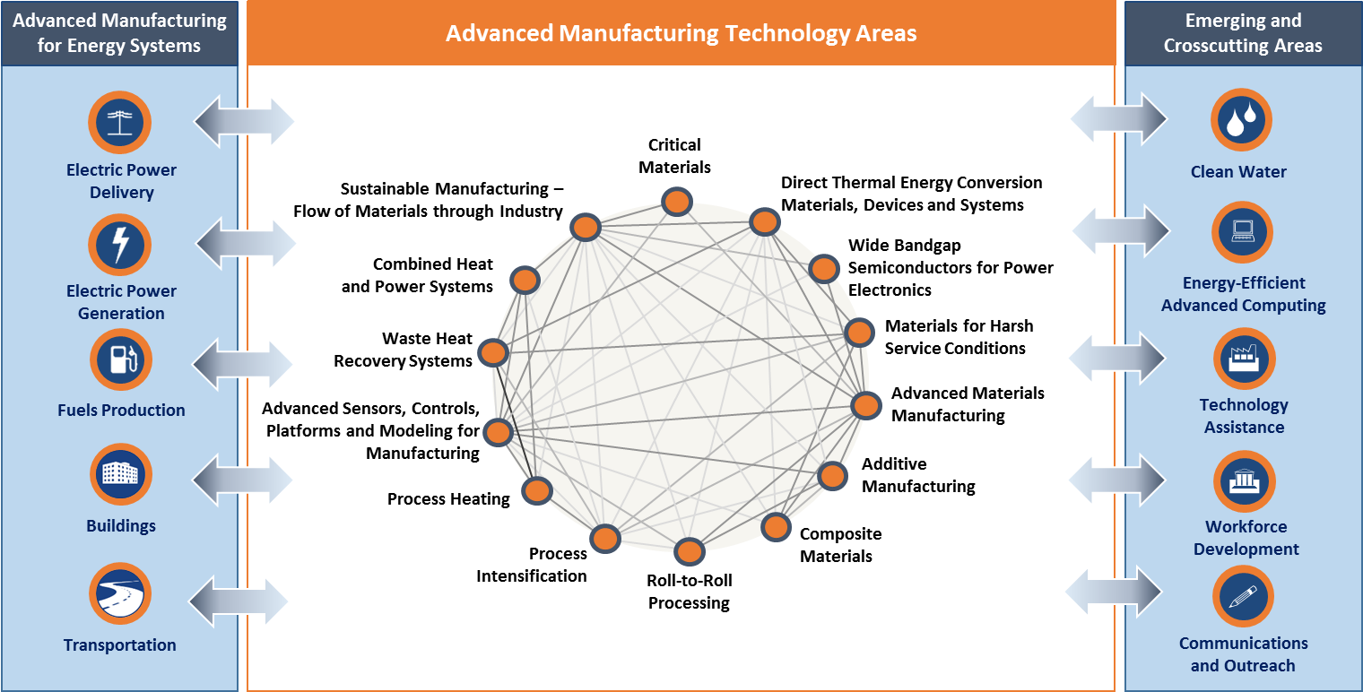
QTR and Multiyear Program Plan (draft) Technologies
Energy & Resource Management
(Information)
Manufacturing Processes
(Processes)
Materials Development
(Materials)
Notes:
Vision: U.S. global leadership in sustainable and efficient manufacturing for a growing and competitive economy.
Mission: Catalyze research, development and adoption of energy-related advanced manufacturing technologies and practices to drive U.S. economic competitiveness and energy productivity.
AMO STRATEGIC GOALS
Improve the productivity and energy efficiency of U.S. manufacturing
Reduce lifecycle energy and resource impacts of manufactured goods
Leverage diverse domestic energy resources in U.S. manufacturing, while strengthening environmental stewardship
Transition DOE supported innovative technologies and practices into U.S. manufacturing capabilities
Strengthen and advance the U.S. manufacturing workforce

Slide 5
TIR Program Introduction
TIR Opportunity Statement:
Many potential industry partners lack in-depth understanding of Lab expertise and resources, or how to work with the National Labs.
Meanwhile, lab researches often do not know the most pressing industry problems. When industry and labs engage, it tends to be on a project-by-project basis, and lacks long-term strategic value for both sides.
Lastly, most lab-industry relationships, when they exist, are one-off relationships with a particular lab.
TIR Vision: Catalyze strong Lab-Industry relationships that result in significant growth in high-impact collaborative research and development

Slide 6
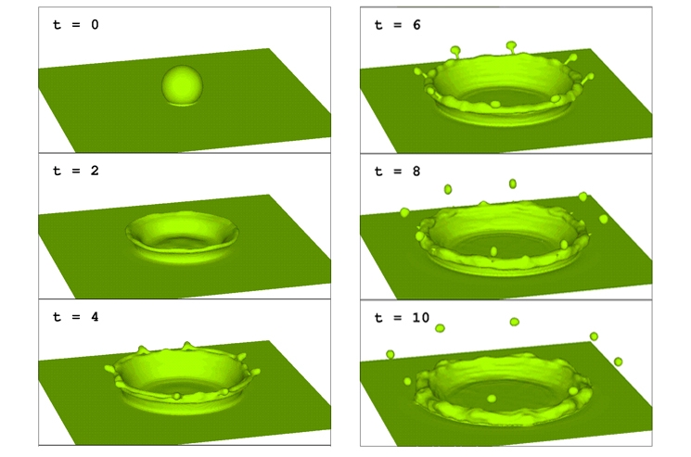
History: Los Alamos’s Industrial Fellows Program
$1 Billion Saved in MFG Costs
44% increase in plant productivity
30% increase in equipment reliability
This simulation of a droplet of liquid falling into a pool of liquid was modeled using Los Alamos National Laboratory's Computational Fluid Dynamics Library (CFDLib), and utilized by Procter and Gamble to simulate a manufacturing process.
https://energy.gov/articles/improved-manufacturing-processes-save-company-one-billion-dollars
Notes:
That was before P&G partnered with the Energy Department's Los Alamos National Laboratory (LANL) in the 1990s. LANL scientists helped P&G engineers develop simulations to improve the reliability of P&G's complex production lines. P&G's 150 facilities worldwide saw a 44 percent increase in plant productivity and 30 percent increase in equipment reliability since they started using the software.
Large-scale implementation of the technology helped save P&G $1 billion in manufacturing costs, according to Procter & Gamble. These cost-saving benefits are applicable towards production lines across the manufacturing sector, which was responsible for $1.7 trillion of the US GDP in 2010, according to the Bureau of Economic Analysis.
But like many early technological advancements, the commercial application wasn't initially clear. LANL researchers had developed advanced statistical models to quantify uncertainties in complex systems, but they didn’t have enough real-world data to know whether they were correct. At the same time, P&G had a lot of operational data from its complex production lines, but no model to use them effectively.
In 2001, eight years after the initial pairing with the lab, P&G commercialized and licensed the product as part of a manufacturing operations toolkit. Touted as a way to keep the machines running as fast as they could for as long as possible, the software also improved machine reliability, lowered the rate of waste and created safer work environments.

Slide 7
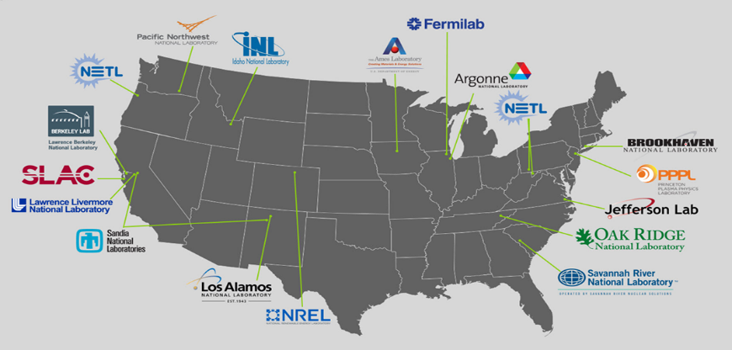
Technologist in Residence Summary: Model
Senior Technologists are identified within a National Lab and a manufacturing company.
The Technologists work together…
…to identify new areas of collaborative research for industry and Lab, and create an agreement and specific scopes of work
Broadening beyond ‘one company – one lab’…
Through the Council of Technologists, program participants will work together to access/resources across the entire Lab enterprise. The Council will also help optimize the process for Lab collaboration.

Slide 8
Technologist in Residence Program
Technologist in Residence (TIR) pairs senior technical staff from national laboratories and manufacturing companies to work together towards impactful manufacturing solutions.
Immediate Objectives:
Identify areas of collaborative R&D
Develop a streamlined method for companies to establish long term relationships with laboratories that result in collaborative research and development
Long-term, strategic public-private partnerships
Additional Objectives:
Enhance transparency into the national lab innovation infrastructure
Enhance awareness of high-impact industrially relevant technology challenges within the national laboratory system; and
Broaden and strengthen networks of Technologists in national laboratories and in industry to more effectively support industry needs and leverage the national laboratory enterprise.

Slide 9
Feedback from Industry:
“The Technologist-in-Residence program has been very useful and fruitful for industry. It made it considerably easier to explore, evaluate and use excellent scientific and technological resources available at National Labs. In less than a year, our TIR partnership has resulted in three separate direction of research that our company plans to pursue in collaboration with several national labs. Both national lab counterparts as well as TIR coordinators were extremely helpful in finding new areas of innovation and in establishing collaborative framework.”
- Dr. Stan Petrash, Henkel North America
“The TIR program has enabled Kyma to access state of the art capabilities and expertise at Argonne that has served to reduce the technical risk and to accelerate our rate of progress on two exciting technology development projects at Kyma. The DOE TIR program provides an opportunity for Kyma to better understand and capitalize on important new collaboration opportunities with leading scientists and to benefit from state-of-the-art capabilities housed within our nation’s DOE Laboratory System. The Argonne team, led by Dr. John Hryn and Dr. Angel Yanguas-Gil, have deep scientific expertise and have been invaluable in helping us solve difficult problems that are inherent to this kind of cutting edge research and development.”
- Keith Evans, President and CEO, Kyma Technologies

Slide 10
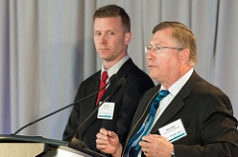
Technologist in Residence Program
Cohort One: Kicked off December 1, 2015

Slide 11
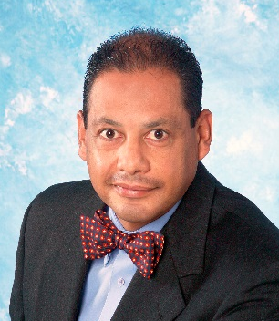
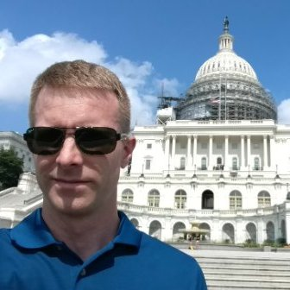
TIR Program Successes
ORNL – Arconic
Core Topics of Focus:
Labs Engaged with:
Results:
Argonne – Cummins
Core Topics of Focus:
Labs Engaged with:
Results:
6 Statement of Work Proposals Developed Across Three Labs (NREL, ORNL, Argonne)
1 active CRADA
Additive Manufacturing
Materials Discovery
High-Performance Computing
High-Entropy Alloys
Ceramic Materials
Heat Exchangers
Ceramic Matrix Composites
Data Analytics
Water Utilization
Lightweight alloys
Joining
Powertrain systems and energy storage technologies.
Increased flexibility for fleet operators
Lower cost of vehicle ownership
Partnering with regional air quality goals
Additional Potential Technology Areas for Exploration:
Better understanding of battery system parameters
Enhanced power electronics cooling technologies
Thermal storage and release technologies
Ames
LLNL
LANL
NETL
NREL
ANL
PNNL
ORNL
NREL
ANL
Sandia
3 CRADAs at the Manufacturing Demonstration Facility
2 proposals funded by the HPC4MFG program
Seedling proposal w ARPA-E
1 User Project at ORNL’s Center for Nanophase Materials Science
2 Strategic Partnership Projects
1 License

Slide 12
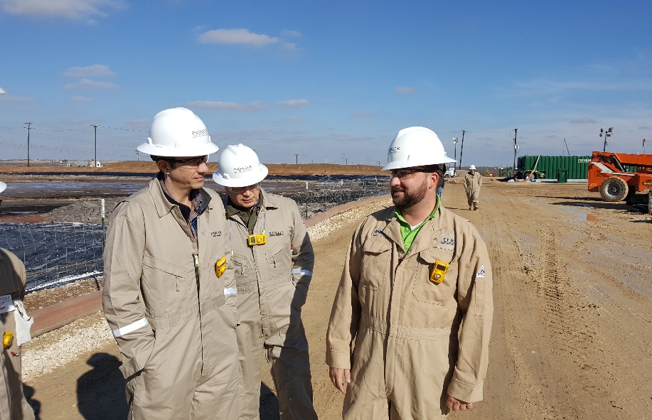
Technologist in Residence Program
Cohort Two: Rolling Application/Kickoff 2016/17

Slide 13
Participating in the TIR program
Cost share: DOE will fund Lab Technologist and any potential other team members for up to $350k. Industrial partner agrees to fund full participation of Industry Technologist, as well as any costs for Lab above DOE’s commitment.
Participation: 18 – 24 months
Eligibility: Department of Energy National Laboratories are eligible to apply as the primary applicant. The proposal must also include an industry partner that is committed to participating. To be eligible, the lab proposal must identify both the senior representative of the industry partner and the senior representative of the DOE National Laboratory that would participate. For this lab call, “industry partner” is defined as a senior representative of a manufacturing company, consortia of companies. At DOE’s discretion, DOE may consider other entities that are similar to the types of entities listed in the sentence above.
Merit Review (1) Innovation, Technical Focus, Project Plan, and
Criteria: Approach (60%)
(2) Team and Resources (40%)
Notes:
Department of Energy National Laboratories are eligible to apply as the primary applicant. The proposal must also include an industry partner that is committed to participating
To be eligible, the lab proposal must identify both the senior representative of the clean energy manufacturing industry partner and the senior representative of the DOE National Laboratory that would participate.
For this lab call, “advanced manufacturing industry partner” is defined as a senior representative of a manufacturing company, consortia of companies, or other. At DOE’s discretion, DOE may consider other entities that are similar to the types of entities listed in the sentence above. m
Proposals submitted after the final proposal deadline will be declined without review.
Proposals may include an appendix of team members’ resumes (no other information or materials). Proposals must not exceed 10 pages single spaced, 12 point font with standard margins. The budget document, the proposed Technologists’ resumes, and the industry partner’s cost match commitment letter can be additional pages beyond the 10 page limit.

Slide 14
Industry Cost Share Requirements
The proposal must detail the private sector partner’s commitment to contribute the amount necessary to cover any additional salary and travel costs for the Lab Technologist team beyond the Federal share of $350,000.
In addition to this cost share to support for the salary and travel of the Lab Technologist, it is anticipated that the Industry partner will cover 100% of the Industry Technologist’s salary and expenses during the TIR program. The proposal must specify the amount and source of funding the industry partner will contribute to the project in the budget template provided. In addition, the proposal shall include a cost share commitment letter signed by the industry partner.
EERE has a budget of $2 million for this pilot, from the Advanced Manufacturing Office. It is envisioned that about 5 Technologist in Residence pairs will be funded through this pilot.

Slide 15
How to Apply
Participant Selection
DOE issued a call for proposals to the laboratories, posted on EERE Exchange.
Applications evaluated on a rolling basis
Applications will describe:
The broad area of technical focus to be explored by the Technologists in Residence and how the technical focus relates to AMO objectives
The approach and activities the pair proposes to carry out to meet the pilot’s and the pair’s objectives
The specific workplan including a budget, metrics, and milestones
The background and capabilities of the individual Technologists and any additional support or resources provided by the participating companies and labs

Slide 16
Lab Points of Contact
Ames Laboratory | Thomas Lograsso | 515-294-5772 | lograsso@ameslab.gov | Deputy Director, Ames Lab
Argonne National Laboratory (ANL) | Suresh Sunderrajan | (630) 252-8111 | ssunderrajan@anl.gov | Director, Technology Development and Commercialization Division
 | David McCallum | (630) 252-4338 | dmccallum@anl.gov | Business Capture Manager
Brookhaven National Laboratory (BNL) | Pat Looney | (631) 344-3798 | jlooney@bnl.gov | Chair of the Sustainable Energy Technologies Department
Fermi National Accelerator Laboratory (FNAL) | Cherri Schmidt | (630) 840-5178 | cherri@fnal.gov | Office of Partnerships & Technology Transfer
Lawrence Berkeley National Laboratory (LBNL) | Elsie Quaite-Randall | (510) 486-7234 | equaiterandall@lbl.gov | Chief Technology Transfer Officer
Oak Ridge National Laboratory (ORNL) | Mike Paulus | (865) 574-1051 | paulusmj@ornl.gov | Director, Technology Transfer Division
Pacific Northwest National Laboratory (PNNL) | Mike Rinker | (509) 375-6623 | Mike.rinker@pnnl.gov | Manager of the Energy Efficiency and Renewable Energy market sector
Princeton Plasma Physics Laboratory (PPPL)
SLAC National Accelerator Laboratory | Mark Hartney | (650) 926-4805 | mhartney@slac.stanford.edu | Director of the Office of Strategic Planning
Thomas Jefferson National Accelerator Facility | Drew Weisenberger | 757-269-7090 | drew@jlab.org | Group Leader, Detector and Imaging Group Staff
Idaho National Laboratory (INL) | Ryan Bills | 208-526-1896 | ryan.bills@inl.gov | Senior Commercialization Manager, Tech Deployment
National Energy Technology Laboratory (NETL) | Michael Nowak | 412-386-6020 | Michael.Nowak@NETL.DOE.GOV | Strategic Partnerships
 | Kate Nielsen | (412) 386-7509 | Katherine.Nielsen@NETL.DOE.GOV
National Renewable Energy Laboratory (NREL) | Bill Farris | (303) 275-3069 | william.farris@nrel.gov | ‎Associate Laboratory Director - Innovation, Partnering & Outreach
Savannah River National Laboratory (SRNL) | Scott McWhorter | 803-761-1109 | scott.mcwhorter@srnl.doe.gov | Manager, Renewable Energy Section
Lawrence Livermore National Laboratory (LLNL) | Richard Rankin | (925) 423-9353 | rankin8@llnl.gov | Director, Industrial Partnerships Office
Los Alamos National Laboratory (LANL) | Steve Stringer | (505) 660-2177 | stringer@lanl.gov | Business Development
Sandia National Laboratories (SNL) | Jeff Nelson | (505) 284 -1715 | jsnelson@sandia.gov | ‎Manager, Center for Integrated Nanotechnologies at Sandia National Laboratories

Slide 17
Initial Eligibility Review
Proposals submitted after the full proposal deadline will be declined without review.
Prior to a full merit evaluation, EERE will perform an initial eligibility screen to determine that (1) the applicant is an eligible entity under this Laboratory Call; (2) the information required by the Laboratory Call has been submitted; (3) all mandatory requirements are satisfied; and (4) the proposed project is responsive to the objectives of the Laboratory Call.
Proposals that fail to pass the initial eligibility review will not be forwarded for merit review and will be eliminated from further consideration.

Slide 18
Merit Review Criteria
Criterion 1: Innovation, Technical Focus, Project Plan, and Approach (60%)
Innovation:
Degree to which this proposal demonstrates additionality: a new relationship between Labs and a private sector industry partner, a new approach to working together, or a previously unexplored area of focus.
Technical Focus:
Degree to which the industry partner’s technical challenges and Laboratory’s suite of capabilities fit the scope of the program;
The extent to which the pair has sufficiently identified the challenges of a particular technology area that enables exploration of expertise and resources at the National Laboratories;
Degree to which the pair is well-suited to address the identified challenges; and
Degree to which the identified private sector technical challenges, if solved, will meet the objectives of the Advanced Manufacturing Office
Approach and Work Plan:
Degree to which the approach detailed in the work plan will achieve the program goals and expectations;
Degree to which the proposed activities will result in increased collaborative research and development between the proposed industry partner and DOE National Laboratories;
Degree to which the proposed activities enable relationship building between the Labs and the participating company/companies;
Degree to which the approach has been clearly described and thoughtfully considered;
Degree to which work plan and task descriptions are clear, detailed, timely, and reasonable, resulting in a high likelihood that the proposed work plan will succeed in meeting the program objectives; and
Degree to which the proposal has demonstrated understanding of potential risk areas involved in the proposed work, and mitigation strategies to address them.
Metrics, Milestones, and Budget:
The strength of the proposed metrics and milestones, such that meaningful interim progress will be made and measured, and inform future efforts; and
The reasonableness of the budget and spend plan for the proposed project and objectives.

Slide 19
Merit Review Criteria
Criterion 2: Team and Resources (40%)
Team Competency:
The capability of the proposed team and available resources to address all aspects of the work plan with a high chance of success based on the technical credentials of the technologists; qualifications, relevant expertise, and time commitment of the individuals on the team;
The ability of the Lab technologist to represent the resources of his or her own Laboratory, and to help the pair navigate across the entire National Lab enterprise; and
Degree to which the Industry Technologist can represent the industry partner’s technical challenges and to devise and enact corporate research and development strategies.
Resources and Support:
How well the supporting resources from the Laboratory and industry partner support the program objectives and commitment to the pair’s success.

Slide 20
Metrics and Milestones
Milestones for technologist pairs include:
Development of a framework partnership agreement that can be modified with statements of work as they are identified
Creation of Statements of Work to be added to the agreement by the end of the pairs’ participation in the Pilot
Technologist pairs may propose additional intermediary milestones.
Metrics to be reported by technologist pairs include:
Number of National Labs visited to build relationships, explore ideas, and evaluate resources
Time spent embedded at Lab or in Industry
Number of scopes of work for R&D collaborations
Meetings with leadership and staff from either Labs or industry to brief and consult about proposed potential ideas for R&D
An assessment of how much a change (from Lab-push to commercial-needs pull) the partnership effected in the proposed R&D collaborations
Scopes of work for proposed collaboration that have moved to contract negotiation or execution
Notes:
Technologists in Residence will work toward an agreed-upon set of milestones and will report on several metrics that describe their approach toward meeting them. Meeting intermediate milestones will be required for passing go/no-go decision points for continuing each pair’s participation in the pilot, and achieving final milestones will indicate success of the individual partnerships. Reported process metrics will help to evaluate different approaches for meeting the target milestones. Reported metrics and milestones will be used to develop a streamlined and uniform approach for companies to establish relationships with Laboratories beyond the duration of the pilot.

Slide 21
Questions?
https://www.energy.gov/eere/amo/technologist-residence-program
Eli Levine
Eli.Levine@ee.doe.gov
202.586.9929

