Slide 1
R&D Consortia Model
Mike McKittrick, R&D Consortia Program Manager
Advanced Manufacturing Office
AMO Peer Review
June 2020 | Washington, DC
manufacturing.energy.gov

Slide 2
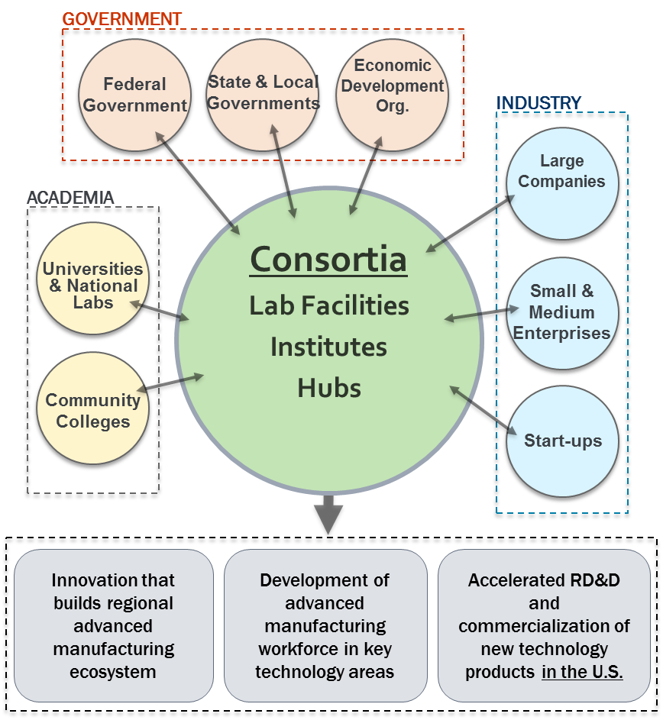
Why an R&D Consortia?
For key technology areas, a portfolio of standalone R&D projects is not sufficient to address the challenges:
Need for a coordinated R&D effort across the supply chain or market sector to make an impact
Education and Workforce Development
Connecting the manufacturing ecosystem
Each R&D Consortia should have:
Clear technology focus
Technology Readiness Level suited to specific technology challenge
Ability to address critical challenges
A balanced portfolio of projects
Active membership from industry, academia, and national labs
Ability to leverage federal funding with non-federal cost share to catalyze a growing ecosystem

Slide 3
AMO R&D Consortia
R&D Consortia | Consortia Type | Technology Area | Lead Organization | AMO Funding/year
Manufacturing Demonstration Facility | Lab Facility | Additive Manufacturing | ORNL | $20M
Critical Materials Institute | Hub | Critical Materials | Ames | $25M
National Alliance for Water Innovation | Hub | Desalination/Water | LBNL | $20M
PowerAmerica | Institute | Wide-Band Gap Semiconductors | N.C. State | $14M
IACMI | Institute | Composites | CCS | $14M
RAPID | Institute | Process Intensification | AIChE | $14M
CESMII | Institute | Smart Manufacturing | UCLA | $14M
REMADE | Institute | Recycling/Reuse | SMIA | $14M
CyManII (selected) | Institute | Cybersecurity | UTSA | $14M
BOTTLE | Lab-led | Plastics | NREL | $5M

Slide 4
AMO R&D Consortia
How do they work?
Hubs vs. Institute vs. Lab-led
Different models have different funding levels, cost-share, sustainability goals
DOE has an agreement with the lead organization
Cooperative Agreement (academia, non-profits)
Utilize the Lab AOP for Lab leads
Consortia Members
Members sign agreements with the lead organization
Agreements include IP, Non-disclosures, US Manufacturing Plan, governance
R&D projects
Stakeholders are engaged to develop a technical roadmap and investment plans
Projects are typically competed through project calls
Organizations have to be members to participate in R&D
Management
Each Institute has a Governing Board and technical committees
Co-investment
Institutes: 50% cost-share, CyManII 20%
Hubs: NAWI 20%, CMI 20% at for-profit companies
MDF: Specific to type of project/CRADA
Peer Reviews
AMO manages a separate peer review for each consortia
Typically 1.5-2 days to review consortia management, operations and R&D portfolio
Sustainability
Institutes are expected to be financially self-sufficient after DOE award

Slide 5
R&D Consortia: Examples of AMO Program Management
Substantial Involvement in Consortia Management, Operations and R&D
Consortia Management
Approval of key operational plans, key personnel, members, IP management plans, sustainability plans
Regular meetings with Consortia Leadership
Budgets and Statement of Project Objectives
Negotiate SOPO and budgets for each budget period with Go/No-Go decision points
R&D Portfolio
Request for Proposals, Project Selection, Project Negotiations, Project SOPOs and budgets, Project Management
Regular meetings with Consortia Technical Leadership and project teams
Consortia Governance
AMO sits on all Institute Governance Boards and appoints other Federal Representatives
Quarterly Assessments
Annual Consortia Peer Review
Award Monitoring
Cooperative Agreement monitoring and modifications
Coordinating with EERE contracting, legal, NEPA
Invoice review/approval

Slide 6
AMO R&D Consortia Team
MDF
Blake Marshall, Kenny Kort, Steve Shooter
CMI
Helena Khazdozian
NAWI
Melissa Klembara, Kenny Kort
PowerAmerica
Al Hefner, Bill Prymak, Lexie Kim
IACMI
Chad Schell, John Winkel, Lexie Kim, Ravi Deo
RAPID
Kate Peretti, John Winkel, Lexie Kim, Melissa Klembara
CESMII
Sudarsan Rachuri, Bill Prymak, Mahesh Mani, Kristen McDaniel, Steve Shooter
REMADE
Chris Hovanec, Debbie Schultheis, Mahesh Mani, John Harrington
CyManII
Chad Schell, Bill Prymak, Kristen McDaniel, Paul Syers
BOTTLE
Melissa Klembara, Kate Peretti
Education and Workforce
Nebiat Solomon, Steve Shooter
THANK YOU!

