Slide 1
ANL –Matt Riddle, Sarang Supekar, Nwike Iloeje
LBNL – Arman Shehabi, William Morrow, Prakash Rao
NREL – Alberta Carpenter, Rebecca Hanes, Samantha Reese, Scott Nicholson, James McCall, Matthew Ringer, Darlene Steward
ORNL – Sujit Das, Sachin Nimbalkar
Energetics – Sabine Brueske, Caroline Dollinger
Peer Review FY2020: Overview of AMO Strategic Analysis
Joe Cresko
Advanced Manufacturing Office, DOE
June 2, 2020

Slide 2



AMO Pillars – Analysis provides data and information
R&D Projects: Bridging the innovation gap
Innovative manufacturing processes, next-generation materials and technologies
R&D Consortia: Public-Private consortia model
Strategic Analysis
Access to physical and virtual tools and expertise to foster innovation and adoption of promising technologies
Technical Assistance: Direct engagement with Industry
Drive a culture of continuous improvement and wide-scale adoption of proven technologies and practices to reduce manufacturing sector energy use

Slide 3
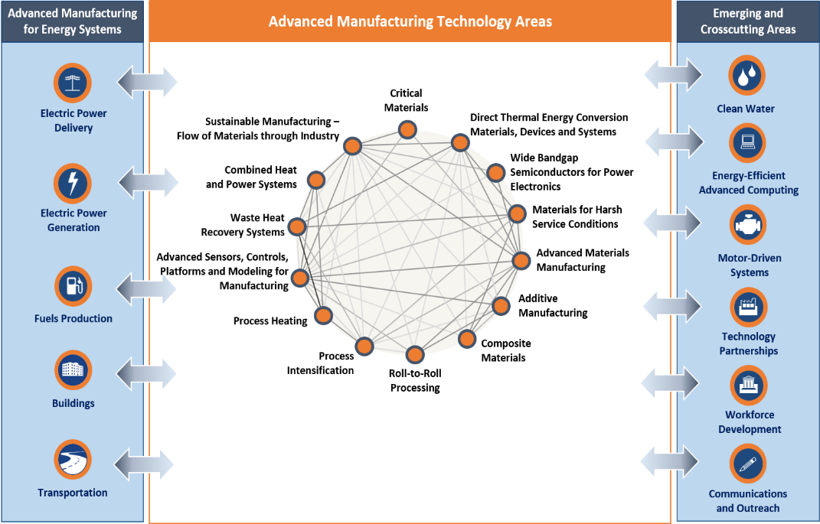
AMO Portfolio Overview
AMO portfolio:
  Core technology areas with potential to significantly improve manufacturing energy efficiency and minimize the life-cycle energy of manufactured products
AMO Multi-Year Program Plan (MYPP):
  Technology-specific performance, economic and energy metrics for each technology area
Analysis of cross-cutting technologies and cross sectoral impacts
https://www.energy.gov/eere/amo/downloads/advanced-manufacturing-office-amo-multi-year-program-plan-fiscal-years-2017

Slide 4
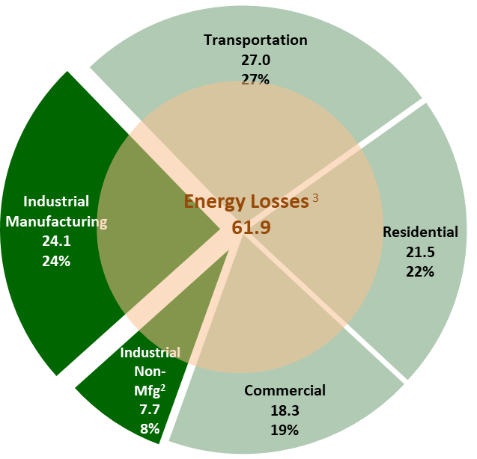
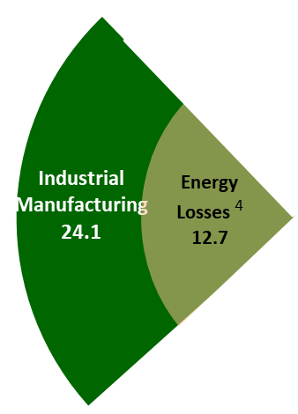
Advanced Manufacturing Energy Opportunity Space
Improve the productivity and energy efficiency of U.S. manufacturing
Reduce life cycle energy and resource impacts of manufactured goods
Manufacturing Goods
Use of Manufactured Goods
More efficient manufacturing reduces energy losses
and…
More efficient manufacturing enables technologies that improve energy use throughout the economy:
Transportation
Buildings
Energy Production and Delivery
Data for 2014
U.S. Energy Economy by Sector
98.5 quadrillion Btu, 2014 ¹
¹ Energy consumption by sector from EIA Monthly Energy Review, 2018
² Industrial non-manufacturing includes agriculture, mining, and construction
³ US economy energy losses determined from LLNL Energy Flow Chart 2014 (Rejected Energy), adjusted for manufacturing losses
⁴ Manufacturing energy losses determined from DOE AMO Footprint Diagrams (2014 data)

Slide 5
Framework to Shape AMO’s Portfolio
An holistic top-down and bottom-up systems approach to
shape the AMO portfolio with the highest potential for impact.
National Needs
Storage
Critical
Materials
Plastics
Cyber
Water
Data, Tools, Methodologies
Fundamental Systems Analyses (e.g., Lifecycle Analyses)
Integrating
Approaches
Strategic Analysis
….
Materials & Processing
Electronics
Chemical Processes
Sensors &
Controls
CHP
….
Applied Technologies & Manufacturing Sciences
Fundamental Science Foundation
Notes:
AMO’s broad portfolio allows the office to respond to national needs nimbly. The office brings fundamental and applied science foundations to bear through an integrative approach and uses fundamental systems methods to tackle new challenges. AMO’s goal is to strengthen manufacturing in the U.S. through both a top-down and bottom-up approach.
Work with other DOE offices to characterize and sketch out National Needs
Use fundamental systems methods to lay out the highest impact manufacturing challenges and opportunities in National Needs.
Target fundamental applied science and technology to address these challenges and opportunities.
Draw from fundamental systems methods to identify emerging national needs.
Build and strengthen fundamental systems methods.
Build and strengthen fundamental applied science foundation.

Slide 6
Context – AMO Analysis Framework
Analysis Objective: Provide independent and credible information to inform AMO decision-making
Tracking past investments
Current assessment, validation
Strategic analysis projections
Retrospective
Introspective
Prospective
Consistent methodology to address
Past investments
Current investments
Future investments
Performance
Energy Impacts
Economics
Cycle of prospective, introspective and retrospective helps AMO gain a sense of investment impacts across time
Notes:
Speak to decarbonization – don’t have any projects in there, view currently as prospective analysis

Slide 7
AMO Strategic Analysis Activities
2. Prospective Technical Studies/Analysis
2A. Manufacturing Water Use and Resiliency
How can a better understanding of manufacturing water use characteristics and risks support water resiliency?
2B. Manufacturing in a Connected Economy
How will the penetration of information and communication technologies (e.g., “smart” products, Internet-of-Things) affect advanced manufacturing R&D opportunities?
2C. Sustainable Manufacturing
What are the opportunities and impact of advanced manufacturing technologies on energy productivity, competitiveness, and moving towards a circular economy?
1. Foundational Energy Analysis
Tools
Other
3. Seawater Desalination Study - Example of analysis that informed AMO direction
Credible data and information to inform current and future AMO and EERE priorities
4. Introspective Portfolio Assessment
How can AMO effectively assess/communicate the progress and contribution of currently funded projects to focus technology areas and ultimately to strategic goals and success indicators?
5. Retrospective Technology Assessment
How can AMO gauge impact of previously supported R&D 10-year tracking of commercial products/technologies?

Slide 8
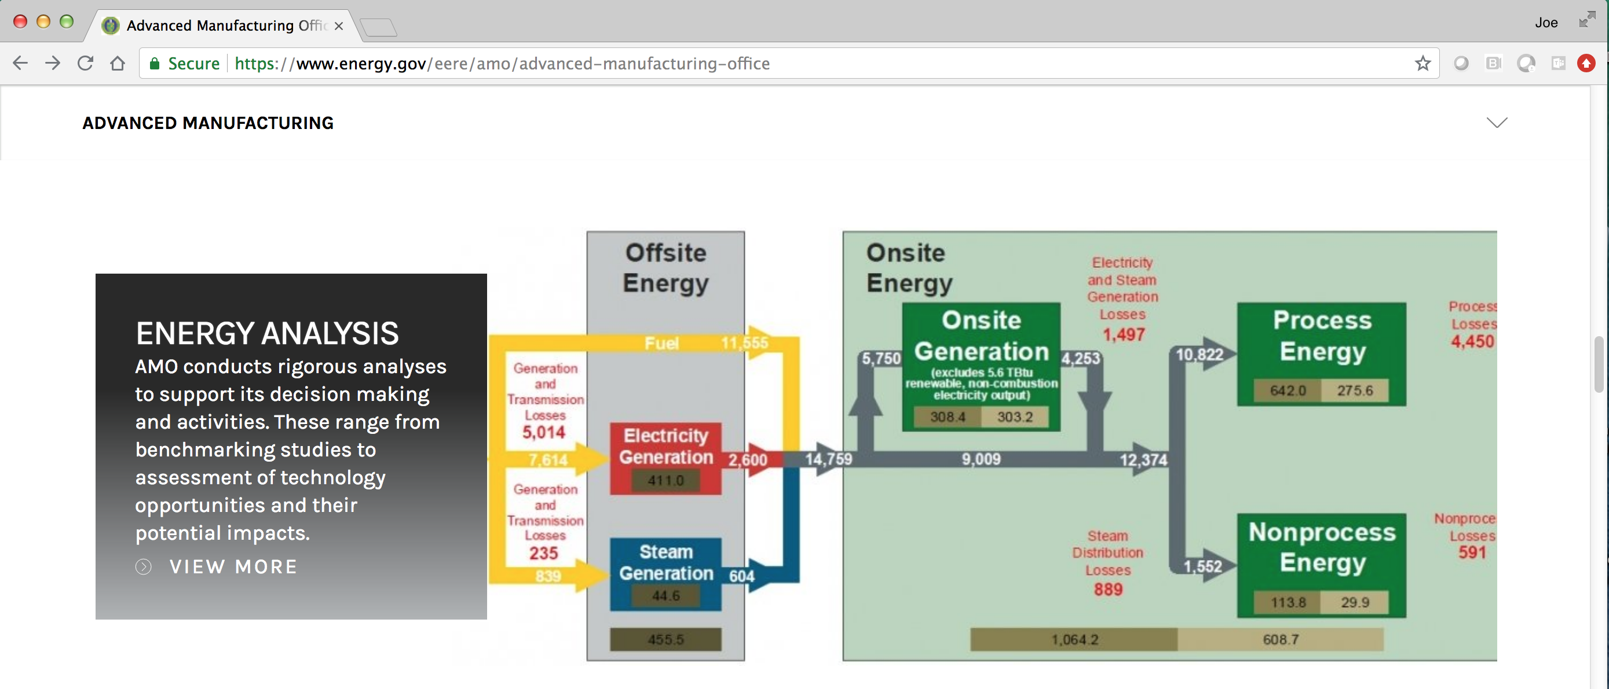
1. AMO Foundational Energy Analysis,
Tools, & Other

Slide 9
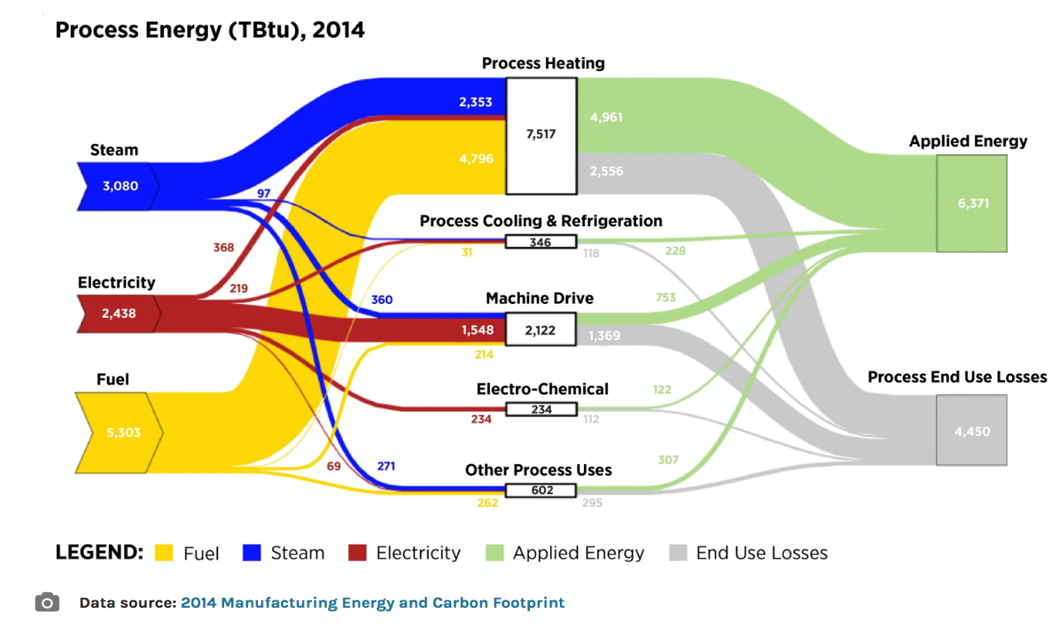
Visualizing data and information
All Manufacturing Sector (NAICS 31-33)
Reference link: https://www.energy.gov/eere/amo/static-sankey-diagram-process-energy-us-manufacturing-sector-2014-mecs
Notes:
Future work will also include further collaboration with scientists at three of the National Laboratories, whose tools & capabilities could be leveraged to make use of and expand on the Bandwidth study data.

Slide 10



Tools and Methodologies
Examples of tools and analytical capabilities at the National Laboratories developed by the AMO Strategic Analysis Team
Materials Flow through Industry (MFI) Tool: a tool to analytically track the energy impacts of shifts in material flows, and to quantify supply chain impacts of current and next-generation technologies.
LIGHTEn-UP Tool: a scenario framework for assessing prospective net energy impacts of a technology/product, accounting for both manufacturing and end-use life cycle phases.
Additive Manufacturing Life Cycle Energy Tool: a user-friendly tool that manufacturers can use to evaluate additive vs. conventional manufacturing processes on a life cycle energy basis.
https://www.nrel.gov/manufacturing/mfi-modeling-tool.html
https://energyanalysis.lbl.gov/tools
https://energyefficiency.ornl.gov/tools-training/
Notes:
Future work will also include further collaboration with scientists at three of the National Laboratories, whose tools & capabilities could be leveraged to make use of and expand on the Bandwidth study data.

Slide 11
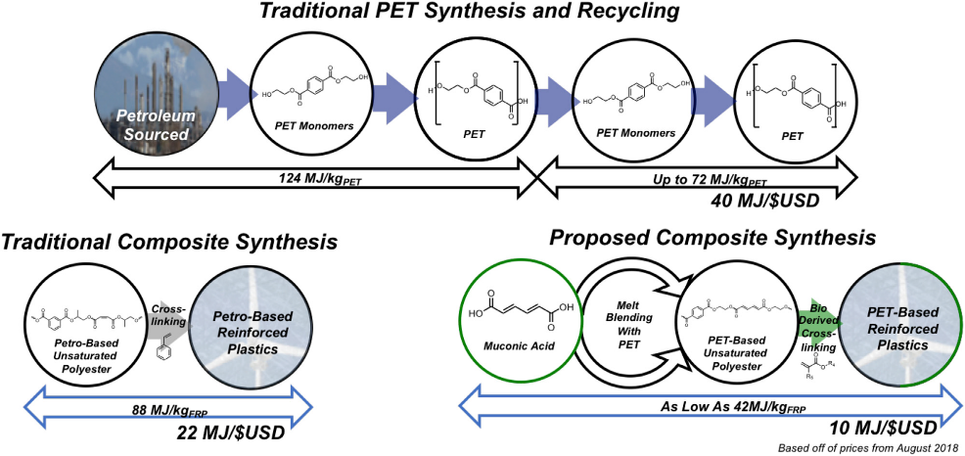
Tools and Methodologies → MFI used for BOTTLE
Example of MFI used to calculate supply chain energy demands of traditional and new synthesis routes for PET
Materials Flow through Industry (MFI) Tool: a tool to analytically track the energy impacts of shifts in material flows, and to quantify supply chain impacts of current and next-generation technologies.
https://www.nrel.gov/manufacturing/mfi-modeling-tool.html
Notes:
Future work will also include further collaboration with scientists at three of the National Laboratories, whose tools & capabilities could be leveraged to make use of and expand on the Bandwidth study data.

Slide 12
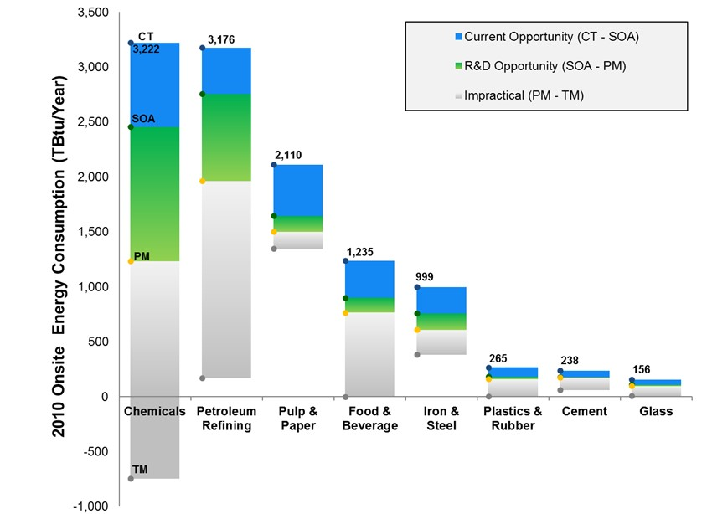
Bandwidth Studies - Energy Savings Potential across Energy Intensive Industries
Starting point to determine manufacturing energy intensity improvements
Provide basis of comparison at product or process level scaled up to the sector level for relative opportunity level comparison
(Feedstock energy excluded)
More info can be found at : https://www.energy.gov/eere/amo/energy-analysis-data-and-reports
Notes:
Current opportunities represent energy savings that could be achieved by deploying the most energy-efficient commercial technologies available worldwide. R&D opportunities represent potential savings that could be attained through successful deployment of applied R&D technologies under development worldwide. More info can be found at : https://www.energy.gov/eere/amo/energy-analysis-data-and-reports

Slide 13
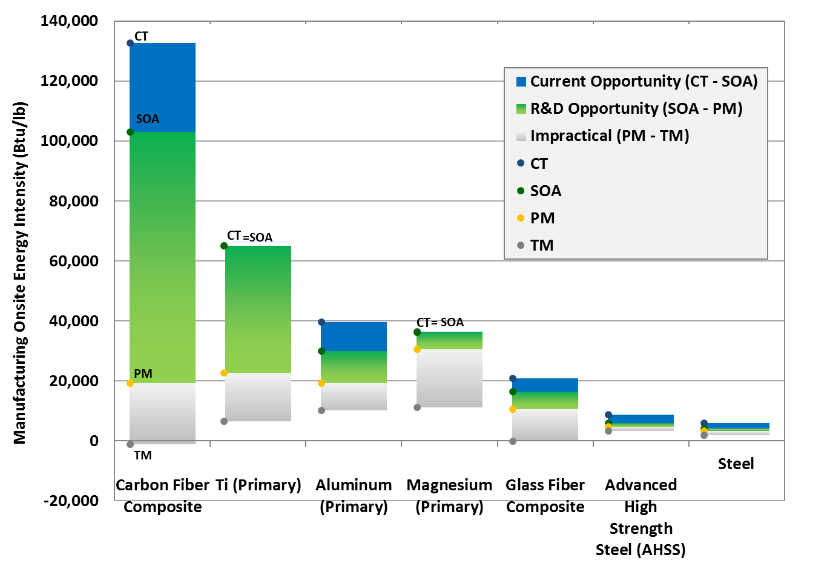
Bandwidth Studies - Energy intensity across Lightweight Materials Manufacturing
(Feedstock energy excluded)
High manufacturing energy use increases costs and reduces competitiveness with incumbent materials
Carbon Fiber Reinforced Polymer (CFRP) composites have the highest manufacturing energy intensity, and also the largest energy savings opportunity.
More info can be found at https://www.energy.gov/eere/amo/energy-analysis-data-and-reports
Notes:
This is the same energy intensity comparison chart, but I have overlaid the graphic with the Bandwidth results showing the current opportunity and R&D opportunity. The CT and SOA energy intensities for carbon fiber composites are well above any other material; but the Practical Minimum is in the ballpark of the energy intensities for other materials. This illustrates that, with R&D progress, carbon fiber composites could compete with other materials even on a manufacturing energy intensity basis.
If anyone asks: this comparison chart assumes (for CFRP) a 50% fiber fraction by weight. The matrix polymer was assumed to be epoxy for CT and SOA, and polypropylene (a thermoplastic) for PM. The consolidation method was assumed to be autoclave forming for CT, resin transfer molding for SOA, and injection molding for PM. In addition, applied R&D technologies have been applied to compute the PM as described earlier.

Slide 14
2. Prospective Technical Studies/Analysis
2. Prospective Technical Studies/Analysis
2A. Manufacturing Water Use and Resiliency
How can a better understanding of manufacturing water use characteristics and risks support water resiliency?
2B. Manufacturing in a Connected Economy
How will the penetration of information and communication technologies (e.g., “smart” products, Internet-of-Things) affect advanced manufacturing R&D opportunities?
2C. Sustainable Manufacturing
What are the opportunities and impact of advanced manufacturing technologies on energy productivity, competitiveness, and moving towards a circular economy?
Detailed slide decks have been posted representing the analysis efforts in each of these areas

Slide 15
2A. Water Use in Manufacturing/Resiliency – Technical Study/Report
Main Topic Areas Covered
Establishing an understanding of manufacturing water use characteristics, including
Featured StA Analysis
Manufacturing water use estimates
Case Study Topics
Emerging water conservation strategies:
Case studies based on data collected from PWP (Plant Water Profiler) tool
Discuss results of analysis and gaps in existing data (a lack in foundational information impedes impact analysis and identification of technology needs)
Dry factories
Industrial water reuse tradeoffs
Framework for evaluating the value of water in manufacturing (inside and outside fenceline)
Smart manufacturing and internet of things (IoT) technologies for water management
Estimating water use, discharge, and consumption
Developing more robust quantification of the value of water for use when identifying technology needs
Establishing why this information is needed to do technology assessments and evaluations
Highlighting advanced technology and process opportunities for water conservation to support resilience
* Expected publication end of 2020

Slide 16
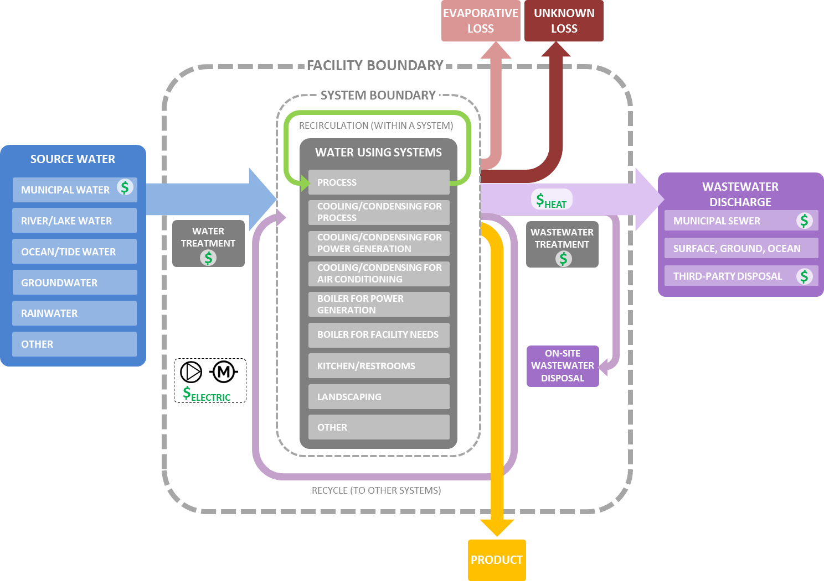
Resilience Strategies: Plant Water Profiler (PWP) concept
Baseline Water Use
and Water Balance
Water Balance:
Identifying unaccounted water flows and unknown water losses by
Comparing system water intake with outflow
Comparing facility water use and discharge with aggregated system-level flows
1
Determine True
Cost of Water
2
True Cost of Water:
Includes cost of water procurement, treatment, distribution, and wastewater disposal
Identify Water Efficiency Opportunities
3
Evaluate Water Efficiency Status through plant and system-specific checklists
Help Prioritize Measures by identifying water use versus true cost intensive systems
Resilience strategies: PWP tool
Notes:
Main diagram (left) shows a generic flow of water within a facility. Right-side boxes indicate the structure of PWP Tool.
In PWP tool, users can provide metered water use at sub-system level or can use provided calculators to estimate water use for different unit operations.
True cost of water is calculated by combining water use estimates and the billed cost associated with water procurement, treatment, distribution, and disposal.

Slide 17
2B. Implications of Advanced Manufacturing in a Connected Economy for a Smart, Sustainable, and Productive Economy – Technical Study/Report
Main Topic Areas
Data characterization
Manufacturing of electronic devices
Featured StA Analysis
Developed framework to assess cost-effectiveness of smart manufacturing applications using cost of conserved energy
Case Studies
Application of cost of conserved energy framework via case studies:
Smart manufacturing applications in breweries
Information and communications technology (ICT) infrastructure
Smart manufacturing opportunities and challenges by sector
Smart manufacturing framework & case studies
Lifecycle analysis of key ICT components
Energy and cost impact analysis of data flow
Continuous casting steel sensor system
Carbon fiber
Smart manufacturing deep dives
Water/wastewater treatment
Iron and steel
Transportation equipment manufacturing
Drafts expected ready for peer review end of CY2020

Slide 18
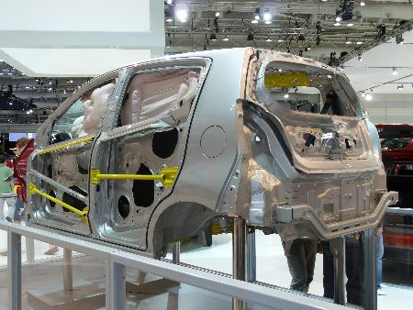
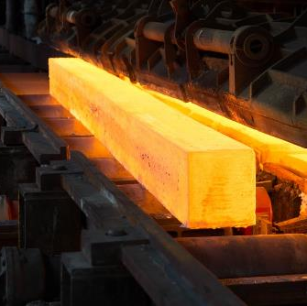
Smart Manufacturing Deep Dive Questions
What does SM specifically mean for the Iron
& Steel and Automotive industries?
What does a smart facility look like for these industries?
How does SM affect supply chains for these industries?
What are current SM opportunities for these industries?
What data is currently collected in plants and
what data would be collected in a SM plant?
What challenges are there for implementing SM technology in these industries? (reliability, cost, security, workforce, etc.)
What are the SM R&D challenges and opportunities?

Slide 19
2C. Sustainable Manufacturing – Technical Study/Report
Main Topic Areas
Sustainable manufacturing strategies for resource conservation
Featured StA Analysis
Developed “wedge” analysis approach to visualizing the benefits of a circular economy
Case Study Topics
Battery recycling with design for recycling analysis
Plastics recycling
Carbon fiber lightweighting
Analysis and illustration of sustainable strategies through case studies
Nickel metal hydride (NiMH) batteries
Integrated biorefinery technologies in pulp & paper industry
Shows case studies results in comparable method
EV Li-ion batteries (LiB)
Municipal solid waste
Provides material, energy, and carbon accounting
Visualizes benefits of circular economy
Design, manufacturing, use, and end of life phase strategies
Industrial food waste recycling
Electrification of Cement Industry
* Expected publication end of 2020

Slide 20
Electrification of Cement Industry – Case Study
  Cement manufacturing is one the most energy and emissions intensive industries consuming 371 tBtu of energy and producing more than 25 million tons CO₂ equivalent of combustion related emission onsite.
Scope
⎫
⎫
⎫
Included in On-Site Energy Analysis
Mining
Raw
Material
⎫
Included only in LCA model
Goals
Determine the impact of electrification to energy use, material consumption and emissions in cement industry
Identify barriers to its implementation of electrotechnology and determine R&D requirements
⎦
Not considered
⎫
Cement Manufacturing
Use
Phase
Mining
Fuel
⎫
⎦
End of Life
Recycle
⎫
⎦
⎫
Transport (Freight)
Fuel Transport
⎦
Electricity Generation
⎫
⎫
Solar, Wind
⎫
Renewable Equipment Manufacturing
Coal, Natural Gas
⎫
Analysis Outline
Baseline process model built from EIA and AMO Reports
Energy and process inputs cross-referenced with LCA database
Inputs and emissions for validated processes used to build LCA model
Material, Energy and Emission impacts scenario forecasts through 2050

Slide 21
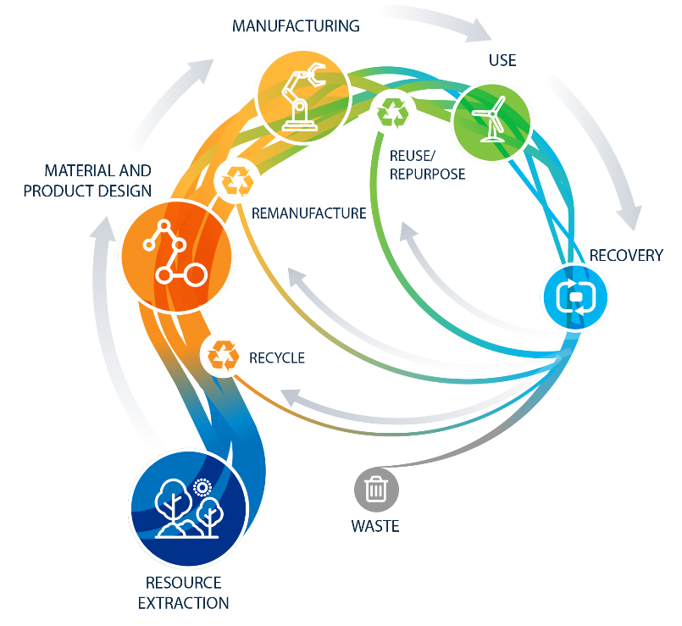
Sustainable Manufacturing → Transition to a Circular Economy
Decarbonization/Energy Efficiency Value
US Food Supply Chain Waste Analysis
Develop an information baseline, and target improvements in energy and material use.
Electrification of the Cement Industry
Supply Chain Analysis-Upcycling Recycled PET
Wedge Analysis Framework and Model and Quadrant Analysis
Battery Rare Earth Element Recycling
Agent Based Model for implementing a Circular Economy for PV
Li-ion Battery (LIB) Recycling

Slide 22
Sustainable Manufacturing – Collaboration Across EERE
Participation by EERE Office
Sustainable Manufacturing Tasks

Slide 23
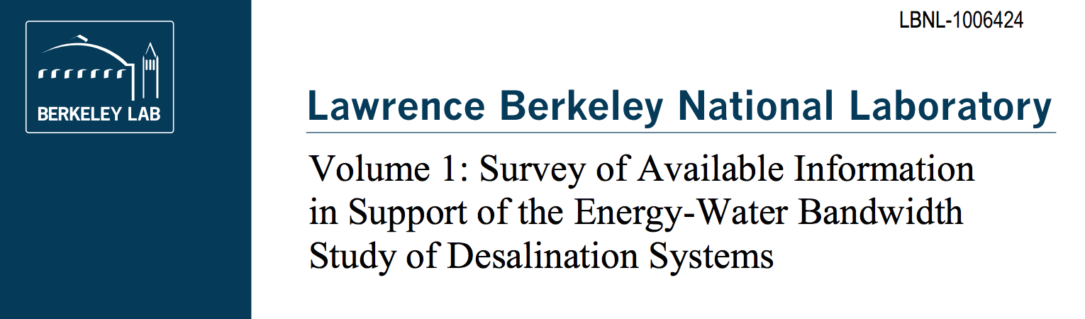

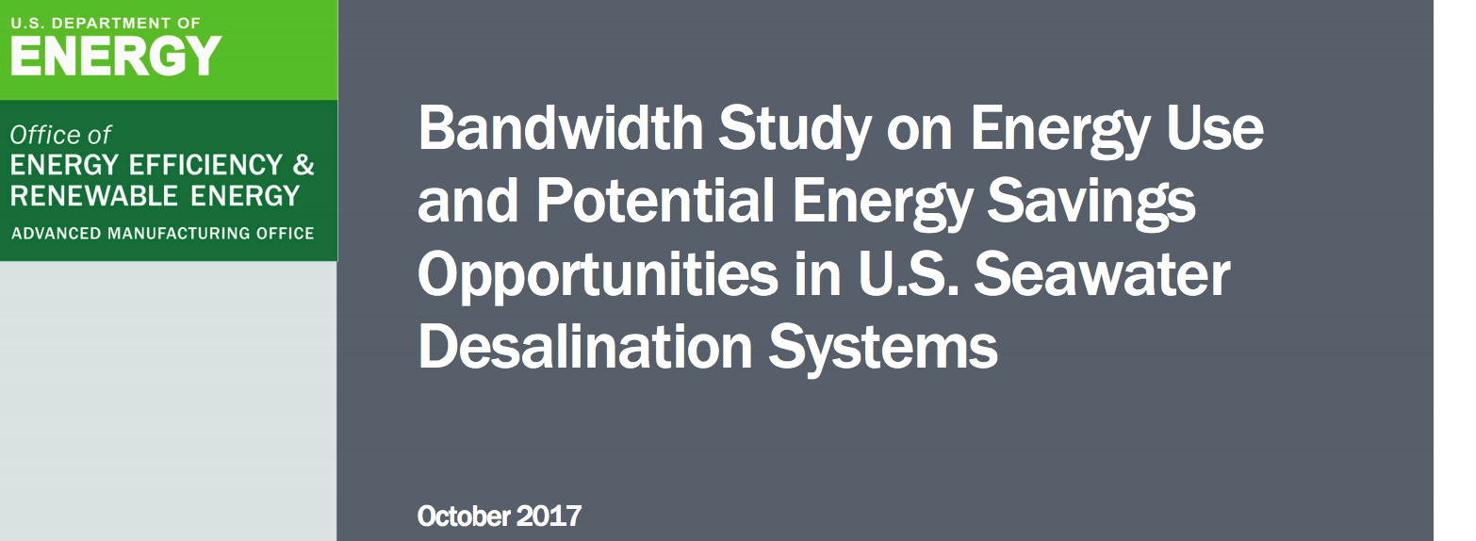
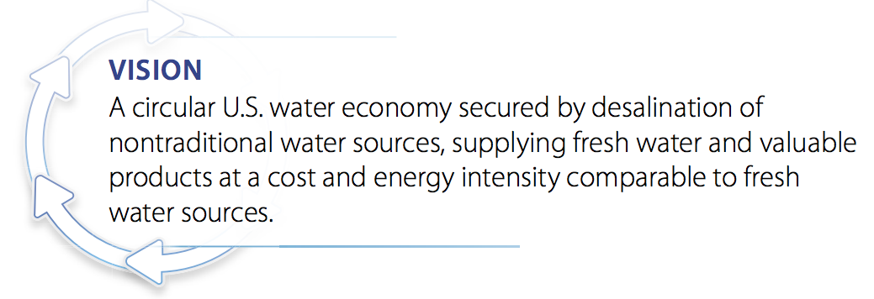
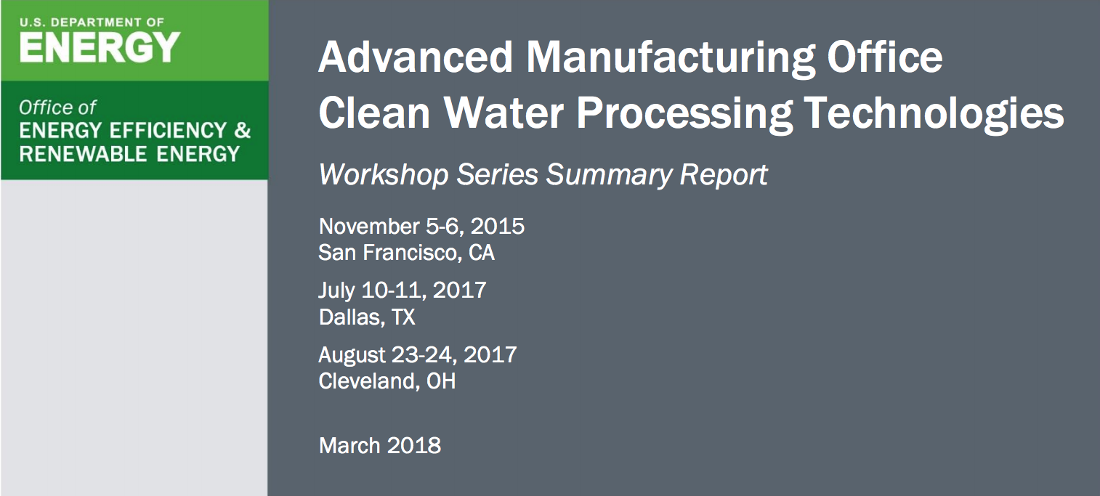
3. Seawater Desalination Study – Example of analysis that informed AMO direction.

Slide 24
Example of Analysis informing prior AMO Investments
Previous analysis conducted by the AMO StA team played a major role in the planning of DOE’s Energy-Water Desalination Hub
Reports and a peer-reviewed journal paper were developed to understand:
  Synthesis of relevant science and latest research and development on energy for desalination systems
  Analysis on the energy savings potential of seawater desalination systems by unit operation
  Projections of energy-related impacts associated with increased uptake of seawater desalination
Analysis was used in FOA

Slide 25
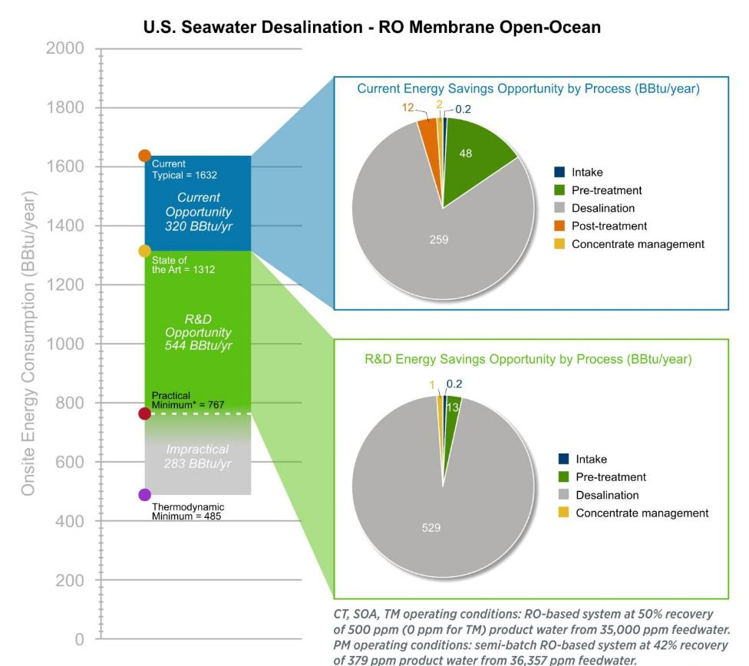
Seawater Desalination - Energy Savings Opportunity for RO system w/ Open Ocean Intake
This system chosen as best representative for U.S. for 2016 facilities and installed capacity
91% of the energy saving opportunity is in the desalination operation
Pretreatment offers the next largest opportunity (7%)
Notes:
The bandwidth study methodology identifies the energy saving opportunity by each unit operation. For seawater desalination, the greatest opportunity (in terms of energy savings) is for the desalination process. The seawater desalination bandwidth study introduced analysis new to bandwidth studies that estimates the reductions in the cost of the product (in this case, potable water) attributable to the energy efficiency improvements identified in the report. As can be seen, energy efficiency alone cannot achieve “pipe parity” but innovation in manufacturing of components, system integration, and environmental impact reduction (especially for the intake water) are also needed.
Intake and concentrate management values are TBtu/year/TDH – would vary based on total TDH
- An R&D Energy Savings Opportunity for post-treatment that is well supported by the literature could not be found
-The PM energy consumption is based on today’s knowledge of R&D technologies tested between laboratory and demonstration scale, referencing the lowest energy intensity value (in this case for semi-bath RO for the desalination unit operation) in the available literature. Current research at the concept level (which does not meet PM definitions) of other systems or technologies may drive the PM energy consumption lower, closer to TM energy consumption. One example is fully batch RO, which when tested at a laboratory or higher scale may show a decrease in energy consumption

Slide 26
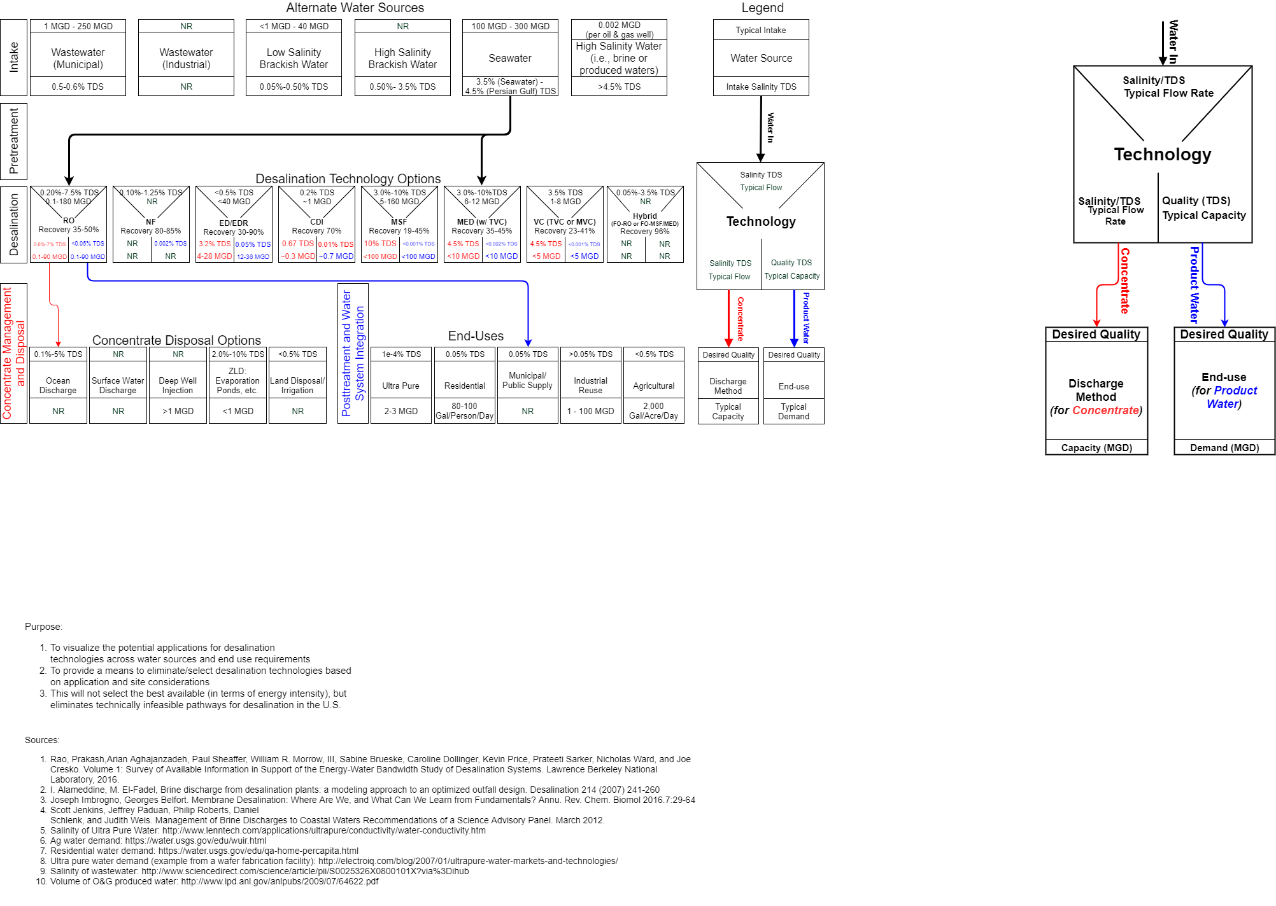
Desalination Pathways – NAWI will map pathways from other sources
2017 Bandwidth analysis for seawater focused on desalinating seawater into municipal potable water (pathway below)→ provided foundational information for the energy water desalination hub
Many other possible pathways, depending upon the feedwater & end use
“Bandwidth Study on Energy Use and Potential Energy Savings Opportunities in U.S. Seawater Desalination Systems” served as an example of the detail the Hub will need for conducting energy/technology evaluations of other non-freshwater sources
Notes:
Sources:
Rao, Prakash,Arian Aghajanzadeh, Paul Sheaffer, William R. Morrow, III, Sabine Brueske, Caroline Dollinger, Kevin Price, Prateeti Sarker, Nicholas Ward, and Joe Cresko. Volume 1: Survey of Available Information in Support of the Energy-Water Bandwidth Study of Desalination Systems. Lawrence Berkeley National Laboratory, 2016.
Alameddine, M. El-Fadel, Brine discharge from desalination plants: a modeling approach to an optimized outfall design. Desalination 214 (2007) 241-260
Joseph Imbrogno, Georges Belfort. Membrane Desalination: Where Are We, and What Can We Learn from Fundamentals? Annu. Rev. Chem. Biomol 2016.7:29-64
Scott Jenkins, Jeffrey Paduan, Philip Roberts, Daniel Schlenk, and Judith Weis. Management of Brine Discharges to Coastal Waters Recommendations of a Science Advisory Panel. March 2012.
Salinity of Ultra Pure Water: http://www.lenntech.com/applications/ultrapure/conductivity/water-conductivity.htm
Ag water demand: https://water.usgs.gov/edu/wuir.html
Residential water demand: https://water.usgs.gov/edu/qa-home-percapita.html
Ultra pure water demand (example from a wafer fabrication facility): http://electroiq.com/blog/2007/01/ultrapure-water-markets-and-technologies/
Salinity of wastewater: http://www.sciencedirect.com/science/article/pii/S0025326X0800101X?via%3Dihub
Volume of O&G produced water: http://www.ipd.anl.gov/anlpubs/2009/07/64622.pdf

Slide 27
4. AMO Introspective Portfolio Assessment (IPA)
4. Introspective Portfolio Assessment
How can AMO effectively assess/communicate the progress and contribution of currently funded projects to focus technology areas and ultimately to strategic goals and success indicators?

Slide 28
Develop Methodologies and Processes to Assess Current Portfolio
Addresses AMO 2018 Peer Review Panel Recommendations:
“... expand the use of techno-economic assessment ... in proposal selection and initial project implementation, particularly for early-stage research efforts.”
“... expand collaboration among AMO Technology Managers to identify best practices ... and disseminate to other projects or activities that may benefit from those best practices.”
Goal: Establish formal process to assess & communicate the progress and contribution of currently funded projects to:
→ AMO’s foundational technology areas
→Strategic goals
→ Success indicators

Slide 29
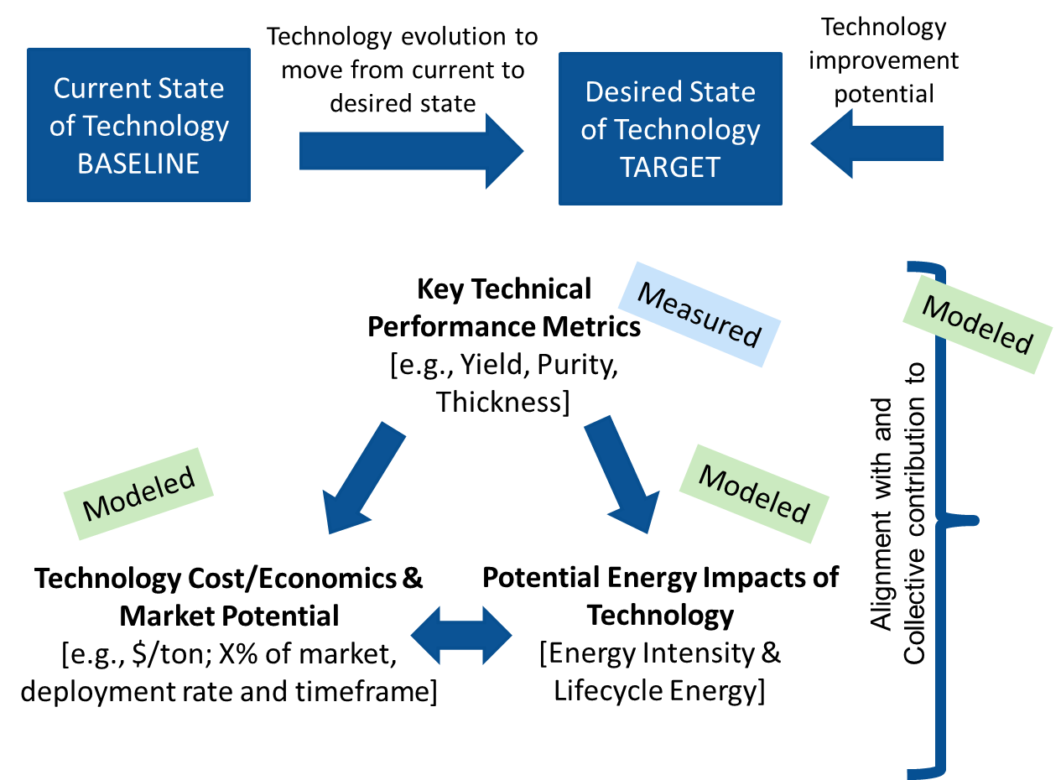
Introspective Portfolio Assessment Method
Focus: Implement a transparent, consistent, and standardized office-wide Introspective Portfolio Assessment methodology and process
Data and information sources include:
  Literature
  Experts
  Field validation
Communicate the progress and contribution of AMO R&D portfolio to:
Technology areas,
AMO strategic goals
Success indicators

Slide 30

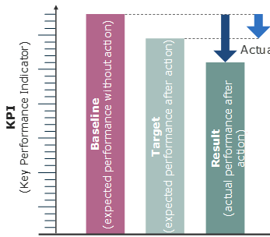




Benefits of IPA
Ensure project alignment with AMO goals
Facilitate communication across AMO stakeholders (PI, TM, PM)
Support data-driven decisions (project and program)
Establish clear metrics for project success and improve transparency
Document baseline and target values
Provide consistent evaluation, tracking, reporting framework
Help get all stakeholders on the same page and align project goals with AMO expectations.

Slide 31
5. Retrospective Analysis – Technology Tracking
5. Retrospective Technology Assessment
How can AMO gauge impact of previously supported R&D 10-year tracking of commercial products/technologies?

Slide 32
Retrospective Analysis
PNNL conducts annual tracking of energy savings from successfully commercialized projects resulting from AMO supported R&D
  Tracking begins when technology is considered commercial (when full-scale unit is operational in commercial setting)
  Tracking continues for the first 10 years the technology is in operation
  Other data tracked:
    Number of units sold, installed, and operating in the United States and abroad (including size and location)
    Units decommissioned since the previous year
    Energy saved
    Environmental benefits
    Improvements in quality and productivity achieved
    Other impacts, such as employment and effects on health and safety
    Marketing issues and barriers

Slide 33
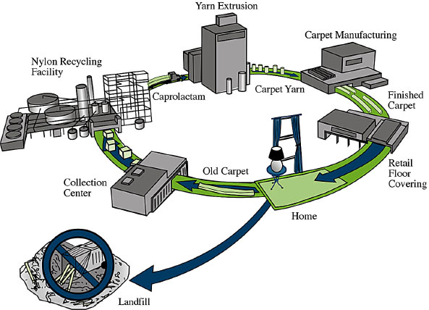
Retrospective Analysis example
Shaw Industries, Inc.: Recovery & use process of nylon from waste carpeting
  Proof-of-principle work supported by AMO
  Largest commercial-scale Nylon-6 recycling plant opened in 2007 (Augusta, GA)
Year | Energy Savings (trillion BTU)
2007 | 0.438
2008 | 0.455
2009 | 0.428
2010 | 0.398
2011 | 0.516

Slide 34
What’s next: Data Management and Analysis – Developing a database to coordinate IPA and RPA
Potential technologies (>3 years to commercialization)
Tracks technology development
Data supports reporting and tracking of progress toward program goals
Emerging technologies
(<3 years to commercialization)
Tracks technologies entering the market
Commercial technologies
Data supports assessing impacts of past investments

Slide 35






AMO Strategic Analysis Team
Thank You
joe.cresko@ee.doe.gov
For additional information:
energy.gov/eere/amo/advanced-manufacturing-office
ANL – Sarang Supekar, Nwike Iloeje Matt Riddle
LBNL – Arman Shehabi, William Morrow, Prakash Rao, Sarah Smith
NREL – Alberta Carpenter, Samantha Reese, Rebecca Hanes, Scott Nicholson, James McCall, Matthew Ringer, Darlene Steward, Debbie Sandor
ORNL – Sujit Das, Sachin Nimbalkar, Kristina Armstrong, Kanchan Upadhyay
Energetics – Sabine Brueske, Caroline Dollinger

Slide 36
Backup Slides

Slide 37
AMO Field Validation (FV)
Process
Validation Plan
On-site Field Validation
Post-Validation and Reporting and Analysis
Projects
Project | FV Focus | FV Site/Scale
Flash Processed Carbon Steels for Automotive Applications | Process performance Product characteristics Process energy requirements | Flash Steelworks Facility (Michigan) – treat 36”wide steel sheet @ 8 ft/min
Polydopamine/PTFE Composite Coating for Large-Scale Journal Bearings in Next Generation Electric Machines | Coating performance Bearing performance Energy requirements | NREL Flatirons Campus (Boulder, CO) – demonstrate 1 MW scale application
Outcomes
Technology validated at commercially-relevant scale in terms of
  Technical performance
  Energy impacts
Basis to inform future R&D investments
Accelerate technology commercialization

Slide 38
2A. Water in Manufacturing - High Level Summary of FY20 Tasks
Analysis Task Area | Labs
Water use in manufacturing - regression estimates | ANL, LBNL, ORNL
Advanced water conservation technologies - Resiliency efforts; industrial water reuse; smart water management; alternate water sources; industrial wastewater treatment/pumping & grid services; dry factories | ANL, LBNL, NREL, ORNL
Water risk in manufacturing - Physical, regulatory, reputational, flood | ANL, LBNL, NREL, ORNL
Value of water to U.S. manufacturing | ANL, LBNL, NREL
Manufacturing "essential water“ | ANL, NREL
Plant Water Profiler (PWP) case studies | ANL, NREL, ORNL
Future water use in manufacturing estimates | ANL, NREL
Report Development (compilation of FY17-FY20 analysis) | ANL, LBNL, NREL, ORNL

Slide 39
2B. Connected Economy - High Level Summary of FY20 Tasks
Analysis Task Area | Labs
Information & Communications Technology (ICT) Infrastructure Analysis | ANL, LBNL, NREL, ORNL
Electronics Manufacturing processes/supply chain | ANL, LBNL, NREL, ORNL
Advanced Computing Technologies – impact on industry | ANL, LBNL, ORNL
Smart Manufacturing – developing systematic evaluation approach for energy, material, water, operational costs, & performance benefits | ANL, LBNL, ORNL
Smart Water | LBNL
Report Development (compilation of FY17-FY20 analysis) | ANL, LBNL, NREL, ORNL

Slide 40
2C. Sustainable Manufacturing- High Level Summary of FY20 Tasks
Analysis Task Area | Labs
Manufacturing sector waste analysis | NREL, ORNL
Supply chain, circular economy, and technology adoption analysis | ANL, NREL, ORNL
Systems dynamic modeling | NREL
Critical Materials Recycling | ANL
Electrotechnologies in process heating | ORNL
Waste heat recovery analysis | ORNL
Energy bandwidth analysis | NREL
Industry supply chain data analysis | NREL
Collaboration – Low TRL technologies working group, EA NEMS | LBNL
Analysis of R&D induced U.S. manufacturing cross-sector economic development | LBNL
Tool development – Materials Flow through Industry (MFI), LIGHTEnUP, Manufacturing economic input/output & imports/exports analysis tool | NREL, LBNL
Case studies and report development (compilation of FY17-FY20 analysis) | ANL, LBNL, NREL, ORNL

Slide 41






Strategic Analysis Team Structure
Joe Cresko
Argonne National Laboratory
Lawrence Berkeley National Laboratory
National Renewable Energy Laboratory
Energetics
Caroline Dollinger
Sabine Brueske
Oak Ridge National Laboratory
Sujit Das
Sachin Nimbalkar
Nwike Iloeje
Sarang Supekar
Bill Morrow
Arman Shehabi
Prakash Rao
Birdie Carpenter
Samantha Reese
James McCall
Rebecca Hanes
Darlene Steward
Scott Nicholson

Slide 42
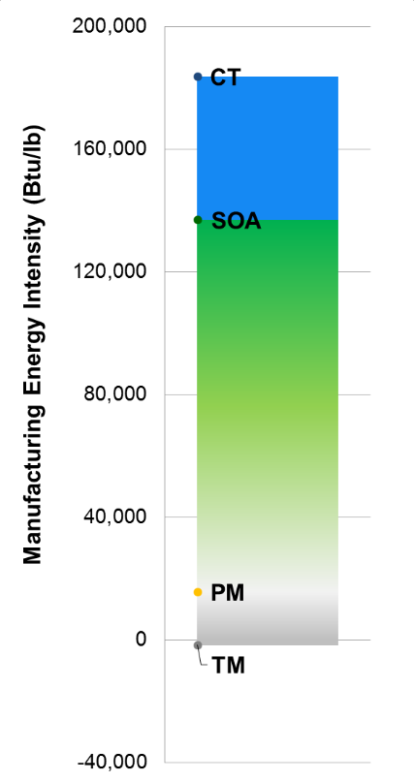
Carbon Fiber Composites Energy Intensity and Opportunity
Current Opportunity
Energy savings if the best technologies and practices available were used to upgrade production
SOA Technology Examples:
motor re-sizing and/or variable speed drives
waste heat recovery
moderate carbon fiber recycling or down-cycling
R&D Opportunity
Additional energy savings if applied R&D technologies under development worldwide were successfully deployed
R&D Technology Examples:
alternative precursor processes
selective heating for carbon fiber conversion
recovery/recycling of the polymer matrix
advanced carbon fiber recycling enabling increased recovery
Notes:
Discuss results (self explanatory)

Slide 43


Analysis informs programmatic and technological progress, as well as early stage R&D
Significant and different scientific and technology challenges exist at different manufacturing scales and maturity
Early Stage R&D
which also informs
within
to lower energy
use in a
that interacts
with
Upstream and Downstream Supply Chains
Components
Mfg. Unit Operations
Tech and Program analysis
Materials
Mfg. Facility
Mfg. Systems
Energy Systems
Processes
Water
Systems
informs
Analysis of these areas: includes current and projected technology performance, component interaction, and system integration is important to inform targets and metrics
Data from analysis informs R&D at various levels of manufacturing maturity and scale

Slide 44
Core manufacturing technologies identified as impactful
http://www.energy.gov/quadrennial-technology-review-2015
Critical Materials
Sustainable Manufacturing /
Flow of Materials through Industry
Direct Thermal Energy Conversion Materials, Devices and Systems
Wide Bandgap Semiconductors for Power Electronics
Combined Heat and Power Systems
Materials for Harsh Service Conditions
Waste Heat Recovery Systems
Smart Manufacturing -Advanced Sensors, Controls, Platforms and Modeling for Manufacturing
Advanced Materials Manufacturing
Additive Manufacturing
Process Heating
Legend
Manufacturing systems level in chapter
Composite Materials
Process Intensification
Secondary impacts assessed
Roll-to-Roll Processing
Manufacturing Systems –
Unit Operations
Production / Facility Systems –
Energy and Resource Utilization
Beyond the Plant Boundaries –
Supply Chain and Life Cycle

Slide 45
Strategic Planning – Informing topic development
A taxonomy of advanced manufacturing technologies helps identify broadly impactful opportunities* in materials, process, and enabling technologies
Unit Op 1.1.a
Technology System 1.1
Unit Op 1.1.b
Application
Area 1
Unit Op 1.1.c
.
.
.
Unit Op 1.n.x
*e.g., impactful across different application areas
Technology System 1.n
Unit Op 1.n.y
Unit Op 1.n.z
Unit Op 2.1.a
*e.g., impactful across unit operations
*Down stream, life cycle impacts
Technology System 2.1
Unit Op 2.1.b
Application
Area 2
Unit Op 2.1.c
Unit Op 2.n.x
Technology System 2.n
Unit Op 2.n.y
.
.
.
Unit Op 2.n.z
Target: 2.5% annual energy intensity improvement
Target 50% life cycle energy savings
.
.
.
.
.
.
Application
Area i
Technology System i.j
Unit Op i.j.k
Beyond the Plant Boundaries –
Supply Chain and Life Cycle
Production / Facility Systems –
Energy and Resource Utilization
Manufacturing Systems –
Unit Operations

Slide 46
Drivers to Reduce Energy & Emissions through the Product Life Cycle
Energy Intensity e.g.:
Process efficiency
Process integration
Waste heat recovery
New Processes
Carbon Intensity, e.g.:
Process efficiency
Feedstock substitution
Green chemistry
Biomass-based fuels
Renewables
New Materials
Use Intensity e.g.:
Recycling
Reuse and remanufacturing
Material efficiency and substitution
By-products
Product-Service-Systems
Improved Products by Next Generation Materials and Processes

Slide 47

AMO Strategic Analysis Team - presentations, journal articles and technical reports
(2013-Present)

Slide 48
2020/2019 – All Publications, Conferences, Reports, Others
Bergerson, Joule, Morrow, William R., McManus, Marcelle, Carbajales-Dale, Michael, Seager, Thomas, Skone, Timothy, Wang, Michael, Posen, Daniel, Cresko, Joe, Miller, Shelie, Matthews, Scott, Williams, Eric, Brandt, Adam, McCoy, Sean, MacLean, Heather, Marriott, Josepth and Garvin Heath. 2019. “Life Cycle Assessment of Emerging Technologies: Discussion of Evaluation Techniques at Different Stages of Market and Technical Maturity." Journal of Industrial Ecology, Special Issue on Life Cycle Analysis of Emerging Technologies. https://doi.org/10.1111/jiec.12954
Iloeje, Chukwunwike, Colon, Jove, Cresko, Joe, and Diane Graziano. 2019. "Gibbs Minimization Model for Solvent Extraction Applied to Rare Earths Separation." Presentation at TMS 2019, 148th Annual Meeting & Exhibition, San Antonio, TX, March 10-14, 2019.
Lewis, Geoffrey M., Buchanan, Cailin A., Jhaveri, Krutarth D., Sullivan, John L., Kelly, Jarod C., Das, Sujit, Taub, Alan I., and Gregory A. Keoleian. 2019. "Green Principles for Vehicle Lightweighting.", Environmental Science Technology 53, no. 8 (March): 4063-4077. https://doi.org/10.1021/acs.est.8b05897
Rao, Prakash, Sholes, Darren, and Joe Cresko. 2019. "Evaluation of U.S. Manufacturing Subsectors at Risk of Physical Water Shortages." Environmental Science and Technology 53, no. 5 (February): 2295-2303. https://doi.org/10.1021/acs.est.8b04896
Rissmana, Jeffrey, Bataille, Chris, Masanet, Eric, Aden, Nate, Morrow, William R. III, Zhouf, Nan, Elliott, Neal, Dell, Rebecca, Heeren, Niko, Huckestein, Bridgitta, Cresko, Joe, Miller, Sabbie A., Roy, Joyashree, Fennell, Paul, Cremmins, Betty, Koch Blank, Thomas, Hone, David, Williams, Ellen D., de la Rue du Can, Stephane, Sisson, Bill, Williams, Mike, Katzenberger, John, Burtraw, Dallas, Sethi, Girish, Ping, He, Danielson, David, Lu, Hongyou, Lorber, Tom, Dinkel, Jens, and Jonas Helseth. 2020. “Technologies and policies to decarbonize global industry: Review and assessment of mitigation drivers through 2070.” Applied Energy 266, (2020). https://doi.org/10.1016/j.apenergy.2020.114848
Rorrer, Nicholas A, Nicholson, Scott, Carpenter, Alberta, Biddy, Mary J., Grundl, Nicholas J., and Gregg T. Beckham. 2019. "Combining Reclaimed PET with Bio-based Monomers Enables Plastics Upcycling." Joule 3, no. 4 (April): 1006-1027. https://doi.org/10.1016/j.joule.2019.01.018
Supekar, Sarang, Graziano, Diane J., Riddle, Matthew E., Nimbalkar, Sachin U., Das, Sujit, Shehabi, Arman and Joe Cresko. 2019. “A Framework for Quantifying Energy and Productivity Benefits of Smart Manufacturing Technologies.” Procedia CIRP 80 (2019): 699-704. Paper presented at the 26th CIRP Life Cycle Engineering Conference, West Lafayette, IN, May 7-9, 2019. https://doi.org/10.1016/j.procir.2019.01.095

Slide 49
2018 – All Publications, Conferences, Reports, Others
Bergerson, Joule, Morrow, William R., McManus, Marcelle, Carbajales-Dale, Michael, Seager, Thomas, Skone, Timothy, Wang, Michael, Posen, Daniel, Cresko, Joe, Miller, Shelie, Matthews, Scott, Williams, Eric, Brandt, Adam, McCoy, Sean, MacLean, Heather, Marriott, Josepth and Garvin Heath. 2018. “Life Cycle Assessment of Emerging Technologies: The case for a sub-discipline research network.” Paper presented at Special Session on Life Cycle Analysis of Emerging Technologies, ISSST 2018, Buffalo NY, June 26-28, 2018.
Cooney, Greg, and Timothy J. Skone. 2018. “DOE Special Session Abstract - Energy LCA at U.S. DOE.” Paper presented at the American Center for Life Cycle Assessment (ACLCA) LCA XVII conference, Fort Collins, CO, September 25-27, 2018.
Graziano, Diane, Supekar, Sarang, G. Krumdick, Nimbalkar, Sachin, and Joe Cresko. 2018. “Strategic Analysis of Smart Manufacturing Applications.” Presentation at the 2018 American Institute of Chemical Engineering (AIChE) Spring Meeting, Orlando, FL, April 22-26, 2018.
Iloeje, Chukwunwike, Graziano, Diane and Joe Cresko. 2018. “A Scalable Gibbs Energy Minimization Model for Solvent Extraction Systems.” Poster presented at the (Young Professional Technical Division Poster Award) TMS 2018, 147th Annual Meeting & Exhibition, Phoenix, AZ, March 11-15, 2018. https://link.springer.com/content/pdf/10.1007/s11837-018-2904-2.pdf
Marcotullio, Peter J., Bruhwiler, Lori, Davis, Steven, Engel-Cox, Jill, Field, John, Gately, Conor, Gurney, Kevin R., Kammen, Daniel M., McGlynn, Emily, McMahon, James, Morrow, William R., Ocko, Ilissa B., and Ralph Torrie. 2018. "Chapter 3: Energy systems." In Second State of the Carbon Cycle Report (SOCCR2): A Sustained Assessment Report. Washington, DC: U.S. Global Change Research Program, pp. 110-188. https://doi.org/10.7930/SOCCR2.2018.Ch3
Morrow, William R., Bergersen, Joule, Carbajales-Dale, Michael, Carpenter, Alberta, Cresko, Joe, Graziano, Diane, Das, Sujit, and Arman Shehabi. 2018. “LCA of Emerging Technologies: An Analysis Framework.” Paper presented at the American Center for Life Cycle Assessment (ACLCA) LCA XVII conference, Fort Collins, CO, September 25-27, 2018.
Rao, Prakash, Morrow, William R., Aghajanzadeh, Arian, Sheaffer, Paul, Dollinger ,Caroline, Brueske, Sabine, and Joe Cresko. 2018. “Energy Considerations Associated With Increased Adoption of Seawater Desalination in the United States.” Desalination 445 (November): 213-224. https://doi.org/10.1016/j.desal.2018.08.014
Reese, Samantha R., Horowitz, Kelsey A., Remo, Timothy W., and Margaret K. Mann. 2018. “Regional Manufacturing Cost Structures and Supply Chain Considerations for SiC Power Electronics in Medium Voltage Motor Drives.” Materials Science Forum 924 (June): 518-522. https://www.osti.gov/biblio/1461362
Reese, Samantha R., Horowitz, Kelsey A., Remo, Timothy W., Mann, Margaret K., and Joe Cresko. 2018. "A Techno-Economic Look at SiC WBG from Wafer to Motor Drive." Presentation at the CS International Conference, Brussels, Belgium, April 9-11, 2018. NREL/PR-6A20-71240. https://www.osti.gov/biblio/1454757

Slide 50
2018 (continued) – All Publications, Conferences, Reports, Others
Shehabi, Arman, Carpenter, Alberta, Cresko, Joe, Das, Sujit, Graziano, Diane, Masanet, Eric, Morrow, William R., Nimbalkar, Sachin, Reese, Samantha, and Sarang Supekar. 2018. “Opportunities and Barriers in a Connected Economy: Developing New LCA Methods for a Digital World.” Paper presented at the American Center for Life Cycle Assessment (ACLCA) LCA XVII conference, Fort Collins, CO, September 25-27, 2018.
Supekar, Sarang D., Graziano, Diane, and Joe Cresko. 2018. “Assessing Trends in Smart Manufacturing Innovation Using Patents.” Poster presented at the ASME/SME 2018 North American Manufacturing Research Conference (NAMRC) and Manufacturing Science and Engineering Conference (MSEC), College Station, TX, June 18-22, 2018.
William R. Morrow III, Joule Bergerson, Joe Cresko, Michael Carbajales-Dale, Heather MacLean, Timothy Skone, Sean McCoy, Arman Shehabi. 2018. “The Intersection of Life Cycle Assessment and Techno-Economic Analysis of Emerging Technologies.” Paper presented at Special Session on Life Cycle Analysis of Emerging Technologies, ISSST 2018, Buffalo NY, June 26-28, 2018.
Yao, Y., W. R. Morrow, III, J. Marano, and E. Masanet. “Quantifying Carbon Capture Potential and Cost of Carbon Capture Technology Application in the U.S. Refining Industry.” International Journal of Greenhouse Gas Control 74, (July 2018): 87-98. https://doi.org/10.1016/j.ijggc.2018.04.020

Slide 51
2017 – All Publications, Conferences, Reports, Others
Alberta Carpenter, William R. Morrow III, Joule Bergerson, Joe Cresko, Michael Carbajales-Dale, Diane J. Graziano, Sachin Nimbalkar, Arman Shehabi, , Matthew E. Riddle “Towards a framework for LCA of emerging technologies” American Center for Life Cycle Assessment XV, Life Cycle Assessment XVII, October 2 - 5, 2017, Portsmouth, NH, USA
Armstrong, Kristina, Das, Sujit and Laura Marlino. 2017. Wide Bandgap Semiconductor Opportunities in Power Electronics. Oak Ridge, TN: Oak Ridge National Laboratory, Clean Energy Manufacturing Analysis Center. ORNL/TM-2017/702. https://www.osti.gov/biblio/1415915
Das, Sujit. 2017. “Innovation in Engineered Plastics, Carbon Fiber & Composites.” Invited Presentation at the Advanced Design & Manufacturing Automotive Conference, Cleveland, OH, March 29.
Hanes, Rebecca J. and Alberta Carpenter. 2017. "Evaluating opportunities to improve material and energy impacts in commodity supply chains." Environment Systems and Decisions 37, no. 1 (March): 6-12. https://doi.org/10.1007/s10669-016-9622-5
Hanes, Rebecca, Carpenter Petri, Alberta C, Riddle, Matt, and Diane Graziano. 2017. "Quantifying Adoption Rates and Energy Savings Over Time for Advanced Manufacturing Technologies." Paper presented at the American Center for Life Cycle Assessment (ACLCA) LCA XVII conference, Portsmouth, NH, October 3-5, 2017. https://www.osti.gov/biblio/1399358
Horowitz, Kelsey A., Reese, Samantha R., and Timothy W. Remo. 2017. Manufacturing: SiC Power Electronics for Variable Frequency Motor Drives. Clean Energy Manufacturing Analysis Center. NREL/BR-6A20-68103. https://www.osti.gov/biblio/1375691
Horowitz, Kelsey, Remo, Timothy, and Samantha Reese. A Manufacturing Cost and Supply Chain Analysis of SiC Power Electronics Applicable to Medium-Voltage Motor Drives. Golden, CO: National Renewable Energy Laboratory. NREL/TP-6A20-67694. https://www.osti.gov/biblio/1349212
Huang, Runze, Riddle, Matthew, Graziano, Diane, Das, Sujit, Nimbalkar, Sachin, Cresko, Joe, and Eric Masanet. (2017). "Environmental and Economic Implications of Distributed Additive Manufacturing: The Case of Injection Mold Tooling: Environmental Implications of Additive Manufacturing." Journal of Industrial Ecology 21, no. S1 (August): S130-S143. https://doi.org/10.1111/jiec.12641
Marcotullio, Peter, Bruhwiler, Lori, Davis, Kenneth, Davis, Steven, Engel-Cox, Jill, Field, John, Gately, Conor, Gurney, Kevin, Kammen, Daniel M., Larsen,Andrew, McGlynn, Emily, McMahon, James, Morrow, William, and Ralph Torrie. 2017. “Chapter 3: Energy systems, State of the Carbon Cycle Report 2.” AGU Fall Meeting, New Orleans, LA, December 11 -15.
Morrow, William R., III., Carpenter, Alberta, Cresko, Joe, Das, Sujit, Graziano, Diane J., Hanes, Rebecca, Suprekar, Sarang D., Nimbalkar, Sachin, Riddle, Matthew E., and Arman Shehabi. 2017. “U.S. Industrial Sector Energy Productivity Improvement Pathways.” American Council for an Energy-Efficient Economy (ACEEE) 2017 Summer Study on Industrial Energy Efficiency, Denver, CO, August 15-18. https://aceee.org/files/proceedings/2017/data/polopoly_fs/1.3687847.1501159031!/fileserver/file/790251/filename/0036_0053_000067.pdf
Morrow III, William R., Bergerson, Joule, Cresko, Joe, Carbajales-Dale, Michael, Carpenter, Alberta, Graziano, Diane J., Nimbalkar, Sachin, Shehabi, Arman, and Matthew E. Riddle. 2017. “Case Studies on the Prospective Analysis of Emerging Technologies” American Center for Life Cycle Assessment XV, Life Cycle Assessment XVII, Portsmouth, NH, October 2-5.
Morrow, William R., Yao, Yuan and John J. Marano. “A Techno-Economic Assessment of Centralized Carbon Capture in U.S. Petroleum Refineries”, Industrial Energy Technologies Conference (IETC) 2017 Annual Meeting, New Orleans, LA, June 20-22.

Slide 52
2017 (continued)
Nimbalkar, Sachin U., Guo, Wei, Wenning, Thomas J., Cresko, Joe, Graziano, Diane, and William R. Morrow. 2017. “Smart Manufacturing Technologies and Data Analytics for Improving Energy Efficiency in Industrial Energy Systems.” Paper presented at the American Council for an Energy-Efficient Economy (ACEEE) 2017 Summer Study on Industrial Energy Efficiency, Denver, CO, August 15-18, 2017. https://aceee.org/files/proceedings/2017/data/polopoly_fs/1.3687886.1501159066!/fileserver/file/790269/filename/0036_0053_000028.pdf
Rao, Prakash, Dollinger, Caroline, Brueske, Sabine, Morrow III, William R., Cresko, Joe, and Arian Aghajanzadeh, “A Proven Methodology for studying energy-water technology efficiency: findings from the seawater desalination bandwidth study”, Industrial Energy Technologies Conference (IETC) 2017 Annual Meeting, New Orleans, LA, June 20-22.
Rao, Prakash, Sholes, Darren, Morrow William R., and Joe Cresko. “Estimating U.S. Manufacturing Water Use.” American Council for an Energy-Efficient Economy (ACEEE) 2017 Summer Study on Industrial Energy Efficiency, Denver, CO, August 15-18, 2017. https://aceee.org/files/proceedings/2017/data/polopoly_fs/1.3687919.1501159097!/fileserver/file/790285/filename/0036_0053_000025.pdf
Reese, Samantha R., Horowitz, Kelsey A., Remo, Timothy W., and Margaret K. Mann. 2017. “A Manufacturing Cost and Supply Chain Analysis of SiC Power Electronics Applicable to Medium-Voltage Motor Drives.” PowerAmerica Webinar. https://www.youtube.com/watch?v=GKICBYG9Xh0
Reese, Samantha R., Horowitz, Kelsey A., Remo, Timothy W., and Margaret K. Mann. 2017. "SiC Power Electronics in Medium Voltage Motor Drives: Trade and Manufacturing Analysis." Poster presented at the International Conference on Silicon Carbide and Related Materials, Washington, D.C., September 17-22, 2017. NREL/PO-6A20-70111. https://www.osti.gov/biblio/1477224
Sandor, Debra, Chung, Donald, Keyser, David, Mann, Margaret, and Jill Engel-Cox. 2017. Benchmarks of Global Clean Energy Manufacturing. Golden, CO: National Renewable Energy Laboratory. NREL/TP-6A50-65619. https://www.osti.gov/biblio/1339937
Schwartz, Lisa, Wei, Max, Morrow, William R., Deason, Jeff, Schiller, Steven R., Leventis, Greg, Smith, Sarah, Leow, Woei Ling, Levin, Todd, Plotkin, Steven, Zhou, Yan. 2017. Electricity End Uses, Energy Efficiency, and Distributed Energy Resources Baseline. Berkeley, CA: Lawrence Berkeley National Laboratory. LBNL-1006983. https://www.osti.gov/biblio/1342949
Supekar, Sarang, Graziano, Diane J., Skerlos, Steve J., and Joe Cresko. (2017). “Comparing Life Cycle Impacts of Conventional Metalworking Fluids with Gas-Based Alternatives across Different Materials and Processes.” Presentation at the American Center for Life Cycle Assessment XVII Conference, Portsmouth, NH, October 5, 2017.

Slide 53
2016 – All Publications, Conferences, Reports, Others
Armstrong, K., and S. Das. “Wide Bandgap Semiconductor Opportunities in Power Electronics.” 4th IEEE Workshop on Wide Bandgap Power Devices and Applications (WiPDA), Fayetteville, AR, November 7-9, 2016.
Carpenter, A., M. Mann, R. Gelman, J. Lewis, D. Benson, J. Cresko, and S. Ma. “Materials Flows through Industry tool to track supply chain energy demand.” American Center for Life Cycle Assessment, Life Cycle Assessment XIV Paper Proceedings, October 2016.
Cassorla, P., and S. Das. “Life Cycle Analysis of Automotive Electronics.” American Center for Life Cycle Assessment, Life Cycle Assessment XIV, Charleston, SC, September 27-29, 2016.
Das, S. “Carbon Fiber Composites Industry Supply Chain Competitiveness.” Presentation at the Education Session, The Composites and Advanced Materials Expo (CAMX) Conference, Anaheim, CA, September 26-29, 2016.
Das, S. “OEM Strategies on LightWeight Metals.” Invited Presentation at the Advanced Lightweight Vehicles and Materials 2016 Forum, Berlin, Germany, October 13-14, 2016.
Das, S., J. Warren, D. West, and S. M. Schexnayder. Global Carbon Fiber Composites Supply Chain Competitiveness Analysis. Oak Ridge, TN: Oak Ridge National Laboratory, Clean Energy Manufacturing Analysis Center, 2016. https://energy.gov/eere/analysis/downloads/global-carbon-fiber-composites-supply-chain-competitiveness-analysis
Dollinger, C. and J. Cresko. “Bandwidth Study on Energy Use and Potential Energy Saving Opportunities in Manufacturing Food and Beverages.” 2016 American Institute of Chemical Engineers (AIChE) Annual Meeting, San Francisco, CA, November 13-18, 2016.
Dollinger, C., P. Rao, and J. Cresko. “Energy and CO₂ Emissions Intensity of Desalination Systems.” 2016 American Institute of Chemical Engineers (AIChE) Annual Meeting, San Francisco, CA, November 13-18, 2016.
Hanes, R., and A. Carpenter (2016). “Evaluating opportunities to improve material and energy impacts in commodity supply chains.” International Symposium on Sustainable Systems and Technology (ISSST), Phoenix, AZ, May 16-18, 2016. https://doi.org/10.1007/s10669-016-9622-5
Huang, R., D. Graziano, M. Riddle, J. Cresko, and E. Masanet. “Knowns and Unknowns of the Current State, Future Trends, and Associated Implications of Additive Manufacturing.” Invited Presentation at the Materials Science & Technology 2016 Technical Meeting and Exhibition, Salt Lake City, UT, October 23-27, 2016.
Huang, R., M. Riddle, D. Graziano, S. Nimbalkar, J. Cresko, and E. Masanet. “Energy and Emissions Saving Potential of Additive Manufacturing: The Case of Lightweight Aircraft Components.” Journal of Cleaner Production 135, (2016): 1559-1570. https://doi.org/10.1016/j.jclepro.2015.04.109, https://www.osti.gov/pages/servlets/purl/1286800
Huang, R., M. Riddle, D. Graziano, J. Cresko, and E. Masanet. “Multi-scale System Dynamics Modeling for Evaluating the Current State, Future Trends and Associated Implications of Additive Manufacturing.” Presentation at the ASME International Mechanical Engineering Congress & Exposition, Phoenix, AZ, November 11-17, 2016.

Slide 54
2016 (continued) – All Publications, Conferences, Reports, Others
Marriott, J., T. Skone, G. Heath, M. Wang, and W. R. Morrow, III. “Contributions to LCA from the Department of Energy.” American Center for Life Cycle Assessment XV, Life Cycle Assessment XVI, Charleston, SC, September 27-29, 2016.
Morrow, W. R. “How Smart Factories Optimize Energy Use and Improve Productivity – California’s Perspective.” Silicon Valley Energy Summit, Precourt Energy Efficiency Center, Stanford University, Palo Alto, CA, June 3, 2016.
Morrow, W. R., A. Carpenter, J. Cresko, S. Das, D. Graziano, S. Nimbalkar, and A. Shehabi. “Developing Robust Methods for Prospective LCA for Early Stage Technologies (Part 1 and 2).” American Center for Life Cycle Assessment XV, Life Cycle Assessment XVI, Charleston, SC, September 27-29, 2016.
Morrow, W. R., J. Cresko, S. Das, and H. Liddell. “Net Energy Consequences of Carbon Fiber Reinforced Polymer Composites in U.S. Light-Duty Vehicle Fleet Light-weighting.” The Composites and Advanced Materials Expo (CAMX 2016), Anaheim, CA, September 26-29, 2016.
Morrow, W. R., A. Shehabi, and S. Smith. Lifecycle Industry GreenHouse gas, Technology and Energy through the Use Phase (LIGHTEnUP) – Analysis Tool User’s Guide. Report No. LBNL-1005777. Berkeley, CA: Lawrence Berkeley National Laboratory, 2016. https://ses.lbl.gov/publications/lifecycle-industry-greenhouse-gas
Morrow, W. R., Y. Yao, and J. Marano. “Refineries in a Carbon Constrained Future - the Potential for Facility-Wide CO₂ Capture at Plant Utilities.” 2016 American Institute of Chemical Engineers (AIChE) Annual Meeting, San Francisco, CA, November 13-18, 2016.
Rao, P., A. Aghajanzadeh, P. Sheaffer, W. Morrow, S. Brueske, C. Dollinger, K. Price, P. Sarker, N. Ward, and J. Cresko. Volume 1: Survey of Available Information in Support of the Energy-Water Bandwidth Study of Desalination Systems. Report No. LBNL-1006424. Berkeley, CA: Lawrence Berkeley National Laboratory, 2016. http://eta-publications.lbl.gov/sites/default/files/lbnl-1006424.pdf
Shehabi, A., S. Smith, H. Fuchs, and W. Morrow. “LCA and the Internet of Things: Life cycle modeling of electronics manufacturing.” American Center for Life Cycle Assessment XV, Life Cycle Assessment XVI, Charleston, SC, September 27-29, 2016.
Shehabi, A., S. J. Smith, N. Horner, I. Azevedo, R. Brown, J. Koomey, E. Masanet, D. Sartor, and W. Lintner. United States Data Center Energy Usage Report. Report No. LBNL-1005775. Berkeley, CA: Lawrence Berkeley National Laboratory, 2016. https://eta.lbl.gov/publications/united-states-data-center-energy
Woodhouse, M., C. Mone, D. Chung, E. Elgqvist, and S. Das. Clean Energy Manufacturing Analysis Center: 2015 Research Highlights. Report No. ORNL/SR-2016/98, NREL/BR-6A50-65312. Denver, CO: National Renewable Energy Laboratory, 2016. https://www.nrel.gov/docs/fy16osti/65312.pdf

Slide 55
2015 – All Publications, Conferences, Reports, Others
Das, S. “Composite Materials: A Future for the Automotive Industry?” 7th Annual Advancements in Automotive LightWeighting Summit by IQPC, Detroit, MI, May 18-20, 2015.
Das, S. “Evaluating LCA for Virgin vs. Recycled Carbon Fibre Composites - focus areas and development opportunities.” Opening Keynote Speech, Go CarbonFibre’15 Recycling Conference, Manchester, UK, October 29, 2015.
Huang, R., M. Riddle, D. Graziano, and E. Masanet. “Multiscale Life-cycle Techno-economic Assessment Model for Advanced Manufacturing Technologies.” International Society for Industrial Ecology, Surrey, England, July 7-10, 2015.
Huang, R., M. Riddle, D. Graziano, and E. Masanet. “Prospective environmental and economic assessment of advanced manufacturing technologies: a multi-scale life cycle approach.” American Center for Life Cycle Assessment XV, Life Cycle Assessment XV, Vancouver B.C., Canada, October 6-8, 2015.
Morrow, W. R., III, A. Carpenter, J. Cresko, S. Das, D. Graziano, S. Nimbalkar, and A. Shehabi. “Cultivating Uniform Methods for Prospective LCA of Emerging Technologies.” Life-Cycle Analysis, XV (LCA XV), Vancouver B.C., Canada, October 6-8, 2015.
Morrow, W. R. III and J. B. Greenblatt. “Autonomous Vehicles (AV) – A game changer in transportation’s environmental impacts?” American Center for Life Cycle Assessment XV, Life Cycle Assessment XV, Vancouver B.C., Canada, October 6-8, 2015.
Morrow, W. R., III, J. Marano, A. Hasanbeigi, E. Masanet, and J. Sathaye. “Assessment of Energy Efficiency Improvement in the United States Petroleum Refining Industry.” Energy 93, Part 1 (2015): 95-105. https://doi.org/10.1016/j.energy.2015.08.097
Morrow, W. R., A. Shehabi, and S. Smith. Manufacturing Cost Levelization Model – User’s Guide. Report No. LBNL-187989. Berkeley, CA: Lawrence Berkeley National Laboratory, 2015. https://ses.lbl.gov/publications/manufacturing-cost-levelization-model
Qi, W., R. Sathre, W. Morrow, and A. Shehabi. Unit Price Scaling Trends for Chemical Products. Report No. LBNL-189844. Berkeley, CA: Lawrence Berkeley National Laboratory, 2015. https://ses.lbl.gov/publications/unit-price-scaling-trends-chemical
Smith, S., W. R. Morrow, III, and A. Shehabi. “The Rise of Smart Manufacturing: Opportunities and Challenges for LCA.” American Center for Life Cycle Assessment XV, Life Cycle Assessment XV, Vancouver B.C., Canada, October 6-8, 2015.
Sunter, D., W. Morrow, J. Cresko, and H. Liddell. “The manufacturing energy intensity of carbon fiber reinforced polymers composites and its effect of life-cycle energy use for vehicle light-weighting.” 20th International Conference on Composite Materials, Copenhagen, Denmark, July 19-24, 2015.
Yao, Y., D. Graziano, M. Riddle, and E. Masanet. “A Case Study of MAMTech Assessment Model: Prospective Life-cycle Technology Assessment of Future U.S. Ethylene Production.” American Center for Life Cycle Assessment XV, Life Cycle Assessment XV, Vancouver B.C., Canada, October 6-8, 2015.
Yao, Y., D. Graziano, M. Riddle, and E. Masanet. “Integrated Life-cycle Technology Assessment Model for Sustainable Chemical Production.” International Society for Industrial Ecology Conference, London, UK, 2015.
Yao, Y., D. Graziano, M. Riddle, and E. Masanet. “Looking into the Future of the Ethylene Industry: A Generic Assessment Model for Emerging Technologies.” 2015 American Institute of Chemical Engineers (AIChE) Annual Meeting, Salt Lake City, UT, 2015.
Yao, Y., D. Graziano, M. Riddle, and E. Masanet. “Opportunities and Challenges for Energy-Intensive Chemicals: Emerging Technology Review.” American Institute of Chemical Engineers (AIChE) 7th Annual Midwest Regional Conference, Chicago, IL, 2015.

Slide 56
2014 – All Publications, Conferences, Reports, Others
Brueske, S., J. Cresko, and A. Carpenter. “Manufacturing Energy Bandwidth Studies: Chemical, Petroleum Refining, Pulp and Paper, and Iron and Steel Sectors.” Energy Systems Laboratory, Texas A&M University, 2014. http://hdl.handle.net/1969.1/152199
Carpenter, A., M. Mann, and R. Gelman. “Department of Energy, Advanced Manufacturing Office Materials Flows Through Industry Tool.” American Center for Life Cycle Assessment, Life Cycle Assessment XIV, San Francisco, CA, October 6-8, 2014.
Das, S. “Growing Importance of Automotive LCA and Its Applications.” The Composites and Advanced Materials Expo (CAMX), Orlando, FL, October 13-14, 2014.
Das, S., E. Masanet, and W. Morrow. “Case Studies – Advanced Lightweight Materials for Transport Vehicles.” American Center for Life Cycle Assessment, Life Cycle Assessment XIV, San Francisco, CA, October 6-8, 2014.
Huang, R., M. Riddle, D. Graziano, and E. Masanet. “Life-cycle Techno-economic Modeling Framework for Net Impact Assessment of Distributed Manufacturing Relative to Centralized Manufacturing for Emerging Technologies.” American Center for Life Cycle Assessment, Life Cycle Assessment XIV, San Francisco, CA, October 6-8, 2014.
Morrow, W. R., A. Shehabi, and S. Smith. “The Lifecycle Industry GreenHouse gas, Technology and Energy through the Use Phase (LIGHTEnUP) tool.” American Center for Life Cycle Assessment, Life Cycle Assessment XIV, San Francisco, CA, October 6-8, 2014.
Nimbalkar, S., D. Cox, K. Visconti, and J. Cresko. “Life Cycle Energy Assessment Methodology and Additive Manufacturing Energy Impacts Assessment tool.” American Center for Life Cycle Assessment, Life Cycle Assessment XIV: Proceedings, San Francisco, CA, October 6-8, 2014.
Nimbalkar, S. U., A. C. Thekdi, B. M. Rogers, O. L. Kafka, and T. J. Wenning. Technologies and Materials for Recovering Waste Heat in Harsh Environment. Report No. ORNL/TM-2014/619. Oak Ridge, TN: Oak Ridge National Laboratory, 2014. https://info.ornl.gov/sites/publications/files/Pub52939.pdf
Shehabi, A., W. Morrow, and R. Sathre. “Prospective Life-cycle Modeling of Nanocomposite Electrochromic Window Coatings.” American Center for Life Cycle Assessment, Life Cycle Assessment XIV, San Francisco, CA, October 6-8, 2014.
Thekdi, A., and S. Nimbalkar. Industrial Waste Heat Recovery: Potential Applications, Available Technologies and Crosscutting R&D Opportunities. Report No. ORNL/TM-2014/622. Oak Ridge, TN: Oak Ridge National Laboratory, 2014. https://info.ornl.gov/sites/publications/files/Pub52987.pdf
Warren, C. D., S. Das, and S. Jeon. “Carbon Fiber Composites in High Volume Ground Transportation: Competition Between Material Alternatives.” The Composites and Advanced Materials Expo (CAMX), Orlando, FL, October 13-14, 2014.
Yao, Y., D. Graziano, M. Riddle, and E. Masanet. "A Life-cycle, Techno-economic Modeling Framework for Net Impact Assessment of Emerging Technologies in the U.S. Chemical Industry." American Center for Life Cycle Assessment, Life Cycle Assessment XIV, San Francisco, CA, October 6-8, 2014.
Yao, Y., D. Graziano, M. Riddle, and E. Masanet. "A Macro-level Impact Assessment Tool for Emerging Technologies in Chemical Industry." 2014 American Institute of Chemical Engineers (AIChE) Annual Meeting, Atlanta, GA, November 16-21, 2014.

Slide 57
2013 – All Publications, Conferences, Reports, Others
Morrow, W. R., J. Marano, J. Sathaye, A. Hasanbeigi, and T. Xu. Assessment of Energy Efficiency Improvement in the United States Petroleum Refining Industry. Report No. LBNL-6292E. Berkeley, CA: Lawrence Berkeley National Laboratory, 2013. https://eta.lbl.gov/sites/all/files/publications/pdf_1.pdf
Morrow, W. R., A. Carpenter, J. Cresko, E. Masanet, S. Nimbalkar and A. Shehabi. “Cross-Sector Impact Analysis of Industrial Process and Materials Improvements.” American Council for and Energy-Efficient Economy (ACEEE) 2013 Summer Study on Industrial Energy Efficiency, Niagara Falls, NY, July 23-26, 2013.

Slide 58
Bandwidth Studies on Energy Use and Potential Energy Savings in U.S. Industrial Sectors
Visit: https://www.energy.gov/eere/amo/energy-analysis-data-and-reports
Sector (Year Published) | Link
Advanced High Strength Steels Manufacturing (2017) | https://www.energy.gov/eere/amo/downloads/bandwidth-study-us-advanced-high-strength-steel-manufacturing
Aluminum Manufacturing (2017) | https://www.energy.gov/eere/amo/downloads/bandwidth-study-us-aluminum-manufacturing
Carbon Fiber Reinforced Polymer Manufacturing (2017) | https://www.energy.gov/eere/amo/downloads/bandwidth-study-us-carbon-fiber-reinforced-polymer-composites-manufacturing
Cement Manufacturing (2017) | https://www.energy.gov/eere/amo/downloads/bandwidth-study-us-cement-manufacturing
Chemical Manufacturing (2015) | https://www.energy.gov/eere/amo/downloads/bandwidth-study-us-chemical-manufacturing
Food and Beverage Manufacturing (2017) | https://www.energy.gov/eere/amo/downloads/bandwidth-study-us-food-and-beverage-manufacturing
Glass Fiber Reinforced Polymer Manufacturing (2017) | https://www.energy.gov/eere/amo/downloads/bandwidth-study-us-glass-fiber-reinforced-polymer-manufacturing
Glass Manufacturing (2017) | https://www.energy.gov/eere/amo/downloads/bandwidth-study-us-glass-manufacturing
Iron and Steel Manufacturing (2015) | https://www.energy.gov/eere/amo/downloads/bandwidth-study-us-iron-and-steel-manufacturing
Magnesium Manufacturing (2017) | https://www.energy.gov/eere/amo/downloads/bandwidth-study-us-magnesium-manufacturing
Petroleum Refining (2015) | https://www.energy.gov/eere/amo/downloads/bandwidth-study-us-petroleum-refining
Plastics and Rubber Manufacturing (2017) | https://www.energy.gov/eere/amo/downloads/bandwidth-study-us-plastics-and-rubber-manufacturing
Pulp and Paper Manufacturing (2015) | https://www.energy.gov/eere/amo/downloads/bandwidth-study-us-pulp-and-paper-manufacturing
Seawater Desalination Systems (2017) | https://www.energy.gov/eere/amo/downloads/bandwidth-study-us-seawater-desalination-systems
Titanium Manufacturing (2017) | https://www.energy.gov/eere/amo/downloads/bandwidth-study-us-titanium-manufacturing

