Slide 1
Where it All Breaks Down
How Cost Growth Exists Within Specific WBS Elements
Cost Estimating Community of Practice | CECOP 2026
Zachary Matheson & Vikram Basude, NA-BA-40
August 12th, 2026

Slide 2


Meet your Speakers
Zachary Matheson
Vikram Basude
OPERATIONS RESEARCH ANALYST, NNSA
Senior Associate, Technomics, Inc.
Zachary is an analyst in the National Nuclear Security Administration (NNSA) Office of Programming, Analysis, and Evaluation (PA&E).
Vikram supports the NNSA at the Office of Programming, Analysis, and Evaluation (PA&E) and the Navy at PEO IWS (Program Executive Office Integrated Warfare Systems). Vikram graduated with a B.S. in Finance from The University of Texas at Dallas.

Slide 3
Agenda
01
Problem, Objective, Approach
02
Data Collection, Normalization, and Validation & Verification
03
Cost Growth Analysis
04
New/Future Capabilities

Slide 4
Problem/Background
PROBLEM
NNSA capital projects face persistent cost growth, limited visibility into lower-level drivers due to inconsistent WBS structures, and re-baselining that can mask cumulative performance degradation in top-level EVM metrics.
OBJECTIVE
Identify which lower-level elements drive baseline deviation, quantify the associated cost, schedule, and scope impacts, and demonstrate how WBS-level insights can improve estimating, benchmarking, and mitigation strategies.
APPROACH
Leverage Normalized Earned Value Management (EVM) Work Breakdown Structures (WBS) with re-defined metrics to identify, quantify, and benchmark baseline deviation drivers across projects.

Slide 5
Data Collection, Normalization, and Validation & Verification
Notes:
Use this slide as a talking track to segue from having our problem and objective statement but not yet knowing the approach. Need to evaluate the data landscape, and how DOE acquisition management is governed. To understand the basis for this analysis, it is important to first consider how NNSA capital acquisition projects are planned, approved, and executed. Projects progress through defined Critical Decision phases and are monitored using cost and schedule performance data, creating a valuable record of how work and expenditures occur over time.

Slide 6
Data
Data processing and data wrangling
1
2
3
Collection
Normalization
V&V
Used a DOE system (PARS) used for tracking, assessing, and reporting on the status and performance of projects
Standardized M&O WBS & escalated project costs
Performed a Qualitative and Quantitative Validation and Verification
  Manufacturer and Operating (M&O) WBS
  Time-phased costs by WBS
  Project Documents
  Leveraged Machine Learning model to standardize at scale
  Used Python script to escalate costs
  Set thresholds to ensure projects were capturing 95% of cost growth
  Trustworthy dataset - ensure no AI hallucinations
Outcomes
Notes:
Critical Decision process governed by 413.3B – required to report earned value (aka phased cost data) for projects >$50M. This project-management framework generates earned value data that captures actual execution across NNSA infrastructure projects. However, because individual projects use different WBS structures and levels of detail, the data is difficult to compare and aggregate directly at the portfolio level.
Key message: the EVM data is valuable not because it produces a more accurate estimate by itself, but because it provides evidence of how cost drivers emerge and accumulate across different project types and WBS elements.

Slide 7
WBS Variations Across Projects Are Inconsistent
Title | Level
TOTAL PROJECT COST | 1
Total Estimated Cost | 2
Management and Support | 3
Design and Non-Recurring Engineering | 3
Site Work | 3
Vertical Construction | 3
Standard Equipment & Utilities | 3
Process Equipment & Instrumentation | 3
Transition and Turnover to Operations | 3
Other Project Costs | 2
Pre-CD-1 Costs | 3
Post-CD-1 Costs | 3
Other Direct Costs | 2
Contractor Fee | 2
Project One | Level
project management | 2
Project Office | 3
Capital Acquisition Estimating Framework 2.0
  Uses UNIFORMATII & Masterformat
  Developed by CEAG (Cost Estimating Analysis Group)
    Cross-functional group encompassing LPSs & HQ
  Allows a way for M&Os to bucket their costs in a standardized format
Project Two | Level
project integration | 2
construction project management | 3
Project Three | Level
project management | 2
03.01.14 project management | 3

Slide 8
AI/ML Solution
What is it?
Scope of data
A tool that reads text, interprets meaning, and classifies it into a predefined category
All Active and Completed NNSA projects
ENGINE
Natural Language
Processing
(NLP) Model
Output
Limitations
CAEF 2.0 standard WBS for each historic WBS
Limited sample size and lack of contextual information
For more details on the model, refer to 2023 CECOP Presentation All in the Hierarchy: Meta-Estimators for Work Breakdown Structures by Maura Lapoff & Patrick Shelton

Slide 9
Qualitative & Quantitative V&V Process Flow
Perform manual re-allocation
Perform validity checks on each lowest level WBS element
Inconsistent or incorrect outputs
Unknown acronyms
Context specific or niche WBSs
Qualitative Checks
Retain Output
Input: Qualitative checked WBS
Identify and compare ACWP to the Total Cost in closeout report
Split project cost categories from ACWP
Pass/Fail QA
Pass
Compare to Actual Closeout reports
Fail
Investigate Omission from Results
Re-Bucketing WBS elements to align with Reported Costs
Maintain quantitative project category split

Slide 10
V&V Process
Includes all corrections and assumptions from historical projects
Accuracy Percentage of WBS Levels
High-Level Elements
19,291
92%
Total number of WBS elements
WBS
New training dataset
Low-Level WBS Elements
Observed limitations
55%
Project Context
Legacy Acronyms
Scope Nuances
Niche WBS Elements
ML Model
All projects WBS standardized to CAEF 2.0
Key Improvements:
Ability to more accurately output standardized WBSs & close the gap on key limitations
10

Slide 11
Cost Growth Analysis

Slide 12
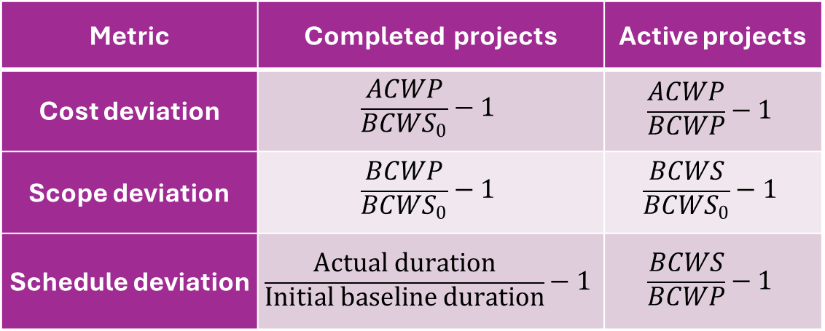
Cost Growth Metrics
Intended to show deviations from the original project baseline, not the most recent re-baseline
Metrics are evaluated for each project at WBS level 3
Metric | Completed projects | Active projects
Cost deviation | $$\frac{ACWP}{BCWS_{0}}−1$$ | $$\frac{ACWP}{BCWP}−1$$
Scope deviation | $$\frac{BCWP}{BCWS_{0}}−1$$ | $$\frac{BCWS}{BCWS_{0}}−1$$
Schedule deviation | $$\frac{Actual duration}{Initial baseline duration}−1$$ | $$\frac{BCWS}{BCWP}−1$$
Notes:
Removed OPCs, removed ACWP before CD-2 to CD-4

Slide 13
Cost Deviation Metrics
Both active and completed projects experience cost inefficiency
  Metrics suggest higher inefficiency for completed projects across most WBS elements, however…
  Discrepancy is likely related to different metrics for active vs. completed projects
Favorable cost deviation for transition to operations (TTO) for completed projects may be a sign that TTO scope is trimmed to be completed off-project
Numbers indicate # of projects
← Better than expected | Worse than expected→

Slide 14
Cost Deviation Metrics
Re-baselined projects show consistently greater cost inefficiency for nearly all WBS tasks than projects which have not been re-baselined
Particularly pronounced for WBS elements that take place “in the field” rather than behind a desk, including
  site work
  equipment procurement and installation
  vertical construction
  transition to operations
Numbers indicate # of projects
← Better than expected | Worse than expected→

Slide 15
Scope Deviation
Large schedule deviations for standard and process equipment are each due to a single outlier project
As suggested before, TTO for completed projects shows evidence of cut scope
Minor scope creep elsewhere, with no clear difference between completed vs incomplete projects
Numbers indicate # of projects
← Better than expected | Worse than expected→

Slide 16
Scope Deviation
Re-baselined projects see scope growth in every category
  Scope discovery is a common cause for project re-baselines.
Non-re-baselined categories mostly appear to have had scope cut
  Perhaps scope was shed to complete within baseline
Numbers indicate # of projects
← Better than expected | Worse than expected→

Slide 17
Schedule Deviation
Completed projects show almost no schedule delays outside of TTO
  Not dependent on the choice of metric; using the active project metric of BCWP/BCWS yields a similar number
May be an artifact of the type of projects in NNSA’s portfolio
  Older projects tended to be smaller, less complex, less expensive, and therefore less prone to delays than today’s active projects
Numbers indicate # of projects
← Better than expected | Worse than expected→

Slide 18
Schedule Deviation
On average, no part of a project completes on or ahead of schedule
Later project phases (which appear toward the bottom) tend to have increasingly longer delays
Numbers indicate # of projects
← Better than expected | Worse than expected→

Slide 19
Lessons Learned
Did a sensitivity analysis with data acceptance criteria
  Any effects of the data cutoff threshold, if they exist, are overshadowed by the effects of influential points in a small dataset
Influential points
  Using the metrics we’ve defined, project activities with small baselines can have an outsized influence on aggregate score even if the actual change in dollars is small
Consider using weighted average or median rather than flat average

Slide 20
Conclusions and Future Work

Slide 21
Ability to accurately, efficiently, and confidently perform…
Lower-Level EVM Project Control
Early Warning Systems
Create XERs
Cost, Schedule, & Phasing Estimating Relationships
Developing PER of when WBS occur throughout the lifecycle of a project
Utilizing Baseline Growth Factors at the WBS level to forecast and assess projects with increased granularity
Our baseline growth defined metrics can allow organizations to detect cost or schedule risks sooner and take corrective action before they escalate.
Organizations which implement these steps will be well-positioned to better quantify cost growth risks, identify mitigation strategies, and ultimately support more informed mission execution

Slide 22
Questions?

Slide 23
Backup

Slide 24
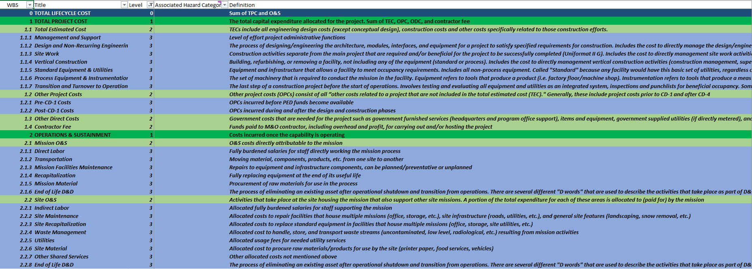
Snapshot of CAEF WBS
Full WBS - Levels 0-9

