Slide 1
Energy Efficiency
Measures on Tribal Facilities
Tribal Energy Program Review Mini-Series
September 10, 2026
Notes:
Welcome everyone, thank you for joining us today for the Tribal Energy Program Review Mini-Series covering Energy Efficiency Measures.
Next Slide Please

Slide 2


Webinar Logistics
How do I turn on live captions?
Click on the “Show Captions” button in the control panel at the bottom of your screen.
Is this webinar being recorded?
  Yes, this webinar is being recorded in and will be available on the IE website: https://www.energy.gov/indianenergy/webinars
Will the slides be shared?​
Yes, a copy of the presentation slides will be shared via email with registrants and will be available on the IE website: https://www.energy.gov/indianenergy/webinars
How do I submit a question?​
Click on the “Q&A” button in the control panel at the bottom of your screen.
Notes:
Before we dive into today's webinar, a few housekeeping items.
To turn on live captions, click on the "show captions" button in the control panel at the bottom of your screen.
To submit a question for the presenters, click on the “Q&A” button in the control panel at the bottom of your screen. This is also where you can message our webinar team if you are having technical issues, and we'll do our best to assist.
Today's webinar is being recorded. The recording, transcript, and slides will be available on the Office of Indian Energy-webinars website in the next 1-2 weeks.
Finally, all registrants for today's webinar will receive a copy of the slides via email, in advance of them being posted on the webinar web page.
Next slide please

Slide 3
Today’s Webinar Will Cover
​
Explore how Tribal communities are integrating energy efficiency measures (EEMs) into new and existing buildings to achieve cost and energy savings.
Hear directly from two Tribes that have successfully implemented EEMs across multiple facilities, gaining insights from their experiences and lessons learned. This webinar will cover various types of EEMs, aiding in the evaluation of their potential suitability for your Tribe's facilities.
Notes:
Today's webinar covers Energy Efficiency Measures, sometimes referred to as “EEMs” for short.
EEMs are technologies and techniques used to minimize energy expenditure. Some common EEMs you might be familiar with are: LED light bulbs and motion sensors that turn on a light when you enter a room. However, there are many other types of EEMs available on the market. For more information about common types of EEMs, please visit the National Lab of the Rockie's National Residential Efficiency Measures Database, which we'll link in the chat.
Today, two Tribes have joined us to explain how they’ve implemented EEMs in their communities.
Next Slide Please

Slide 4

Office of Indian Energy Overview
Amy Lukens
Technical Project Officer/
Physical Scientist
Notes:
To kick things off, I’ll start with a few brief introductions and a snapshot of the Office of Indian Energy.
My name is Amy Lukens, I’m a Technical Project Officer for the Office of Indian Energy, and I’ll be your host today.
Next Slide Please

Slide 5
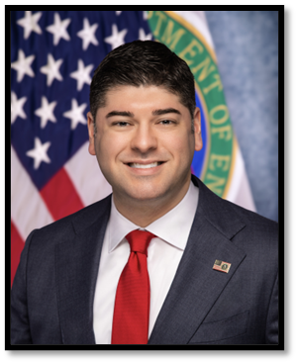
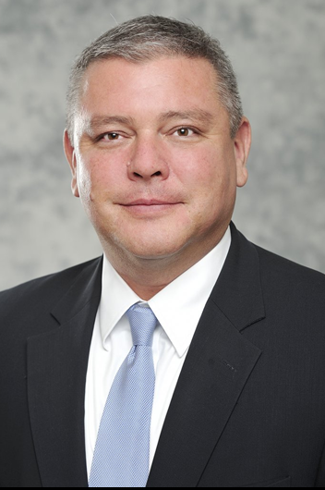
Office of Indian Energy Leadership
Office of the
Under Secretary of Energy
Office of Indian Energy
Eric Mahroum
Director
David Conrad
Deputy Director
Notes:
The Office of Indian Energy is under the leadership of our Director and Deputy Director.
Mr. Eric Mahroum was appointed Director of the Office of Indian Energy Policy and Programs on Jan. 12, 2026. This appointment follows his appointment as the Director of DOE’s Office of State and Community Energy Programs. Eric proudly served in the Trump administration in 2017, also at DOE. Eric has a track record of forging partnerships, promoting innovation, and connecting entrepreneurs with America’s dynamic energy sector.
Mr. David Conrad serves as the Deputy Director for the DOE Office of Indian Energy. He has previously served at the Department of Interior (DOI) and in other roles supporting Indian Country.
Next Slide Please

Slide 6
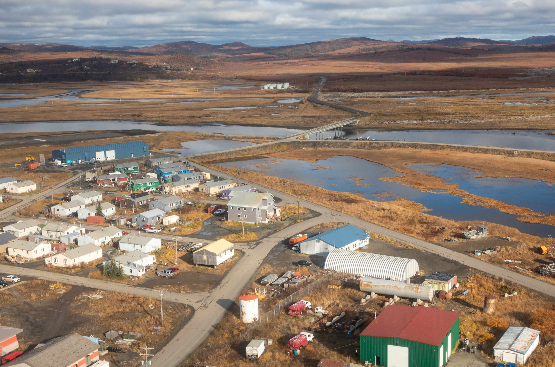
Office of Indian Energy Mission
The Office’s mission is in its Congressional authorizing statute:
Promote Tribal energy development, efficiency, and use.
Reduce or stabilize energy costs.
Enhance and strengthen Tribal energy and economic infrastructure.
Electrify Indian lands and homes.
The Office of Indian Energy was established by Congress in the Energy Policy Act of 2005 under 45 USC 7144e & 25 USC 3502(b).
The remote Native Village of Unalakleet, Alaska completed two rounds of technical assistance with the Office of Indian Energy, focused on energy efficiency and microgrids. Photo by Werner Slocum / NLR
Notes:
Under the Energy Policy Act of 2005, the Indian Tribal Energy Development and Self Determination Act of 2005 authorized the creation of the Department of Energy's, Office of Indian Energy.
Our mission is to
-Promote Tribal energy development,
-Reduce energy costs,
-Enhance Tribal energy and economic infrastructure, and
-Electrify Indian lands and homes.
We celebrated the 20-year anniversary of the Office of Indian Energy last year. We're excited to continue our support of Tribal Nations as they pursue their energy vision. We are continuing to find ways to be more efficient and effective, as we rise to meet our Congressional mandate and achieve our mission.
Next Slide Please

Slide 7



How the Office Supports Indian Country
Financial
Assistance
Technical
Assistance
Capacity
Building
Cost-share leveraged funding to support Tribal energy development
No-cost planning, analysis, commerce, and engineering support for successful project outcomes
Capacity building to enable Tribes to fully participate in unleashing American energy
Notes:
(How the Office of Indian Energy Supports Indian Country)
The Office of Indian Energy offers three main areas of support to Tribes:​
First, financial assistance on a competitive basis to develop and deploy energy infrastructure and technology​.
Second, no-cost Technical Assistance to advance Tribal energy projects and energy commerce.​
And third, capacity building activities through webinars, workshops, and workforce development opportunities with the goal of supporting Tribes to fully participate in unleashing American energy.
Next slide please

Slide 8
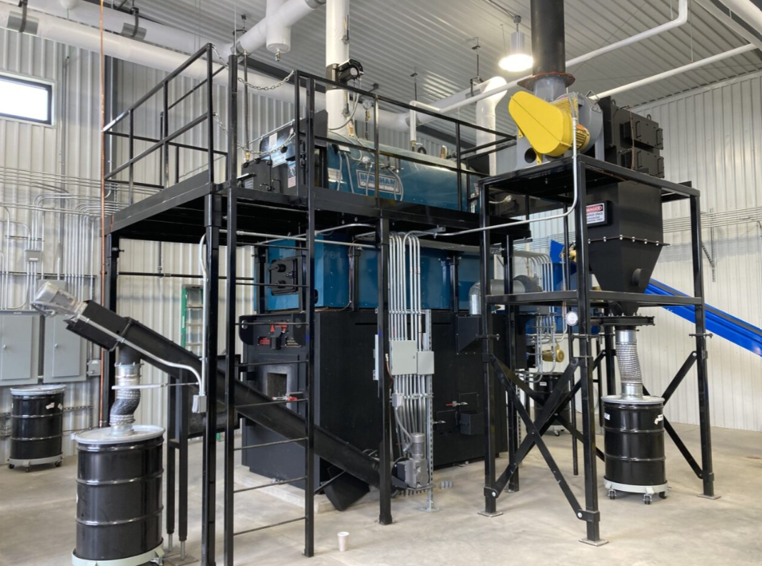
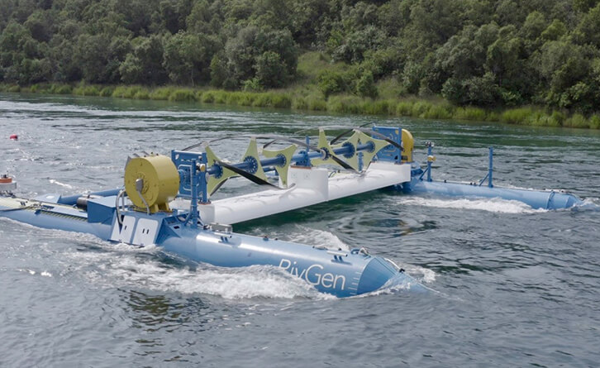
Who the Office of Indian Energy Supports
The Office of Indian Energy supports Indian Country, specifically:
Indian Tribes
  Federally recognized Indian Tribes
  Alaska Native Corporations
Intertribal Organizations
Tribal Energy Development Organizations
Fond du Lac Band of Lake Superior Chippewa (MN) Biomass District Heating System for its Brookston Community Center in 2025 Photo by Josh Gregory, DOE
Igiugig, AK installed its first RivGen in 2019 with support from DOE Water Power Technologies Office. In 2021 the Village began installing a second device co-funded by the Office of Indian Energy. Photo from ORPC
Eligible entities listed under (25 USC §3502(b)(2))
Notes:
(Who the Office of Indian Energy Supports)
The Office of Indian Energy Supports Indian Country. This includes:
Federally recognized Indian Tribes
Alaska Native Corporations
Intertribal Organizations, and
Tribal Energy Development Organizations
Pictured here are two projects our office has funded, featuring energy projects that diversify energy sources to strengthen energy reliability and affordability.
Next slide please

Slide 9
Forest County Potawatomi:
Energy Efficiency Measures
Sara M. Drescher
Senior Attorney and Energy Manager
Forest County Potawatomi
Notes:
Now I’d like to hand over the presentation Ms. Sara Drescher, Senior Attorney and Energy Manager for the Forest County Potawatomi.
Next Slide Please

Slide 10
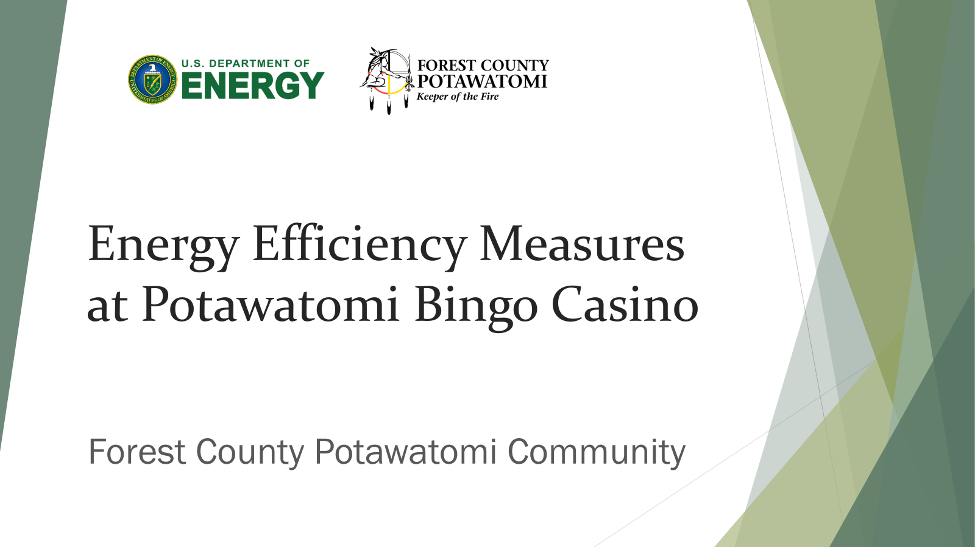

Slide 11
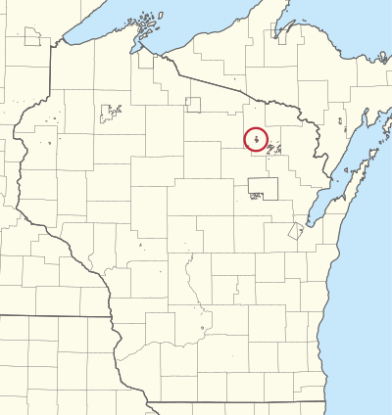
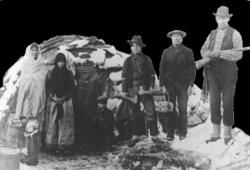
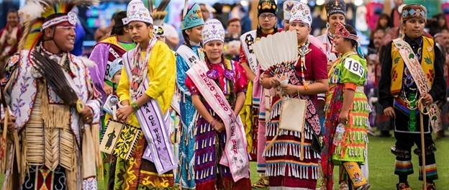
Forest County Potawatomi Community
The Potawatomi were once a part of a historical confederacy made up of the Ojibwa, Odawa and Potawatomi Nations known as the Council of the Three Fires.
  Ojibwa: “Older Brother” and “Keeper of the Faith”
  Odawa: “Middle Brother” and “Keepers of the Trade”
  Potawatomi: “Little Brother” and “Keeper of the Fire”
Notes:
The Potawatomi were once a part of a historical confederacy made up of the Ojibwa, Odawa and Potawatomi Nations known as the Council of the Three Fires. The Ojibwa were addressed as the “Older Brother” as such were also the “Keeper of the Faith”. The Odawa were referred to as the “Middle Brother” and were the “Keepers of the Trade”. The Potawatomi were known in this confederacy as “Little Brother” and “Keeper of the Fire”.

Slide 12
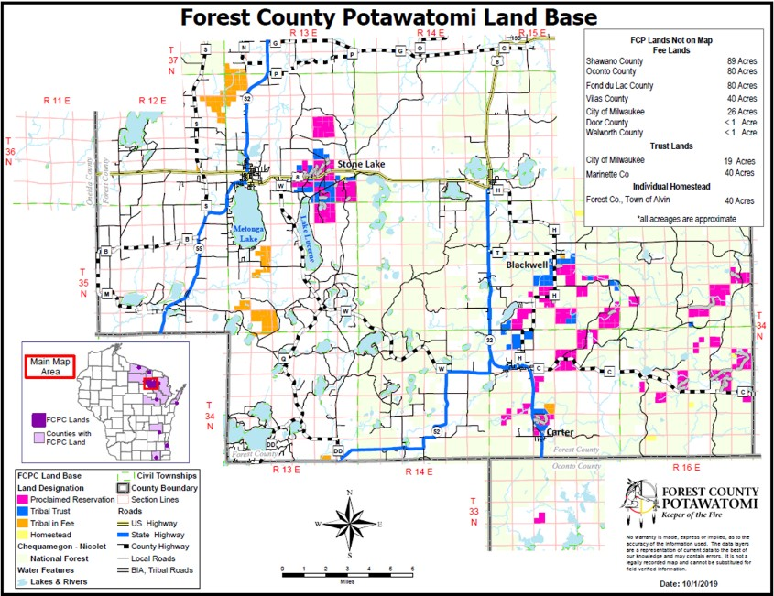


Slide 13

Environmental Mission Statement
The traditional values of the Forest County Potawatomi Community teach us to respect all living things, to take only what we need from mother earth, and to preserve the air, water, and soil for our children.
Reflecting these values, we take leadership in creating a sustainable and healthy world. We resolve to reduce our own environmental impacts and to take steps to remedy the impacts of others.
We encourage others to do the same. We also seek legislative and policy changes that protect the environment for all people, including generations to come.
(Adopted November 20, 2008)

Slide 14
Background FCPC Energy
FCPC’s solar PV projects have developed over 3 MW of behind the meter generation at individual sites.
On the reservation in Forest County Wisconsin, the majority of government buildings have energy use offset by solar between 17 and 99.9%

Slide 15
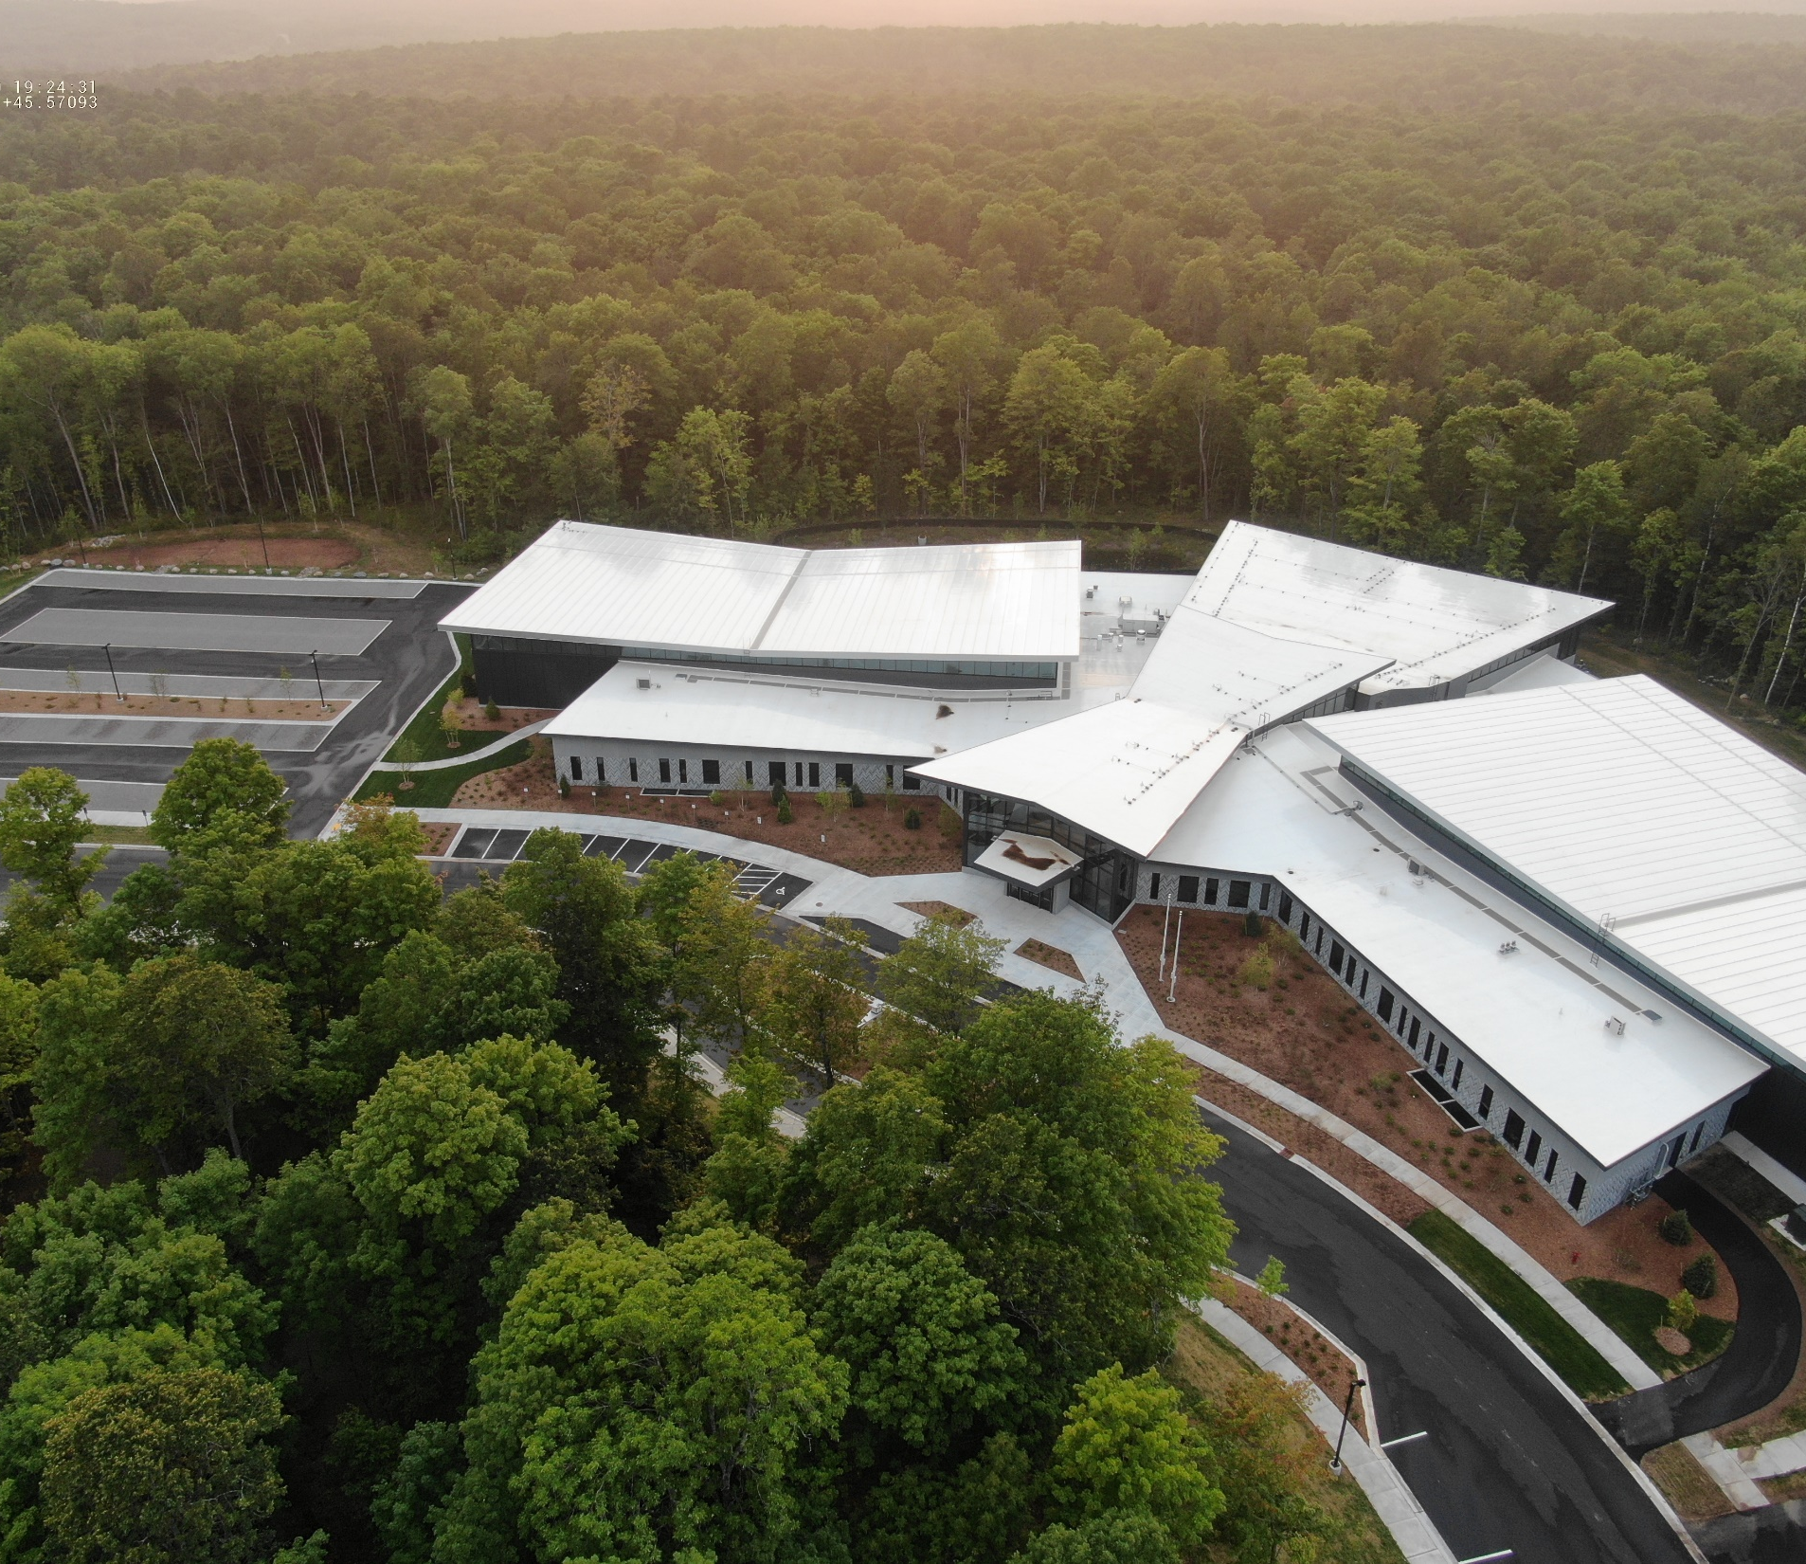
Why Energy Efficiency?
Based on the Tribe’s environmental mission, FCPC values, budget constraints and aging systems the Tribe has been focusing on retrofitting aging systems and technological changes to capture energy savings through efficiency. Minimizing building energy demand, even in existing structures should;
Pay for itself over its lifespan;
Provide cost savings while lowering energy demand;
Be technologically deployable within the construction timeline; and
Be grant eligible.

Slide 16
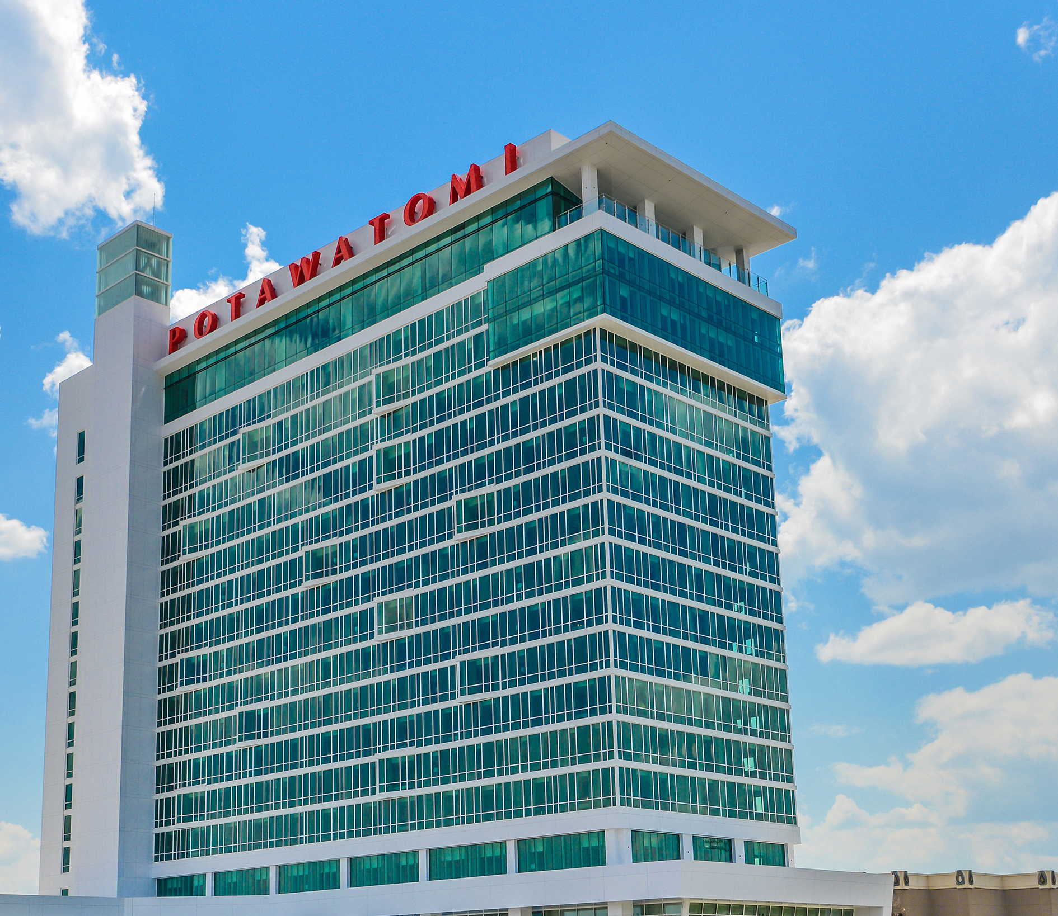
PBC ENERGY EFFICIENCY PROJECT

Slide 17
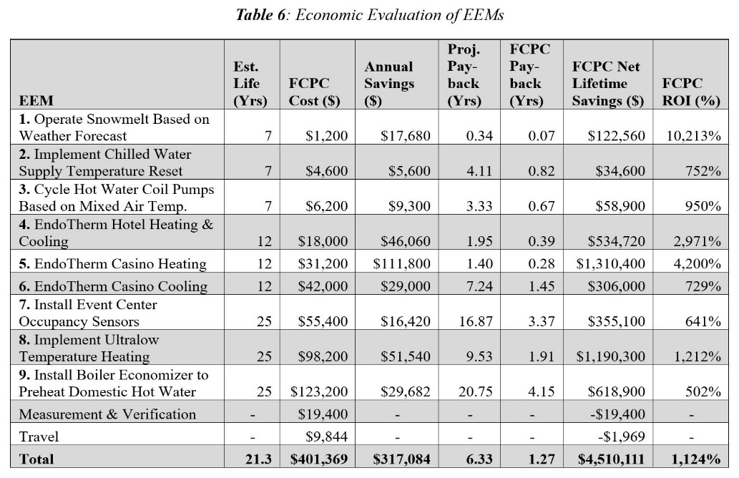
FOREST COUNTY POTAWATOMI COMMUNITY
Milwaukee Hotel and Casino HVAC Efficiency Upgrades
Topic Area 1.B
Project Summary
Key Personnel/Organizations
The Forest County Potawatomi Community (FCPC) project will install nine energy efficiency measures focused on the HVAC system at the Milwaukee Potawatomi Hotel and Casino (PHC), which is the Tribe’s largest energy demanding facility. The project goal is to promote FCPC energy sovereignty through the installation of cost-effective energy efficiency measures. This goal would be achieved through the following objective: Save 959,040 kWh and 263,000 therms in the first year of operations after the installation of all 9 EEMs.
Applicant: Forest County Potawatomi Community (FCPC), a federally recognized Indian tribe
Project Manager: Sara M. Drescher
Budget
Federal funds requested: $1,605,475
Cost-share proposed: $401,369
Total Project Costs: $2,006,844
Project Outcomes
After the implementation of all 9 EEM’s, FCPC anticipates a project lifetime energy savings of 13,488 MWh and 4,288,000 therms, resulting in a lifetime carbon reduction of 22,684 metric tons (MT) of CO₂e. Over the lifespan of the EEMs, the project would save the Tribe $4,510,111, and has a total project payback of 6.33 years and an FCPC payback of 1.27 years. The deployment of the EEMs will assist FCPC in reaching its goal of energy sovereignty through the use of 100% carbon neutral renewable energy, by reducing the load required to offset.
Insert a picture or chart
summarizing key project
milestones, outcomes, or location.
Insert a picture or chart
summarizing key project
milestones, outcomes, or location.
Notes:
Over the lifespan of the EEMs, the project would save the Tribe $4,510,111, and has a total project payback of 6.33 years and an FCPC payback of 1.27 years.

Slide 18
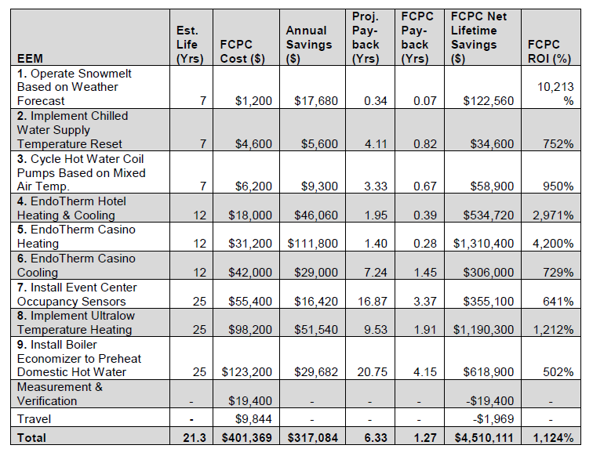
Options Selection and Economics

Slide 19
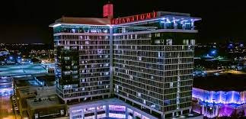
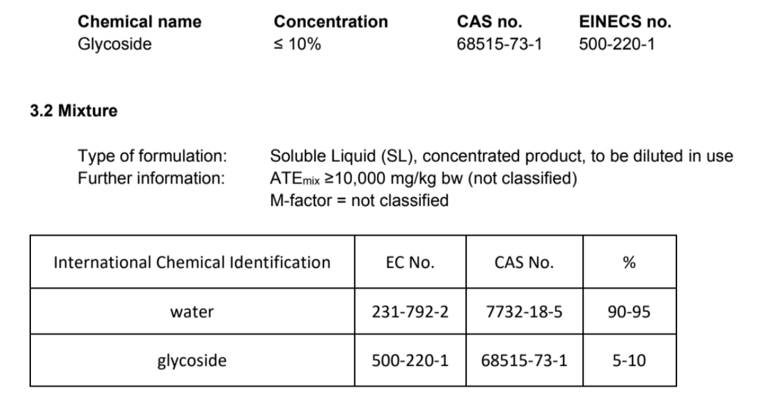
EndoTherm- Hydronic Additive
Chemical additive for HVAC loops that reduces surface tension and improves heat transfer.
Organic and non-corrosive additive, around 1% of total volume.
Energy savings from 15-50% based on results from other buildings.
Federal buildings have started using the product.

Slide 20
Project Delays and Problems
PBC had a fire in its HVAC systems in Spring of 2026.
At the time of the fire the contracts for the EEMs were waiting to be signed by Executive Council. We were able to pull the contracts back and delay work with the contractors.
The revisions to the HVAC systems may require project changes. For example, the stack economizer is for components of the old system.
The fire has resulted in months of discussions with HVAC companies, new/replacement designs and working through insurance which has significantly delayed the Tribe’s ability to implement the EEM project.
FCPC will be seeking an extension and project revisions to support the new design.

Slide 21

Notes:
Thank you, Sara.
Next Slide Please.

Slide 22
Q&A
How do I submit a question?​
Click on the “Q&A” button in the control panel at the bottom of your screen.
Notes:
Now we’d like to take some time for questions. Please click on the Q&A button and type in your question. While you type, we'll cover some questions submitted during registration. We'll do our best to get to as many questions as we can, but please note that we do have time limitations.
Leave time for questions to be typed.
After questions: Thank you again, Sara. We’ll also have time at the end of the webinar if additional questions arise
Next Slide Please

Slide 23
Oneida Indian Nation:
Facility Energy Efficiency Measures
Bryan Mignone, Deputy General Counsel &
Matthew Johnston, Grant Administrator
Oneida Indian Nation
Notes:
Now I’d like to hand over the presentation Mr. Bryan Mignone, Deputy General Counsel, and Mr. Matthew Johnston, Grants Administrator for the Oneida Indian Nation.
Next Slide Please

Slide 24
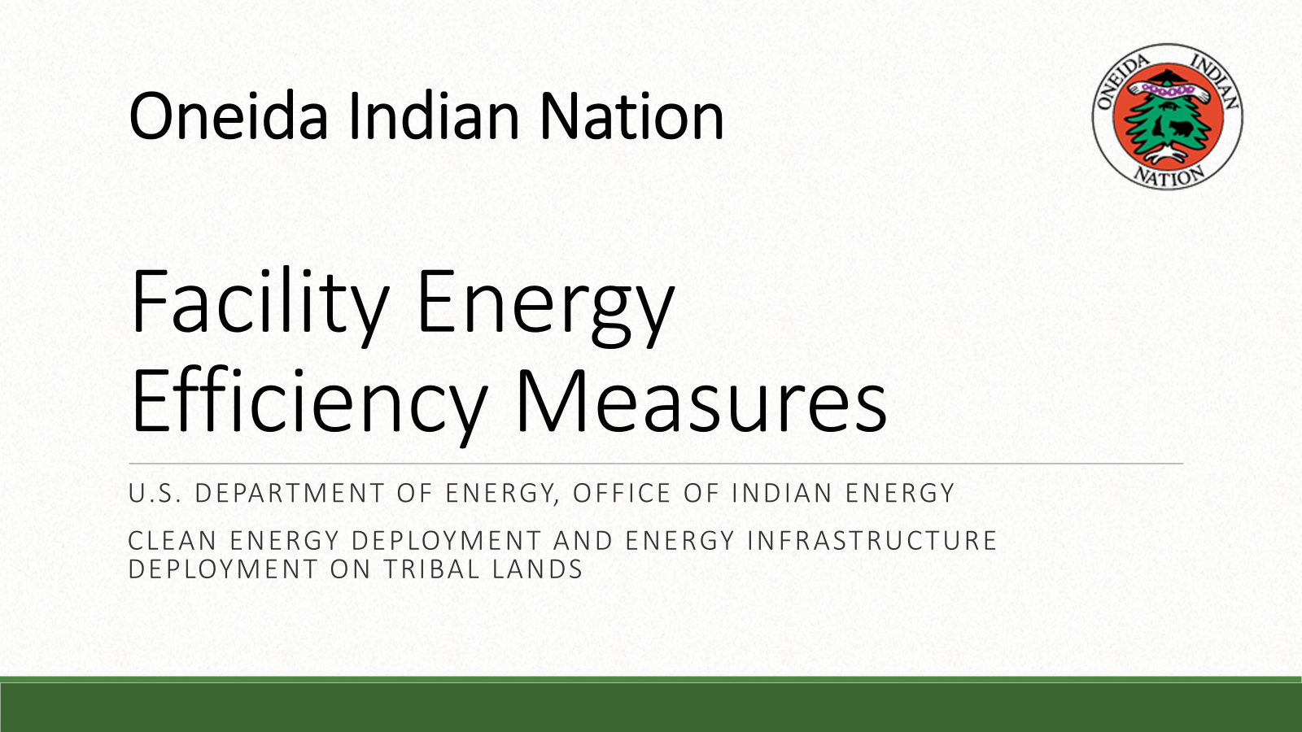

Slide 25


Oneida’s DOE Energy Efficiency Projects
Across three DOE Office of Indian Energy awards, the Oneida Indian Nation is cutting energy use and operating costs across Nation-owned buildings—advancing the Nation’s commitment to protect its resources for the seventh generation to come.
The FY19 Facility Energy Efficiency Project is complete. The FY22 Clean Energy Deployment and the FY23 Energy Efficiency Project Phase 2 are both in progress.
Every measure was identified through professional ASHRAE Level II energy audits that ranked upgrades by cost-effectiveness and payback period.

Slide 26
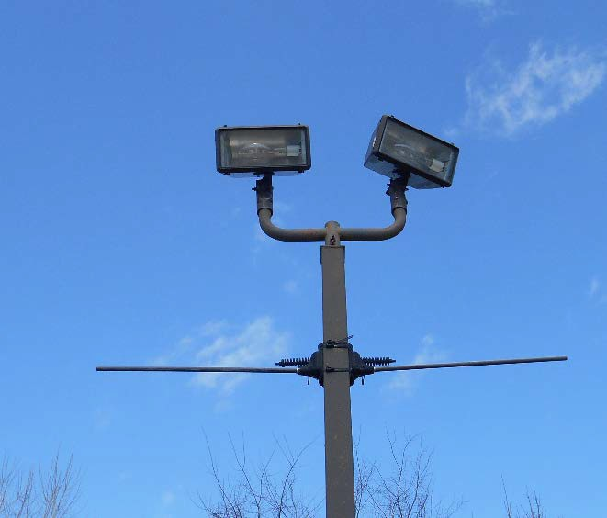
FY19: What We Accomplished
All energy efficiency measures were installed and operational by December 31, 2024:
  Kitchen exhaust hood controls installed so they don’t run constantly.
  Central Utility Plant (CUP) chilled water optimization upgrade.
  CUP chilled water pump upgrade to VSDs.
  29 parking-lot light poles replaced with LED fixtures at Turning Stone.
  Snow melt boiler put into service.
  87 Remote thermostats placed.
  LED replacement light fixtures in 28 buildings.
Eleven high-efficiency HVAC units installed after staff reassessed which units were genuinely due for replacement.
A 12-month no-cost extension (to Dec 31, 2025) let every system complete a full 12-month savings-verification period.

Slide 27
  Verified Energy & Cost Savings
  FY19 Facility Energy Efficiency Project • Verified 2023–2025
  Savings were verified over a full 12-month period using B3 Benchmarking (whole-building method) for Nation facilities with a deemed-savings method for the Turning Stone campus, drawn from utility billing data.
Year | Cost Savings | Electricity (kWh) | Natural Gas (therms) | GHG (tCO2e)
2023 | $334,924 | 2,620,154 | 72,693 | 2,241
2024 | $303,232 | 2,470,263 | 94,514 | 2,094
2025 | $280,188 | 2,765,943 | 43,701 | 1,448
Total | $918,344 | 7,856,360 | 210,908 | 5,783

Slide 28
FY22 Award: Clean Energy Deployment
Central Utility Plant Upgrades
Air compressor Variable Frequency Drive (VFD) upgrade: replace a 50-hp air compressor with a VFD unit to cut energy use and better match plant demand.
Boiler VFD: Upgrading both Cleaver-Brooks boilers with VFDs and upgraded combustion controls, cutting electrical and gas use. Expanded to both boilers under a scope modification using funds reallocated from the eliminated economizer.
Lighting Upgrades
LED retrofit of the Event Center: the 48,000 sq ft main arena (seats 5,000)—replacing compact-fluorescent high-bay and can fixtures.
LED retrofit of the Showroom: (seats 715), replacing the existing compact-fluorescent can fixtures with dimmable LEDs compatible with the existing dimming system.

Slide 29
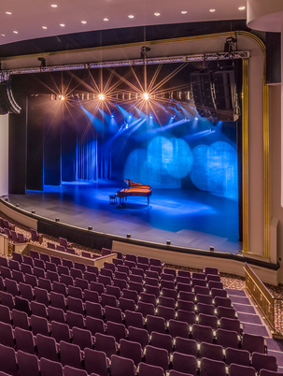
FY22 Award: Clean Energy Deployment (status)
DOE granted this last quarter Boiler VFDs, Event Center lighting, and Showroom lighting.
Air compressors for Oneida’s central utility plant have shipped; pre-installation walkthrough scheduled with the electrical contractor.
Boiler VFD contract with the vendor is being finalized; lighting contract negotiation is in progress.

Slide 30
FY23 Award: Energy Efficiency Phase 2
Turning Stone Event and Banquet Center: VFDs on air-handler fans plus variable-air-volume conversion; electricity savings and lower emissions.
Turning Stone Shenandoah Clubhouse Hot Water Pump: Add a VFD to the pumps; current valves can’t fully close, wasting boiler energy.
Turning Stone Shenandoah Clubhouse Hot Water Valve: Replace control valves so they fully close; natural-gas savings and lower emissions.
Turning Stone Brook Hotel Building New Boiler and Hydronic Heating Upgrade: Install a right-sized 2 MBTU condensing boiler for summer load, replacing the oversized existing boiler.
Turning Stone Convention Center New Occupancy Controls: Occupancy controls for six conference rooms to cut lighting and shut off HVAC when unoccupied.
Car Care Facility Weatherization: Replace failing double-paned windows with high-efficiency units (lower thermal and solar gain).
Other measures: additional lighting upgrades, weatherization, and occupancy sensors across facilities.

Slide 31
FY23 Award: Energy Efficiency Phase 2 (status)
Team member parking and RV park: lighting completed and invoiced this quarter.
Shenandoah Clubhouse pump and valve controls: nearing completion; Central Utility Plant lighting installation underway.
Previously completed: Car Care windows, SavOn convenience stores in Chittenango, NY, lighting controls, and Dream Catcher Plaza windows.
Lodge lighting: whole-building control panel obsolete and parts unavailable; options under review.
Back House lighting: information-gathering underway; the next batch of vendor-approval bids is being assembled.
Event & Banquet Center: Postponed to avoid disruption during peak wedding season.

Slide 32
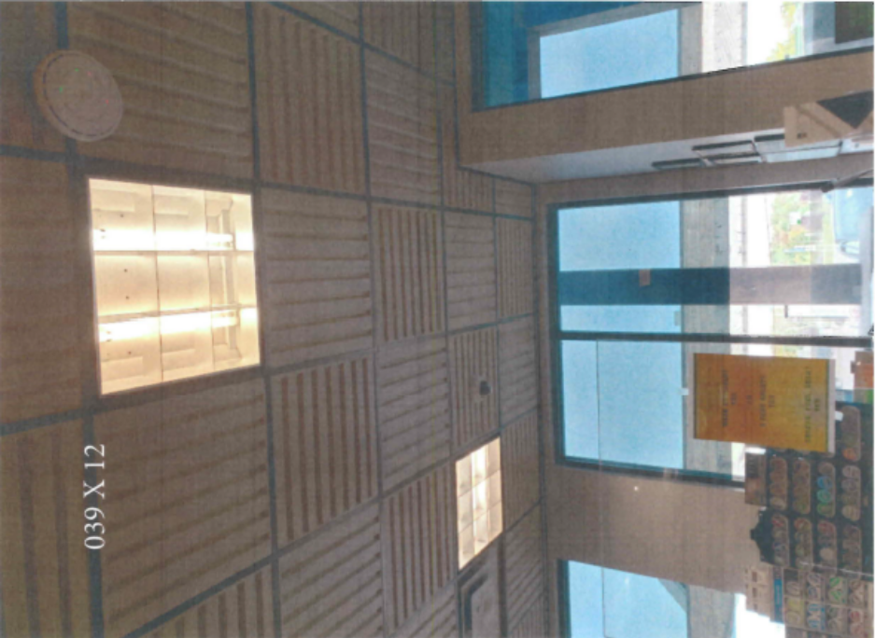
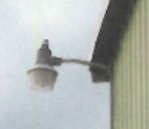
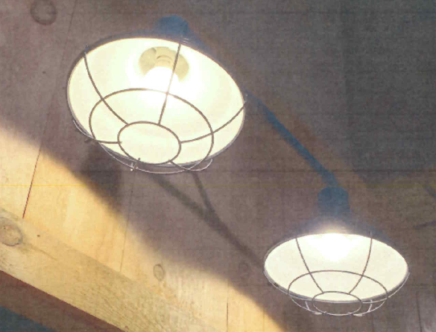
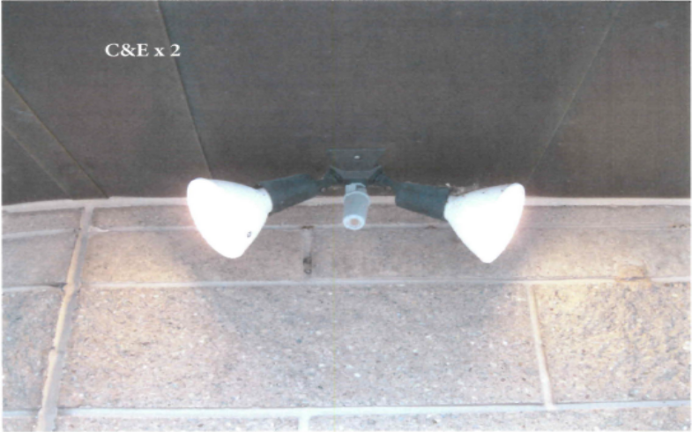
How Vendor Approval Works
Every measure follows the same path before installation can begin:
Develop a detailed scope of work and equipment list for the measure.
Solicit multiple competitive bids per the Nation’s federal procurement policy.
Issue RFPs for each element—some components need separate materials, installation, mechanical, and electrical bids.
Hold vendor walkthroughs to answer questions and firm up bids.
Analyze the bids and document the selection in a decision memo.
Compile the approval package and submit it to DOE—no contract can be executed until DOE approves the vendor.
Execute the contract and begin installation once DOE approval is received.

Slide 33
Challenges
      Vendor-Approval Timing
      The vendor approval can take some time; while pending, quotes expire and some vendors decline to honor them.
      Re-bids and re-quotes add cost and push schedules.
      Operating a 24/7 Resort
      Installations are coordinated around active casino operations and major renovations at Turning Stone and Point Place.
      Staffing Transitions
The Turning Stone VP of Engineering departed in Aug 2024; the Director of Facilities absorbed the work amid competing priorities. A new VP for Engineering & Physical Plant was appointed in March 2026.
COVID-19 (FY19 award)
For the completed award, the pandemic drove supply-chain, labor, and cost impacts; DOE’s cost-share reduction and no-cost extension were essential to completion.

Slide 34
Next Steps
FY22 Clean Energy Deployment: execute the boiler-VFD contract and the lighting contracts, and complete the compressor installation.
FY23 Energy Efficiency Project Phase 2: complete the Shenandoah controls, advance the Back House and Lodge measures, and submit the next batch of vendor approvals.
The FY22 award runs through September 30, 2027 and the FY23 award through December 31, 2027, providing a runway to finish the remaining measures and begin savings verification.

Slide 35
Thank You!
Questions?
Notes:
Thank you, Bryan and Matthew.
If you have a question for Bryan or Matthew please click on the Q&A button at the bottom of your screen to type your question.
Again, we'll cover some questions submitted during registration while you type.
Next slide please

Slide 36
Q&A
How do I submit a question?​
Click on the “Q&A” button in the control panel at the bottom of your screen.
Notes:
Leave time for questions to be typed and answered
After questions: Thank you again, Bryan and Matthew. If attendees think of questions in the future, you may reach out to the Office of Indian Energy, and we’ll do our best to answer.
Next slide please

Slide 37
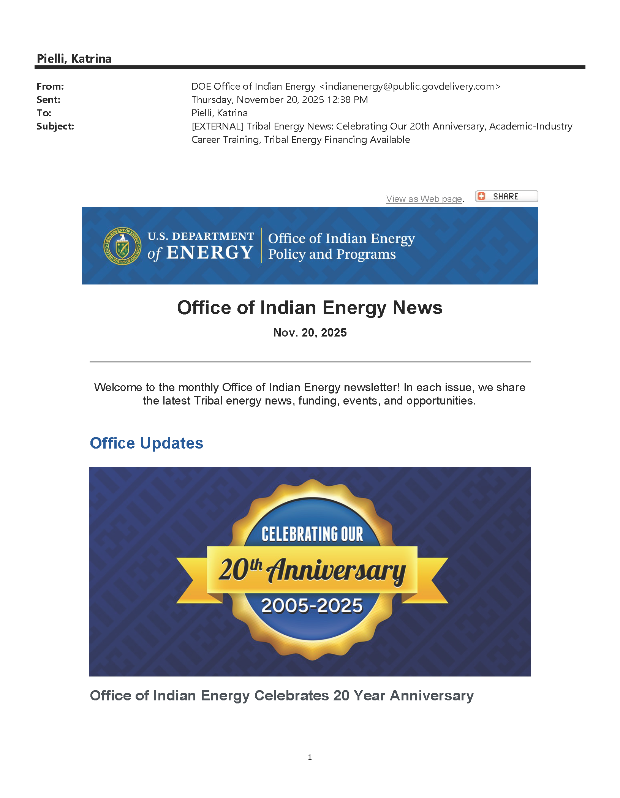

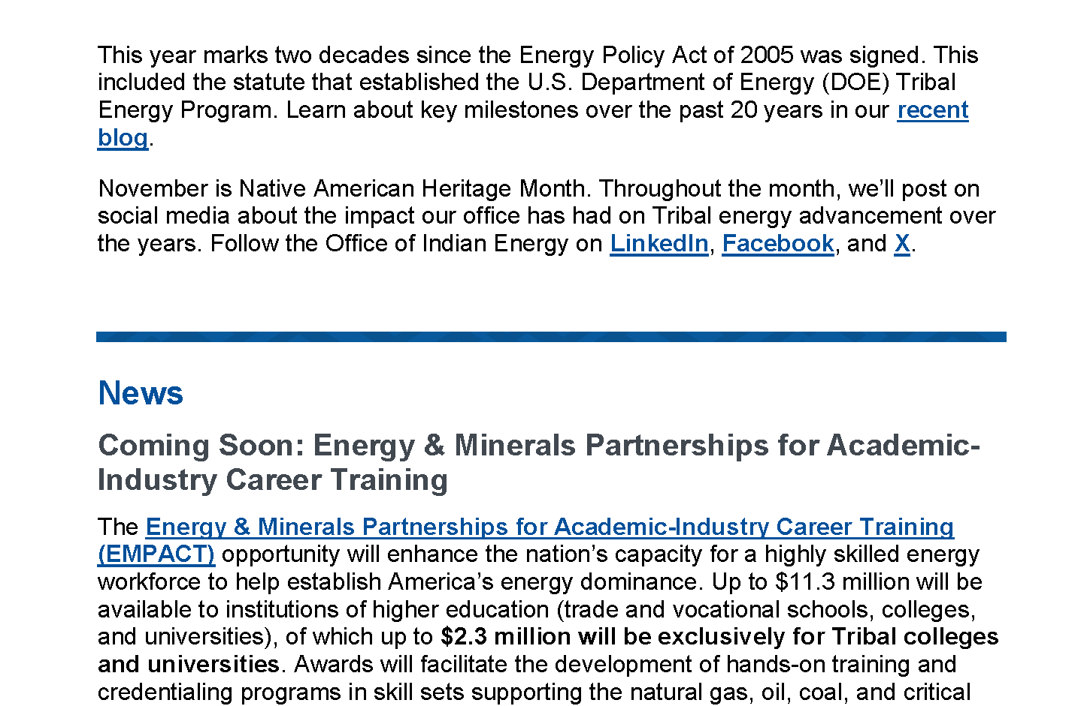

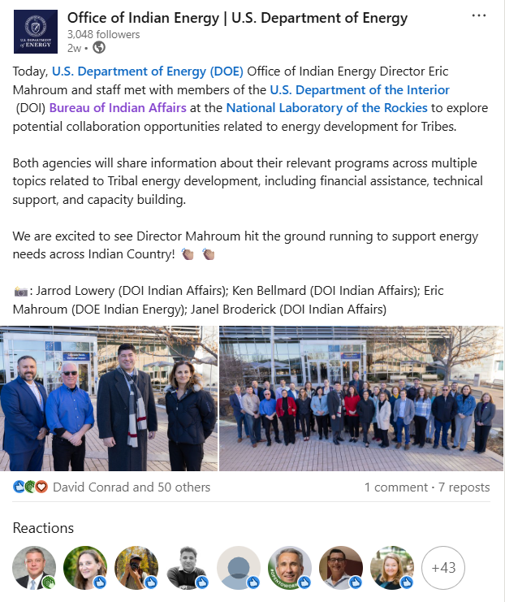



Stay Connected!
Office of Indian Energy
(240) 562-1352
indianenergy@hq.doe.gov
energy.gov/indianenergy
Subscribe to get our email updates:
energy.gov/indianenergy/office-indian-energy-newsletters
Social Media
linkedin.com/company/DOEIndianEnergy
facebook.com/DOEIndianEnergy
x.com/DOEIndianEnergy
Notes:
We’d love to stay connected with any attendees today. You can connect with the Office of Indian Energy via our website found at the top of this slide, through our newsletter, or via our social media pages.
Next slide please

Slide 38
Thank you!
Notes:
Special thanks to our presenters (Sara, Bryan, and Matthew) for taking the time to share their energy projects with us. We are proud to work together with you all on these projects that are reducing energy costs in your communities.
Have a great rest of your day, and take care.

