Slide 1

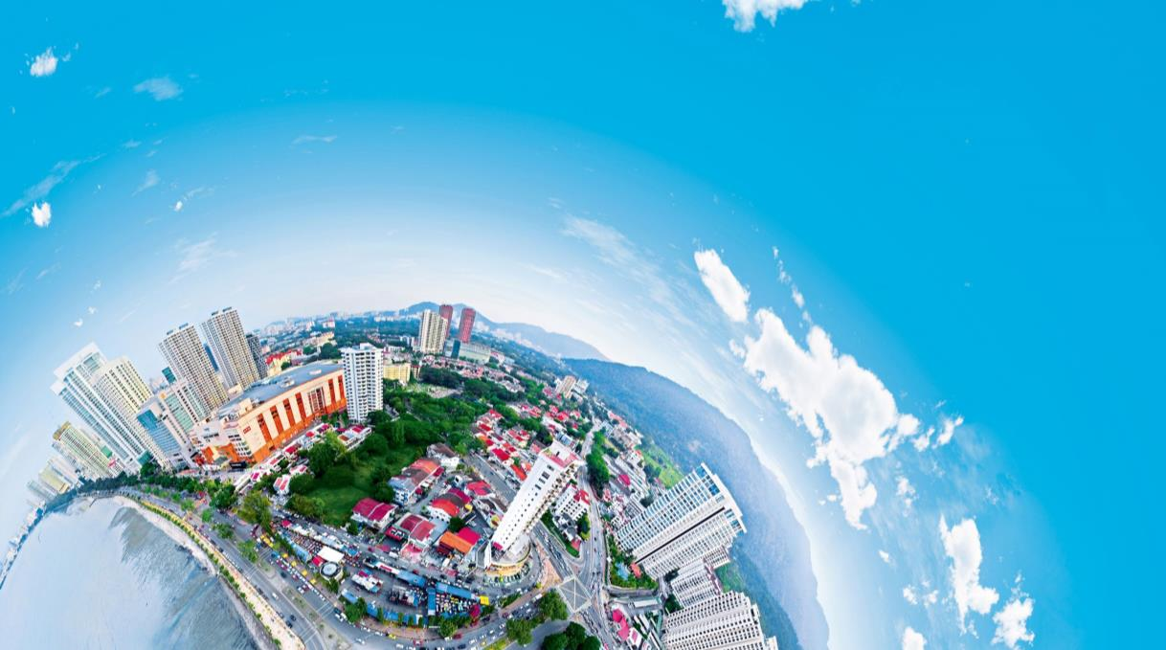

VEOLIA WATER TECHNOLOGIES
Industrial Perspectives

Slide 2
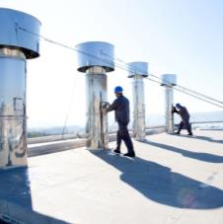
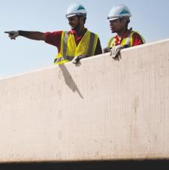
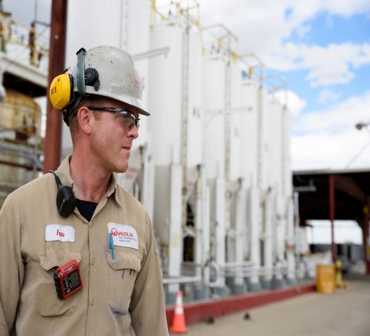
Veolia in a few Word
Veolia designs and implement solutions for water, waste and energy management,
participating in the sustainable development of cities and industries.
Liquid and solid
non-hazardous and hazardous waste management Our expertise covers the entire waste life cycle from collection to recycling, leading to the ﬁnal recovery of waste as materials or energy.
energY
WASTE
Energy efficiency, efficient management of heating and cooling networks, green energy production.
WATER
Management of the global water cycle,
from production and distribution of drinking water to the collection, treatment and recycling of wastewater.

Slide 3
Resourcing the world
Help the next generation of industrials address the Energy-Water Nexus challenges
Enhancing Valorization opportunities
- High value product recovery
- Zero Liquid Discharge treatment train
Water cycle management as a Core competency in the new manufacturing age
- Circular Economy
- Trusted partner more than a utility supplier.
Preserving Resources
- Norms compliances

Slide 4
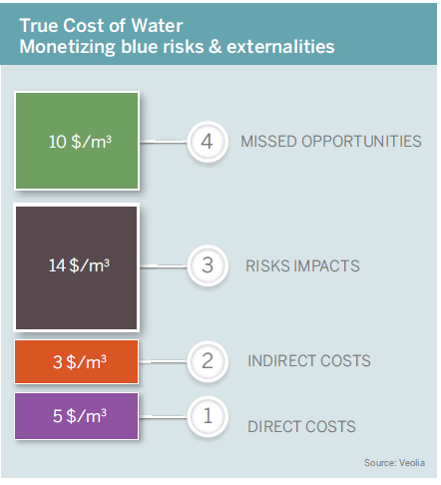
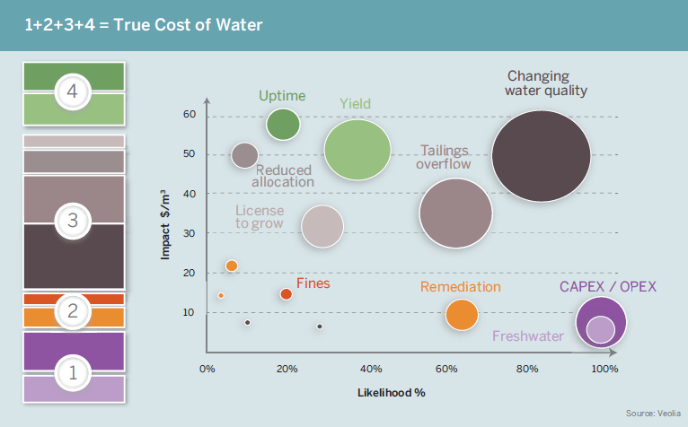
Augmented value proposition: “You do not manage what you do not value”
Understanding the Energy-Water Nexus from a system perspective: Water Management is now part of the whole manufacturing/production cycle

Slide 5
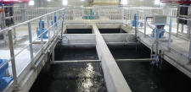
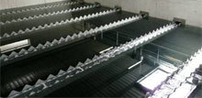
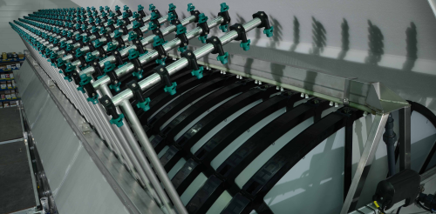
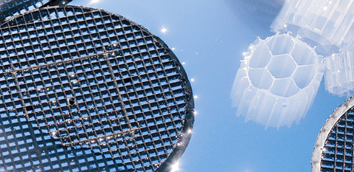
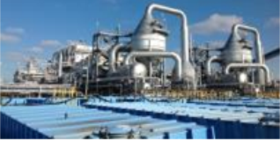
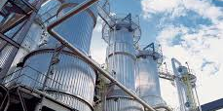
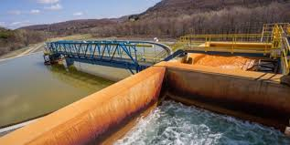
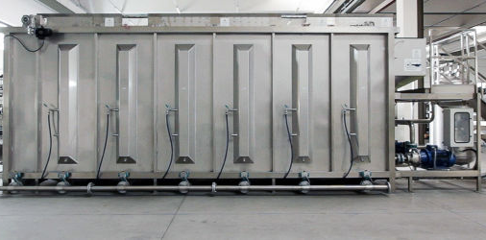
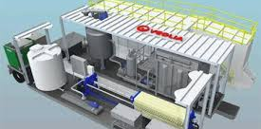
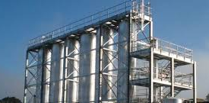
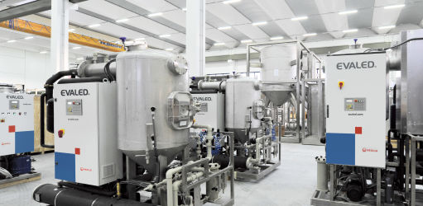
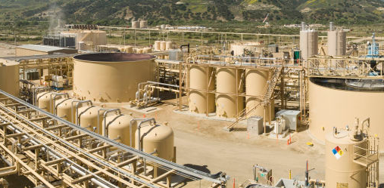
Augmented technological needs: The current gaps
Selective Separation Processes + Selective Biological Processes (monovalent vs divalent I, Selenium, Specs vs Regulation)
Cost effective ZLD treatment line (bridging the needs between RO and Evaporation) Technology
Digitalization (Performance optimization, Reliability & Robustness, Continuous monitoring & Control, Analytics)

Slide 6
