Slide 1
A Validation a Day Keeps the Errors Away: Refining Data with Novel Health Checks
Emily Van Hoose (NA-BA-40; Technomics Inc.)
Daniel Puentes (NA-BA-40)
August 11, 2026

Slide 2



Meet the Presenters
Emily Van Hoose
Daniel Puentes
Emily Van Hoose holds an international MS in Politics, Economics, and Philosophy from Universität Hamburg and a BA in Economics & Political Science from Bucknell University. She leads method development efforts for NA-BA-40 Program Analysis and Evaluation (PA&E). Emily brings her experience as an economic consultant specializing in large-scale infrastructure and transportation projects in the Middle East.
Daniel Puentes is a physical scientist in the programmatic cost estimating office for the NNSA. Daniel develops analytical products and also leads studies to support program offices across the nuclear security enterprise. He is also a federal lead for model development to improve the fidelity and confidence of cost models in the O&S space. Daniel graduated with his PhD in Physics in 2023 from Michigan State University.

Slide 3
How much do you trust your data?
Somewhat
Data-driven decisions shape how government resources are allocated
Official databases are assumed to be validated and reliable
But what happens when health checks fail to diagnose the root cause of inconsistencies?
Analysts are left treating symptoms of unreliable data rather than solving the problem
Trust
Not at all
Completely
Don’t assume published data is accurate by default; validate it yourself.

Slide 4
Data sources used across the lifecycle
Databases | Acquisition | Operations & Sustainment | Disposal
G2 Program Management System
PARS Project Assessment and Reporting System
PRWG Programmatic Recapitalization Working Group
CAAT Capital Acquisition Analytical Toolkit
CostEx / PlanEx Cost Execution / Planning Execution
BUILDER Sustainment and Management System
STARS Standard Accounting and Reporting System
FIMS Facilities Information Management System
PA&E leverages these data sources to develop a capital infrastructure LCCE model
Note: This is not the comprehensive list of all the available databases used within NNSA.

Slide 5
DOE’s Real Property Management System
FIMS: Facilities Information Management System
  Managed by Office of Asset Management
  Tracks operating and maintenance cost down to the building level
Conducts an internal V&V process prior to publishing
Considered the gold standard in data management and real property management reporting
Primary Data Source
Data Field SME
FIMS Site Rep

Slide 6

A Brave New World: Analyst-Driven Diagnostics
Despite FIMS’ V&V rules, challenges with data reliability remain
  Historically, FIMS Site Reps prioritize data reporting over data accuracy
Analysts should perform their own diagnostics to identify errors and inconsistencies
Develop custom validation rules to pinpoint reliable, high-quality data
Goal: Enhance unsuitable databases, like FIMS, to add value and increase confidence in results

Slide 7
Our approach to diagnostics for FIMS
Variables
Brainstorm
Root Cause Analysis
  Consider what platform the dashboard should be built with
  Identify variable types
  Research the database’s existing validation rules
  Consider new validation rules that may be more applicable to the use case
  Flag discrepancies and look at the data from different lenses
  Perform a RCA where flags are concentrated and locate the reason(s) behind these discrepancies
Platform
Research
Flag discrepancies

Slide 8
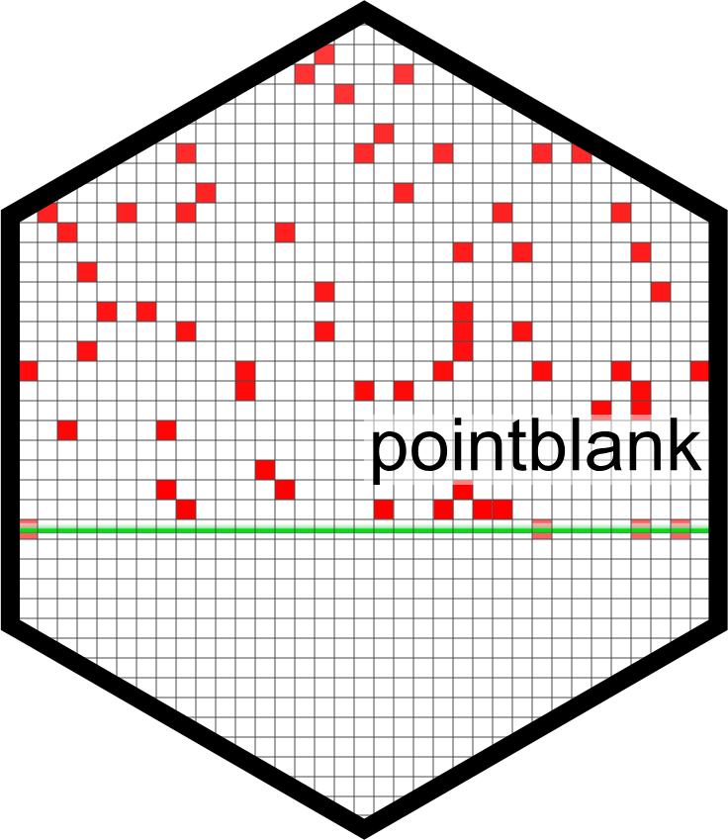
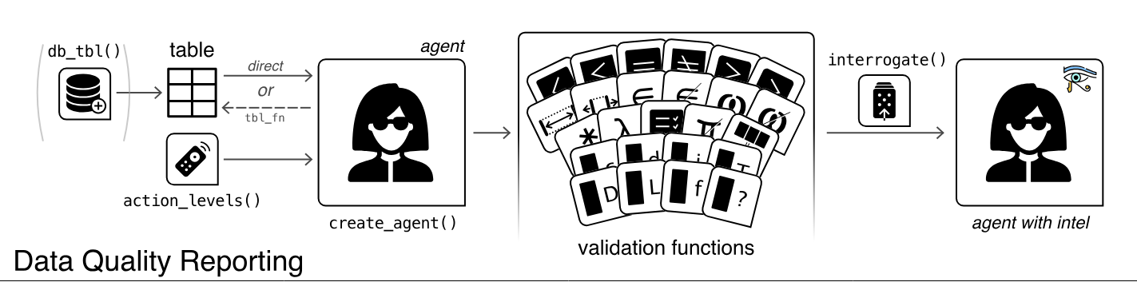

Turning the approach into a tool
Anyone can build a dashboard; our research is more about the process that analysts can apply to perform their own validation efforts
The secret to our process: Analysts see data from a different lens, so that knowledge paired with a consistent validation tool opens up countless opportunities for optimized V&V

Slide 9
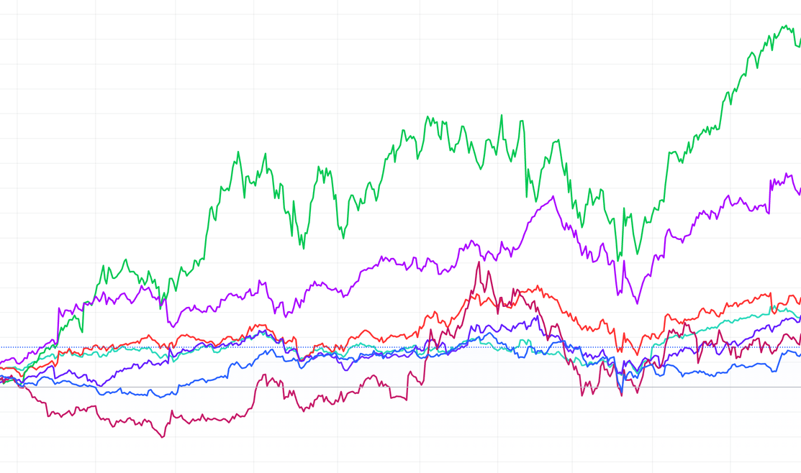
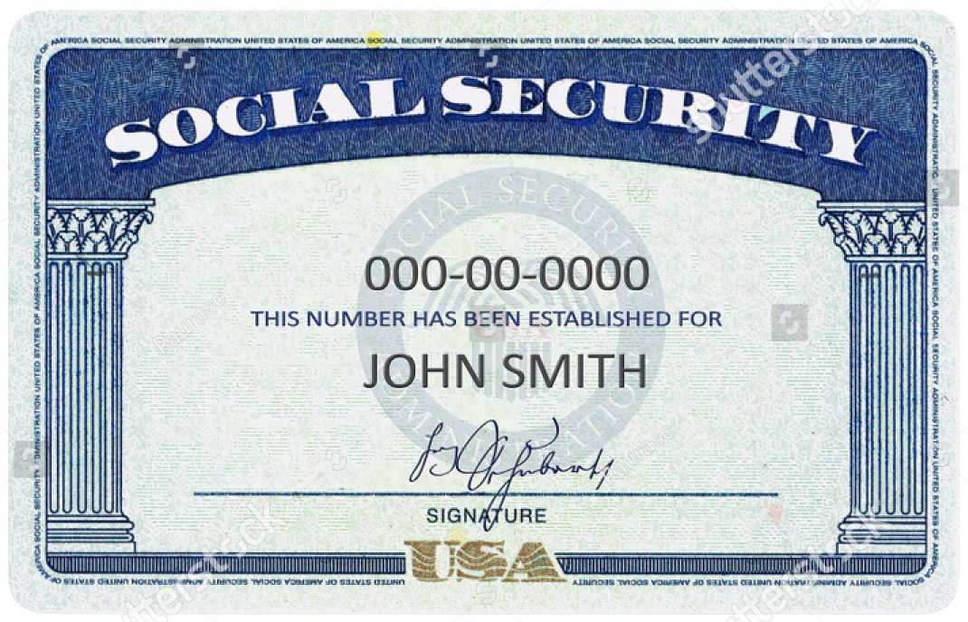
Identify variable types
Importance of Variable Identification
Sets expected behavior over time to avoid misinterpreting validation rules
Prevents false errors by aligning validation rules with variable types
Maps variable behavior and assigns admissible anomaly types for dynamic and static variables
Dynamic Variables
Static Variables
Should change over time as conditions or values update
Should stay the same over time unless there’s a specific reason to change
Maintenance costs, operating costs
Year built, asset type

Slide 10
Determine validation rules
Established
Holistic
Augmented
Validation checks already implemented by the database owners as part of the standard data-entry and system controls
Interpretation of the combined rule set to evaluate overall data health and suitability for use
Additional checks introduced by analysts to address gaps not covered by established rules
routine vitals & standard screening panel
working diagnosis & clearance decision
targeted tests to explain observed symptoms

Slide 11
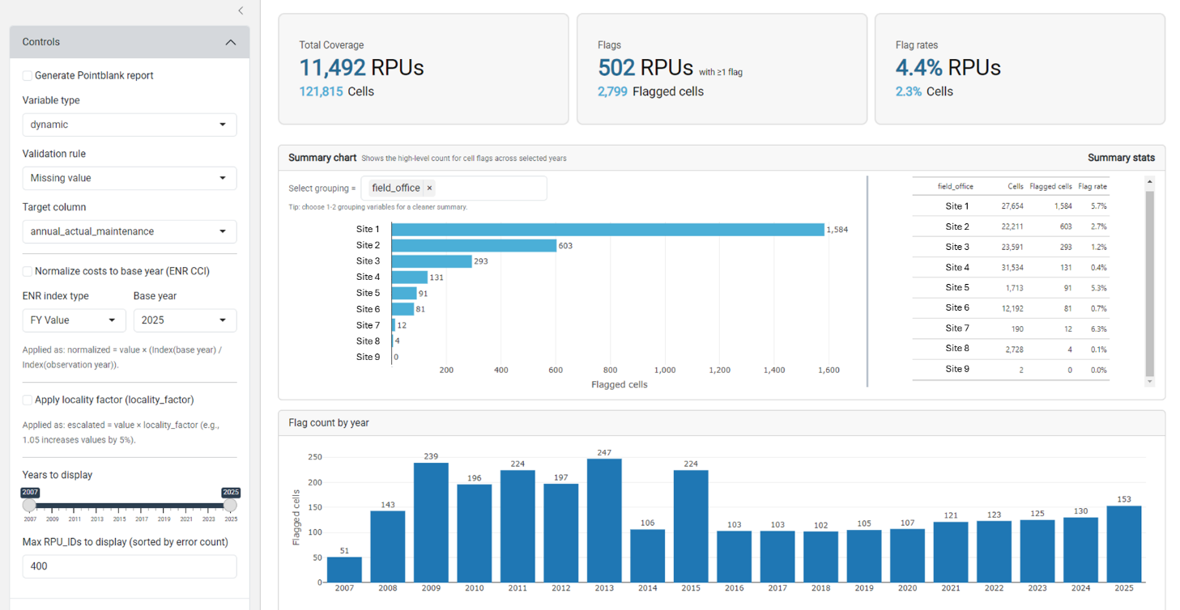
Case Study – FIMS Validation

Slide 12
Potential Root Cause Analysis
Purpose of Root Cause Analysis
Validation Rule Themes and Root Causes
  Identifies the origin of problems, corrective measures, and prevention methods
  Leads to more efficient operations and improved system performance
Established
Data entry or process noncompliance
Integration/ETL mapping errors
Control failures
Problem
Cause
Root Cause
Root Cause
Cause
Root Cause
FIMS consists of data inconsistencies
Anomaly checks only flag the problems
Systemic breakdown in adherence to established protocols
Example
Augmented
Uncaptured business logic or blind spots
Latent structure issues
Reporting artifacts
Holistic View
System pipeline breakpoints
Unit/scale/coding regime shifts
Organizational inconsistency

Slide 13
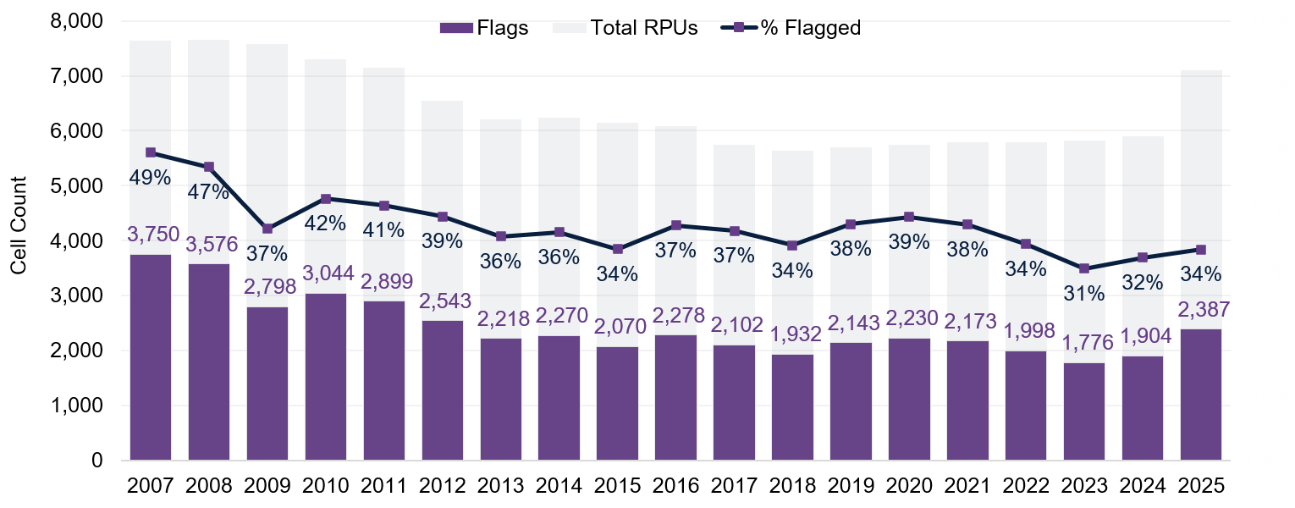
Established rules:
Detection without correction
Anomaly Check for Operating Assets with an Annual Actual Maintenance = $0
FIMS runs 21 anomaly checks before annual reporting
Sites are expected to either correct or validate flagged values
In 2025, 34% of RPUs (operating assets with $0 maintenance costs) were published with no correction
68% of RPUs flagged for operating assets with $0 maintenance costs between 2007 to 2025
Anomalies identified but not corrected before publishing
Root Cause
Data entry or process non-compliance
11,492 total RPUs existed between 2007 to 2025
68% (7,807 RPUs) with ≥ 1 flag
Note: % Flagged not to scale

Slide 14
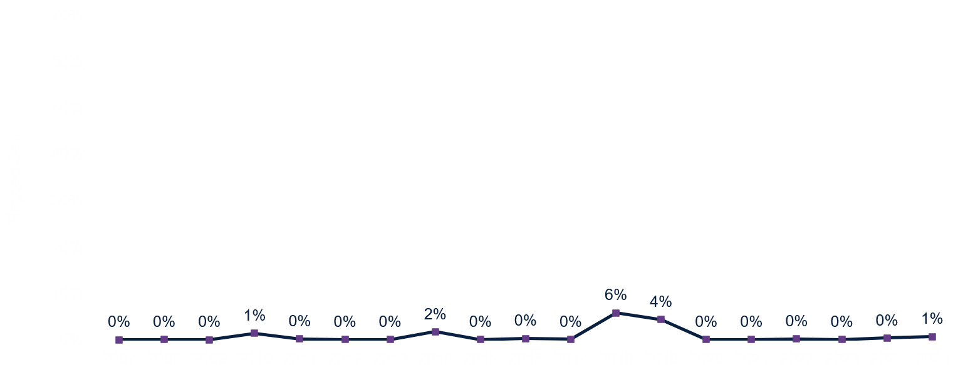
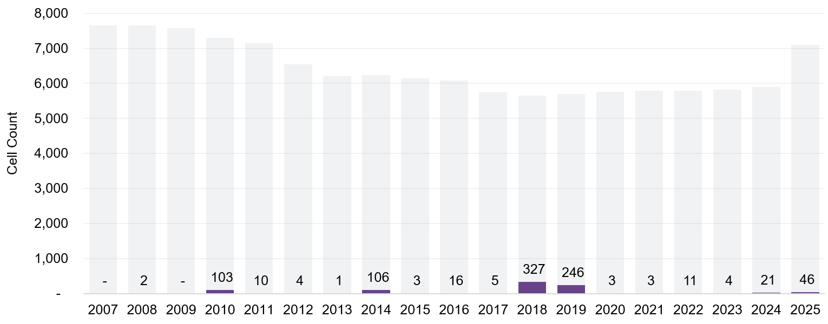
Augmented rules:
Closing the gaps
Categorical Stability of Year Built
Categorical stability checks static variables and flags if values change year-over-year
Year built should never change
63% of flags concentrated in 2018–2019
Changes in 2018/2019 traced to FIMS definition changes in release memos
Augmented rules reveal what established rules were not designed to catch
Root Cause
Reporting artifacts
11,492 total RPUs existed between 2007 to 2025
7% (794 RPUs) with ≥ 1 flag
Note: % Flagged not to scale

Slide 15
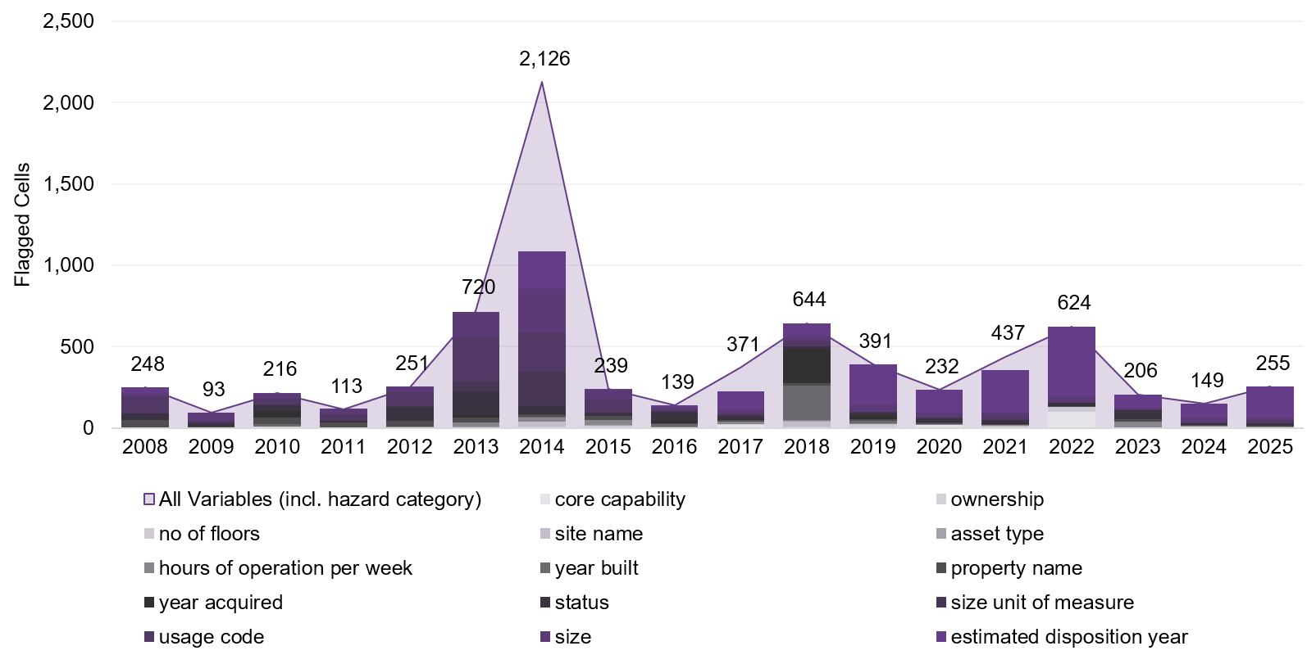
Holistic view:
Targeted treatment
Categorical Stability Flag Counts by Variable – Undisclosed site
Holistic view is the bird’s eye view by variables, time, sites, and/or other categories
This example drills into one site to observe unique patterns
DOE Office of Inspector General audit report in early 2014 discussed variances in FIMS’ site-submitted data, emphasizing importance in accurate reporting
Hazard category accounted for 49% of flags in 2014
2014 is still the year with the most flags, even when hazard category is omitted
Organizational inconsistency
Weak enforcement
Definition/structure drift
Root Cause

Slide 16
Analyst validation is a control – not the permanent fix
?
What does analyst validation do?
What does analyst validation not do?
What is the goal?
Database owner uses analyst findings to:
correct the underlying discrepancies
update protocols and documentation so expectations are consistent
implement controls that reduce the likelihood of recurrence
Detects discrepancies
Separates reliable from unreliable data
Supports defensible estimates
Generates evidence for action
Fix upstream processes
Eliminate recurring issues by itself
Replace database-owner responsibility
Create durable governance change along
Next step: Elevate findings to database owners for corrective action and re-validation

Slide 17
Closing the loop on the data quality cycle
Current state
Re-discovery loop
Desired state
Corrective feedback loop
Analyst detects and quantifies discrepancies
Detect
Patch
Diagnose
Detect
Diagnose
Database Owner Intervention
Improved reliability
Re-validation
More trusted system of record
Provide evidence package with fields, records, clusters, root causes
Repeated process without communication or intervention from database owner
Test whether issues decline
Training, protocols, enforcement, controls

Slide 18
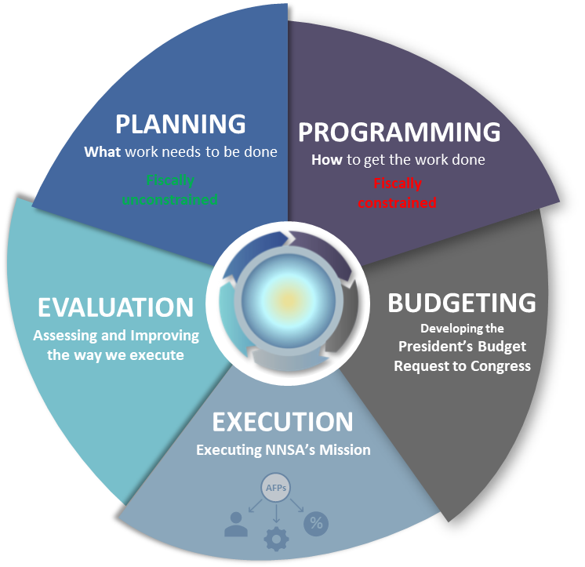
Applications – NNSA PPBE & beyond!
Challenge for PPBE
Dashboard Solution
Data flows are fragmented across many systems
Information is manually re-entered between systems
Errors propagate forward into decisions and budget estimates
Parameter governance: identifies stable, model-ready fields
Selective reliability: identifies records defensible enough for planning and cost estimating
Applicable beyond NNSA PPBE: DOW · DHS · NASA · HHS · VA

Slide 19
Lessons learned
Escalate
  Direct findings to database owners for durable change
Contextualize
  Pair flags with human judgement and domain knowledge
Customize
  Tailor rules to your database and use case
The dashboard will not fix a database, but it can quickly show where the data is dependable, where it is not, and what to investigate further.

Slide 20
The Diagnosis is in:
From symptoms to solutions
1
2
3
Symptoms
Diagnosis
Treatment
A database with unchecked errors is like a patient with undiagnosed symptoms
Routine checks catch common issues, but targeted diagnostics find root causes
The dashboard is the tool that moves us from symptom management to treatment
A validation a day keeps the errors away!
Questions?

Slide 21
Thank you!
If you have any additional questions, please reach out to:
Emily Van Hoose emily.vanhoose@nnsa.doe.gov
Daniel Puentes daniel.puentes@nnsa.doe.gov

