Slide 1
The use and features of off the shelf Cost Processor - WebEVM, and its interfaces between estimating, scheduling, risk, and finance.
Derek Gunter – Y-12
Coley Griffin – Pantex
Mark Taylor – IMC
August 13, 2026

Slide 2
Abstract Description, under Best Practices
WebEVM - Off the shelf, estimating features included in the Y-12 and Pantex installed Cost Processor
Current / Future state interfacing directly as a goal.
Interfaces with other project control systems - Primavera P6, Acumen, Active Risk Manager (ARM), and SAP for our multi-year resources/materials.
Use cases as to when/why/how we would use WebEVM’s new built features.
Capabilities
Future vision - Data Integration Templates (DITs) directly

Slide 3
Enhancing the Data Integration Template with the EVMS Cost Processor
Problem
Manual population of data
New Process Workflow
Streamlined estimating workflow
Improved Traceability
Legacy workflows used large spreadsheets
Solution
Price and house within the EVMS Cost Processor
Benefits
Can focus on Cost & Risk Models
Better Forecasting
Data Standardization helps compare apples-to-apples
Improves parametric and analogous estimating
Proactive risk management
Strategic Impact
Risk-informed estimating and management

Slide 4
Problem
Legacy DIT population methods relied on manual spreadsheets and disconnected systems
High risk of human error
Poor data comparability and inconsistent data integration
Misalignments between cost and schedule data difficult to detect
Delayed risk detection resulting in reactive risk management
Long start-to-finish cycle time

Slide 5
SCHEMATIC FOR DATA INTEGRATION FILE CREATION
NNSA Risk Scoring
NNSA Cost and Schedule Uncertainty Scoring
DATA INTEGRATION
PRESCIENCE
P6 Schedule file XER
P6 Extract
ACUMEN
Schedule Risk Import File
Schedule dates P50/P80
-Uncertainty Only
-Unc w/Risks Unmitigated
-Unc w/Risks Mitigated
Labor Escalation Rate
ARM Risk Report
Cost Risk Import File
Formatted Prescience Data
Cost Results P50/P80
-Uncertainty Only
-Unc w/Risks Unmitigated -Unc w/Risks Mitigated
Cost Estimate Acumen Import File
Recalculated $ value P50/P80
-Uncertainty Only
-Unc w/Risks Unmitigated
-Unc w/Risks Mitigated
MR by FY at P50
& P80
GWBS/CWBS Crosswalk
Schedule Quality Logic
DCM-14 Point
Uncertainties Graphs & Tables
Uncertainties + Risk Not Mitigated
Uncertainties + Risk Mitigated
Risk Exposure Comparison
Tornado Charts and Tables
Uncertainties Graph-Donut
Cost & Schedule Risk Register
Contingency Rates to Import excel file
-Uncertainty Only
-Unc w/Risks Unmitigated
-Unc w/Risks Mitigated

Slide 6
Solution
New Process for cross-functional team using the EVMS Cost Processor
Run SCURA
Import file to P6
Verify Resource Quantities
Price in WebEVM
Review and Compare Data
Generate DIT

Slide 7








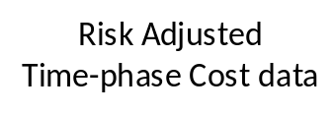
System Integration Workflow
SURA
DIT
Costed Schedule
Overlay
Risk Informed Schedules
Deterministic Schedule
Deterministic
Cost
Risk Informed
Cost
CURA
DIT
Notes:
Files collected by Cost Processor
Deterministic Schedule
P50/P80 Risk Informed Schedule
Deterministic Cost
P50/P80 Risk Informed Cost

Slide 8
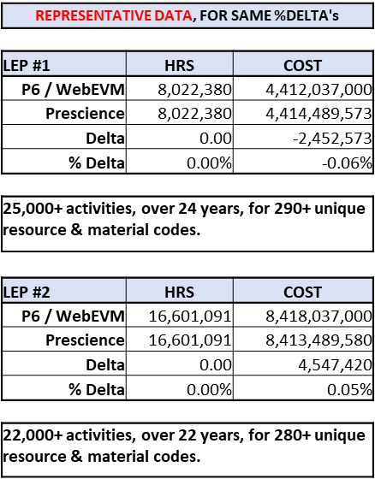
Data Migration Testing
Tested new process using previously submitted SCURA/DIT input data files.
  3 - LEPs, and Bradley Fighting Vehicle
The results showed the new method produces outputs nearly identical to prior submissions, confirming the accuracy and reliability of this approach.
Analysis: Considering that each rate calculator priced over 20K activities, for over 20+years (using 12 periods/yr.), with a mix of (capital & expense) overhead keys, for ~300 resources (CNS resources & Materials) for each period's specific out-year resource rate and out-year material escalation rate. The delta % result is statistically insignificant.

Slide 9
Performance Comparison
Quantitative Efficiency Metrics
Performance Metric | Prescience | WebEVM | Delta / Savings
Processing Speed per Run | 30 min/run | 10 min/run | 20 min saved per run (3x faster)
Scenarios Required (per site) | 12 runs | 6 runs | 6 runs eliminated (50% run reduction)
Total Cycle Time (1 Site) | 360 min (6 hours) | 60 min (1 hour) | 5 hours saved per site
Total Cycle Time (Both Sites) | 720 min (12 hours) | 120 min (2 hours) | 10 hours saved (83% time reduction)

Slide 10

Pantex Delivers DIT for W93/MK7
W93/MK7 served as Pantex’s first program to utilize this integrated system for the WDCR/DIT delivery in February and April 2026.
Process Automation: Replaced a 1–2 week manual process with a 1–2 day automated system.
Resource and Cost Savings: Reduced task duration and labor hours by 90%, generating an estimated cost savings of $162,000 per program WDCR/DIT.

Slide 11
Benefits
Streamlined Estimating Workflow
Less manual input
Reduced risk of human error
Faster start-to-finish cycle time, allowing more time for data analysis and stakeholder review
More Focus on Cost & Risk Model
The better the inputs, the more realistic the output

Slide 12
DEMO

Slide 13
System Integration Workflow
SURA
DIT
Costed Schedule
Overlay
Risk Informed Schedules
Deterministic Schedule
Deterministic
Cost
Risk Informed
Cost
CURA
DIT
Notes:
Files collected by Cost Processor
Deterministic Schedule
P50/P80 Risk Informed Schedule
Deterministic Cost
P50/P80 Risk Informed Cost

Slide 14
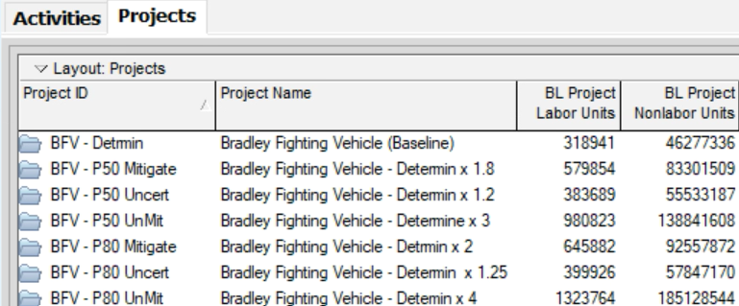
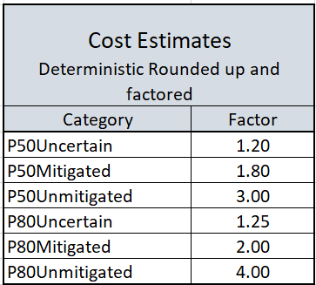
System Integration Workflow
SURA
DIT
Risk Informed Schedules
Schedules
1 Deterministic
6 Risk Informed
Deterministic Schedule
6 Risk Adjusted Cost Estimates
Deterministic
Cost
CURA
DIT
Notes:
Files collected by Cost Processor
Deterministic Schedule
P50/P80 Risk Informed Schedule
Deterministic Cost
P50/P80 Risk Informed Cost

Slide 15
Questions?

