Slide 1
Unlocking EVM’s Potential: Data Speaks
Ryan Cindrich, NA-BA-40
Thursday, August 13th

Slide 2
Agenda
-Introduction
-Background
-Problem and Solution
-Demo
-Conclusion

Slide 3

Introduction
Ryan is an analyst supporting the NNSA office of Programming, Analysis, and Evaluation (PA&E). Ryan has a BS in Mechanical Engineering.

Slide 4
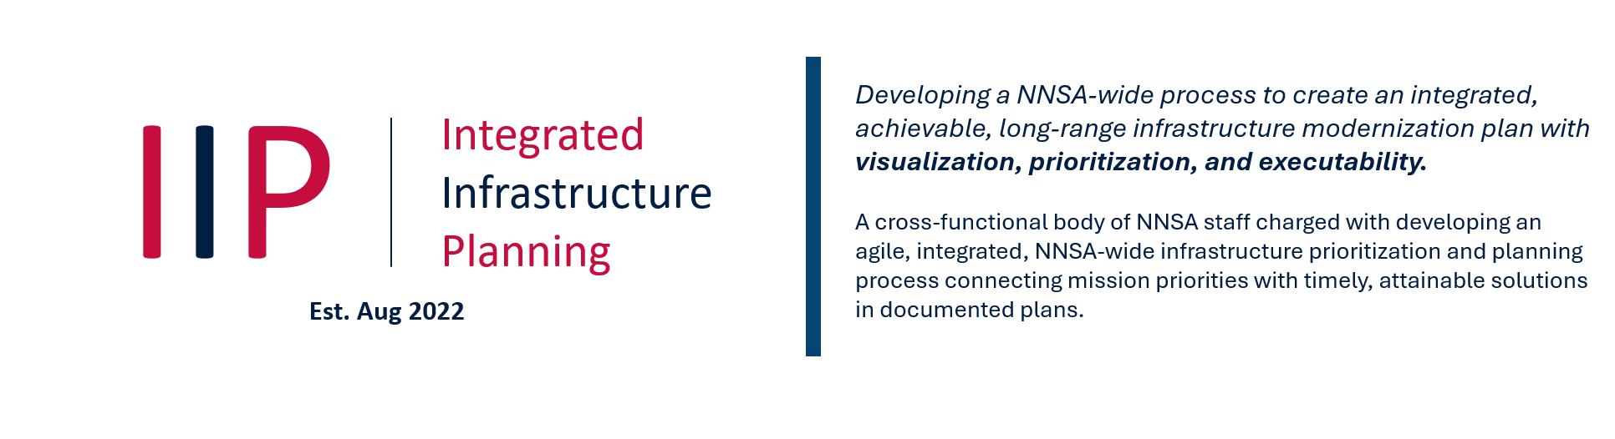
NA-BA-40: Office of Programming, Analysis, and Evaluation (PA&E)
PA&E directly supports Integrated Infrastructure Planning (IIP):
PA&E supports enterprise-level planning, programming, cost analysis, and program evaluation across the Nuclear Security Enterprise (NSE)
Membership: NNSA Programs (NA-10, NA-20, NA-40, NA-70, NA-80, NA-90), Mission Support Offices (ESH, IM, MB, Security), Field Offices, and Labs, Plants, and Sites (LPS) Partners.

Slide 5
Integrated Infrastructure Planning Sub-Team 5 (IIPS5)
1. Visualization Models & Tools
2. Programming
Each team is responsible for ensuring enterprise level planning is integrated into every aspect of decision making
Sub-team 5: Cost Estimating
Lead by Julie Anderson (PA&E) & Tyler Wean (NA-90)
Tasked to improve and standardize enterprise-wide cost analysis
Responsible for overseeing “Implementation Plan to Improve Line-Item Cost Estimate Quality”
FY26 IIPS5 Focus Areas
Schedule Analysis
Earned Value Management
7. Minor Construction
3. Prioritization Criteria
IIP
Sub-Teams
6. Data Management
4. Planning
Enhancements
5. Cost Estimating

Slide 6
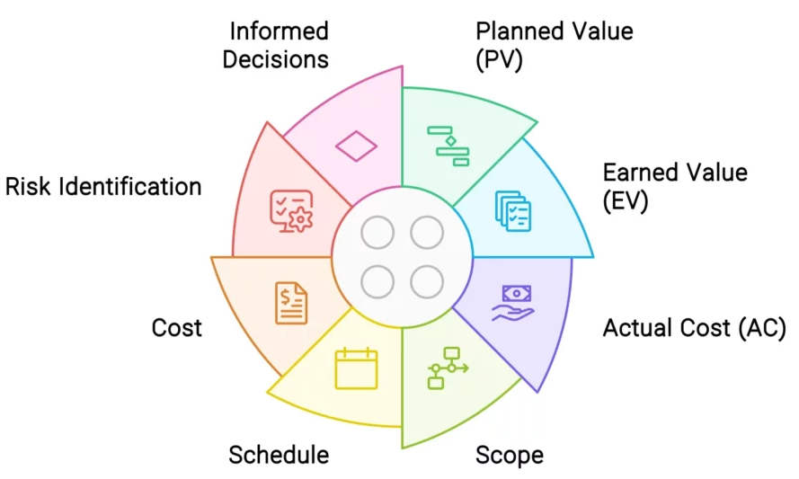
What is Earned Value Management?
Earned Value Management (EVM) integrates scope, schedule, and cost into a single project performance framework.
EVM compares:
  Planned Value: work planned to be completed
  Earned Value: budgeted value of work completed
  Actual Cost: cost incurred to complete the work
EVM helps answer:
  Are we accomplishing the work we planned?
  Are we spending more or less than expected?
  Are current trends indicating future cost or schedule problems?
DOE Order 413.3B, Program and Project Management for the Acquisition of Capital Assets, establishes project management direction for DOE and NNSA capital acquisition projects.
Image from Six Sigma

Slide 7
Where Does EVM Fall Short?
IIPS5 has observed systemic challenges in project health visibility:
  Lack of engagement
  Ineffective EVM Metrics
  Data Quality
These issues force a reactive management style, hindering early intervention and the ability to manage risks proactively

Slide 8
False EVM Data Delivers False Confidence
Inadequate, or incorrect EVM data undermines decision-making:​
  Control Accounts showing above 100% completion​
  Data driven by a single Work Package​
  Large BAC decreases
  Gaining performance without associated costs
Distorted EV feeds into the Estimate at Complete (EAC), making certain projections unreliable
​
Of 11 projects analyzed:

Slide 9
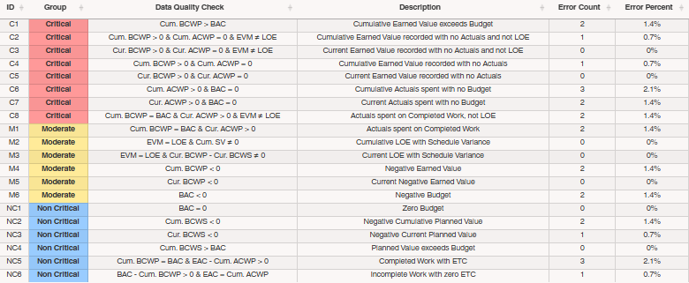
Improving EVM Data Quality through IIPS5
IIPS5 Solution: ​Collect, understand, and improve EVM data through improved reporting and collaboration
  Data Quality Indicators (DQIs) evaluate EVM data against DCMA guidelines and SME-developed rules
  The Data Quality Report (DQR) contains Executive-level DQI results, from portfolio-level to individual WBS levels.

Slide 10
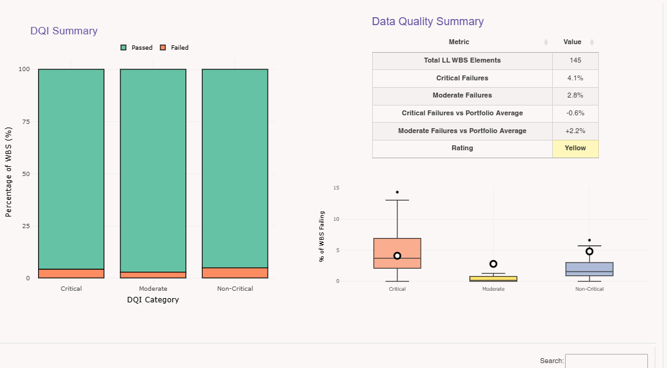
Data Quality Report (DQR)
DQR summarizes all DQI results into a standalone & shareable HTML file at the project-level, site-level, or Program Office (PO)-level
  Usage does not require access to NNSA Databases

Slide 11
Demo

Slide 12
Conclusion
The Data Quality Report and associated Data Quality Indicators allow stakeholders to identify EVM pain points and solve systemic data quality issues.
Questions?

Slide 13
Ryan Cindrich: ryan.cindrich@nnsa.doe.gov
Hannah Lee: hannah.lee@nnsa.doe.gov
Julie Anderson: julie.anderson@nnsa.doe.gov

