Slide 1
Targeted Innovation & Technology Transition (SBIR/STTR, EPSCOR, LEEP, TCF, and Energy I-Corps)
Tina M. Kaarsberg and G. Jeremy Leong
Advanced Manufacturing Office
AMO Peer Review
June 2020 | Washington, DC
manufacturing.energy.gov

Slide 2







Innovation and Technology Transition Abbreviations
Small Business Innovation Research/Small Business Technology Transfer (SBIR/STTR)
Experimental Program to Stimulate Competitive Research (EPSCoR)
Lab-embedded entrepreneurship program (LEEP)
Technology Commercialization Fund (TCF)
Energy Innovation Corps (Energy I-Corps)

Slide 3
5 Program Portfolio Linked to AMO Goals
TCF
SBIR
4.Transition DOE-supported innovative technologies and practices into U.S. manufacturing capabilities
LEEP
5.Strengthen and advance the U.S. manufacturing workforce
Energy I-Corps
EPSCoR
1.Improve the productivity, competitiveness, energy efficiency, and security of U.S. manufacturing
2.Reduce the life cycle energy and resource impacts of manufactured goods
3.Leverage diverse domestic energy resources and materials in U.S. manufacturing, while strengthening environmental stewardship
Name | FY19 $ | Since | # projects
SBIR/STTR | ~$12.8M | 1983 | 68
EPSCOR | ~$0.5M | 1992 | 2
LEEP | ~$8.0M | 2015 | 15
TCF | ~$3.1M | 2005 | 10
Energy I-Corps | ~$1.0M | 2016 | 13

Slide 4
Innovation Pipeline-> Ecosystem
Old Linear View
New Innovation Ecosystem View
Manufactured Product
Basic R&D
Applied R&D
Demonstration
New R&D
Manufacturing R&D
Scale-up/ Scale-out
Manufactured Product
Fundamental
R&D
Technology R&D
Other discipline
Other technology
New R&D

Slide 5
SBIR/STTR Goals, Process, Websites
Get small business innovation INTO federal government
Use small business innovation to get technologies out of the government
Stimulate U.S. technological innovation
Encourage innovation in socially & economically disadvantaged persons
SBIR/STTR is a Gated Process w/ 3 Funding Phases
Phase I
Concept Development
6 months
> $200,000
Phase II
Prototype Development
24 months
>$1,150,000
Phase III
Commercialization
SBIR data rules but No SBIR funding
AMO SBIR energy.gov/eere/amo/small-business-innovation-research-sbir-0
EERE SBIR energy.gov/eere/sbir
DOE SBIR science.energy.gov/sbir
USG SBIR sbir.gov

Slide 6
SBIR/STTR Phase I: Announced 5/21/20
Subtopic/ Topic | Award Details
6a: Atomic Precision for Energy Efficient and Clean Energy-Related Microelectronics | 2D transistors, CNT FETs for 5G, quantum metrology, AP opto-electronics, AP phase change memory
6b: Sensors for Harsh and Corrosive Environments | Fiberoptic pressure, ultrasonic waveguides, Wireless sensors
6c: Critical Materials Supply Chain Enabling Research | Recycling rare earth elements, cobalt, extrusion of Mg alloy, high throughput sorting, spark plasma sintering,
6d: Water: Cost-effective Energy Recovery for Modular Desalination | Sliding Element ERD, Micro-Hydro Scroll Turbine ERD
15a: Novel Utilization Strategies for Ocean Plastic Waste | Upcycling Material, Compact Catalytic Membrane Reactor
16b: Thermal Energy Storage | Nano particles for thermochemical energy storage
17a: Compact Power Conditioning Systems for High-Torque, Low-Speed | Direct-drive wind/water generators, MV SiC Based PCS
APM
Materials HSC
Critical Materials
Water
Plastics
Energy Storage
Power Electronics

Slide 7
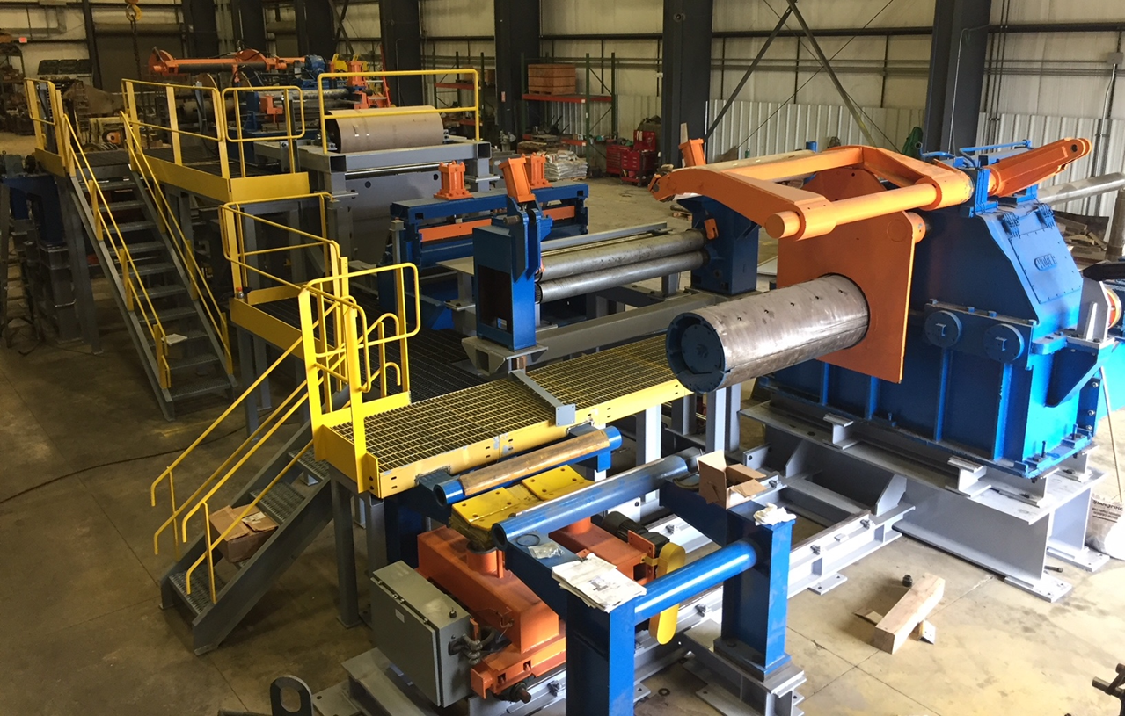
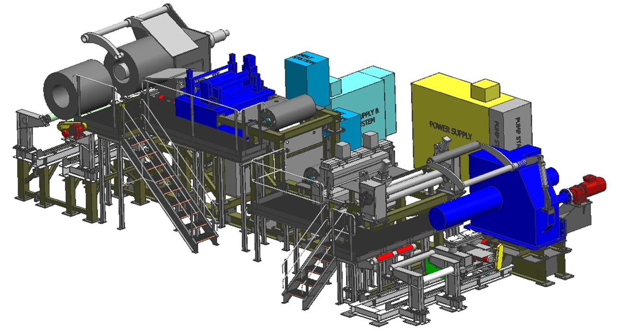
SBIR Success: Flash Steel Phase III
FY 2013 Flash Steel (Bainite) wins Phase I
FY 2014-17 Phase II and Phase IIB process R&D and pilot plant
Related FY15 Lab Call with ANL/ORNL: to investigate microstructure—grain size reduction →mechanical strength (Hall Petch strengthening (figure at right)
FY 2017 DOE’s SBIR Small Business of the year
“Getting an SBIR really put us on the map …but the biggest benefit was the ability to interact with world class metallurgists like those at DOE & Oak Ridge National Laboratory. …Gary Cola Founder and CTO
Full Interview at: https://www.energy.gov/eere/technology-to-market/sbir-successes-interviews-past-winners
FY 2018 Phase III: Full-scale prototype heat treating line completed

Slide 8
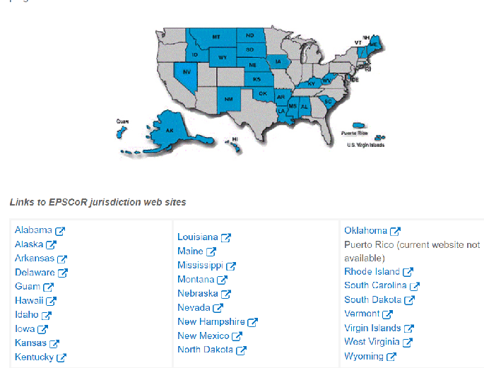

Experimental Program to Stimulate Competitive Research
Originally an NSF R&D program for underserved institutions and states.
DOE EPSCOR was established by Section 2203 of the Energy Policy Act of 1992 (P.L. 102-486)
AMO seeking to expand program (now AM for superalloys and Materials for HSC).
https://science.osti.gov/bes/epscor

Slide 9
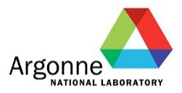


The idea behind Lab-Embedded Entrepreneurs
Spin the nation’s top innovators “in” to the National Labs
VC
Non-VC
M&A
Recruit the
best energy technology innovators
Leverage expert mentorship and world-class facilities at the national labs on a win-win basis
Position
people and technology for market
Goal: Empower innovators to mature their ideas from concept to first product, positioning them to align with the most suitable commercial path to bring their technology to scale.

Slide 10
Three Lab-embedded Nodes
cyclotronroad.org, at Lawrence Berkeley National Laboratory, California
chainreaction.anl.gov, at Argonne National Laboratory, Illinois
innovationcrossroads.ornl.gov, at Oak Ridge National Laboratory in Tennessee.
https://www.energy.gov/eere/amo/lab-embedded-entrepreneurship-programs

Slide 11
2018 LEEP Finalist Technologies (all 3 nodes)
Advanced Capacitors
Quantum Dot manufacturing for digital displays
Advanced Absorbents for water treatment
Advanced Flow batteries
Low cost bio-sensors for water testing
Advanced coatings for windows
Advanced membranes for HFCs
WBG electronics for motors
Advanced imaging sensors
High volume carbon nanotube separation
Advanced carbon-fiber production
New Nickel-Manganese-Cobalt cathode production
Production of graphite from lignin products
Hydrogen production from organic waste
Advanced anodes for lithium batteries
Advanced tools for Cryo-TEM devices
Production of high-purity radio-isotopes for medical treatments
Industrial scale production of lipid nanoparticles for pharmaceuticals
ML-based temperature control for refrigeration systems
New method for hydrogen generation
New industrial enzyme production
New method for advanced high-volume carbon nanotube production
Industrial-scale DNA production
Advanced production of textile-embedded sensors
AI-enabled, physics-based meteorological modeling system for advanced weather prediction
Modular semiconductor manufacturing process
Lenseless imaging system
Advanced electrocaloric cooling system
Advanced sensors for emissions monitoring
Embedded machine-learning systems for mixed-signal processing
Advanced sensor systems for building thermal dynamics monitoring
New optical transistor based systems
Embedded energy-harvesting sensor systems

Slide 12
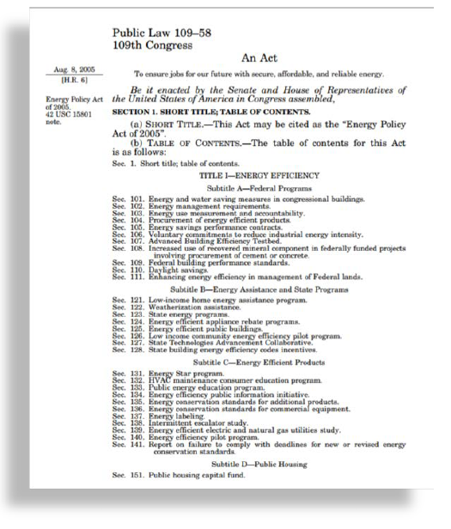
Technology Commercialization Fund (TCF)
Congressionally mandated (EPAct 2005, Section 1001e)
Run by the Department of Energy Office of Technology Transitions (OTT)
Allocates 0.9% of AMO’s applied energy R&D budget every fiscal year
To provide matching funds with private partners to promote promising energy technologies for commercial purposes
AMO leverages TCF selections of successful, high impact, sun setting projects to complement and enhance our R&D portfolio and span a wider TRL range
Increased potential to overcome additional “valleys of death” and to increase pipeline potential for commercial success
Between FY16-19, AMO has funded 30 projects totaling over $9.3M in federal funding and over $21.2M in total funding (including cost share)
In FY20, AMO plans to fund 8 projects totaling over $3.5M in federal funding

Slide 13
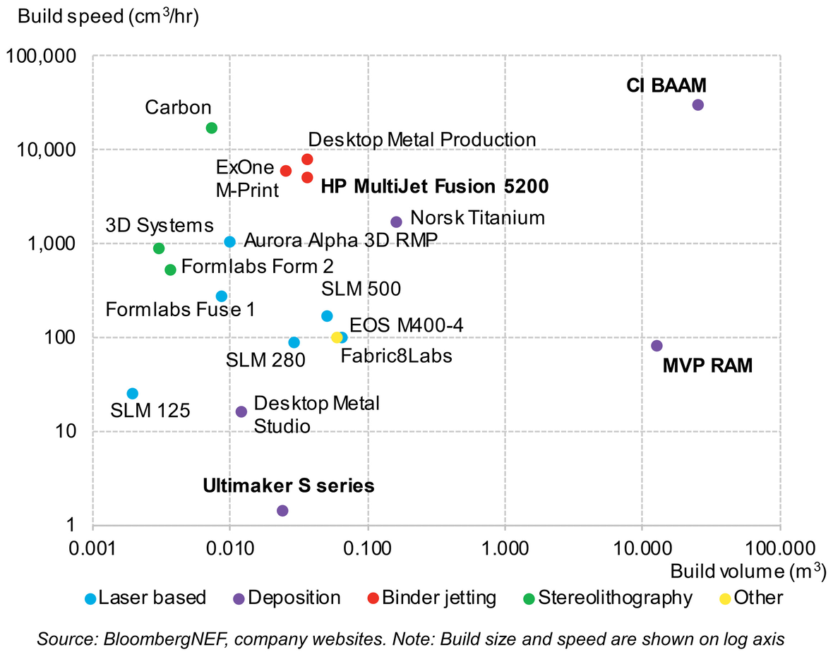
TCF Success: Magnum Venus Products (MVP)
MVP was the commercialization partner with ORNL on the FY16 TCF project called Additive Manufacturing of Thermoset Cellular Structures that developed the thermoset AM machine.
Bloomberg New Energy Finance recently reported on the advancements in 3D printers that are enabling mass production, especially binder jetting. The article specifically called out the efforts of Cincinnati, Inc. (CI) and Magnum Venus Products (MVP) to push “3D printing into larger parts, hoping to cut into mass manufacturing by lowering the number of assembly steps and reducing material waste for objects like cars and kayaks. MVP has developed a system specifically for composites to address high labor costs for the material.”

Slide 14
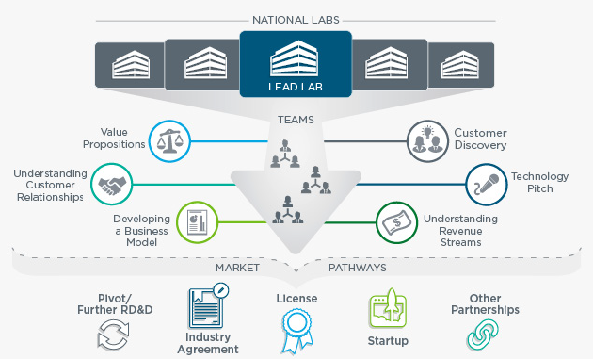
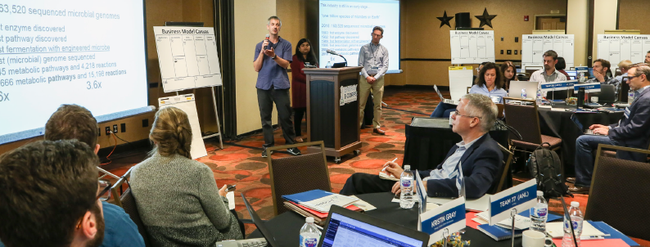
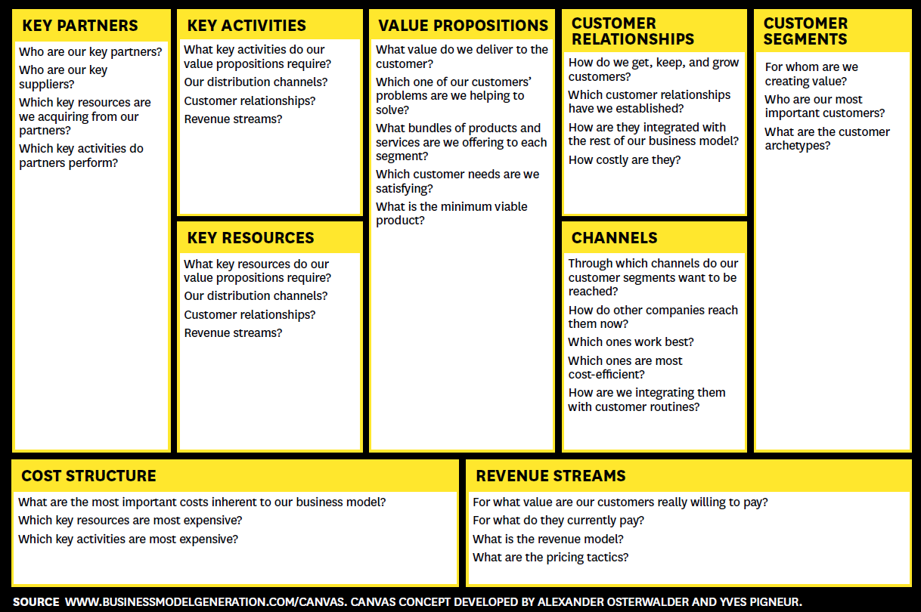
Energy I-Corps
Run by the Department of Energy Office of Technology Transitions
Managed by National Renewable Energy Laboratory (NREL)
A rigorous 2-month training program for national lab performers to evaluate industry needs and potential market applications for their technologies
Define technology value propositions
Conduct customer discovery interviews
Develop viable market pathways for their technologies

Slide 15
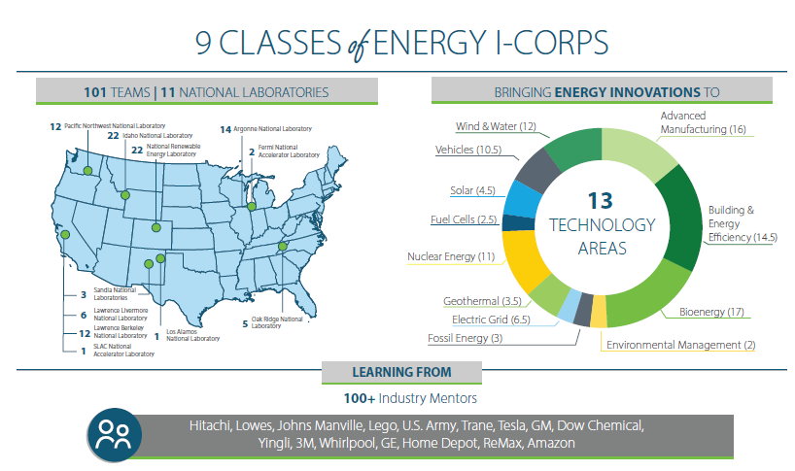
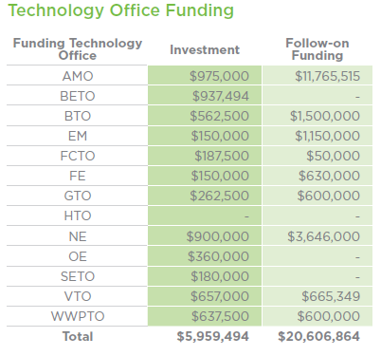
Energy I-Corps at a glance
Each team is funded at $75K for time and travel
https://energyicorps.energy.gov/

Slide 16
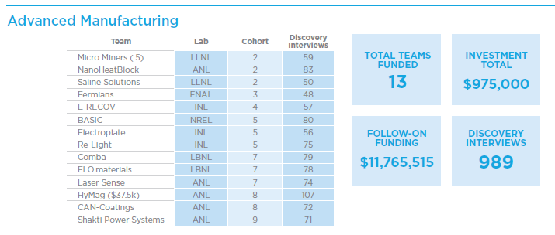
Energy I-Corps Accomplishments/Successes
Team | Lab | Cohort | Discovery Interviews | Follow-on Funding
Micro Miners (Co-GTO) | LLNL | 2 | 59 | $1,200,000*
NanoHeatBlock | ANL | 2 | 83 | $3,300,000
Saline Solutions | LLNL | 2 | 50 | $999,040
Fermians | FNAL | 3 | 48 | N/A
E-RECOV | INL | 4 | 57 | N/A
BASIC | NREL | 5 | 80 | $17,500
Electroplate | INL | 5 | 56 | N/A
Re-Light | INL | 5 | 75 | N/A
COMBA | LBNL | 7 | 79 | $3,600,000
FLO.materials | LBNL | 7 | 78 | $2,500,000
Laser Sense | ANL | 7 | 74 | $748,975
HyMag (co-WPTO) | ANL | 8 | 107 | N/A
CAN-Coatings | ANL | 8 | 72 | N/A
Shakti Power Systems | ANL | 9 | 71 | N/A
2 teams underway | LLNL/ANL | 10 | TBD | N/A
4 additional teams selected | PNNL/INL | 11/12
Summary of the first 9 cohorts
*1/2 Follow-on Funding counted toward office total
AMO is largest technology office investor of this program with the highest amount of follow-on funding from our teams

Slide 17
5 Programs Support AMO Projects and EERE\AMO
Additive Manufacturing Composites Sustainable Manufacturing/ Circular Economy
Advanced Materials Materials for Harsh Conditions Critical Materials Energy Storage
Energy-Water Nexus/Water Security Grand Challenge Process Intensification/ Chemical Manufacturing Roll-to-Roll Manufacturing
Power Electronics Combined Heat and Power Waste Heat Recovery/Process Heating
Smart Manufacturing Cybersecurity High Performance Computing for Manufacturing
Technical Partnerships Workforce Development/ Investing in People
Initiatives
Mission,
Goals
Priorities
SBIR
TCF
LEEP
Energy I-Corps
EPSCoR

Slide 18
EXTRA after This
EXTRA

Slide 19
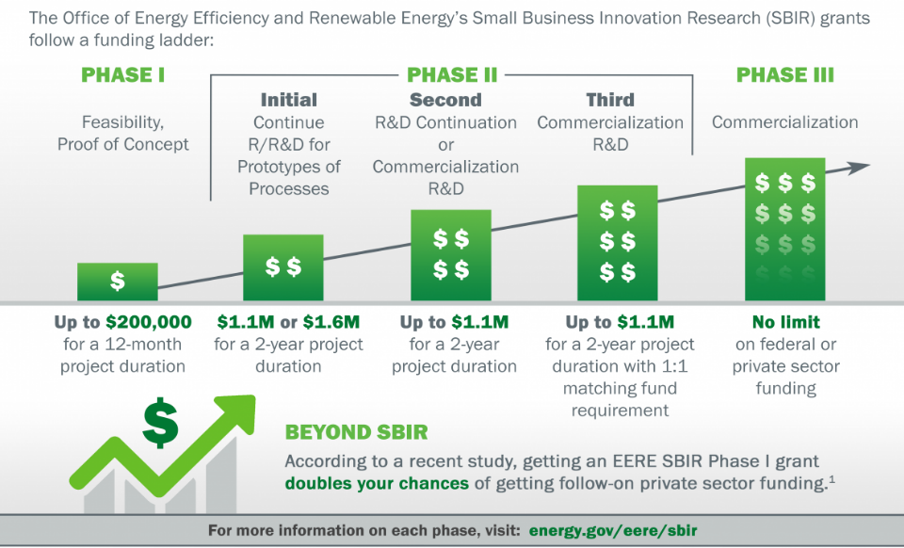
SBIR/STTR Phases –Amount and Duration

Slide 20
2019 Study Shows EERE SBIR Economic Impacts
Economic Benefit
2017 study by Prof. Sabrina Howell of NYU Stern School of Economics showed that and EE Phase I grant nearly doubles a firms chance of getting VC funding.
Innovation Benefit
Latest study (Feb. 2019) by Dr. Howell shows that getting these grants increases a firm’s patenting by nearly 250 percent-- and even more for younger and smaller firms (startups) while also increasing jobs and firm revenue.
https://www.energy.gov/sites/prod/files/2019/03/f60/sbir-eere-fe-analysis-howell-report-2019.pdf

