Slide 1
Observations of Manufacturing Readiness Levels and Technology Readiness Levels
Abby Schendt, NA-BA-44
August 2026

Slide 2
Who has attended one of my prior TRL presentations?

Slide 3
Agenda
Introduction
Data and Statistics
TRLs and MRLs: Are they Correlated?
Conclusion and Future Work

Slide 4
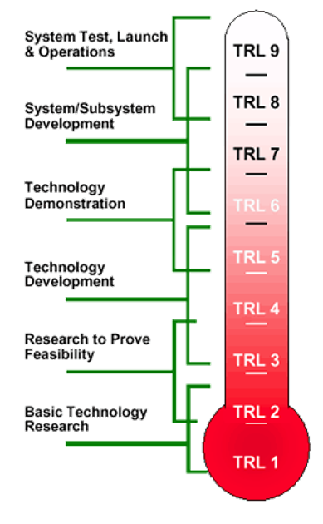
Introduction to Technology Readiness Levels
TRLs provide a rubric, most often graded 1 through 9, that standardize the measure of maturity for a technology, component, process, or system
Each TRL has a defined set of criteria for entry and exit, demonstrating progression; guides for TRL definition exist from GAO, NASA, DoD, NNSA, and other organizations
Collecting the TRL also allows us to build a data-informed risk assessment of a program's schedule while accounting for the scope of technology maturity
Increasing Technology Maturity

Slide 5
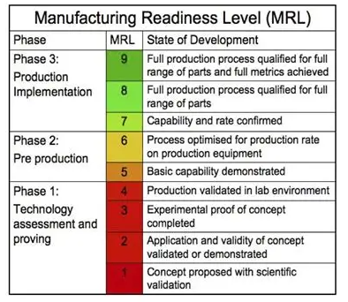
Introduction to Manufacturing Readiness Levels
MRLs provide a rubric, most often graded 1 through 9, that standardize the measure of maturity for a technology, component, process, or system
Understanding and implementation of MRLs is less mature than TRLs

Slide 6
Why are TRLs and MRLs Important?
Risk Mitigation and Management – helps managers identify at-risk technologies early on prior to integration
Standardized Assessment – different areas of experience/practice use different terms to communicate. TRL/MRLs offer a common definition across multiple areas
Guides Funding and Allocation of Resources – lower TRL/MRLs may be more appropriate for early R&D funding rather than program/project funding
Allows for Maturation Planning – if a low maturity technology is deemed irreplaceable to a system, the program manager can plan schedules to the lagging component

Slide 7
Schedule Analysis Methodologies
Standard Methodologies
Milestone Analysis- uses historical data
Schedule Estimating Relationships- uses historical data
Bottoms Up- Relies on SME input
Newly Developed Methodologies for NNSA Projects
Independent Chain Analysis of Risk and Uncertainty in Scheduling (ICARUS)¹ - Uses SME input and adds historical performance
TRL/MRL - Time to completion based on technology and manufacturing maturity; uses SME input and adds historical performance
NIMS adjusted earned value estimate (NAEVE) ² - uses historical data
Presented in in a different brief
Still in development

Slide 8
Advantages of Using TRLs for Schedule Analysis
Does not rely on a critical path analysis or an IMS - Allows for early program analysis before critical path or schedule is defined and allows for a detailed schedule analysis ahead of the heavy investment of an IMS
Other metrics like milestones are internal and not tied to specific technical, production, or other achievements - Programs can take out “liens” on items that have faced technical or schedule risk and requirements for entry to specific milestones can change
Clearly demonstrates the impact of the outliers in technology maturation - It doesn't matter if 80% of components are complete; if one component is incomplete the program cannot proceed
Helps focus program on higher risk technologies – communicates the specific risk of individual technologies to allow for programs to make trade-off decisions and focus effort on schedule drivers

Slide 9
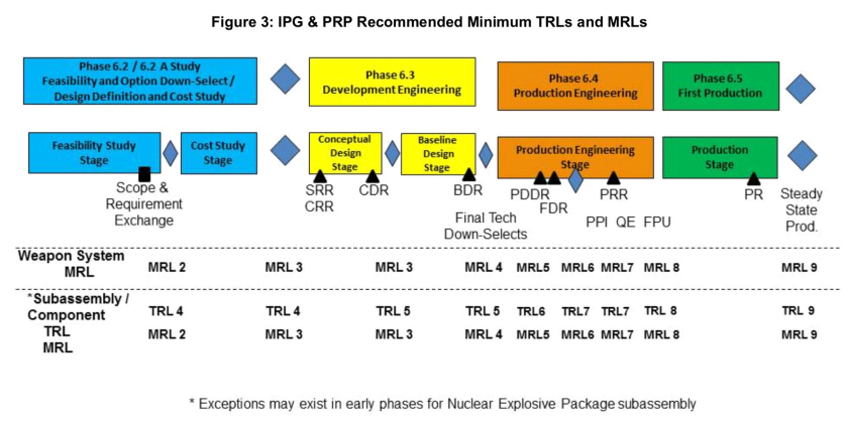
TRL/MRLs and the 6.X/Phase X Process
Note: While the above graphic from C019 is not reflective of the most recent DP TRL policy, it demonstrates the alignment of TRLs and MRLs and the 6.X Process

Slide 10
Time to Component FPU
Chart updated based on new data
Uses normal distributions to add durations and statistics together
  Note the model itself does not assume normality!
Getting 80% of components is within the program schedules, but something always goes wrong!

Slide 11
Design Maturity as a Predictor of Duration
New Design components starting at TRL 2 will take 11-14 years to complete Component FPU.
New Design components starting at TRL 5 will take 6.5-8.5 years to complete Component FPU.
New Design components take approximately 4-6 years longer to reach component FPU compared to remanufactured components.

Slide 12
Time to Component FPU
Uses normal distributions to add durations and statistics together
  Note the model itself does not assume normality!

Slide 13
Design Maturity as a Predictor of Duration
Reuse/Remanufacture components take 0.5-1.25 years longer than new design components to reach manufacturing maturity.

Slide 14
TRL/MRLs and the 6.X/Phase X Process
Note: While the above graphic from C019 is not reflective of the most recent DP TRL policy, it demonstrates the alignment of TRLs and MRLs and the 6.X Process

Slide 15
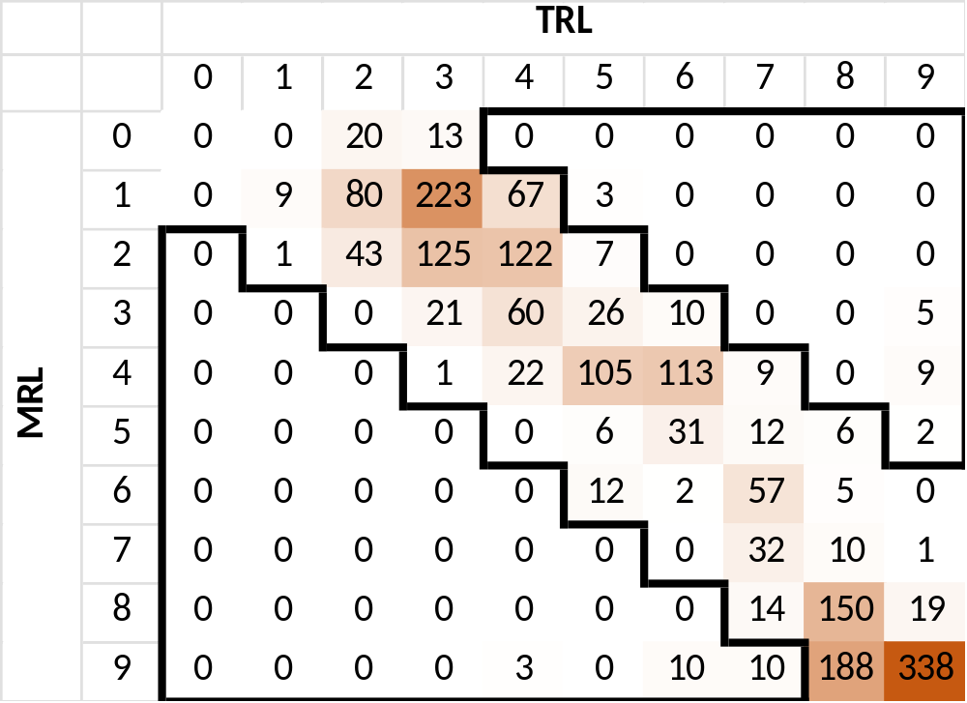
TRLs and MRLs are Highly Correlated
Of all the records for components with a TRL and MRL in the same quarter, ~2% of all components had an or a TRL more than 4 higher of the MRL at any point in the development timeline​
We can see that the levels closely follow the trajectory laid out by C019

Slide 16
TRLs and MRLs are Highly Correlated
Of all the records for components with a TRL and MRL in the same quarter, ~2% of all components had an or a TRL more than 4 higher of the MRL at any point in the development timeline​
We can see that the levels closely follow the trajectory laid out by C019
6.2/6.2A
6.3
6.4
Component FPU

Slide 17
Conclusions
Design maturity impacts schedule for technical maturity
Once you set up a manufacturing line, there is no difference in design maturity, but if you have not recently manufactured (measured by design maturity), design maturity is a driver of schedules
Manufacturing maturity is tied to design maturity

Slide 18
Future Work
Need to keep collecting data
  It’s a never ending goal
  Construction Projects provide TRLs, but not consistently
Mapping data to lower levels
  Components get mapped to various categories based on descriptions, but some are judgement calls and need SME review
  Category reviews focus on design maturity, but should grow to collect electrical/mechanical, and DA

Slide 19
Thank you!

