Slide 1
Teaching AI to Think Like a Cost Estimator:
Custom Skills and Agents in PARS
Cost Estimating Community of Practice (CECOP)
August 12, 2026
Amber Young
Project Assessment & Reporting System (PARS) Owner
DOE Office of Project Management
Sam Runner
PARS Deputy Project Manager
TechSource, Inc. supporting DOE PM
DOE Office of Project Management, Project Controls and Policy Division (PM-30)
Demo by Derek Gunter, Consolidated Nuclear Security (CNS)

Slide 2
Agenda
1
Pulse check
Opening poll
5
Meet Walt
PARS’s secure LLM & skills
2
PARS in brief
What it is, how it got here
6
AI Dashboards
Your data, your way (demo)
3
The data foundation
JSON DID, quality checks, integrated data
7
AI models
BWC & CAEF 2.0 WBS standardization
4
AI in PARS today
Three initiatives, maturity focus
8
Walt for cost estimating
Real examples from CNS Y-12
We’ll take questions and comments at the end, via an open feedback board

Slide 3

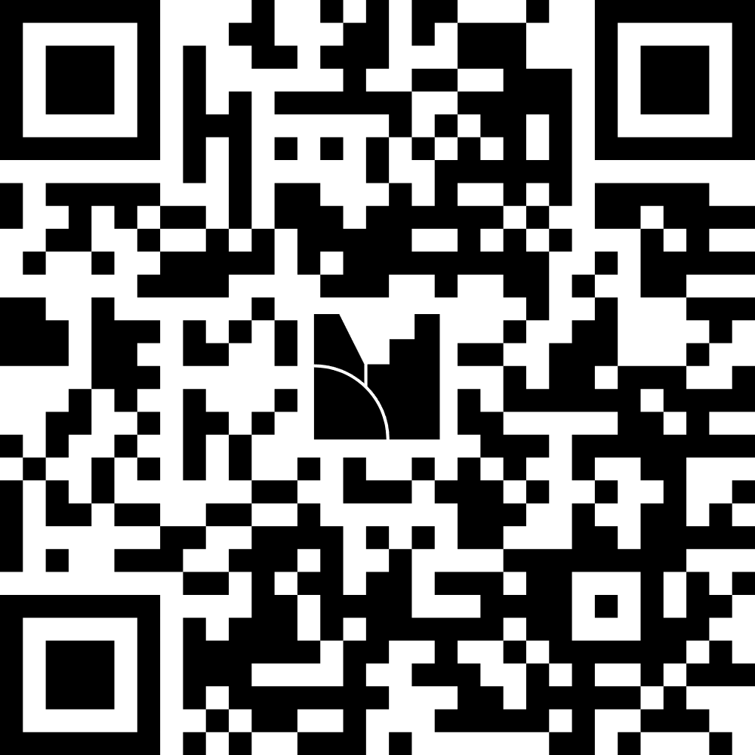
INTERACTIVITY · 01
Pulse check: who’s in the room?
How familiar are you with PARS?
never opened it → daily user
Have you met Walt?
who? → we talk every day
join at menti.com
5853 9874
How comfortable are you with GenAI tools?
skeptical → power user

Slide 4
What is PARS?
The Project Assessment and Reporting System: DOE’s system of record for capital asset project performance, as required by DOE Order 413.3B.
Projects ≥ $50M TPC report earned value after CD-2; the portfolio is tracked from CD-0 through closeout
One shared view for contractors, FPDs, program offices, and HQ analysts
WHY IT MATTERS FOR COST ESTIMATORS
Historical actuals
6+ years of monthly EVMS history across over 500 projects; 300+ closed out, 200+ in active execution
Comparable by construction
Creating BWC mappings for projects’ WBS to a common EPCC structure for future benchmarking
Quality-checked at the gate
600+ automated DIQ checks validate data before it reaches your estimate

Slide 5
PARS History Timeline: From Origins to Modernization
Late 1990s
2005
2008
2010
2011
2018
2023-25
PARS Established
GAO Report
Root Cause Analysis
PARS Implementation
PARS II Launch
Empower Integration
JSON Migration
Origins & Foundation
System Evolution
Modernization
Late 1990s-2005
2011
2023-2025
PARS established for earned value reporting. GAO assessed data reliability
PARS II: automated uploads, web-based COTS platform, direct EV extraction
CSV to JSON migration. Enhanced DIQ checks. Software tool integration
2008-2010
2018
Impact
RCA identified PM gaps. CAP drove corrective action. Formal implementation
Empower® integrated for advanced EVMS analysis and custom dashboards
Standardized reporting, improved data quality, enhanced accountability
150+
600+
3wks→2d
Projects with CPP data
Automated DIQ Checks
Data Validation Speed
~60 actively uploading JSON · 100+ Historical
~40 critical real-time DIQs preventing import, ensuring quality
From 3-week manual review to 2-day automated pipeline

Slide 6
Data-Driven EVMS at DOE
Three questions every agency faces, and where DOE started from:
“Where is your data?”
Siloed across contractors, formats, and systems, no single source of truth
“Can you trust it?”
Manual checks and inconsistent standards delayed validation
“Can you act on it?”
Weeks from submission to insight force reactive management
Fragmented data
fragmented sources, inconsistent formats
Common foundation
one repository, one schema
Faster decisions
analysis runs on live, trusted data
Core message: DOE has addressed its data problems with a centralized repository, standardized format, automated quality checks, and maturity-based assistance.

Slide 7
The Foundation: JSON Data Item Description (DID) & Automated QA
The JSON DID: DOE’s machine-readable EVMS standard
600+ automated DIQ checks so errors are caught in minutes, rather than weeks
Machine-readable
API-ready; validated against schema on arrival
Comprehensive
Full field definitions for every EVMS element, version-controlled
Structural
CA or SLPP below a WP in the WBS hierarchy
Completeness
Activity missing an earned value technique
Threshold
Unfavorable CV beyond threshold needs a root-cause narrative
Cross-dataset
Schedule predecessor missing between datasets
Interoperable
Powers real-time exchange between tools, including the AI tools being shown today
Critical checks block acceptance at import
Major / Minor flag data-quality concerns for follow-up
For estimators
One standard format is what makes 150+ projects’ history comparable, the requisite material for benchmarking and parametric work.
5 → 0 When we started the transition in 2022, we had an average of 5 DIQ failures per project.
After working with sites, production now has zero.

Slide 8
One Integrated Platform = Comprehensive Insight
The PARS database undergirds our System of Record, powering our various tools for data view and analysis.
OA: Overview and Assessment
Federal foundation: projects, WBS, budgets, contract & financial reference data
CPP: Contractor Performance
Monthly JSON submissions; 6+ years of EVMS history, queryable in real time
DMS: Document Management
AI semantic search across Narratives, IBRs, reports, and other documents
…and the ways you already see it:
Leadership reporting
The monthly analyst reports briefed up the chain draw on this same backbone
Walt
Guided analysis in a secure chat. Can explain EVMS concepts, summarize documents, run scripted deep-dives on project data, execute skill playbooks
AI Dashboards
Self-serve project & portfolio dashboards. A user can start in plain English, refine, then save. A saved dashboard reruns the same deterministic queries every time, ready to export
One database, many perspectives.

Slide 9
Optimization Through AI: Three Current Initiatives
Design principle: AI augments human judgment rather than replacing it. Every initiative pairs AI capability with a defined human role.
DMS Semantic Search
OPERATIONAL
“Show variance narratives mentioning supply-chain delays” for instant pattern recognition across every project document.
Human role: interpret patterns, identify systemic issues
Walt’s Assessment Suggestions
OPERATIONAL
Compares project data against historical patterns; suggests assessment focus areas from leading indicators.
Human role: final assessment decisions and context
COACH Training Program
LAUNCH WINTER 2026
AI-powered onboarding for contractor EVMS teams: plain-language DIQ explainers plus a hands-on sandbox.
Human role: complex problem-solving and relationships
How it compounds
JSON DID standardization
Automated DIQ checks
Deep analysis
Actionable insights
Cleaner submissions each cycle mean better analysis and less time between data and decision.
Optimization = shrinking the data-to-insight pipeline.

Slide 10
Reframing the Conversation: Maturity Over Compliance
The most powerful shift DOE made was psychological:
IP2M METRR maturity scale: DOE application
Old model: “Did you comply?”
Punitive, checkbox mentality. Adversarial contractor relationships. Stagnant improvement.
Predictive analytics, real-time CAM dashboards, portfolio lessons learned
Integrated processes, proactive risk management, root-cause analysis
New model: “Where are you on the maturity curve?”
Developmental, growth mindset. Contractors engage as partners. Continuous improvement.
Assessed with the IP2M METRR framework (DOE + Arizona State University)
1 No EVMS
2
3
4 Compliant
5 Optimized
Compliance is the floor (Level 4)
Optimization (Level 5) is where AI tooling pays off

Slide 11
INTERACTIVITY · 02
Before we introduce him…
If you could ask an assistant one question about your project’s data, what would it be?
Answers show live as a word cloud
join at menti.com
5853 9874

Slide 12
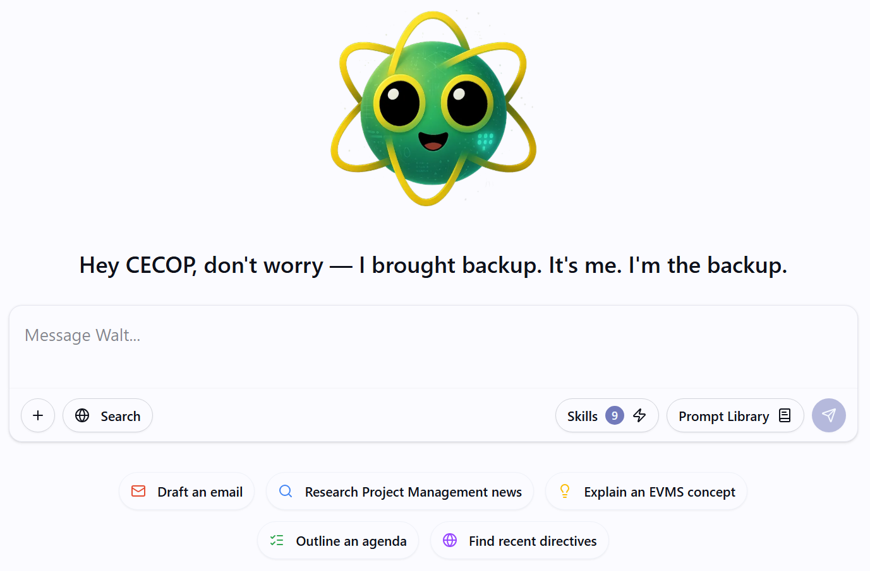
Meet Walt
Walt was originally launched as PARSGPT in mid-2023
Provides all PARS users access to a secure LLM hosted on Microsoft Azure Gov cloud (Currently OpenAI GPT-5.1)
Secure sandboxed workspaces allow for basic data-analysis within chat
Targeted skills and prompts to empower EVMS analysis

Slide 13
Walt’s Skills
9 default skills built by the PARS team + 9 community skills and growing
Skills are reusable instructions that extend Walt’s capabilities
Use them to create repeatable workflows and share them with your colleagues
PARS TEAM DEFAULT SKILLS
PARS JSON Tools · Empower · Excel Sheets · Word Docx · PowerPoint Slides · PDF Tools · DOE Branding · Custom Skills Creator
Community skills are built by users like you, enabling org-wide collaboration as analysts iterate and refine what prompts and workflows yield the best results.
SHARED COMMUNITY SKILLS
Basis of Estimate Generation · Parametric Model Development · Cost of Quality Estimate · Risk Root Cause Analysis · Risk Register Governance

Slide 14
Walt vs Joulix
 | Walt | Joulix
Access | Requires a PARS account | Accessible to most of DOE
Data integration | Native to your PARS data, with specialized EVMS tools | DOE memos & some org data built in; needs careful prompting for EVMS work
Collaboration | Prompts can be shared; chats are solo | Collaborative projects
Best at | Understanding and working with EVMS data | General-purpose work across DOE
Data governance | Safe for PARS-UCNI*, data stays in the PARS environment | Most CUI & DOE data acceptable (not EXPT, ITAR, NNPI, UCNI)
Not competitors, but different tools for different situations.
* None of the PARS environment is approved for EXPT, ITAR, NNPI, or any classified materials

Slide 15
Additional PARS AI Features
Dashboards, models, and what’s next

Slide 16
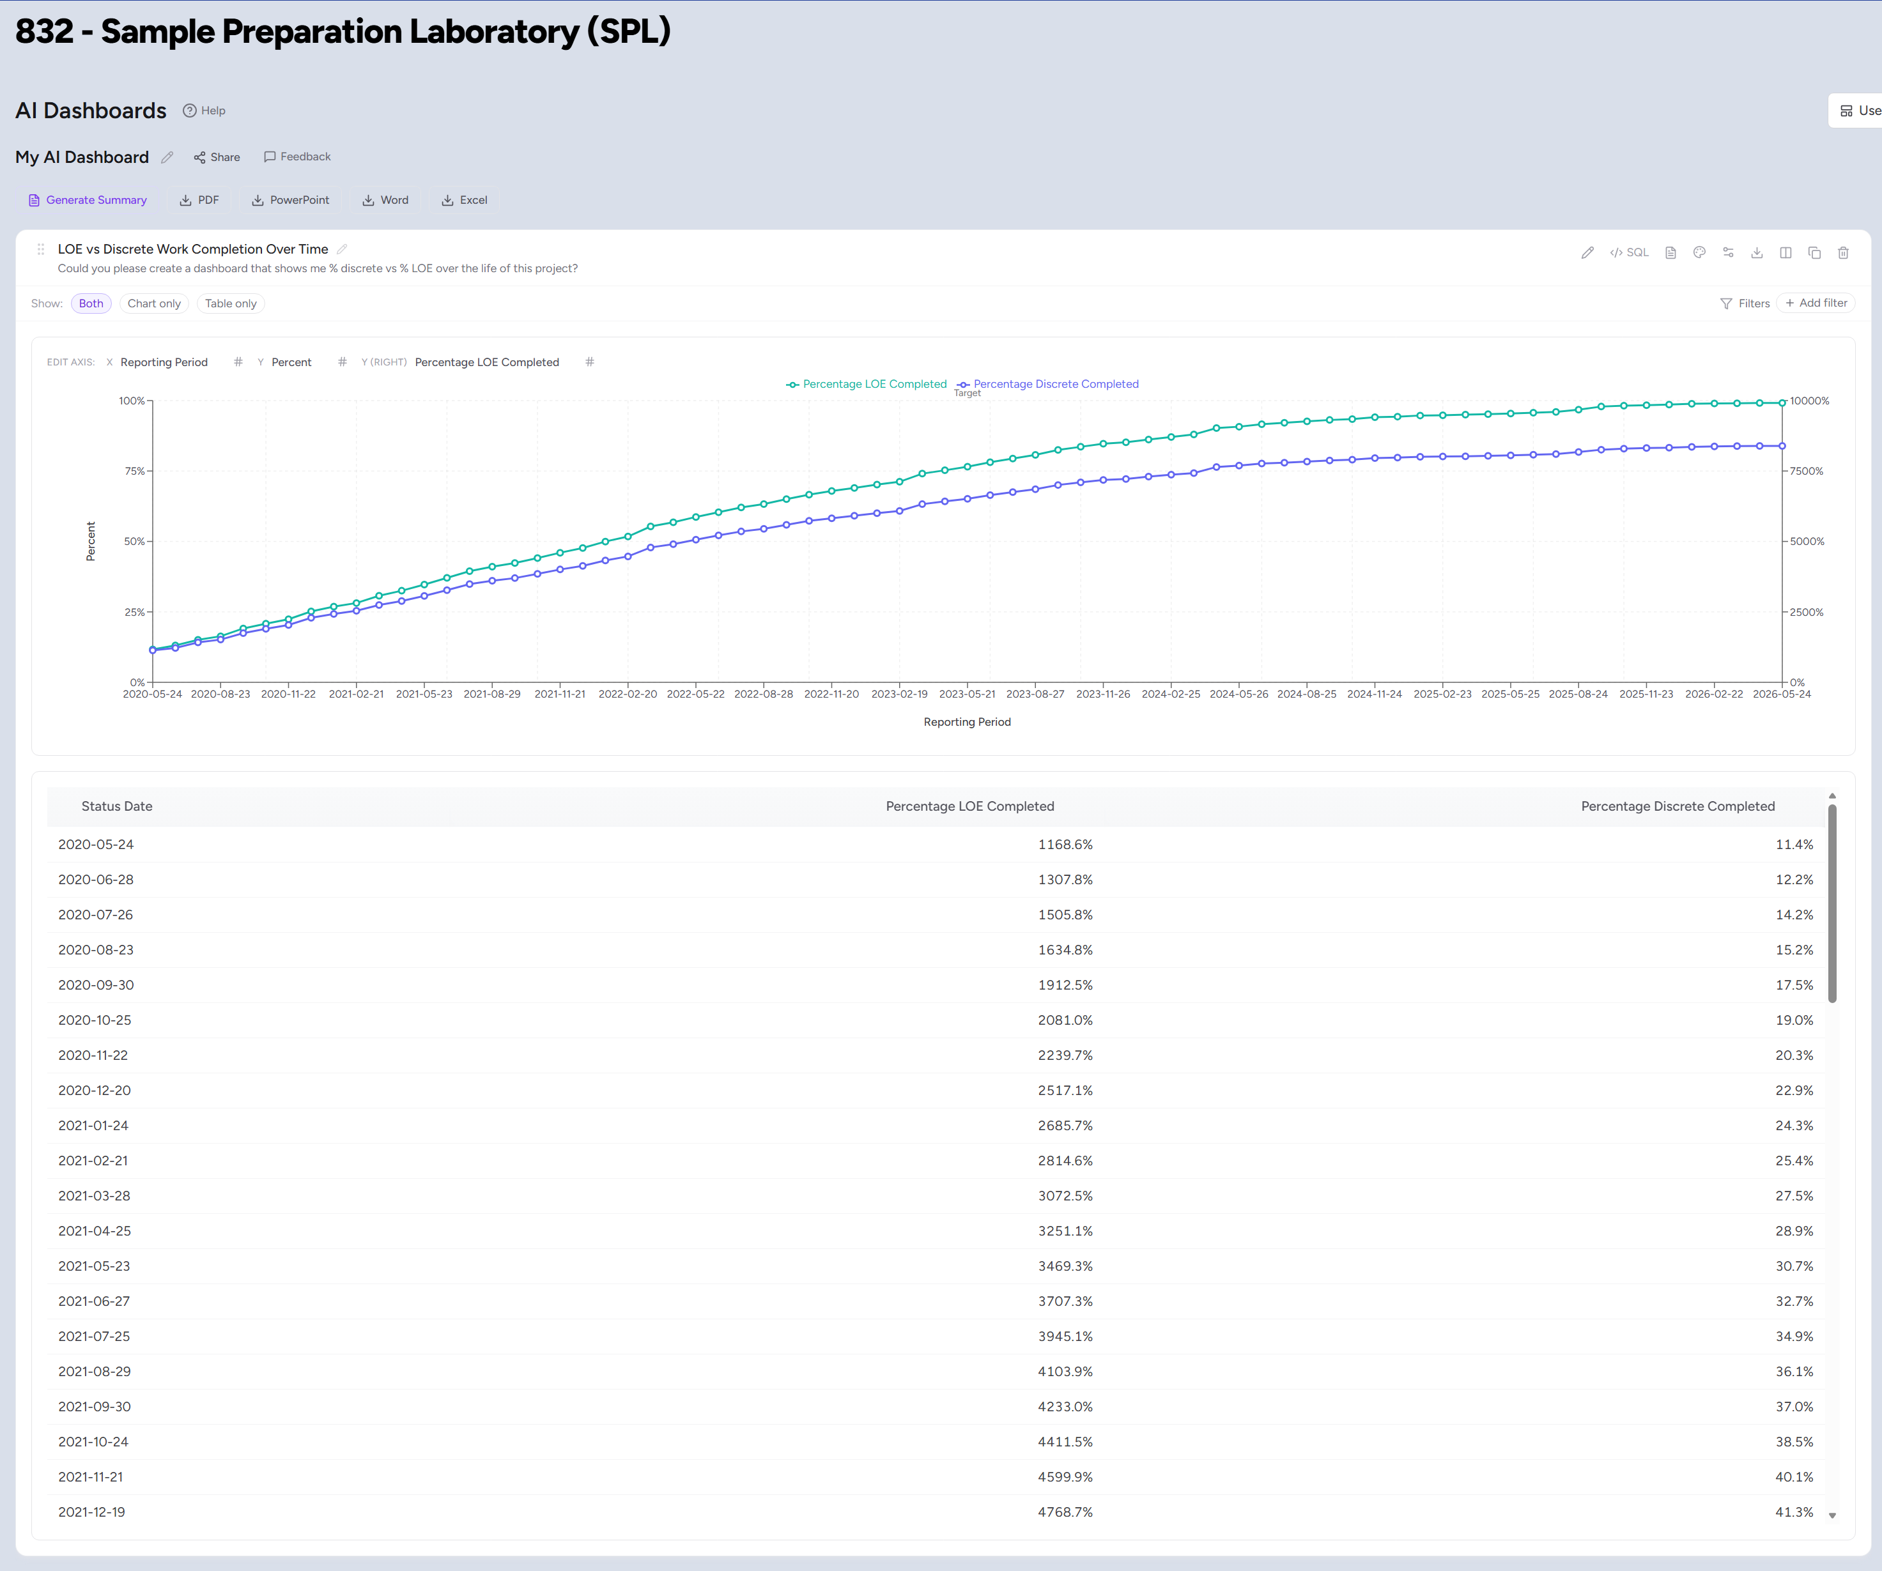
AI Dashboard – Build Custom PARS Reports
Currently in beta testing, coming soon!
Empowers all PARS users to create their own custom dashboards, to slice and view their data how they like it
A secure LLM can take your natural-language query and transform it into an interactive dashboard
The AI doesn’t see your data without you asking it to
What would your perfect PARS report be? If you can think it, you can make it!

Slide 17
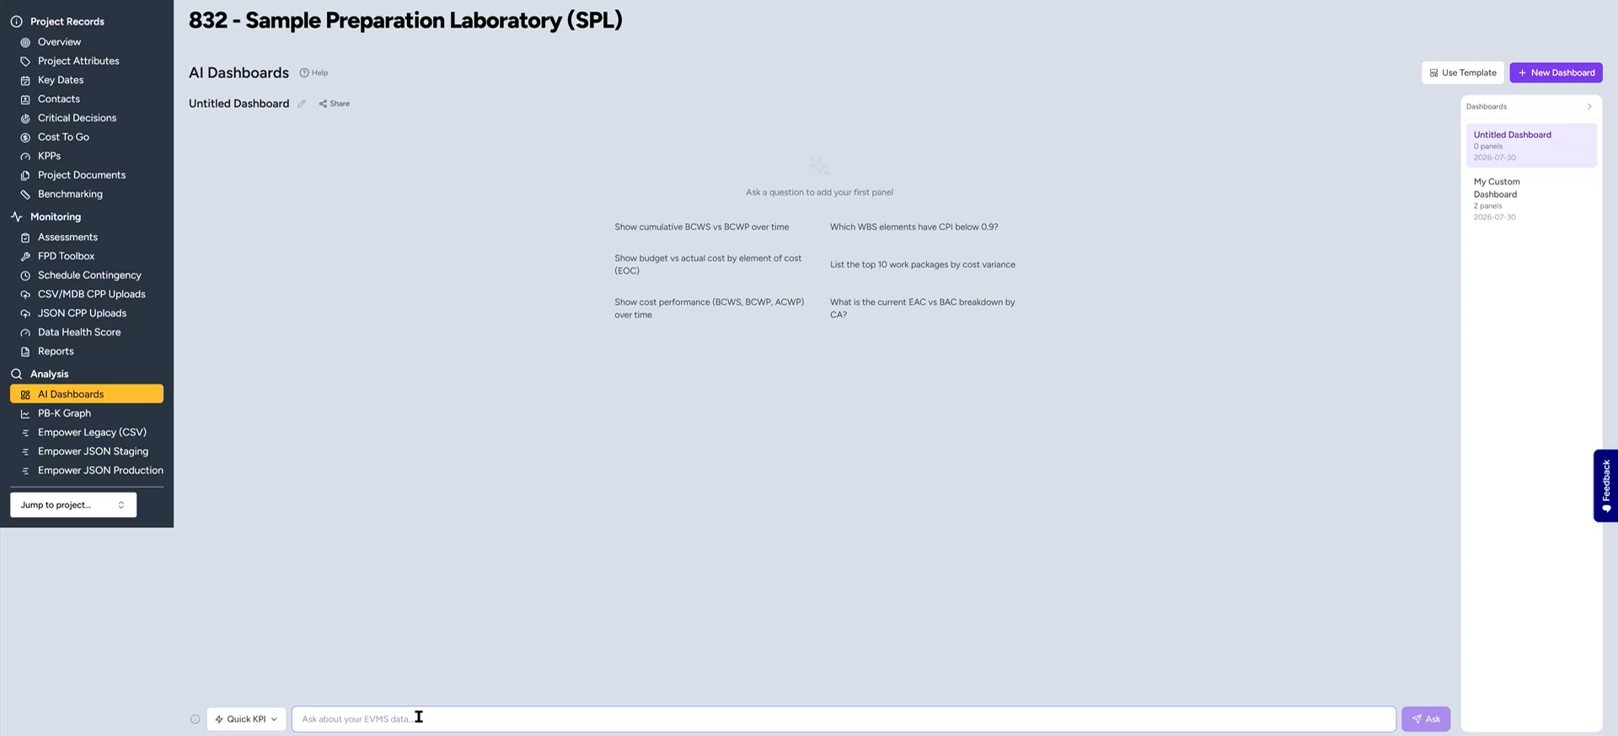
AI Dashboard – Demo

Slide 18
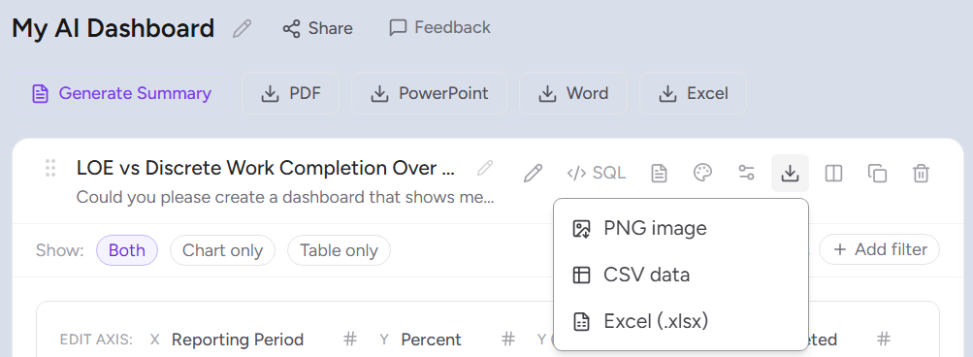
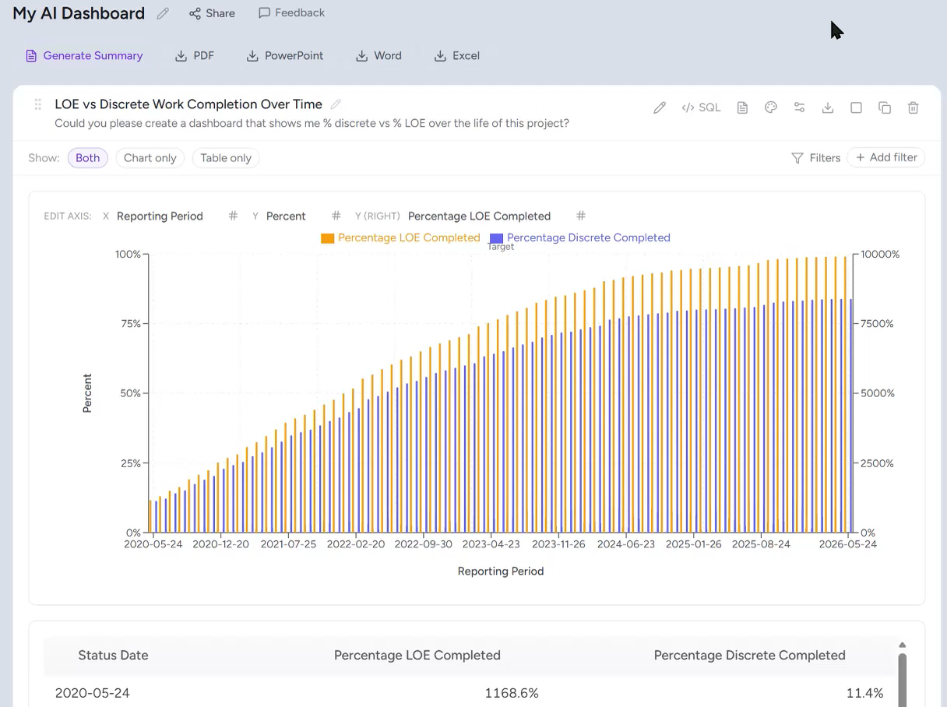
AI Dashboard – Your Data, Your Way
The PARS AI Dashboard empowers users to create and share data dashboards, enhanced by LLM natural-language queries
All customizable dashboard elements can be tweaked within the UI, no chat required
Adjust as needed, the user is fully in control
Full manual or AI assisted? You decide!
Saved dashboards are deterministic and reproducible
Export to: PDF, PowerPoint, Word, Excel, or PNG, for all your data portability needs

Slide 19
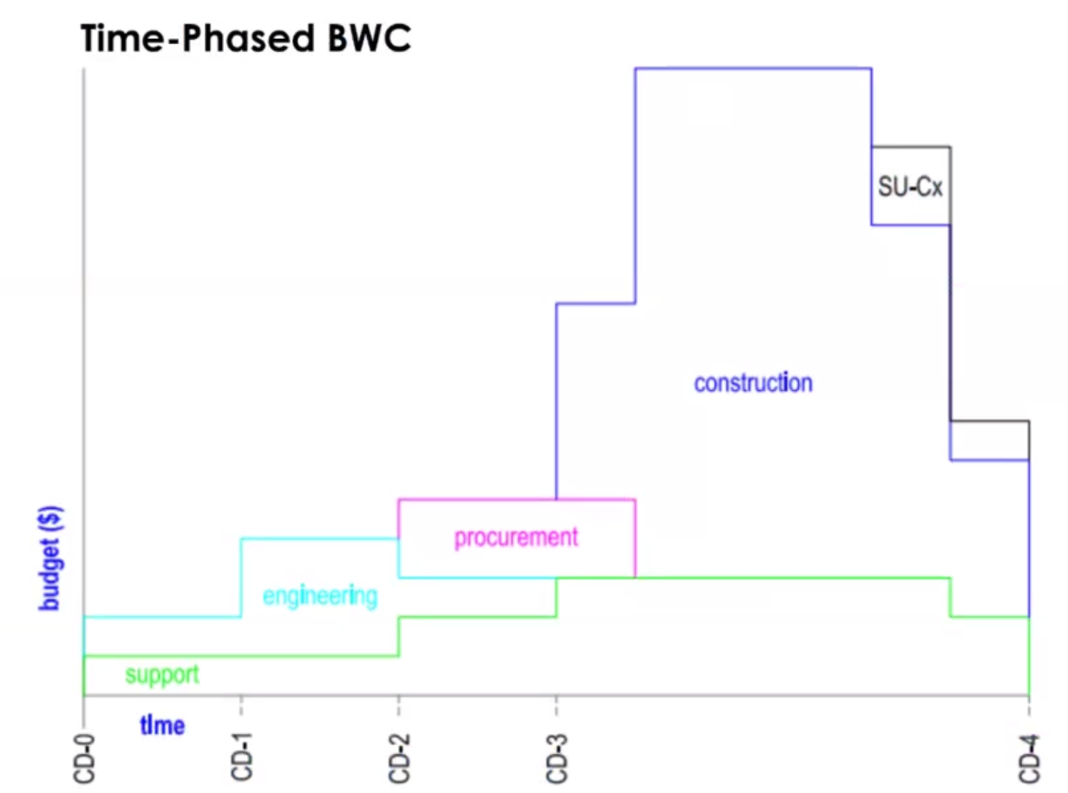
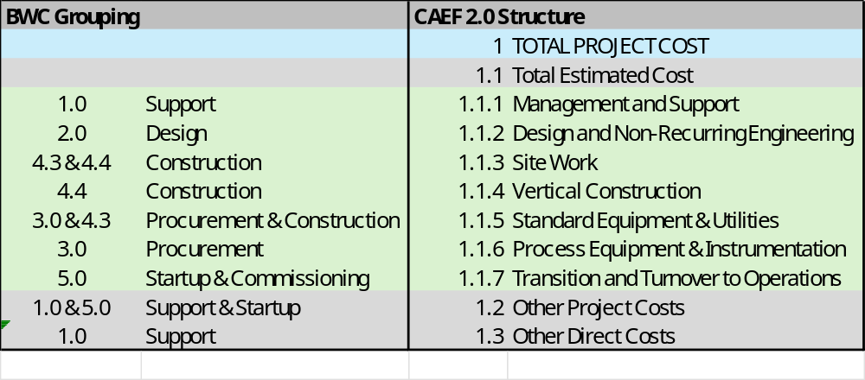
AI Models – BWC & CAEF 2.0 WBS Standardization
The Base Work Construct crosswalks every project’s WBS to a common 2-level EPCC framework — Support · Engineering · Procurement · Construction · SU-Cx — normalizing work for benchmarking and baseline-realism checks.
AI models in PARS use this standardization to map contractor WBS elements to BWC & CAEF categories automatically, creating consistent groupings without manual crosswalking.
Coming soon
Notional time-phased BWC — DOE PM Newsletter, March 2023 (Kong, Ogrodnik, Franks, Young)

Slide 20
Demo: Walt Cost Estimating
Real-world cost estimating examples from CNS, Y-12 by Derek Gunter

Slide 21
INTERACTIVITY · Q&A
Your turn
Questions you have
Anything from today, answered live
“I’d like to see more of…”
Features, training, data, use cases. Tell us where to go deeper
join at menti.com
5853 9874
“I’m still concerned about…”
Security, accuracy, workflow. Your honest feedback

Slide 22
Thank you
Questions after today? We’d love them.
Amber Young: PARS Owner · DOE Office of Project Management (PM-30)
amber.young@hq.doe.gov
Sam Runner: PARS Deputy Project Manager · TechSource, supporting DOE PM
samuel.runner@hq.doe.gov
PARS Support: General inquiries, or request a PARS account for Walt access
support@pars.doe.gov
pars.doe.gov · wiki.pars.doe.gov · json.pars.doe.gov · DOE Office of Project Management, Project Controls & Policy (PM-30)

