Slide 1
Scoping Meeting
ETEC Supplemental Environmental Impact Statement
March 6, 2025

Slide 2
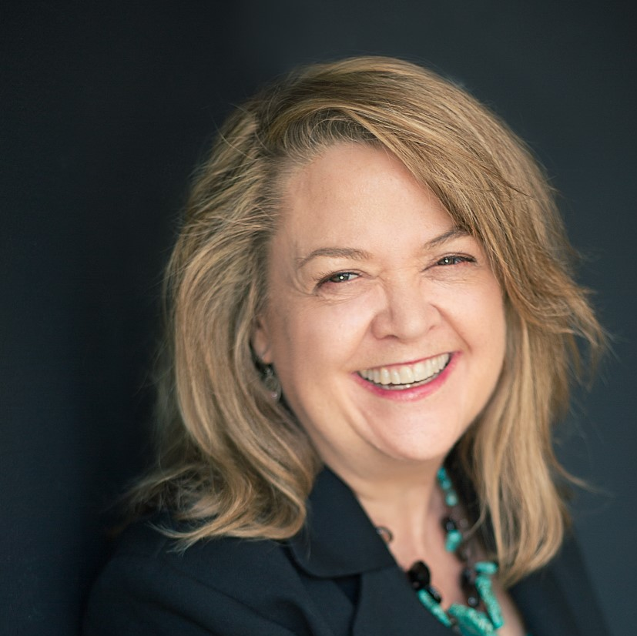

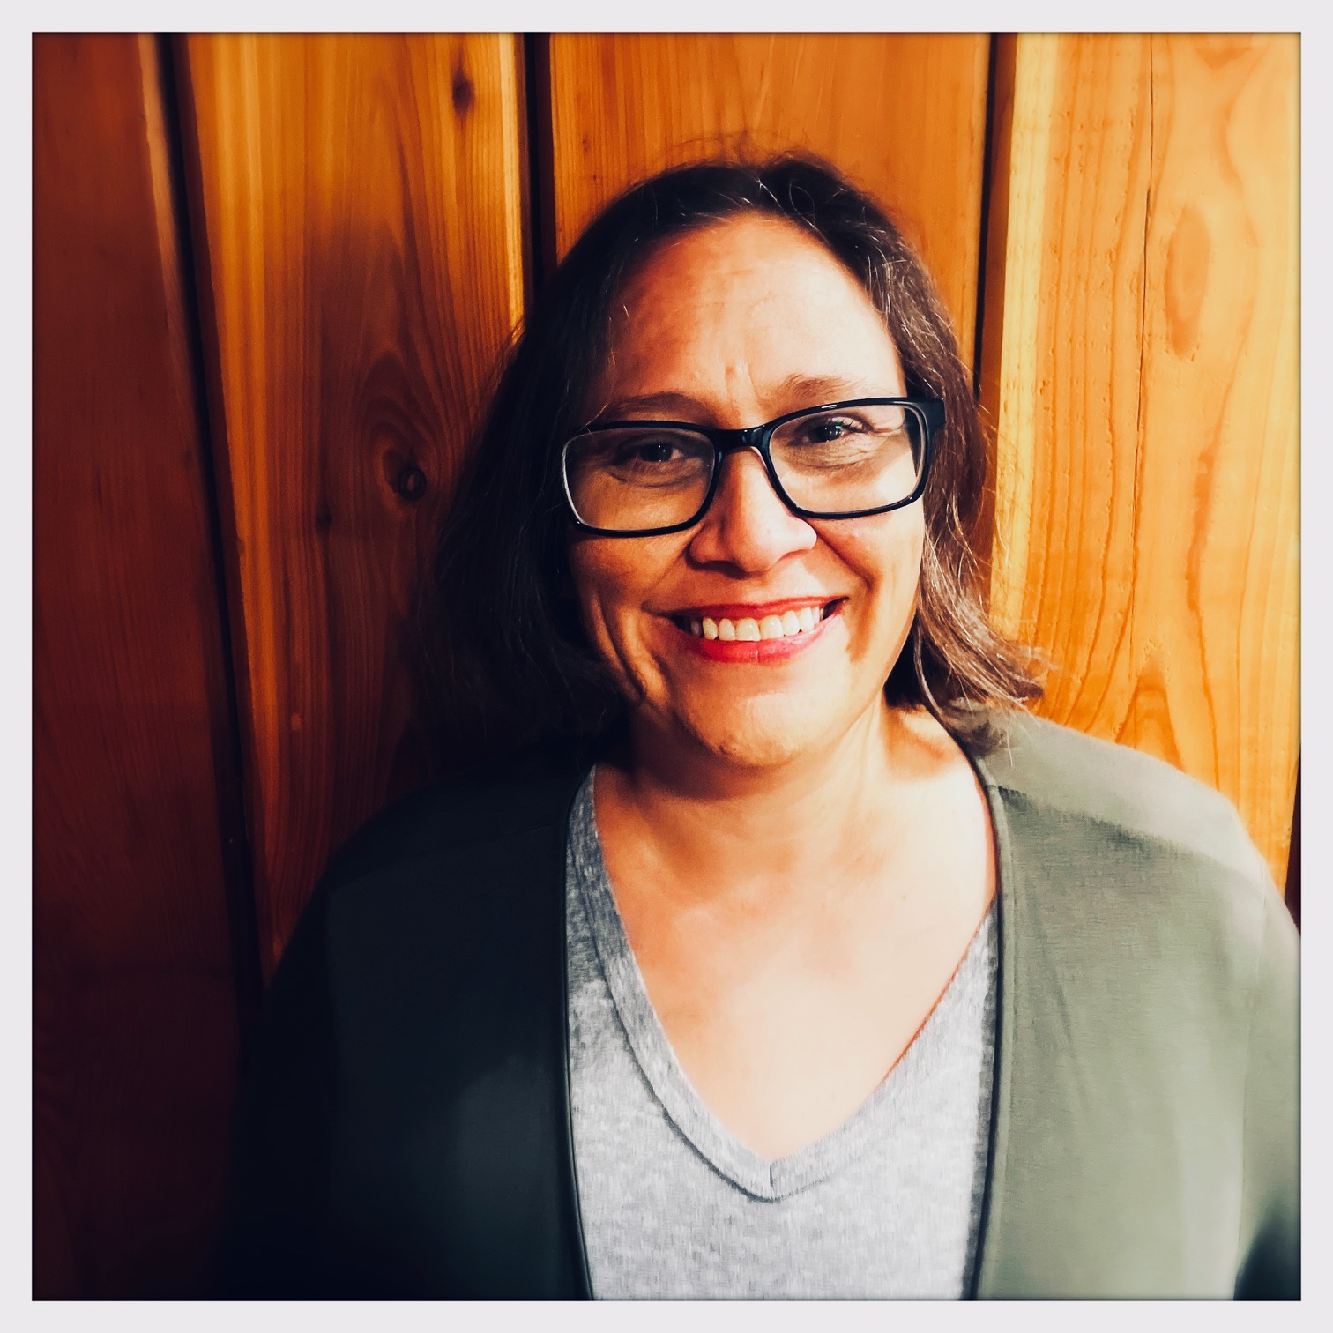
With You Today
Wendy Green Lowe
P2 Solutions
Meeting Facilitator
Dr. Josh Mengers
DOE-EM
Federal Project Director, ETEC
Pamela Hartman
DOE-EM
Federal Project Deputy Director, ETEC

Slide 3
Presentation Overview
PROJECT BACKGROUND
Site Overview
Project Scope
NEPA Status
Recent Progress
NEPA
PROCESS
Changes since FEIS
SEIS Steps
Purpose and Need
Proposed Alternatives
COMMENT SUBMISSION
Timeline
How to make comments count
How comments will be used

Slide 4
Project Background

Slide 5
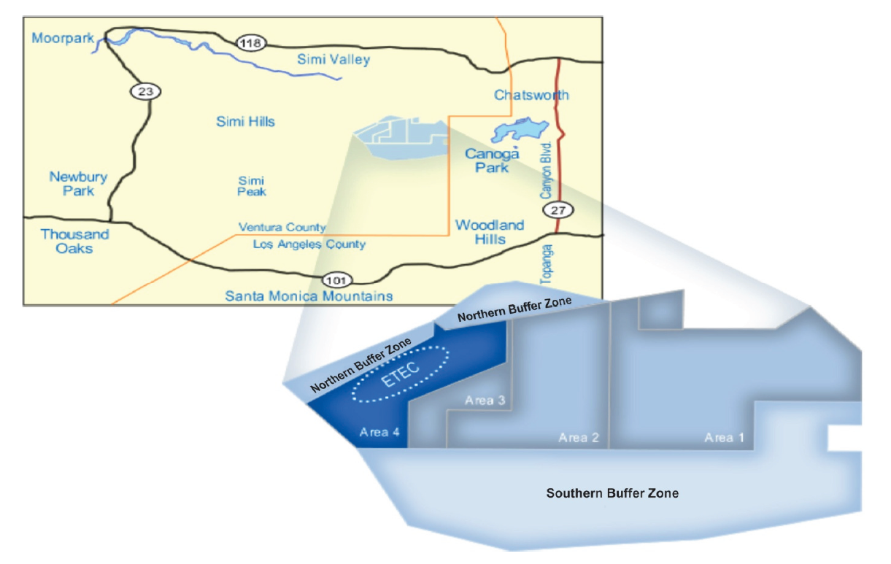
Site Overview
SSFL is a 2,850-acre site located in eastern Ventura County, adjacent to Los Angeles County.
DOE conducted nuclear energy and liquid metals research in Area IV of SSFL starting in the 1950s
DOE has been remediating Area IV since before R&D operations ceased in 1998.

Slide 6
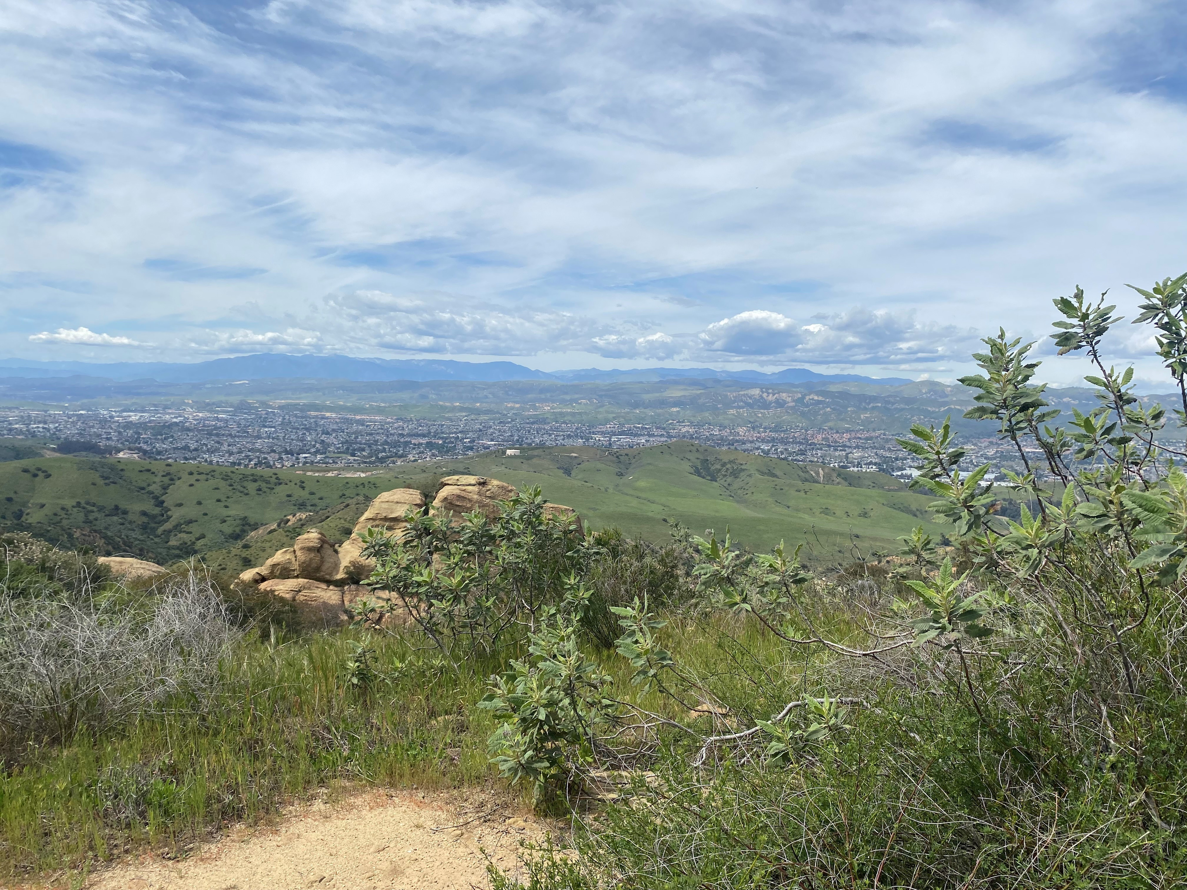
Project Scope
Remediate groundwater and soils:
Groundwater cleanup governed by 2007 Consent Order.
Soils to background per 2010 Administrative Order on Consent (AOC).
Removal of remaining DOE-owned below-grade structures in Area IV.

Slide 7
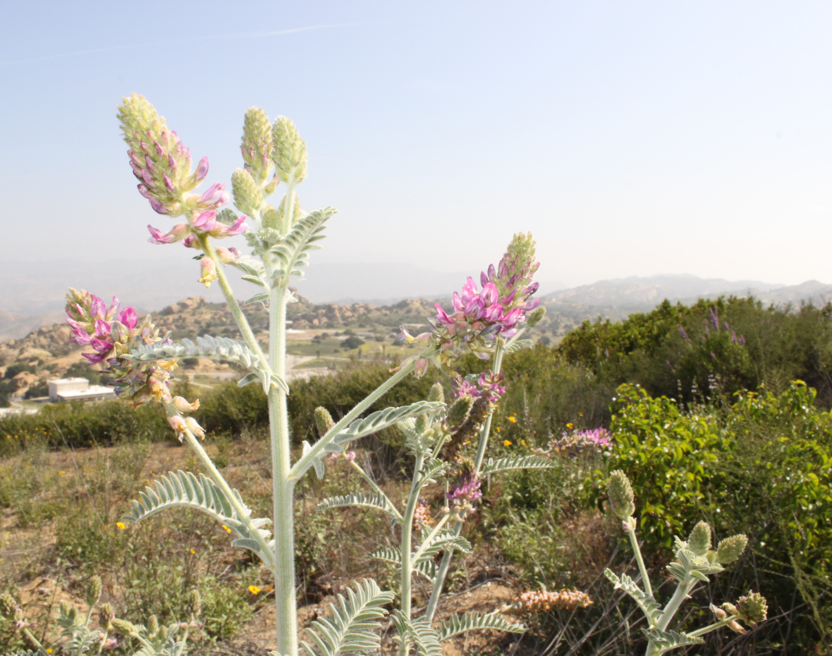

NEPA Status
November 2018 – Final Environmental Impact Statement (FEIS) for Remediation of Area IV and the Northern Buffer Zone of the Santa Susana Field Laboratory (DOE/EIS-0402)
September 2019 – Record of Decision (ROD) for Building Demolition (84 FR 51150)
November 2020 – ROD for Groundwater Remediation (85 FR 71640)
National Environmental Policy Act (NEPA) is a federal law that requires federal agencies to identify and consider the environmental consequences of implementing projects.
Notes:
In our Final EIS DOE included Building Demolition, Groundwater Remediation, and Soil Remediation.

Slide 8
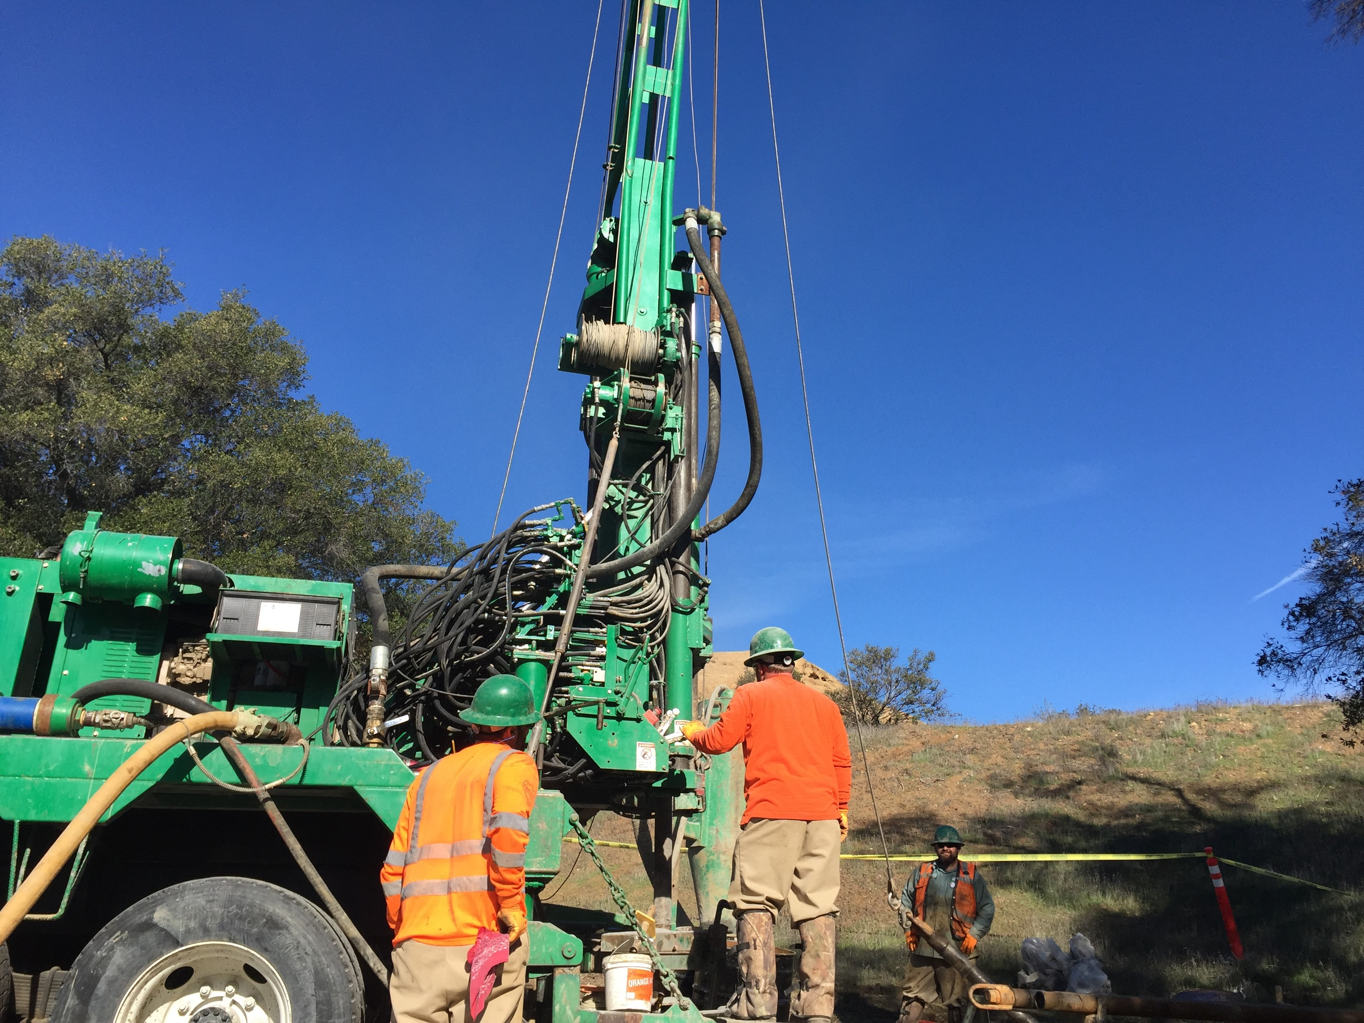
Recent Progress
Cleanup Highlights:
Since 2017: More than 60,000 gallons of contaminated groundwater have been removed from the site.
2021: Completed demolition of all remaining above-ground DOE-owned buildings.
2024: DOE installed an automated pumping system at the Former Sodium Disposal Facility, which allows DOE to continue the groundwater interim measures more effectively.
Future Cleanup Plans:
Next steps include ramping up groundwater remediation, completing building demolition, completing a ROD for soils, and begin soil remediation.
Notes:
The automated system pumped an estimated 1,500 gallons in January 2025.
Therefore, as of the end of January 2025, approximately 58,000 gallons have been removed by the GWIM.

Slide 9
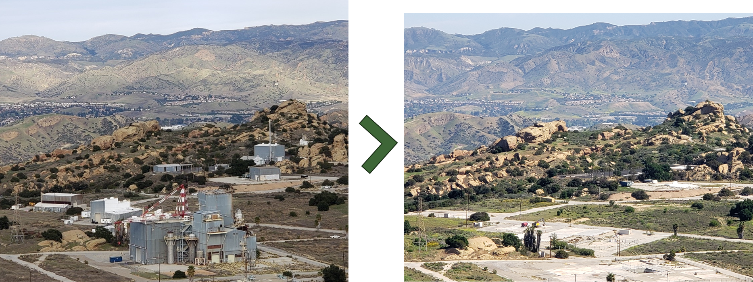
Building Demolition
The FEIS and Buildings ROD allowed DOE to demolish 18 buildings between July 2020 and October 2021.

Slide 10
NEPA Process

Slide 11

NEPA & the SEIS Process
In accordance with the National Environmental Policy Act (NEPA), DOE is preparing a SEIS for soil remediation at SSFL.
A SEIS is prepared when:
An agency makes substantial changes to the proposed action that are relevant to its environmental concerns.
There are substantial new circumstances or information about the significance of adverse effects that bear on the analysis.
The agency determines that the purposes of NEPA will be furthered by doing so.
What is a Supplemental Environmental Impact Statement (SEIS)?
A NEPA process that provides additional analysis for an existing or ongoing Environmental Impact Statement.
Notes:
What is the National Environmental Policy Act (NEPA)?
NEPA is a federal law that requires federal agencies to identify and consider the environmental consequences of implementing projects.

Slide 12
Changes Since the 2018 SSFL Area IV FEIS
Environmental Conditions
Woolsey Fire
Biological and Cultural Resources
Socioeconomic Data
Disposal Facilities
Project Status +
New Information
Buildings ROD and demolition
Groundwater ROD and remediation progress
Laboratory Method Reporting Limits (MRL) and backfill availability data
Department of Toxic Substances Control’s proposed Multiple Lines of Evidence (MLE) approach
Boeing Settlement Agreement
Laws, Regulations, and Permits
NEPA - Fiscal Responsibility Act of 2023
DOE NEPA Implementing Regulations (10 CFR 1021)

Slide 13
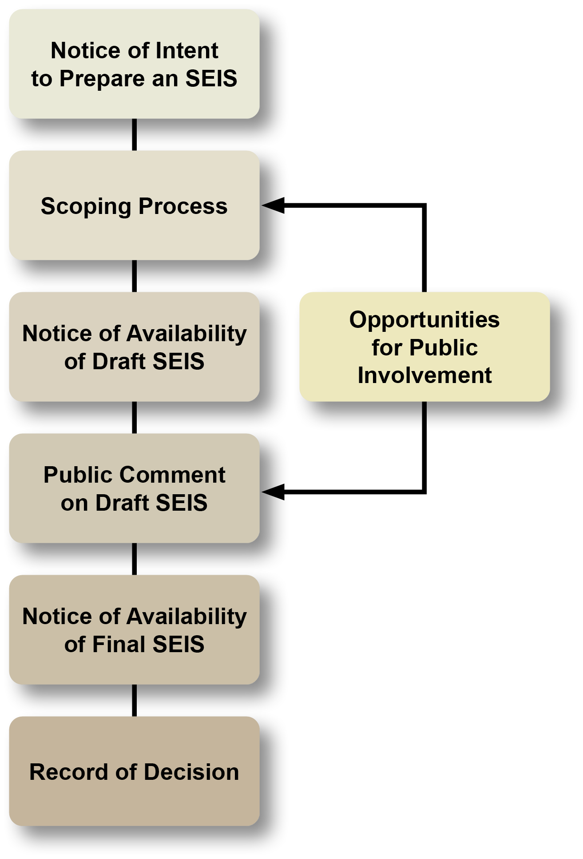
SEIS Steps
DOE Published a Notice of Intent to Prepare a SEIS on December 27, 2024 (89 FR 105555) in the Federal Register
This publication initiated a 60-day public scoping period, extended 30 days: December 27, 2024, to March 27, 2025.
DOE is hosting 2 public scoping meetings to get community feedback that will help DOE with proposing final, implementable cleanup plans at SSFL.
The second public scoping meeting will be an in-person, open house on Tuesday, March 18, 2025, at 6 pm at the Grand Vista Hotel, 999 Enchanted Way, Simi Valley, CA 93065
The main driver of this SEIS is to analyze updated alternatives than those prepared in the 2018 EIS.
Notes:
DOE encourages community participation during the public scoping period and looks forward to hearing feedback on the proposed alternatives.
The scoping period was extended to March 27 due to the wildfires that impacted the LA area. While none of the fires impacted SSFL, DOE wanted to provide additional time for the public to participate in the scoping period.

Slide 14

Purpose & Need
DOE needs to complete remediation of SSFL Area IV and the Northern Buffer Zone to comply with applicable requirements for cleanup of radiological and hazardous substances.
These requirements include laws, regulations, orders, and agreements.
To this end, DOE proposes to clean up the affected environment in Area IV and the NBZ in a manner that is protective of the environment and the health and safety of the public and workers.
Public safety,
the protection of human health and the environment is DOE’s foremost priority.

Slide 15
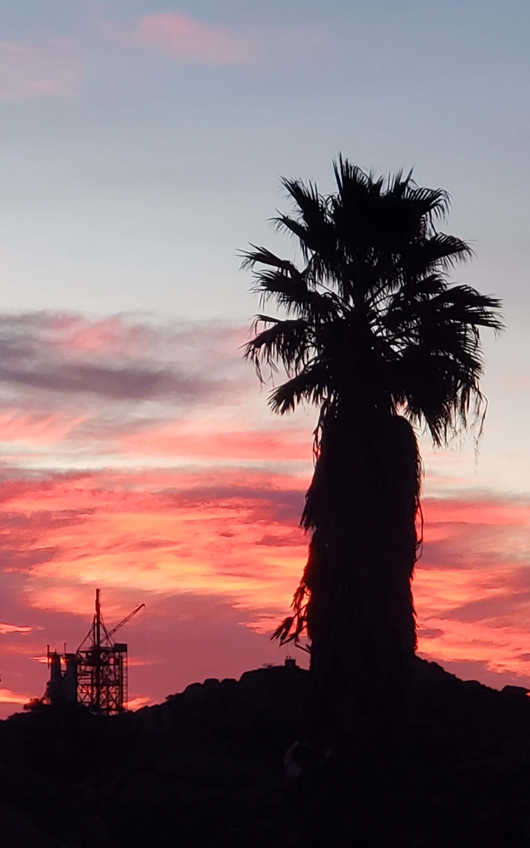
FEIS Soils Alternatives
Soils remediation alternatives considered in DOE’s 2018 FEIS included:
Cleanup to AOC Look-Up Table (LUT) Values
Cleanup to Revised LUT Values
Conservation of Natural Resources
  Residential Scenario
  Open Space Scenario
No Action Alternative

Slide 16

Issues with AOC LUT
Provisional Look-Up Table (LUT) values developed to define background are not implementable.
Backfill soils needed to restore the site are not available at the established cleanup standards.
The LUT values for some contaminants are lower than laboratory detection capabilities.
The pristine sites used to develop the provisional LUT values would not pass as clean.
Preservation of natural and cultural resources remains key goal for DOE in our cleanup at SSFL
Notes:
Section 2.3.3.1 of the Final EIS: Implementability of the 2010 AOC Requirements
High Level of Uncertainty in Cleanup Decisions
Acceptable Error Rate
Background Data AOC LUT Failures
Total Petroleum Hydrocarbon AOC LUT Value
Changes in Site Knowledge Since the Signing of the 2010 AOC
2010 AOC Backfill Soil Requirements
From DTSC’s Feb 3, 2025 MLE Tech Memo :
The Problem Statement section:
“The simple comparison approach in the 2010 Administrative Orders on Consent (AOCs) does not accurately determine when soil is consistent with local background. Specifically, the ‘not to exceed’ approach misidentifies soil as contaminated when it is not, which is known as a false positive error”
“If the technically inaccurate approach is not remedied by adopting a new approach, such as the proposed MLE approach, DTSC is forecasting the non-beneficial removal of soils and the inability to find backfill soil in sufficient quantity and quality to meet the required standards for site restoration. The AOCs authorize DTSC to determine the best option available if confirmation sample laboratory results exceed the 2013 Chemical Look-Up Table (LUT) values.”

Slide 17
Proposed Action
DOE proposes to remediate chemically and radiologically impacted soil in Area IV and the NBZ; dispose of resulting material; and restore the affected environment in accordance with applicable laws, orders, regulations, and agreements with the State of California.
Preliminary Alternatives
DOE has no Preferred Alternative at this time,
but will identify a Preferred Alternative in the Final SEIS.
In addition to the NEPA required No Action Alternative, DOE proposes to evaluate three new soil cleanup alternatives in the SEIS:
  1. Updated Look Up Table (LUT) Values
  2. Multiple Lines of Evidence (MLE)
  3. Resident with Garden
Notes:
DOE wants to identify cleanup plans that are protective but would avoid doing more harm than good as we execute DOE’s mission at SSFL.
We are focused on getting the levels right to avoid unnecessary soil removal and execute the final stretch of DOE’s mission at SSFL
We are also re-evaluating whether each of the alternatives from the EIS is still reasonable and should be evaluated.

Slide 18
Preliminary Description of Alternatives
DOE will propose updated Look Up Table (LUT) values.
Resolves issues DOE identified with the LUT values to reduce false positives by:
  Accounting for laboratory detection capabilities,
  Incorporating data from the pristine background site.
The proposed alternative would retain the other provisions of the AOC.
Updated Look Up Table (LUT) Values Alternative
18

Slide 19
Preliminary Description of Alternatives
DTSC proposed a soil cleanup approach that uses Multiple Lines of Evidence (MLE) for soil remediation that would be consistent with the 2010 AOC required clean up to background.
The MLE approach uses risk assessment to ensure the protection of human health while minimizing unnecessary removal of clean soil and destruction of critical habitats and cultural resources.
The use of MLE enables a more reliable decision making by requiring different types of supporting evidence.
The U.S. Environmental Protection Agency identifies the use of multiple lines of evidence as a best practice in environmental cleanup.
Multiple Lines of
Evidence Alternative
19
Notes:
The MLE alternative: DOE is analyzing DTSC’s newly proposed approach.
From DTSC’s Feb 3, 2025 Tech Memo:
“The proposed MLE approach is intended to reduce the false positive error rate to a rate closer to the project-wide goal of 5% or less, while also consistent with the 2010 AOCs required clean up to background.”
“For the sole objective of ensuring the final remedy is protective of human health, risk is considered in the proposed MLE approach. Accordingly, any concentrations left in place would not represent an increased risk over background levels.”
“When DTSC is referring to risk in reference to the proposed MLE approach the word ‘risk’ is distinct and separate from what is referred to as a ‘risk-based’ cleanup approach.”
“proposed MLE approach would be applied on a sample-by-sample basis, consistent with the AOCs”
DTSC has a ‘Soil Smarts Learning Series’ website https://dtsc.ca.gov/santa_susana_field_lab-soilsmartsbackgroundcleanup/ with additional information about their MLE alternative

Slide 20
Preliminary Description of Alternatives
  This alternative follows standard risk assessment protocols in identifying locations for a soil cleanup action and is being considered for areas where Boeing is responsible for cleanup. This alternative requires that the remediated areas would be safe for people to live onsite and eat homegrown produce from a backyard garden.
Resident with Garden Risk-Based Alternative
20

Slide 21
Potential Environmental Effects
Land Resources including land use, recreation, infrastructure, and aesthetics and visual quality
Geology and Soils including mineral and paleontological resources
Surface Water including floodplains and wetlands
Groundwater Resources
Biological Resources including vegetation, wildlife, and threated, endangered, and rare species
Air Quality
Noise
Transportation and Traffic including radiological and non-radiological wastes to disposal sites and clean replacement soil to SSFL
Human Health and Safety including occupational and public health and safety, and site accidents including from natural disasters and intentional destructive acts
Waste Management
Cultural Resources including archeological, historical, and Native American culturally important sites and consultations
Socioeconomics
Cumulative Effects
21

Slide 22



Summary of Preliminary Alternatives
Updated Look-Up-Table Values
Multiple Lines of Evidence
Resident With Garden Risk-Based
Updated LUT values that reduce the false positive rate.
Retains the other provisions of the AOC
Background cleanup using risk assessment to protect human health
+ minimize removal of clean soil
+ minimize the unnecessary destruction of critical habitats and cultural resources
Follows standard risk assessment protocols in identifying locations for soil cleanup action.
Remediated areas would be safe for people to live onsite and eat homegrown produce from a backyard.
Notes:
Updated Look Up Table (LUT) Values Alternative
DOE identified issues with the Administrative Order on Consent (AOC) Look Up Table (LUT) values and method reporting limits, to include:
1. Provisional LUT values developed to define background are not implementable.
2. Backfill soils needed to restore the site are not available.
3. Provisional cleanup standards set for some contaminants are lower than laboratory detection capabilities.
4. The undeveloped sites used to develop the provisional LUT values would not pass as clean.
In response, DOE developed proposed ‘‘Updated’’ LUT values that reduce the false positive decision error rate. The proposed Updated LUT Alternative would retain the other provisions of the AOC.
Multiple Lines of Evidence Alternative
DTSC developed a soil cleanup option termed the Multiple Lines of Evidence (MLE) approach that maintains a background cleanup by using risk assessment to ensure the protection of human health while minimizing unnecessary removal of clean soil and destruction of critical habitats and cultural resources.
The use of MLE makes the argument stronger and more reliable by requiring different types of proof to support an idea.
The U.S. Environmental Protection Agency identifies the use of MLE as a best practice in environmental cleanup.
Resident With Garden Risk-Based Alternative
This alternative follows standard risk assessment protocols in identifying locations for a soil cleanup action and is being considered for areas where Boeing is responsible for cleanup. This alternative requires that the remediated areas would be safe for people to live onsite and eat homegrown produce from a backyard garden.

Slide 23
Comment Submission

Slide 24
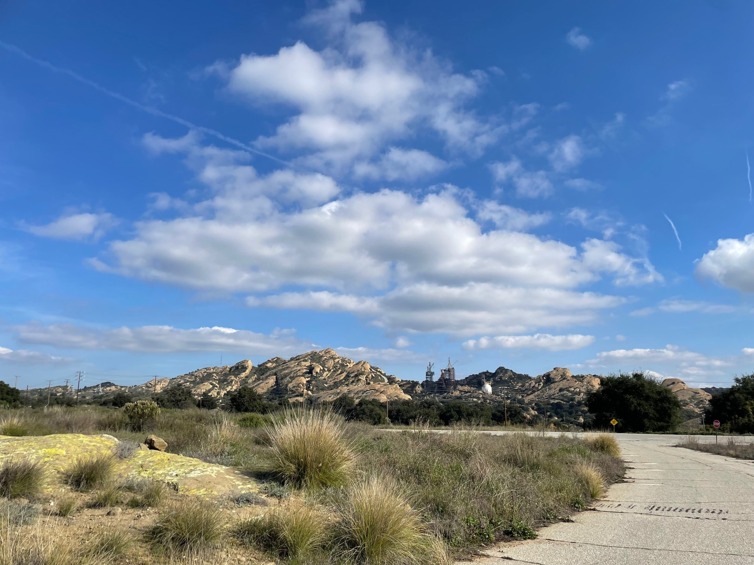
Make Your Comments Count
All Scoping Comments Will be Part of the Official Project Record
DOE invites comments on the identification of reasonable alternatives, information and analyses relevant to the Proposed Action, and specific environmental issues to be addressed.
It is important to understand that commenting on a proposal is not a “vote” on whether the Proposed Action should take place.
Keep comments specific to the scope of the Proposed Action and alternatives and give examples of how these may affect you and / or the community.
24

Slide 25
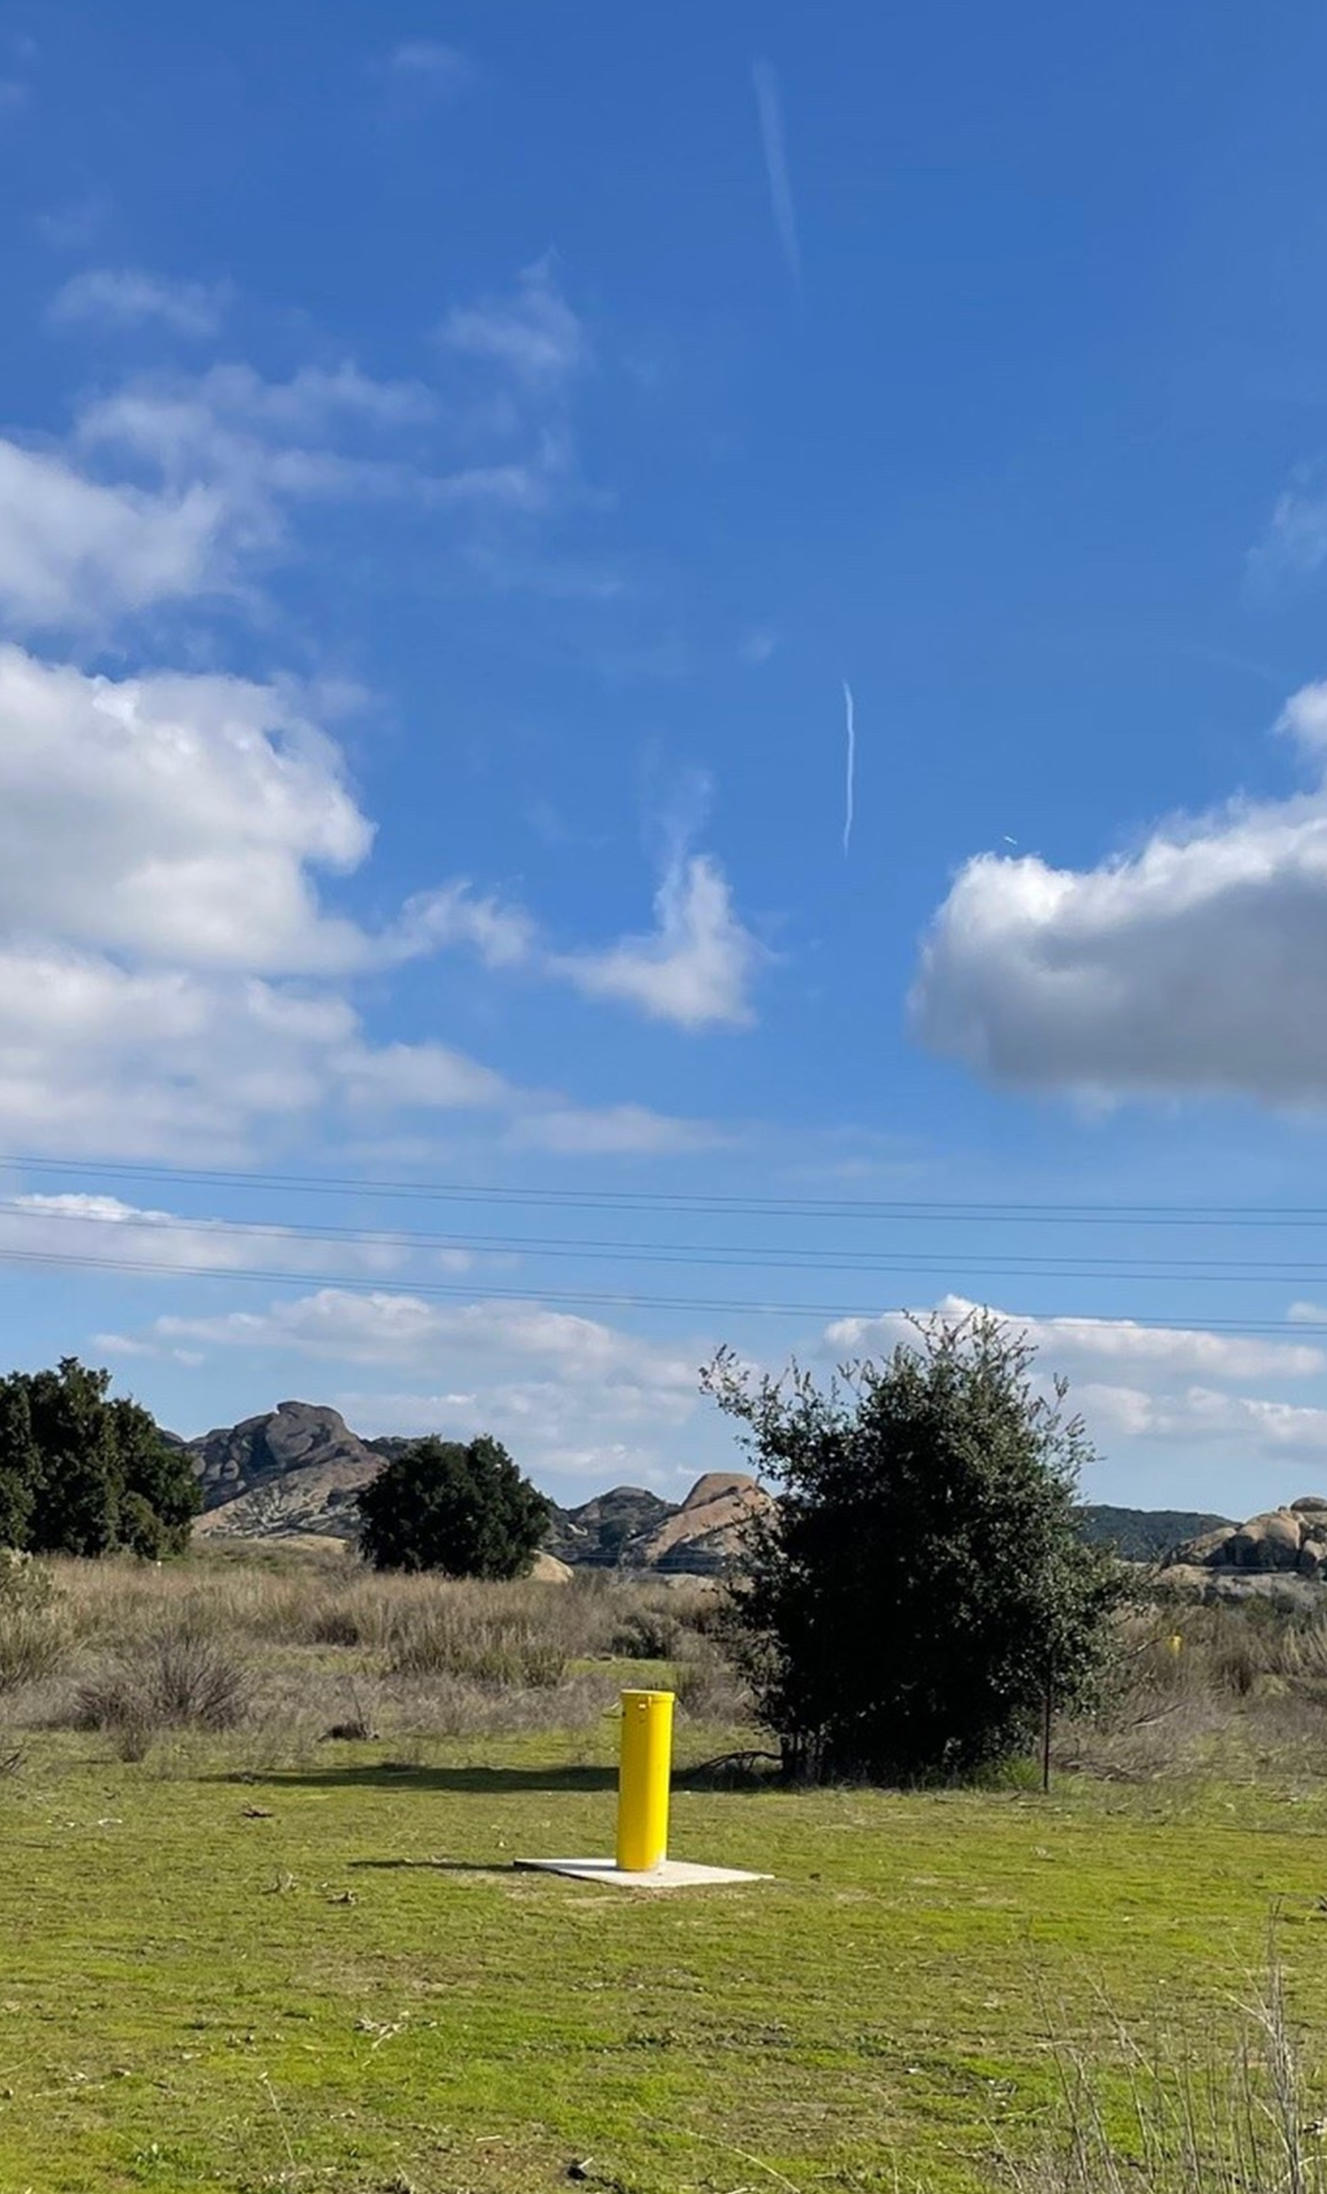
How Comments Will be Used
When the scoping period is finished, DOE will analyze comments, determine if changes to the scope of the SEIS are necessary, and prepare the Draft SEIS.
The Draft SEIS will also include a summary that identifies all relevant alternatives, information, and analyses submitted by commenters for consideration by the lead and cooperating agencies.
DOE may respond to individual comments or groups of comments by making changes to the Proposed Action or alternatives, developing new alternatives, modifying its analyses, making factual corrections, or explaining why a comment does not require a change.

Slide 26
SEIS Timeline
Provide Comments TODAY:
Use Zoom’s “raise your hand” feature to enter the queue to make an oral comment
Submit comments LATER:
Send an email with “Scoping Comments” in the subject line to:
SSFL_DOE_SEIS@emcbc.doe.gov
Send comments by US Mail to:
  Dr. Joshua Mengers,
  NEPA Document Manager,
  c/o Leidos
  2109 Air Park Road SE,
  Suite 200
  Albuquerque, NM 87106
Public Comment Period Began
December 19, 2024
Public Scoping Meetings
March 6 and 18, 2025
Public Comment Period Ends
March 27, 2025
Notice of Availability for the Draft SEIS
Summer 2026
Notice of Availability for the Final SEIS
Spring 2027
Notes:
These dates are estimates and are subject to change

Slide 27
Thank you for your attention
Next Segment: Oral Comment Period

Slide 28
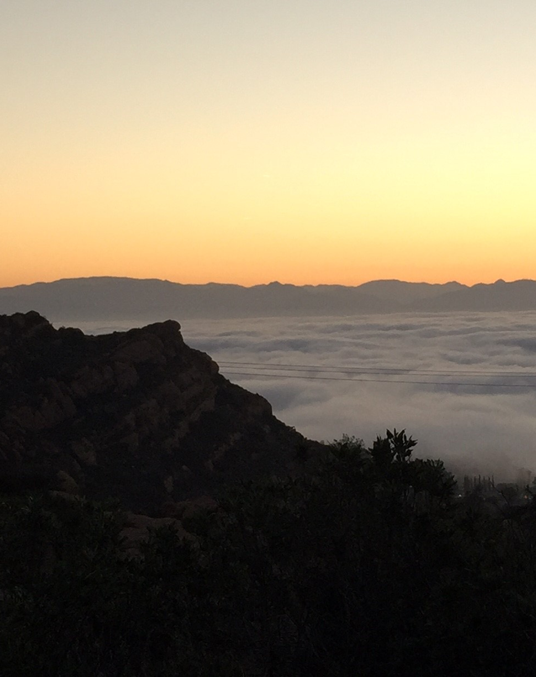
Protocols
To Submit an Oral Comment at Tonight’s Meeting:
Locate Zoom’s “Raise Hand” feature at the bottom of your screen, click “Reactions,” and “Raise Hand” to alert a member of our team to unmute you.
Comments are limited to 3 minutes. Time will not be yielded.
State your name and any affiliation you may be representing.
Phrase your comments in the form of a statement. DOE will not be responding to questions at this meeting.
Please be respectful of other commenters.
Additional comments can be submitted in writing by sending an email to SSFL_DOE_SEIS@emcbc.doe.gov (use subject line “Scoping Comments”)
Notes:
*REMINDER* DOE will prioritize commenters who expressed interest in providing oral comments over email first
If you are unable to finish your comment in the allotted time, you can submit it in writing by sending an email to SSFL_DOE_SEIS@emcbc.doe.gov (use subject line “Scoping Comments”)
**If needed: Each person who speaks will have 3 minutes. In order to ensure that everyone commenting receives the same amount of time, you will not be able to yield your time to another attendee.

Slide 29
SEIS Timeline
Provide Comments TODAY:
Use Zoom’s “raise your hand” feature to enter the queue to make an oral comment
Submit comments LATER:
Send an email with “Scoping Comments” in the subject line to:
SSFL_DOE_SEIS@emcbc.doe.gov
Send comments by US Mail to:
  Dr. Joshua Mengers,
  NEPA Document Manager,
  c/o Leidos
  2109 Air Park Road SE,
  Suite 200
  Albuquerque, NM 87106
Public Comment Period Began
December 19, 2024
Public Scoping Meetings
March 6 and 18, 2025
Public Comment Period Ends
March 27, 2025
Notice of Availability for the Draft SEIS
Summer 2026
Notice of Availability for the Final SEIS
Spring 2027
Notes:
These dates are estimates and are subject to change

Slide 30
Protocols
To Submit an Oral Comment at Tonight’s Meeting:
Locate Zoom’s “Raise Hand” feature at the bottom of your screen, click “Reactions,” and “Raise Hand” to alert a member of our team to unmute you.
Comments are limited to 3 minutes. Time will not be yielded.
State your name and any affiliation you may be representing.
Phrase your comments in the form of a statement. DOE will not be responding to questions at this meeting.
Please be respectful of other commenters.
Additional comments can be submitted in writing by sending an email to SSFL_DOE_SEIS@emcbc.doe.gov (use subject line “Scoping Comments”)
Notes:
*REMINDER* DOE will prioritize commenters who expressed interest in providing oral comments over email first
If you are unable to finish your comment in the allotted time, you can submit it in writing by sending an email to SSFL_DOE_SEIS@emcbc.doe.gov (use subject line “Scoping Comments”)
**If needed: Each person who speaks will have 3 minutes. In order to ensure that everyone commenting receives the same amount of time, you will not be able to yield your time to another attendee.

Slide 31
Thank you for attending
We look forward to seeing everyone in person at the open house:
Tuesday, March 18, 2025, at 6 p.m.
Grand Vista Hotel, 999 Enchanted Way, Simi Valley, CA 93065

