Slide 1
Simulation-Based Design and Optimization of Waste Heat Recovery Systems
WBS 2.1.0.80 (NREL) and WBS 2.1.0.81 (LBNL)
National Renewable Energy Laboratory
Lawrence Berkeley National Laboratory
10/1/2018 – 9/30/2021
Nicholas Long – NREL Co-PI
Michael Wetter – LBNL Co-PI
U.S. DOE Advanced Manufacturing Office Virtual Program Review
June 2-3, 2020
This presentation does not contain any proprietary, confidential, or otherwise restricted information.

Slide 2

Overview
Project Title:
Simulation-Based Design and Optimization
of Waste Heat Recovery Systems
Project Budget and Costs:
Budget | DOE Share | Cost Share | Total | Cost Share %
Overall Budget | $3,000,000 | $250,000 | $3,250,000 | 8%
Approved Budget (BP-1&2) | $3,000,000 | $250,000 | $3,250,000 | 8%
Costs as of 3/31/20 | $787,113 | $25,000 | $812,113 | 3%
Timeline:
Project Start Date: 01/01/2019
Budget Period End Date: 09/30/2021
Project End Date: 09/30/2021
Barriers and Challenges:
District energy systems are underutilized because integrated design tools do not exist to quantify their value proposition
Waste heat energy sources are not evaluated in connection to potential end users, namely buildings
Project Team and Roles:
Nicholas Long, NREL, Co-PI, Project Management,
Software Architecture and Building Modeling
Amy Allen, NREL, District System Optimization Methods
Michael Wetter, LBNL, Co-PI, Dynamic Modeling and Simulation, 5th Generation DHC Systems
Antoine Gautier, LBNL, Technical Lead, 4th Generation DHC Systems
Wangda Zuo, University of Colorado – Boulder, 1st and 2nd Generation DHC Systems
Katy Hinkelman, University of Colorado – Boulder, Modelica Modeling
Valentin Gavan, ENGIE Lab CRIGEN, Industry Feedback
AMO MYPP Connection:
3.1.12 Waste Heat Recovery Systems
  Lack of end use for waste heat
  Low temperature waste heat
3.1.13 Combined Heat and Power (CHP) Systems

Slide 3
Project Objective(s)
Problem
  Most unrecovered industrial waste heat (~60%) is at low temperatures (< 450°F / 232°C),
  with often no viable end use within the facility
  Temperature of heat source and sink has a critical impact on
    Efficiency of heat engines and heat pumps
    Heat exchanger sizing and material requirements (corrosion with condensation)
    Overall economics of the waste heat recovery process
Opportunities
  Grow the demand for low temperature waste heat recovery by connecting industrial facilities with district heating systems
  Leverage large-scale seasonal energy storage of low-quality heat at the district level
Objective: create a modular simulation tool for district energy systems, able to
  Represent a variety of energy conversion processes, including combined heat and power systems
  Represent the resulting cascading temperature levels
  Support the design of fifth generation district heating and cooling systems with ambient water loop and geothermal energy storage
  Run coupled simulation of the entire energy system: from the heat recovery processes, to the building loads
  Quantify unrealized value for the waste heat producer (industrial process) and cost savings to the waste heat consumer (building in a district)

Slide 4
Technical Innovation
Conventional simulation frameworks
  Are siloed between
    Building energy modeling
    District hydronic distribution modeling
    Plant and energy conversion process modeling
    Control sequence modeling
  And cannot
    Co-simulate buildings, district, and waste heat sources
    Properly represent system controls, temperature, and pressure transients
    Evaluate heat recovery potential both at the building and at the district level
    (energy quality is not considered consistently over the whole energy system)
Consequences
  It takes several weeks of PhD labor to build a full-scale co-simulation model
  Most developments are evaluated based on rules of thumb and spreadsheets
New simulation tool requirements
  Unified modeling framework, from the plant to the load
  Supporting simulation of fast pressure and control transients (hydronic analysis)
  Open-source, open-standard and modular (seamless integration of new models)
  With advanced templating for streamlined modeling of complex energy systems
  And a comprehensive library of system models for waste heat recovery

Slide 5
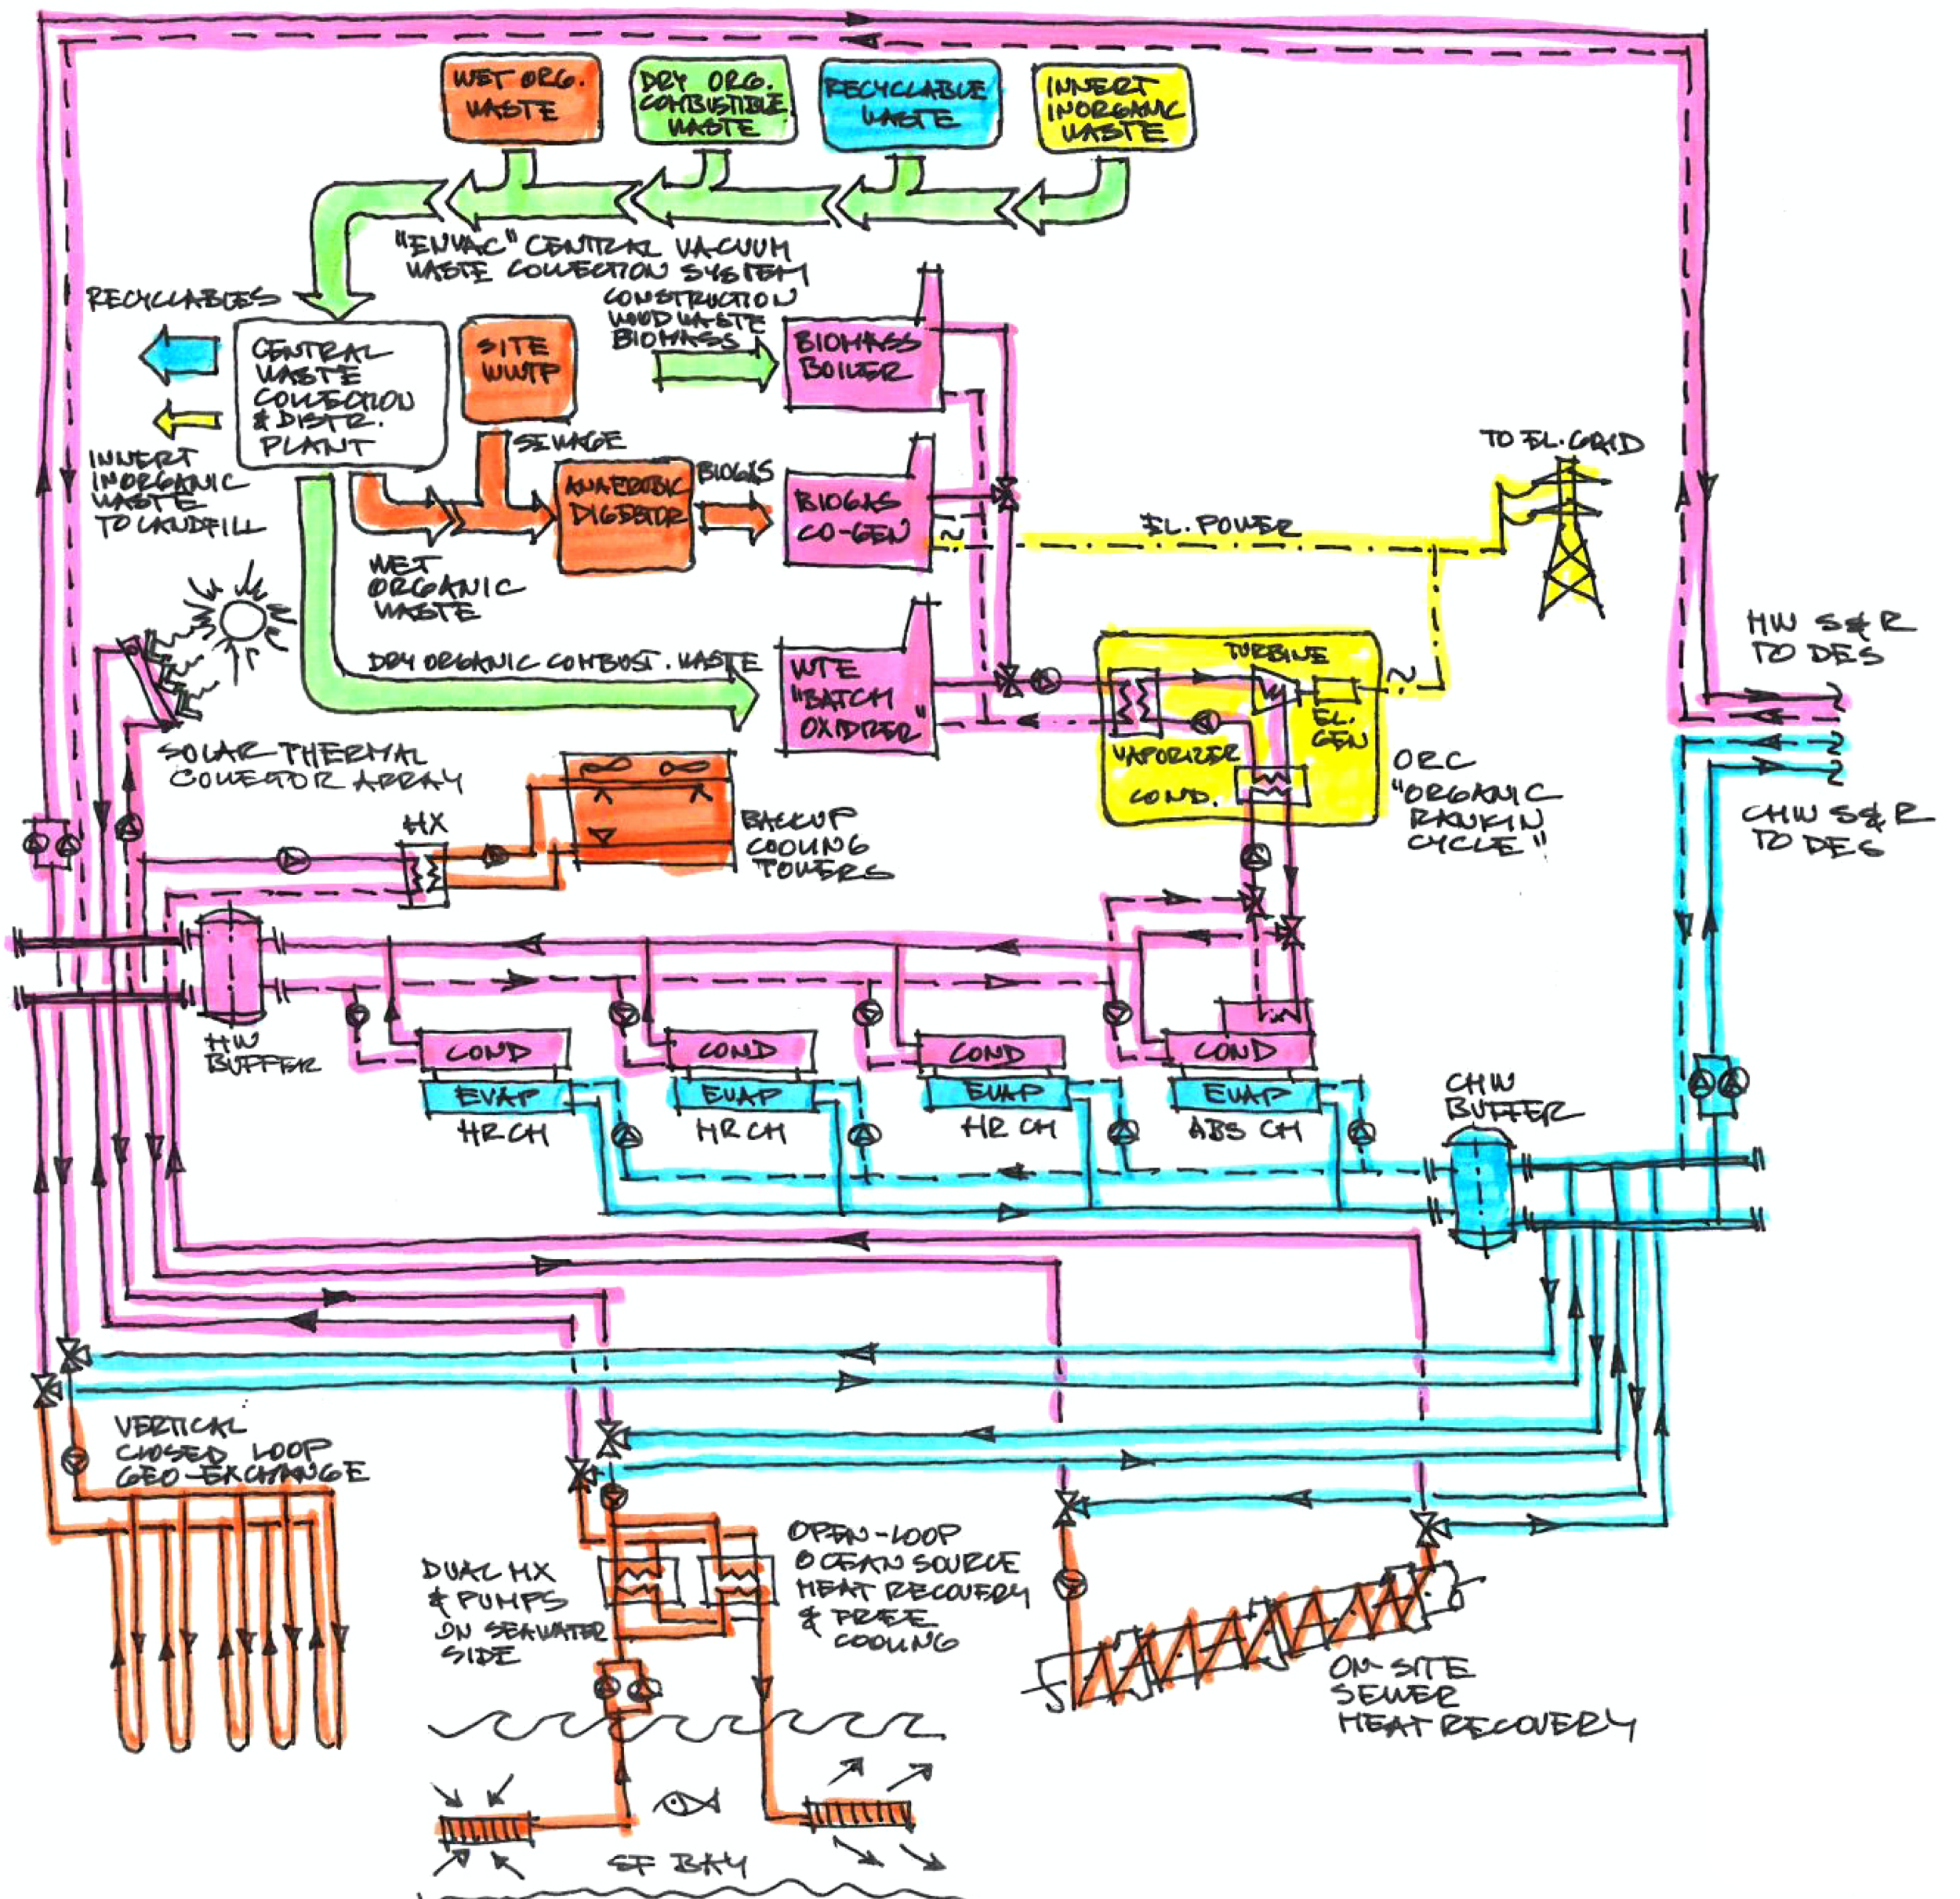
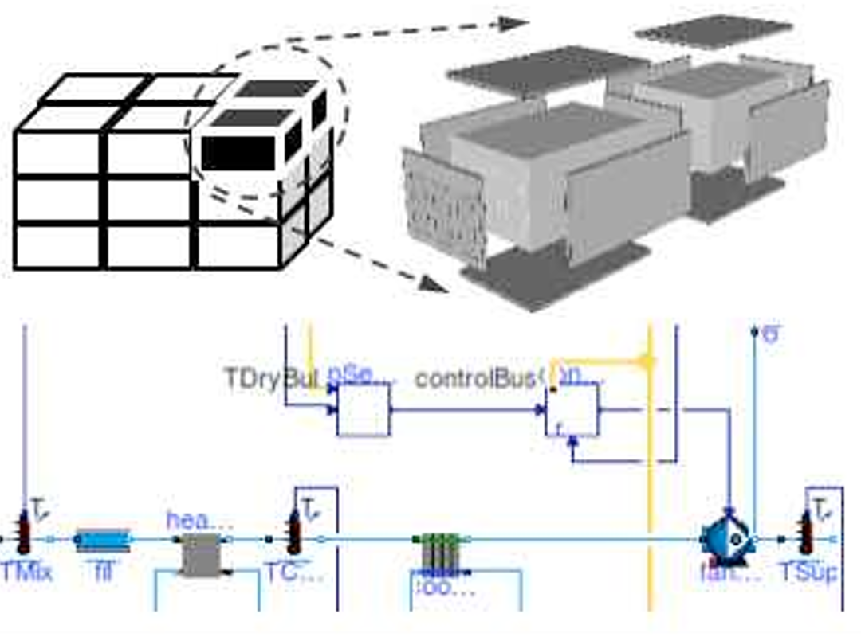
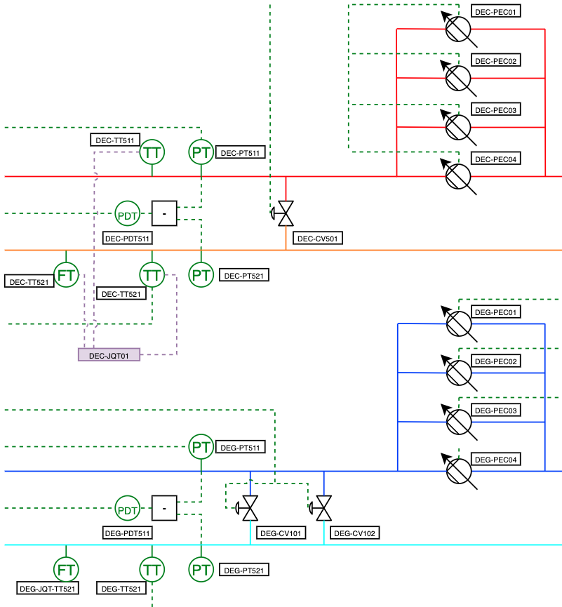
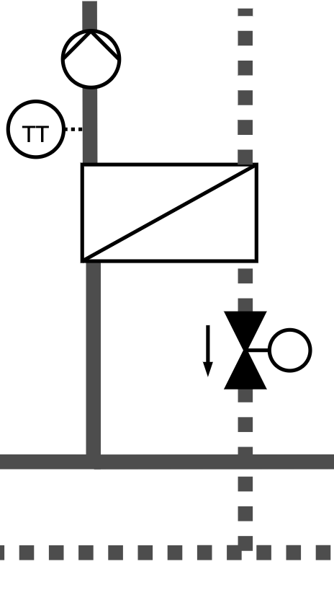
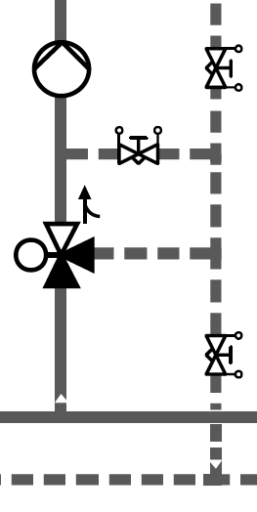
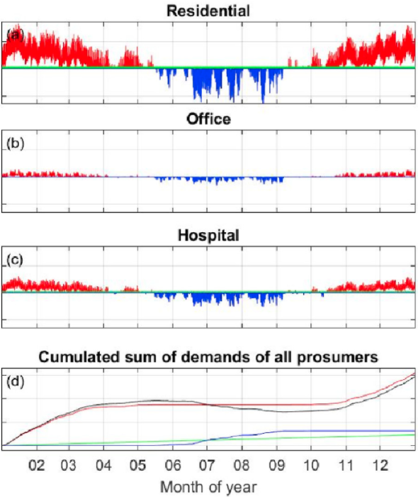
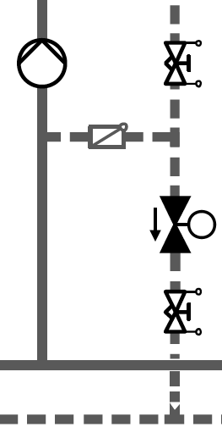


Technical Innovation
Courtesy of Integral Group – Hunters Point Eco-District
Courtesy of Engie – Thassalia DHC Distribution System
Plant / energy conversion process modeling
Waste heat recovery from high exergy manufacturing process
Through low exergy heating / chilled water production
To ultra-low exergy seasonal energy storage
Hydronic distribution modeling
Library of typical hydronic layouts and controls for central distribution and consumer interconnection
Precise representation of pressure, flow rate and temperature variation with the load
Building and HVAC modeling
Allow for reusing models authored by the design team, or authoring project specific models, or using time series from meter data or regression models
Realistic control sequence representation for all applications

Slide 6
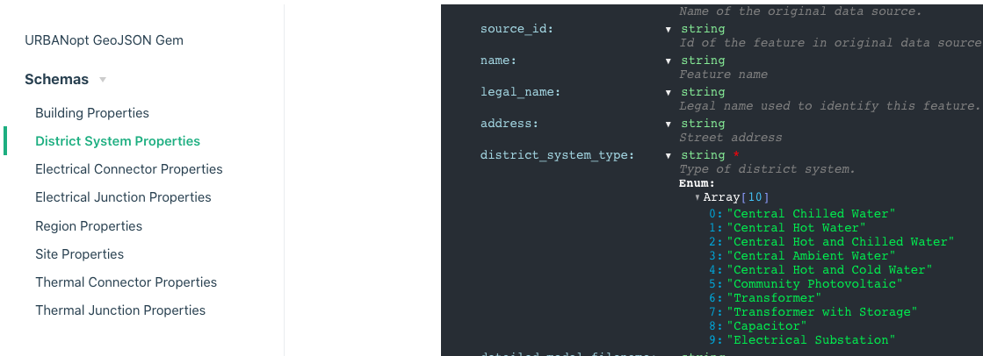
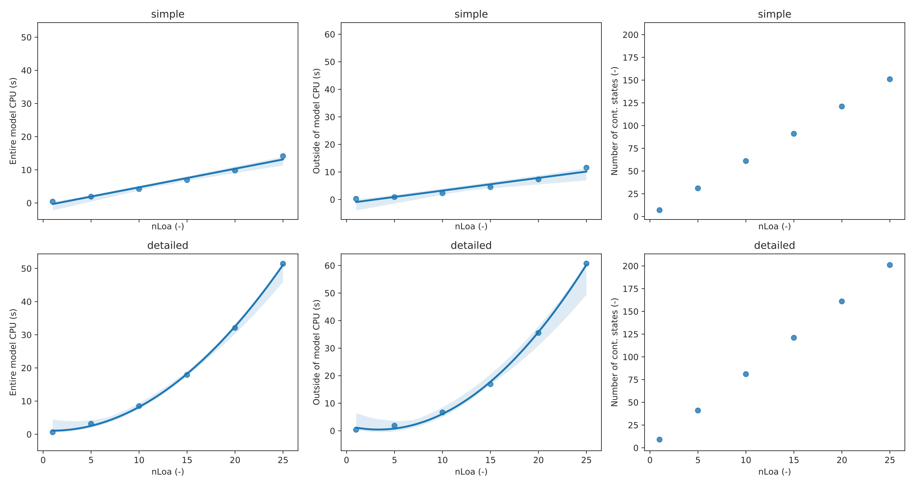
Technical Approach
Modelica as a foundational standard
  Open, industry-driven standard for multi-physics & controls, equation-based modeling
Leverage key DOE investments
  Spawn of EnergyPlus
  Modelica Buildings Library
  Existing URBANopt platform
Schema-based configuration files
to interface with third-party
graphical user interface
Challenges
  Modularity
  Reconfiguration of complex
  thermo-fluid models and
  control sequences, with a limited
  number of high-level parameters
  Scalability
  Number of iterations
  typically scales cubic in the
  number of state variables for
  implicit differential equation solvers,
  tailored modeling approaches are
  devised for linear scaling of CPU time

Slide 7
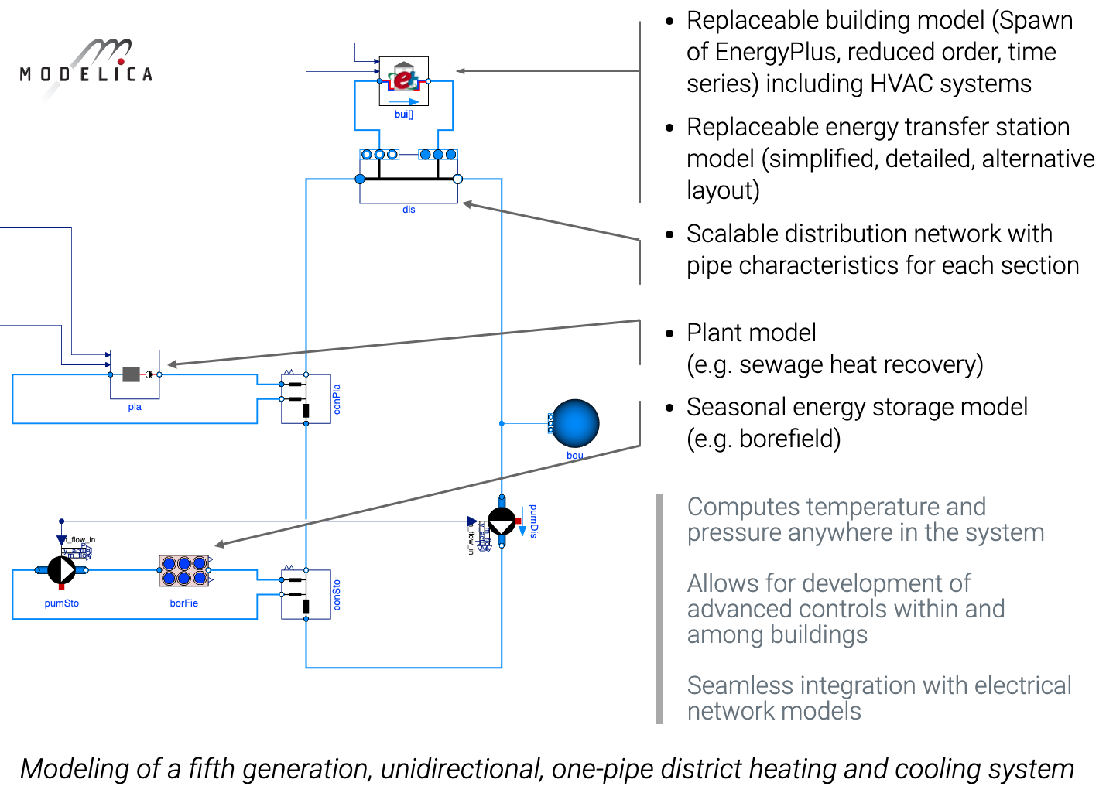
Technical Approach

Slide 8
Results and Accomplishments (1 slide max)
Milestone/Tasks | Status
Milestone Building Importer (6/30/19) – Designed Application Programming Interface (API) to export building models and to import them into Modelica. API designed, implemented and tested for 3 types of building models: time series, reduced order models (leverages TEASER development from IBPSA Project 1), Spawn of EnergyPlus models. | Achieved
Milestone Component Models (1/15/20) – Implemented at least three models models for waste heat utilization, and integrated them into continuous integration testing. Development of direct cooling energy transfer station (ETS) with in-building pumping, direct cooling without in-building pumping, and a cooling tower for district energy central plants. | Achieved
Milestone Component Models (1/31/20) – Implemented at least one model for waste heat utilization, and integrated them into continuous integration testing. Release of models for: combined heat and power systems based on internal combustion engines or Stirling engines (“topping cycles”), absorption chillers with steam as heat source, and water-source reversible heat pumps. We further planned the development of a model for combined heat and power systems based on Rankine cycle (“bottoming cycle”) for applications in low grade heat recovery. | Achieved
Milestone URBANopt with Modelica Engine and New Component Models (3/31/2020) – Integrate a Modelica simulation engine into URBANopt with ability to perform an analysis similar to the existing EnergyPlus workflow. Modelica component models for waste heat recovery devices have been committed to the Project’s GitHub repository. GeoJSON to Modelica Translator was released in alpha with basic ability to create building load models and ETS systems connected to an infinite source district system. Released new steam medium models for Modelica. | Achieved
Milestone Energy Transfer Station Models (3/31/20) - Implemented at least two template models for common Energy Transfer Stations (ETS) and integrated them into continuous integration testing. The development of a generic ETS model for fifth generation district systems is being finalized. The development of a generic ETS model for fourth generation district systems is planned next. | Partially achieved
Milestone Complete District System Model (6/30/20) – Components from previous milestones are assembled into a complete district system model. This should be considered a preparation step for upcoming case study, and the resulting be committed to a public or private GitHub repository. | In Progress
NREL Milestone Alpha version of URBANopt Modelica Edition is released (9/30/20) - All of the previous milestones are aggregated into an alpha version of URBANopt for Modelica. Software shall be made available on the project website and documentation will be published to carry out a basic workflow. | In Progress

Slide 9
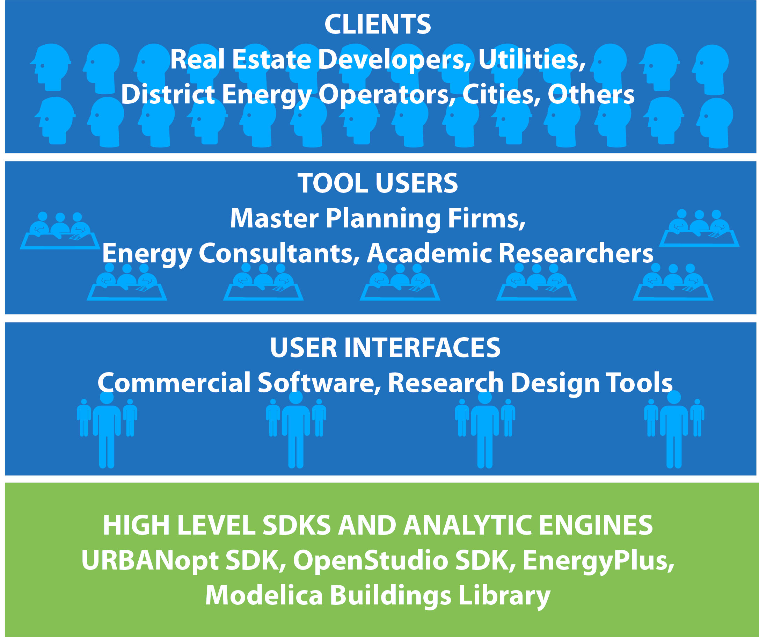





Transition
Ladybug Tools

