Slide 1
OSHA’s Final Rule on
Occupational Exposure to
Respirable Crystalline Silica
David O’Connor
May 12, 2016

Slide 2
Final Rule Published on March 25, 2016

Slide 3
Reasons for the Rule
Previous permissible exposure limits (PELs) are formulas that many find hard to understand
Construction/shipyard PELs are obsolete particle count limits
General industry formula PEL is about equal to 100 µg/m³; construction/shipyard formulas are about 250 µg/m³

Slide 4
Most Important Reason for the Rule
Previous PELs do not adequately protect workers
Exposure to respirable crystalline silica has been linked to:
Silicosis
Lung cancer
Chronic obstructive pulmonary disease
Kidney disease
Extensive epidemiologic evidence that lung cancer and silicosis occur at exposure levels below 100 µg/m³

Slide 5
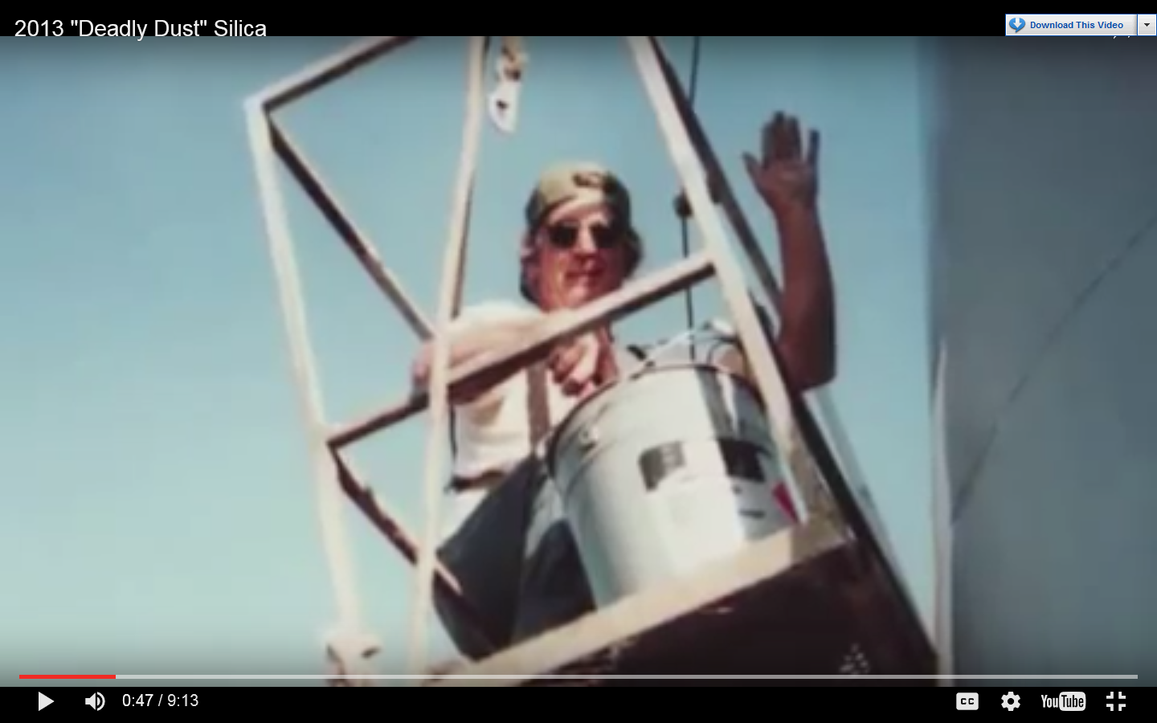
Most Important Reason
for the Rule (cont.)
Bill Ellis

Slide 6
Health Benefits
OSHA estimates that once the effects of the rule are fully realized, it will prevent:
More than 600 deaths per year
  Lung cancer: 124
  Silicosis and other non-cancer
  lung diseases: 325
  End-stage kidney disease: 193
More than 900 new silicosis cases per year

Slide 7
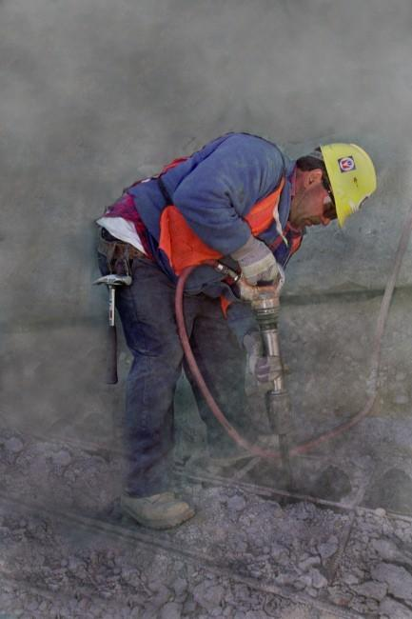
Scope of Coverage
Three forms of silica: quartz, cristobalite and tridymite
Exposures from chipping, cutting, sawing, drilling, grinding, sanding, and crushing of concrete, brick, block, rock, and stone products (such as in construction operations)
Exposures from using sand products (such as glass manufacturing, foundries, and sand blasting)

Slide 8
Industries and Operations with Exposures
● Construction ● Glass manufacturing ● Pottery products ● Structural clay products ● Concrete products ● Foundries ● Dental laboratories ● Paintings and coatings ● Jewelry production ● Refractory products ● Asphalt products ● Landscaping | ● Ready-mix concrete ● Cut stone and stone products ● Abrasive blasting in: ○ Maritime work ○ Construction ○ General industry ● Refractory furnace installation and repair ● Railroads ● Hydraulic fracturing for gas and oil

Slide 9
Workers and Industries Affected
2.3 million workers:
  Construction: 2 million
  GI/Maritime: 300,000
676,000 establishments
  Construction: 600,000
  GI/Maritime: 76,000

Slide 10
Respirable Crystalline
Silica Rule
Two standards:
  One for general industry and maritime
  One for construction
Similar to other OSHA health standards and ASTM consensus standards

Slide 11
General Industry/Maritime Standard
(a) Scope
(b) Definitions
(c) Permissible exposure limit (PEL)
(d) Exposure assessment
(e) Regulated areas
(f) Methods of compliance
  (1) Engineering and work practice controls
  (2) Written exposure control plan
(g) Respiratory protection
(h) Housekeeping
(i) Medical surveillance
(j) Communication of silica hazards
(k) Recordkeeping
(l) Dates

Slide 12
General Industry/Maritime -
Scope
All occupational exposures to respirable crystalline silica are covered, unless objective data shows exposures remain below 25 µg/m³ as an 8-hr TWA under any foreseeable conditions.
Agricultural operations and exposures resulting from processing of sorptive clays are not covered.
General industry employers can follow the construction standard in some very limited circumstances.

Slide 13
Permissible Exposure Limit (PEL)
PEL = 50 µg/m³ as an 8-hour TWA
Action Level = 25 µg/m³ as an 8-hour TWA

Slide 14
Exposure Assessment
Required if exposures are or may reasonably be expected to be at or above action level of 25 µg/m³
Exposures assessments can be done following:
  The performance option
  The scheduled monitoring option

Slide 15
Performance Option
Exposures assessed using any combination of air monitoring data or objective data sufficient to accurately characterize employee exposure to respirable crystalline silica

Slide 16
Objective Data
Includes air monitoring data from industry-wide surveys or calculations based on the composition of a substance
Demonstrates employee exposure associated with a particular product or material or a specific process, task, or activity
Must reflect workplace conditions closely resembling or with a higher exposure potential than the processes, types of material, control methods, work practices, and environmental conditions in the employer's current operations

Slide 17
Scheduled Monitoring Option
Prescribes a schedule for performing initial and periodic personal monitoring
If monitoring indicates:
  Initial below the AL: no additional monitoring
  Most recent at or above the AL: repeat within 6 months
  Most recent above the PEL: repeat within 3 months
  When two consecutive non-initial results, taken 7 or more days apart, are below the AL, monitoring can be discontinued
  Reassess if circumstances change

Slide 18
Appendix A – Methods of Sample Analysis
Employers must ensure that samples are analyzed by a laboratory that follows the procedures in Appendix A
Appendix A specifies methods of sample analysis
  Allows for use of OSHA, NIOSH, or MSHA methods
  Analysis must be conducted by accredited laboratories that follow specified quality control procedures

Slide 19
General Industry/Maritime – Regulated Areas
Required where exposures can reasonably be expected to exceed the PEL
Must be demarcated in any manner that limits workers in the area
Must post warning signs at entrances
Respirator use required

Slide 20
Methods of Compliance –
Hierarchy of Controls
Employers can use any engineering or work practice controls to limit exposures to the PEL
Respirators permitted where PEL cannot be achieved with engineering and work practice controls

Slide 21
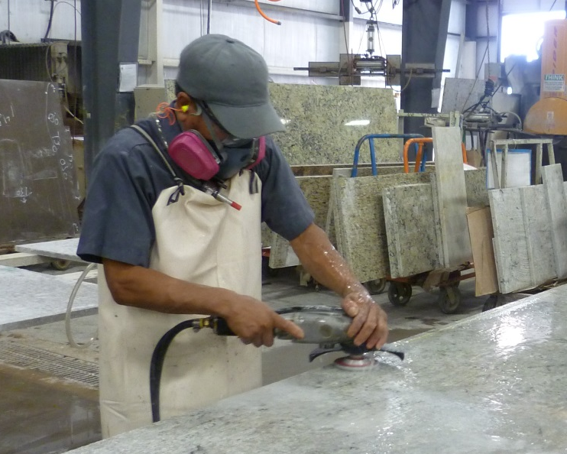
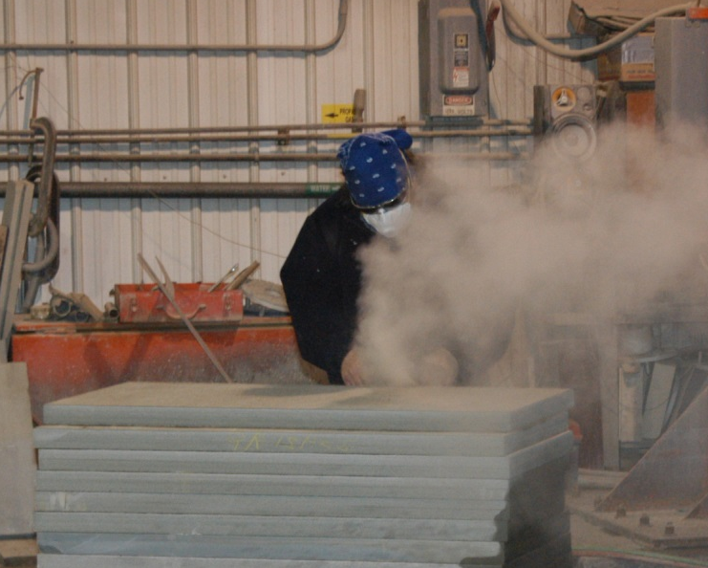
Engineering Controls
Grinding stone
without engineering controls
Polishing stone using water to control the dust

Slide 22
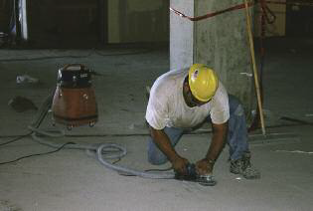
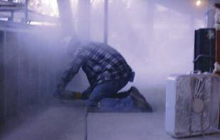
Engineering Controls (cont.)
Grinding without engineering controls
Grinding using a vacuum
dust collector

Slide 23
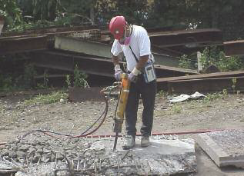
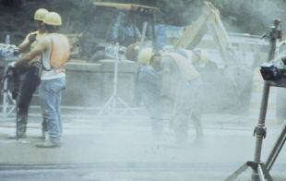
Engineering Controls (cont.)
Jackhammer use without engineering controls
Jackhammer use with water spray to control dust

Slide 24
General Industry/Maritime – Written Exposure Control Plan
The plan must describe:
  Tasks involving exposure to respirable crystalline silica
  Engineering controls, work practices, and respiratory protection for each task
  Housekeeping measures used to limit exposure

Slide 25
Respiratory Protection
Must comply with 29 CFR 1910.134
Respirators required for exposures above the PEL:
  While installing or implementing controls or work practices
  For tasks where controls or work practices are not feasible
  When feasible controls cannot reduce exposures to the PEL
  While in a regulated area (General Industry/Maritime)

Slide 26
Housekeeping
When it can contribute to exposure, employers must not allow:
  Dry sweeping or brushing
  Use of compressed air for cleaning surfaces or clothing, unless it is used with ventilation to capture the dust
Those methods can be used if no other methods like HEPA vacuums, wet sweeping, or use of ventilation with compressed air are feasible

Slide 27
General Industry/Maritime –Medical Surveillance
Employers must offer medical examinations to workers who will be exposed above the action level for 30 or more days a year
Employers must offer examinations every three years to workers who continue to be exposed above the trigger
Exam includes medical and work history, physical exam, chest X-ray, and pulmonary function test (TB test on initial exam only)

Slide 28
Medical Opinion
Worker receives report with detailed medical findings, any work restrictions, and recommendations concerning any further evaluation or treatment
Employer receives an opinion that only describes limitations on respirator use, and if the worker gives written consent, recommendations on:
  Limitations on exposure to respirable crystalline silica, and/or
  Examination by a specialist

Slide 29
Communication of Hazards
Employers required to comply with hazard communication standard (HCS) (29 CFR 1910.1200)
Address: Cancer, lung effects, immune system effects, and kidney effects as part of HCS
Train workers on health hazards, tasks resulting in exposure, workplace protections, and medical surveillance.

Slide 30
Recordkeeping
Must maintain records per 29 CFR 1910.1020 for:
  Air monitoring data
  Objective data
  Medical records

Slide 31
General Industry/Maritime –
Compliance Dates
Employers must comply with all requirements of the standard by June 23, 2018, except:
  For tasks where controls or work practices are not feasible
  Employers must comply with the action level trigger for medical surveillance by June 23, 2020. (The PEL is the trigger from June 23, 2018 through June 23, 2020.)
  Hydraulic fracturing operations in the oil and gas industry must implement engineering controls to limit exposures to the new PEL by June 23, 2021.

Slide 32
Construction Standard
(a) Scope
(b) Definitions
(c) Specified exposure control methods
OR
(d) Alternative exposure control methods
  (1) PEL
  (2) Exposure Assessment
  (3) Methods of Compliance
(e) Respiratory protection
(f) Housekeeping
(g) Written exposure control plan
(h) Medical surveillance
(i) Communication of silica hazards
(j) Recordkeeping
(k) Dates

Slide 33
Construction – Scope
All occupational exposures to respirable crystalline silica are covered, unless employee exposure will remain below 25 μg/m³ as an 8-hr TWA under any foreseeable conditions.

Slide 34
Construction –
Specified Exposure Control Methods
Table 1 in the construction standard matches 18 tasks with effective dust control methods and, in some cases, respirator requirements.
Employers that fully and properly implement controls on Table 1 do not have to:
  Comply with the PEL
  Conduct exposure assessments for employees engaged in those tasks

Slide 35
Example of a Table 1 Entry
Equipment / Task | Engineering and Work Practice Control Methods | Required Respiratory Protection and Minimum APF
 |  | ≤ 4 hr/shift | > 4 hr/shift
Stationary masonry saws | Use saw equipped with integrated water delivery system that continuously feeds water to the blade. Operate and maintain tool in accordance with manufacturer’s instructions to minimize dust emissions. | None | None

Slide 36
Example of a Table 1 Entry
Equipment / Task | Engineering and Work Practice Control Methods | Required Respiratory Protection and Minimum APF
 |  | ≤ 4 hr/shift | > 4 hr/shift
Handheld power saws (any blade diameter) | Use saw equipped with integrated water delivery system that continuously feeds water to the blade. Operate and maintain tool in accordance with manufacturers’ instruction to minimize dust When used outdoors When used indoors or in an enclosed area | None APF 10 | APF 10 APF 10

Slide 37
List of Table 1 Entries
Stationary masonry saws
Handheld power saws
Handheld power saws for fiber cement board
Walk-behind saws
Drivable saws
Rig-mounted core saws or drills
Handheld and stand-mounted drills
Dowel drilling rigs for concrete
Vehicle-mounted drilling rigs for rock and concrete
Jackhammers and handheld powered chipping tools
Handheld grinders for mortar removal (tuckpointing)
Handheld grinders for other than mortar removal
Walk-behind milling machines and floor grinders
Small drivable milling machines
Large drivable milling machines
Crushing machines
Heavy equipment and utility vehicles to abrade or fracture silica materials
Heavy equipment and utility vehicles for grading and excavating

Slide 38
Fully and Properly Implementing Controls Specified on Table 1
Presence of controls is not sufficient.
Employers are required to ensure that:
  Controls are present and maintained
  Employees understand the proper use of those controls and use them accordingly

Slide 39
Employees Engaged in Table 1 Tasks
Employees are “engaged in the task” when operating the listed equipment, assisting with the task, or have some responsibility for the completion of the task
Employees are not “engaged in the task” if they are only in the vicinity of a task

Slide 40
Respiratory Protection Requirements on Table 1
Respirators required where exposures above the PEL are likely to persist despite full and proper implementation of the specified engineering and work practice controls
Where respirators required, must be used by all employees engaged in the task for entire duration of the task
Provisions specify how to determine when respirators are required for an employee engaged in more than one task

Slide 41
Construction –
Written Exposure Control Plan
The plan must describe:
  Tasks involving exposure to respirable crystalline silica
  Engineering controls, work practices, and respiratory protection for each task
  Housekeeping measures used to limit exposure
  Procedures used to restrict access, when necessary to limit exposures

Slide 42
Construction –
Competent Person
Construction employers must designate a competent person to implement the written exposure control plan
Competent person is an individual capable of identifying existing and foreseeable respirable crystalline silica hazards, who has authorization to take prompt corrective measures
Makes frequent and regular inspection of job sites, materials, and equipment

Slide 43
Construction –
Medical Surveillance
Employers must offer medical examinations to workers who will be required to wear a respirator under the standard for 30 or more days a year.
Employers must offer examinations every three years to workers who continue to be exposed above the trigger
Exam includes medical and work history, physical exam, chest X-ray, and pulmonary function test (TB test on initial exam only)

Slide 44
Construction –
Compliance Dates
Employers must comply with all requirements (except methods of sample analysis) by June 23, 2017
Compliance with methods of sample analysis required by June 23, 2018

Slide 45
Guidance and Outreach
Silica Rulemaking Webpage: www.osha.gov/silica
  Fact sheets
  FAQs
  Video
Appendix B – Medical Surveillance Guidelines
Coming soon - Small Entity Compliance Guides

Slide 46

Questions?

