Slide 1

SCURA-thon
2026 Overview
August 13, 2026

Slide 2

Vision
Putting the practice in CECOP
Transition from isolated SCURA compliance to collective capability
Active Learning Maturity Continuum
  1. Passive – “Knowledge” stage; lectures and written procedures
  2. Interactive – “Understanding” stage; scripted workshops and group discussions
  3 Applied – “Capability” stage; joint exercises with unscripted, complex scenarios
  4. Adaptive – “Mastery” stage; collaborative solutions and adapting capabilities
Bottom-up, peer-to-peer, intrinsic learning
Notes:
Continue SCUR-A-THON overall goal of building/sustaining an ongoing venue for a community of practice to share knowledge

Slide 3
SCURA-thon 2026
Standard Weapons Mod and Infrastructure Data Set
  Same schedule
  Same cost estimate
  Same base risk information
Teams were asked to:
  Analyze
  Determine top priorities
  Create solutions/mitigations
  Pitch their solutions to the Shark Tank for funding

Slide 4
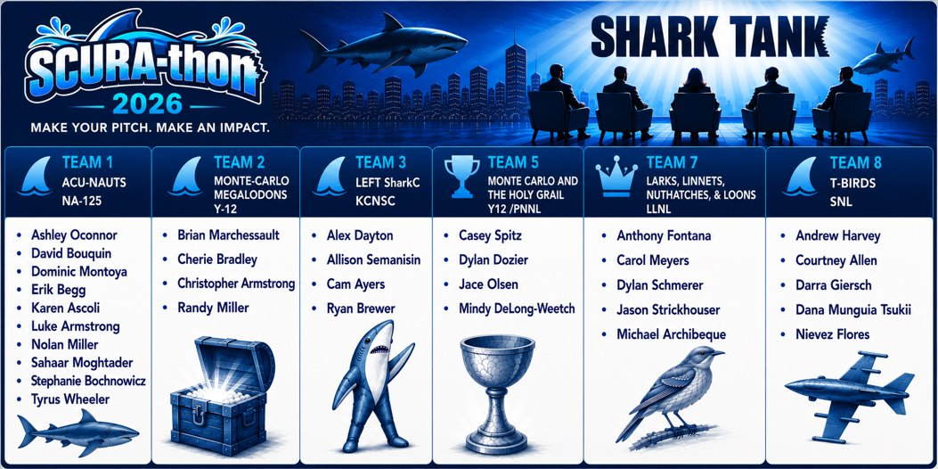
Event Recap
Notes:
Hackathon → Datathon → SCUR-A-THON

Slide 5
Insights
Everyone got funded!
Networking (Steve didn’t know Jacob) (Dominic met new W93 risk manager Alex)
Expanding participation – infrastructure and science
Y12 Team included weapons mod and infrastructure reps – added VALUE (different response because of Brian)
Practiced the pitch with real questions.
Had fun! Allowed presentation creativity. (Y-12 sharks!)
Exposing non-SCURA practitioners to results use with management
Produced best practice
Notes:
1. Addressing that the sites DA,PA,FPO, took an approach to analyze the data set from their own site/FPO experiences, but that it furthered conversations on how we’re not in a silo and the tool will help further future conversations.
2. For the NA-125 team, we are mostly risk managers, and our scheduler friend Nolan. We participate in the risk portion of the analysis, but it was insightful to understand the whole process and the vast amount of work that goes into it.
3. From sites to the FPO, opportunities for future conversations amongst the team to work together and improve the analysis.

Slide 6
Feedback
Each LPS focus was different. A cross-site working group/pre-Acumen submittal may be beneficial
The hearing of different thoughts and approaches makes me try to think of a new approach for potential path forward and solutions
Collaboration with other sites was a great learning experience to help our sites become better at our analysis
Think out of the box; collaborate
Dialogue with questions and answers
Broadening my perspective on how to communicate, mitigations and justification
Reach out to the community for best practice and lessons learned as well as cross site risks. Focusing on moving away from individual site bubble.
You should illicit as much feedback as possible and compare/cross-reference your results against others running the same analysis on the same scenario.
I liked the variance of the discussions of why things were selected other options, issues/concerns with recommendations, decisions, etc.
Contracting options can be used creatively

Slide 7
Best Practices
Template for management presentation
Assumptions slide inclusion
Instead of ‘Mitigate All’ – mitigate the top risk drivers
  Have a ‘ready on deck’ next cut
  Deeper, more thorough mitigation planning for the few vs. spray everything
Use results to inform future actions – feeds active Risk Management
Concise summary of situation, proposal, and ask
Dynamic and a conversation – ‘not a diet, a lifestyle’
Notes:
Continue SCUR-A-THON overall goal of building/sustaining an ongoing venue for a community of practice to share knowledge

Slide 8
Final thoughts/Next Steps
Virtual Post Session on September 14 from 1000-1100 MT - reach out if interested
Fall Risk Summit at Y12 on November 3-5, 2026 – consider site support and attendance
Thank-you for participating!
  Teams – great job by everyone!
  Shark Panel – kudos to Steve’s shark head!
  SCURA-thon MB support – we couldn’t do it without you!

