Slide 1
Degradation Mechanisms and Development of Protective Coatings for TES and HTF Containment Materials
National Renewable Energy Laboratory (NREL)
SunShot Lab Proposal Development Process (LPDP)
Dr. Judith Gomez (Vidal), NREL - Materials Engineer IV
Profs. M. Anderson and K. Sridharan from University of Wisconsin

Slide 2
Project Objective
Acquire understanding of fundamental degradation mechanisms of materials in molten salts (MS) and supercritical CO₂ (sCO₂) to extend their lifetime to 30 years at the SunShot relevant temperatures of 600 to 800°C using corrosion mitigation approaches.
Project Duration:
3 years and 5 months
Project Budget:
$2,610,145

Slide 3
Corrosion in Molten Salts (MS)
Eutectics MS evaluated: (Na,Li)Cl, (Zn,K)Cl, (Na,K)Cl, (Mg,K)Cl, (Na,K)CO₃, and (Na,K,Li)CO₃ in N₂, Ar, CO₂, or ZA atmospheres.
Probabilistic cost analyses probed that there is a clear cost benefit for using protective coatings to tanks and other CSP components.
Conventional long-term weight-change and electrochemical techniques were employed for MS.

Slide 4
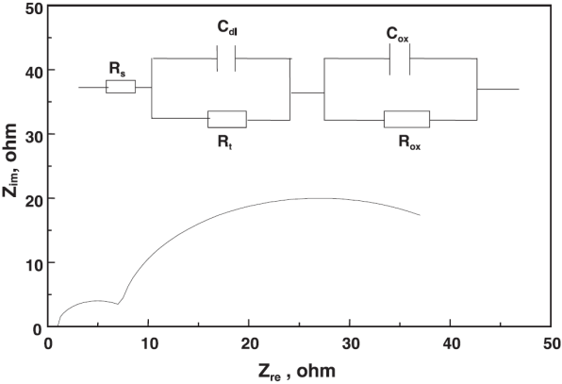
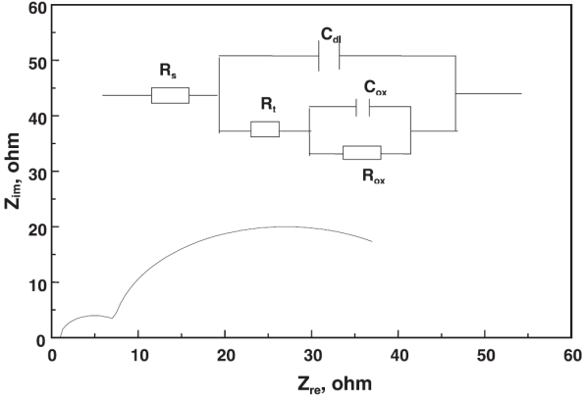
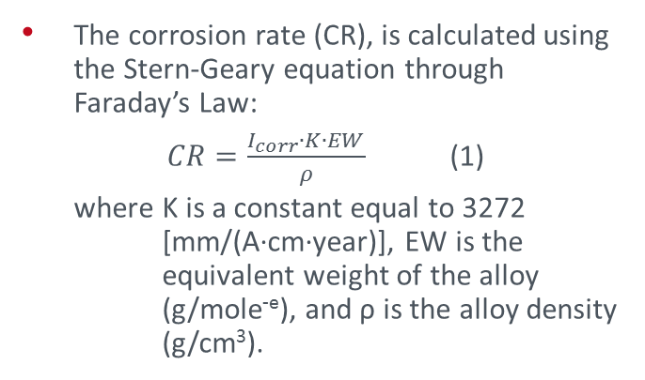
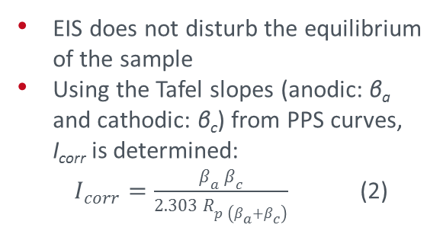
Electrochemical Techniques
Potentiodynamic polarization sweep (PPS)
Electrochemical impedance spectroscopy (EIS)
βa
βc
(a)
(b)
Nyquist plots (schematic impedance spectrum) with equivalent circuit models for (a) Protective scale, and (b) Localized corrosion
The corrosion rate (CR), is calculated using the Stern-Geary equation through Faraday’s Law:
$CR=\frac{I_{corr}∙K∙EW}{ρ}$ (1)
where K is a constant equal to 3272 [mm/(A·cm·year)], EW is the equivalent weight of the alloy (g/mole^{-e}), and ρ is the alloy density (g/cm³).
EIS does not disturb the equilibrium of the sample
Using the Tafel slopes (anodic: β_{a} and cathodic: β_{c}) from PPS curves, I_{corr} is determined:
$I_{corr}=\frac{β_{a}{ β}_{c}}{2.303 R_{p \left(β_{a}+β_{c}\right)}}$ (2)

Slide 5
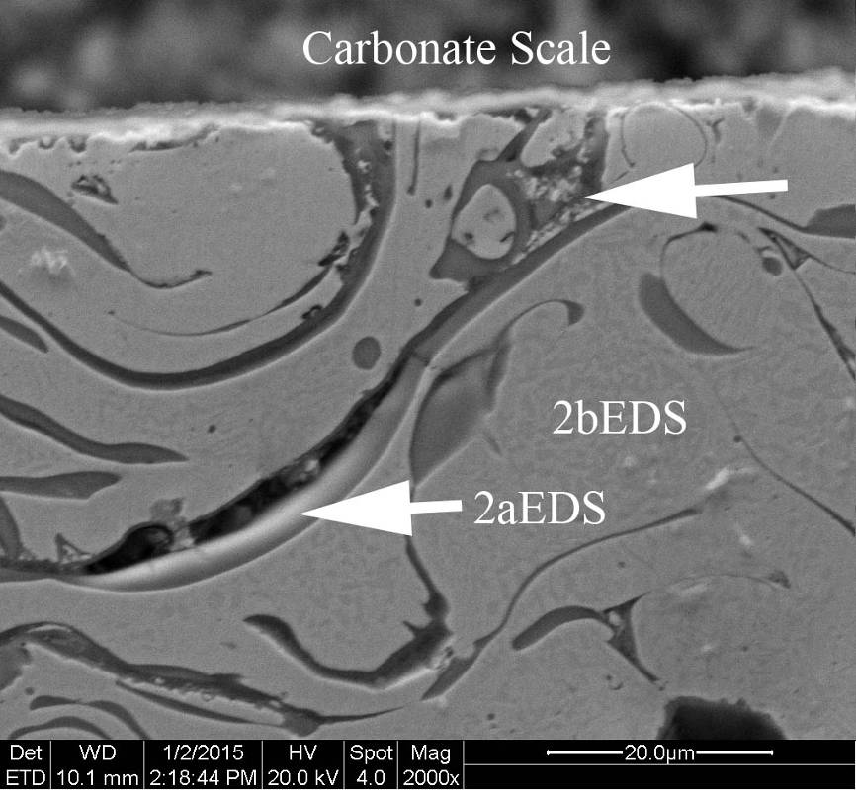
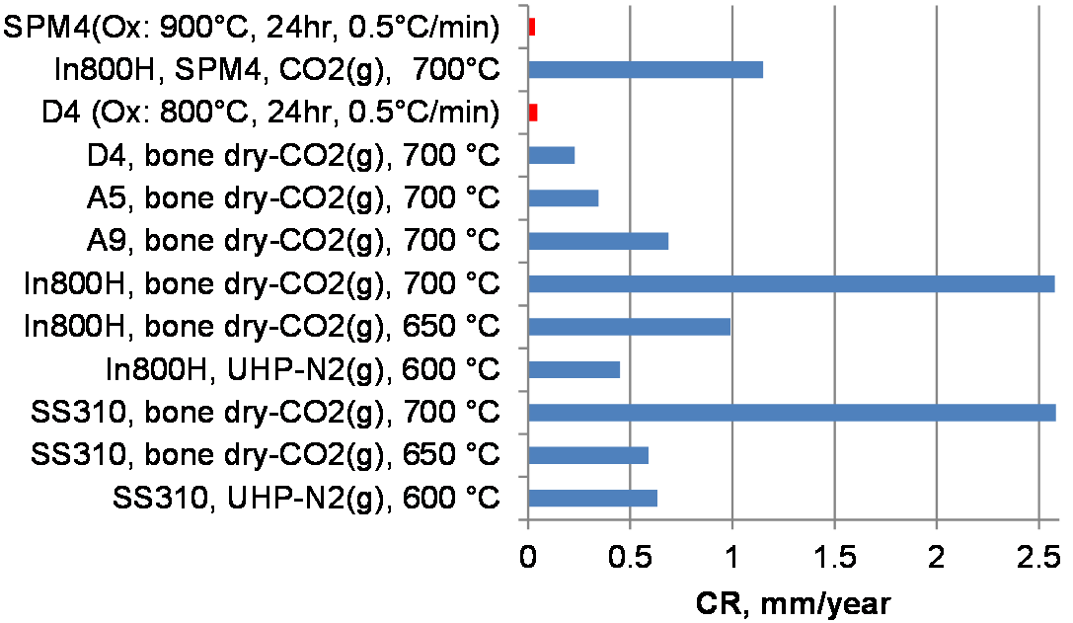
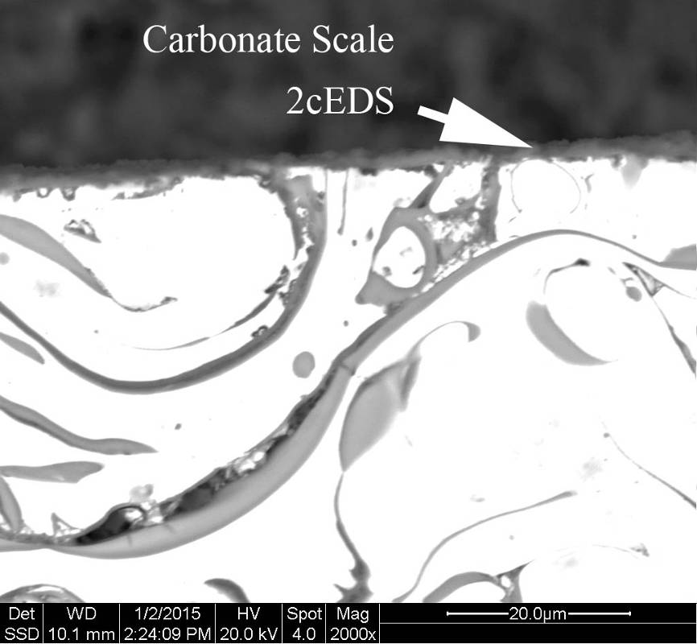
Corrosion in Molten Carbonates
Pre-oxidized Ni-Base Coatings
Corrosion rates (CR) of bare and coated alloys in eutectic Na₂CO₃ – K₂CO₃ – Li₂CO₃ at 600º, 650º and 700ºC in N₂(g) and CO₂(g) atmospheres
a) SE-SEM, (b) BSE-SEM of APS-NiCoCrAlHfSiY (CR = 34 µm/year) pre-oxidized (air, 900°C, 24 h, 0.5°C /min) and exposed to molten carbonate at 700°C
34 µm/year (APS-NiCoCrAlHfSiY)
46 µm/year (HVOF-CoNiCrAlY)
(a)
Best two coatings exposed to MS in bone-dry CO₂ at 700°C.
EDS [wt.%] | Phase
 | 2a | 2b | 2c
C | 0.9 | 0.9 | 4.4
O | 39.0 | 2.3 | 22.2
Al | 44.2 | 9.8 | 17.8
Cr | 1.4 | 20.0 | 12.0
Co | 1.9 | 23.7 | 13.3
Ni | 2.7 | 46.4 | 21.9
Y | 9.9 | - | -
K | - | - | 1.1
Na | - | - | 6.3
(b)
There is no indication of relatively coarse pitting or corrosion attack.
The spheroidal porosity (not connected) did not allow the penetration/permeation of the molten salt.

Slide 6
Corrosion in Molten Chlorides
Castable Cements
Silica-based castable cements with BN films, to block the porosity, were capable of protecting containment metallic alloys from the attack of molten chlorides at high temperatures (650°C). The cements were not chemically stable in KNa-CO₃ at 750°C and KNaLi-CO₃ at 600°C.

Slide 7
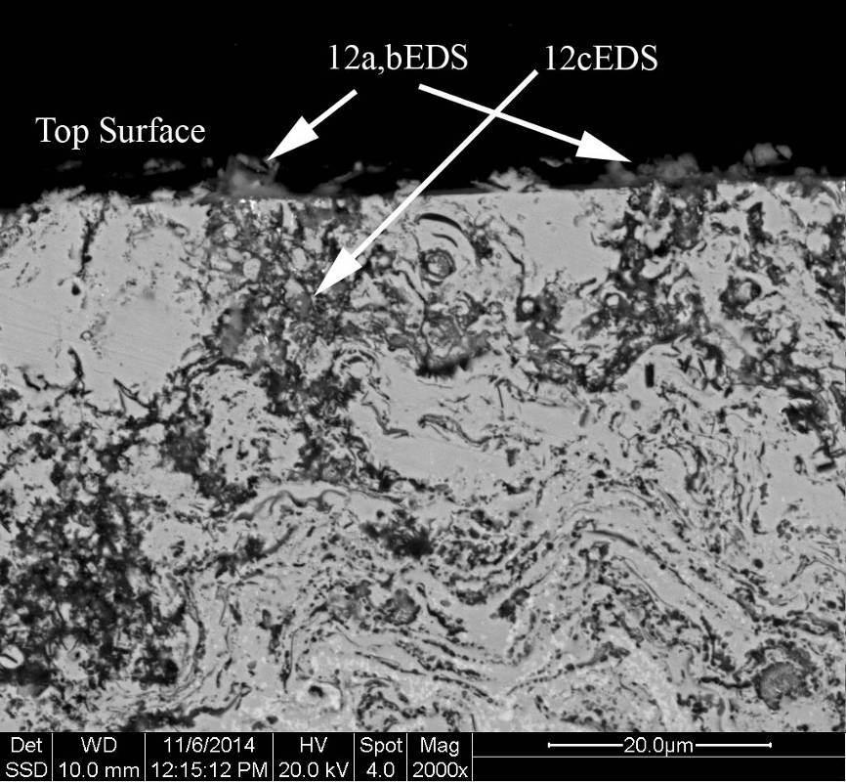
Pre-oxidized Ni-Base Coatings
Corrosion rates (CR) of bare and coated alloys in NaCl – 55.47 wt.%KCl at 700°C in N₂(g) atmosphere
BSE-SEM image of HVOF–NiCoCrAlY (air, 900°C, 24 h, 0.5°C /min) after corrosion
(CR = 192 µm/year )
192 µm/year (HVOF-NiCoCrAlY)
EDS [wt.%] | Phase
 | 12a | 12b | 12c
O | 22.8 | 31.2 | 20.2
Al | 0.3 | 2.2 | 26.1
Si | 0.8 | 1.0 | 1.2
Cr | 48.2 | 50.1 | 116.8
Fe | 1.1 | 1.2 | 0.6
Co | 5.5 | 2.3 | 12.5
Ni | 10.8 | 2.7 | 20.6
Y | 8.6 | 7.1 | 0.5
The multiphase dark "wavy" or "swirled" constituent in a light contrasted matrix is consistent with those observed for thermally sprayed coatings. The swirly dark phase is higher in Al and O, presumably alumina. The surface is comprised by a mixture of Al-rich, Cr-rich and possibly Y-rich oxide phases.
Original flat surface is remaining after salt exposure characteristic of low corrosion obtained.
At 700°C the corrosion of 310SS in carbonates (2.456 mm/year) is less aggressive than in chlorides (4.589 mm/year).

Slide 8
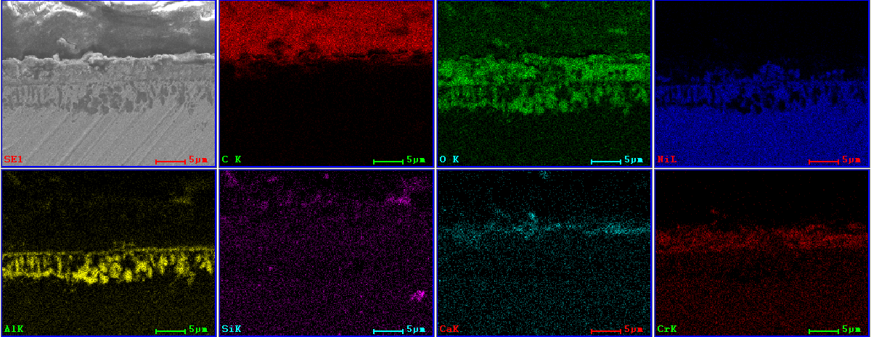
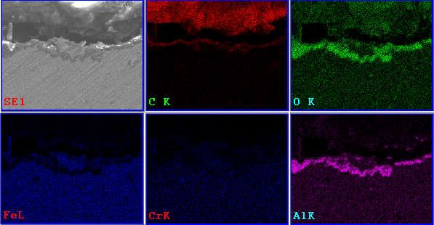
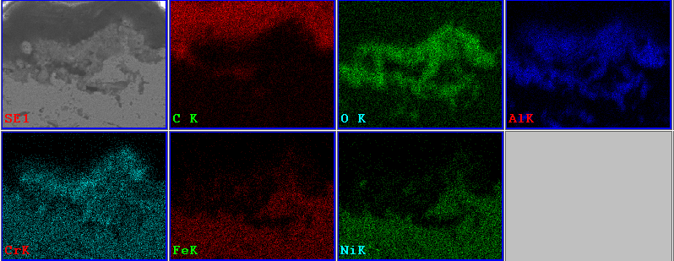
Alumina Forming Alloys (AFA)
In702 (1050°C, 4h)
APMT (950°C, 8h)
HR224 (1050°C, 4h)
Mass and thickness losses of pre-oxidized alloys exposed to eutectic MgCl₂ – 64.41 wt.% KCl at 700°C in flowing Argon up to 500 hours
FESEM-EDS of pre-oxidized AFA alloys in zero air (ZA)

Slide 9
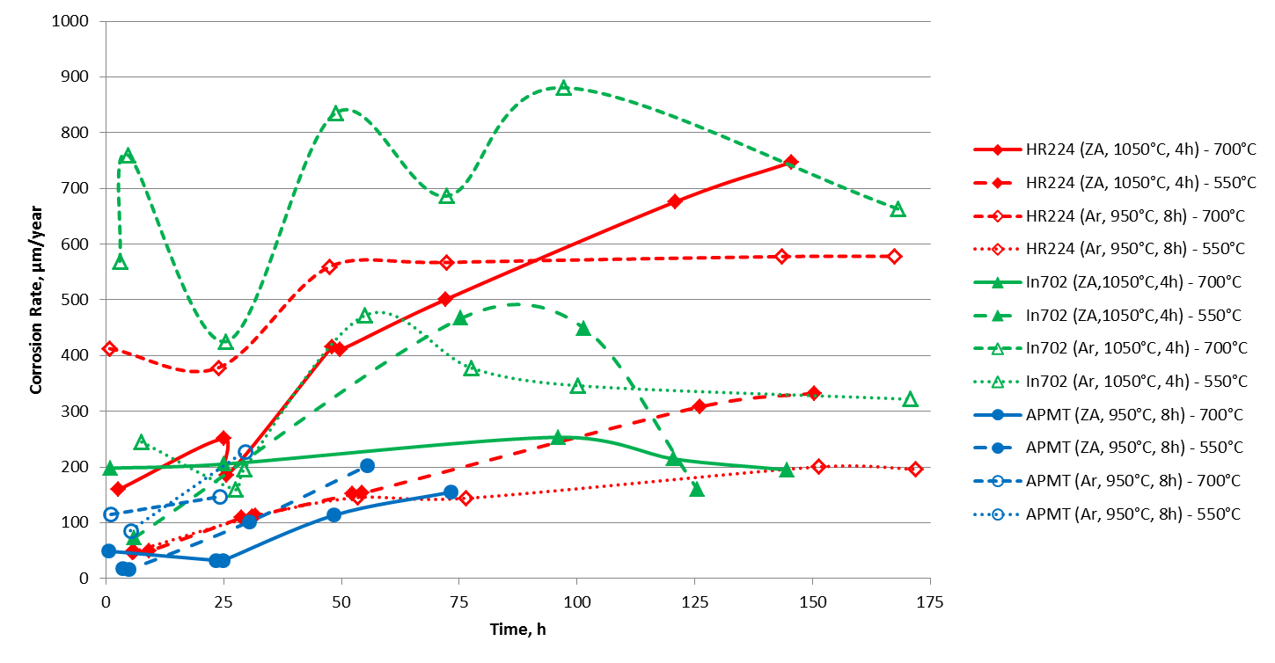
Corrosion of AFAs with Thermal Cycling
Corrosion rates of pre-oxidized alloys exposed to eutectic MgCl₂ – KCl thermally cycled (700–550°C) under flowing Argon up to 175 hours
FESEM/EDS analyzes showed that oxide scales were not protective.
Cr-depletion was observed near the surface.
Alumina layers did not remain stable.

Slide 10
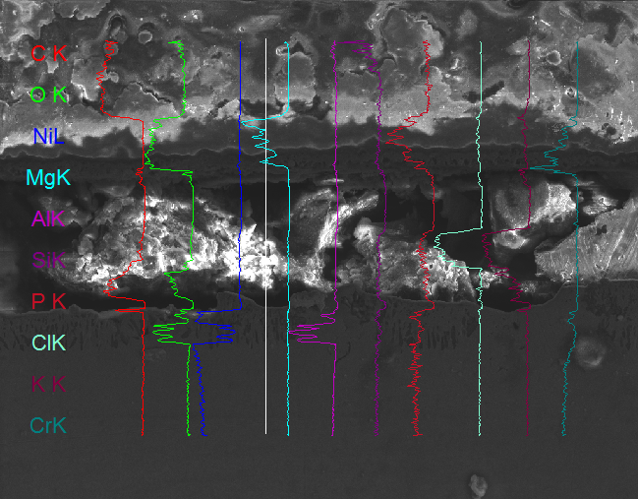
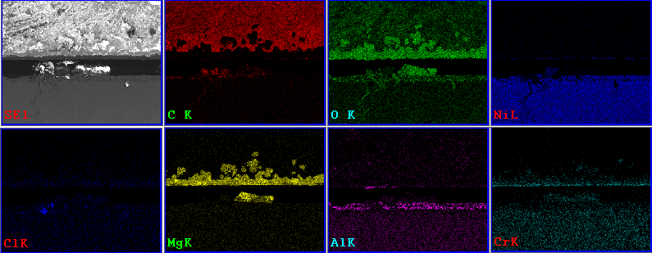
AFA exposed to Molten Chlorides in an Oxidizing Atmosphere
In702 (ZA, 1050°C, 4h) exposed to MgCl₂ – KCl thermally cycled (550 – 700°C) under static ZA during 185 h.
Alumina remained stable and grew from ~5 to ~13 µm. There is no sign of localized intergranular corrosion.
Oxidizing atmospheres could be allowed if molten chlorides are exposed to pre-oxidized AFA alloys because alumina scales remained stable which did not occur in Ar atmospheres.
Long-term weight change corrosion tests will be required to determine corrosion rates and change of corrosion mechanism with time.

Slide 11
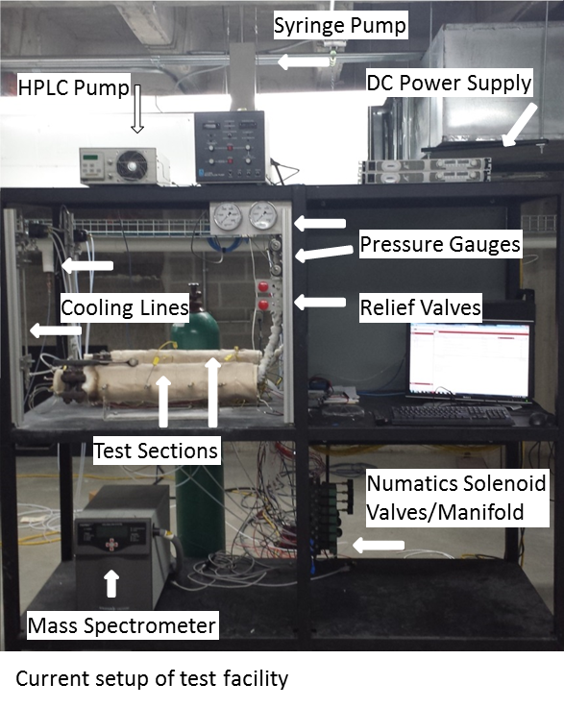
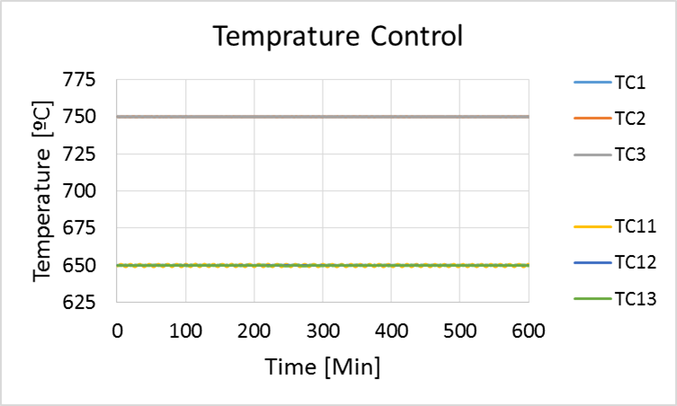
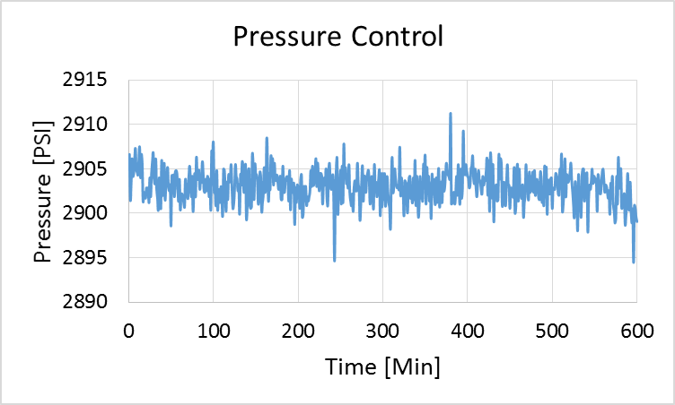
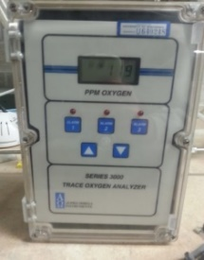
Supercritical CO₂ Testing Facilities University of Wisconsin - Madison
Key Features
Four systems with five total autoclaves
Temperature control allows system to operate within ± 1ºC
Testing temperature up to 750ºC for IN625 autoclave
Pressures up to 3600 ± 2 psi for IN625 autoclave
System operates at an average flow rate range of ~0.1 kg/h
CO₂ refresh rate ~ 2 h
Mass spectrometer used for impurities other than O₂/CO
LLD: 10 ppm
Accuracy: ± 5 ppm
Oxygen Sensor to measures concentration of O₂ in CO₂ bulk gas
Accuracy: ± 1 ppm
Gas Chromatograph for low levels of CO in CO₂ bulk gas
LLD: 50 ppb
Accuracy: ± 2.5 ppb

Slide 12
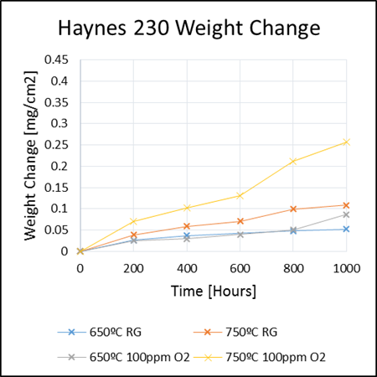
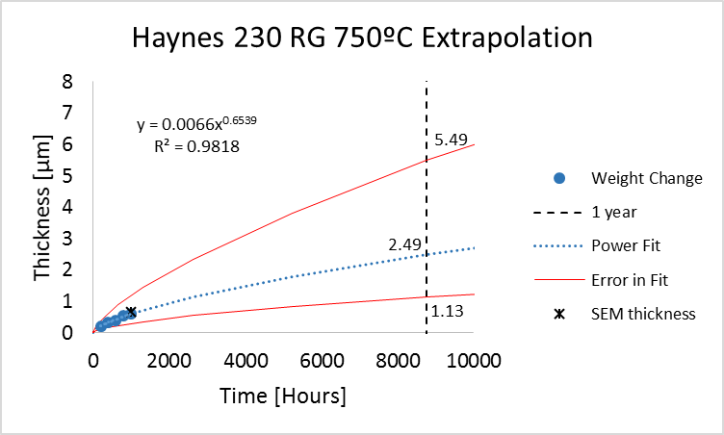
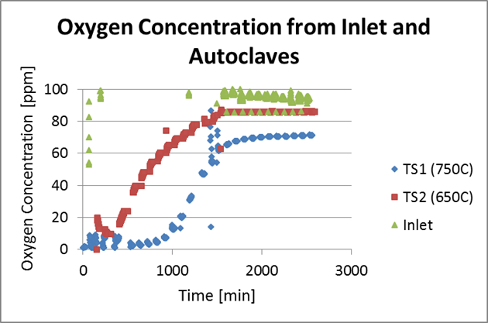
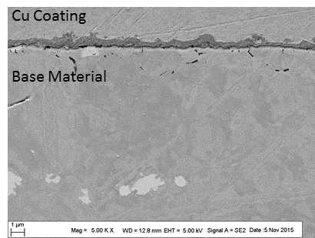
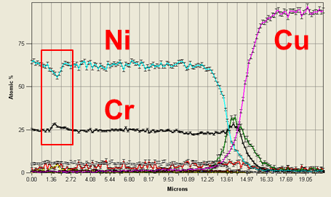
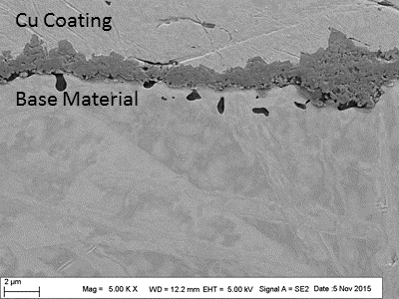
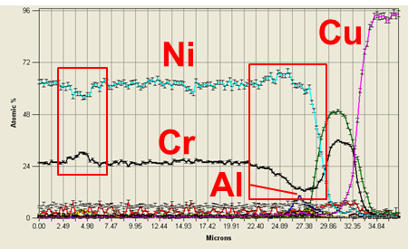
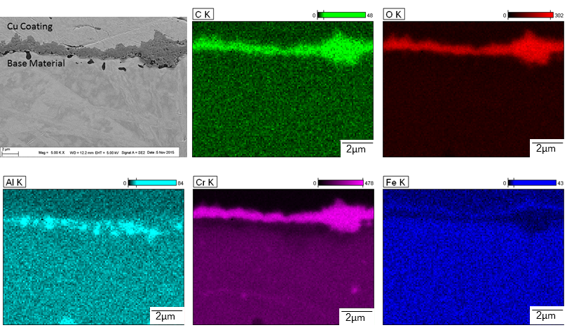

sCO₂ Corrosion Results
Based on power fit equation:
Used time dependent data out to 1000 hours
Used ratio of thickness to weight change from SEM to determine approximate thickness of oxide after 1 year
$$W=a∗t^{b}$$
Oxygen levels were recorded in CO₂ gas before entering the testing autoclave (inlet), as well as at the exit of the autoclave for 650 and 750ºC tests. (Plotted for 100ppm test above)
H230 Cross-sections after 1000 h of exposure
The presence of C suggests that adding O₂ does not completely stop the deposition of C during the oxidation.
Increase in Cr along grain boundary suggests presence of Cr-carbide.
Also resolved : i) void formation and Cr-depletion, ii) formation of Cr, and Fe-rich oxides, and iii) Al increase beneath oxide.
750ºC, 100ppm 750ºC, RG
EDS cross-sections of H230 after 1000 h of exposure in O₂-doped CO₂
Sample exposed to RG-CO₂ showed no observable Cr-depletion zone.
Cr-depletion zone for O₂-doped exposure in red box on right.
Cr-carbides found in both samples (indicated by red boxes on left side of both line scans).

Slide 13
Future of Corrosion Mitigation Approaches
Kinetic and corrosion mechanisms must be studied under higher oxidation potentials to determine if the AFAs can be used in chloride molten salts since it seems alumina protective layers are stable and could re-heal.
Vapor phase with oxidizing atmospheres are very aggressive to chromia forming alloys.
Samples exposed to CO₂ without O₂-doping produced less than 5 µm/year of extrapolated oxide. Significantly thicker oxides with evidence of spallation was obtained in O₂-doped CO₂. Adding O₂ does not completely stop the deposition of C during the oxidation process. Carburization of the alloys exposed to sCO₂ must be evaluated.

