Slide 1


INNOVATIVE METHODS. EXCEPTIONAL PEOPLE.
www.Andrew-Morgan.com
Say What?! Prompting Large Language Models for Smarter Cost Analysis
Anil Divvela

Slide 2

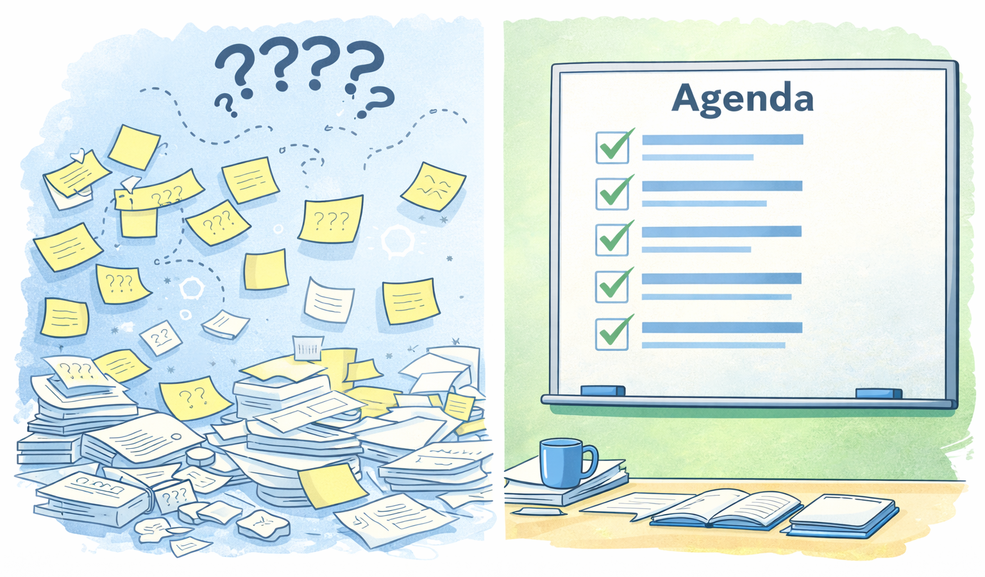

Agenda
  Introduction
  Prompting Overview
  Prompting Checklist
  Prompting in Practice
  Use Cases
  Responsible Use & Governance Guardrails
  Conclusion
  Questions
  Resources

Slide 3



Introduction
A little on me and what we’re going to cover today
Background:
18 years of experience (Cost / Data analysis)
B.S., Industrial Engineering, Purdue
M.B.A, Boston College
Certified Cost Estimator Analyst (CCEA)
Project Management Professional (PMP)
PEO Defense Healthcare Management Systems (DHMS)
Objective:
    Discuss how to effectively deliver a prompt into a Large Language Model (LLM)
    Discuss a few examples that might be helpful in the work we do
Anil Divvela, M.B.A., PMP®, CCEA®

Slide 4





Overview
  Intended Audience?
  Someone that is interested in learning how to develop prompts in an LLM, or who is looking to add efficiency or refinement to their prompts
  Anyone trying to get their work done faster
  What is Prompting?
    In the context of AI or a Large Language Model (LLM) it is a question, command, or statement provided to an artificial intelligence model to guide its response generation (geeksforgeeks.com)
  What is an LLM?
    A Large Language Model is an AI system trained on vast amounts of text to understand and generate human-like language, enabling it to answer questions, summarize information, reason over text, and assist with tasks through natural language.
  How to get started?
    Go to ChatGPT.com, Google Gemini, claude.ai, genai.mil, acqbot.mil (Consider your organizations restrictions)

Slide 5
Prompting Checklist
What makes for a good prompt?
  Define a singular objective
  What one thing should this prompt accomplish?
  Provide context
  What background, domain, or situation does the model need to understand?
  Constrain scope and assumptions
  What is in bounds, out of bounds, and taken as given?
  Specify output format and depth
  How should the answer be structured and how detailed should it be?
  Provide example outputs (if available)
  Anchor structure and expectations.
  Request verification
  Ask the model to critique its own logic, assumptions, and limitations.
        Validate
        Review for reasonableness, traceability, and fitness for use.
Treat prompts like analytical models: define scope, state assumptions, control outputs, and validate results

Slide 6
Prompting in Practice (1/2)
How to Approach Prompting
Basic Prompt
Refined Prompt
What should I make for breakfast?
I am looking for a simple, quick breakfast option that I can prepare on a weekday morning.
Provide a baked oatmeal recipe that:
Uses 5 or fewer ingredients
Can be prepared in less than 30 minutes
Format the output as a recipe card with:
Ingredients
Step-by-step instructions
Include:
Any assumptions (e.g., pantry items, serving size)
A validation check to confirm the recipe meets the stated constraints
Note any logical gaps or unsupported steps”
Effective prompting yields insightful results

Slide 7
Prompting in Practice (2/2)
Basic Prompt:
What should I make for breakfast?
Refined Prompt:
~Baked Oatmeal Recipe
Output:
Pancakes
Scrambled eggs
Smoothie
Toast with avocado
Oatmeal
Observations:
Broad, generic ideas
No structure or detail
Not directly actionable
Requires follow-up questions
Output:
Baked Oatmeal Recipe
Ingredients (5):
Rolled oats
Milk
Banana
Maple syrup
Cinnamon
Instructions:
Preheat oven to 375°F
Mix all ingredients
Pour into baking dish
Bake for 25 minutes
Assumptions:
Pantry staples available (e.g., baking dish)
Serving size: 2–3
Validation Check:
Meets ingredient and time constraints
No unsupported steps
  Better questions → clearer, usable outputs
Notes:
How do we apply these concepts to cost Analysis?

Slide 8

Professional Use Case 1 (1/2)
  Scenario: Using LLMs to Support Data Collection & Analogy Identification
  Problem
  You need to identify comparable programs or organizations to support a cost estimate, often with limited visibility into relevant data.
Background / Context:
You are new to a program and tasked with developing a cost estimate. You have limited knowledge of where to find data or comparable efforts. Analysts often rely on identifying analogous programs across organizations (e.g., USAF, USN, Army).
Approach: Structured Research Prompting
Use targeted prompts to identify analogous organizations and surface relevant data based on mission, scale, and operating environment.
Notes:
How do we apply these concepts to cost Analysis?

Slide 9
Professional Use Case 1 (2/2)
Prompt Progression: From Vague to Actionable
Good:
Find similar organizations to DHA.
Better:
Identify organizations analogous to DHA. Include mission similarity, program characteristics, and data availability. Provide results in table format.
Best:
You are a cost analyst supporting a healthcare IT program.
Identify organizations analogous to DHA that operate in similar mission space, scale, and regulatory environments.
For each organization, provide:
Mission/domain similarity
Program characteristics (especially software-intensive efforts)
Data availability (Public / Restricted / Unknown)
Key assumptions and any gaps in available information
Present results in a structured table and flag any unsupported claims.
Value
Faster identification of analogies and benchmarks
Structured comparison across organizations
Flexibility
Adjustable by scope (Program, PEO, Agency)
Tailored to domain or data needs
Notes:
How do we apply these concepts to cost Analysis?

Slide 10
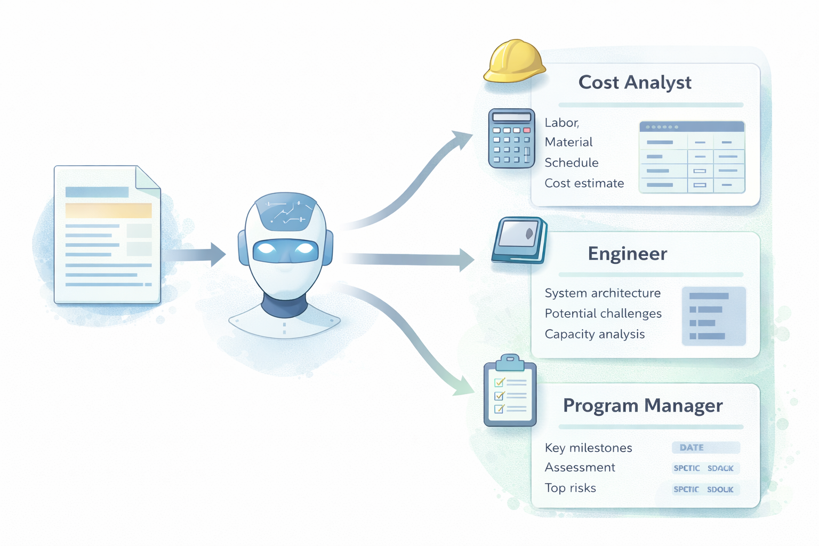
Professional Use Case 2 (1/2)
Scenario: Generating SME Insight with LLM Role Prompting
Problem
Cost estimates require SME judgment to validate assumptions, identify cost drivers, and surface risks, but SMEs may be unavailable, inaccessible, or nonexistent.
Background / Context
You are developing a cost estimate and need input from subject matter experts. However, SMEs may be unavailable or difficult to engage early in the process.
Approach: Role-Based Prompting
Use structured prompts to simulate expert perspectives and generate initial insights on cost, risk, and program considerations.

Slide 11
Professional Use Case 2 (2/2)
Prompt Progression: From Vague to Analytical
Good
What are the risks in this program?
Better
Identify potential risks in a software-intensive DoD program.
Include technical, schedule, and integration risks.
Best (Role-Based Prompting)
You are a senior DoD Contracting Officer with experience supporting software-intensive acquisition programs.
Based on your experience, describe:
What aspects of this program would raise concern early in the acquisition process
Where uncertainty or risk is most likely to emerge
What information you would need to feel confident in proceeding
Explain your reasoning and highlight any assumptions or gaps that would require further validation.
Value
Rapid perspective generation
Structured expert-style reasoning
Flexibility
Applicable across roles (PM, Engineer, Scheduler, etc.)
Adaptable to different program types and domains

Slide 12

Professional Use Case 3 (1/2)
Scenario: Using LLMs to Synthesize & Review Large Document Sets
Problem
You must review large volumes of material (~1,500 pages) to extract key insights, risks, assumptions, and decision points, often amid time constraints.
Background / Context
Analysts frequently review technical documents, acquisition artifacts, or policy instructions. The challenge is identifying what matters without reading everything line-by-line.
Approach: Structured Document Synthesis Prompting
Use targeted prompts to guide the LLM in analyzing, summarizing, and synthesizing large document sets into actionable insights.

Slide 13
Professional Use Case 3 (2/2)
Prompt Progression: From Vague to Actionable
Good
Summarize this document.
Better
Summarize this document and identify key themes and findings. Provide your response in bullet format.
Best
Based on your review of the provided documents, identify:
Key themes and findings
Cost drivers and assumptions
Areas of risk or ambiguity
Inconsistencies or gaps across sources
Provide your response in a structured summary format.
Highlight any unsupported claims and note where additional validation is needed.
Value
Accelerated document review
Structured synthesis across sources
Pattern and inconsistency identification
Security & Governance Considerations
Confirm appropriate ATO for the LLM environment
Verify document classification level before upload
Ensure compliance with organizational data handling policies

Slide 14

Responsible Use & Governance Guardrails
LLMs Augment Analysis — They Do Not Replace Analyst Judgment
1. Maintain Accountability
You are responsible for all outputs
AI outputs must meet professional standards
2. Verify Before Use
Validate facts, data, and claims
Distinguish sources vs. model interpretation
3. Manage Risk
Treat confident outputs with caution
Do not use unverified information
4. Protect Data
Confirm ATO and classification
Follow data handling policies
5. Preserve Traceability
Document prompts and assumptions
Ensure reproducibility

Slide 15

Conclusions / Recommendations
Wrapping up
    Start small; prompting improves with practice
    Detailed questions drive more usable outputs
    Structure and context make the biggest difference
    Document and validate outputs to maintain rigor
    These tools support your analysis; they don’t replace your judgment
Prompting doesn’t change what analysts do — it improves how we ask

Slide 16
  Questions?

Slide 17

Resources
Learn the Basics
LearnPrompting.org
Google AI Essentials (Coursera)
GenAI.mil (prompting basics)
Apply It in Practice
OpenAI Prompting Guide
Anthropic Prompt Library
Microsoft AI Prompt Engineering
Use It Responsibly
NIST AI Risk Framework
GAO AI Accountability Framework

