Slide 1
Reviews You Can Use:
Process Improvements to the Weapons Design Cost Report (WDCR) and Baseline Cost Report (BCR)
Mike Metcalf and Victoria Codding
Technomics support to Program Analysis and Evaluation (PA&E)
August 12, 2026

Slide 2
Agenda
WDCR/BCR Submission Process
  Definitions
  Phase X
  BOE, DIT and SURA/SCURA
PA&E End-to-End Support
  Building Capability & Readiness
  Lead Structured Reviews
  Strengthening Program Defensibility

Slide 3
WDCR/BCR
Submission Process

Slide 4
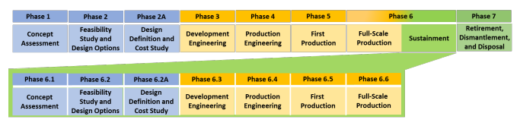
WDCR/BCR Definition
The Weapons Design Cost Report (WDCR) provides a description of the option and preliminary cost estimates for design, qualification, and production activities
The Baseline Cost Report (BCR) formally updates the WDCR based on late development and pre-production activities
Phase X Process
(New weapons)
Phase 6.X Process
(LEPs, Major Alts, Modifications)
WDCR
BCR
BCR Update

Slide 5
Summary of PA&E Involvement in the WDCR/BCR Estimates
Labs, Plants and Sites (LPS) develop and submit scope, cost, schedule, and risk inputs and other artifacts.
FPO and PA&E each review and analyze the following artifacts:
  Basis of Estimate (BOE)
  Data Integration Template (DIT)
  Schedule Cost Uncertainty Risk Analysis (SCURA)
LPS partners update and finalize site inputs based on reviews
FPO consolidates all inputs into a report for WDCR or BCR.
Notes:
The WDCR is an iterative process where LPS partners develop scope, cost, schedule, and risk inputs using defined requirements.
The FPO consolidates into a report, undergoing a review and approval before informing the BCR. NNSA has used this process over a decade.
PA&E streamlined execution through BOE, DIT, and SCURA training, standardized templates, and structured feedback.
To strengthen defensibility, PA&E created Component Benchmarking Tool enabled data driven, component level comparisons to validate estimates & identify anomalies.
PA&E expanded support by integrating EVM, historical data, and strategic planning as programs advance through BCR cycles & will discuss process improvements that impacted the successful W93 WDCR.

Slide 6
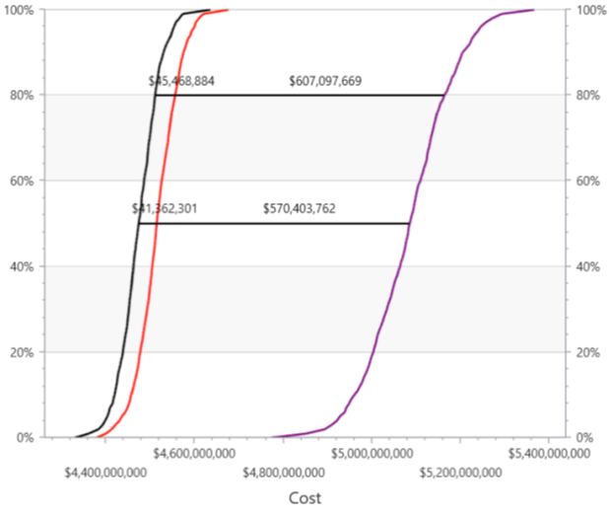
WDCR/BCR Estimates Detail and Documentation
*Example from SCURA Training
BOE: a justification of scope, assumptions, quantities, cost‑estimating methods, risks, and supporting documentation to develop a defensible cost estimate.
DIT: a record of labor, material, and other cost elements derived from resource‑loaded schedules (RLS), capturing actuals and future projections for program estimating and review.
SCURA: a schedule and cost integrated analysis that incorporates risk and uncertainty.
Uncertainty Only
Uncertainty
+ Cost Risk Events
Uncertainty
+Cost Risk Events
+Cost of Schedule Ext

Slide 7
PA&E: End‑to‑End Support

Slide 8
PA&E Responsibilities Across the WDCR/BCR Process
Build Capability & Readiness
Develop and deliver BOE, DIT, and SURA/SCURA training across programs.
Support WDCR/BCR management with streamlined templates and requirements reflecting best practices
Integrate lessons learned to continuously improve program submission quality.
Lead Structured Reviews
Conduct formal reviews of BOE, DIT, SCURA artifacts and provide actionable feedback.
Align reviewer inputs with standardized prompting questions and error language.
Implement CRM workflows for tracking comments, enforcing accountability, and providing traceability.
Strengthen Program Defensibility
Perform cross‑program comparisons with the Component Benchmarking Tool.
Identify anomalies, gaps, missing justification, or inconsistent metrics.
Provide analysis that confirms or challenges site inputs to ultimately enhance the estimate’s justification documentation and credibility

Slide 9
PA&E Support to Submission Process and Timeline
LPS
FPO
PA&E/CEAG
*Sample timeline from W80-5, varies by Program
Deliverable Duration
1 Month
2 Month
1 Month
2 Month
1 Month
3 Month
Consolidate
& Review
Consolidate & Review
Consolidate & Review
Check-In #1 Development
Check-In #2 Development
Final
Development
Familiarization Review
Familiarization Review
Other Reviews
FPO provides feedback to LPSs
Provide consolidated feedback to LPSs
Review Summit
DRAFT Submission
FINAL Submission
Check-In #1 Submissions
Check-In #2 Submissions
Additional BOE and DIT Training informed by submissions

Slide 10
PA&E
Build Capability & Readiness

Slide 11
PA&E Training & Program Support
BOE/DIT
  PA&E delivered training for W93 (2024 & 2025) and W80-5 (2025)
  Lessons from W93 were applied to W80-5 and continue to enhance data quality and submission continuity across programs
  Training typically occurs ~1 year prior to Phase 3/6.3, 4/6.4 and 5/6.5 milestones​
  Key References:
    Training Session recordings/modules
    Templates and requirements from FPO
SURA/SCURA
  PA&E collaborated with the FPO to deliver stakeholder training and communicate program‑specific timelines and requirements for W93 WDCR and W80-5 BCR
  Recurring Timeline: ~1 year prior to Phase 3/6.3, 4/6.4 and 5/6.5
  SCURA-thon 2024-2026
  Key References:
    Training Session recordings/modules
    Templates and requirements from FPO
    SURA/SCURA Cookbook

Slide 12
Strengthening Reviews Through PA&E Insights
W93 Lessons Learned
Early Practice Runs Improve Outcomes
  Early 30‑day practice reviews set clearer expectations and strengthened LPS partner coaching on required detail levels.
Cross‑Referencing Accuracy Is Critical
  Errors in referenced Data Integration Templates reduced BOE effectiveness as a comparative review tool.
Rigorous Justification Is Needed
  Unclear methodologies, missing metrics, and weak travel justifications highlighted the need for stronger analytic rigor.
Process is More Iterative than Expected
  Updates driven by FPO requests or from LPS partners directly were more frequent and difficult to manage than expected.
W80-5 Lessons Applied
  Reviewer Training and Selection
    Early reviewer selection and targeted training improved understanding of program context and strengthened the identification of technical risks.
  Structured Review Process
    Implementing a coordinated, structured workflow increased review consistency and reduced early‑stage errors across BOE, DIT, and SCURA products.
  Standardized Documentation
    Adopting uniform visuals, tables, and templates improved SCURA product validation and enhanced alignment across submissions.
  Component Benchmarking Tool
    Developing integrated benchmarking dashboards increased efficiency and supported comparative analysis across programs, improving defensibility and cross‑program consistency.

Slide 13
PA&E Lead
Structured Reviews

Slide 14
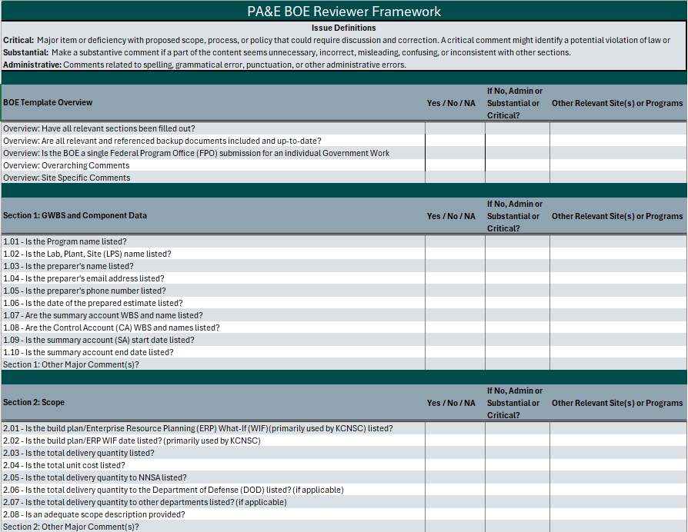
PA&E Reviewer Framework & Implementation
Developed standardized checklists and error language to ensure consistent, traceable alignment across BOE, DIT, and SURA/SCURA.
Coordinates review workflows across PA&E, CEAG, and the FPO to strengthen quality assurance and streamline the review process.

Slide 15
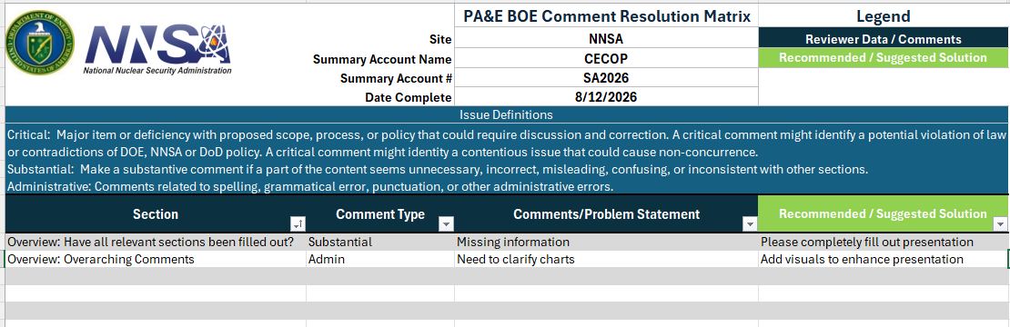
PA&E CRM Structured Feedback for BOEs, DITs, and SCURAs
Enhances reviewer effectiveness by aligning feedback with the structured prompting questions defined in the review framework
Streamlines and organizes reviewer comments, ensuring only actionable items are returned to the LPS for revision
Standardized error language to clearly identify issues, improve clarity and reduce ambiguity during reviews

Slide 16
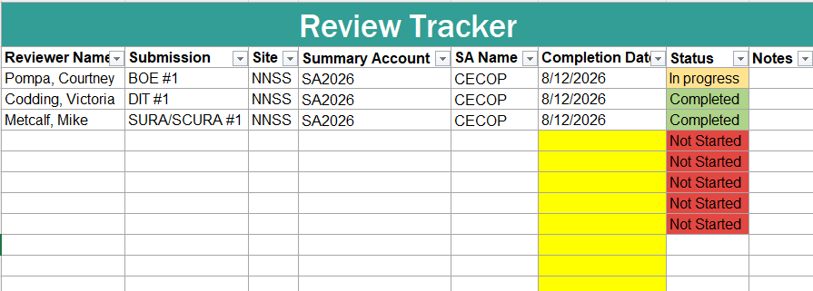
PA&E Resource Planning and Tracking
PA&E allocates review resources based on program needs
Reviewers document progress and maintain visibility into review status
CEAG volunteers select reviews based on their availability / expertise and submit status updates upon completion.
Best practice is a minimum of two formal reviews conducted for each submission when possible

Slide 17
Strengthen Program Defensibility

Slide 18
Component Benchmarking Tool Background
Mission from W93 ahead of WDCR: help give context to site estimates, and help answer questions of "does it make sense?" and "is it defensible?"
PA&E implemented a study on behalf of the W93 to:
Develop a tool that supports detailed WDCR review and cross-check.
  Generate automated comparisons of site DIT submissions and generate to normalized historical weapons programs
  Present analysis in hours and dollars, including detail of major components (or LOE), projections vs. actuals, and other measures to evaluate site inputs compared to recent programs
Provide advanced component-level benchmark analysis to request further review or justification of site submissions
Develop a repeatable process and documentation to support future WDCR and BCR reviews for other weapons programs.

Slide 19
Development Process
Reviewed Data Sets for initial targets
  Settled on CostEx (provides hours actuals) and EVM (provides initial and final EACs as first targets)
  Second targets (in forthcoming updates) include historical DITs, SCORE inputs, and Charge Code Data
Developed a Benchmarking Work Breakdown Structure (BWBS) for comparisons
  Historical data and incoming program data have different levels of detail
  Allows for easy comparisons at the least common denominator level
Built tool modules around WDCR Review use cases
  Module 1: DIT Review Tool (Unclassified CUI and ESN Secret/Restricted Data)
  Module 2: WDCR/BCR comparison to CostEx Hours and Dollars Actuals (Unclassified CUI)
  Module 3: WDCR/BCR comparison to EVM actuals and EACs (ESN Secret/Restricted Data)
Developed methodology for Adjusted Dollars to improve comparisons
  Aligns historical programs as if they started the same year as W93 (FY2021)
  Enables reviewers to use W93 Then Year dollars but still have escalation-adjusted comparisons

Slide 20
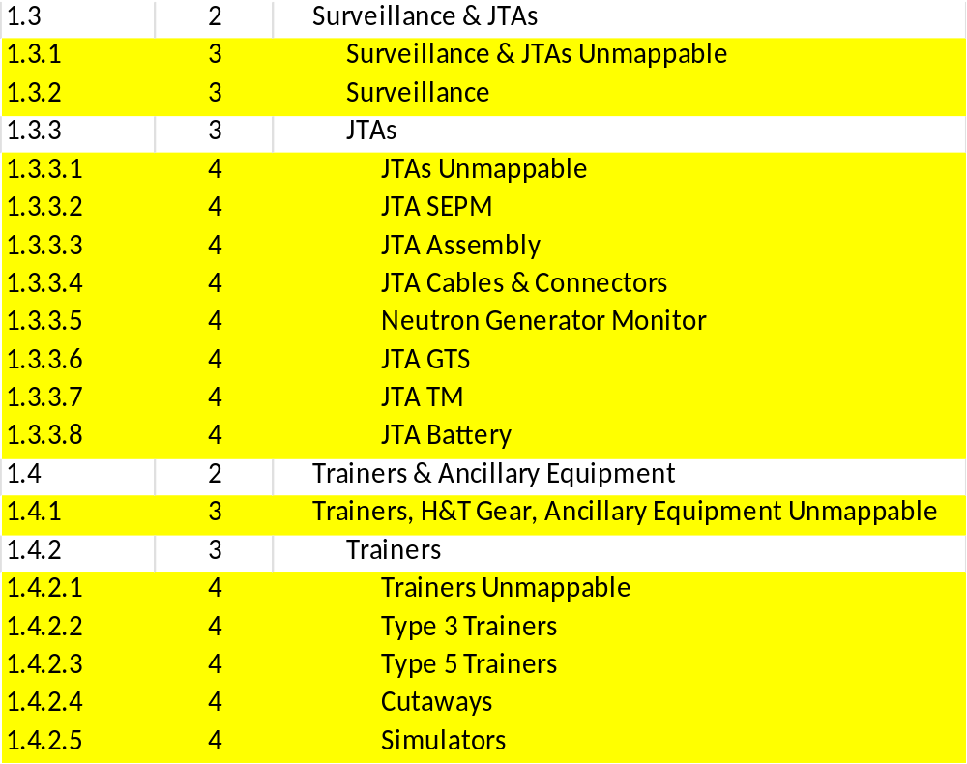
The Magic of the Benchmarking Work Breakdown Structure (BWBS)
UWBS Grandparent
Mapping occurs at marked Yellow levels, and can easily be summarized in White parent elements
“Unmappable” elements available at all levels to ensure cost data is maintained with as much detail as possible
Example (representative) Mapping and Use:
W93 DIT has individual Trainer elements (Type 3 Trainer, Type 5 Trainer, Cutaways) as Summary Accounts;
B61-12 historical data includes elements of “Trainers” with no further detail;
W88 Alt 370 historical data includes detail for Type 3 Trainer, Type 5 Trainer, and Simulators;
Example BWBS Detail
Results:
  B61-12 mapped to “Trainers Unmappable”
  W88 and W93 mapped to known trainer detail
  W93 can be compared to W88 at component level and both W88 and B61-12 at Trainer BWBS Parent level and Trainers & Ancillary Equipment BWBS Grandparent level

Slide 21
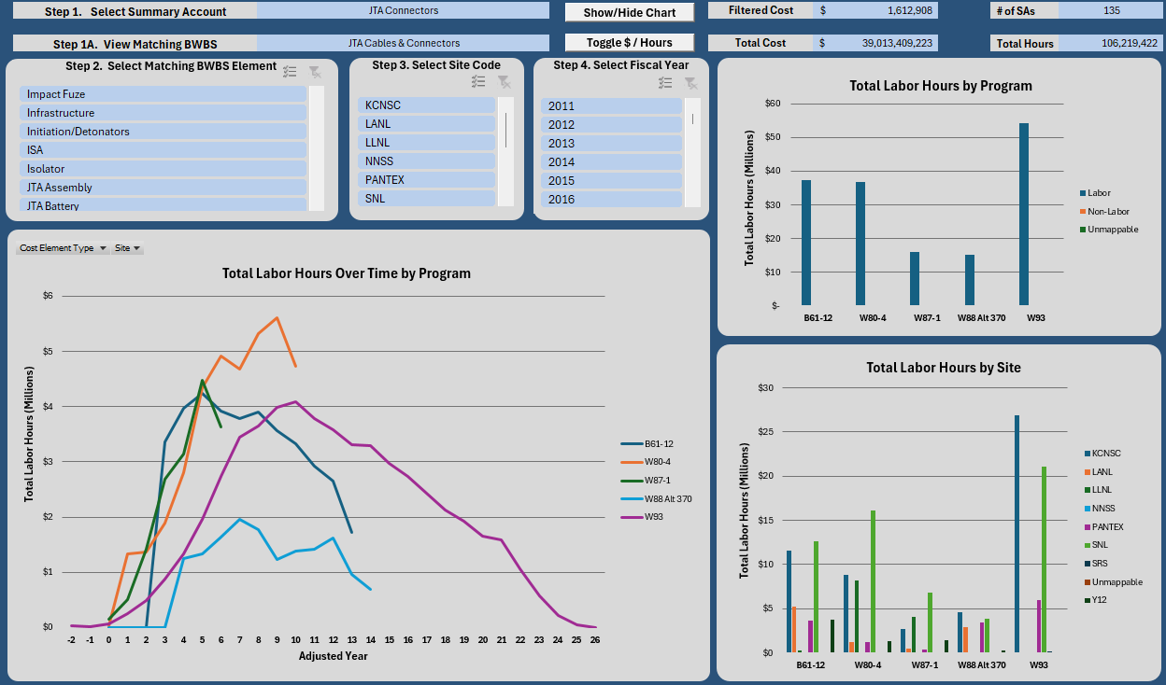
Module 2: Cost Ex Hours (Representative Values, not actuals)

Slide 22
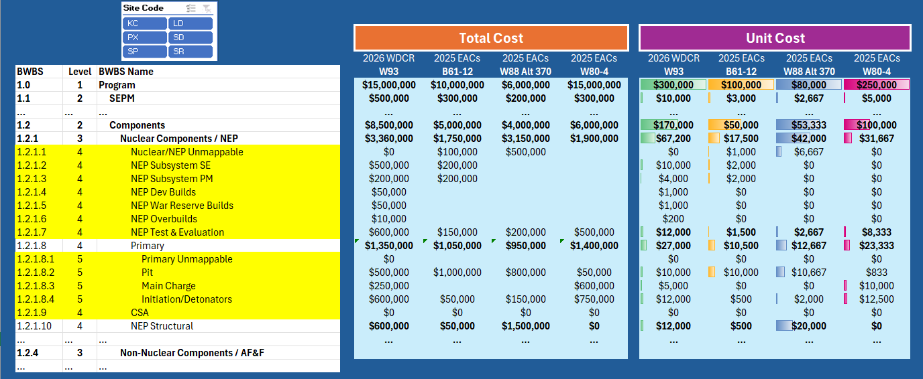
Module 3: EVM Comparisons (Representative Values, not actuals)

Slide 23
Review Process Impact

Slide 24
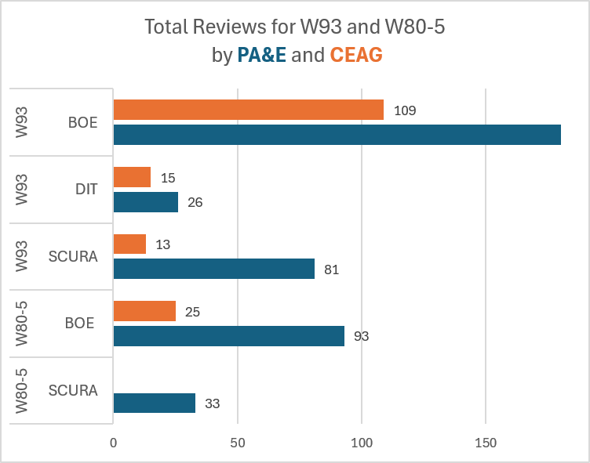
PA&E Review Process Results
PA&E completed a total of 786 reviews and facilitated 162 CEAG reviews in FY25/26
PA&E and CEAG will conduct additional reviews for W80-5 during their BCR
553
The W93 Program Office noted that PA&E's tools, reviews, and analysis were instrumental in completing the WDCR on time
PA&E’s work reinforced the program’s confidence in presenting the WDCR to NNSA leadership and external stakeholders

