Slide 1

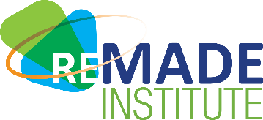
Reducing EMbodied-energy And Decreasing Emissions (REMADE) Institute
ACCELERATING THE TRANSITION
TO A CIRCULAR ECONOMY
U.S. DOE Advanced Manufacturing Office Program Review Meeting
Washington, D.C.
June 2-3, 2020
Dr. Nabil Nasr
Sustainable Manufacturing Innovation Alliance
Award Number DE-EE0007897
1/13/2020 – 12/31/2021
This presentation does not contain any proprietary, confidential, or otherwise restricted information.

Slide 2
Institute Overview
Schedule
Membership
REMADE award issued Jan 2020 & funding released in May 2020
Projected end date December 2021
BP1 – May ‘17- Mar ‘18.
BP2 – Apr ‘18 – Sep ’19
BP3 – Sep ’20 – Sep ‘21
Working on BP4 continuation application.
39 projects selected from first three project calls
Completed (1), Active (28), Awaiting Sub-award/In Negotiations (10)
95 Members as of 5/11/20
42 Industry • 27 Academic
21 Affiliate • 5 National Labs
88% Involved in REMADE Activities
50 Involved in Projects
90% Retention Rate
BP3 - 20 New Members in BP3, 3 Members did not renew (BP3)
Budget
Challenges
$140M award, $70M federal / $70 match
Received $10M from New York State to support cost share
Institute is meeting the 1:1 cost share requirement
Fiscal year 2020/2018/2020 audit successfully completed
Receivables and payables current, including annual membership dues
Technology Development Funding – Tech Dev Funding Allocated below plan – Increasing funding/projects, launching Transforming Industry Projects
Timely Release of RFPs/Project Approval – Approval process for RFPs and recommended projects requires DAS approval – Adds 1-month delay on either end of the process
Number of Active Projects – Have 22 small Exploratory Projects, which has significantly increased overhead w/project management
Discontinued requests for Exploratory Projects in RFPs.
Increased funding available/project
 | FY 17 Costs | FY 18 Costs | FY19 Costs | FY20 Q1-Q2 Costs | FY20 Q3-FY21 Costs | Totals
DOE Funded | $361K | $1.5M | $1.87M | $1.58 | $62.4M | $67.8M
Cost Share | $42.7K | $2.23M | $2.14M | $1.71M | $63.9M | $170M
FFRDC | $59.4 | $343K | $268K | $130K | $1.41M | $2.25M
REMADE Addresses Sustainable Manufacturing Technical Targets 14.1, 14.2, and 14.3 from AMO Multi-Year Program Plan (MYPP)

Slide 3




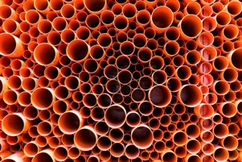

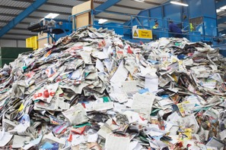
REMADE Institute Objective:
Reduce embodied energy and carbon emissions through early stage applied research & development
REMADE STRATEGIC GOALS
REMADE TECHNICAL PERFOMANCE METRICS (TPMs)
Develop transformational technologies that enable U.S. manufacturers to:
Expand recycling, recovery, remanufacturing & reuse
Reduce primary materials consumption
Increase utilization of secondary materials
Lower energy consumption and emissions
Achieve cost & energy parity between primary and secondary materials
Primary
Feedstock (FS)
Consumed
Secondary FS
Processing
Energy
Embodied
Energy
Efficiency
Cross-
Industry
Reuse
GHG
Emissions
Cost and
Energy Parity
↓30%
↓30%
↑25%
↓20%
4 Material Classes
Metals
Polymers
E-waste
Fibers
REMADE is a public/private partnership developing transformational technologies to accelerate the transition to a Circular Economy for plastics, metals, fibers and e-waste

Slide 4
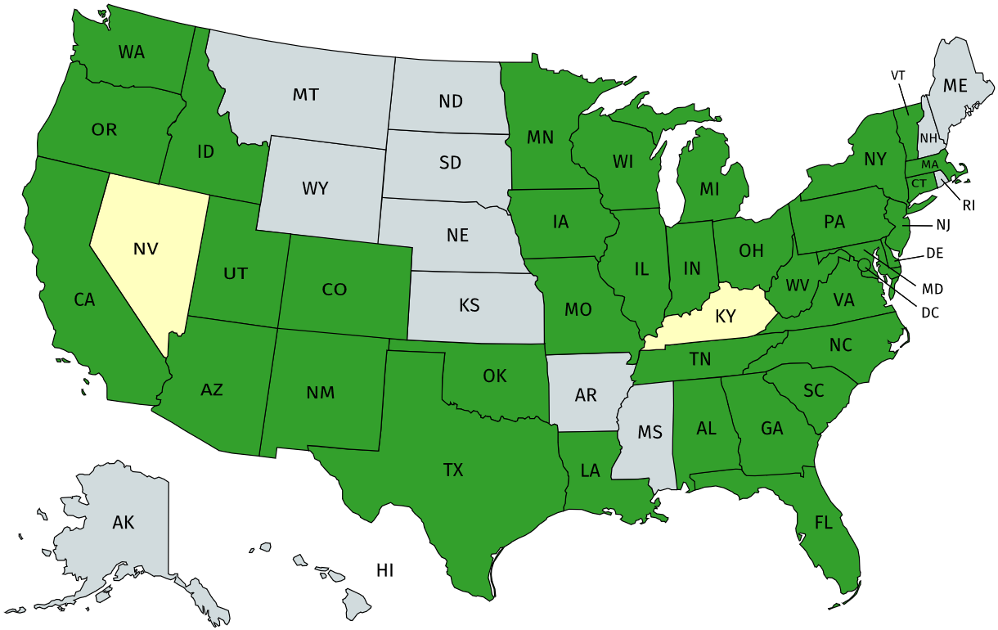


























































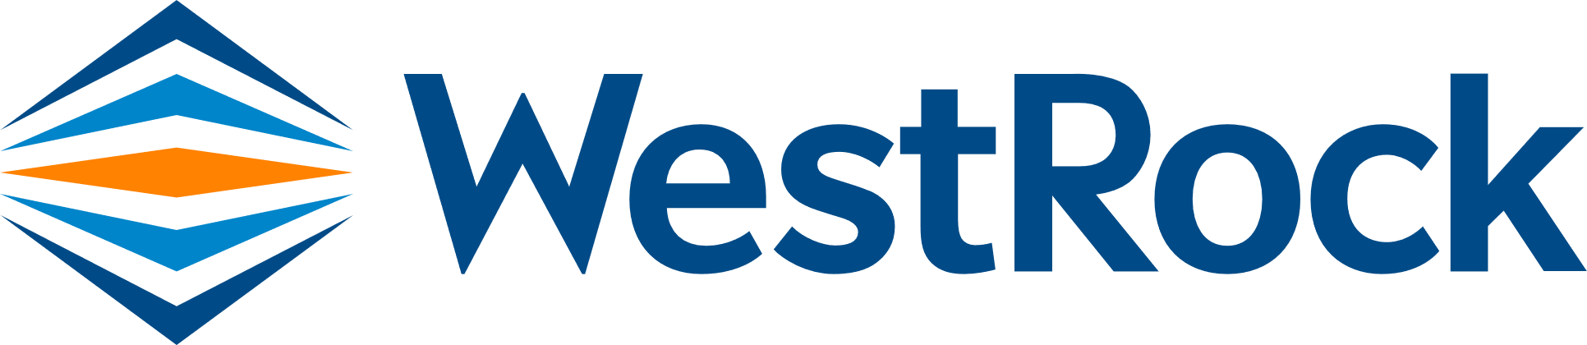


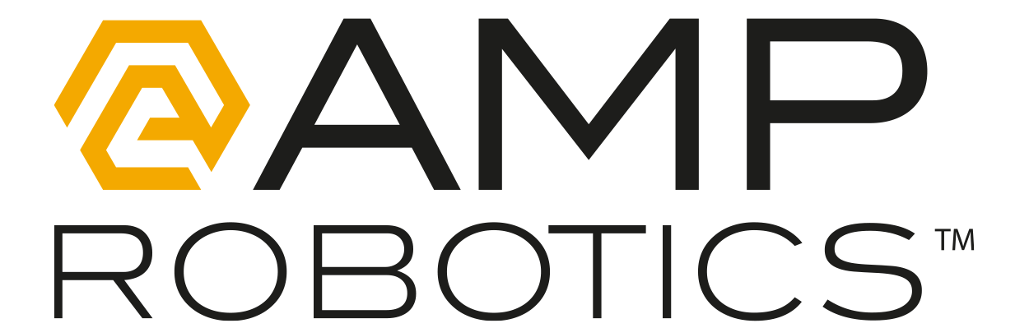



























REMADE Members
Diverse membership composition supports the mission and goals of the Institute
Nationwide industry-focused consortium
Member locations well aligned with labor markets corresponding to REMADE focus areas
50 member organizations are involved in Institute projects selected for award
Member
Interested Party
REMADE Labor Market
Kent County
Department of
Public Works
Ohio State University
University of Michigan
Industry (44%)
Academic (29%)
Michigan State University
Affiliate (22%)
National Lab (5%)

Slide 5
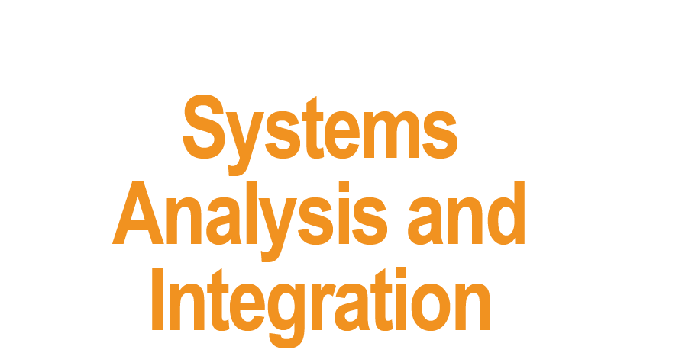
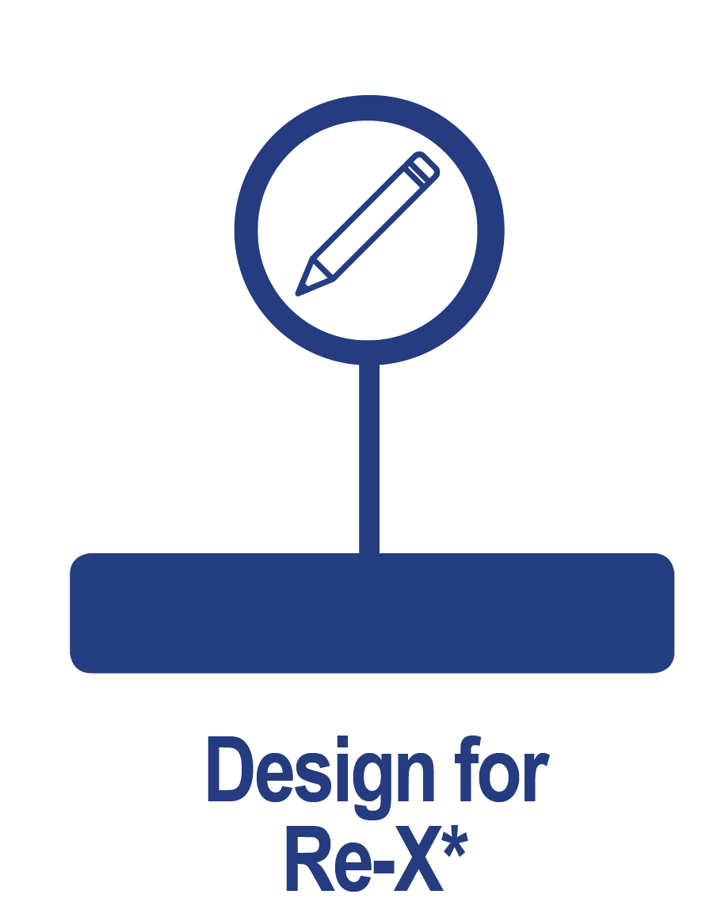
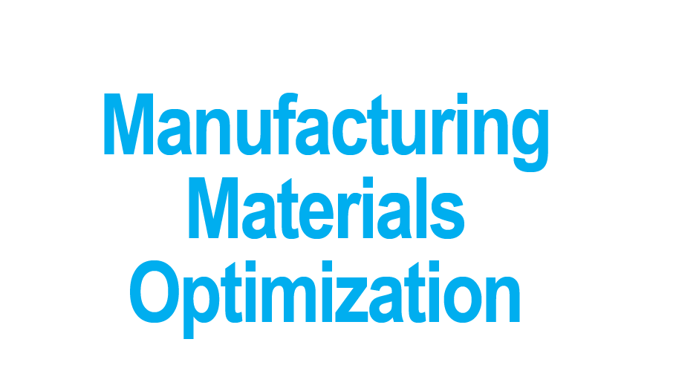
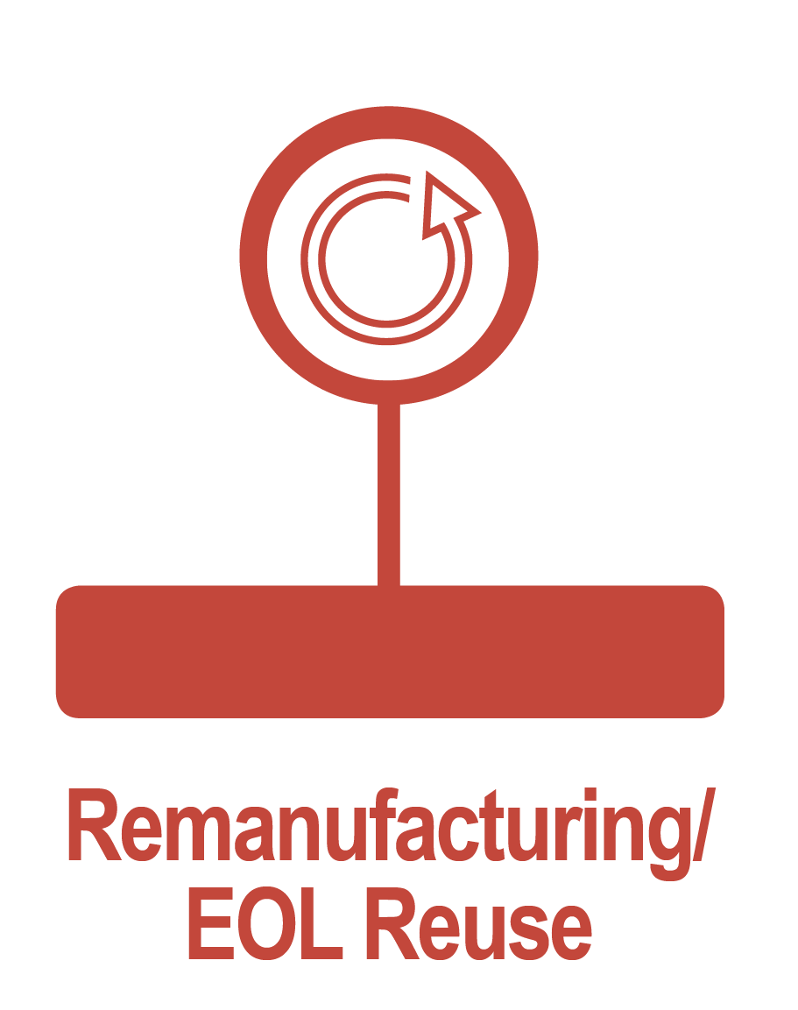

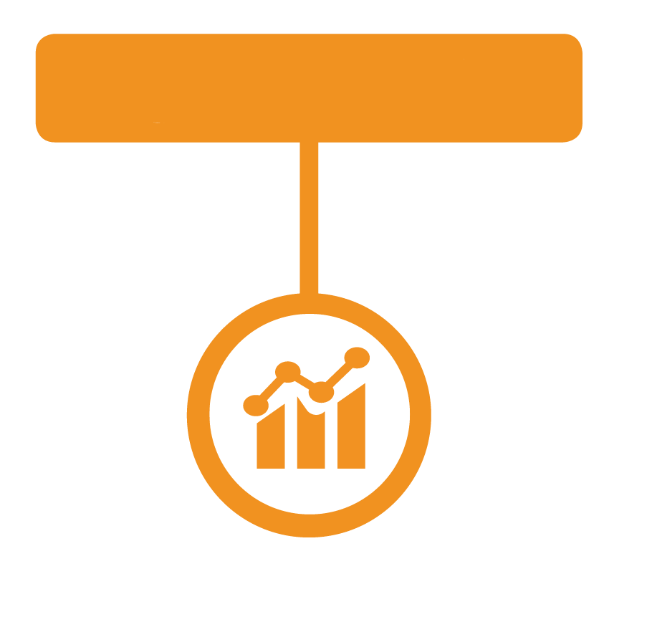

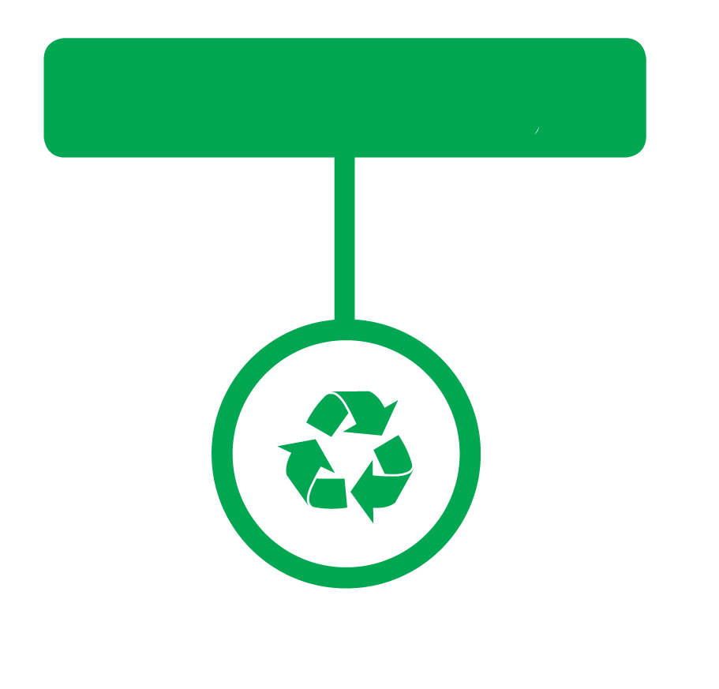



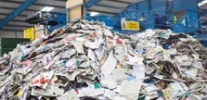
Technology Innovation across the Material Lifecycle
A national consortium of member organizations comprised of industry, academia, national laboratories, trade associations, and non-profit entities collaborating on early stage applied research activities and the development & dissemination of key industrial technology initiatives
TECHNOLOGY FOCUS AREAS ORGANIZED AROUND 5 NODES DESIGNED TO ADDRESS CROSS-CUTTING CHALLENGES
Data collection, standardization, metrics, and tools for understanding material flow
Technologies to reduce in-process losses, reuse scrap materials, and utilize secondary feedstock in manufacturing
Rapid gathering, identification, sorting, separation, contaminant removal, reprocessing and disposal
Design tools to improve material utilization and reuse at End-of-Life (EOL)
Efficient and cost effective technologies for cleaning component restoration, condition assessment, and reverse logistics
^{Metals}
^{Polymers}
^{E-waste}
^{Fibers}
Technology Innovation – Organized by Stages of the Material Lifecyle
^{MATERIAL CLASSES}
© 2020 Sustainable Manufacturing Innovation Alliance. Funding provided by the U.S. Department of Energy’s Office of Energy Efficiency and Renewable Energy (EERE) under Advanced Manufacturing Office Award Number DE-EE0007897.
Notes:
The REMADE Institute, located in Rochester, NY, is part of a US-government sponsored program called Manufacturing USA that was created via an interagency initiative between the Department of Defense, Department of Energy, and Department of Commerce. Today, there are 14 Institutes across the United States that are part of this program – each with a specialized technology focus and a goal of supporting the future of manufacturing in the US through innovation, collaboration, and education. The Institutes serve as consortium of members from industry, academia, national labs, trade associations, and non-profit organizations that come together to collaborate on key industrial technology challenges and work on breakthrough initiatives and solutions that will advance the broader industry forward.
REMADE is comprised of 5 technology focus areas that are interconnected to address cross-cutting themes and challenges in the overall circular economy. Four of the areas, or nodes, align to the material lifecycle stages:
Design for Re-X – Involves the use of design tools to improve material utilization and promote reuse and recycling at product End-of-Life and disposition.
Materials Optimization – Covers technologies to reduce in-process losses, reuse scrap materials, and utilize secondary feedstocks in manufacturing processes.
Remanufacturing & End-of-Life Reuse – Focuses on improving technologies for assessing the remaining life and residual value of products and components, achieving cost parity for material reuse, and developing restoration methods to restore components to “like-new” condition.
Recycling & Recovery – Corresponds to the rapid gathering, identification, sorting, separation, contaminant removal, reprocessing, and disposal of a wide variety of materials and substrates.
The fifth node, Systems Analysis & Integration, addresses systems level issues that are broader in scope than any one particular node and have the potential to impact the other 4. Aspects like data collection, standardization, metrics, and tools for understanding material flow are captured in this focus area.
And within the REMADE technology focus areas, the Institute is honing in on addressing the needs of 4 primary material classes – metals, polymers, e-waste, and fibers.

Slide 6









Current Technology Portfolio
39 Selected Projects ● 50 Collaborating Organizations ● $20 Million Project Value
4 Projects
$1.6M
3 Projects
$2.1M
3 Projects
$4.9M
7 Projects
$2.9M
13 Projects
$8.3M

Slide 7
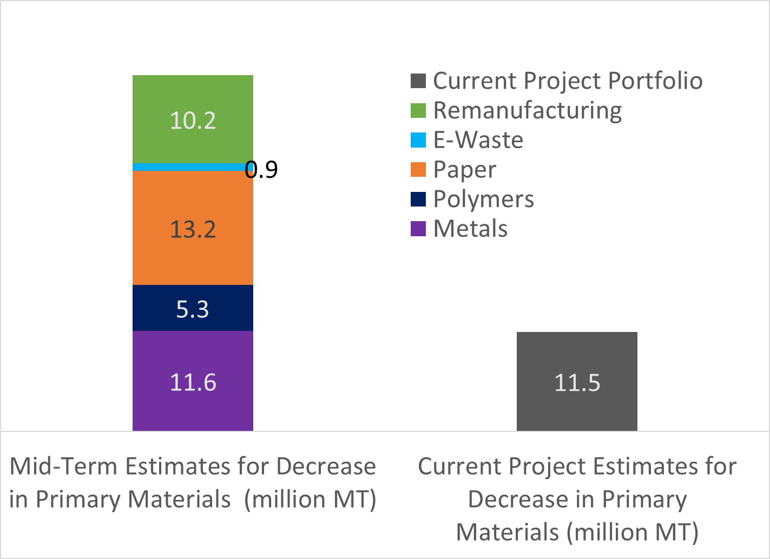
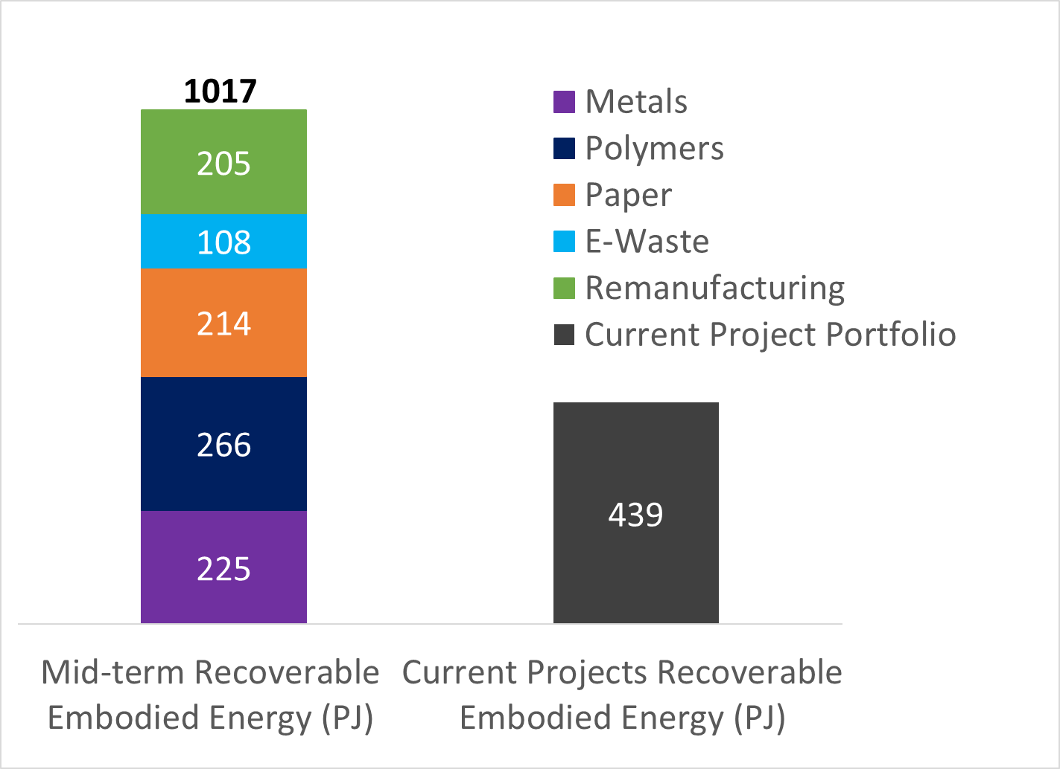
Technical Approach – Balanced Portfolio across Material Classes + Project Impacts
Progress vs 5-Yr Primary Feedstock Reductions
Node Node | Thrust Area | # Projects | Material Classes
 |  |  | Metals | Polymers | E-waste | Fibers
 | Material Flow, Lifecycle Analysis, and Systems Analysis Methods, Tools, and Data | 2 | 1 | 2 | 1 | 1
 | Techno-economic Analysis Models and Tools | 3 |  |  | 1 | 2
 | Design for Re-X Metrics & Assessment Frameworks | 1 |  |  | 1
 | Design for Re-X Methods and Tools | 4 | 4
 | High-impact Design for Re-X Application Domains
 | Manufacturing and Process Control | 3 | 1 | 1 |  | 1
 | Characterization, Qualification & Simulation | 2 | 1 | 1
 | Robust Non-destructive Inspection/ Evaluation Technologies | 3 | 3
 | Remanufacturing Analysis Tools & Methods | 3 | 1 |  | 2
 | Low-cost Component Repair Technologies and Restoration Methods | 3 | 2 |  | 1
 | Technologies/Tools to Increase Collection & Recovery | 1 |  |  |  | 1
 | Mechanical Recycling Technologies for Sorting, Separating, and Liberating Materials | 8 | 2 | 4 | 2
 | Chemical and Solvent-Based Recycling & Separation Technologies | 1 |  | 1
 | Characterization, Cleaning & Purification | 4 | 2 | 1 |  | 1
 | Education & Workforce Development | 1 |  |  |  | 1
 | TOTALS | 34 | 17 | 10 | 8 | 7
Progress vs 5-Yr Embodied Energy Reductions

Slide 8
5-Year Target TPMs
Confirming Research Activities Enable REMADE to meet TPMs
(Technical Approach)
1018
Embodied Energy
Reduction (PJ)
41.2
Primary Feedstock
Reduction (MMT)
41.2
Secondary Feedstock Reduction (MMT)
REMADE’s research portfolio, including projects from solicitation 19-01, is expected to support the achievement of 26% to 53% (depending on the TPM) of the 5-year Target TPMs for the Institute.
The research funding that has been committed for these projects is slightly more than 20% of the Institute’s planned 5-year research budget.
51.2
Emissions Reduction
(MMTCO₂eq)

Slide 9
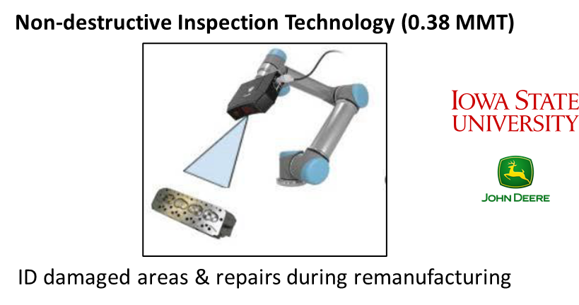
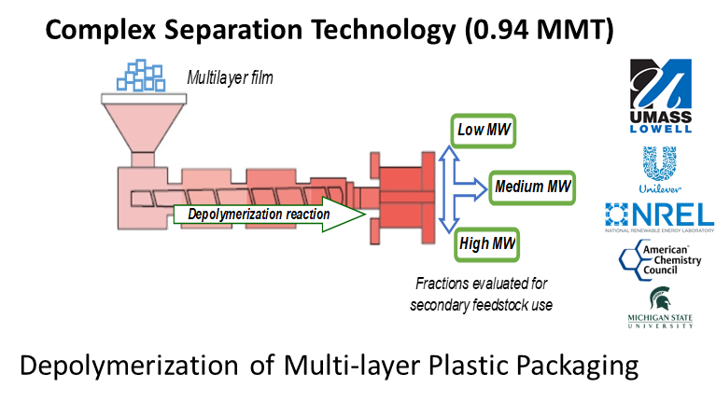
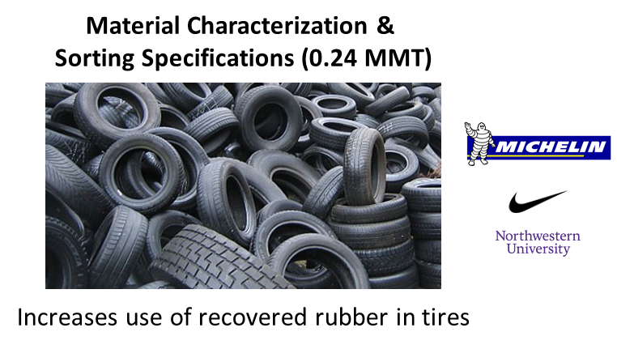
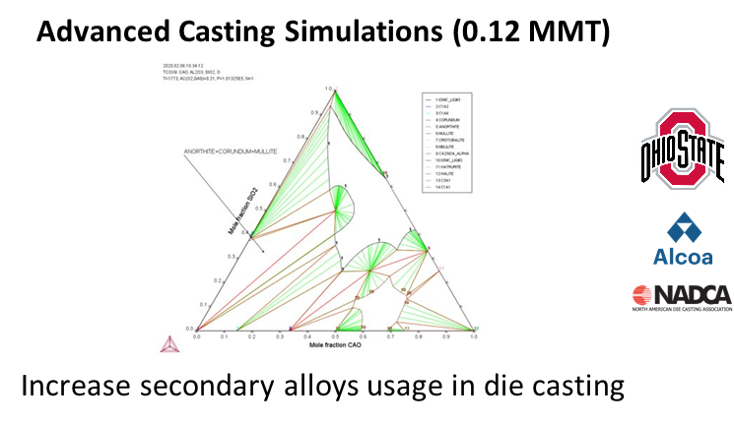
Transformational Technologies for U.S. Manufacturers (Results & Accomplishments)
Reduce primary materials consumption (5-Year Goal – 41.2 MMT)
Increase utilization of secondary materials (5-Year Goal – 41.2 MMT)

Slide 10
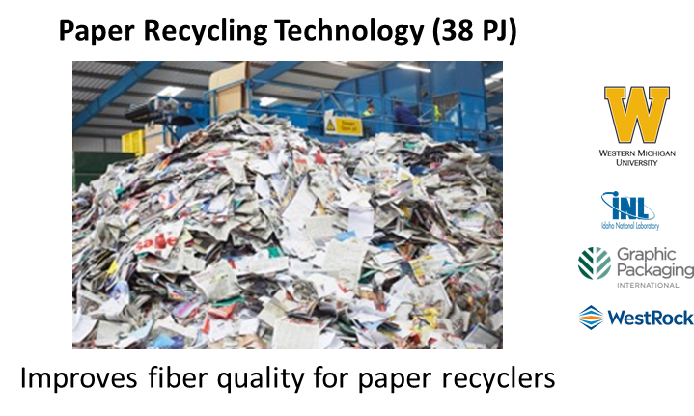
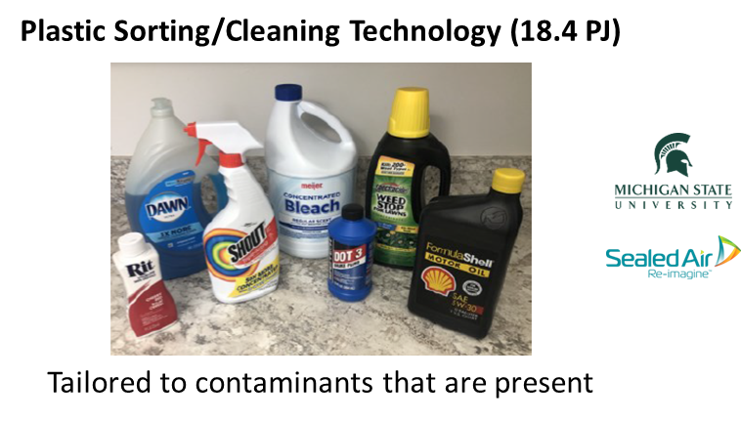
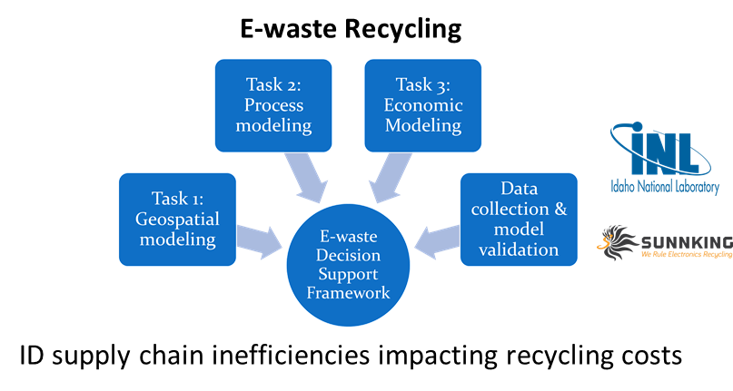
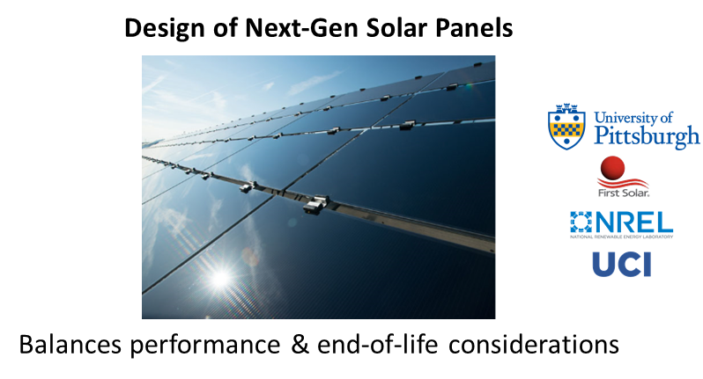
Transformational Technologies for U.S. Manufacturers (Results & Accomplishments)
Lower energy consumption and emissions (5-Year Goal – 1018 PJ)
Achieve cost & energy parity between primary and secondary materials

Slide 11
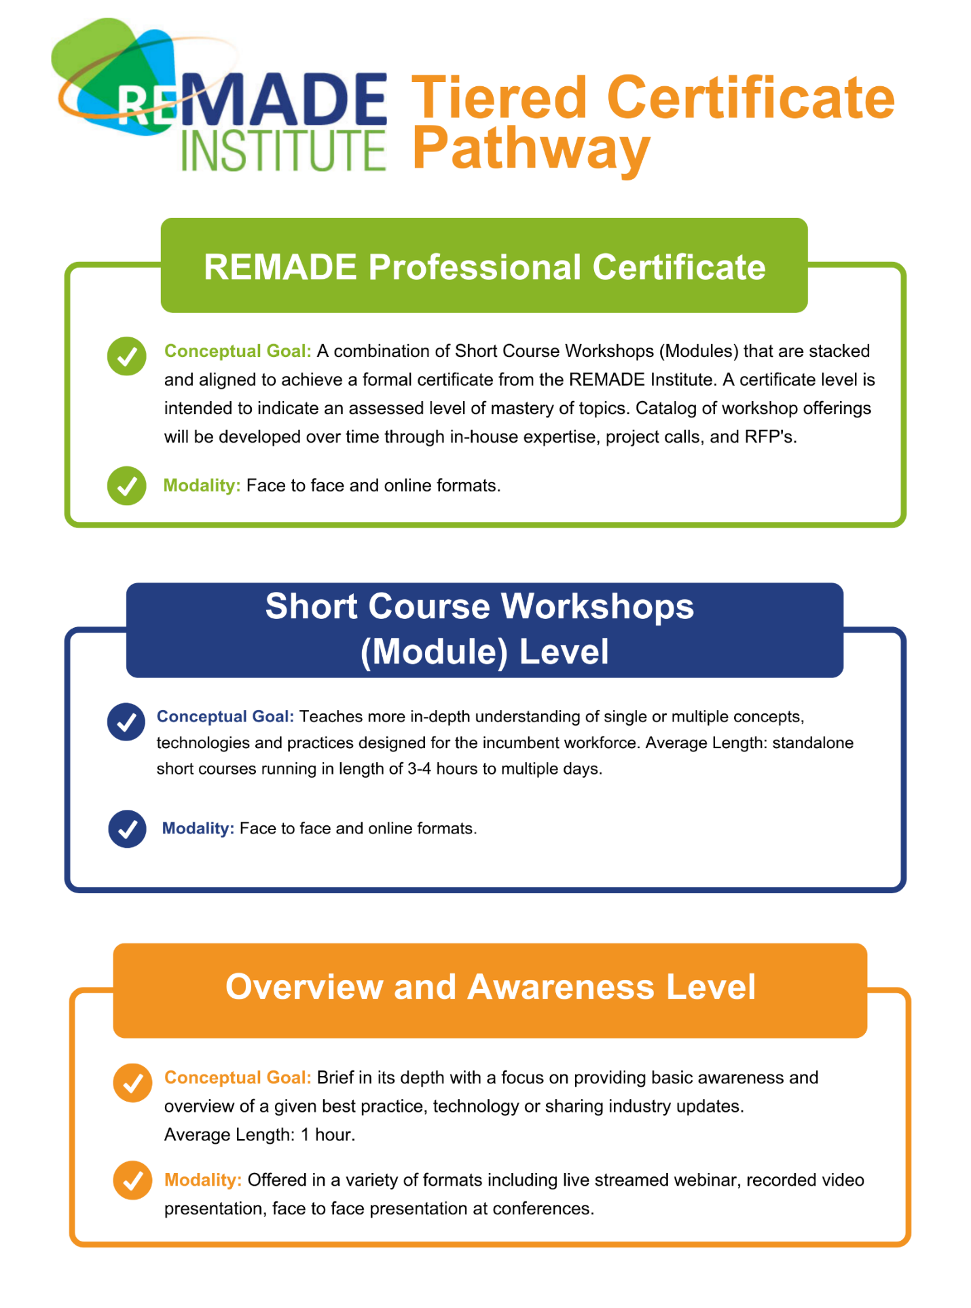
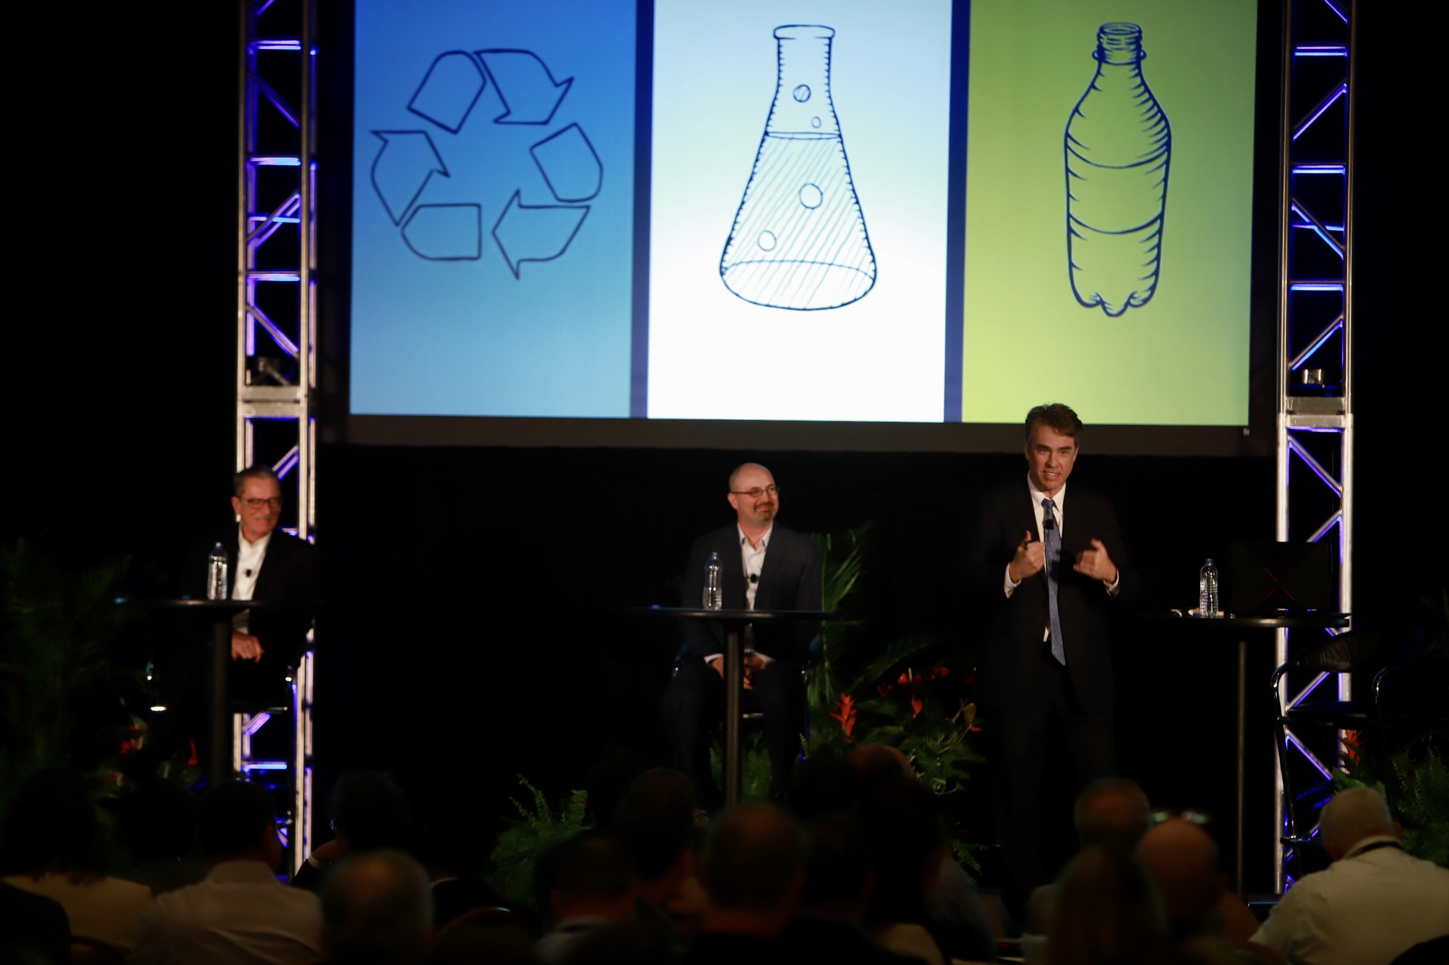
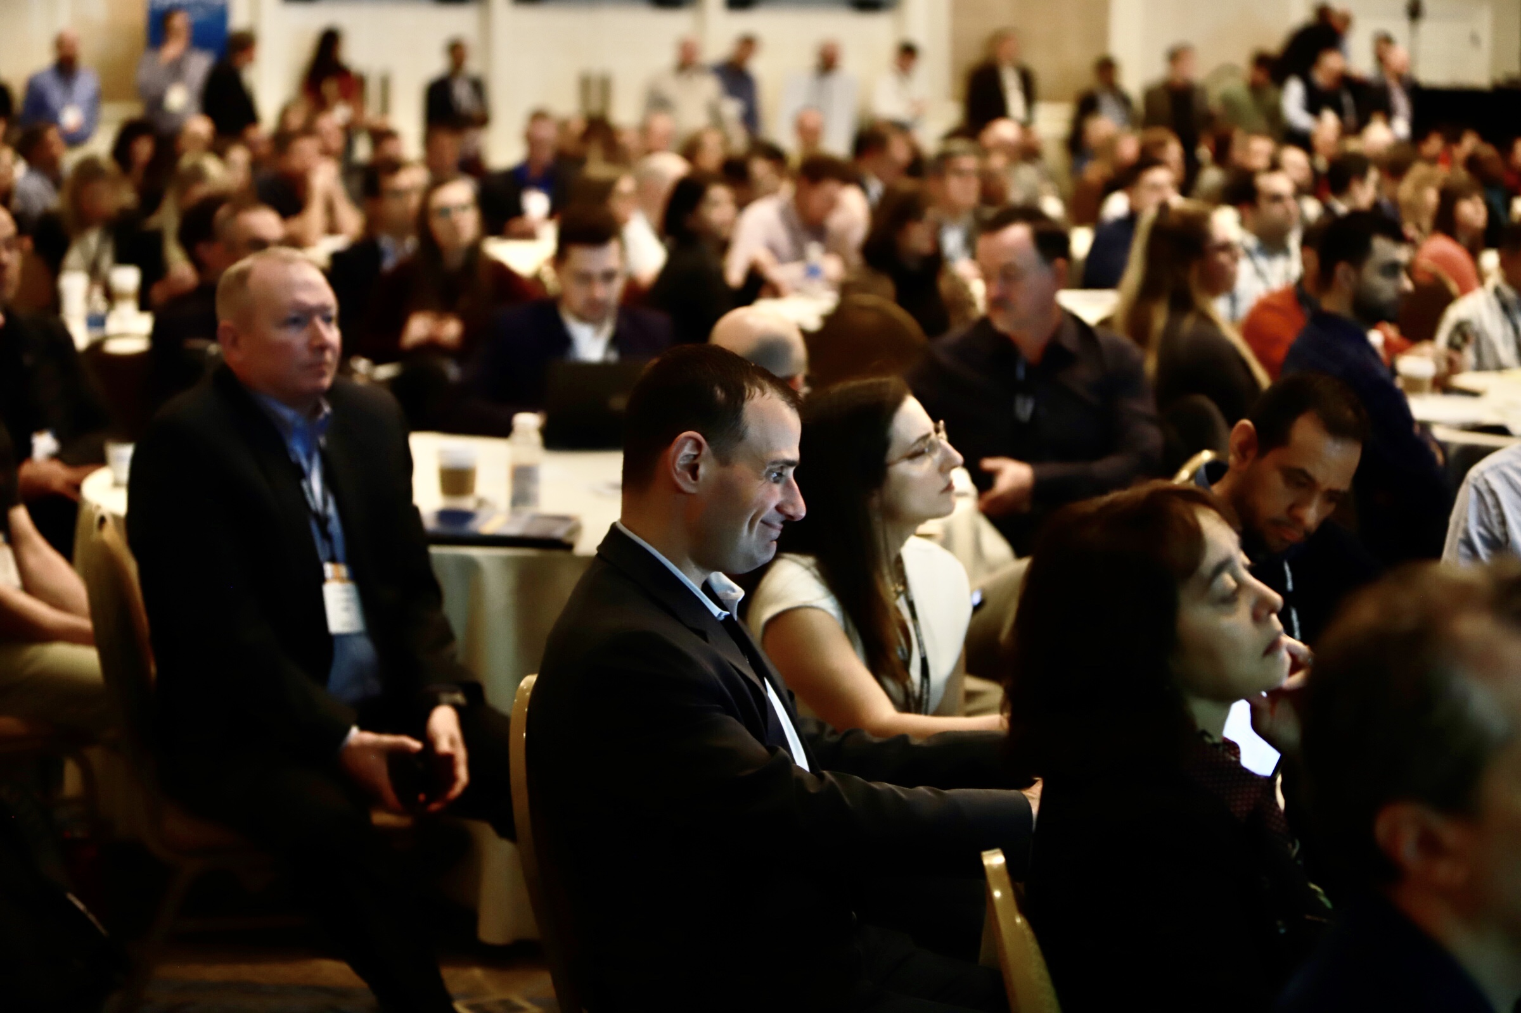
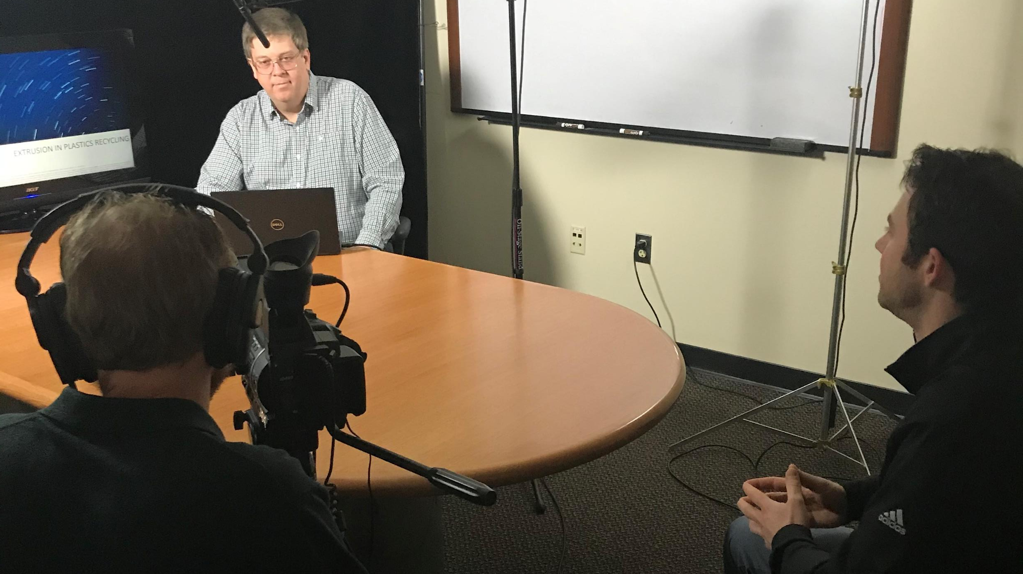
Results & Accomplishments – Educ. & Workforce Dev.
Crash Course in Plastics Recycling
(Plastics Recycling Association Conference)
Three (3) Certificates being developed
Plastic Recycling Certificate will launch by August 31
Content for Certificates will be developed August 31
Seven (7) Workshops held in this BP – 526 Attendees
Topics Covered included Recycling & Recovery (2), Remanufacturing (4), and Manufacturing (1)
Seven (7) webinars held in this BP – 305 attendees
Two (2) additional webinars planned in June/July
All webinars based on REMADE projects
Plastics Recycling Modules
(Available on Online Portal – May ‘20)
Online Training
Online portal launched in May
Four (4) plastic recycling modules will provide initial content
Technical Leadership Committee developing modules (Summer ‘20)
First EWD project selected - fibers recycling (early 2021 launch)

Slide 12
Results and Accomplishments
Projects
31 Projects recommended from first two project calls (Apr ‘19)
First project completed (Dec’ 19), 28 Projects underway, 10 Projects in negotiation/or awaiting sub-award
Portfolio Analysis
Evaluated Impact of the Project Portfolio vs the TPMs – on track to achieve mid-term impacts
Percent of the mid-term impacts the 39 projects projected are projected to achieve:
Embodied energy consumption (-43%), Emissions reduction (54%)
Primary material consumption (-28%), Secondary material consumption (+26%)
Membership
Growing Membership – Currently 95 Members - 90% Retention Rate
20 new Members in Q1 (11 industry, 5 Academic, 4 Affiliates) vs Three (3) Members who did not renew.
88% of Member Orgs involved in REMADE, 50 Members involved in REMADE Projects
Education and Workforce Development
EWD Training is well underway – 7 Webinars and 7 Workshops Attracted 831 Participants
First EWD Project Selected – Pulp & Paper Recycling
Online portal has been launched and initial content in plastic recycling now available
Pilot Certification will be launched by end of August
Content for two additional certificates will be completed in August as well.

Slide 13
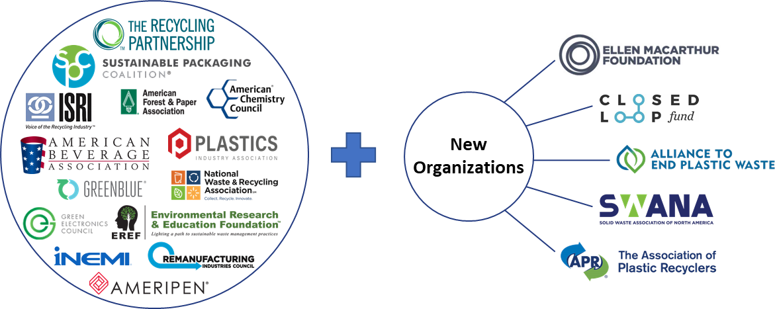
Transition (beyond DOE Assistance) - Activities Supporting Sustainment Plan
REMADE membership has increased by 30%
Membership retention is >88%
88% of members are actively engaged (i.e. projects, LOI, committees)
Announcing industry-led Grand Challenge Request For Proposal (RFP)
Institute intends to award 2-3 projects up to $10M each
First RFP ffocused on transforming the plastics recycling industry
NIST funding opportunity for high impact projects to respond to COVID-19
Covers projects from $250k - $10M
Non-federal cost share is NOT required
$200k sponsorship - NY Empire State Development
Hosting 4 workshops for NY-based organizations
Funding technology projects within the state
REMADE is exploring ways to cultivate a Special Interest Group comprised of member-based affiliate organizations who may have specific interest in accessing & collaborating on technology-driven solutions & innovation.

