Slide 1
Refractory Solar Selective Coatings
SuNLaMP project 1746
Start: 10/1/2015 End: 9/30/2018
Jeffrey Elam, Senior Chemist, Argonne National Laboratory

Slide 2
Outline
Overview
Problem Statement and Value Proposition
Technical Approach
Objectives, Milestones and Results
Path to Market
Acknowledgements

Slide 3
Overview
Partners:
Argonne National Laboratory (Lemont, IL)
Northwestern University (Evanston, IL)
Deutsches Zentrum für Luft- und Raumfahrt (DLR, Stuttgart, Germany)
Innosense, LLC (Torrance, CA)
Project Duration: 36 Months, 10/1/2015 – 9/30/2018
Budget: DOE: $3,479,108; Cost Share: $126,613; Total: $3,605,721

Slide 4
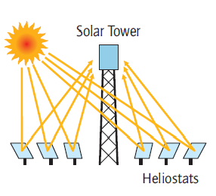
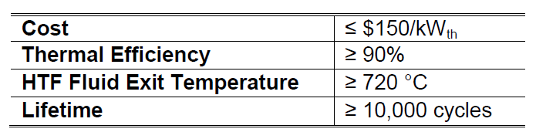
Problem Statement
Sunshot 2020 Targets for CSP Power Tower:
High temperature receiver coatings are required, having selective absorber efficiency, η_{sel} > 90% at 720°C

Slide 5
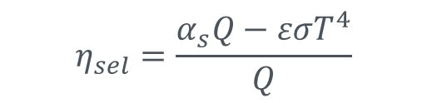
Problem Statement
Consequences of High Temperature Operation:
Solar spectrum and black body spectrum merge
Emittance increases as T⁴
Coatings can oxidize at high T
Delamination of coating from thermal cycling
$$η_{sel}=\frac{α_{s}Q−εσT^{4}}{Q}$$
α_{s}: absorptivity
ε: emittance
T: Receiver temperature
Q: irradiance on receiver
σ: Stefan-Boltzmann constant
No naturally-occurring materials meet the Sunshot targets
New coatings must be engineered

Slide 6
Value Proposition
Photonic structure tunes cut-off wavelength, ε(λ)
Nanostructure and composition tune absorptivity, α_{s}(λ)
Refractory nanocomposite resists oxidization
Mesopores and chemically-bonded coating resist delamination

Slide 7
Technical Approach
Atomic Layer Deposition (ALD)
Mesoporous Scaffolds

Slide 8
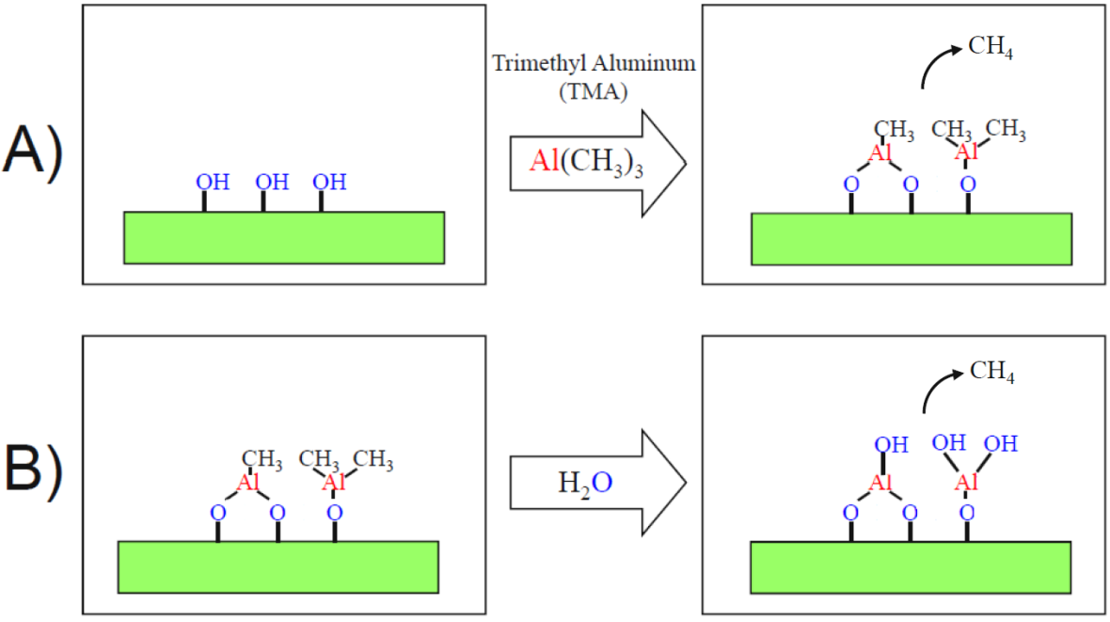
Surface Chemistry for ALD
Binary reaction sequence
1 monolayer of Al₂O₃ per A/B cycle
Notes:
deltaG= -282 kcal/mol Al2O3 at 200C

Slide 9
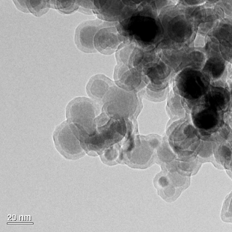
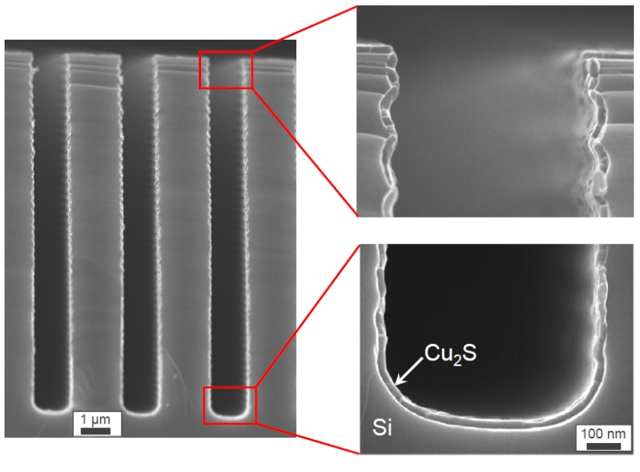
Conformal ALD Films on Non-Planar Substrates
ALD Cu₂S in high-aspect ratio silicon trenches
ALD Al₂O₃ on ZrO₂ nanoparticles

Slide 10
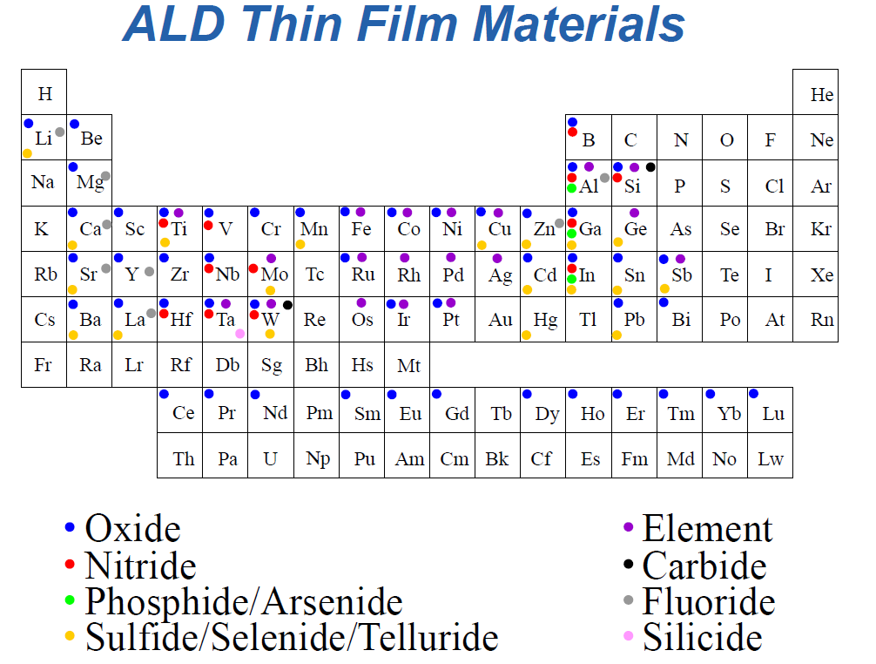
Many Film Chemistries are Possible

Slide 11
ALD of W-Al₂O₃ Composite Films
Combine 2 ALD processes:
  TMA/H₂O → Al₂O₃ : insulator, ρ=10¹⁶ Ωcm
  WF₆/Si₂H₆ → W : conductor, ρ=10⁻⁴ Ωcm
TMA
H₂O
WF₆
Si₂H₆
Tune resistivity with W/(W+Al₂O₃) cycle ratio

Slide 12
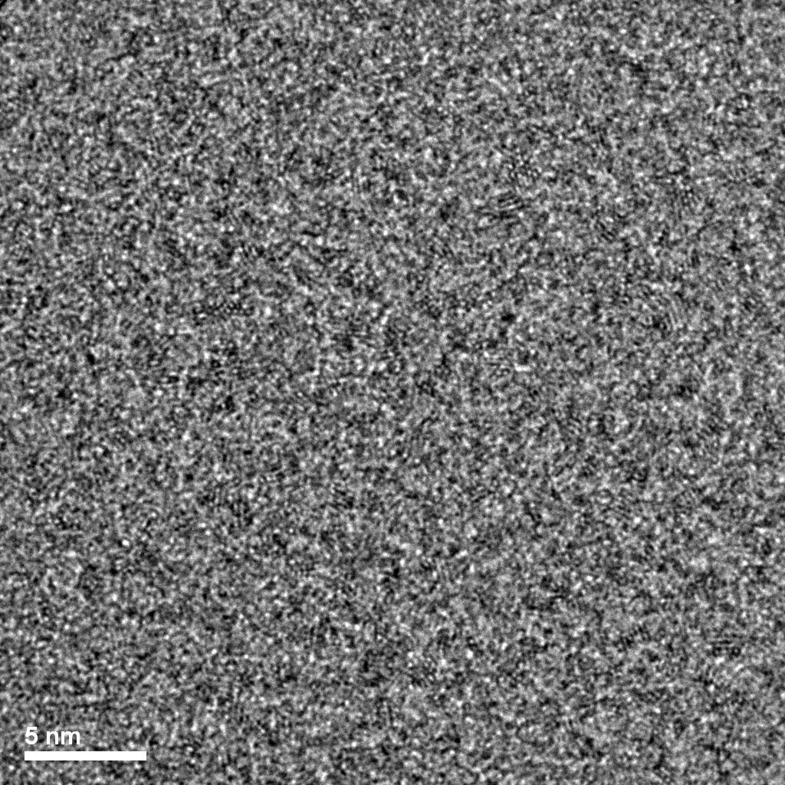
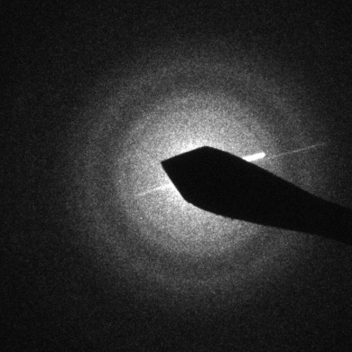
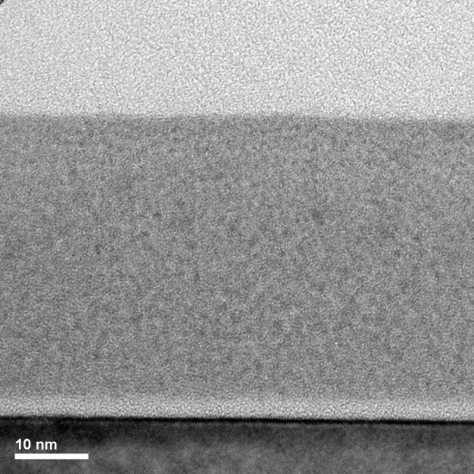
TEM of 10% W-Al₂O₃ Composite
1 nm
5 nm
1-2 nm nanoparticles embedded in amorphous matrix

Slide 13
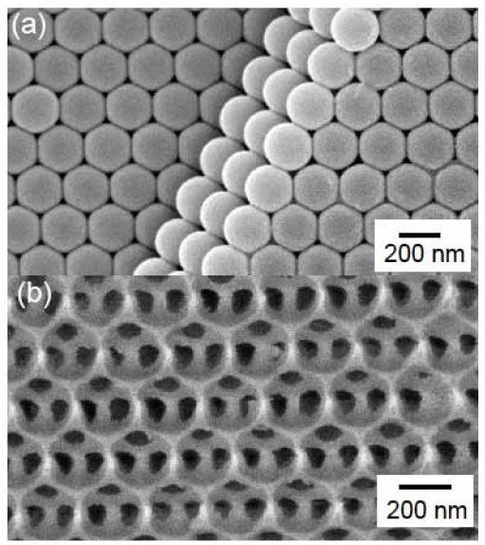
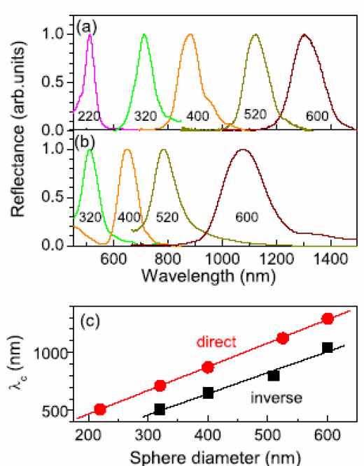
Synthesis of Mesoporous Scaffolds
Xerogel, drop-casting, dip-casting, spray-casting, 3D printing
3D ordered opal, inverse opal, random structures
Sol gel, organically-modified silicate, organic porogens

Slide 14
Modelling of Photonic Structures
Finite difference time domain (FDTD) method
MEEP simulation software (developed by MIT)
Calculate emissivity, ε(λ) from input scaffold geometry and refractive index measured for ALD nanocomposites
Photonic structure reduces emissivity by >70%

Slide 15
ALD Indium Tin Oxide in Inverse Opal Template

Slide 16
Objectives
Develop refractory solar selective coatings meeting DOE SunShot 2020 goals:
    Thermal efficiency >91%.
    Withstand 9000 hours in 800°C air
    10,000 thermal cycles to 800°C in air
    Environmental and on-sun testing
    No delamination, efficiency loss below 0.6%/year.
    Manufacturable, and LCOC<$1/MWth

Slide 17
Milestones
Phase 1: Identification of at least 5 selective absorber coatings that have been shown through a statistical t-test to have η’_{sel}≥0.91 and P≥99% at a 95% confidence interval equivalent after heating in air at 650°C for 24 hours and 10 thermal shock cycles in air from 25-650°C. Also, we will provide a validated optical model that predicts the η’_{sel} performance of selective absorber coatings to within 10% of their measured values.
Phase 2: Identify at least 2 coatings that have been shown via a one-sided statistical t-test at the 95% confidence interval equivalent to meet the following criteria: η’_{sel}≥0.91, D<0.6%/year, and P≥99% after environmental testing, 10,000 thermal shock cycles to 800°C, and 4500 hours in air at 800°C. Also, identify at least 1 coating for which LCOC<1.
Phase 3: Develop a new technology for refractory solar selective coatings for CSP that meet the DOE SunShot 2020 goals. These coatings will be engineered at multiple length scales to have η’_{sel}≥091. Demonstrate that the coatings withstand 9000 hours in air at 800°C, 10,000 thermal cycles to 800°C in air, and a barrage of environmental and on-sun testing without delamination, and with an efficiency loss below 0.6%/year. Show a promising route towards manufacturability and LCOC<$1/MWth.

Slide 18
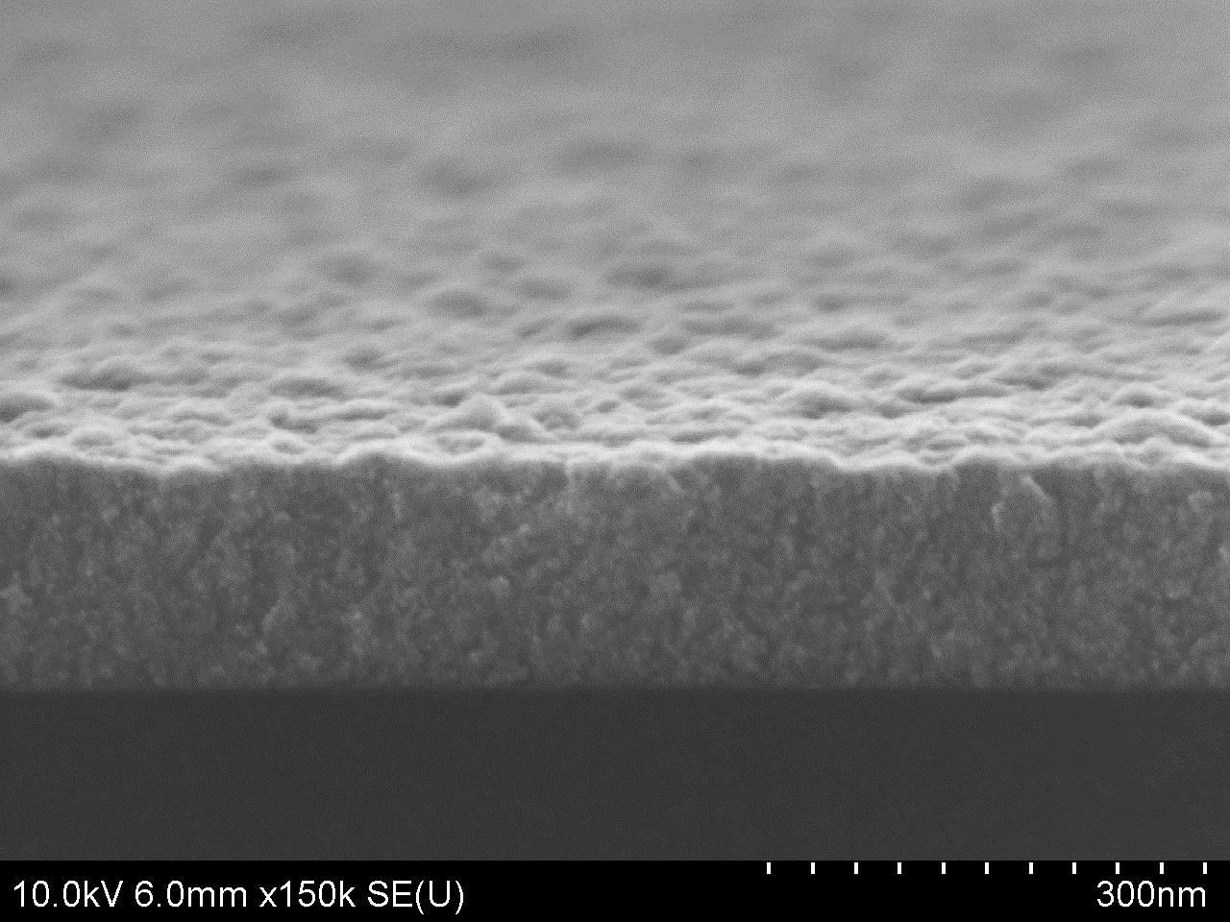
Results
ALD W:Al₂O₃ Nanocomposites
Tunable composition of ALD W/Al₂O₃ nanocomposite

Slide 19

Optical Properties of ALD W:Al₂O₃ Nanocomposites
Tunable optical properties
Maximum solar efficiency at 40% W
$$η_{sel}=\frac{α_{s}Q−εσT^{4}}{Q}$$

Slide 20
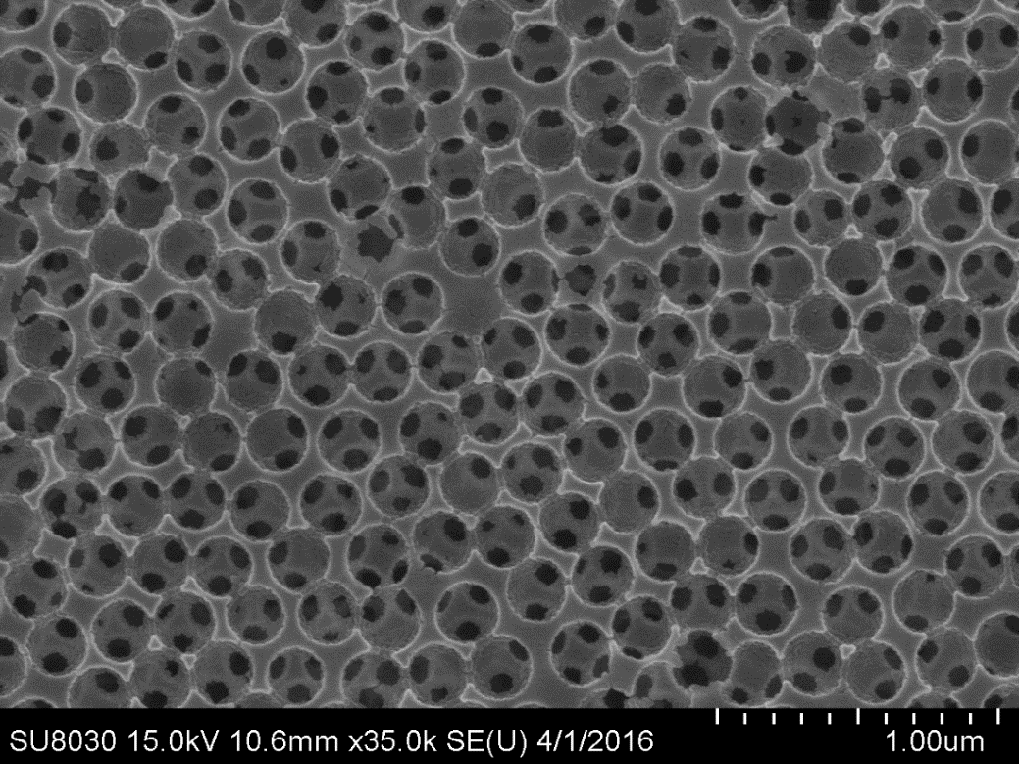
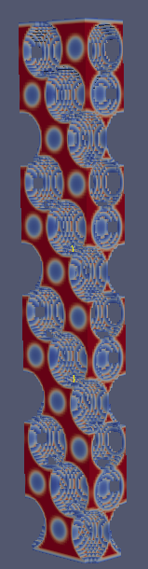
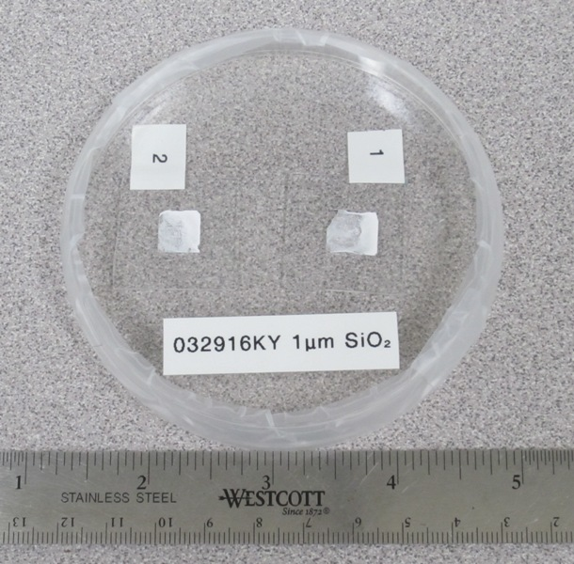
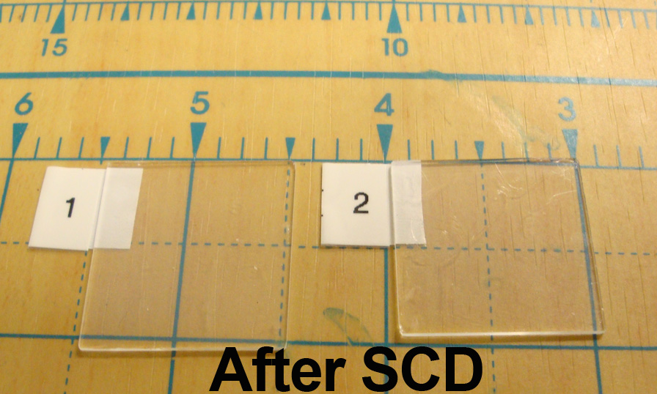
Synthesis and Modeling of Photonic Scaffolds
Inverse Opals
Opals
Mesoporous scaffolds infiltrated with ALD W/Al₂O₃ nanocomposite
Aerogels
Dielectric constant calculated for 3D inverse opal of ALD W/Al₂O₃ nanocomposite

Slide 21
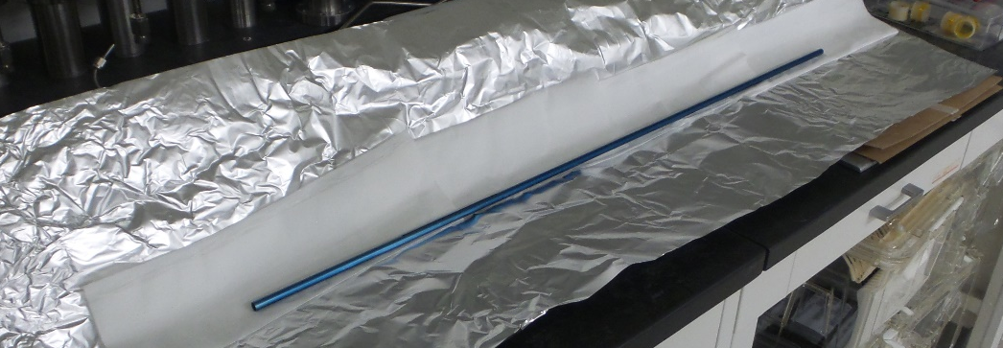
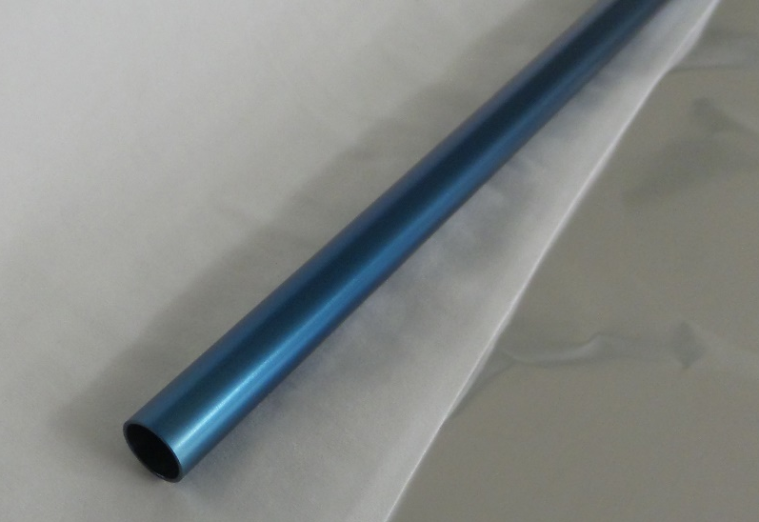
Path to Market
CRADA (cooperative research and development agreement)
  Defines working relationships and contributions from each partner
  Project partners own IP they develop individually
B&W manufactures coated receivers
  Licenses necessary IP from all parties to manufacture coatings
  Technology transfer through work-for-others
  ANL could pilot manufacture coated tubes
Coated receivers incorporated into CSP plants
  eSolar or General Electric
Alternatively: 3rd party
  Licenses coating technology, manufactures receivers, builds CSP plants
ALD ZrN on 2 meter tube

Slide 22

Acknowledgements
Argonne: Anil Mane, Jason Avila, Angel Yanguas-Gil, Joseph Libera
Northwestern: Joseph Hupp, Jian Liu
Innosense: Uma Sampathkumaran, Kevin Yu, Kisholoy Goswami
DLR: Reiner Buck, Florian Sutter
SuNLaMP Program, Award #DE-EE0001746

