Slide 1
Quantifying Success Probabilistic Forecasting for On-Budget,
On-Time Projects
Remmie Arnold, Technomics, Inc.
Office of Cost Estimating and Program Evaluation (CEPE), NA-1.3
National Nuclear Security Administration
August 11, 2026

Slide 2

CEPE Background
Office of Cost Estimating and Program Evaluation (CEPE)
NA-1.3
  CEPE’s Statutory Role: “The Director shall be the principal advisor to the Administrator, the Deputy Secretary of Energy, and the Secretary of Energy with respect to cost estimation and program evaluation for the Administration.” - 50 U.S.C. § 2411 (b)(1)
  Established in the FY 2014 National Defense Authorization Act (NDAA) in recognition of a gap in the National Nuclear Security Administration’s (NNSA) capacity to independently determine the costs of programs and projects and adequately budget for them.

Slide 3

Agenda
Purpose
Problem & Focus
Inside View
Outside View
Data & Analysis
Example
Next Steps

Slide 4
Purpose
Promote
Cost and Schedule Estimating Best Practices
Opportunity
To utilize Reference Class Forecasting
Support
Integrated Project Teams as they plan for project risk
This is a crosscheck, not a replacement for current methods or a prescription for specific risk values.

Slide 5
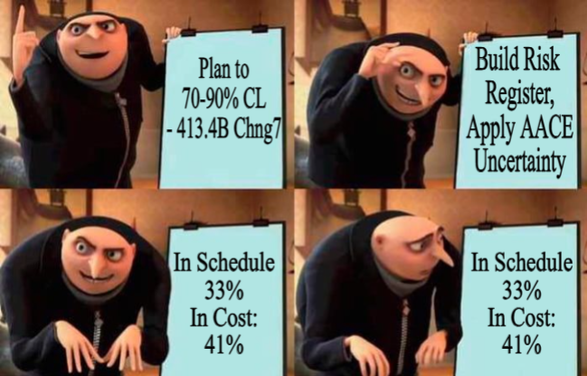

Problem
      Bent Flyvbjerg: 9 out of 10 large projects exceed their budgets¹; no improvement over 70 years².

Slide 6
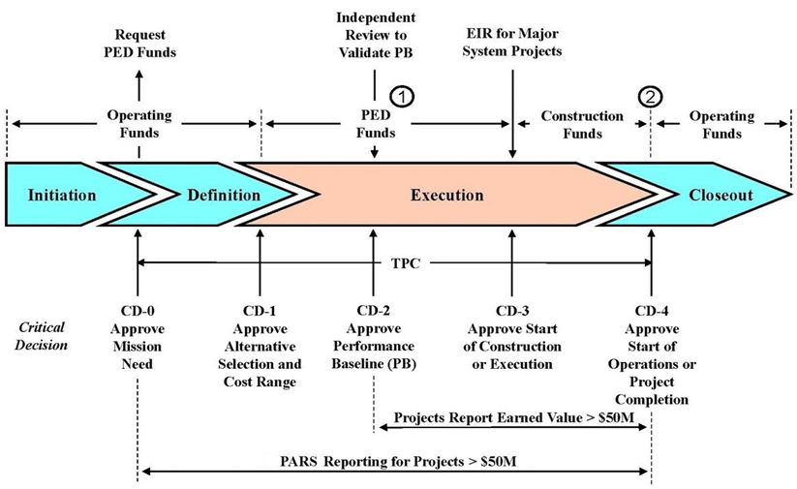
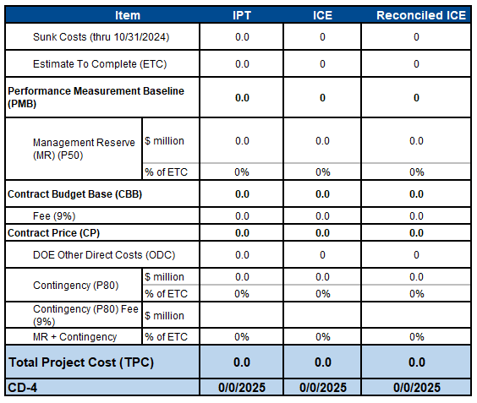



Focus
01
  Post CD-2/3 growth
Source: 413.3b Chng7
02
  Over deterministic estimates
03
for construction projects >$300M
  executed by the NNSA (NA) and Office of Science (SC)
04

Slide 7
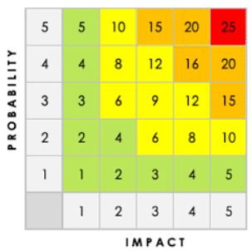
Traditional Method
(Inside View)
Confidence Levels are achieved by adding Management Reserve and Contingency to a deterministic point estimate.
Commonly utilized MR&C estimating approach at CD-2/3 is Bottom-Up
  SME informed Risk Register
  SME or Industry benchmark uncertainty
Strengths
Highly accurate (if scope is well defined)
Traceable and defensible
Enables execution
Assigns ownership
Limitations
  Experience Informed
  Optimism bias
  False Precision
  Can miss unknown unknowns

Slide 8
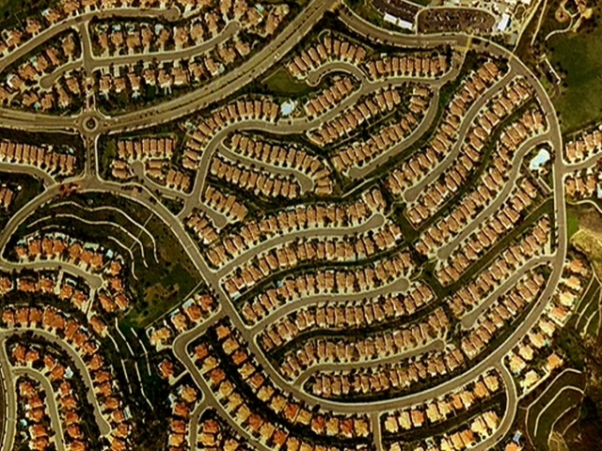
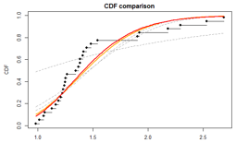
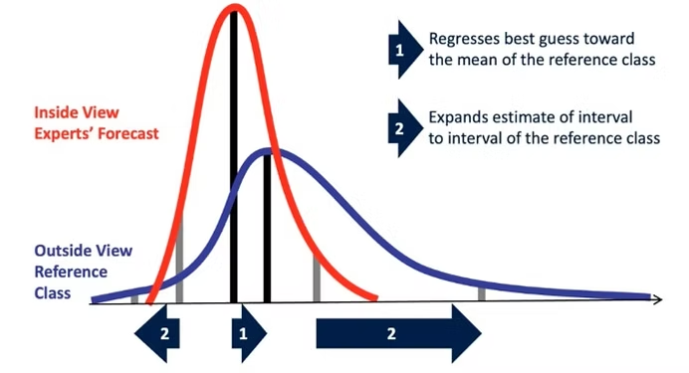
Opportunity
(Outside View)
Reference Class Forecasting
  Uses historical data from similar projects to provide an objective forecast
Reference Class
Historical analogous projects
Method
Top level crosscheck (CER adjacent)
Application
New project compared to distribution of historical analogous projects
Source: www.pmlogic.com
Reference Class Problem: Which reference class do I use?

Slide 9
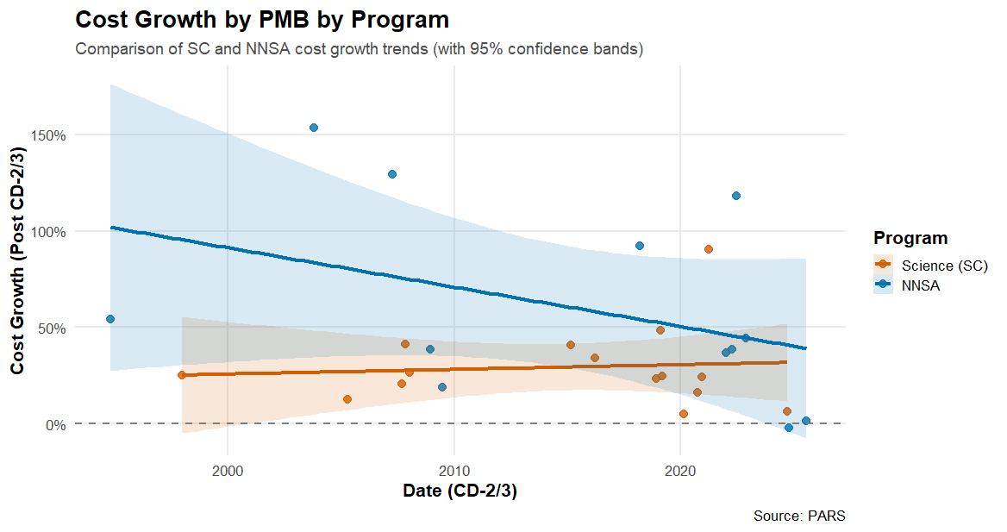
Data (36 Projects)
*5 projects have BCP’d
PARS
Time Dependent
Size Dependent
Office Dependent
???
???

Slide 10

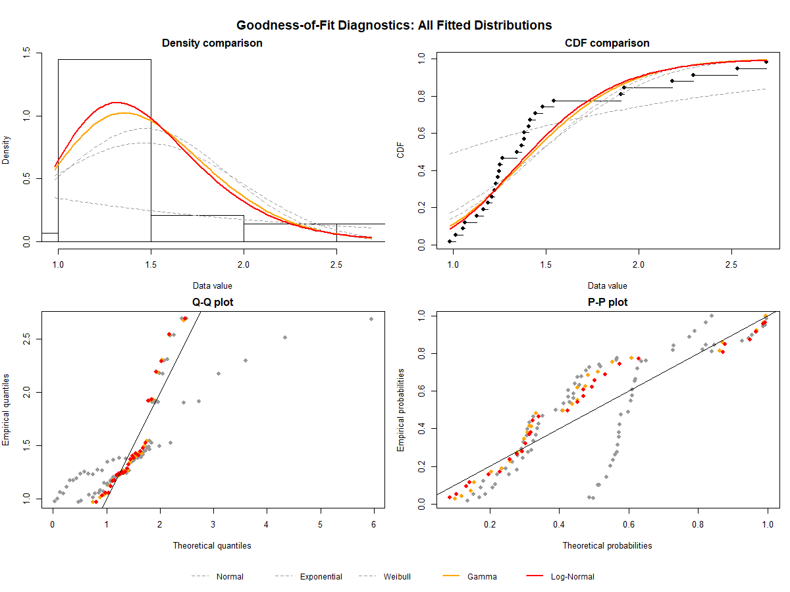
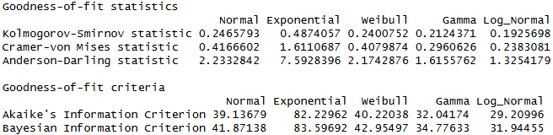

Analysis
Analyze cost and schedule growth post-CD-2/3 for Reference Class Data
Best fit: Log-Normal distribution
Lowest fit stat values
Statistically significant parameters

Slide 11
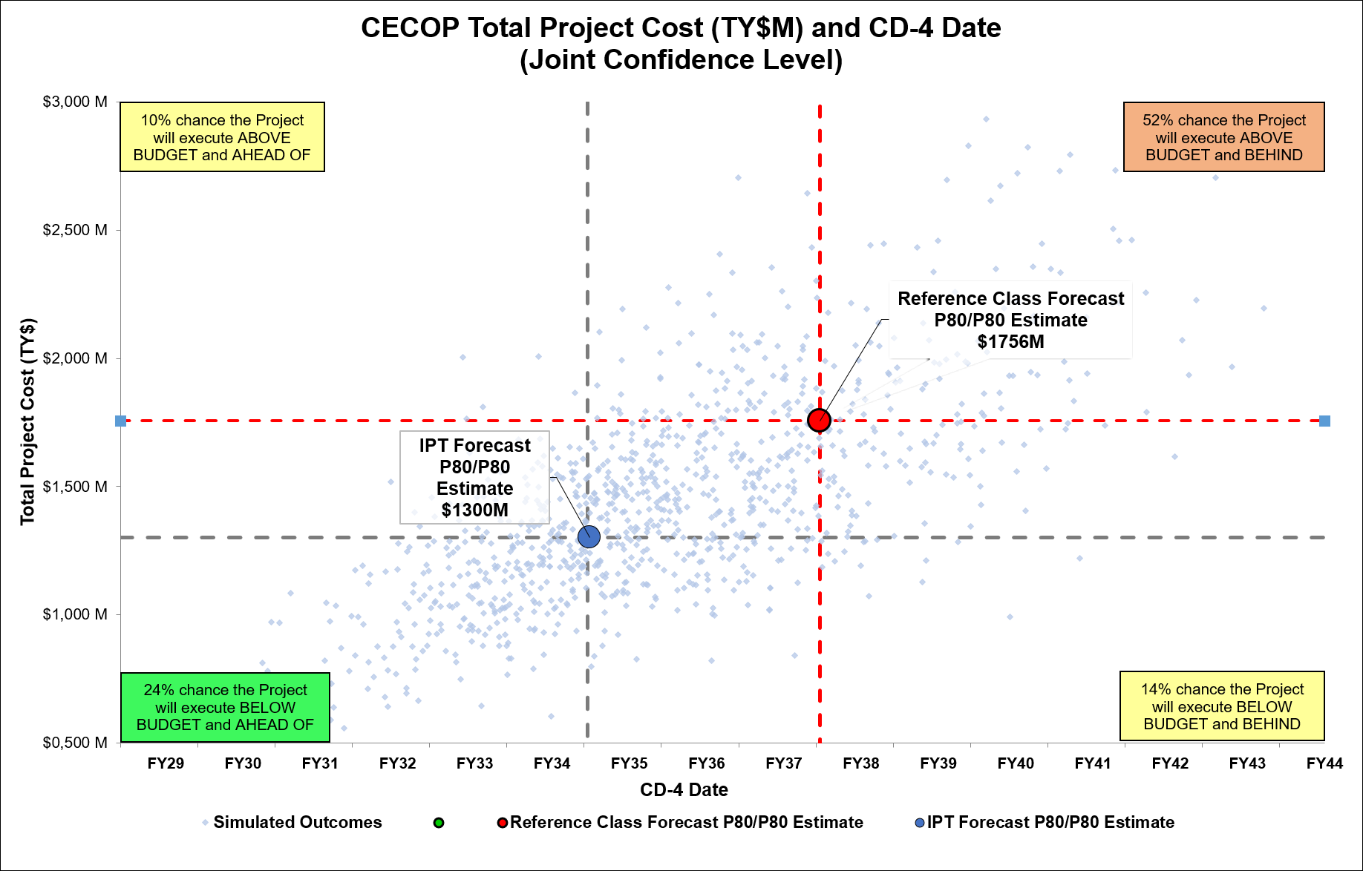
Example (Simulated Data)
$1B Deterministic TPC (CD-2/3)
IPT MR&C = $300M (80% CL)
RC Forecast = $756M (80% CL)
  IPT cost MR&C CL = 38%
  IPT schedule MR&C = 35%

Slide 12
Next Steps
(As time allows)
Collect data
Cost, duration, confidence level, and scope/admin change data
Mature Method
Stress test reference classes, distributions, and assumptions
Implement
Pilot cases, user guide, and decision-support workflow

Slide 13
Back-Up

