Slide 1
Non Electric CSP RD&D
Sunshot Conference
April 19 – 20 Del Mar CA
Notes:
If you’re like millions of other Californians, chances are you don’t think about natural gas much.
You use it at home to cook your food… to heat your house…. and to take hot showers…
But it’s something you don’t give a second thought to. You just want it to work when you need it.
And that makes sense because it’s how we use natural gas every day.
But what you may not know is the essential role that natural gas plays in California’s future. In fact, the health of our state’s environment and economy depends on natural gas.
I’m here to share that bigger perspective… and give you something to think about the next time you turn on your stove.
It starts with a problem we all face together…

Slide 2
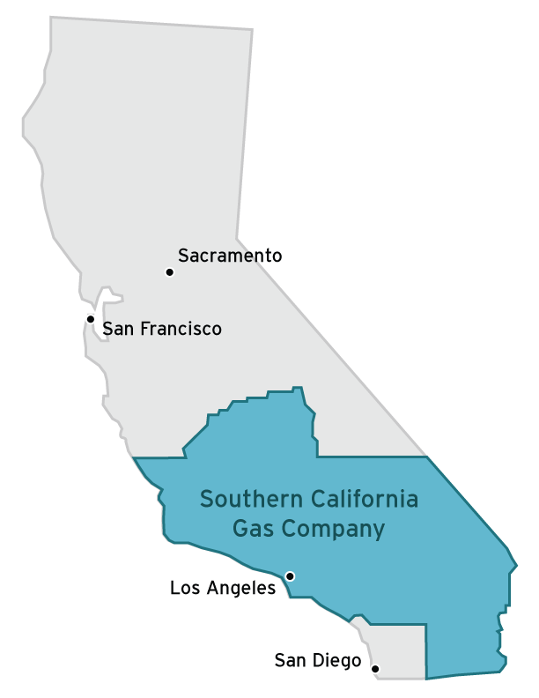
SoCalGas
Largest natural gas distribution utility in the US
An active part of the community for more than 140 years
Serve 12 counties and more than 21 million people
Employ more than 8,000 Californians
Notes:
So I’m here to talk with you about SoCalGas…and you may be wondering why I’m spending so much time on the bigger picture.
The answer is simple: Southern California is our home too—and we work hard to protect it.
We have been an active employer and community member for more than 140 years. Our kids go to Southern California’s schools and play in its parks.
As a company, we’re pretty humble. We like doing our work and quietly making a difference.
But today…there’s too much at risk, the stakes are too high to keep going about our work quietly.
Things need to change in Southern California and SoCalGas is a vital part of the solution. As the country’s largest natural gas distribution utility, we need to take a stand—we need to advocate on behalf of the 21 million people we serve.
They are not only our customers, but our co-workers, family, friends and neighbors.

Slide 3
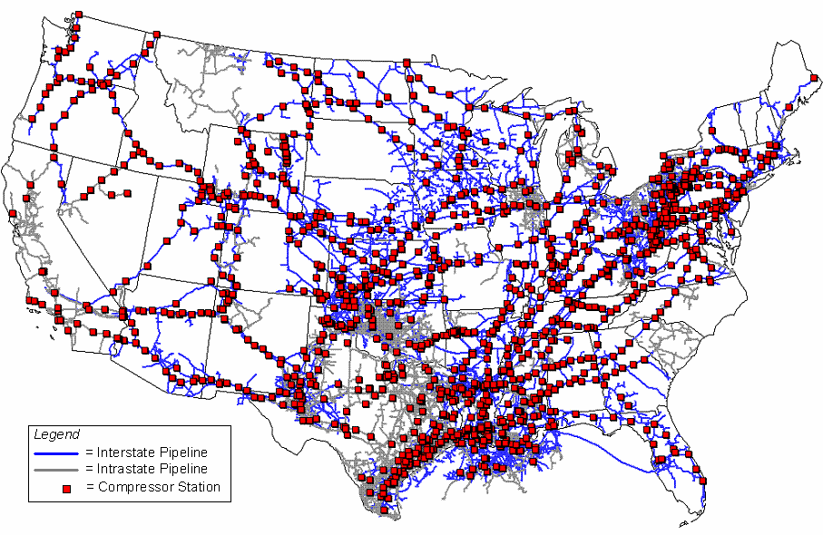
NG Grid
U.S. Natural Gas Pipeline Compressor Stations
Notes:
So I’m here to talk with you about SoCalGas…and you may be wondering why I’m spending so much time on the bigger picture.
The answer is simple: Southern California is our home too—and we work hard to protect it.
We have been an active employer and community member for more than 140 years. Our kids go to Southern California’s schools and play in its parks.
As a company, we’re pretty humble. We like doing our work and quietly making a difference.
But today…there’s too much at risk, the stakes are too high to keep going about our work quietly.
Things need to change in Southern California and SoCalGas is a vital part of the solution. As the country’s largest natural gas distribution utility, we need to take a stand—we need to advocate on behalf of the 21 million people we serve.
They are not only our customers, but our co-workers, family, friends and neighbors.

Slide 4
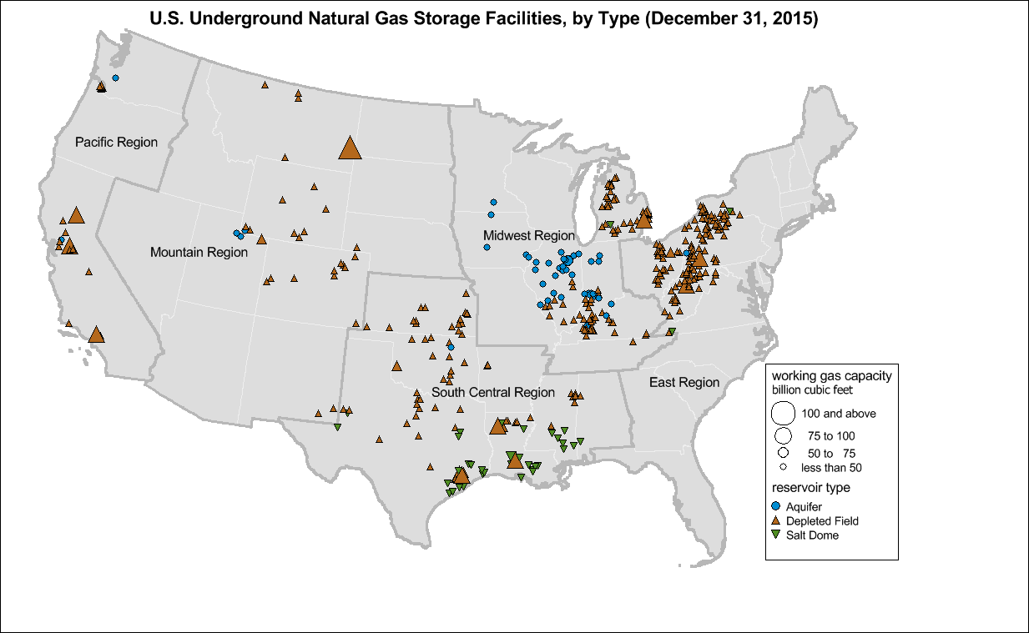
400 Facilities
4.7 Tcf Capacity
118 Bcf Daily Delivery
NG Storage

Slide 5
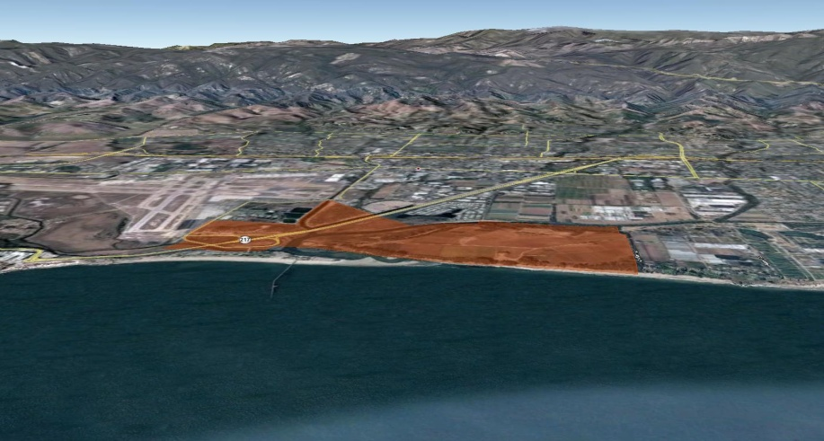
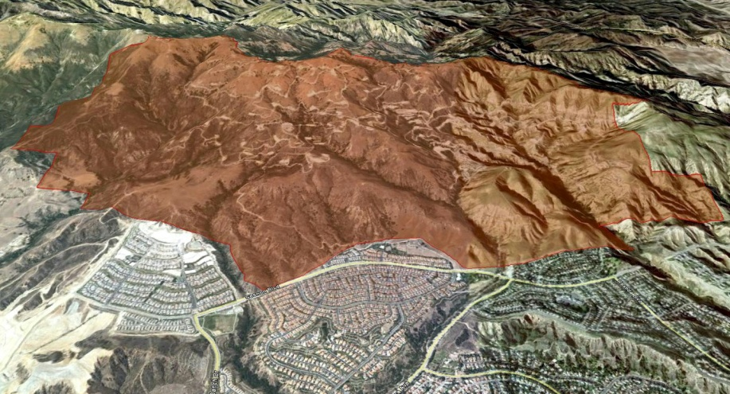
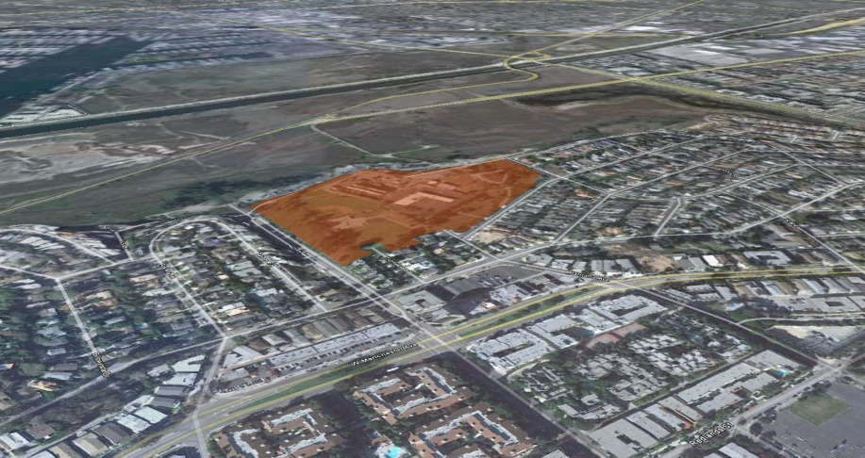
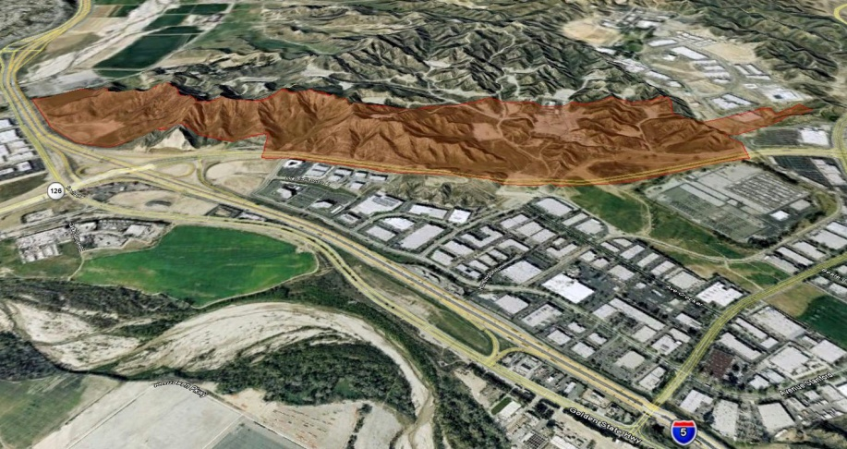
SoCalGas
137 Bcf of NG Storage
Equivalent to
>11 TWh of
electricity
storage
Aliso Canyon
Goleta
Playa Del Rey
Honor Rancho
Notes:
We’re up for the task. Our past actions prove it.
Whether it’s our investments in pipeline safety…
our industry-leading customer service…
or our ongoing work to reduce our company’s environmental impact.
We demonstrate our commitment to the region, our customer and the environment through action.
Take our work in energy efficiency, for example…
Our energy energy efficiency programs have helped customers save >505 million therms over the last 22 years—that’s equal to taking more than 526,000 cars off the road.
SoCalGas is a big reason why California’s natural gas sector has already met the 2020 GHG reduction goals—that’s more than 5 years ahead of schedule.

Slide 6
Low Carbon Resources
Energy Efficiency Thermal-Power Integration
Biogas Recovery & Biomass Gasification
Carbon Capture Utilization & Storage
Solar-Electrochemical
Artificial Photosynthesis
Solar Thermal

Slide 7

The Case for RNG
Ceramic Fuel Cells - A dead end technology
MATTHEW WRIGHT
19 MAR 2015
“The first problem with Ceramic Fuel Cells’ Bluegen offering is that it's a fossil fuel generator…”

Slide 8
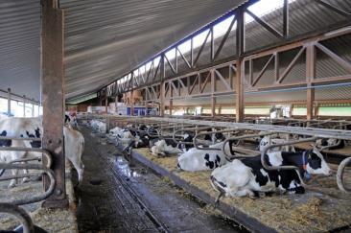
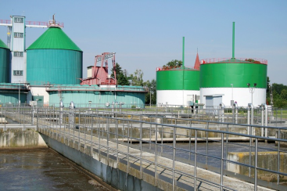
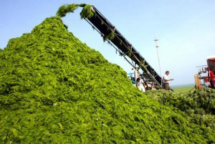
RNG
SoCalGas has been active in RNG development since 2006
Currently offer a tariff service to condition biogas to pipeline quality and will accept biogas from organic sources and landfills that meet gas quality standard
The critical issues for development of significant quantities of RNG are
Regulatory structures to monetize the value of the renewable attribute (e.g. renewables credits or procurement mandates)
Cost reduction for conversion and conditioning technologies
These issues are addressable

Slide 9
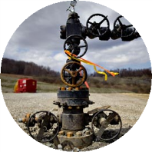
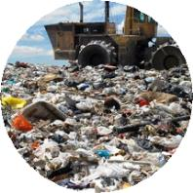
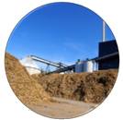
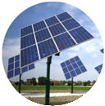

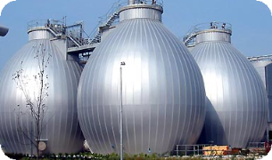
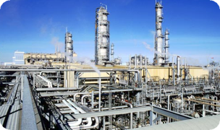
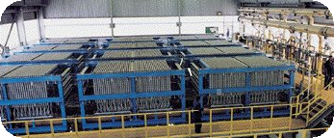
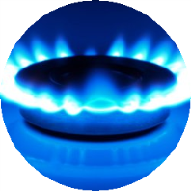
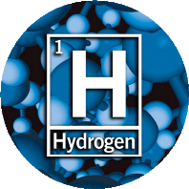
RNG Pathways
CCUS
Organics Conversion
Power-to-Gas
Artificial Photosynthesis
Anaerobic Digestion
Thermo-chemical
Electrolysis
Renewable Natural Gas
Hydrogen
CO2
Methanation
Reformation
Notes:
Keys to the kingdom. SoCalGas is working on all of these pathways.

Slide 10
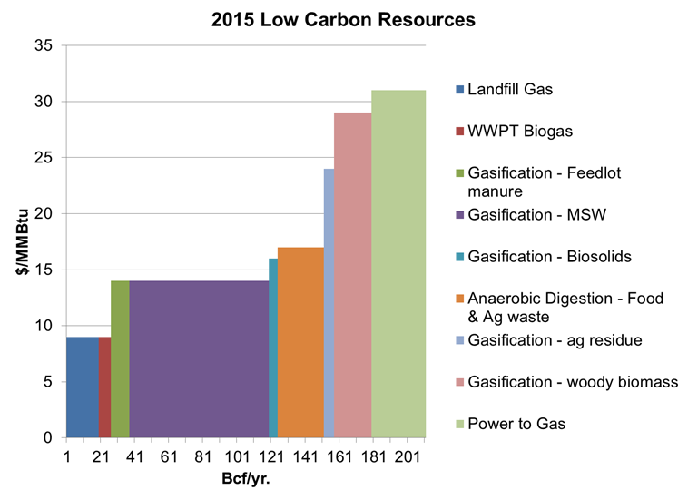
Resource potential is significant
Right side of the stack becomes
wider and less expensive over time
Estimated 2020 RNG Supply Potential
0 50 100 150 200
BCF/yr

Slide 11
Non Electric CSP Opportunities
Process Steam
EOR
Biomass gasification
Hydrogen
RNG, methanol, plastics
CO2 Capture

Slide 12
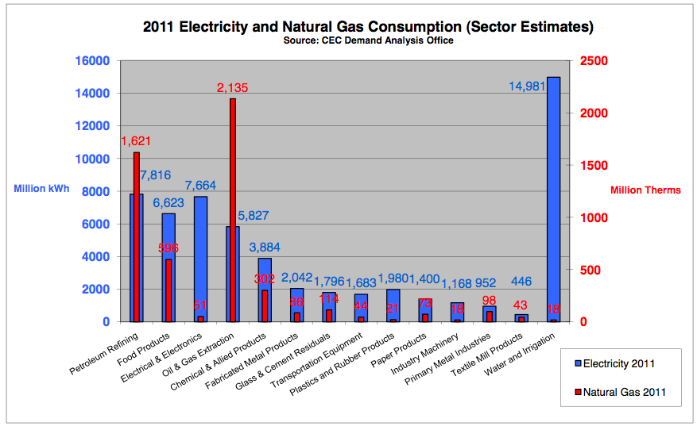
Huge Market for Steam EOR
Largest single C&I use of natural gas in CA, by far.
12

Slide 13
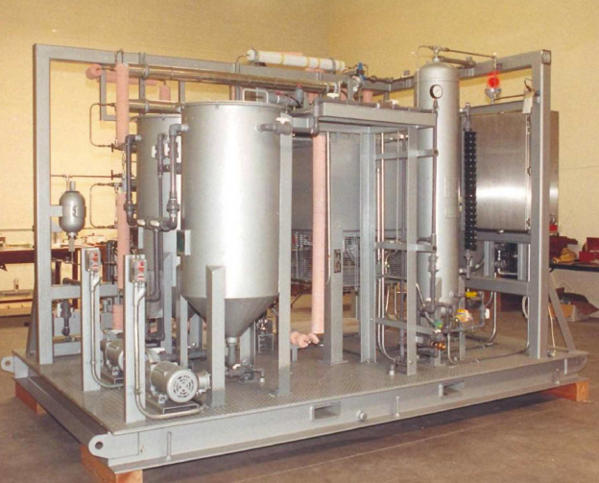
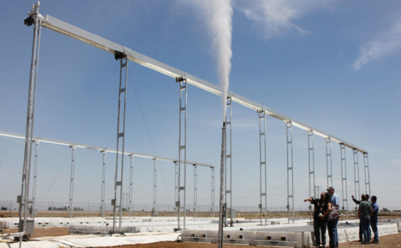
Solar + Biomass to Biocrude & RNG
Integrated Concentrated Solar Power (CSP) and Hydrothermal Processing (HTP)
Convert dairy manure into low-carbon, high-quality renewable natural gas (RNG) for injection into the pipeline
Collaboration Partners
California Energy Commission
Genifuel Corp. (Hydrothermal Processing System)
Hyperlight Energy (Solar Thermal System Integration)
Energy Solutions (Techno-Economic Analysis)
NREL (Solar Thermal Optimization)
Skid-mounted HTP system
Hyperlight Solar Thermal System

Slide 14
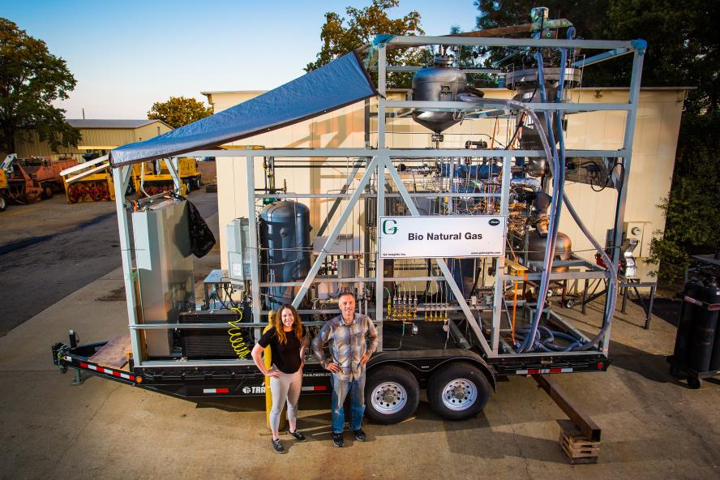
Thermal-Chemical Gasification and Methanation

Slide 15
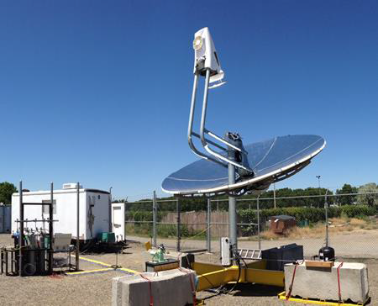
CNTP Reforming
Solar Thermal Catalytic H2 Production
Low-cost
20% solar hydrogen
Notes:
So I’m here to talk with you about SoCalGas…and you may be wondering why I’m spending so much time on the bigger picture.
The answer is simple: Southern California is our home too—and we work hard to protect it.
We have been an active employer and community member for more than 140 years. Our kids go to Southern California’s schools and play in its parks.
As a company, we’re pretty humble. We like doing our work and quietly making a difference.
But today…there’s too much at risk, the stakes are too high to keep going about our work quietly.
Things need to change in Southern California and SoCalGas is a vital part of the solution. As the country’s largest natural gas distribution utility, we need to take a stand—we need to advocate on behalf of the 21 million people we serve.
They are not only our customers, but our co-workers, family, friends and neighbors.

Slide 16
Hydrogen Production Via Solar Steam-Methane Reforming with Water-Gas Shift
Solar-to-Thermal Energy Conversion (Concentrator): 84%
Solar Energy In
(1 kJ_{s})
Renewable Energy Portion of Stream:
3.25 kJ_{c} – 2.6 kJ_{c} = 0.65 kJ_{c}
Thermal-to-Chemical Energy Conversion (Reaction System): 77%
Products Out
(3.25 kJ_{c})
Reactants In
(2.6 kJ_{c})
Solar Thermochemical
Reaction System
(2.6 kJ_{c})
(CH₄ + H₂O)
(CO₂ + H₂)
Net Solar-to-Chemical Energy Conversion Efficiency: 65%
Net Idealized Reaction:
CH₄ + 2H₂O → CO₂ + 4H₂
Productivity Projections:
2015: ~ 42.9 lb H₂ per MMBTU Solar
2020: Up to 52.8 lb H₂ per MMBTU Solar

Slide 17
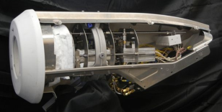




Solar Steam Methane Reforming Synthesis Gas Product can be used for a Variety of Purposes
SunShot project at the Pacific Northwest National Laboratory
Efficient conversion of solar energy into chemical energy
Augments the chemical energy quantity of natural gas
Decreases carbon intensity of natural gas from 55 g CO₂/MJ to 44 g CO₂/MJ
Along with power generation, multiple chemical products are possible
Hydrogen for fuel cell vehicles or for reinjection into the natural gas pipeline as renewable natural gas
Methanol as a commodity chemical or as a low-carbon intensity additive to gasoline

Slide 18
THANK
YOU!
Notes:
Thanks for listening and I’m happy to take any questions you have for me.

