Slide 1
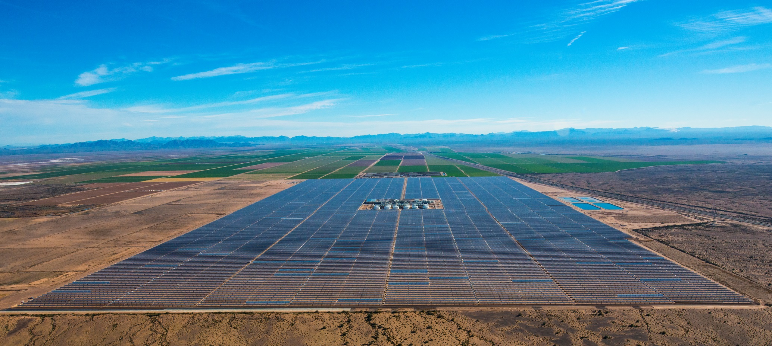
CSP Project Update
Solana: The worlds largest parabolic trough solar power plant
280 MWe with 6 hours of thermal energy storage
Hank Price, PE
Former CTO ASLLC
Solana Generating Station (Source: Abengoa)

Slide 2
Lessons Learned from Solana
Hank Price, PE
Solar Dynamics LLC
Notes:
Intro

Slide 3
Solana Generating Station (Source: Abengoa)
Notes:
Solana is the largest single CSP plant in the world.
It has the cheapest PPA of the 5 US CSP plants
One of only 2 plants to have TES
Only plant to be designed to dispatch power to the Utility
Significant cost reduction possible

Slide 4




Storage allows improved operational flexibility to meet utility peak loads. Arizona Public Service system peaks:
  Summer Peak: 12 Noon to 8pm, June – September
  Winter Peak: Early morning, evening
CSP plant generation
Solar Radiation (not scaled)
Electricity demand (not scaled)
Solana Operational Data (Source: Abengoa)

Slide 5
Solana Generating Station Operational Data
Clear Day, 2 Turbines, Summer APS Profile
Cloudy Day, 1 Turbine, Summer APS Profile
Clear Day, 1 Turbine, Winter APS Profile
Clear Day, 24 / 7 Op., Summer APS Profile
Solana Operational Data (Source: Abengoa)

Slide 6
Does it make sense to build large plants?
Solana was built large to take advantages of economies of scale.
Economy of scale achieved in solar field assembly.
Economy of scale not achieved as well in other areas:
  Two 140 MW steam turbines
  Four steam generators – two 50% trains per steam turbine
  6 parallel thermal energy storage (TES) units
  8 solar fields and 2 HTF pump groups
The HTF system is large and complex
  Twice the HTF per m² of collector area relative to 50 MW plant.
Schedule – Took almost 3 years to build
O&M – Large complex plant
  Lots of equipment to operate and maintain
  Takes time to get around.
Build smaller plants in a power park configuration

Slide 7
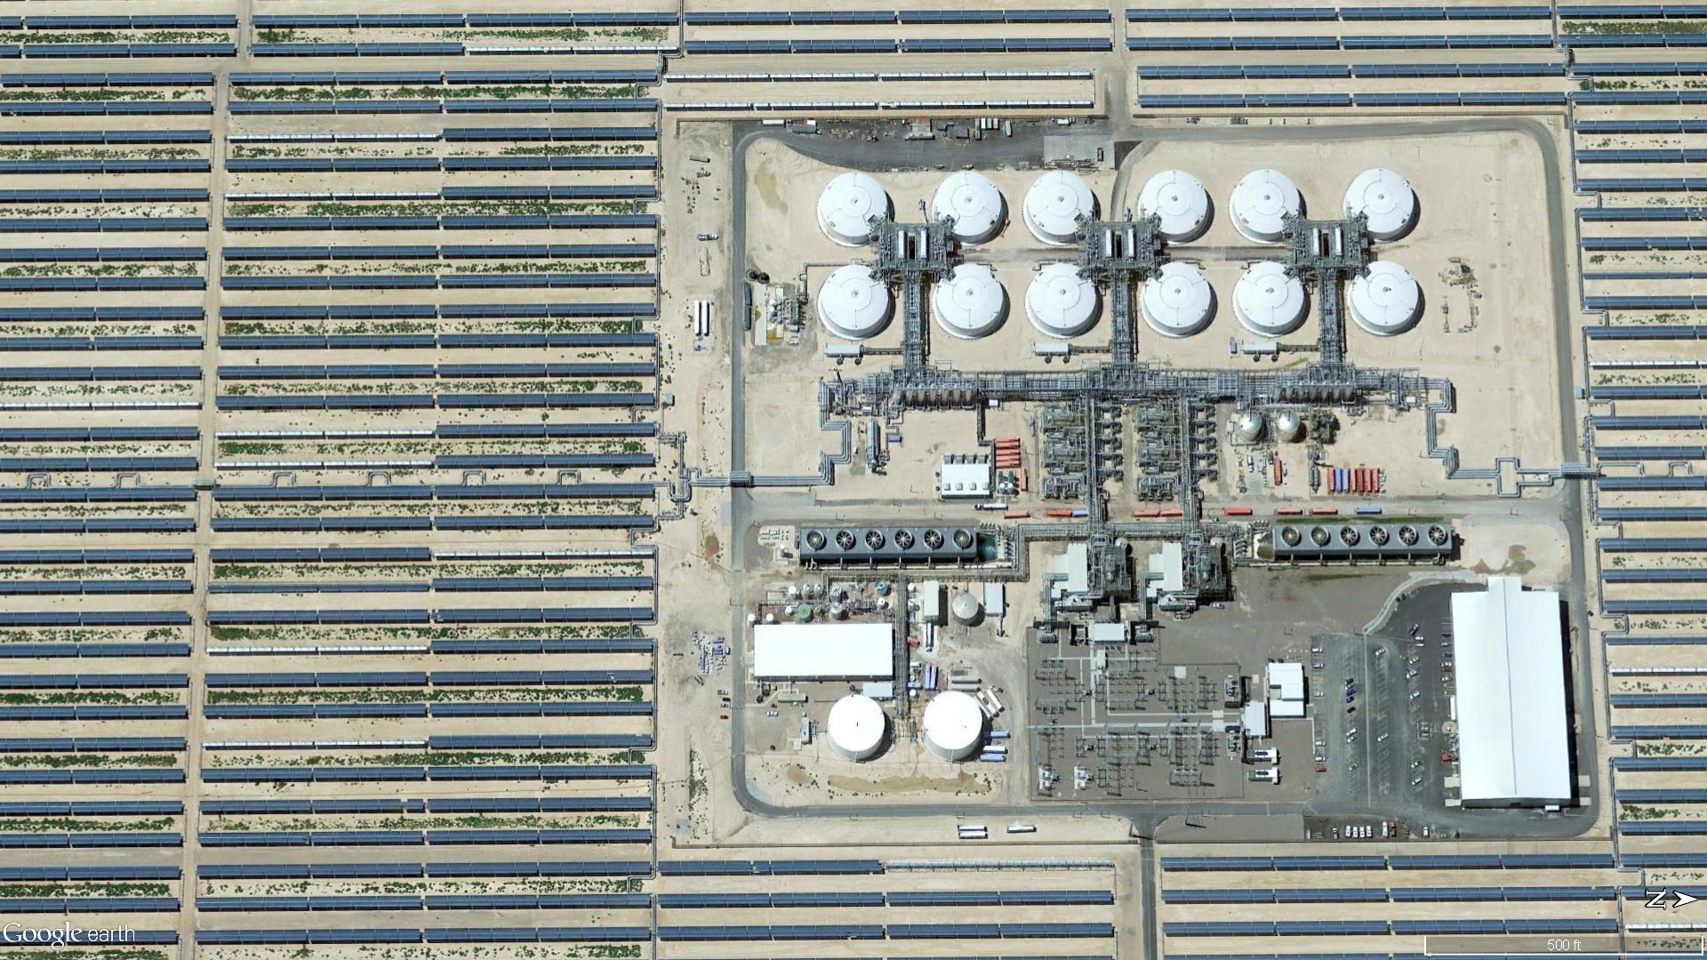
Solar Field
Solar field performance
  E2 parabolic trough collectors are operating at high availability and performing well.
No significant availability issues
Mirror Washing
  Able to maintain reflectivity at goal with ~1 wash per month.
Newer collectors are better
and cheaper!
Solana Parabolic Trough Collectors (Source: Abengoa)
Notes:
Solana uses the new E2 parabolic trough collector. How is this collector performing. What kind of availability is being experienced. What is the experience with high winds? How is the mirror washing done and what is reflectivity is being maintained.

Slide 8
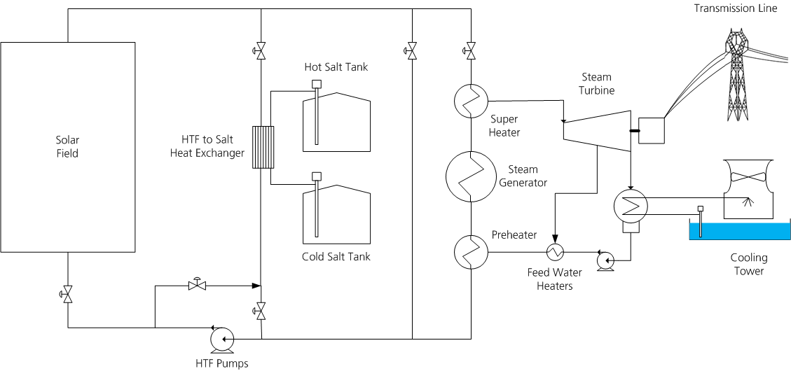
HTF System
Source: Google Earth

Slide 9
HTF System
HTF System
  The HTF system is very complex due to size and complexity of the plant
  Ullage system - H2O removal
  Expansion system undersized
  Night circulation – split main plant from SF
Solar field loop flow balance for 800 parallel loops
  Used high quality manual globe valves.
  Initial flow balance based on hydraulic model calculated valve position.
  Temperature transient method to estimate loop flow w/o flow meters.
  Achieving excellent flow balance.
HTF temperature control
  Achieving high solar field outlet temperatures.
  Long warm-up in winter.
  Operation in partially cloudy weather
  Operation when TES full.
Lots of opportunity for improvement and cost reduction
Notes:
The HTF system has over 3 million gallons of HTF and connects the solar field to the power plant and TES system. The HTF system is very complex at Solana due to having 808 parallel loops of collectors, 8 solar fields with separate flow control, 2 HTF pump trains, 4 steam generation trains connected to 2 steam turbines and 6 parallel TES units.
Solana is the only trough plant build in the U.S. with an indirect molten-salt thermal energy storage system (TES). Solana uses plate frame heat exchanges between the HTF and molten salt storage system. How have these heat exchangers worked? The plant build the TES HXs on top of platforms above the salt storage tanks. This is to allow the salt to drain back to the the tanks to minimize the risk of freezing in the piping and HX. This is expensive, does it make sense for future plants. What other lessons can be learned from the TES experience at Solana. Operationally, how is the system working?
Can you balance the flow in a 3 square mile solar field with 808 loops of collectors? Solana has developed a process of flow balancing its fields that has enabled it to be potentially the best flow balanced plant (at least in my knowledge). This technique could be used at other trough plants.

Slide 10
Thermal Energy Storage System
Plate frame heat exchanger
  Excellent heat transfer
  Low allowable temperature gradients restricts operation
  Difficult to repair
  Recommend alternative design
Long shafted pumps
  No issues
Elevated HX platform
  Expensive
  Access issue for O&M
  Consider alternative configuration
Tank - low salt heel design
  Tank in tank sump
  Separate circulation loop with external salt heaters and HX for HTF freeze protection
  Recommend more traditional design
Salt piping & heat tracing
  Important to pay attention to design and installation.
Tanks & salt
  No major issues
Notes:
Solana is the only trough plant build in the U.S. with an indirect molten-salt thermal energy storage system (TES). Solana uses plate frame heat exchanges between the HTF and molten salt storage system. How have these heat exchangers worked? The plant build the TES HXs on top of platforms above the salt storage tanks. This is to allow the salt to drain back to the the tanks to minimize the risk of freezing in the piping and HX. This is expensive, does it make sense for future plants. What other lessons can be learned from the TES experience at Solana. Operationally, how is the system working?

Slide 11
Power Cycle
Two 140 MWe turbines vs. one 280 MWe
  Costs more
  Takes more people to operate
  Operational flexibility
Water treatment
  Water quality worse than expectation
Wet vs. Dry Cooling
  Go dry!
Steam generation system
  HTF Start-up Bypass
  Turbine full bypass to condenser
  Over night thermal maintenance
Significant opportunity for improvement and cost reduction.
Source: APS 2016 All Source RFP
Notes:
As is often the case, many of the problems at Solana are with the “conventional” equipment at the plant.
What types of problems have been experienced and what can be done about this at future plants?
How is the plant O&M compared to design expectations?

Slide 12
Keep it simple
If you cannot understand the P&IDs, it is too complex.
You need to design all subsystems to work together.
  Bring vendors together to workout interface
Design with the idea of the required O&M.
  Instrumentation
  Valves and automation
  Auxiliary piping and systems
Every attempt to save cost usually ends up costing more somewhere else.
  Low cost condenser
  Auxiliary cooling system
  HTF Expansion Tank
  Salt tank heel
Heat exchangers leak – design for it.
Piping has to be done right in a plant that cycles
Conventional equipment is not conventional in a solar plant
Civil works matter

Slide 13
General
Need to shorten the project cycle time
  Designs for rapid construction.
  Goal EPC on site for <12 month
Take advantage of technology
  Wireless instrumentation?
  Autonomous operation?
  Data mining
  Sun sensors?
Mirror washing
  Robots for mirror washing
  Dry wash
  Anti soiling coatings
We need better weather forecasting
  24-48 hrs
  Nowcasting – the next 2 hours

Slide 14
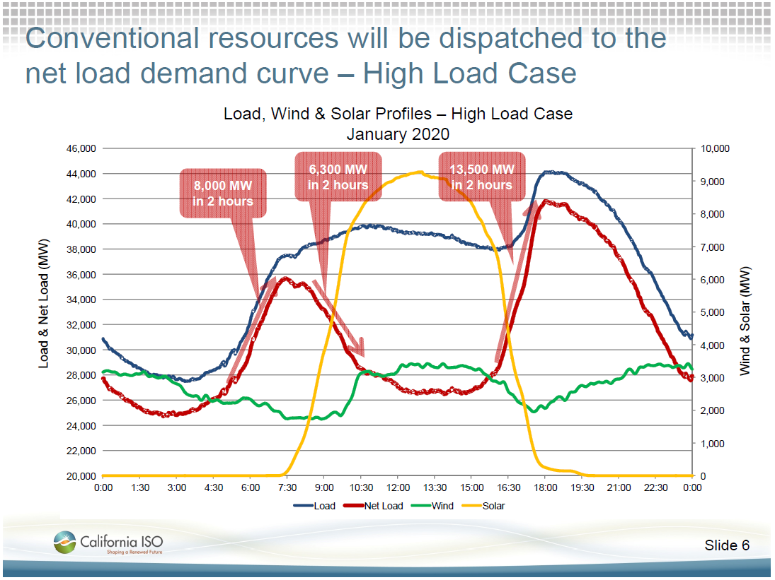
CAISO Duck
Source: Clyde Loutan, CSP Today USA 2012 – 6th Concentrated Solar Thermal Power Conference & Exhibition, California ISO, June 27-28, Caesars Palace, Las Vegas

Slide 15
Example of a MS Tower Peaker Operation
Seasonal APS system load with 600MW STE at 30% CF
Solar Contributors: PV: 600 MW STE: 600 MW
Winter
Spring
Summer

Slide 16
Energy Payment ($/MWh) vs. Capacity Factor
Source: CEC Cost of Generation Model 2016

Slide 17
Capacity Payment ($/kW-Yr) vs. Capacity Factor
Combined Cycle (CC)
Advance Gas Turbine (AGT)
Source: CEC Cost of Generation Model 2016

Slide 18
Energy & Capacity Payments
 | 200 MW Advanced Gas Turbine |  |  |  | 500 MW Combined Cycle
Capacity Factor | 7.5% | 10.0% | 15.0% | 20.0% | 20.0% | 30.0% | 50.0% | 80.0%
Energy Payment Only
Energy Payment ($/MWh) | $435 | $346 | $257 | $213 | $209 | $159 | $119 | $96
Capacity Payments Only
Capacity Payment ($/kW-Yr) | $272 | $288 | $321 | $354 | $347 | $395 | $493 | $638
Combined Energy + Capacity
Capacity Payment ($/kW-Yr) | $222 | $222 | $222 | $222 | $250 | $250 | $250 | $250
Energy Payment ($/MWh) | $79 | $79 | $79 | $79 | $59 | $59 | $59 | $59
Source: CEC Cost of Generation Model 2016

Slide 19
APS Needs >2700 MWe by 2024
2016 All Source RFP just first Step
Source: APS 2016 All Source RFP
IRP_Stakeholder_Presentations.pdf

Slide 20
Source: APS 2016 All Source RFP
IRP_Stakeholder_Presentations.pdf

Slide 21
APS 2016 All Source RFP
APS Needs
  In this RFP, APS requests competitive proposals (“Proposals”) for capacity resources totaling approximately 400-600 MW, which are able to start delivery by June 1, 2020.
  APS’s additional capacity and energy need is in the summer months of June through September, between the hours of 3 PM to 9 PM. APS expects that flexible, dispatchable summer resources will provide the highest overall value.
  Conversely, energy that is non-dispatchable by APS and is proposed as must-take energy outside of the summer peak time periods will generally be viewed and evaluated less favorably.
  Mixed resources allowed (Renewable, energy storage, DSM, thermal)
APS Thermal Capacity Resources:
  Proposed system shall be capable of operating at 114° F and twenty percent (20%) humidity, at 100% Contract Capacity for a minimum of 4 consecutive hours.
  The Proposed project must be fully dispatchable by APS with Automatic Generation Control capability (“AGC”/load following capability).
  Be capable of stable operation at a minimum operating level of sixty percent (60%) loading or lower without exceeding the legal limits for emissions
  Capable of at least two (2) starts per day, minimum ramp rate of ten percent (10%) per minute of summer capacity rating.
Source: APS 2016 All Source RFP

