Slide 1

The Value of CSP With Storage
And cost reduction opportunities
CSP SunShot Program Summit
April 2016
Bill Gould
Chief technical officer
solarreserve

Slide 2
Within the Rapidly Growing Renewable Energy Market, Solar Thermal with Integrated Storage Plays a Key Role
Global energy market context
Solar thermal with storage deploys commercially viable technology that can displace fossil fuel generation
The installed capacity of renewable energy is forecast to more than double by 2025 to reach 3,203 GW or 39% of global installed capacity
The highest share of total renewable energy capacity additions is expected to come from solar power, representing 35.1% of additions through 2025 with wind energy following closely behind at 32.7%
The addition of intermittent wind and solar PV resources will further stress transmission systems causing many load serving entities to seek a clean energy dispatchable solution to ensure electric reliability
Energy storage allows the generator to control a plant’s output and dispatch when electricity is at peak pricing
Storage allows the facility to produce more than twice as much net annual output as solar without storage
Renewable capacity additions: 2012-2025
Solar thermal with storage can operate like a conventional power plant
Source: Frost & Sullivan
Other
555 GW
Solar PV
547 GW
Nuclear
4%
Intermittent renewables
66% (1,082 GW)
Wind
535 GW
Firm output ensures a more stable and secure transmission system
Fossil
fuels
38%
Renewable
58%
CSP with storage is set to realize falling installation costs as global deployment accelerates
Global total
capacity additions
2,836 GW

Slide 3
Framework: The Value of CSP with Storage
CSP with storage delivers multiple value streams which are increasingly important in the changing energy landscape
Ancillary Services
Intrinsic Stability
Energy and Capacity Value
Risk Management
Operating Flexibility
Frequency regulation
Spinning reserve
Non-spinning reserve
Ramping support / load following
Black start
Fault ride-through capability
Inertia / frequency response
Voltage / VAR support
Time-shift generation to the highest-value times
Replace conventional resources for flexibility and reliability
Higher utilization of transmission assets
Less fuel / O&M from startup / cycling the fleet
No “round-trip” losses
Hedges:
Power price
Ancillary service price
Integration costs
Improved forecast error
Lower reserve requirements
Long-term dispatch flexibility
Stable lifetime performance and value
Responsive curtailment
Slow the net load ramps
Smooth intra-hour variability
Ease the integration of intermittent renewables
Integration with other thermal generators
Curtailment issues and shifting of the net load peak will reduce the value of renewables without storage in the future
Studies have shown how the value of renewables without storage declines as penetration increase
In contrast, storage allows CSP to deliver superior value over the long term
Base (no PV)
2%
6%
10%
PV penetration and hour

Slide 4
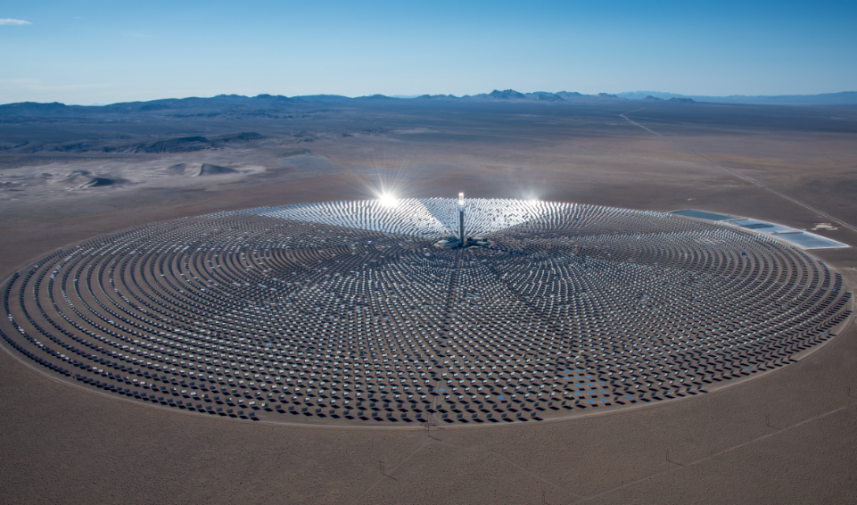
CSP with Storage: Cost Reduction Opportunities

Slide 5
SolarReserve CSP Cost Reductions
Cost (USD $mm)
39% Cost Reduction
Smaller collector field, slightly higher storage due to capacity & TOD constraints
Larger collector field, larger receiver and storage to take advantage of higher DNI and baseload requirements
Cost reductions achieved to date set the platform for future reductions of hard and soft costs

Slide 6
SolarReserve CSP Cost Reductions: Collector Field Capex Detail
The collector field is a comparatively large part of the overall EPC scope, and has the largest potential for cost reductions through serial production and scale economies
Structural elements can be reduced without compromising optical quality or durability (e.g., wireless, thinner glass, improved foundations)
Overall soft costs decline further as a result of capex cost reductions
Crescent Dunes collector field
Redstone collector field
Future collector field advancement
Approximately half of the cost of Crescent Dunes’ heliostats consisted of structural elements
Cost reduction of Redstone’s heliostats achieved primarily through structure steel reduction
Facet improvements further reduce structural requirements
SolarReserve has achieved significant collector field cost reductions to date,
and has line of sight to 10% additional reduction in the short term

Slide 7
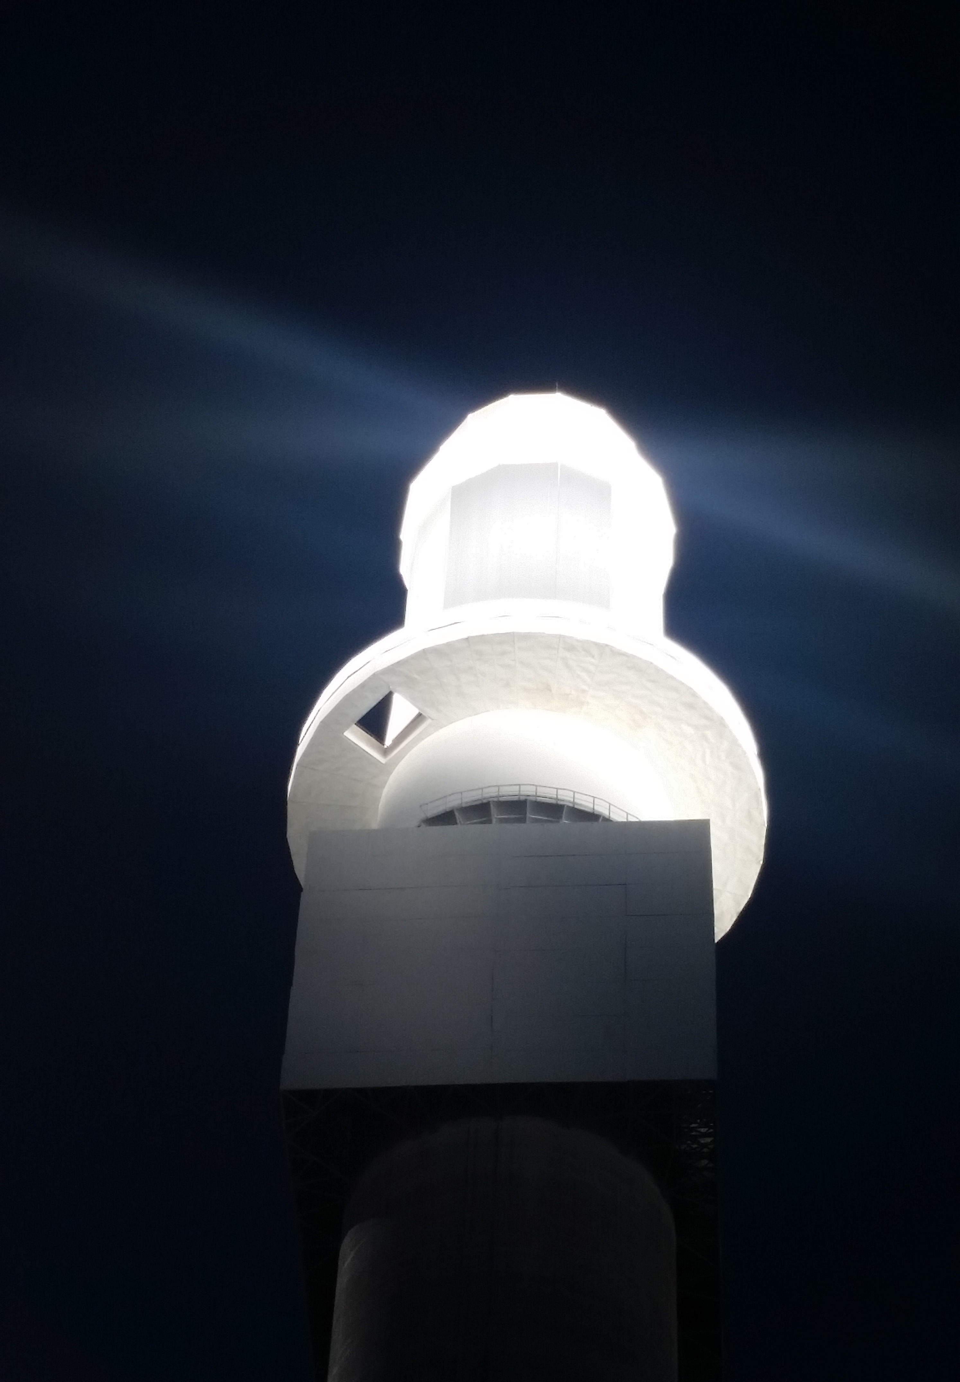
SolarReserve CSP Cost Reductions: 800°C Receiver
Recipient of CSP APOLLO program award from U.S. Department of Energy SunShot Initiative to develop ceramic receiver that breaks through current temperature and performance barriers, while meaningfully increasing efficiency, energy storage capabilities and lowering capital cost
Partnering Organizations
UC San Diego
University of Arizona
Receiver Development Goals
High outlet temperature to drive higher efficiency supercritical power cycles using thermal storage
Compatible with Oxy-Chloride molten salts
30 year life (10,000 thermal cycles)
90% thermal efficiency
Affordable capital cost
Result – key component that enables lower cost of electricity (6¢/kWhe)

Slide 8
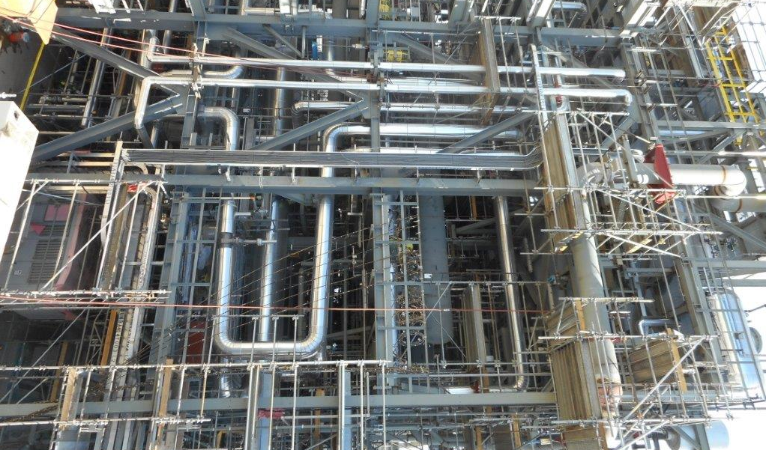
SolarReserve CSP Cost Reductions: BOP

Slide 9
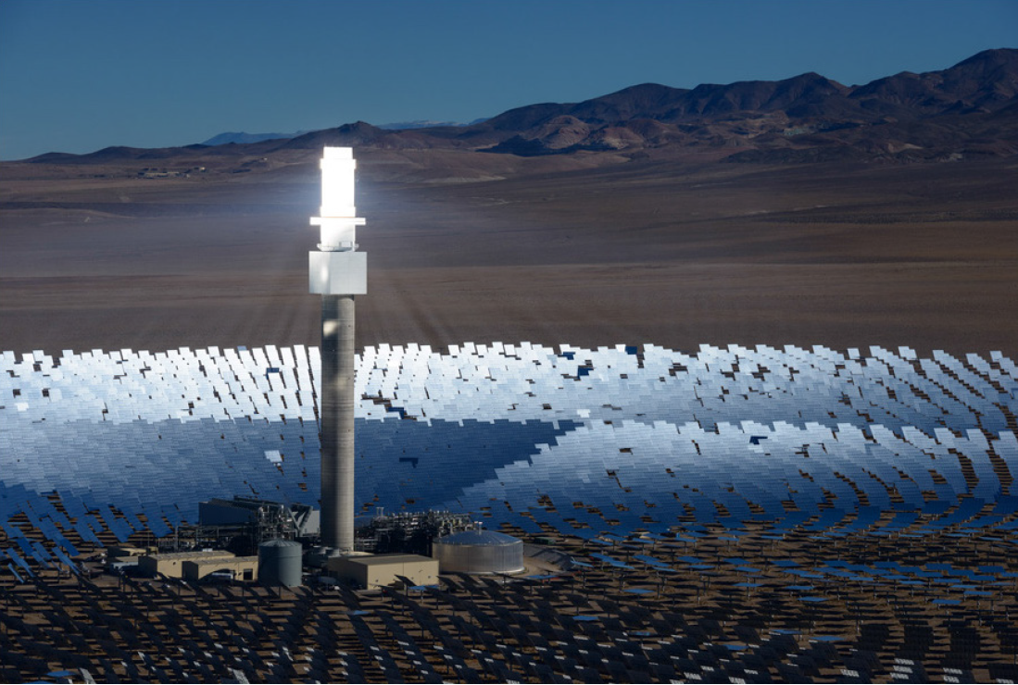
CONTACT INFORMATION
Corporate Headquarters
520 Broadway
6th Floor
Santa Monica, CA 90401
www.SolarReserve.com
Phone: +1.310.315.2200
Toll-Free: +1.866.622.2778
Fax: +1.310.315.2201
Email: Info@SolarReserve.com

