Slide 1
CSP Program Summit – Welcome!
Joe Stekli, CSP Program Manager and Acting T2M Program Manager
Solar Energy Technologies Office

Slide 2
Summary
Team Intro
SunShot Overview
Near-Term Market Focus

Slide 3

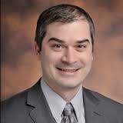

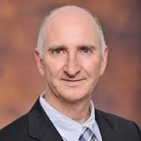
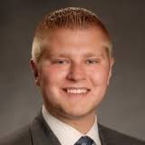
CSP Team
Matt Bauer – SETA
Christine Bing – Technical Project Officer
Levi Irwin – SETA
Jennifer Johnson – Operations
Mark Lausten – SETA
Jake Mees – FPA

Slide 4
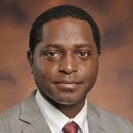
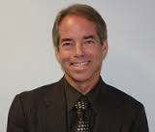
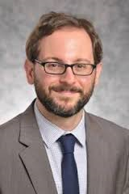

CSP Team
Andru Prescod – SETA
Tommy Rueckert – Technical Project Officer
Avi Shultz – Technology Manager
Rajgopal Vijaykumar – Technology Manager

Slide 5
Summary
Team Intro
SunShot Overview
Near-Term Market Focus

Slide 6

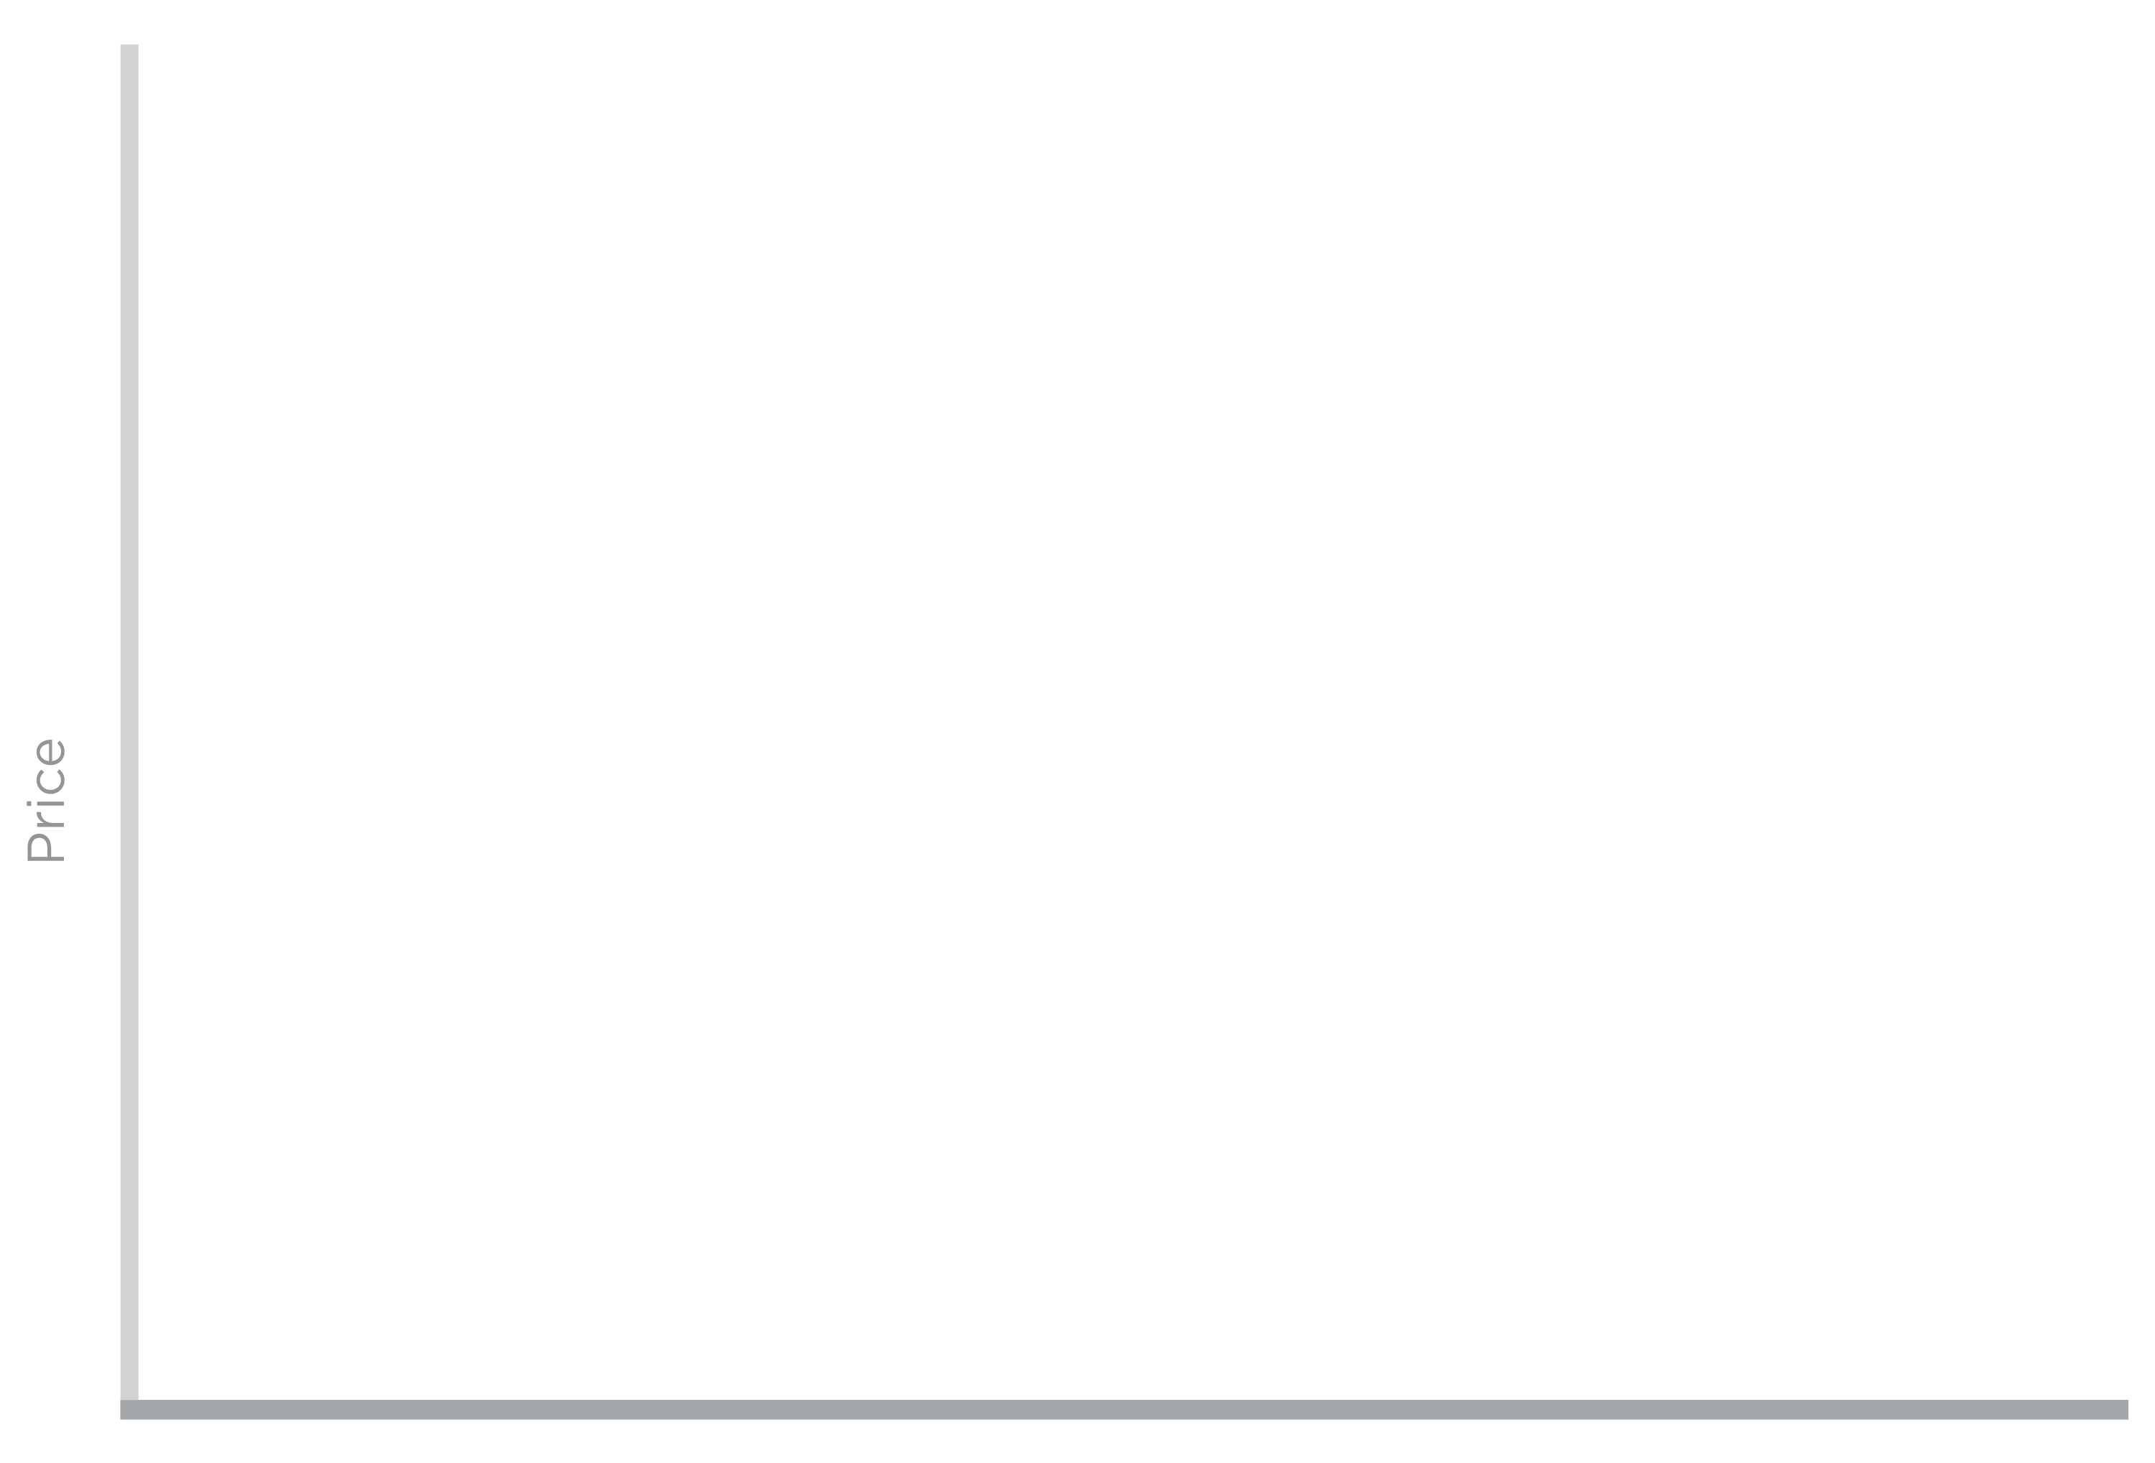
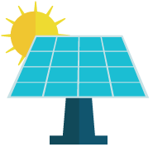



SunShot Initiative
SunShot Goal:
6¢/kWh without subsidy
A 75% cost reduction by 2020
Price
SunShot
Initiative
6¢/kWh
Coal
Nuclear
Gas
Solar
Notes:
The SunShot Initiative is a collaborative national effort to reduce the total cost of solar by 75% so it can be cost-competitive with other energy sources by 2020. DOE supports several programs that work toward this aggressive goal along the entire cost spectrum. Among these, the Incubator program is unique because it addresses all of the targeted reduction areas needed to achieve cost parity.

Slide 7
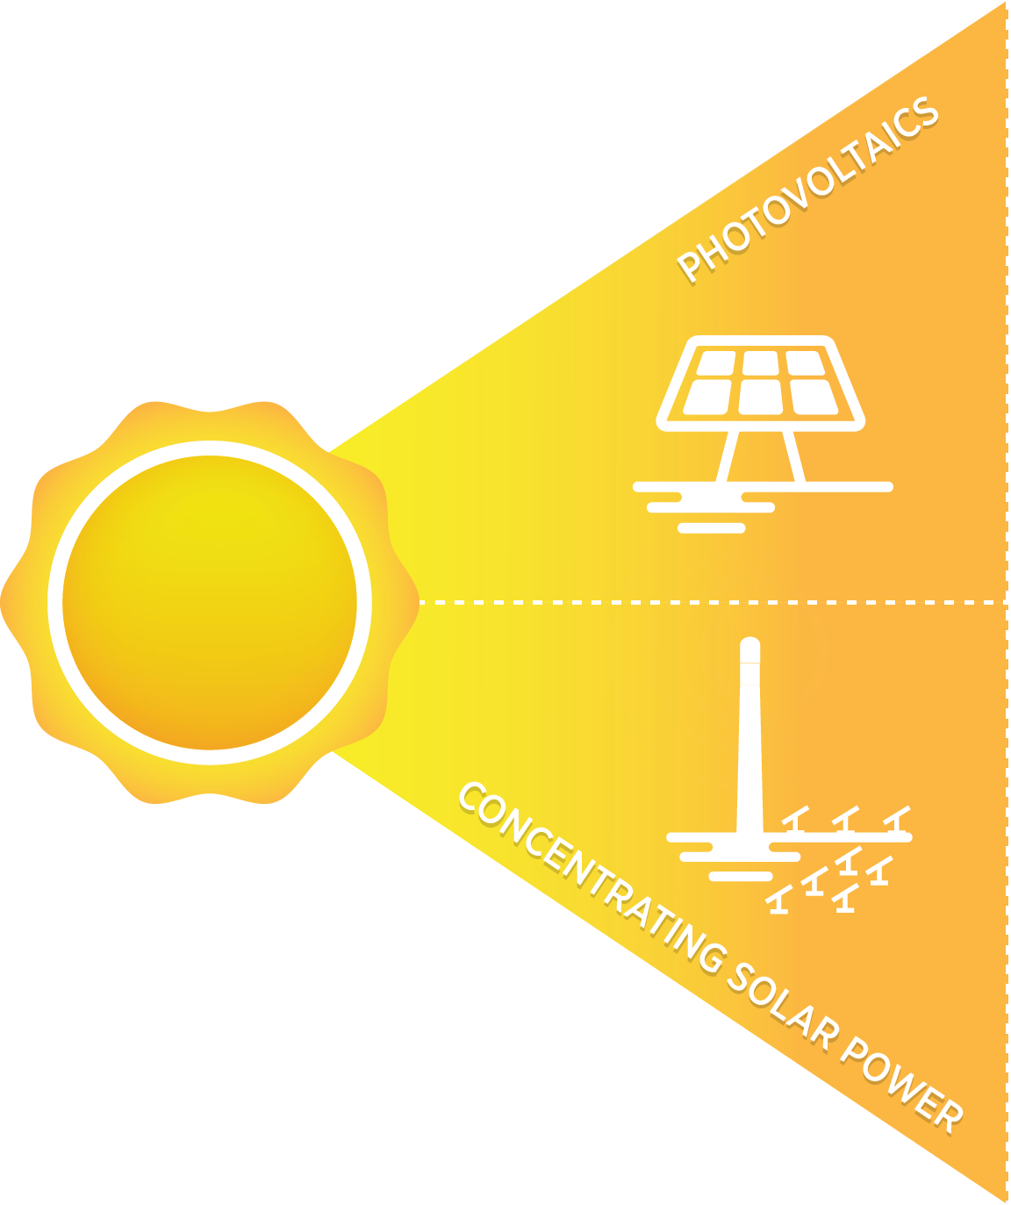
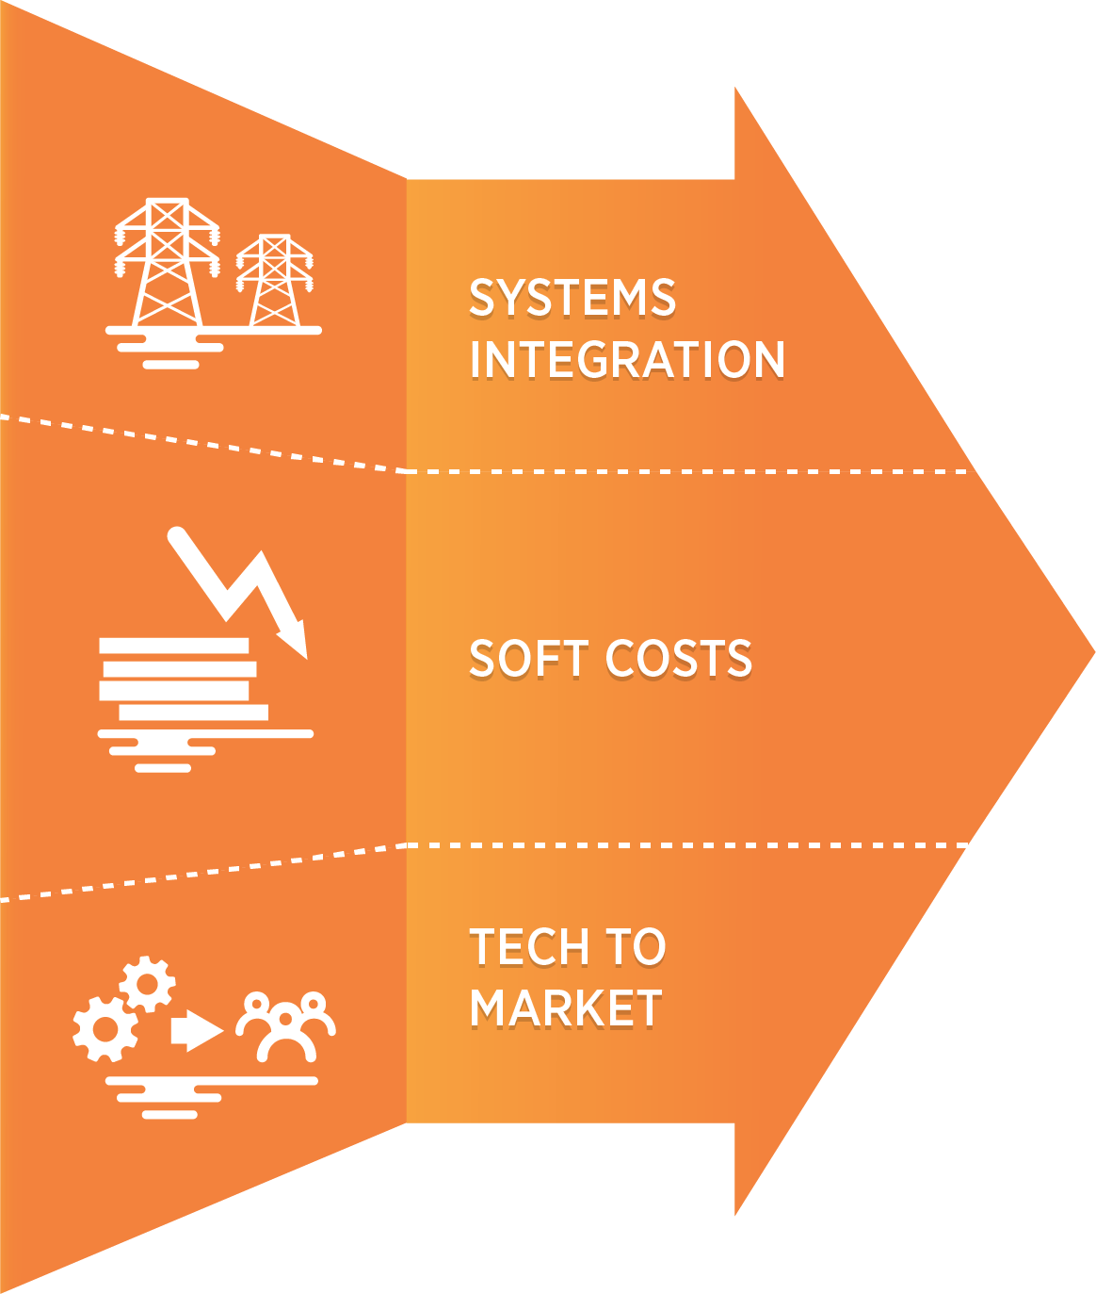
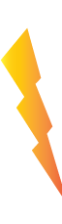
SunShot Program Structure
$1/Watt
SunShot
2020 Goal

Slide 8

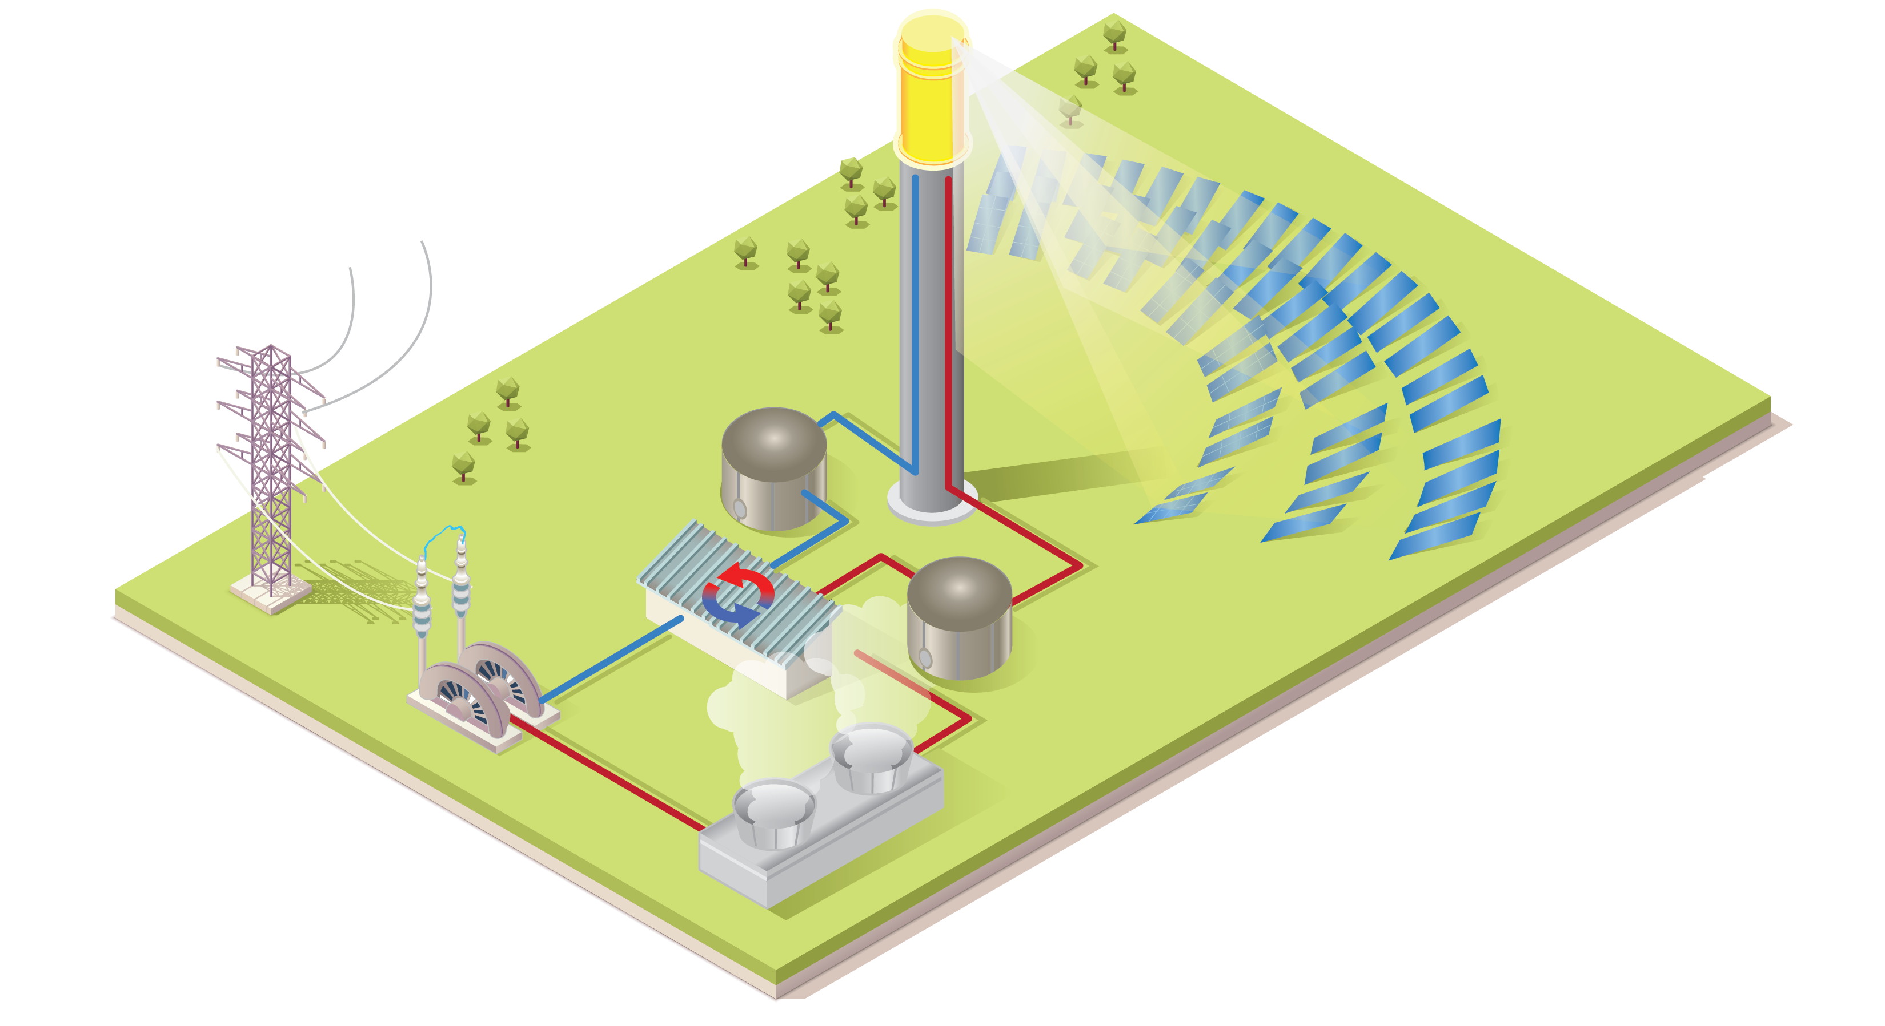
Concentrating Solar Power Joe Stekli, Program Manager
RECEIVER
SOLAR FIELD
6¢/kWh
HEAT
TRANSFER FLUID
POWER BLOCK
THERMAL STORAGE

Slide 9

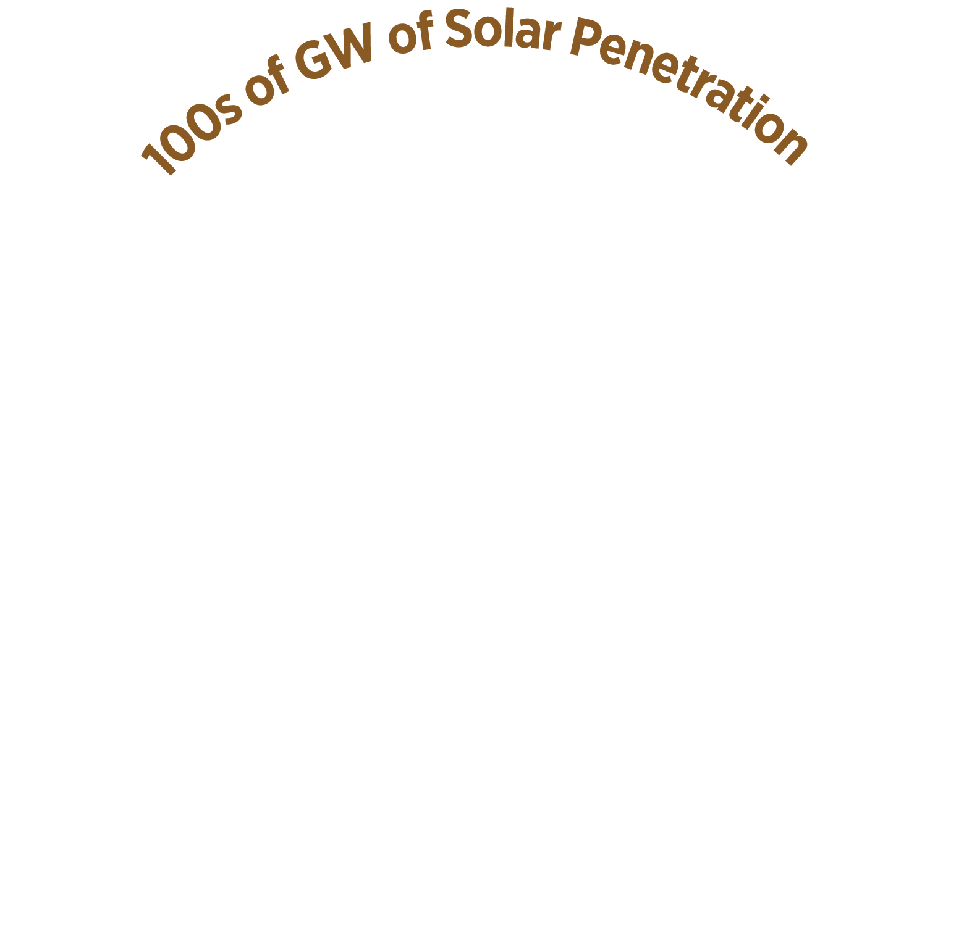


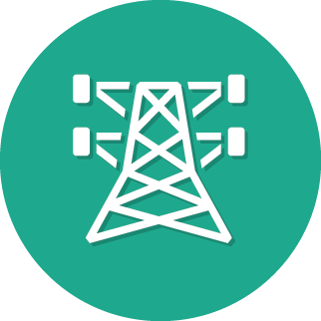


SYSTEMS INTEGRATION Dr. Guohui Yuan, Program Manager
GRID PERFORMANCE
AND RELIABILITY
DISPATCHABILITY
POWER
ELECTRONICS
COMMUNICATIONS
Notes:
Over the next decade, SunShot’s Systems Integration subprogram envisions a penetration scenario of 100’s of GWs of solar to be interconnected onto the nation’s electric grid. The fundamental challenges for this high solar penetration are quantified and addressed in the following inter-related thrust areas:
Grid Performance and Reliability: Achieve high penetration solar at the distribution level (< 69kV) and on the transmission grid in a seamless, safe, reliable and cost-effective manner.
Dispatchability: Ensure that solar power plants based on PV and concentrating solar power (CSP) technologies at the utility and distributed scales are capable of being dispatched in a fashion that is comparable to or better than conventional power plants.
Power Electronics: Seek to develop intelligent devices with advanced functionalities that maximize the power output from PV arrays on one side and serve as the interfaces to the electrical grid (or end use circuits) on the other, while ensuring that the overall system’s costs for performance, safety, reliability, and controllability are minimized.
Communications: Effectively inform grid operations with high-level integration of solar to enable visibility across multiple spatial scales (from the end-user load through the distribution substation and beyond) and at multiple time scales (from microseconds to hours and days). Significantly advance information, communication, and sensor technologies to adequately monitor the behavior and manage the impact of integrating solar technologies into the grid. Enable enterprise-level integration of PV management systems with grid management systems in order to provide important information to grid operators.

Slide 10
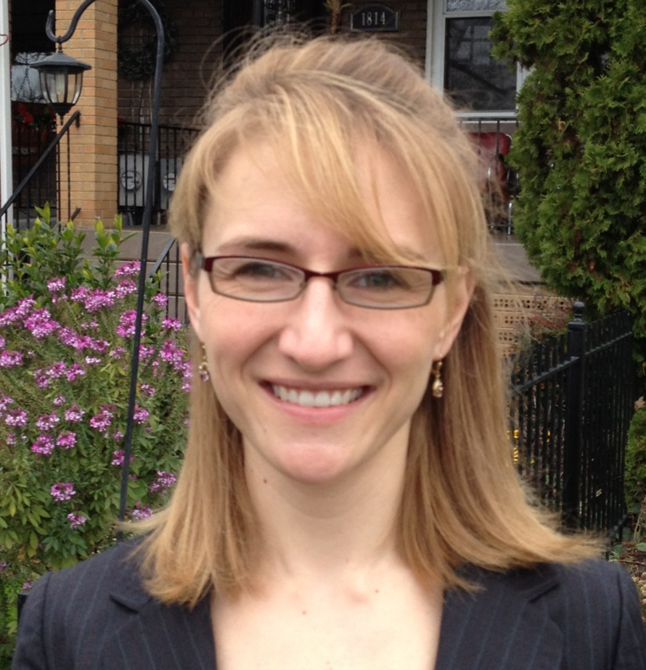

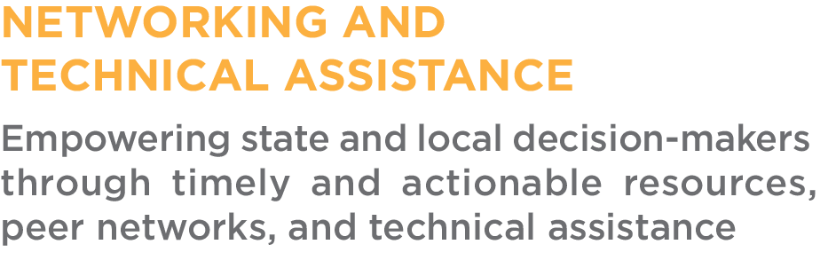


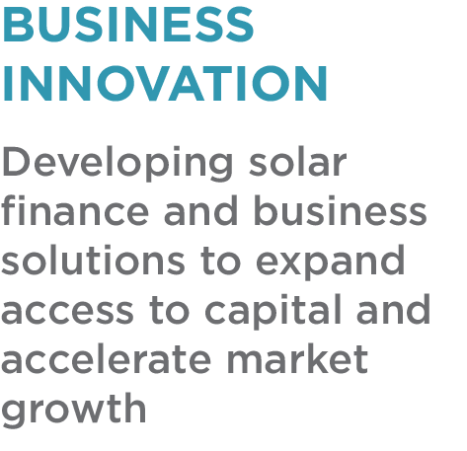
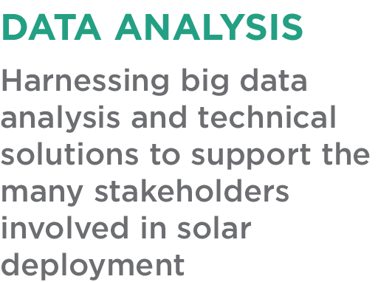

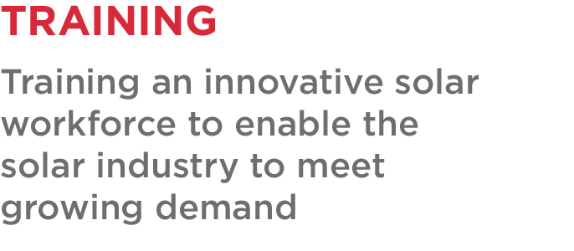
Balance of Systems (Soft Costs) Dr. Elaine Ulrich, Program Manager

Slide 11
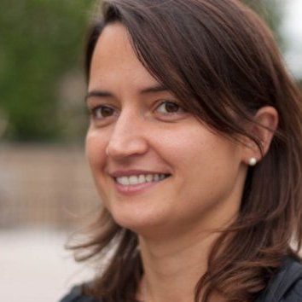
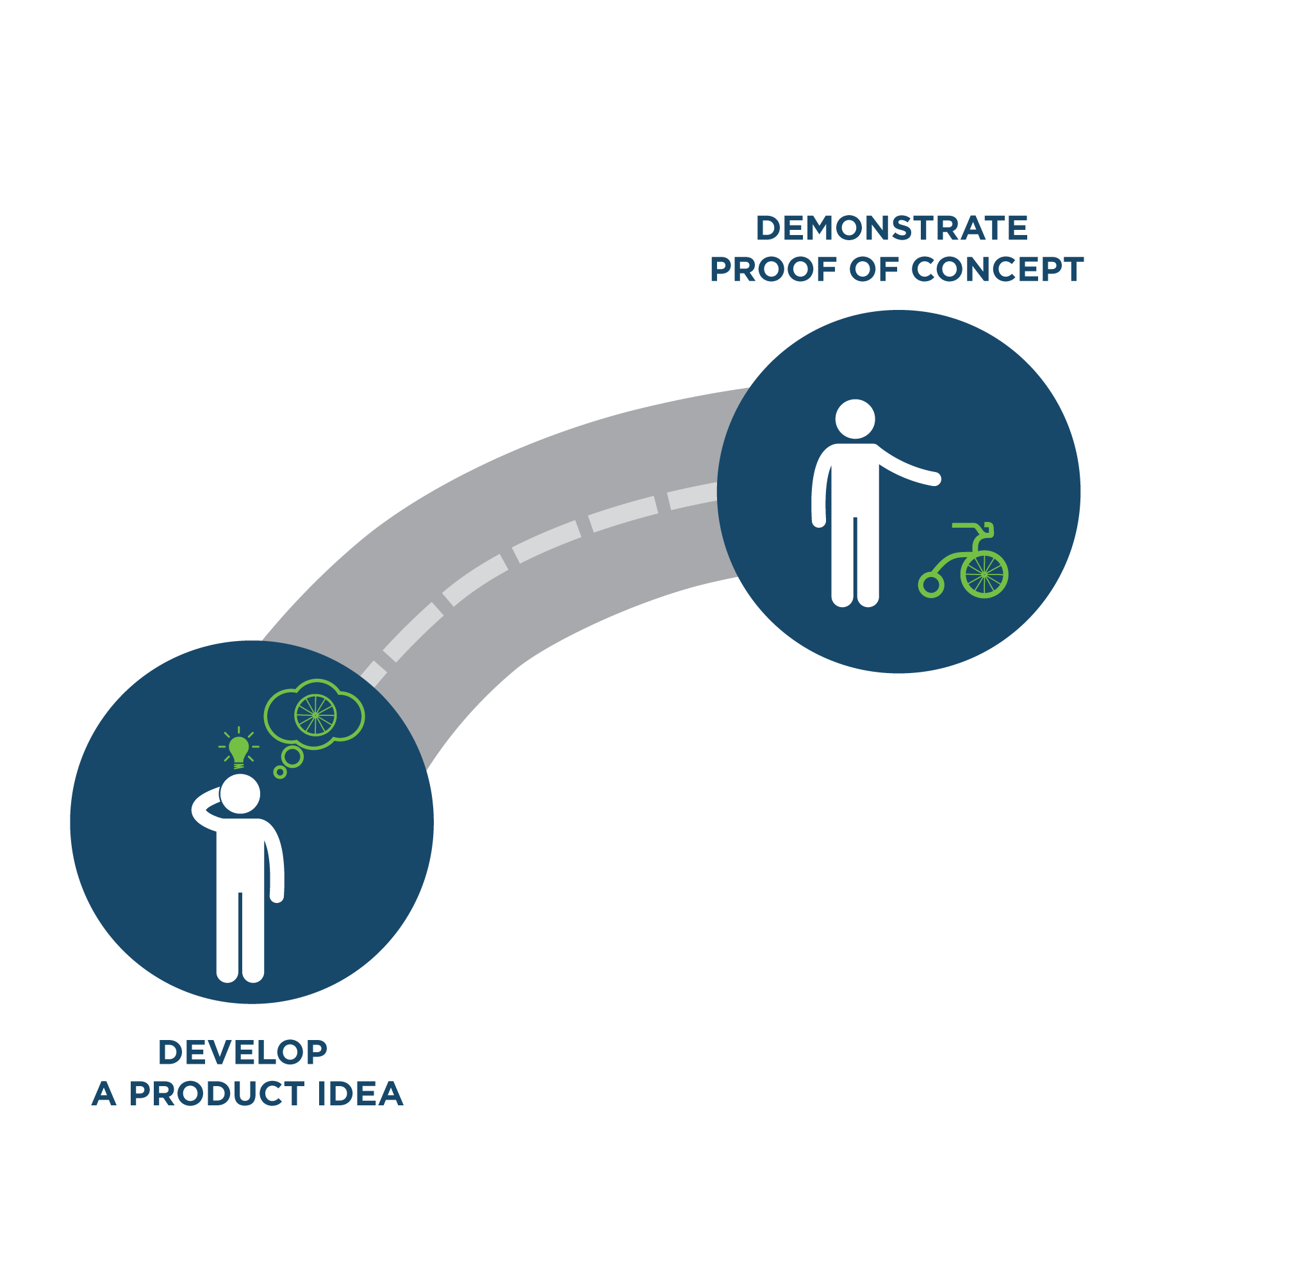
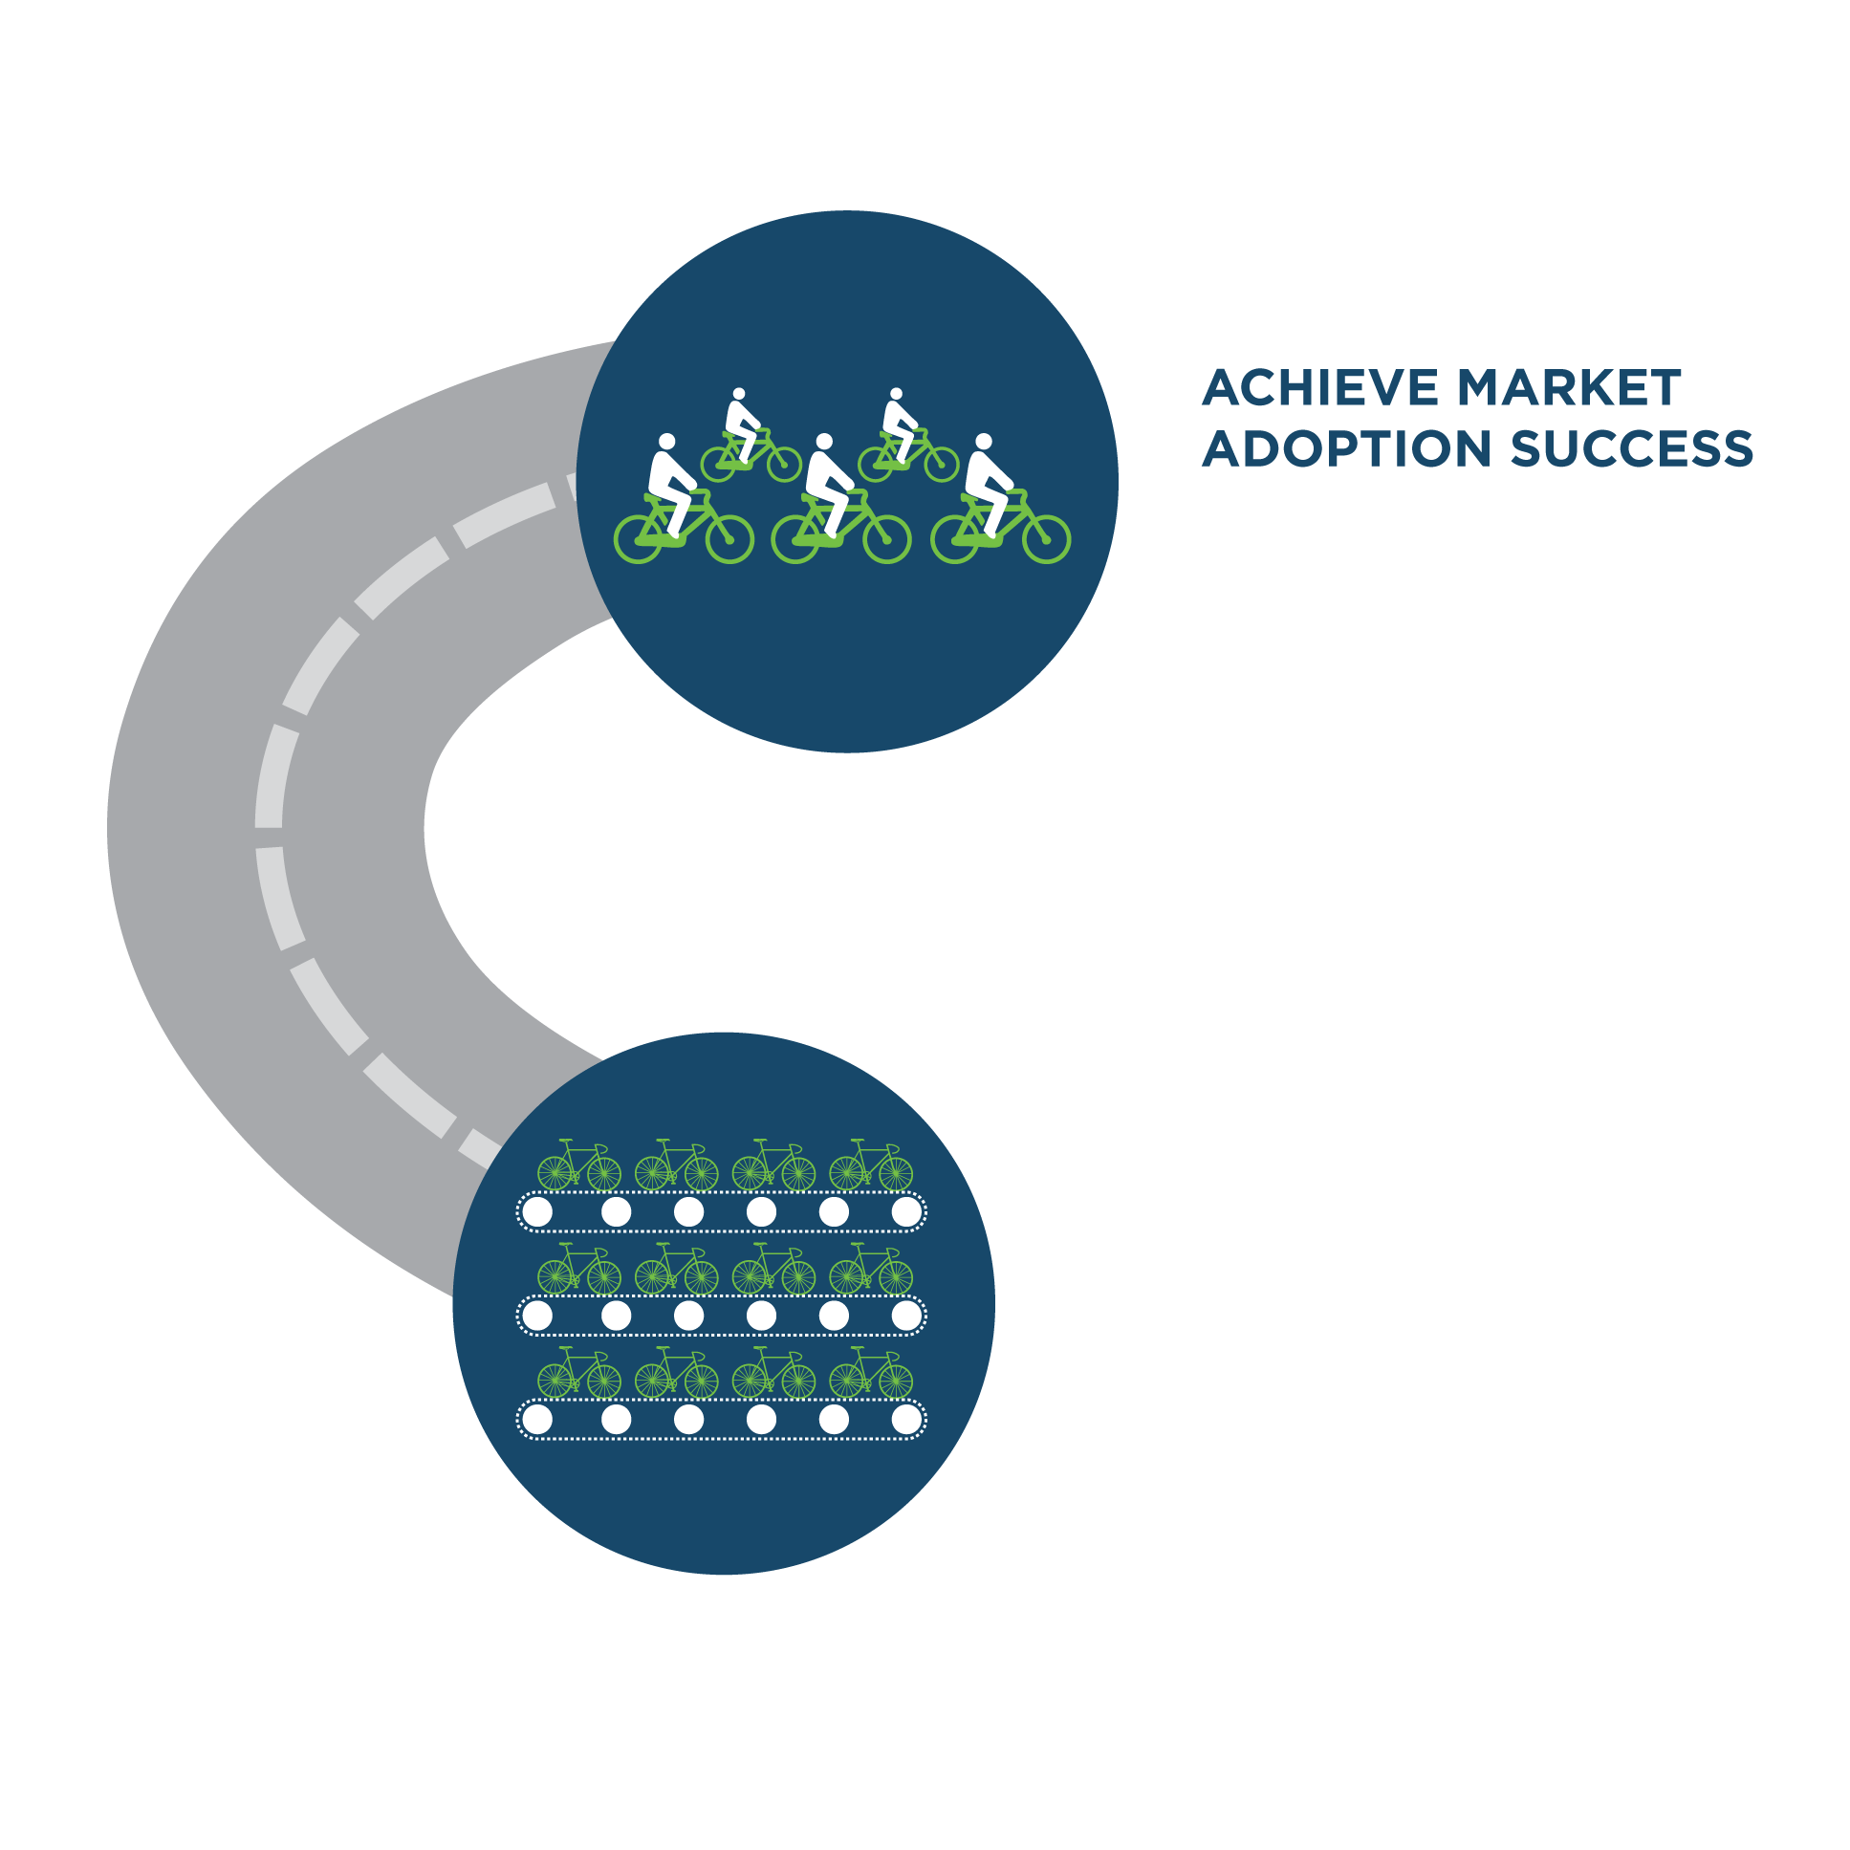
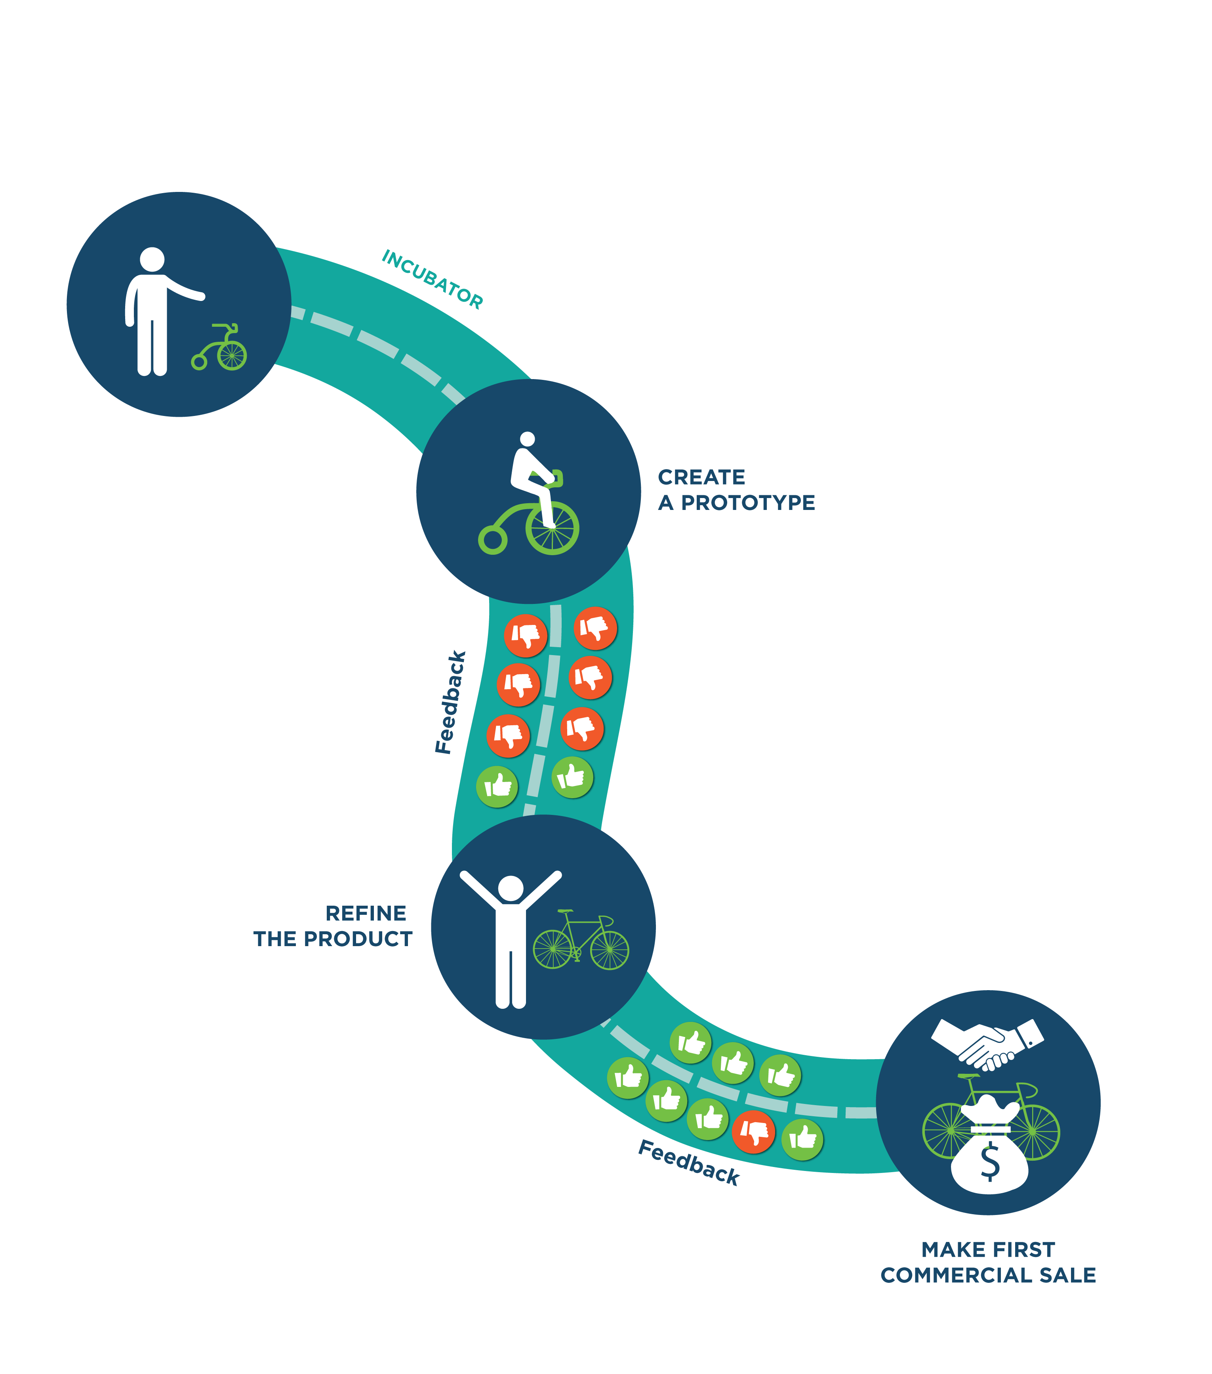
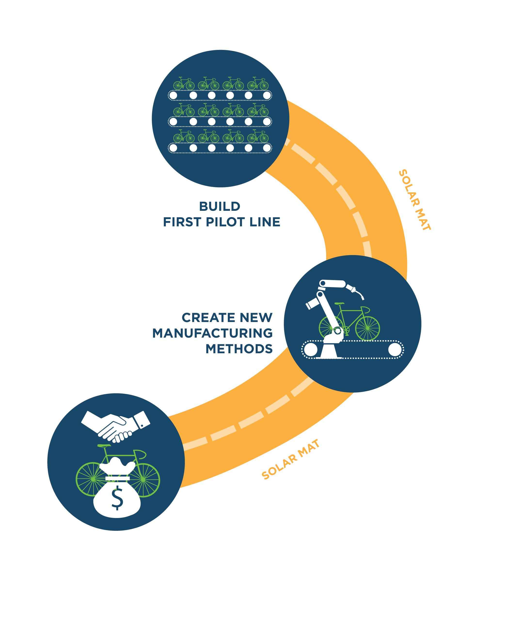
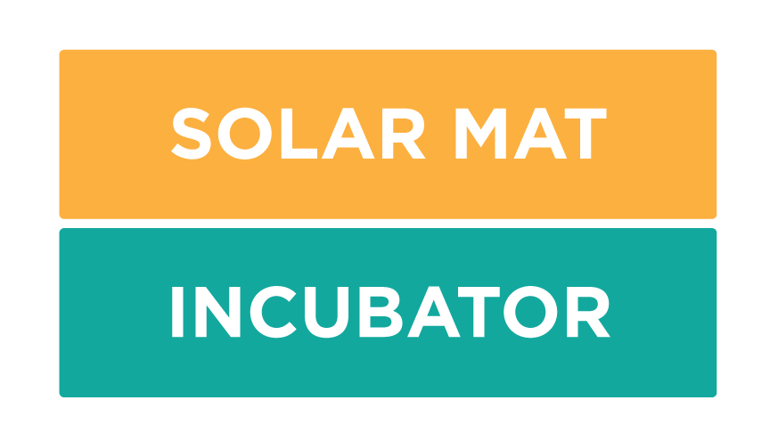
Technology to Market Joe Stekli, Program Manager

Slide 12
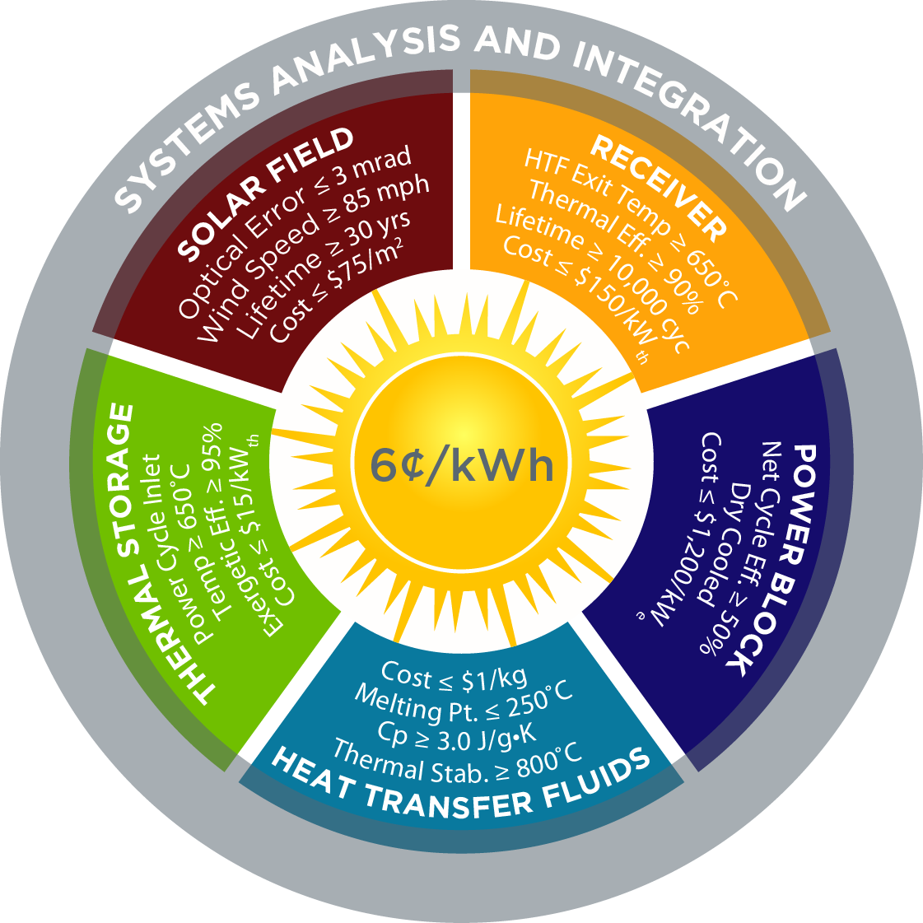

Competitive Initiatives
3 FOA’s, $72M executed in the past year!!!
$10M COLLECTS (2016)
$29M CSP SuNLaMP (2015)
$33M CSP: APOLLO (2015)
$25M SolarMat II (2014)
$20M CSP: ELEMENTS (2014)
$10M CSP-HIBRED (2013)
$ 8M PREDICTS (2013)
$15M SolarMat (2013)
~$350M in Total CSP R&D Funding
$10M SunShot MURI (2012)
$30M National Lab R&D (2012)
$ 5M BRIDGE (2012)
$56M SunShot CSP R&D (2012)
$ – M Incubator/SBIR (Recurring)
$53M CSP Baseload (2010)
$29M ARRA (2009)
$27M Thermal Storage (2008)
$25M CSP R&D (2007)

Slide 13








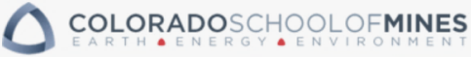


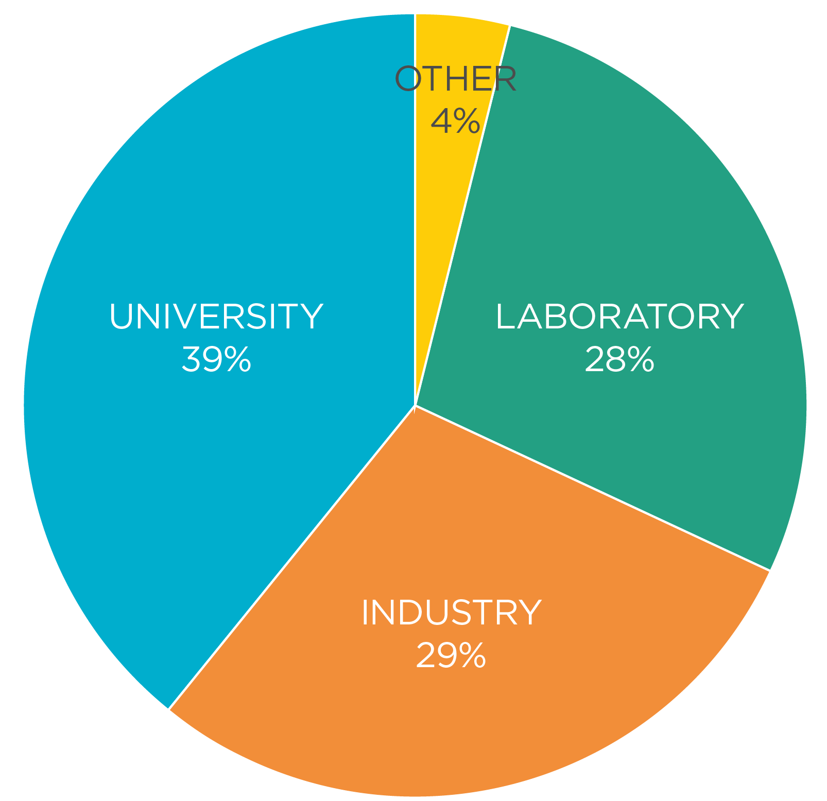






















Notes:
The goal of the FOA is to fund innovations and developments of next-generation CSP technologies for
significantly reducing the solar field cost to < $75/m2 while improving optical efficiency,
increasing receiver operating temperature to > 650 deg C while improving thermal efficiency and
increasing power cycle conversion efficiency > 50% with dry cooling.
Today I am pleased to announce that the Department of Energy will invest up to $55M over 3 years to support these innovations and developments.
The funding will support 21 different projects at companies, universities, and the DOE as well as other Federal agency’s national laboratories. The montage of logos of institutions involved reflect the truly collaborative effort toward the SunShot goal.
You can see all the projects at the Tech Forum later today.

Slide 14
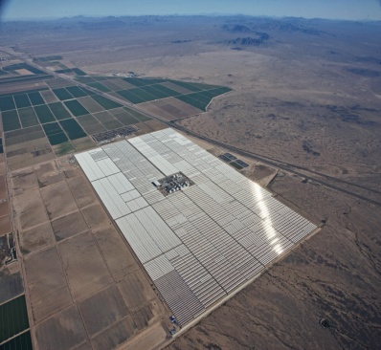
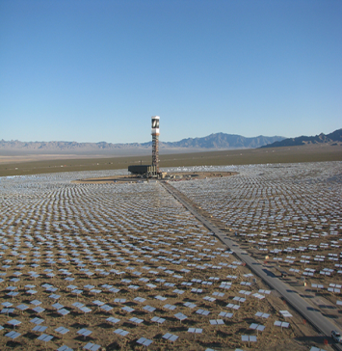
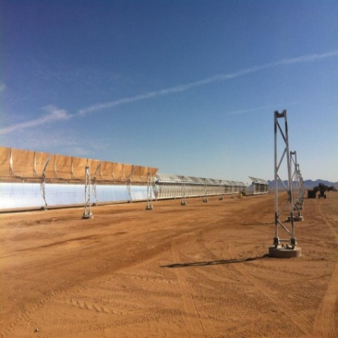
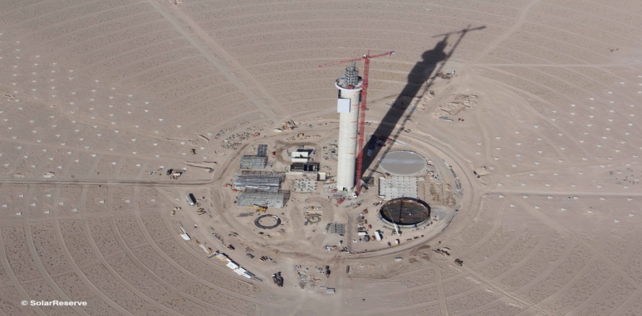
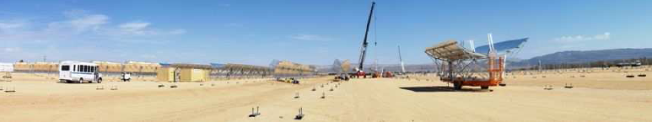
Recent CSP Deployment in US
Project | Solana | Ivanpah | Genesis | Crescent Dunes | Mojave
Utility | APS | SCE + PG&E | PG&E | NVE | PG&E
State | Arizona | California | California | Nevada | California
Size | 280 MW | 392 MW | 250 MW | 110 MW | 280 MW
Technology | Trough/Storage | Tower | Trough | Tower/Storage | Trough
COD | October 2013 | February 2014 | March 2014 | February 2016 | Late 2014
DOE Loan | $1.45 B | $1.63 B | $0.85 B | $.74 B | $1.2 B
Company | Abengoa | BrightSource | NextEra | SolarReserve | Abengoa
 |  | Total New CSP in US: 1,312 MW
Notes:
COD: Commercial Operation Date
LGP: Loan Guarantee Program

Slide 15





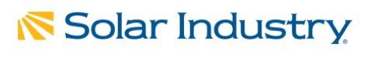
SunShot CSP in the News
DOE SunShot Project to Enhance the Efficiency of Concentrated Solar Power Technology
September 2015
Project to Enhance the Efficiency of Concentrated Solar Power Technology
September 2015
Concentrating Solar Power (CSP) Systems are Anticipated to Reach $53.7 Billion by 2020
September 2015
SolarReserve Receives CSP SunShot Award, to Advance Storage Technology
September 2015
Sandia Begins Testing Of Advanced Thermal Storage System for CSP
July 2015

Slide 16
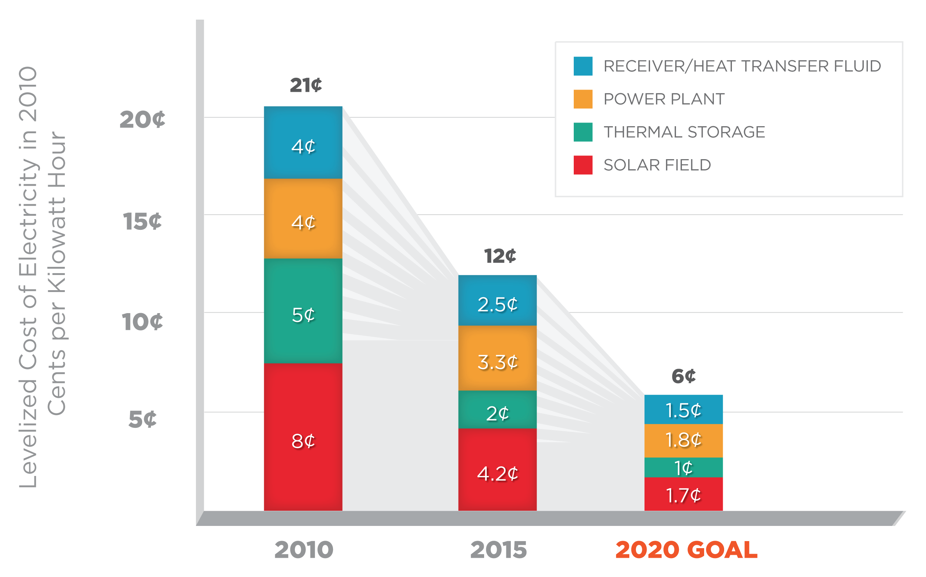
The Falling Cost of Concentrating Solar Power

Slide 17
Summary
Team Intro
SunShot Overview
Near-Term Market Focus

Slide 18
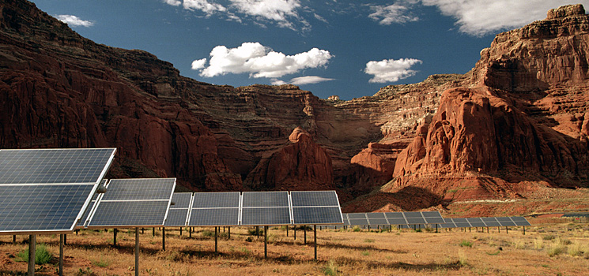
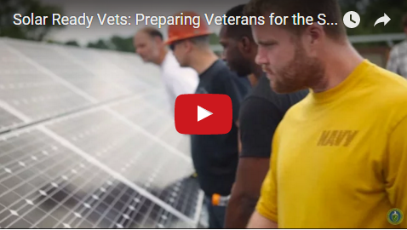


America Will Achieve its SunShot
Program Opens Doors in Growing Solar Industry
Solar energy will be cost competitive with fossil fuels by 2020, if not before, the director of the Department of Energy’s Solar Technologies Office said in New York Thursday.
“Solar Ready Vets leverages the talent, work ethic and skills that our transitioning service members gain from the military, enabling them to enter the rapidly growing solar energy industry,” said Dr. Lidija Sekaric, director of the SunShot Initiative.

Slide 19
Utility-Scale Pricing (>5 MW)
U.S. CSP plants without storage reporting prices between $4-$5/W_{AC}
Significantly higher than PV plants installed at same time
Source: Individual system pricing from corporate press releases & public filings. Additional information gathered from publicly available grant data from Treasury Department. http://www.treasury.gov/initiatives/recovery/Pages/1603.aspx. Specific project location and system size based on various press releases and corporate filings. Grant basis is assumed to be 1.00/0.30 of grant award.

Slide 20
US System Projected Deployment
US deployment projections also vary substantially with 2040 deployment ranging from 60 GW (EIA) to 460 GW (BNEF)

Slide 21
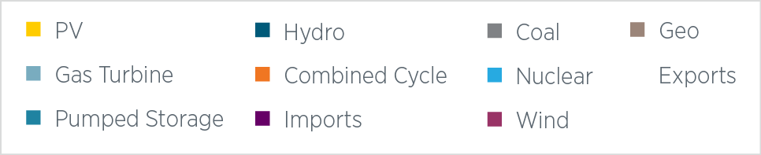
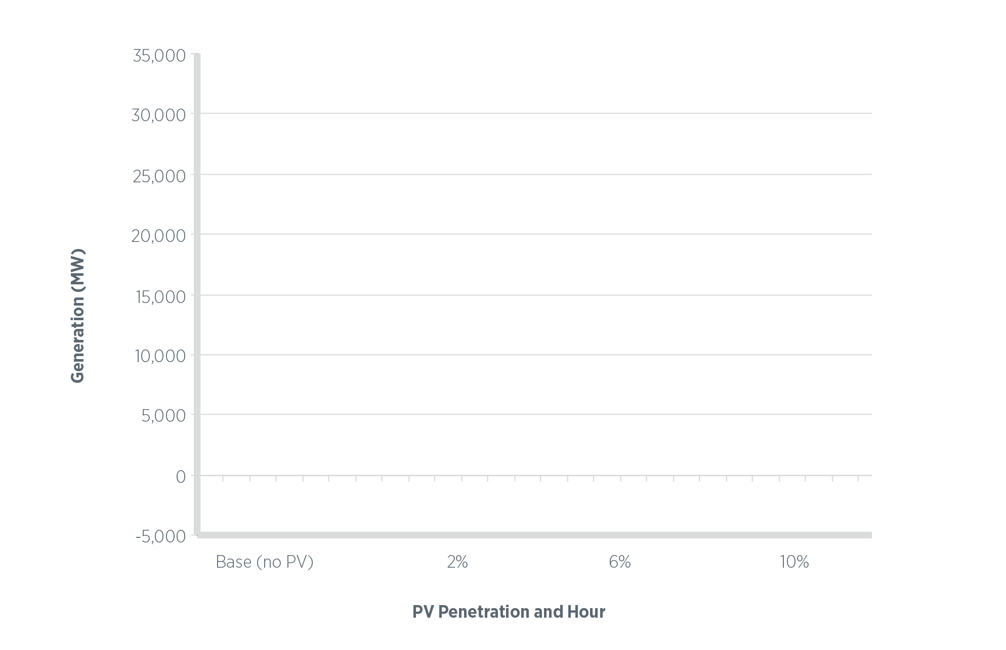
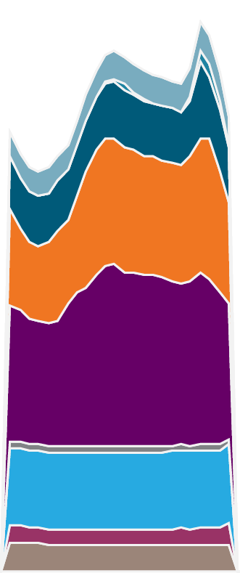
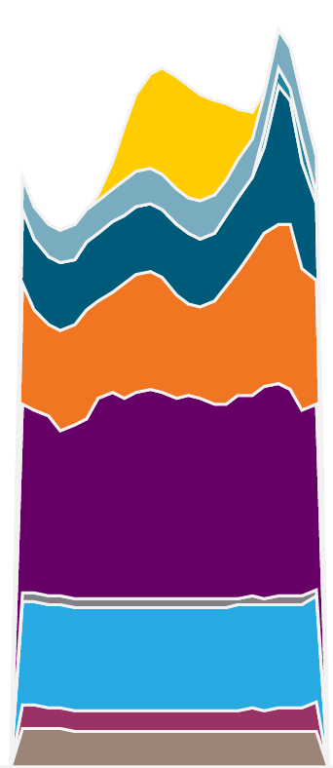


Excessive Ramp Rates and Minimum Load Constraints
Denholm, et al., (2011)

Slide 22
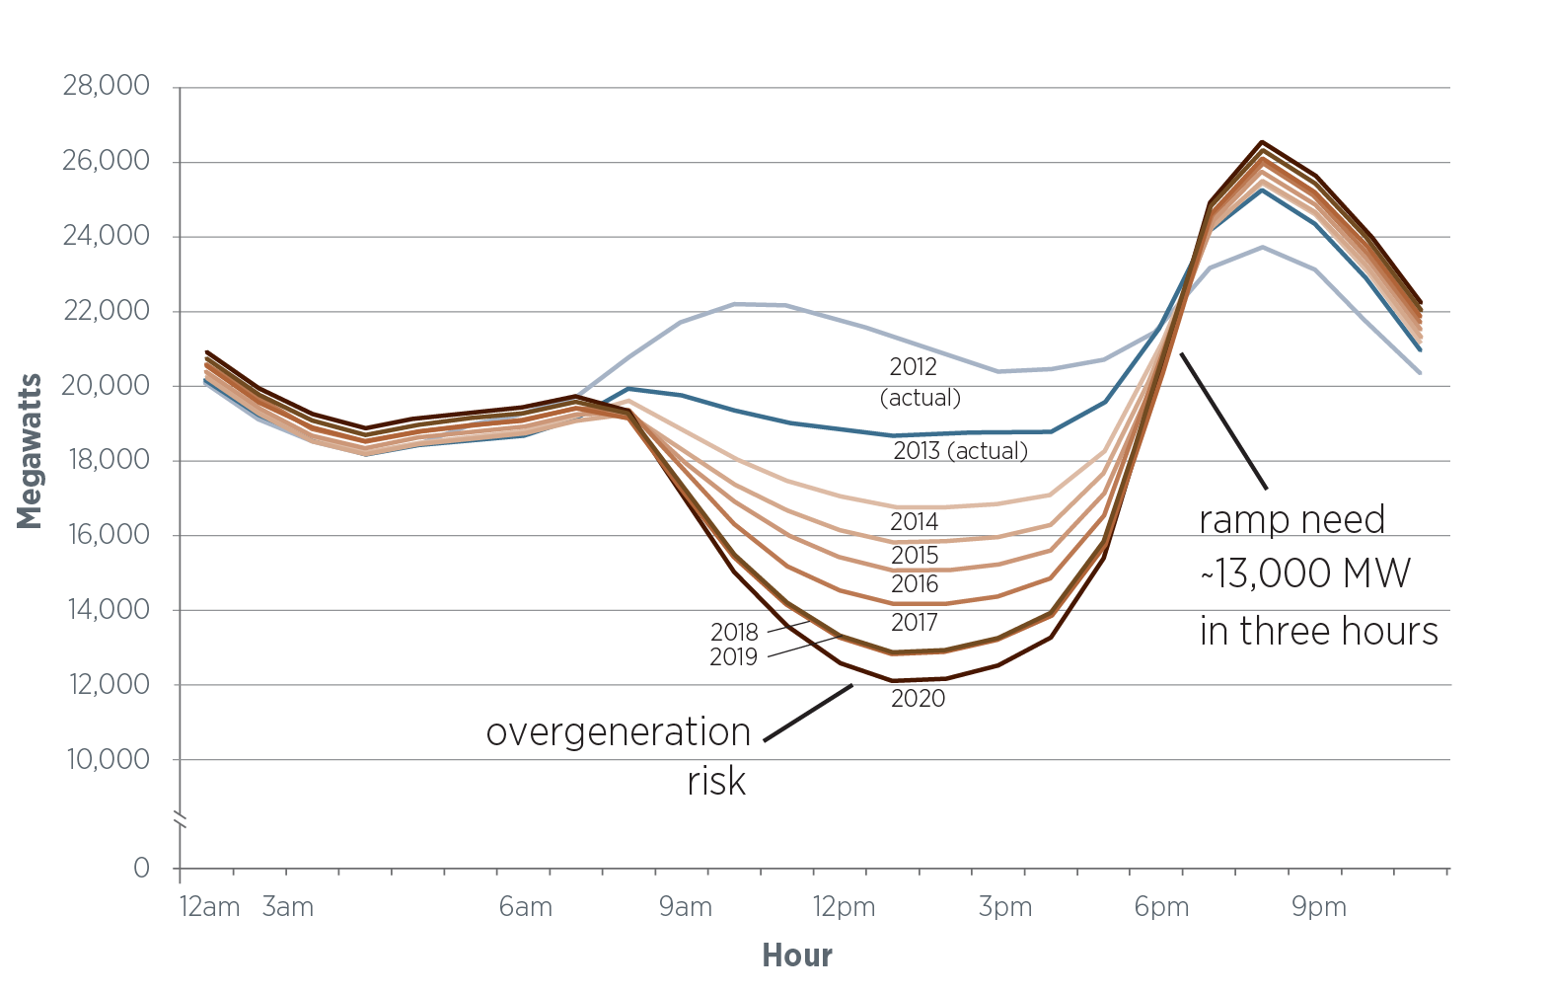


Near Term Opportunities for CSP: The CAISO Duck Curve
(March 31)
http://www.caiso.com/Documents/FlexibleResourcesHelpRenewables_FastFacts.pdf

Slide 23
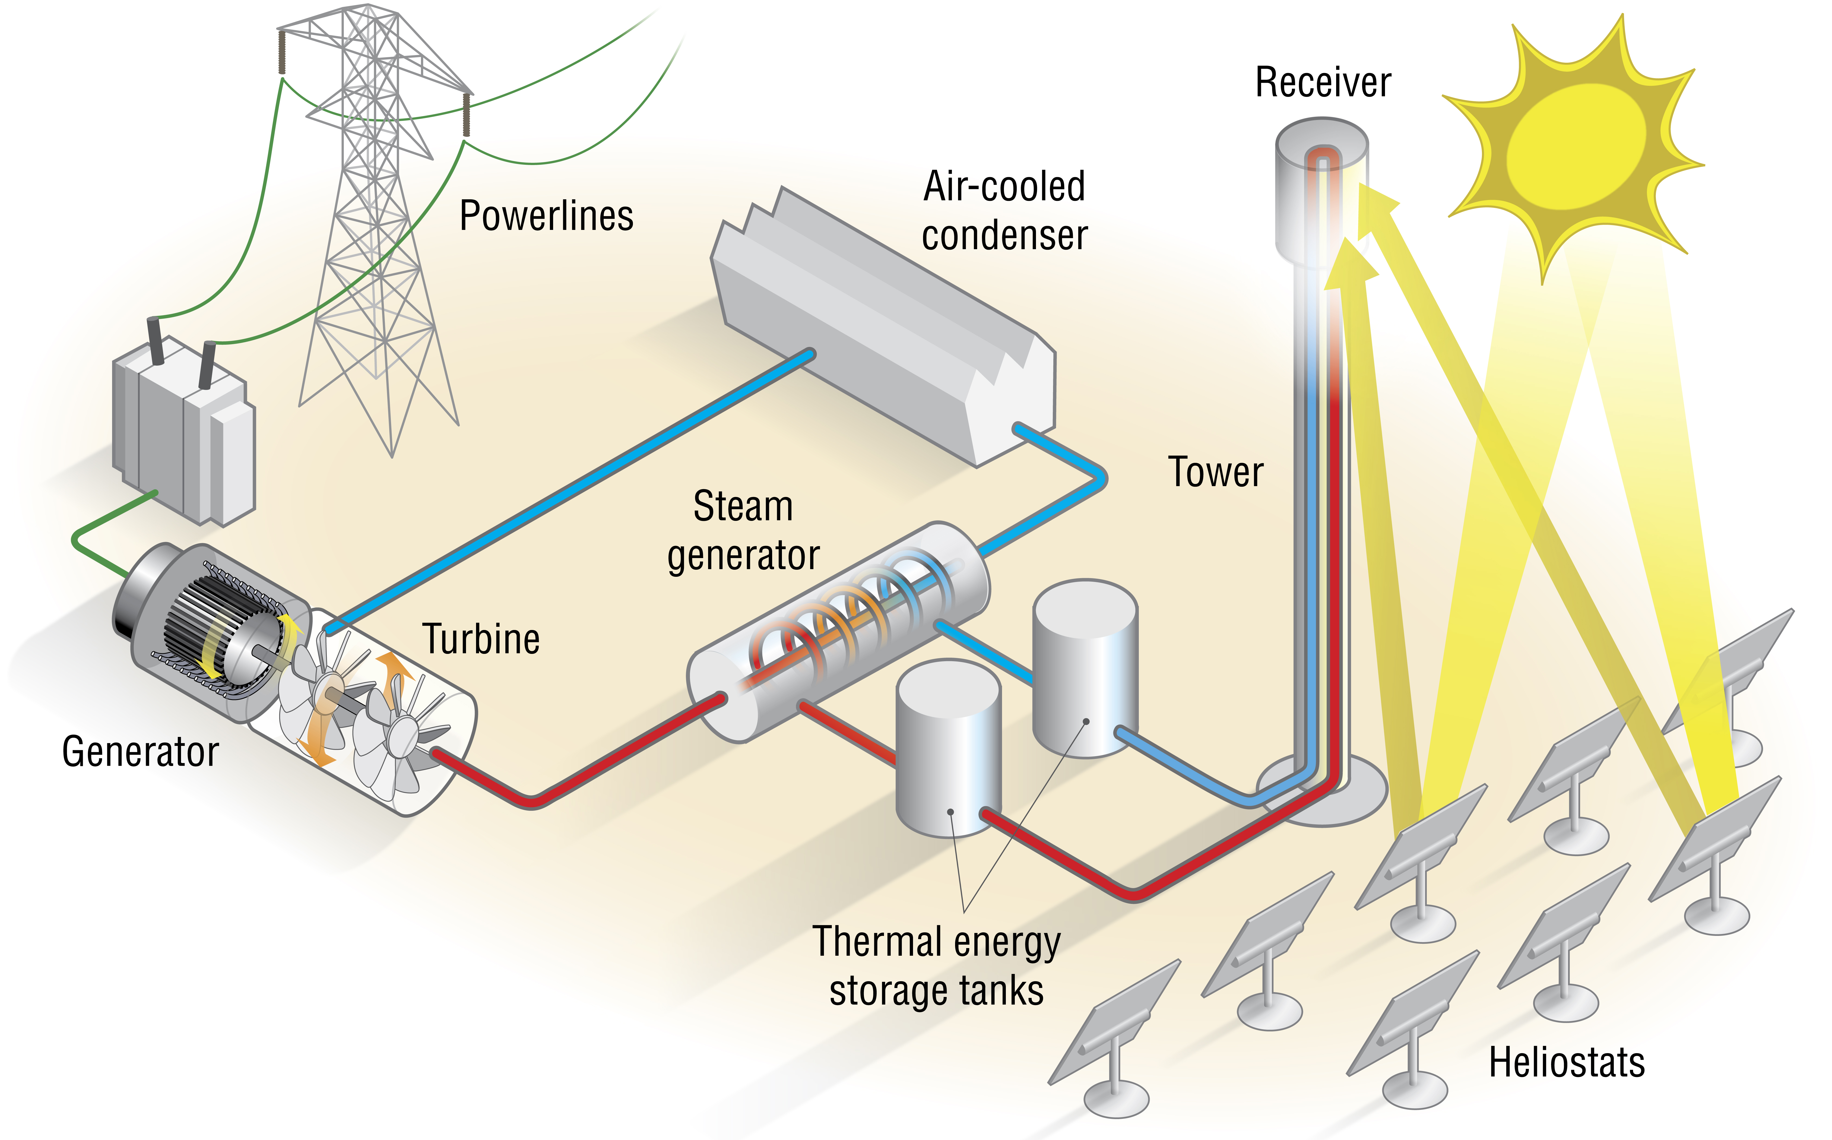

Near-term Business Case for CSP in the US
Think about what the “ideal” CSP plant look like in the future?
Low-cost, mass-manufactured solar field
Low-cost, efficient power block
Low-cost thermal energy storage
Meets current market demands
Smaller (10-50MW), modular, and flexible systems
sCO2 is critical
Capital efficient
Construction times <1 year
Smaller amounts of capital needed per plant => private sector financing
Co-optimize with PV
Additionally, must find alternative markets for CSP
Hybridization, Desal, EOR, Process Heat

Slide 24
Investment Tax Credit (ITC) Extension
Commercial credit reverts to 10% if projects are not completed by year end 2023
The ITC’s were renewed for 5 years in the Consolidated Appropriations Act, 2016 (H.R. 2029) Omnibus bill
Originally set to revert to 10% (Section 48 for business owners) or expire (Section 25D for residential owners) in 2017, the 30% credits were extended through 2020, and will step down through 2022
Section 48 (business owners): 26% in 2020, 22% in 2021, and 10% in 2022; bill changes deadlines from “placed in service” to “start of construction” for projects placed in service before 2024
Section 25D (residential owners): 26% in 2020, 22% in 2021, and expires in 2022 (deadlines remain “placed in service”
The agreement was paired with an extension a 5-year Wind PTC extension (which will decline in value beginning in 2017), and an end to the crude oil export ban
Other technologies such as geothermal, biomass, landfill gas, incremental hydroelectric and ocean energy projects did not receive an extension and must be placed in service by 2016
The Clean Power Plan begins to take effect in 2022 which may provide additional
incentives for solar
Source: Consolidated Appropriations Act, 2016 (H.R. 2029).

Slide 25
Joe Stekli, CSP Program Manager and Acting T2M Program Manager joseph.stekli@ee.doe.gov SunShot Initiative, Solar Energy Technologies Office

Slide 26
Backup Slides

Slide 27
SETO Budget Over Time
SETO budget grew by 3X in 4 years (‘06-’10) but has remained relatively flat since then
Since 2009 SETO has requested more than it has been appropriated
In 2009 ARRA infused over $100MM in funding spread over ~3 years
Individual program budgets have changed dramatically over time
Since 2010, CSP & PV funding have fallen while TTM, SI, and BOS have grown
26
Sources: DOE FY ‘99-’16 Congressional Budget Requests.

