Slide 1
Energy-Water Nexus
Melissa Klembara, Technology Manager
Diana Bauer, Senior Technical Manager for Strategy
Joe Cresko, Chief Engineer
Advanced Manufacturing Office
AMO Peer Review
June 2020 | Washington, DC
manufacturing.energy.gov

Slide 2
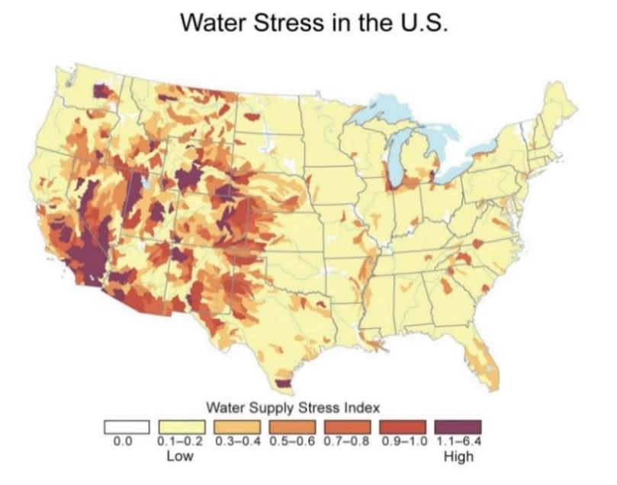
Energy-Water Nexus Background – Water Availability
It is becoming increasingly important to ensure sufficient supplies of water at a reasonable cost from a variety of sources. This will position U.S. manufacturers of these technologies to capture the > $700B global market for clean water – and a water secure world is a priority for this Administration.
Increasing water scarcity, variability and stress in U.S.; global challenges are risk to national security ¹:
Vulnerabilities in infrastructure:
Utilities curtailing power generation due low water availability.
Aging municipal waste water treatment infrastructure, facing exorbitant replacement costs.
Competition for water resources challenge water-intensive manufacturing industries could undermine future economic growth
Shift toward more energy intensive water resources will increase $/m³ and ultimately effects future energy demand.
Energy and water costs are trending up as resources become more strained.
Water is viewed as a strategic resource with national security implications.
More than a 1/3 of the world already suffers from shortages of potable water—with a rise to 50% by 2025.
¹ U.S. Government Global Water Strategy. https://www.state.gov/documents/organization/275842.pdf

Slide 3
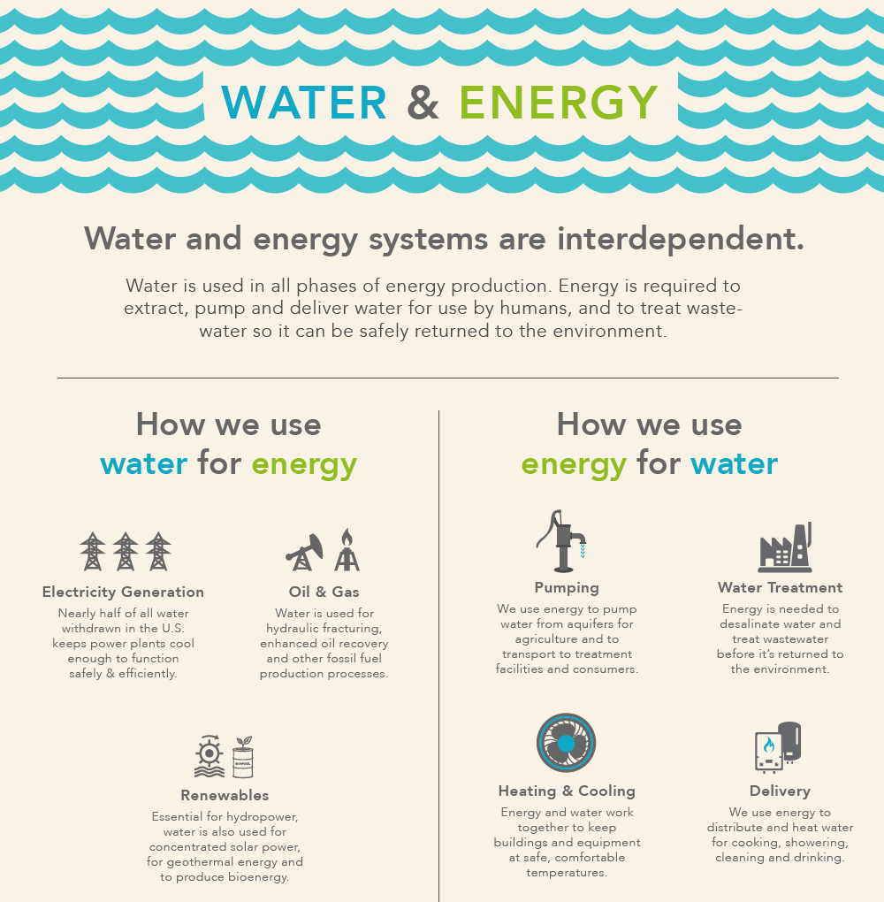
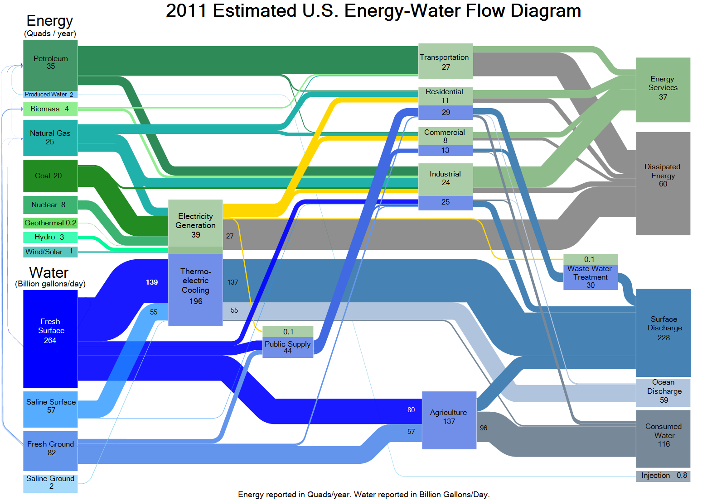
Energy-Water Nexus Background - Interconnectedness
U.S. flows of energy and water are intrinsically interconnected, in large part due to the characteristics and properties of water that make it so useful for producing energy and the energy requirements to treat and distribute water for human use. Water is needed for energy and energy is needed for water.
https://www.energy.gov/downloads/water-energy-nexus-challenges-and-opportunities
Notes:
This slide is about energy for water and water for energy.
The complexity of energy and water
Water for Energy→ energy resource development
Extraction, processing, power generation
Energy for Water→ water resource development
Processing, treatment, distribution

Slide 4
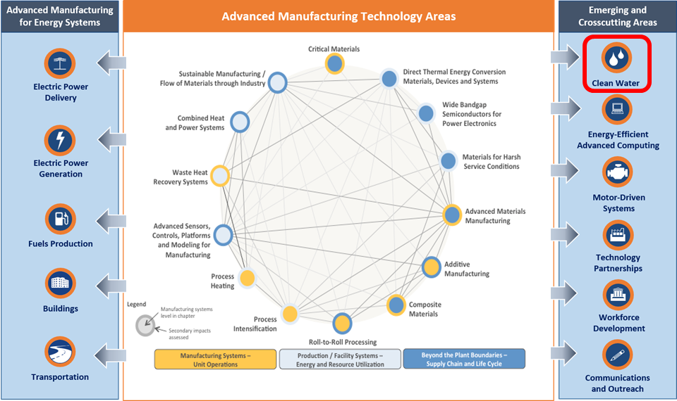





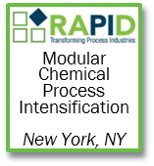

Energy-Water Nexus Background - AMO Linkage
AMO laid the groundwork in strategic analysis and had an existing R&D portfolio in key foundational technical areas related to clean water, such as: advanced materials, process intensification, process heating and cooling, sensors and controls, roll to roll manufacturing, and additive manufacturing.

Slide 5
Energy-Water Nexus Background - Timeline
2012
DOE’s Energy-Water Nexus Crosscut Team was formed.
2014
DOE published The Water-Energy Nexus: Challenges and Opportunities, which laid the foundation for subsequent work for the Department
2015
DOE hosted an Energy-Water Nexus Roundtable Series that engaged stakeholders from industry, academia, utilities, state and local governments, National Laboratories, and other federal agencies in focused discussions about the energy-water nexus. AMO initiates Better Plants Water Savings Pilot.
2015 - 2017
DOE conducted three stakeholder workshops and a Request for Information (RFI) from 2015 through 2017 and released a summary report in 2018, Advanced Manufacturing Office Clean Water Processing Technologies Workshop Series Summary Report. Stakeholder feedback indicated that there are key technology platforms and pre-competitive areas of R&D, modeling, and analysis that cut across the water sources and sectors. In 2017, AMO released the Seawater Desalination Bandwidth Study. Energy-Water Nexus becomes a DOE Crosscut in Congressional Budget and helps with coordination in EERE/SC/FE.
2017
DOE held a workshop on Basic Research Needs for Energy and Water. The workshop goal was to define priority research directions for: (1) enhancing the efficiency of water use in energy-intensive processes; (2) minimizing water use for energy production; and (3) increasing the availability of fresh water through new developments and improvements in energy-intensive water purification and distribution processes.
2017 - 2020
In FY17-20, AMO was appropriated a total of $85M for an Energy-Water Desalination Hub – marking the first substantial investment in the area for DOE. In September 2019, DOE selected the National Alliance for Water Innovations to lead the Hub. In 2018, OSTP Released a federal coordination plan for desalination and DOE launched Water Security Grand Challenge. In FY20, another $20M appropriated for R&D in energy efficient technologies for water and wastewater facilities (FOA Under Development).
Notes:
The take away from this slide is that there has been nearly 10 years of work and collaboration going on to inform AMO activities. AMO is making the largest single investment in the department, but it’s well connected and contributing to the leadership in other broader efforts under the Water Security Grand Challenge, which I will talk about in a few slides.
Some reports highlighted in the slide that informed our approach:
2014 DOE Energy Water Nexus Report
AMO Strategic Analysis → SW Desalination Bandwidth Studies Volumes 1 and 2 - This bandwidth study examines energy consumption and potential energy savings opportunities in U.S. seawater desalination plants.
AMO series of 3 workshops → Clean Water Workshop Report
Better Plants Water Accelerator and Other Water Tools developed by AMO’s Technical Partnerships for Water Efficiency
Office of Science Basic Research -> Reports on Energy and Water
Started seeding some work via SBIR in 2017 (and again in 2020)
The culmination of this information, plus appropriations starting in FY17 for $20 million for an Energy-Water Desalination Hub, initiated DOE/AMO’s work in earnest in the Energy-Water Nexus area.
Related Resources
Energy-Water Desalination Hub, Funding Opportunity Announcement (FOA) Number: DE-FOA-0001905, https://eere-exchange.energy.gov/FileContent.aspx?FileID=f681a69e-0b53-4754-982d-5456bac591b2
Water Security Grand Challenge website: https://www.energy.gov/eere/water-security-grand-challenge.
Coordinated Strategic Plan to Advance Desalination for Enhanced Water Security. NSTC. March 2019. Available online at: https://www.whitehouse.gov/wp-content/uploads/2019/03/Coordinated-Strategic-Plan-to-Advance-Desalination-for-Enhanced-Water-Security-2019.pdf

Slide 6
Energy-Water Nexus Challenges and Barriers
Given the diversity of non-traditional water needs and respective requirements, there are multiple shared technical challenges to producing clean water at the energy requirements, cost, and carbon footprint comparable to today’s fresh water purification technologies
Energy intensity: water purification is energy intensive with the intensity increasing with contamination concentration.
Cost of water: market penetration of new technologies varies geographically because of uneven water costs in different parts of the country due to acquisitions of water rights and other factors.
Contaminants: may vary widely in type and quantity, even within a given water source, making a single solution hard to achieve.
Materials: that can withstand high pressures, salts, and bio-fouling and that can improve selectivity in separation of contaminants or recovery of resources.
Membranes: that can remove a wide array of impurities while enabling high throughput of recovered water as well as membranes with embedded sensor technology to monitor when membrane systems need to be flushed.
Integrating complete water systems: entire systems need to be integrated and evaluated at connected systems to enable optimal performance across multiple sectors (agriculture, municipal, industrial, utility, oil and gas).
Limited suppliers: need more domestic suppliers to manufacture critical components and parts.
Public sector risk aversion: many water and wastewater systems are owned by public entities, which are often reluctant to invest in new, efficient technologies that are seen as unproven.
Notes:
These challenges and barriers are from our MYPP - they are pretty broad and crosscutting to multiple non traditional water sources. These were informed by some of the earlier reports and workshops mentioned on the previous slides.
We used these as a way to start to frame FOAs (potentially using additional stakeholder workshops or RFIs) –to then get at more granular, specific objectives and targets., which I will talk about on the next slide.
Note, these are AMO programmatic high level. The NAWI hub, which I will also talk about in a few slides, has developed a framework of challenge areas (called APRIME) and will be drilling down to a more granular level of specificity for the scope of the Hub through roadmapping.

Slide 7
Energy-Water Nexus Objectives and Targets
OBJECTIVE
Advance technologies to improve the processing and production of water from a variety of water sources – surface, ground, brackish, sea, produced (such as those from oil and gas extraction), highly saline extracted (resulting from CO2 injection), and municipal wastewater – at the same economic, energy, and environmental impact as currently supplied water.
TARGETS
Provide water at <500 milligrams per liter (mg/l) total dissolved solids (TDS) at a maximum cost of $0.10/m3 and 0.5 kWh/m3for water from brackish sources.
Provide water at <500 mg/l TDS at a cost of $0.50/m3 and 1 kWh/m3 for water from seawater.
Provide purified water from produced water sources for industrial use at processing costs below $1/m3 and 1 kWh/m3 to eliminate the need for well re-injection.
Research and develop advanced manufacturing technologies with potential to reduce cost for equipment and parts for water processing by 50%.
Reduce net energy consumption of waste water treatment by 50% in 10 years.
Notes:
These are high level AMO objectives in the energy-water space, with specific targets that were informed by earlier reports/workshops. These were used to inform the Hub FOA and other activities that AMO is doing in the energy-water space.
How do we measure progress against these targets? Through our specific investments – such as the NAWI Hub – will have TEA and LCA tools developed this year (called Water TAPs and Water DAMS) to baseline SoT and track progress against targets like these for cost/m3 water and energy intensity, among others. I’ll talk more about that later.

Slide 8
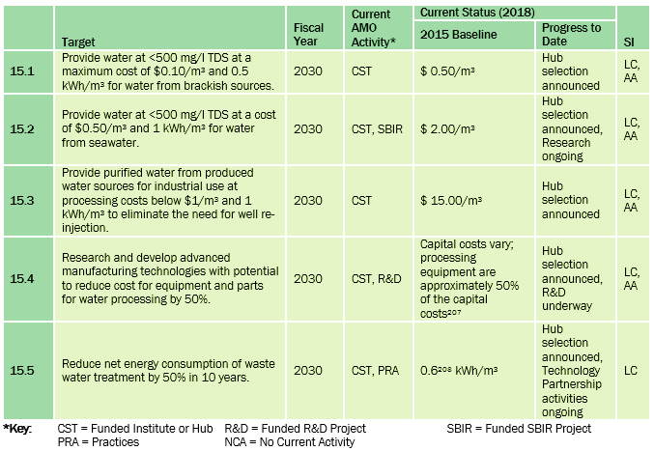
Energy-Water Nexus Objectives and Targets
.
SI = Success Indicators
AA = Affordability & Availability
LC = Life Cycle Energy
Notes:
All of this information then informed the development of Energy-Water Desal Hub FOA – released December 2018.

Slide 9
AMO’s Current Energy-Water Nexus Portfolio
National Alliance for Water Innovation (NAWI)
The Hub led by LBNL with ORNL, NREL and NETL is focused on increasing water availability at lower energy intensity and cost to achieve “pipe parity” water. Total: $100m (Fed) +$33.6m (CS)
Technology Partnerships (Volunteer Programs and Tools)
Water accelerator and water profiler tool for Better Plants partners
Industrial Assessment Centers (IACs) look at water efficiency
Water Resource Recovery Prize (Water Security Grand Challenge)
Strategic Analysis
AMO Seawater Desalination Bandwidth Study
Industrial water analysis paper (under development)
Ongoing analysis coordinated with NAWI & WSGC activities
Energy-Water Nexus in AMO
NAWI (Energy Water Desalination Hub)
Strategic Analysis
Energy Recovery Device SBIR
Waste-water FOA
Emerging Technologies Projects
Technology Partnerships
Water/Wastewater FOA (under development)
$20M based on FY20 Congressional language
Emerging Technologies Projects (Individual R&D Projects)
PFAS project selected Emerging Tech FOA (Joe Cresko leads)
Other: HPC4Manufactuirng, SBIR, EPSCOR, TCF and Energy-I Corp
Energy Recover Device (ERD) topic for small, modular desalination systems. 2 projects just announced, total: $412,000
Notes:
Across the AMO Portfolio (Consortia, R&D, Analysis, and Technical Partnerships) and, under the broader auspices of the WSGC, we are making investments to innovative technologies and activities to increase water availability, improve energy efficiency, and bring down costs. In the next few slides, I’m going to focus in on two of these – the NAWI Hub and Technical Partnerships.

Slide 10
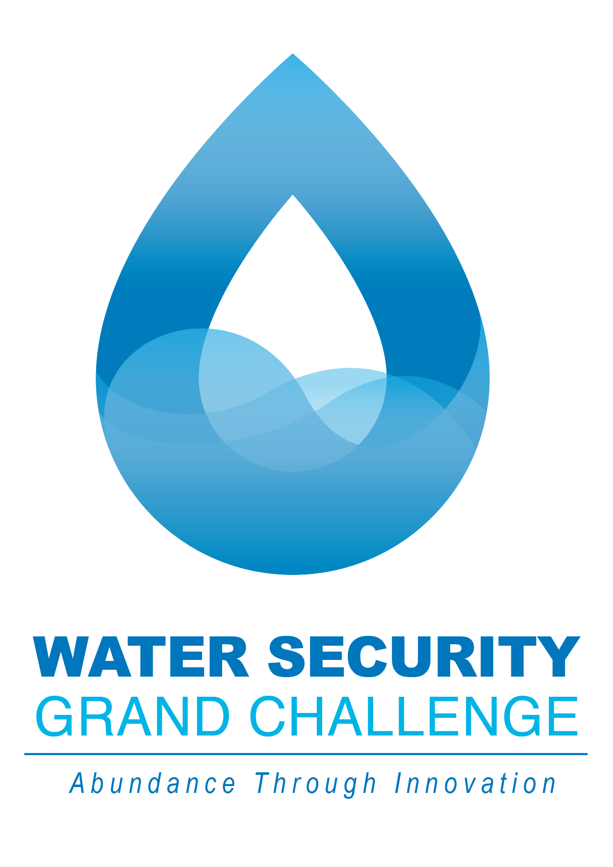
EERE/DOE Initiatives and White House Priorities
The Water Security Grand Challenge is a White House initiated, DOE led framework to advance transformational technology and innovation to meet the global need for safe, secure, and affordable water.
Advance transformational technology and innovation to meet the global need for safe, secure, and affordable water. By 2030:
Launch desalination technologies that deliver cost-competitive clean water.
Transform the energy sector’s produced water from a waste to a resource.
Achieve near-zero water impact for new thermoelectric power plants, and significantly lower freshwater use intensity within the existing fleet.
Double resource recovery from municipal wastewater.
Develop small, modular energy-water systems for urban, rural, tribal, national security, and disaster response settings.
Notes:
These portfolio of activities fit more broadly under the WSGC.
In October 2018, the WH and DOE launched the Water Security Grand Challenge. The Energy-Water Desalination Hub Supports all the goals of the WSGC.
AMO is collaboratively leading the WSGC (Diana Bauer).

Slide 11
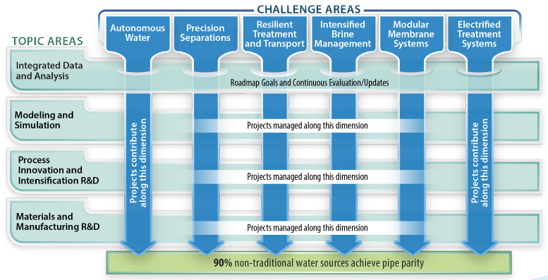
NAWI – Overview
The National Alliance for Water Innovation (NAWI) was selected in 2019 to lead DOE’s Energy-Water Desalination Hub (Hub) to achieve pipe parity water from non traditional water sources in U.S. Their vision is for distributed, modular water treatment systems to increase water availability.
NAWI is focused on early-stage R&D that will enable pipe parity for 90% of non-traditional water sources within 10 years --using energy-efficient, water efficient, cost competitive, and manufacturable technologies for multiple end-use applications guided by the A-PRIME Challenge Areas (shown above).
Notes:
The goal of NAWI for pipe parity water connects directly back to the MYPP targets. NAWI will develop baseline state of technology TEAs/LCAs for various water source to end use pathways, and track progress of their research portfolio toward pipe parity water. These tools will be publically available in Water-DAMS and Water-TAPs for sharing R&D data and assessing TEA/LCA through water treatment process modeling tools. A slide on those in included in back-up slides.

Slide 12
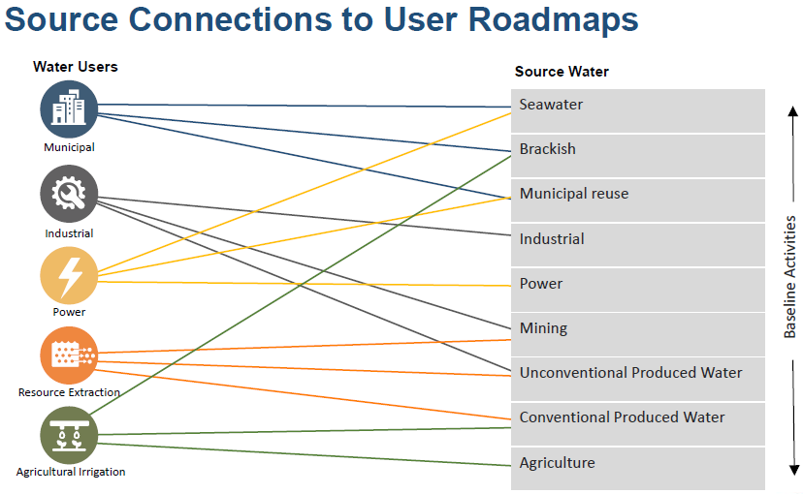
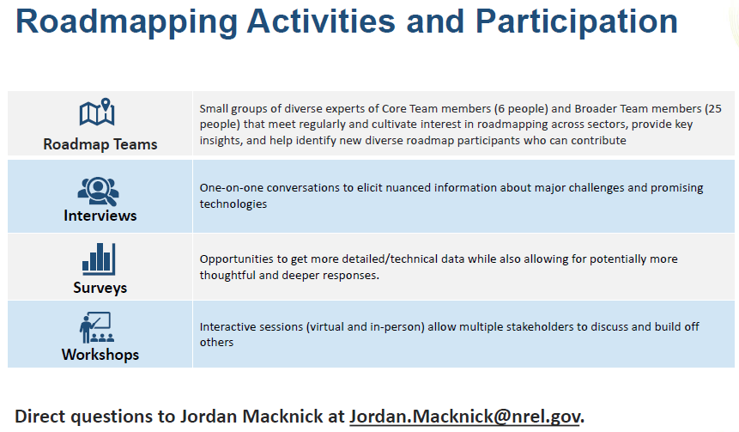
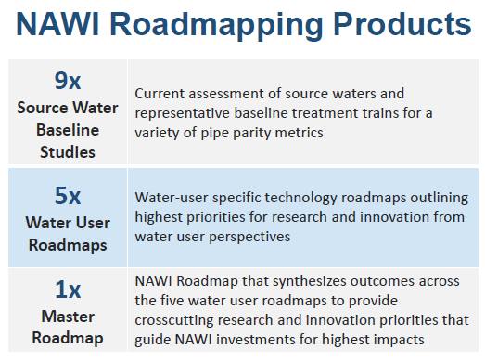

NAWI Roadmapping - Outcomes
NAWI will identify the highest impact research areas using the APRIME framework and using the tools being developed by NAWI such as Water TAPs and Water DAMS and continue to track progress toward “pipe parity” water, which links back to AMO’s MYPP objectives and targets.
Notes:
The AMO Desal Bandwidth study created a foundation for the NAWI Hub to build onto and look at other non-traditional sources of water and end users. As an office, we take a leadership role from the beginning to give this and other consortia investments a “running start”.
NAWI will be approaching these roadmapping from the APRIME challenge area framework and leveraging baseline state of technology and targets developed through Water DAMS and Water TAPs. They will identify the highest impact, common research needs across the various water source to end users to inform future RFPs run by the Hub.

Slide 13

Technical Partnerships: Water Efficiency Resources and Tools
Water Savings Pilot in 2014, more than 45 partners across commercial, public, industrial and multifamily sectors committed to track water use intensity improvements and share successful strategies and solutions
Result: This white paper features insights from leading manufacturers on developing new, or improving existing, water management programs.
Expanded to water savings initiative – saving water saves energy! https://betterbuildingssolutioncenter.energy.gov/better-plants/water-savings-initiative
DOE’s Better Plants Program created the Plant Water Profiler (PWP) Tool from AMO Strategic Analysis to help manufacturers:
Understand the procurement, use, and disposal of water in their plants,
Be cognizant of the true cost of water, including the costs associated with water procurement, treatment, distribution, and wastewater disposal; and
Identify opportunities to reduce water use and achieve associated cost savings.
https://www.energy.gov/eere/amo/measur
Industrial Assessment Centers (IACs) to add water savings audits.
Water Resource Recovery Price, as part of WSGC

Slide 14
Energy-Water Nexus Collaborations
No one office or agency “owns” water space, so coordination is key for larger impact;
Engaging with the across the water sector and water supply chain is important to accelerate technology deployment
Through the Water Security Grand Challenge, AMO is collaborating with other DOE offices such as Water Power Technology Office, Solar Energy Technology Office, Bioenergy Technology Office, Nuclear, Arpa, Fossil Energy, SPIA, International Affairs, These other offices have water related R&D, analysis activities such as:
FE Produced Water Analysis and R&D
WPTO Irrigation Modernization
BETO Resource Recovery R&D
SETO Solar Desalination R&D
DOE International team: US-Israel energy-smart water infrastructure testbed as part of Binational Industrial Research and Development (BIRD) Energy Program
Other agencies with equities in energy-water nexus that we are coordinating with include:
EPA Water Reuse Action Plan
Bureau of Reclamation Prizes and R&D
With many other agencies through National Nanotechnology Coordination Office | www.nano.gov
Notes:
Much of this coordination now happens has part of the WSGC
Remove prize references in the bullets.

Slide 15
AMO’s Energy-Water Nexus Accomplishments
AMO Bandwidth Study – First study to characterize potential desalination l R&D opportunities.
Better Plants Resources and Tools
NAWI Hub
In first year of operations
Roadmapping and Tool development underway
WSGC Water Resource Recovery Prize to accelerate resource recovery from municipal wastewater across the United States (Phase 2 under development)
Water/Wastewater FOA based on FY20 Congressional Language (under development)

Slide 16
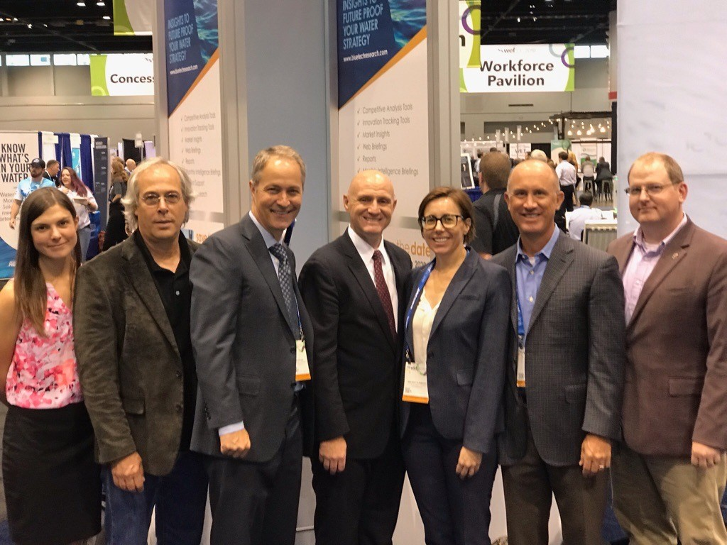
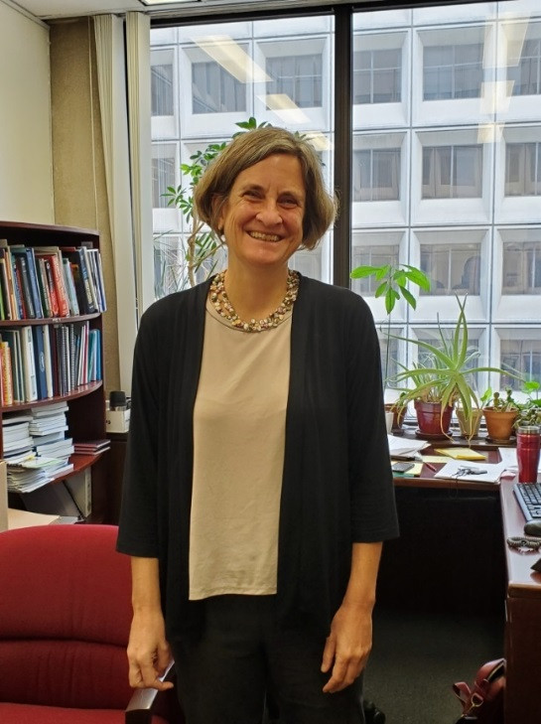
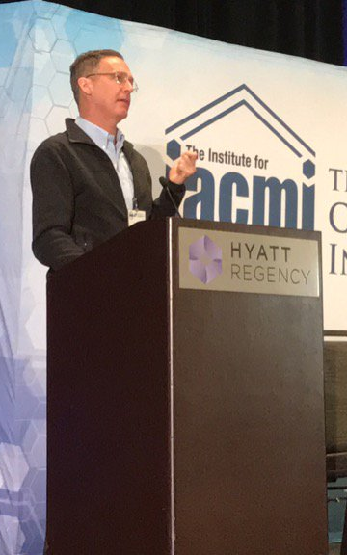
AMO Energy-Water Nexus Team
NAWI team with EERE AS Daniel Simmons and Melissa Klembara, AMO Technology Manager
Diana Bauer, Senior Technical Manager for Strategy
Joe Cresko,
AMO Chief Engineer
THANK YOU!

Slide 17
Thank you!

Slide 18
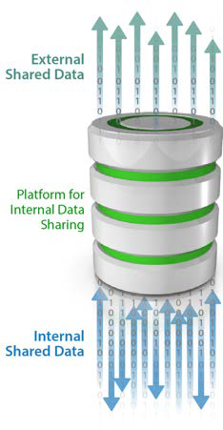
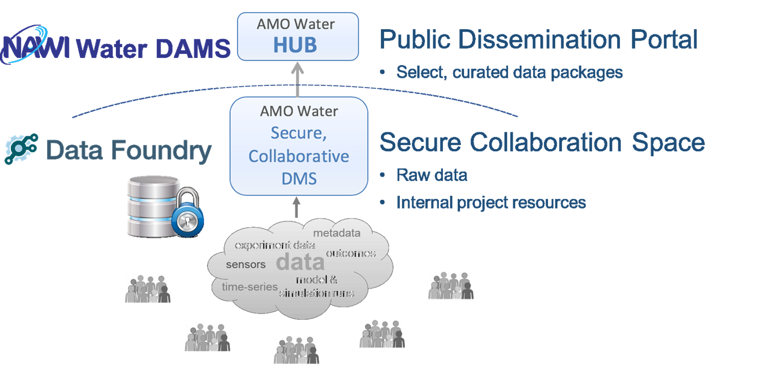
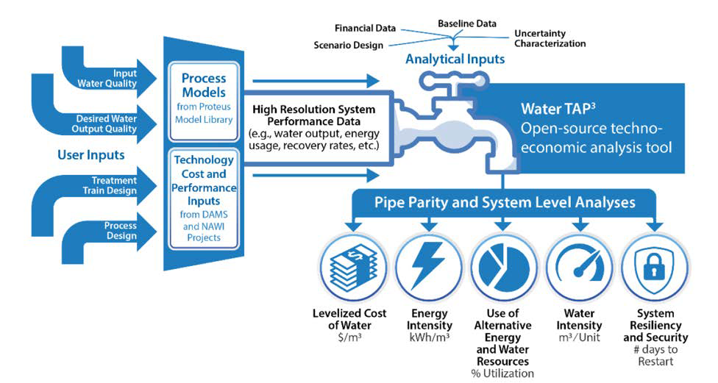
Energy-Water Nexus Activities
NAWI will develop publically available data sharing and modeling tools called Water-DAMS and Water TAPs to make it easier to share R&D data and evaluate water technologies cost, energy and environmental trade-offs.
Water Data and Analysis Management System (Water-DAMS)
Water-DAMS will serve as the nation’s primary source of data relevant to R&D on water technologies.
Water Techno-economic Analysis Pipe Parity Platform (Water-TAP³)
Water-TAP³ will be an analytically robust platform for evaluating water technology cost, energy and environmental trade-offs across water sources, sectors, and scales.
Notes:
Back up slide

