Slide 1
Sustainable Manufacturing / Circular Economy
Christopher Hovanec, Ph.D.
Technology Manager
Advanced Manufacturing Office
Kathryn Peretti, Ph.D.
Technology Manager
Advanced Manufacturing Office
AMO Peer Review
June 2020 | Washington, DC
manufacturing.energy.gov
Notes:
We may want to add definitions of sustainable manufacturing and circular economy. Joe said he can provide.

Slide 2
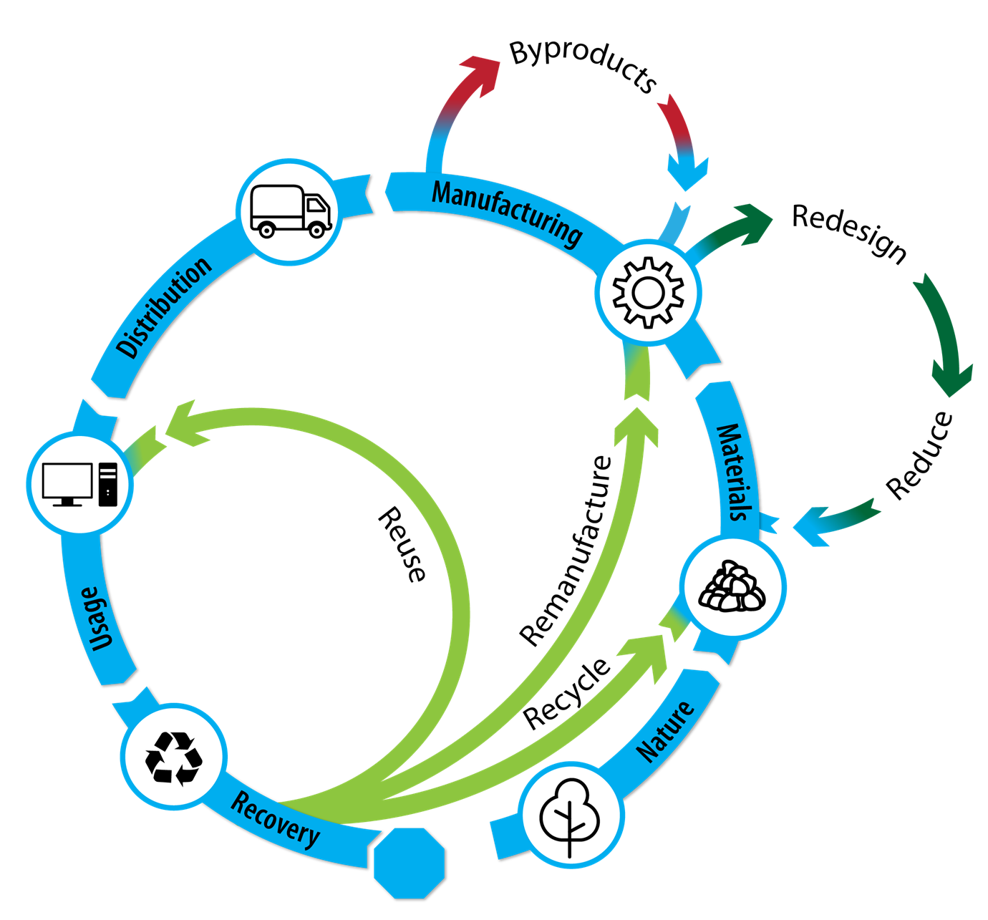
Sustainable Manufacturing / Circular Economy
Sustainable manufacturing encompasses a wide range of systems issues, including energy intensity, carbon intensity, and use intensity.
Opportunity:
The US uses roughly 20% of the global primary energy supply and 15% of globally extracted materials
The US generated close to 2.7 GT of waste in 2000, a 26% increase since 1975
In 2014, IPCC report indicated that 75% of carbon emissions result from indirect sources such as extraction and production of materials, indicating supply chain optimization represents a key opportunity for emissions reduction.
Use of secondary feedstocks represents a $2 trillion opportunity for the U.S.
Sustainable Manufacturing Reduces:
Energy Consumption
Material/Resource Consumption
Environmental Impact
Carbon Emissions
Notes:
1-2 slides on topic
How do we (AMO) define this topic
What is the opportunity space, etc (e.g., QTR content)
What is AMO’s role/interest in this technical area
Make sure to cover any major EERE/DOE initiatives and White House priorities relevant to the technical topic

Slide 3
Sustainable Manufacturing Background
Sustainable manufacturing is a principle for technology in advanced manufacturing.
Alignment with AMO and EERE priorities: Sustainable manufacturing supports
Reducing life cycle energy and resource impacts of manufactured goods
Leveraging of domestic materials in manufacturing
Strengthening of environmental stewardship
Transitioning innovative technologies and practices
Strengthening U.S. manufacturing workforce.
EERE Plastics Innovation Challenge (PIC)
Lowering embodied energy by:
Distributed Manufacturing (PI/Chemical Manufacturing, Additive)
Material Substitution (Composites, Bio-based)
Material Efficiency (Additive, secondary material use)
Product Lifetime Extension
Notes:
1-2 slides on topic
How do we (AMO) define this topic
What is the opportunity space, etc (e.g., QTR content)
What is AMO’s role/interest in this technical area
Make sure to cover any major EERE/DOE initiatives and White House priorities relevant to the technical topic

Slide 4
Sustainable Manufacturing Challenges and Barriers
Economic barriers for recycling materials:
Low value
Low volumes/concentration
Embedded in complex products
Technological Barriers:
Lack of efficient methods and tools to track materials through the product lifecycle to optimize material use
Low product yields due to material loss during processing (in-plant scrap)
Materials are not designed with recycling/reuse in mind
Rare, costly, and energy intensive gases are often vented during use because they are harmless and difficult to capture
Supply Chain challenges:
Portions of the supply chain may be dependent on politically unstable regions
Manufacturing is typically centralized in few locations, while products are distributed, causing energy to spent on transportation and making collection for recycling challenging
Notes:
These are pulled and paraphrased from the MYPP. They are not all relevant to what we are working on or will present. (I think these are pretty relevty relevant to all the stuff we’re working on, we can discuss – but I agree we could add more. But I think that is what the later slides are for to drill down to specific Activities. -- MELISSA) It might be worth putting in a few challenges/barriers that REMADE has discovered in their roadmapping.

Slide 5
Sustainable Manufacturing Objectives and Targets
OBJECTIVE
Advance technologies and tools to Improve resource efficiency in the manufacturing industries, including recycling and reuse, and lower the life cycle cost and cross-sectoral energy impacts of manufactured products.
TARGETS
Develop material reuse, recycling, remanufacturing, and/or reprocessing technologies that enable an absolute increase in recycling rate by 30% in select energy-intensive materials and 25% improvement in embodied-energy efficiency.
Develop tools and technologies to reduce the cost of using recycled feedstocks in existing processes to cost parity (including energy) with primary feedstocks.
Develop technologies and targeted end use products that have the potential to improve material efficiency compared to 2015 SOA, resulting in 10x reduction in primary material feedstock and 20% lower GHG emissions.
Develop technologies and targeted end use products that have the potential to reduce water intensity compared to 2015 SOA.

Slide 6
Technical Topic Key Concepts/Thrusts
TARGETS
AMO Activity
Develop material reuse, recycling, remanufacturing, and/or reprocessing technologies that enable an absolute increase in recycling rate by 30% in select energy-intensive materials and 25% improvement in embodied-energy efficiency.
Develop tools and technologies to reduce the cost of using recycled feedstocks in existing processes to cost parity (including energy) with primary feedstocks.
Develop technologies and targeted end use products that have the potential to improve material efficiency compared to 2015 SOA, resulting in 10x reduction in primary material feedstock and 20% lower GHG emissions.
Develop technologies and targeted end use products that have the potential to reduce water intensity compared to 2015 SOA.
BOTTLE,
REMADE
Analysis tools, BOTTLE,
REMADE
BOTTLE,
REMADE
NAWI,
Better Plants
Notes:
Mission: Enable the early stage applied R&D of key industrial platform technologies that could dramatically reduce the embodied energy and carbon emissions associated with industrial-scale materials production and processing. By focusing its efforts on eliminating and/or mitigating the technical and economic barriers that prevent greater material recycling, recovery, remanufacturing, and reuse (Re-X), the REMADE Institute seeks to motivate the subsequent industry investments that will be required to complete technology development and deploy these technologies across the U.S. manufacturing ecosystem.

Slide 7



Sustainable Manufacturing Activity - Analysis
Examples of tools and analytical capabilities at the National Laboratories developed by the AMO Strategic Analysis Team
Materials Flow through Industry (MFI) Tool: a tool to analytically track the energy impacts of shifts in material flows, and to quantify supply chain impacts of current and next-generation technologies.
LIGHTEn-UP Tool: a scenario framework for assessing prospective net energy impacts of a technology/product, accounting for both manufacturing and end-use life cycle phases.
Additive Manufacturing Life Cycle Energy Tool: a user-friendly tool that manufacturers can use to evaluate additive vs. conventional manufacturing processes on a life cycle energy basis.
Notes:
Mission: Enable the early stage applied R&D of key industrial platform technologies that could dramatically reduce the embodied energy and carbon emissions associated with industrial-scale materials production and processing. By focusing its efforts on eliminating and/or mitigating the technical and economic barriers that prevent greater material recycling, recovery, remanufacturing, and reuse (Re-X), the REMADE Institute seeks to motivate the subsequent industry investments that will be required to complete technology development and deploy these technologies across the U.S. manufacturing ecosystem.

Slide 8
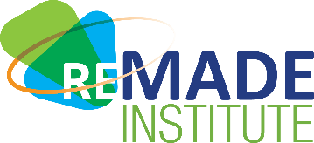


Technical Topic Key Concepts/Thrusts - REMADE
Reducing EMbodied-energy And Decreasing Emissions (REMADE) Institute
Goals:
(1) develop technologies capable of reducing energy and emissions through a reduction in primary material consumption and an increase in secondary feedstock use in domestic manufacturing,
(2) develop technologies capable of achieving “better than cost and energy parity” for key recycled materials
(3) promote widespread application of new technologies across multiple industries.
Primary
Feedstock (FS)
Consumed
Secondary FS
Processing
Energy
Embodied
Energy
Efficiency
Cross-
Industry
Reuse
GHG
Emissions
Cost and
Energy Parity
Technical Performance Metric (TPMs)
↓30%
↓30%
↑25%
↓20%
Notes:
Mission: Enable the early stage applied R&D of key industrial platform technologies that could dramatically reduce the embodied energy and carbon emissions associated with industrial-scale materials production and processing. By focusing its efforts on eliminating and/or mitigating the technical and economic barriers that prevent greater material recycling, recovery, remanufacturing, and reuse (Re-X), the REMADE Institute seeks to motivate the subsequent industry investments that will be required to complete technology development and deploy these technologies across the U.S. manufacturing ecosystem.

Slide 9
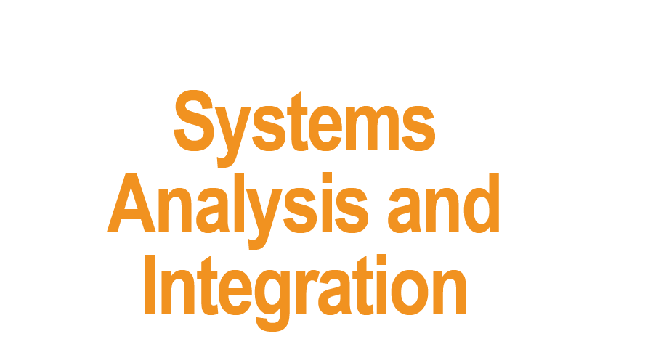
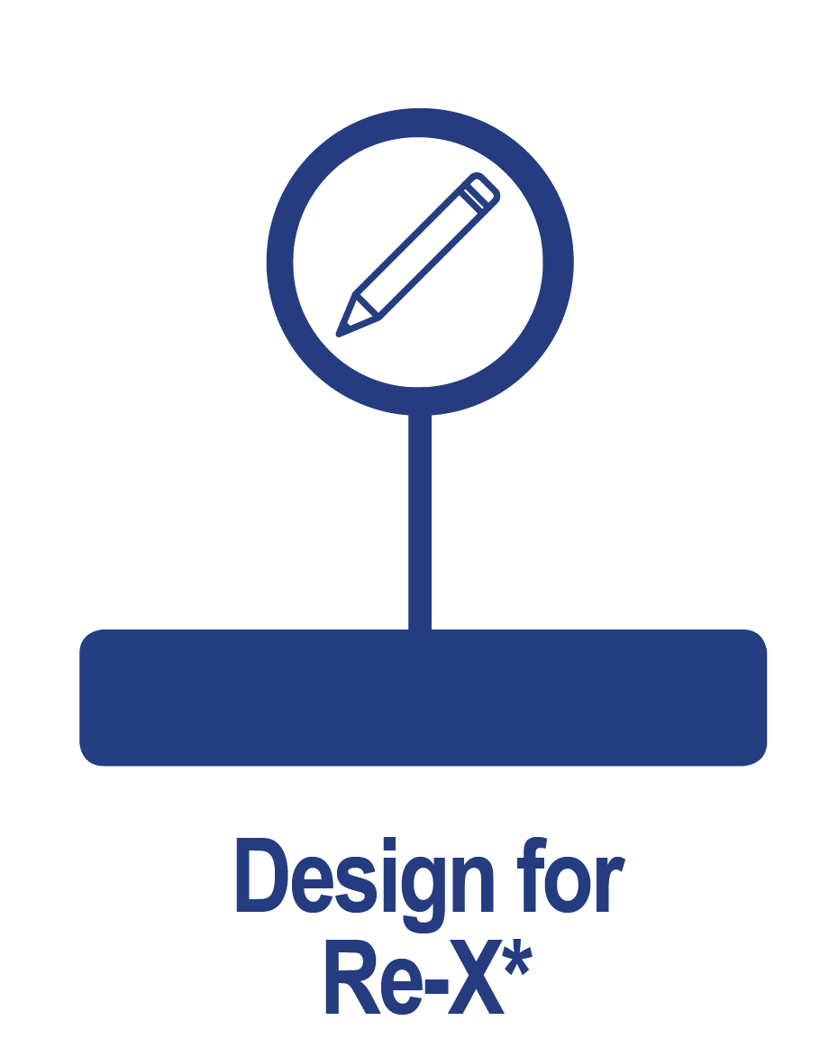
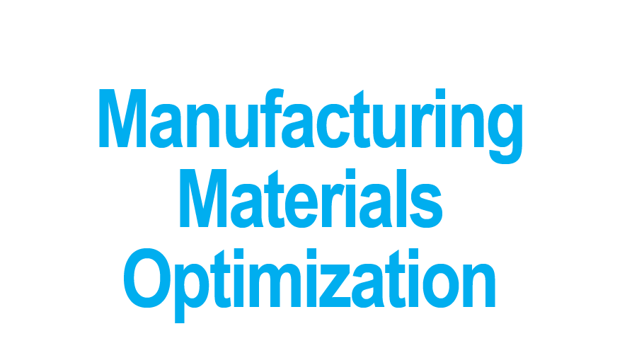
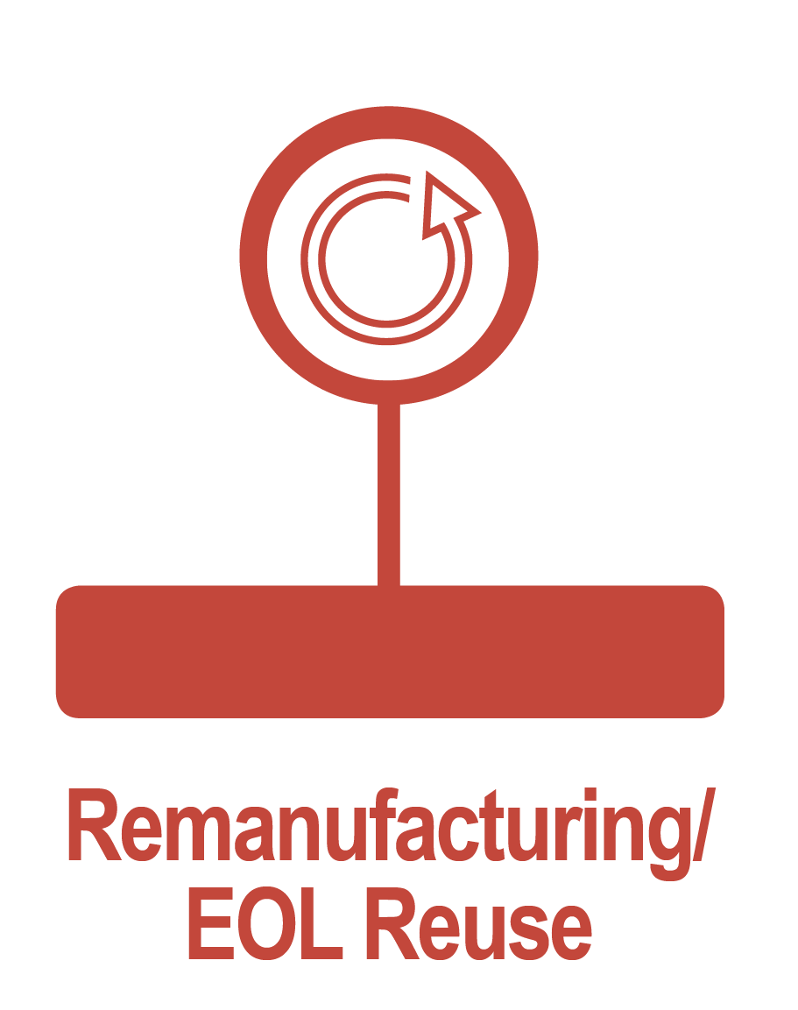

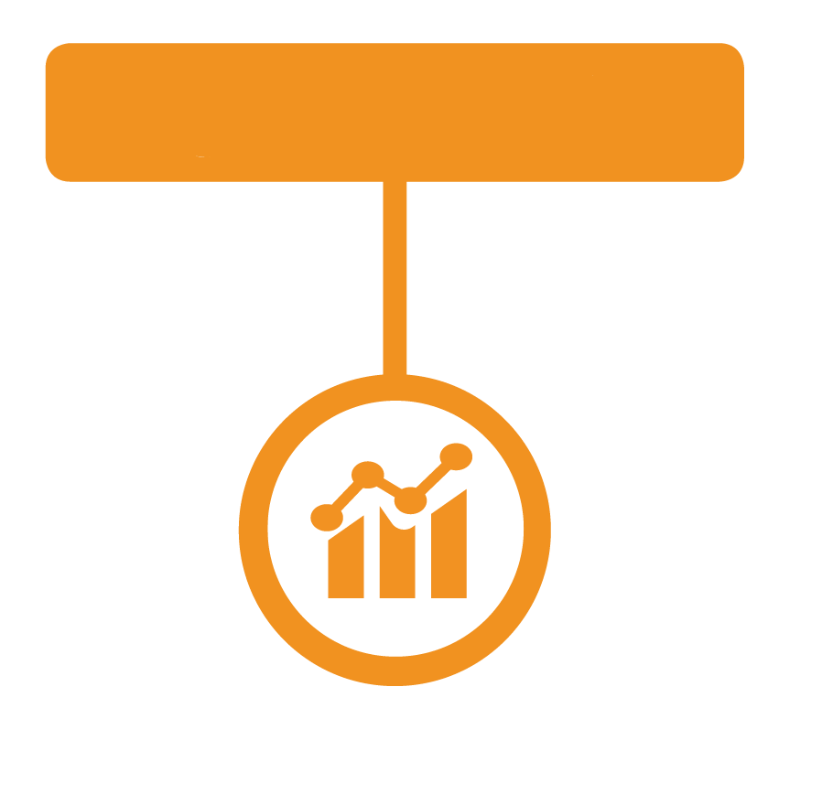
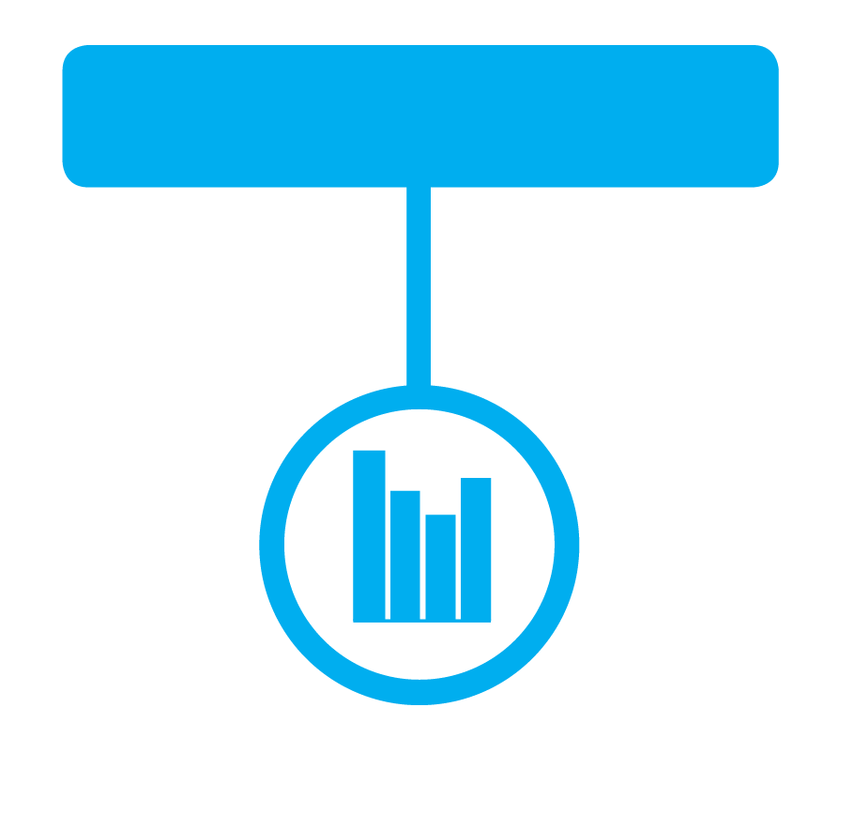
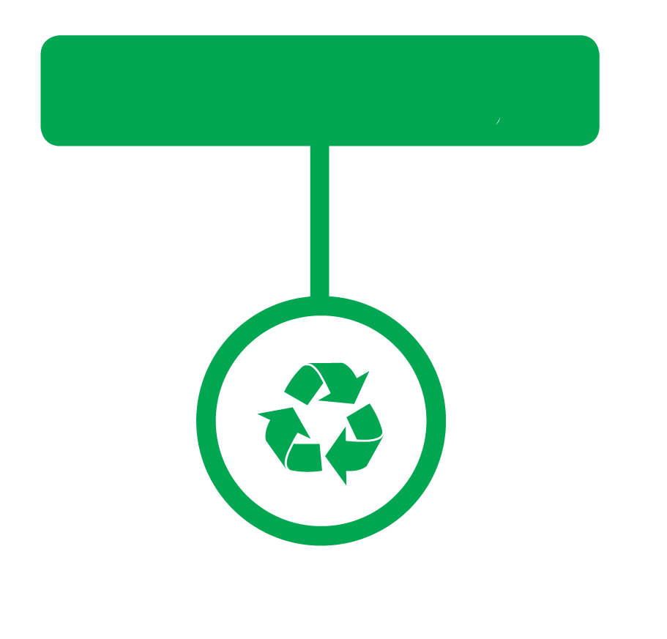
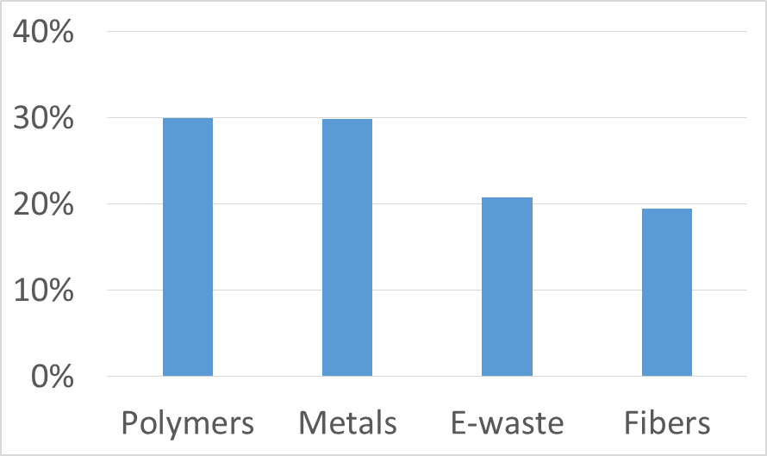
Technical Topic Current Portfolio
Technical Focus Areas
Intended 5-Year Allocation of R&D Funds
Current Allocation of R&D Funds by Material Class
Notes:
To achieve these goals, the research agenda for the Institute is structured across five (5) REMADE nodes that include the following core activities:
Systems Analysis and Integration---Data collection, standardization, metrics and tools for understanding materials flows in the economy
Design for Re-X---Development of design methodologies and tools to improve material utilization at end-of-life
Manufacturing Materials Optimization---Development of technologies to utilize secondary feedstocks, reuse scrap materials and reduce in-process losses in manufacturing
Remanufacturing and End-of-life Reuse---Development of cost-effective technologies for cleaning, component restoration, condition assessment, and reverse logistics
Recovery and Recycling--- Development of technologies for rapid gathering, identification, sorting, separation, contaminant removal, cleaning, reprocessing and reuse of secondary materials.

Slide 10
Technical Topic Activities
Technical Focus Areas | Thrust Area
System Analysis & Integration | Material Flow, Lifecycle Analysis, and Systems Analysis Methods, Tools, and Data
 | Techno-economic Analysis Models and Tools
Design for Re-X | Design for Re-X Metrics & Assessment Frameworks
 | Design for Re-X Methods and Tools
 | High-impact Design for Re-X Application Domains
Manufacturing Materials Optimization | Manufacturing and Process Control
 | Characterization, Qualification & Simulation
Remanufacturing & EOF Reuse | Robust Non-destructive Inspection/ Evaluation Technologies
 | Remanufacturing Analysis Tools & Methods
 | Low-cost Component Repair Technologies and Restoration Methods
Recycling & Recovery | Technologies/Tools to Increase Collection & Recovery
 | Mechanical Recycling Technologies for Sorting, Separating, and Liberating Materials
 | Chemical and Solvent-Based Recycling & Separation Technologies
 | Characterization, Cleaning & Purification

Slide 11





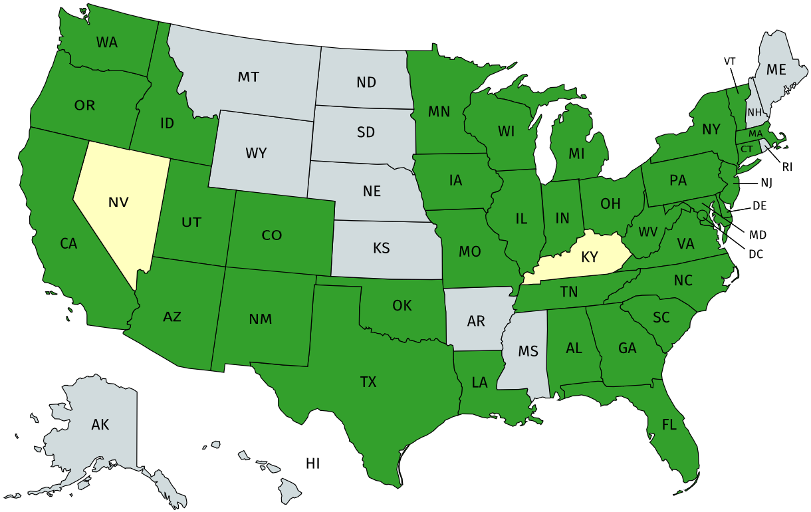
























































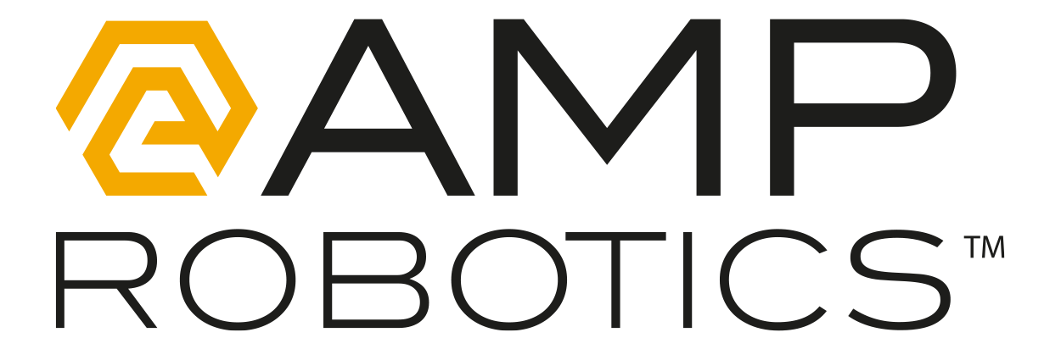






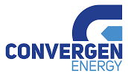




















Technical Topic Collaborations
Diverse membership composition
Nationwide industry-focused consortium
50 member organizations involved in Institute projects
88% of member organizations actively engaged
Membership is growing
Member
Interested Party
REMADE Labor Market
Kent County
Department of
Public Works
Ohio State University
University of Michigan
Industry (44%)
Academic (29%)
Affiliate (22%)
Michigan State University
National Lab (5%)

Slide 12
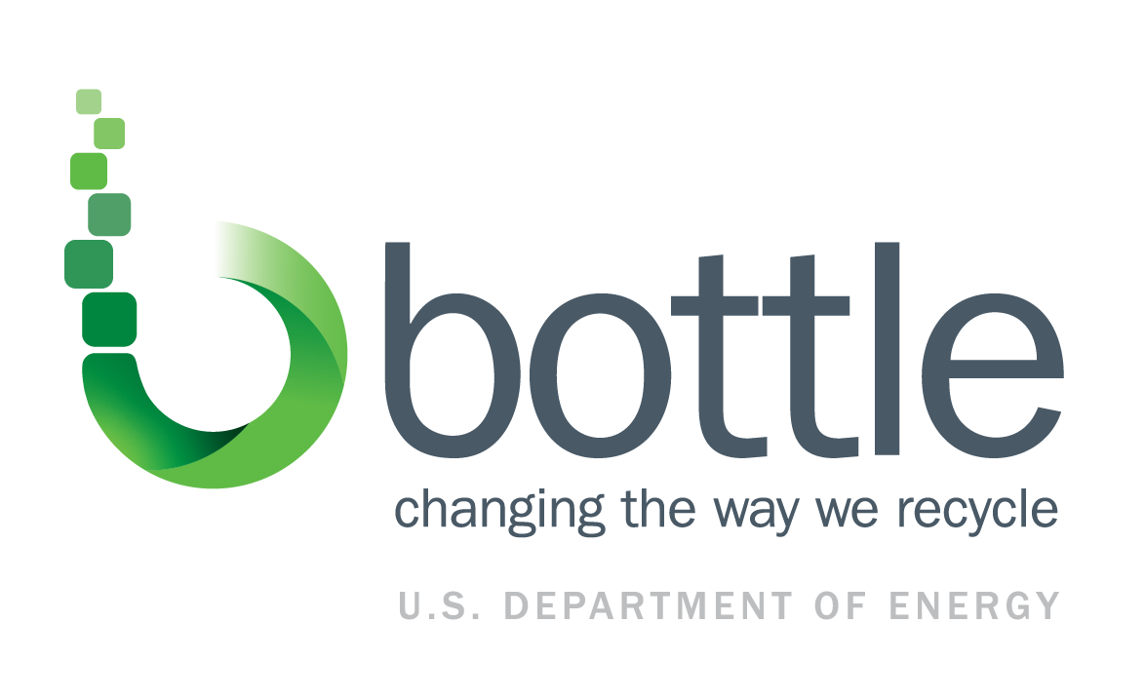
Technical Topic Key Concepts/Thrusts - BOTTLE
Bio-Optimized Technologies to keep Thermoplastics out of Landfills and the Environment (BOTTLE)
Consortium using unique capabilities of the DOE National Laboratories to advance cutting-edge R&D.
Mission: develop robust processes to upcycle waste plastics and develop new plastics that are recyclable-by-design.
Metrics include:
>50% energy savings relative to virgin material production
>75% carbon utilization from waste plastics
>2x economic incentive above price of reclaimed materials

Slide 13
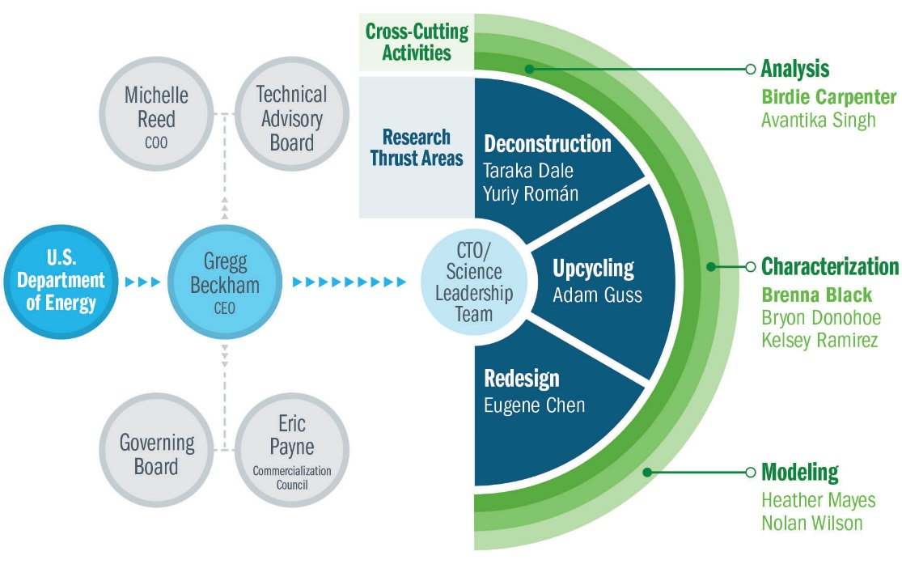
Technical Topic Current Portfolio- BOTTLE
BOTTLE is organized around 3 key research areas with 3 crosscutting activities that support and inform that research:
Deconstruction thrust will develop and improve novel chemical, biological and hybrid methods to deconstruct existing plastics to intermediates and products.
Upcycling thrust aims to convert intermediates from deconstruction into high value products.
The purpose of the redesign thrust is to develop new, bio-based polymers that are designed for infinite recyclability.
The BOTTLE FOA is organized similarly, with 3 subtopics:
Polymer deconstruction and upcycling
Polymer redesign
Partnering with BOTTLE on consortia objectives

Slide 14
Technical Topic Planned Activities - BOTTLE
Completed an assessment of the current economics, market sizes, supply-chain energies, and greenhouse gas emissions associated with 19 major commodity plastics.
This work establishes the baseline for economics and supply-chain energy for all proposed work in the consortium for FY21-FY23 and fills the need of baselining for the broader community.
Established key partnerships and structure for the Consortium:
National Renewable Energy Lab is the lead
Other National Labs involved in seed: Los Alamos National Lab and Oakridge National Lab
Academic Partnerships in seed: Montana State University, Colorado State University, Mass. Institute of Tech.
Reaching out to industry to expand membership and funds and establish an avenue to commercialize BOTTLE technology.

Slide 15
BOTTLE Consortium Collaboration
The BOTTLE Consortium will expand its collaboration in the coming years by:
Adding National Labs to the membership
AMO and BETO solicited DOE National Labs to add scope and capabilities to the consortium as it moved into its full effort. A proposal with the full scope and additional partners will be peer reviewed this summer.
BOTTLE FOA will add both industry and academic partners
BOTTLE Leadership is working to add industry partners who will provide funds for directed research.

Slide 16
Sustainable Manufacturing Accomplishments/Successes
REMADE Institute:
First project completed (Dec’ 19), 28 Projects underway, 10 Projects in negotiation/or awaiting sub-award
Progress made towards achieving TPMs
Growing Membership – Approaching 100 members with high retention rate
EWD Training is well underway – 7 Webinars and 7 Workshops
First EWD Project Selected
BOTTLE Institute and FOA:
Completed an assessment of the current economics, market sizes, supply-chain energies, and greenhouse gas emissions associated with 19 major commodity plastics.
Analysis work establishes the baseline for economics and supply-chain energy for all proposed work in the consortium for FY21-FY23 and fills the need of baselining for the broader community.
Established key partnerships and structure for the Consortium.
Reaching out to industry to expand membership and funds in.
BOTTLE FOA has received considerable interest. Selections will be made in late summer.

Slide 17
AMO Sustainable Manufacturing Team
Joe Cresko
John Harrington
Christopher Hovanec
Melissa Klembara
Mahesh Mani
Blake Marshall
Michael McKittrick
Kate Peretti
Debbie Schultheis
THANK YOU!

Slide 18
Plastics Innovation Challenge (PIC)
On November 2019, DOE launched the Plastics Innovation Challenge (PIC) to dramatically reduce plastic waste and position the US as a leader in advanced plastic recycling technologies.
The PIC is intended to be a comprehensive and coordinated effort that spans fundamental and applied research that takes advantages of capabilities within the National Lab, academia and industry.
DOE will use a variety of funding opportunities, partnerships and other programs to achieve PIC goals.
PIC goals are for the U.S. to reach the following by 2030:
Collection: Develop novel collection technologies.
Deconstruction: Develop biological and chemical methods for deconstructing plastic waste into useful chemical streams.
Upcycling: Develop technologies to upcycle waste chemical streams into higher-value products.
Design for recyclability: Develop new plastics that are recyclable-by-design and can be scaled for domestic manufacturability.
Commercialization: Support a domestic plastics upcycling supply chain for U.S. companies to scale and deploy new technologies.

Slide 19
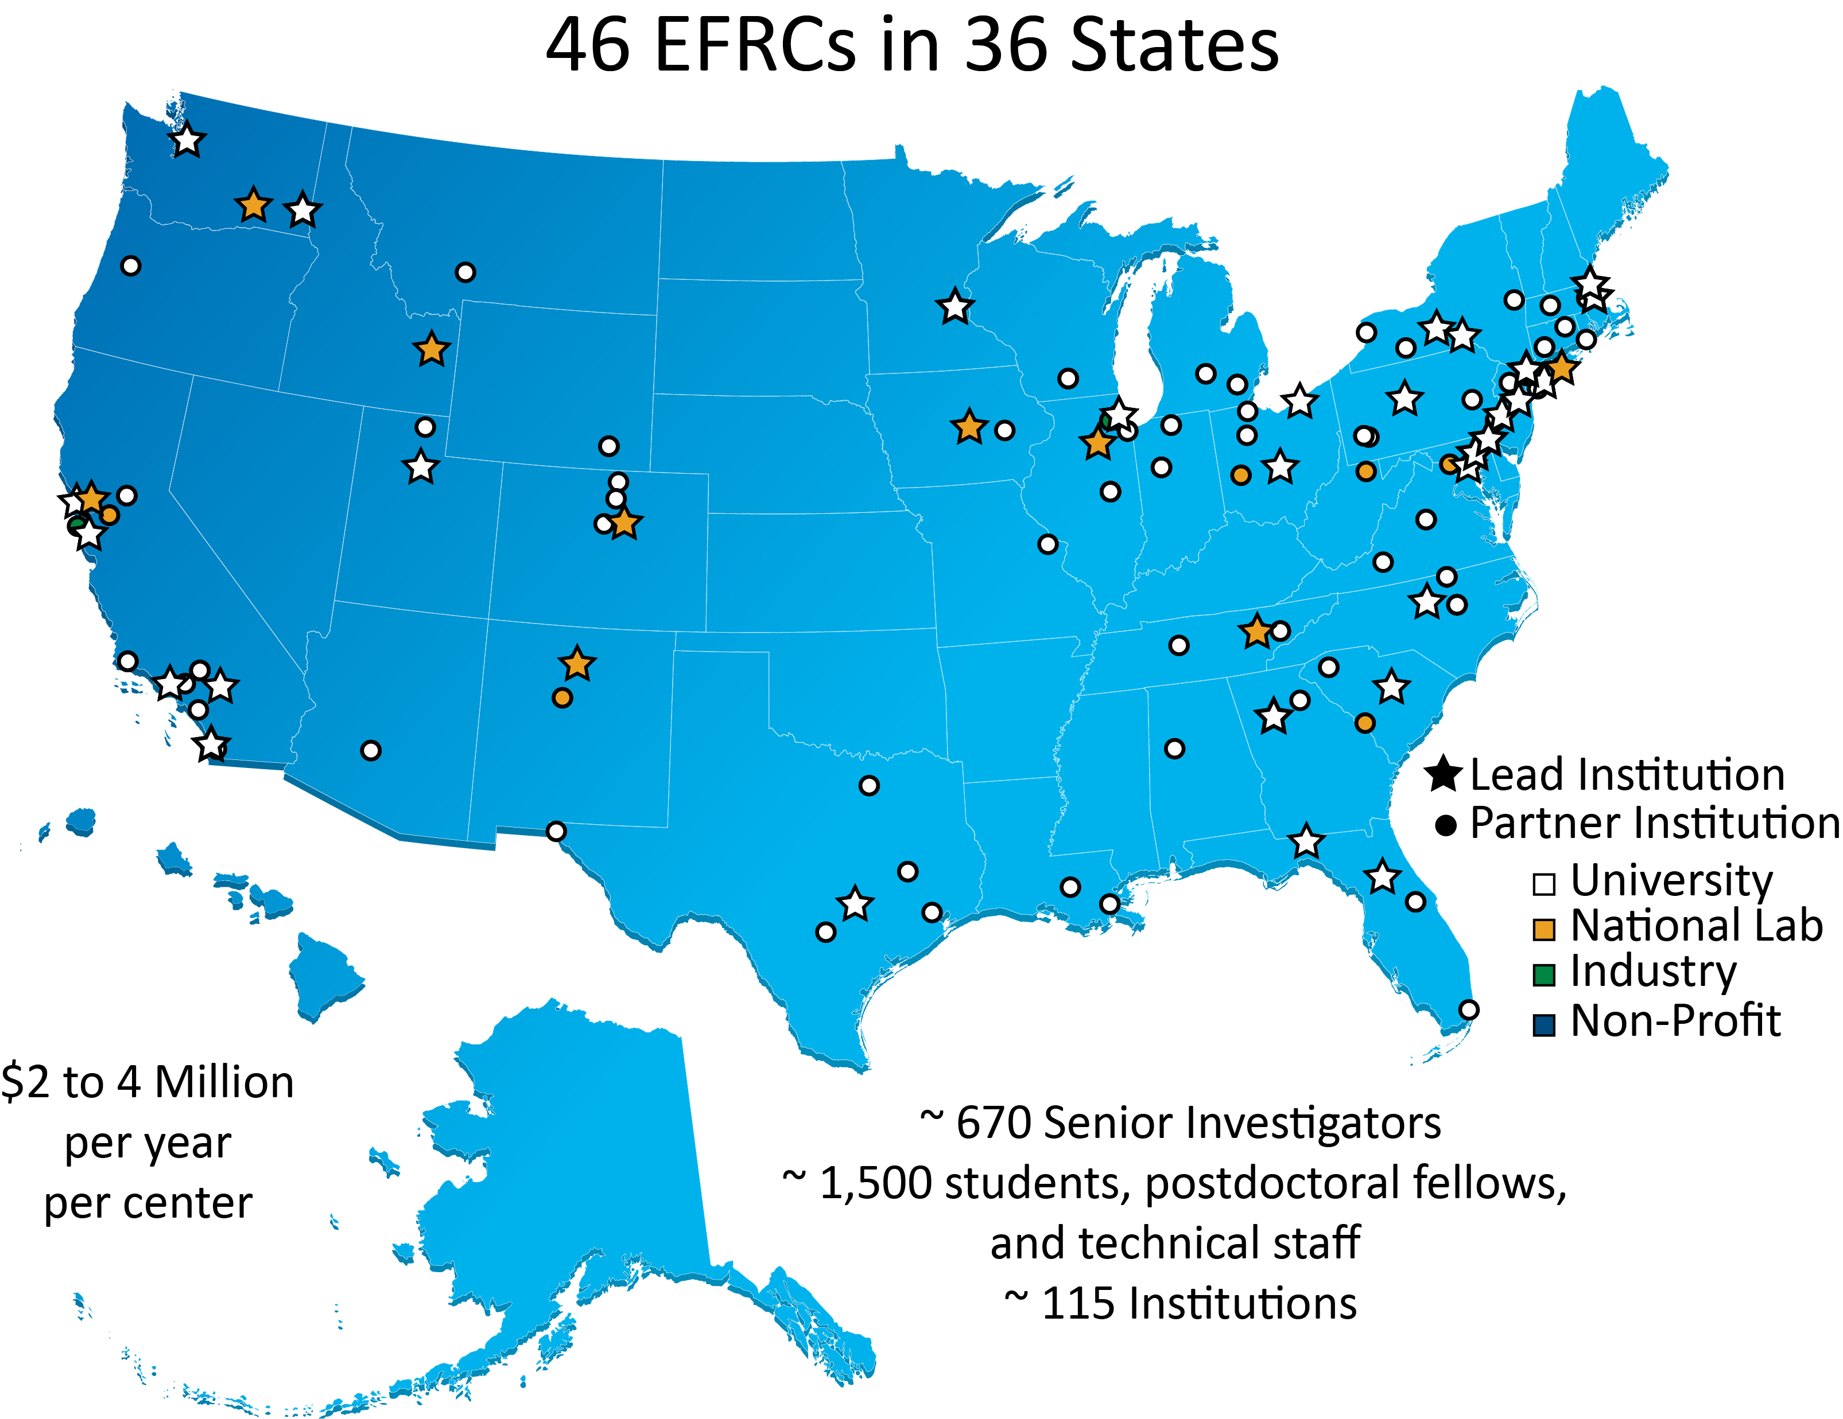

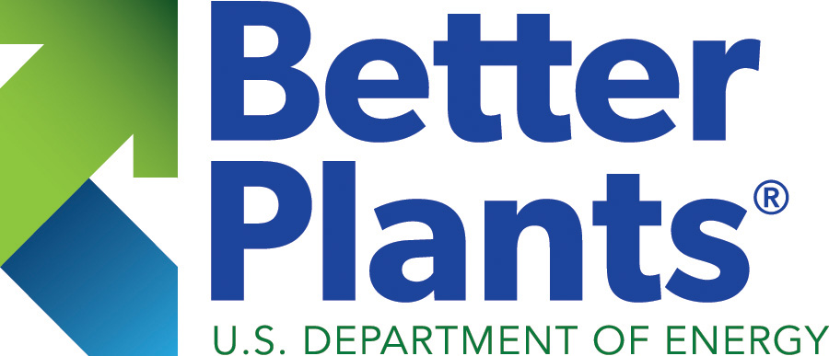
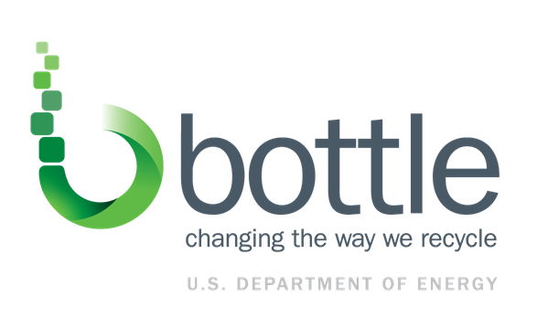

Plastics Innovation Challenge (PIC) is a DOE-wide Effort that Spans RD&D Stages
PIC ties into the broader EERE Circular Economy initiatives
DOE is funding research in plastics recycling and upcycling through:
Emerging Frontiers Research Centers (Office of Science)
REMADE Institute Request for Proposals (AMO)
BOTTLE FOA and BOTTLE Consortium (AMO/BETO)
DOE is accelerating deployment of technology that will reduce plastic waste through SBIR topics in Ocean Plastics Upcycling (AMO/BETO) and Collection (WPTO)
The Better Plants Waste Reduction Pilot will work directly with industry to set waste reduction goals and share best practices
Ensuring coordination across DOE and across agencies (NSF, EPA, Commerce) through routine phone conversations and teleconferences.

Slide 20
DOE Investment in Sustainable Manufacturing
2018
2019
2020
2017
2021
2022
2023+
REMADE Institute: Federal funding - $70M; total expected funding - $140M
Seed BOTTLE Consortium Effort
$2M ($1M BETO/$1M AMO)
BOTTLE Consortium – estimated $10M/yr ($5M AMO)
BOTTLE FOA – 2-3yr R&D Projects $25M ($15M AMO)
Better Plants - $XM/yr; launched a Waste Reduction Pilot and Water thing in 2019

