Slide 1
Additive Manufacturing
Blake Marshall, Technology Manager
Chris Hovanec, Technology Manager
Advanced Manufacturing Office
AMO Peer Review
June 2020 | Washington, DC
manufacturing.energy.gov

Slide 2
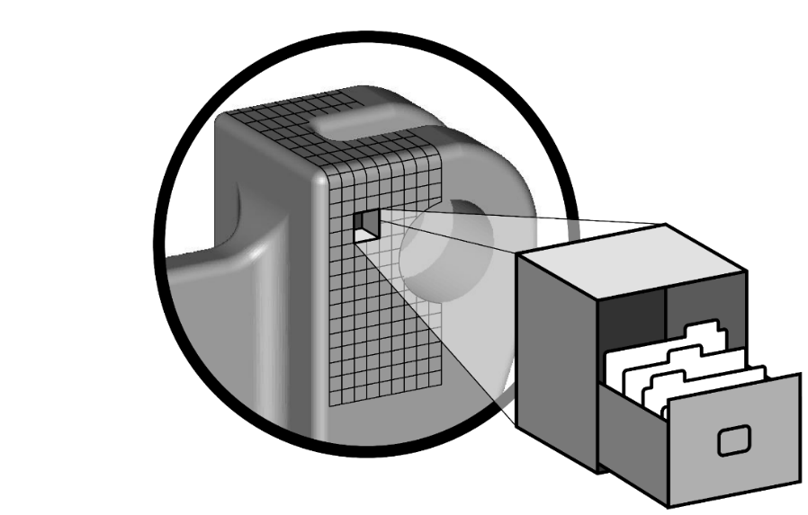
Additive Manufacturing Background
Additive Manufacturing (AM) processes deposit materials in a point-to-point fashion to fabricate complex components directly from a digital design file. AM and “3D Printing” are generally synonymous.
AM Benefits:
  Novel innovative geometries
  Consolidation of complex assemblies into single parts
  Decreased lifecycle energy consumption and waste
  Reduced time to market
  Higher performance components
  Increased manufacturing agility
AMO AM Process focus:
  AMO focuses on AM processes at the scale, speed, and cost relevant to industrial production
  AMO targeted end uses: direct use components (e.g. structural parts), indirect use components (e.g. tooling), AM materials (e.g. powder processing), Rapid prototyping for industry.
  AMO supports powder bed fusion, binder jetting, polymer extrusion, directed energy deposition, concrete extrusion, hybrid AM/subtractive, and other AM process technologies

Slide 3
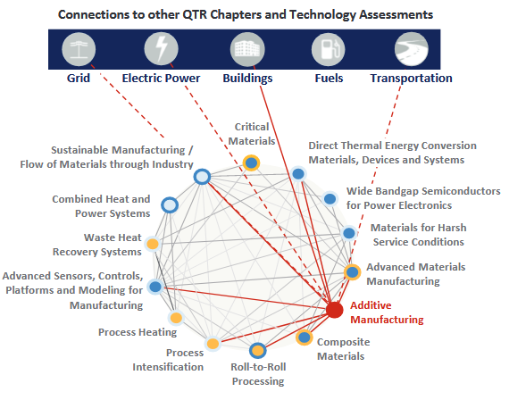
Additive Manufacturing Background
  AM is a broadly-applicable process technology supporting missions across DOE
  Net-shaped components with tailored properties and/or enhanced performance can impact many different applications and use cases
AMO supported or enabled AM R&D

Slide 4
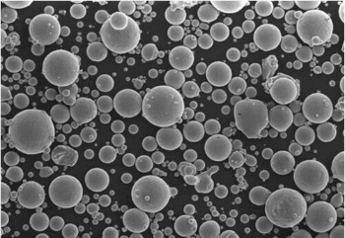
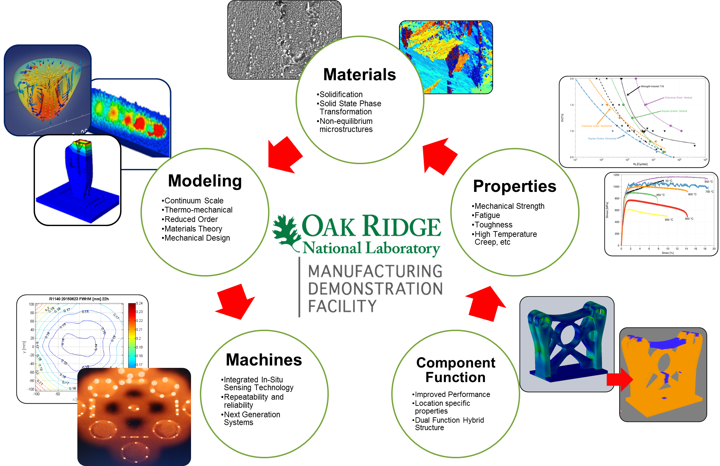
Additive Manufacturing Background
  AM energy impacts are application-specific and expressed here as Use Cases
  AM growth is inevitable, application of AM for energy-relevant impact is not
Enabling R&D
Energy efficient Use Cases for AM
AM Materials Development
Novel material development process
Energy efficient material processes
Bio-derived materials
AM material recyclability
Composite development for AM process
Lower embodied energy
Increase AM process yield
Better material properties and performance
Supply chain for widespread adoption
"Gas Atomised Metal Powder" by Ceram Materials is licensed under CC BY-NC-SA 2.0
Fundamental AM Process R&D
Adoption in energy market
Decrease material waste
Decrease process energy for a given product
Decrease lifecycle energy for a given product
Increase component performance
Known process-structure-property relationships for each point in a part
Computational tools including AI, modeling/simulation to predict and validate properties
Novel process development
Recycling processes

Slide 5
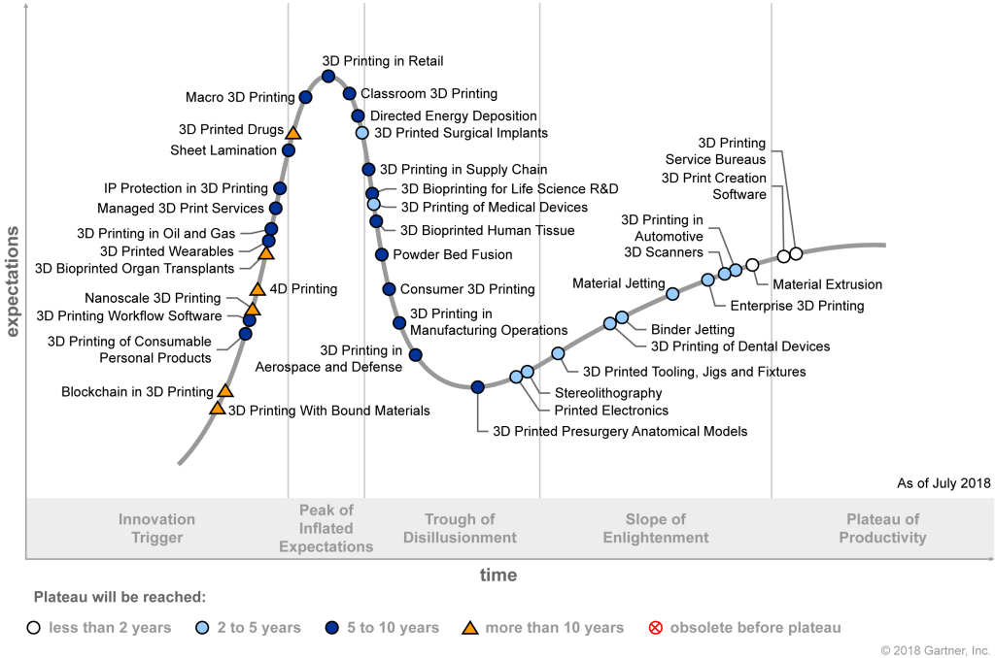
Additive Manufacturing Challenges and Barriers
  The promise of AM typically overshadows current capabilities and the need for improvement
  Significant R&D is required to overcome these challenges for widespread adoption
Challenges:
Materials compatibility
Modeling and simulation capability
Validation and certification
Process control
Tolerances
Surface finish
Processing speed
Scalability
See AMO Multi-year Program Plan for further discussion
Gartner Hype Cycle for 3D Printing
https://www.gartner.com/en/documents/3881825

Slide 6
Technical Topic Objectives and Targets (MYPP)
OBJECTIVE
Advance additive manufacturing technologies that (1) increase the reliability at which parts can be produced at specifications required by industry, (2) increase the range of high-performing materials and processes, and (3) advance characterization and modeling techniques for qualification and certification of parts, in order to reduce lifecycle energy use and costs and enable more innovative products compared to conventional manufacturing methods
TARGETS
6.1 Develop advanced materials, manufacturing technologies, and end use products with the potential to reduce lifecycle energy impact by 50% by 2025 compared to the 2015 state-of-the-art.
6.2 Demonstrate AM components whose physical properties at cost/value outperform selected conventionally produced parts by 20%
Develop rapid qualification methodologies that reduce certification cost to 25% of the total component cost
6.3 Develop next-generation AM systems that deliver consistently reliable parts with predictable properties to six standard deviations (“six-sigma”) for specific applications

Slide 7
Technical Topic Objectives and Targets (MYPP)
Energy-efficient
Use Cases for AM
(see previous slides)
Lower embodied AM parts
Increase AM process yield
Better material properties and performance
Supply chain for widespread adoption
Adoption in energy market
Decrease material waste
Decrease process energy for a given product
Decrease lifecycle energy for a given product
Increase component performance
TARGETS
Develop advanced materials, manufacturing technologies, and end use products with the potential to reduce lifecycle energy impact by 50% by 2025 compared to the 2015 state-of-the-art. (AMO Success Indicator)
Demonstrate AM components whose physical properties at cost/value outperform selected conventionally produced parts by 20% (Target 6.1)
Develop rapid qualification methodologies that reduce certification cost to 25% of the total component cost (Target 6.2)
Develop next-generation AM systems that deliver consistently reliable parts with predictable properties to six standard deviations (“six-sigma”) for specific applications (Target 6.3)
Use cases and impact on targets varies by activity and/or project

Slide 8
Additive Manufacturing Key Thrust – Cross Cutting Disciplines
Manufacturing Demonstration Facility (MDF) at Oak Ridge National Laboratory example
Courtesy Oak Ridge National Laboratory

Slide 9
Additive Manufacturing Key Thrust – Cross Cutting Disciplines
Manufacturing Demonstration Facility (MDF) at Oak Ridge National Laboratory example
Courtesy Oak Ridge National Laboratory

Slide 10
Additive Manufacturing Current Portfolio
Manufacturing Demonstration Facility (MDF) at Oak Ridge National Laboratory
  AMO Consortia focused on Additive Manufacturing started in FY12
  Congressionally Directed funding in FY20 ($20M planned FY20)
  Additional projects selected from AMO 2018 Lab Call:
    Development of a high throughput laser system for soft magnetic materials to revolutionize motor technology
    Infrastructure Scale Additive Manufacturing
Innovative High-Feed Rate Additive Manufacturing Using Sustainable Nano- Micro- Cellulose-Reinforced Thermoplastic Composites
  AMO MDF Hub-And-Spoke Consortia focused on bio-derived materials and additive process development
  Represented in Composites portfolio for FY20
  Selected through AMO 2018 Lab Call
  Congressionally directed funding in FY20 ($20M planned FY20)
Science-based Acceleration of the Full Value Stream for Metal Additive Manufacturing: Expedited AM Powder Development
  AMO Project focused on AM metal feedstock development
  Represented in Advanced Manufacturing Materials portfolio for FY20
  Selected through AMO 2018 Lab Call

Slide 11
Additive Manufacturing Current Portfolio
AMO FY19 Multi-topic FOA (projects in negotiation or recently kicked off)
  No specific additive manufacturing topic (represented in other technology portfolios)
  11 projects utilize AM as a process technology
    Topic 1, Subtopic 1.1: Accelerate the Manufacturing Process Design and Development Cycle for Advanced Energy Conversion and Storage Materials (4)
    Topic 1, Subtopic 1.2: Innovative Manufacturing Processes for Battery Energy Storage (2)
    Topic 1, Subtopic 1.4: Process-Informed Science, Design, and Engineering of Materials and Devices Operating in Harsh Service Conditions (4)
    Topic 3, Subtopic 3.2: High Power to Heat Ratio, High Efficiency Combined Heat and Power (CHP) (1)
AMO FY20 Multi-topic FOA (selections TBD)
  Topic 1: Efficiency Improvements in Advanced Manufacturing Processes
    1.1 Subtopic 1.4: Integrated Additive Manufacturing Processes for Advanced Wind Blade Production

Slide 12
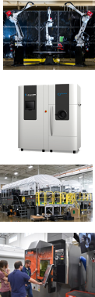
Additive Manufacturing Activities
Manufacturing Demonstration Facility (MDF) at Oak Ridge National Laboratory FY20 Activities (1)
  AM Powder Bed Project
    Task 1: High Temperature Ni Alloys Development
    Task 2: High-Temperature Al Alloys for Additive Manufacturing
    Task 3: Tool fabrication for advanced plastics/composites using laser powder bed fusion
    Task 4: Binder Jet Additive Manufacturing
  Polymer Additive Manufacturing
    Task 1: Thermoplastic Polymer AM
    Task 2: Reactive Polymer AM
    Task 3: Integrated Polymer Processes
    Task 4: AM Molds and Dies
  Large Scale Metals AM
    Task 1: Robotic Wire Arc
    Task 2: Robotic Laser Wire
  AM Hybrid Systems
    Task 1: Hybrid CNC
    Task 2: Robotic Machine Tool
  Digital Factory
  Technology Collaborations

Slide 13
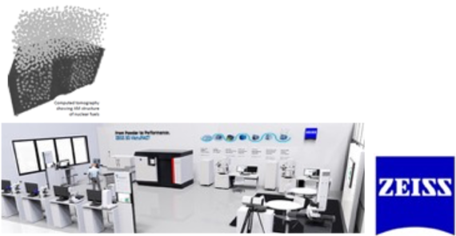
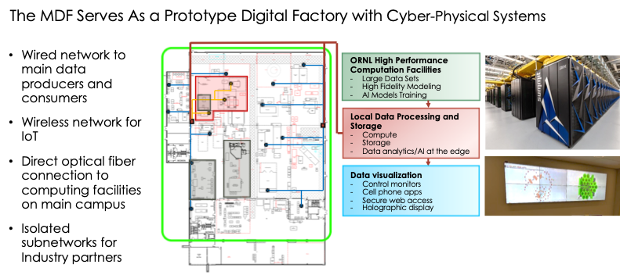
Additive Manufacturing Activities
Manufacturing Demonstration Facility (MDF) at Oak Ridge National Laboratory (3)
More than 80 advanced systems, of which ~60% (>$30M) is industry-provided
ORNL and Zeiss are partnering to develop a comprehensive powder to part characterization methodology.
See MDF project slides for more information

Slide 14
Additive Manufacturing Activities
Manufacturing Demonstration Facility (MDF) at Oak Ridge National Laboratory FY20 Activities (2)
  AM Powder Bed Project (selected FY20 goals)
    Task 1: Fabricate a 10x10x50mm single crystal Ni-base superalloy from a crack-prone high gamma prime alloy with any stray grain formation being below +/-7.5 degrees; the turbine industry standard for single crystal acceptance.
    Task 3: Steel tool will be deposited with density >99% and a heat treated hardness of 45 HRC.
  MDF project goals target energy-efficient use cases, which support MYPP targets overall
Energy-efficient
use cases for AM
Lower embodied AM parts
Increase AM process yield
Better material properties and performance
Supply chain for widespread adoption
Adoption in energy market
Decrease material waste
Decrease process energy for a given product
Decrease lifecycle energy for a given product
Increase component performance

Slide 15
Additive Manufacturing Activities
Science-based Acceleration of the Full Value Stream for Metal Additive Manufacturing: Expedited AM Powder Development
Thermodynamic Assessment
Energy-efficient
use cases for AM
Lower embodied AM parts
Increase AM process yield
Better material properties and performance
Supply chain for widespread adoption
Adoption in energy market
Decrease material waste
Decrease process energy for a given product
Decrease lifecycle energy for a given product
Increase component performance

Slide 16
Additive Manufacturing Collaborations
Geothermal Manufacturing Prize American-Made Challenge (FY20 – live solicitation)
  $4.65M in total prizes – Geothermal Technologies Office and AMO support in additive manufacturing
Additive Manufacturing of Large Scale Metal and Composite Structures for Nacelles (co-funded with WETO) (CRADA finishing in 2020) co-funded with Wind Energy Technologies Office
AMO Co-hosts AM Manufacturing Workshop with National Nuclear Security Agency to align research objectives (postponed in FY20 due to COVID-19, timing TBD)
AMO Coordination with America Makes Manufacturing USA Institute (AMO supported in the past but no FY20 projects)
Science-based Acceleration of the Full Value Stream for Metal Additive Manufacturing: Expedited AM Powder Development (Active project FY20)

Slide 17
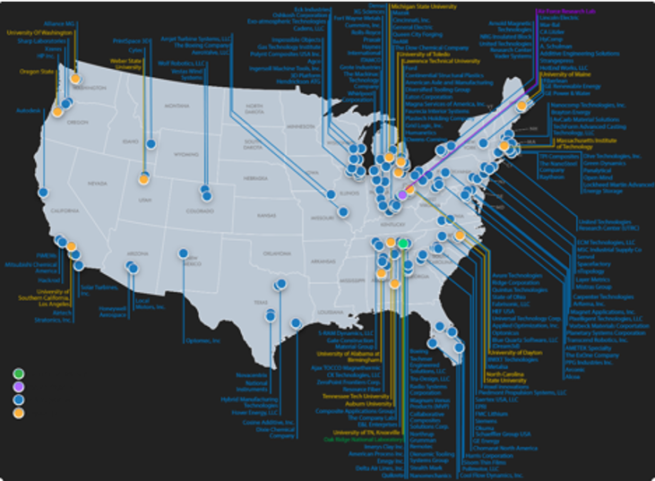
Additive Manufacturing Collaborations
Collaborations through Manufacturing Demonstration Facility (MDF)
  AMO work scope aligned with technology needs of other DOE offices – Wind Energy Technologies Office (VTO), Water Power Technologies Office, Building Technologies Office, Vehicles Technology Office, Office of Nuclear Energy (NE), Office of Fossil Energy (FE), Office of Electricity Delivery and Reliability (OE), National Nuclear Security Agency (NNSA).
  91 total partners previously co-located at MDF (cumulative since FY12) – Government (DOE National Labs, NASA, DOD), and Industry.
  AMO-funded MDF resources leveraged for significant ORNL programs sponsored by other Agencies– DOE (NE, NNSA, OE, VTO), DOD and smaller efforts from other agencies.
  191 total Technical Collaborations (typically CRADAs) through MDF:
Status | Phase 1 | Phase 2 | TOTAL
Pending Agreement | 16 | 4 | 20
Active | 34 | 12 | 46
Complete | 111 | 17 | 128
Total | 161 | 33 | 194

Slide 18
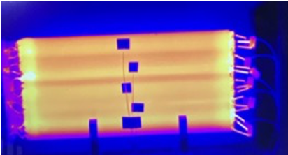

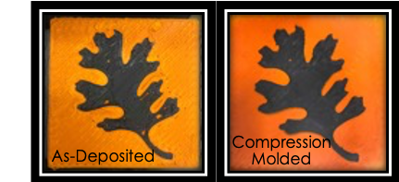
Additive Manufacturing Successes
Select FY20 accomplishments and energy efficient use cases
Self Heated AM Molds
Energy-efficient
use cases for AM
Lower embodied AM parts
Increase AM process yield
Better material properties and performance
Supply chain for widespread adoption
Adoption in energy market
Decrease material waste
Decrease process energy for a given product
Decrease lifecycle energy for a given product
Increase component performance
Award Winning High Strength Binder
Wire co-extrusion for active heating
Self-heated smart AM layup tool for advanced composite parts
The use of a self-heated tools will help to avoid potential bottlenecks and high capital spends (i.e. Autoclaves)
  ORNL and ExOne co-developed binder for binder jet that enables tailored strength of green part without loss of shape for sand casting molds and wash out tooling.
  Leads to lower off-gassing and less polymer content.
Design and application based multi-materials for functional structures
AM-enabled advanced composite process examples
Better mechanical performance (11% increase in strength and 35% increase in modulus) than sandwiched or compression molded alone.
Notes:
Tie to targets and goals

Slide 19
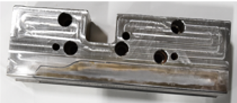
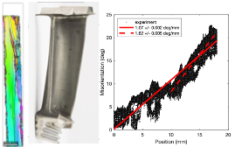
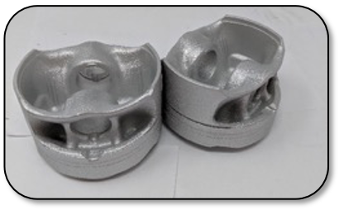
Additive Manufacturing Successes
Select FY20 accomplishments and energy efficient use cases
More durable hot stamping dies
Microstructure Control for High Temperature Materials
Energy-efficient
use cases for AM
Lower embodied AM parts
Increase AM process yield
Better material properties and performance
Supply chain for widespread adoption
Adoption in energy market
Decrease material waste
Decrease process energy for a given product
Decrease lifecycle energy for a given product
Increase component performance
Dienamic Tooling Systems collaboration of multi-material print with integral cooling channels
Produced 25K parts on production line
Full size single automotive stamping die currently in progress
Microstructure control for enhanced materials performance: single crystals and twisted crystals
New materials for extreme environments and enabling advanced component designs
Design of High Temperature Al Alloys for Additive Manufacturing
Higher performance metallic part examples
New printable alloys with high-temperature strength better than existing wrought alloys
Thermal diffusivity comparable to conventional alloys
Working with industry partners for component demonstrations in aerospace and automotive industries
Notes:
Tie to targets and goals

Slide 20
AMO Technical Topic Team
Blake Marshall, Technology Manager
Chris Hovanec, Technology Manager
Tina Kaarsberg, Technology Manager
Stephen Sikirica, Technology Manager
THANK YOU!

