Slide 1
Enabling the Future of Advanced Roll-to-Roll (R2R) Manufacturing
Brian Valentine, Technology Manager
Advanced Manufacturing Office
AMO Peer Review
June 2020 | Washington, DC
manufacturing.energy.gov

Slide 2
R2R Manufacturing Background
Technical Definition
Opportunity Space
R2R manufacturing is a low-cost, high throughput technique for continuous two-dimensional (2-D) deposition of materials over large areas onto moving webs, carriers, or other substrates.
Known also as “web processing” and “reel-to-reel processing,” R2R manufacturing creates products on a roll of flexible plastic, paper, glass, ceramic, composite, or metal foil.
R2R manufacturing enables low-cost production of complex-functional, large surface area devices needed for many clean energy applications, and many R2R products cannot be produced using other known techniques.
Electrochemical energy storage and conversion
Fuel cells & electrolyzers
Advanced batteries
Flexible electronics and integrated hybrid circuits
Flexible photovoltaics
Separation membranes
CO₂ capture and conversion
Water purification
Selective barrier materials
Window films
Vapor barriers
Circular economy
Drying thermal budget

Slide 3
R2R Manufacturing Interconnectivity within AMO
Rapid Advancement in Process Intensification Deployment (RAPID)
Advanced Sensors & Controls and Modeling for Manufacturing – Clean Energy Smart Manufacturing Innovation Institute (CESMII) and HPC4Mfg
Sustainable Manufacturing
Direct Thermal Energy Conversion
Advanced Materials Manufacturing (AMM)
Additive Manufacturing (AM)
National Alliance for Water Innovation (NAWI) Hub
REMADE Institute
Interagency Interconnectivity → DoD/DOC Institutes: NextFlex, Lift, America Makes, ARM, NIMBL, AFFOA, Biofab USA, AIM, MxD

Slide 4
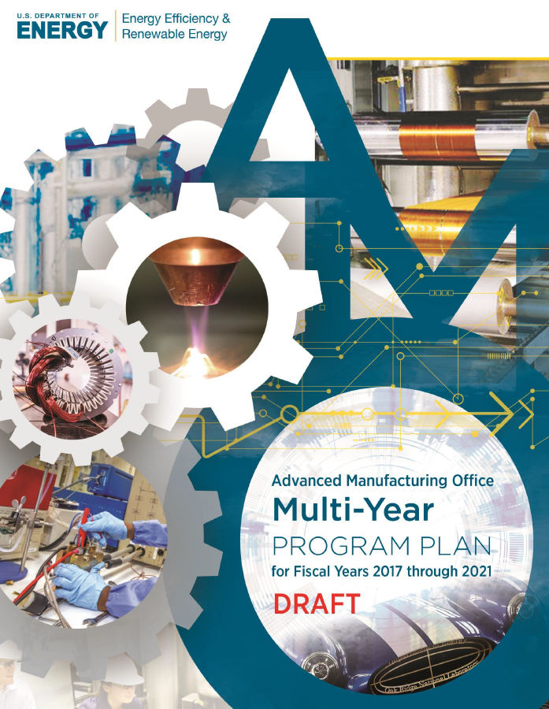
Advance technologies to reduce cost, increase precision, and enable in-line quality control and defect detection, resulting in expanded use of R2R processing to produce clean energy technologies:
R2R Manufacturing Challenges and Barriers
Continuous processing: need for low-temperature, continuous processing on flexible substrates, including nontraditional substrates such as stretchable plastics and textiles.
Registration and alignment challenges: lack of reliable, high-speed registration and alignment techniques, particularly for multilayer devices.
Scalability: need for high-throughput and large-area printing/deposition techniques compatible with a wide range of materials, inks, and substrates.
Materials compatibility: need for development of novel aqueous ink and substrate materials compatible with roll-to-roll processing techniques for application-specific properties.
Defects in complex coatings (i.e. flexible electronics): defects can cause open and short circuits, leading to device failure; defect avoidance and detection challenging for continuous roll-to-roll processes.
Stoichiometry control and bath depletion in electroplating systems: poor control of stoichiometry in continuous, high-speed coating systems, resulting in non-uniformities and oxidation issues.
Availability of materials data: lack of databases populated with material properties and fabrication process parameters to enable effective modeling and simulation.

Slide 5
MYPP R2R Manufacturing Objectives and Targets
OBJECTIVE
Target 8.1 Develop technologies to reduce the cost per manufactured throughput of continuous R2R manufacturing processes.
Target 8.2 Develop in-line instrumentation tools that will evaluate the quality of single and multi-layer materials in-process.
TARGETS
Increase throughput of R2R processes by 5× for batteries and capacitors and 10× for printed electronics, as well as substrates and membranes used in support of these products.
Develop capabilities to enable detection, registration, alignment, and co-deposition of multilayer coatings with features <1 µm using scalable continuous processes.
Develop scalable and reliable R2R processes for solution deposition of ultra-thin (<10 nm) films for active and passive materials.
Develop in-line multilayer coating technology on thin films (<10 µm) with yields >95%.
Develop in-line QC methodologies for real-time identification of defects and expected product properties during continuous processing at all size-scales with a focus on the “micro” and “nano” scale traces, lines, and devices (i.e., <1 µm at 300 ft/min for R2R processing in air and <10 nm at 20 ft/min for vacuum processing).
Develop technologies for increasing the measurement frequency of surface conditions without significant cost increase and a goal of a 10-nm in-line profilometry at a production rate of 100,000 mm²/min.

Slide 6
R2R Manufacturing Opportunity Space and Future Vision for AMM Collaboration Expansion
What is currently being addressed:
Colloidal processing & dispersion processing
Drying & curing physics
Scalable electrospinning
Multilayer coating deposition (slide, dual slot-die)
High-throughput deposition techniques
In-situ device testing & advanced materials characterization
Macroscopic parameter & continuum mathematical modeling
Vision for addressing future MYPP needs:
Multilayer, multi-pass coating alignment & registration methods
Flexible electronics and defect detection
Continuous processing on flexible substrates
Compatibility of novel aqueous inks with substrates
Optimization and QC of electroplating baths
Property databases for modeling
Expansion of R2R Advanced Materials Manufacturing (AMM) Collaboration – ORNL, ANL, LBNL, NREL, SNL – to cover gaps by growing current efforts and addressing future needs.

Slide 7
R2R Manufacturing Current Portfolio
Current Portfolio:
Saint-Gobain – “Development of Roll-to-Roll Simultaneous Multilayer Deposition Methods for Solid-state Electrochemical Devices using Highly Particulate Loaded Aqueous Inks”
R2R Advanced Materials Manufacturing (AMM) Collaboration - funded through FY21
New FY20 Projects (DE-FOA-0001980 Topic 1.2 Awards):
Forge Nano – “Reducing the Cost and Energy of Lithium-ion Battery Manufacturing using High Throughput Atomic Layer Deposition Processes”
Applied Materials – “Advanced Anode Manufacturing through Ultra-Thin Li Deposition”
Navitas Advanced Solutions Group – “High Throughput Solvent-free Manufacturing of Battery Electrodes”
Western Michigan University – “Enabling Advanced Electrode Architecture through Printing Technique”
Albemarle – “Thin-Film Lithium Metal Manufacture by Room Temperature Electrodeposition”
Arkema – “Roll-To Roll Manufacturing of Low Cost and Safer Lithium Ion Batteries”
UCLA – “Innovative Design and Manufacturing of 2.5D Battery with High Energy and Power Density”
Co-supported (with HFTO) Electrolyzer Manufacturing R&D Topic 1 (DE-FOA-0002229)
FY22-24 Phase 3 expansion of R2R AMM Collaboration – plans to submit a request to continue Collaboration efforts through the competitive process of a FY21 Lab Call.

Slide 8
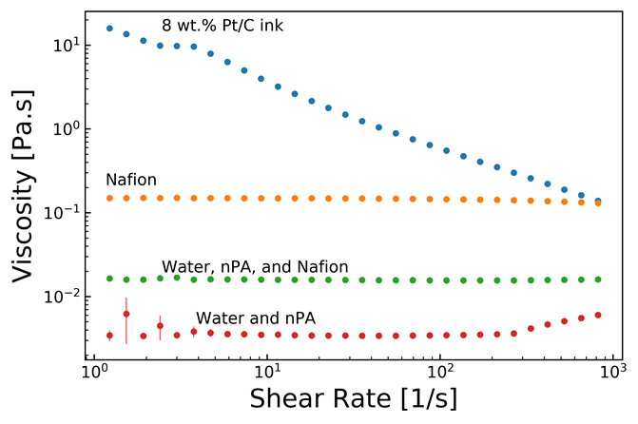
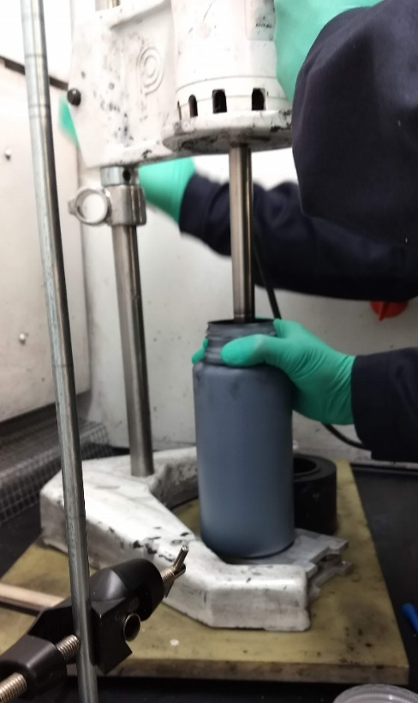
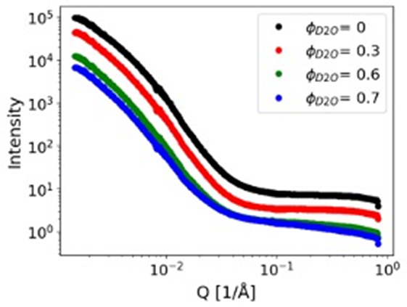
R2R Manufacturing Activity: Ink & Dispersion Characterization
Target: Develop in-line multilayer coating technology on thin films (<10 µm) with yields >95%.
Target: Develop scalable and reliable R2R processes for solution deposition of ultra-thin (<10 nm) films for active and passive materials.
Goals:
Understand how ink composition and interactions determine ink structure
Optimize ink stability and processing
Optimize coatability and interaction with substrate
Understand impact of ink composition on device performance
List of activities:
AMM/R2R Multi-lab Collaboration
Saint Gobain multi-layer R2R coating project
Examples: Steady-shear rheology (left), GP-SANS (below)
Example: High-shear ink mixing

Slide 9
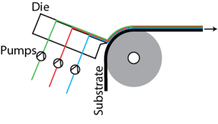
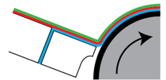
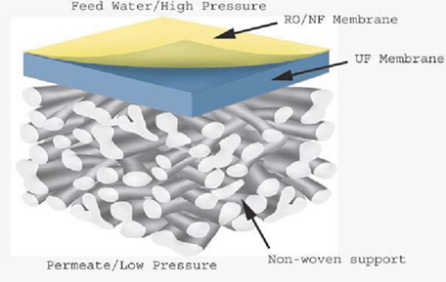
R2R Manufacturing Activity: Multilayer Coating
Target: Develop in-line multilayer coating technology on thin films (<10 µm) with yields >95%.
Relevance: electrochemical energy storage and conversion, electro-optical devices, chemical and water processing membranes, flexible electronics, barrier films
Innovation: structures and functionality can be created that are not accessible by sequential coatings
Potential Impact: increased throughput; decreased energy intensity, footprint, CAPEX
List of activities
AMM/R2R Multi-lab Collaboration
Saint Gobain multi-layer R2R coating project
Connections to other Tech Topics
RAPID
NAWI
Battery manufacturing projects
Technology example: Multi-layer slide die coating
Application example: Water purification membrane

Slide 10
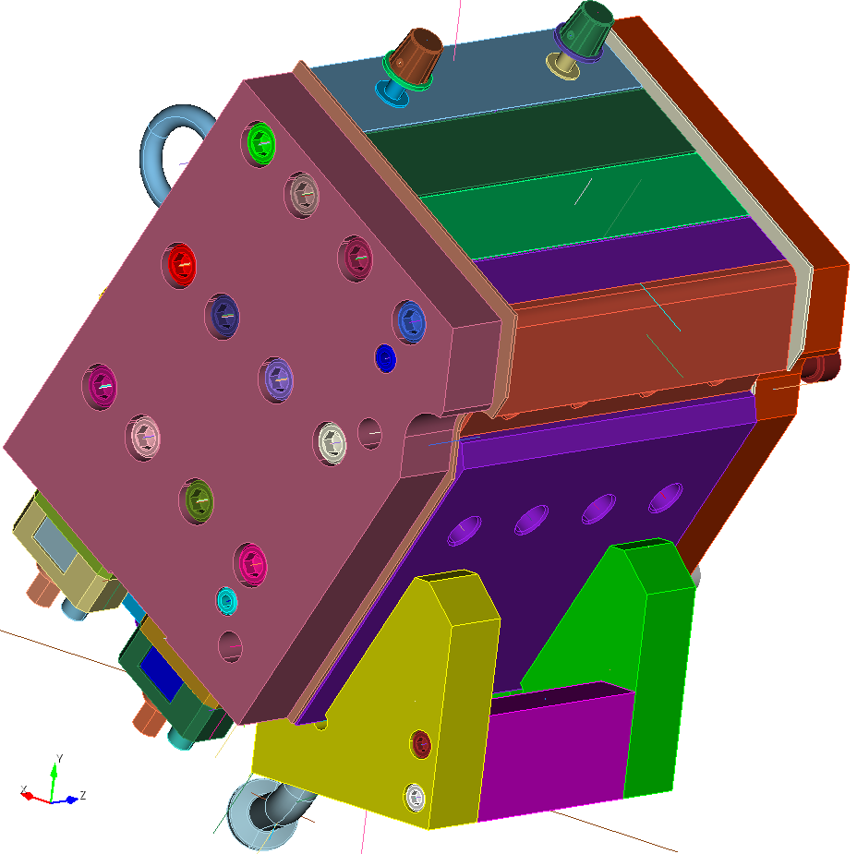
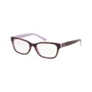
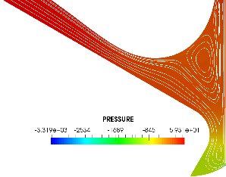
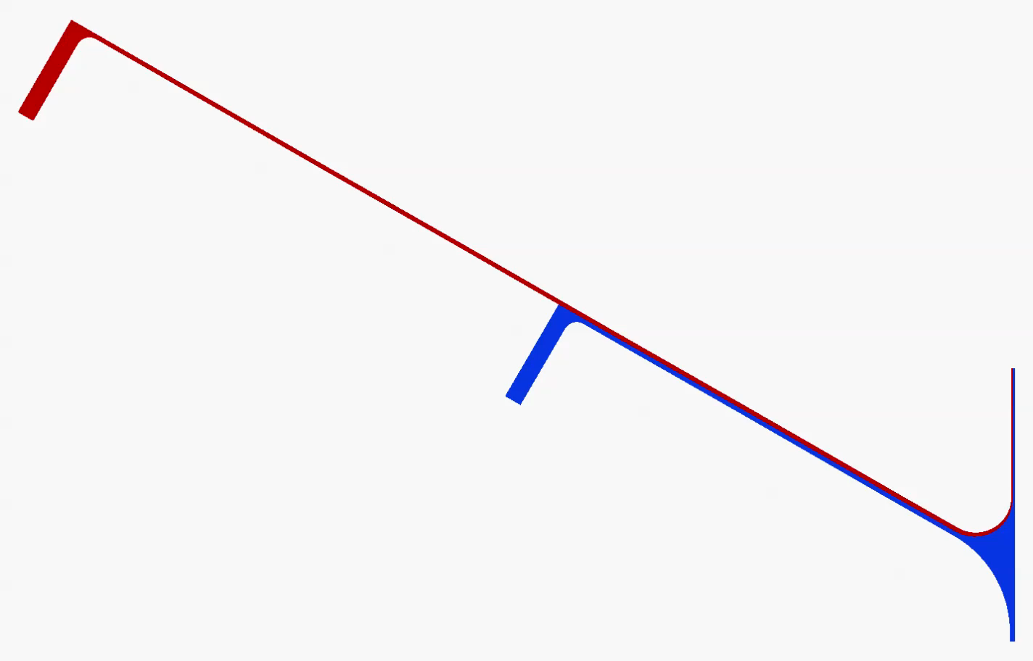

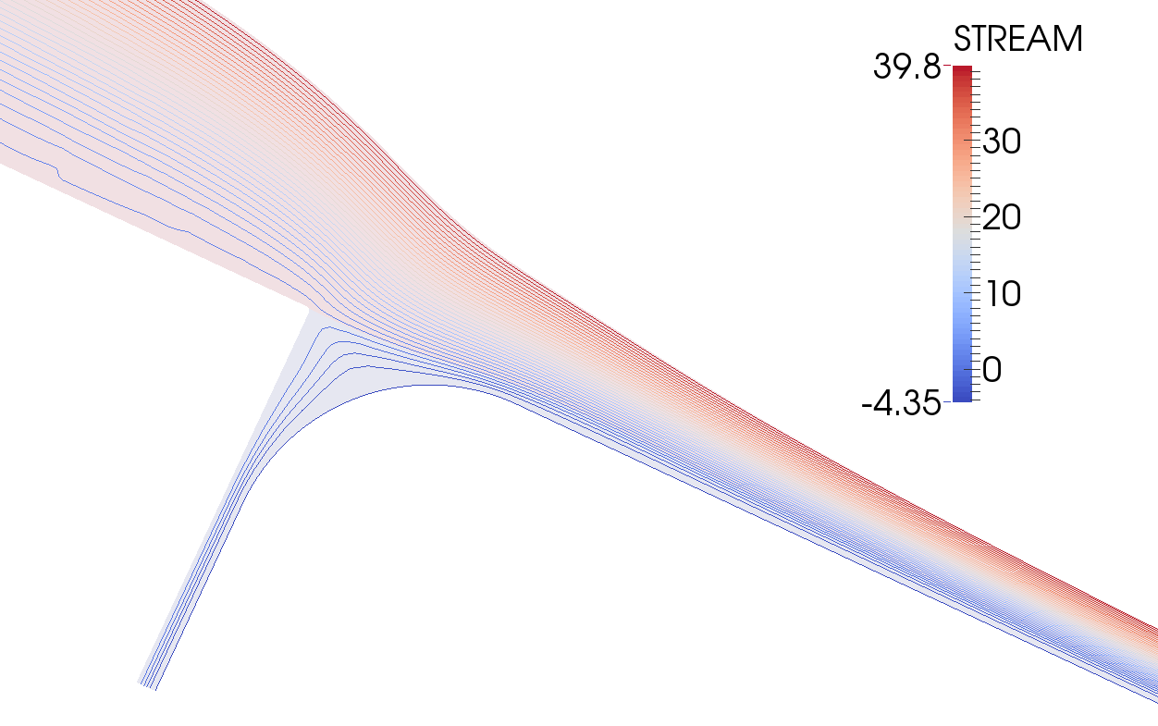

R2R Manufacturing Activity: Modeling & Simulation of Multilayer Slide Coating and Drying Physics
Coating Models of Capillary Hydrodynamics
Target: Continuum Scale Models for process design and scale-up
Deposition models for single- and multi-layer slide, slot, and related coating methods
Drying and solidification models that track thermal, diffusion, and other key physical rate processes
Ongoing model validation from published literature and coating trials at ORNL and NREL
Software platform based on open-source Goma 6.0 (gomafem.com) finite element software
User-interface and training
Liquid bridge
Solid Model-NREL 3 layer slide die
Pattern of flow near layer merger
2-layer Slide die
Web
Drying Models: Reaction/diffusion/Energy transport
Validated single layer model – Price et al. (1997)
Substrate

Slide 11
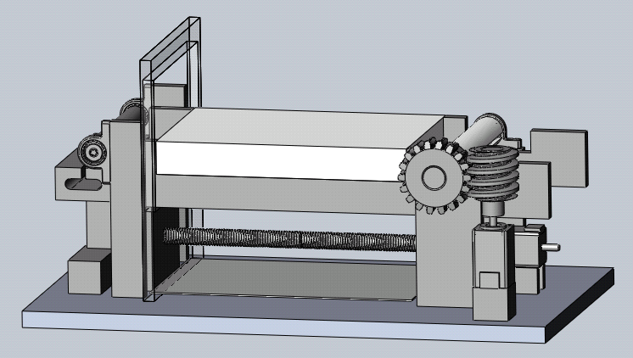
Technical Target: Elucidating multilayer coating consolidation physics and obtaining key drying parameters for process optimization and modeling
R2R Manufacturing Activity: Mimicking of Manufacturing Conditions with Custom Table
Designed enclosed miniature automated table to observe drying dynamics in combination with different analytical tools (X-ray radiography, XRD, XAS, IR spectroscopic mapping, optical microscopy, visible and IR cameras, humidity sensors, etc.)
Interchangeable heater options: IR or convective
Controllable atmosphere within enclosure
Controlled substrate tension
Monitor coating height, concentration distributions, component states, evaporation rate, crack formation, etc.
Computer automation to allow operation in beamline hutches and to support readily reproducible experiments
Goal is to develop methodology for using results to build coating drying models that connect component-level and macroscopic behavior

Slide 12
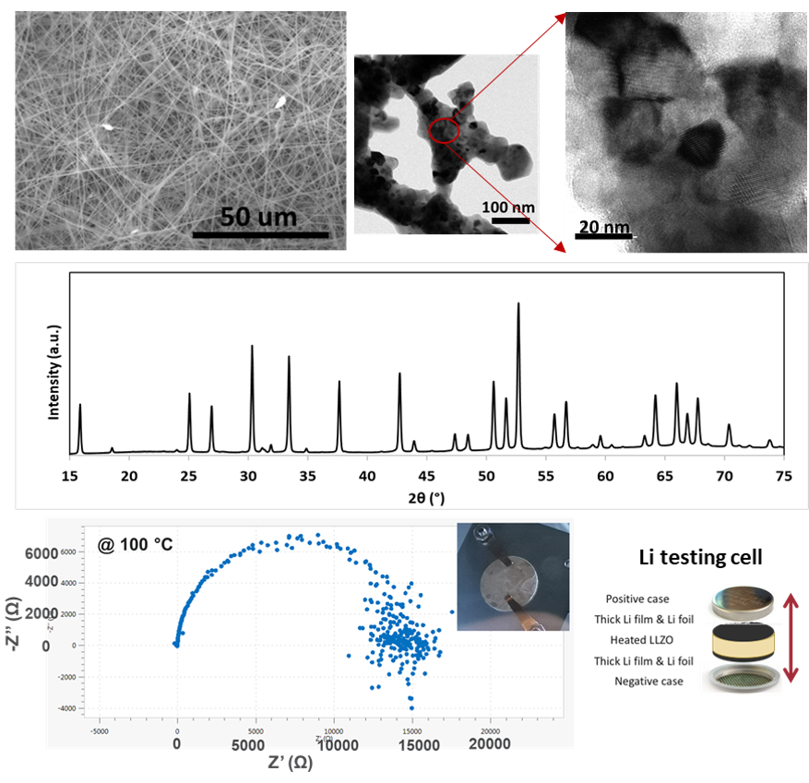
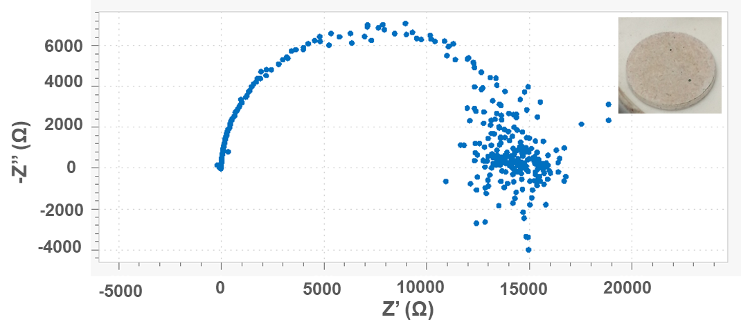
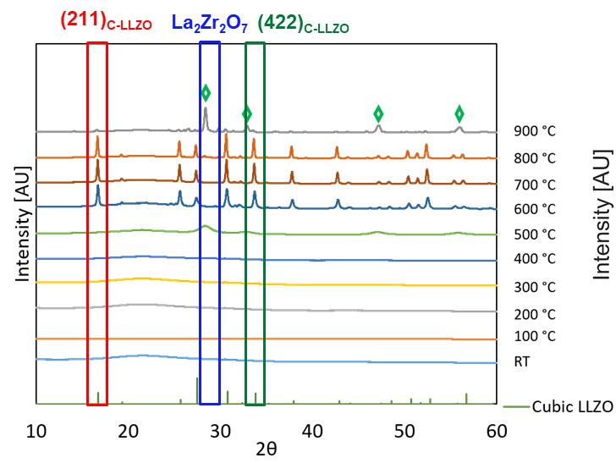
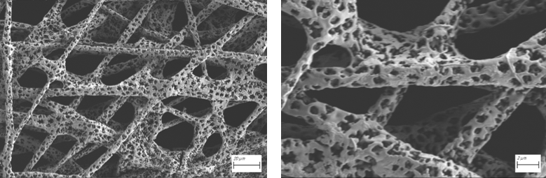
R2R Manufacturing Activity: Solid-State Lithium Battery Materials Synthesis by Electrospinning Technology
Target: Develop Li₇La₃Zr₂O₁₂ (LLZO) nanofibers for solid-state lithium battery applications
Benefit:
A nanofiber 3D network can provide a long, continuous lithium-ion transport path and facilitate fast-charging.
Material candidates for dual-conductor composite electrolytes.
Progress:
Developed nanocrystalline LLZO fibers that formed high-ionic- conductivity cubic phase at low temperatures
Low-T synthesis avoided lithium loss and impurity-phase formation.
Understood LLZO formation and phase transition with temperatures through in-situ wide angle x-ray scattering (WAXS)
Synthesized highly porous LLZO fibers for composite SSB cathode applications
SEM and TEM images of as-spun and annealed LLZO
XRD of 600 °C annealed c-LLZO
Impedance
In-situ WAXS at APS
1.3 x10⁻⁵ S/cm at 100 °C
SEM of the highly porous LLZO fibers
DMF-based LLZO fibers rapidly calcined at 700 ºC for 1 h.

Slide 13


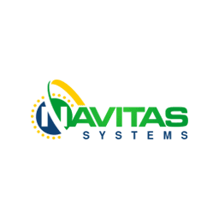


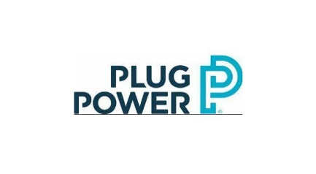




R2R Manufacturing Collaborations
AMO DE-FOA-0001980 Topic 1.2 battery manufacturing FY20 awards (co-supported by VTO)
HFTO DE-FOA-0002229 Topic 1 Electrolyzer Manufacturing R&D (co-supported by AMO)
AMO R2R Advanced Materials Manufacturing (AMM) Collaboration

Slide 14
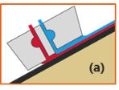
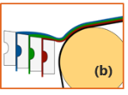
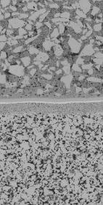
Simultaneous Multilayer R2R Coating
Title: Development of Roll-to-Roll Simultaneous Multilayer Deposition Methods for Solid-State Electrochemical Devices Using Highly Particulate Loaded Aqueous Inks
Objective:
Fabricate & characterize functional devices R2R cast from dual slot and multilayer slide coating
Evaluate potential benefits for various applications
Project Team
Jeff Peet, Saint-Gobain
Sujit Das, ORNL
Advisory Board
David Wood III, ORNL
Balu Balachandran, ANL
Mike Lanagan, Penn State
Peter Schweizer
R2R AMM Connections
Claus Daniel, ORNL
Randy Schunk, Sandia
Mike Ulsh, NREL
Results:
Dual-slot casting of 3 tapes laminated into 6-layer structure
Slide coating of 3-layer tapes
Design rules for co-casting of highly loaded aqueous slurries
Analysis of economic impact
Connected with academic, industrial, and national lab partners to chart path forward
6 layer structure from
dual slot cast tapes

Slide 15
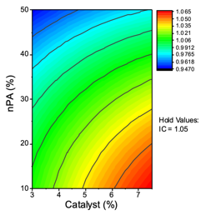
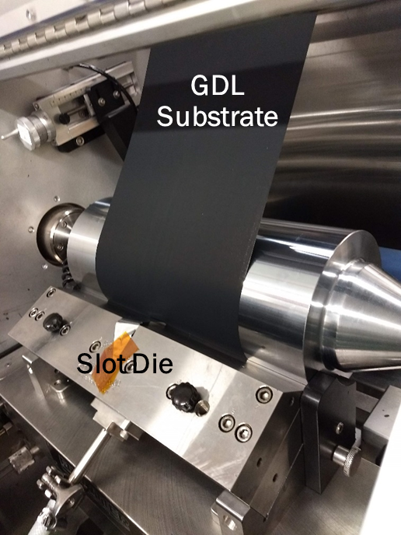
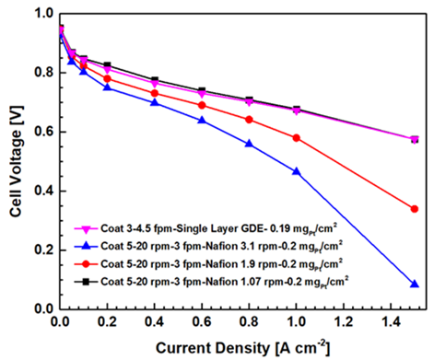
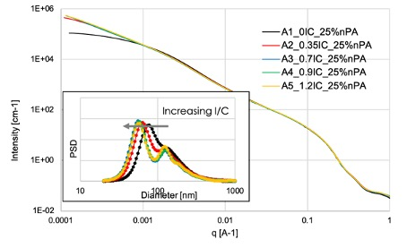
Accomplishment: Eliminated Need for PEM Fuel Cell Cathode Overlayer via Direct Coating
PEMFC single-layer and multi-layer electrode performance based on ink characterization studies
Utilized statistical design to develop ink property models
Performed ink characterization, including rheology, USAXS and SANS
Completed single and multi-layer electrode coating, meeting target catalyst loading
Fabricated test cells and measured in situ performance
Regression model (A: catalyst, B: nPA, C: I/C ratio)
Density (g/cm³) = 0.02132A-0.03748B+0.000685417C-0.0031A²-0.01B²+0.0003333C²-0.00644AB+0.00398AC-0.0085BC+1.01279
Regression model and contour plot for catalyst ink properties
Dual slot die coating
Comparison of particle size distribution in inks by USAXS
Device testing comparison

Slide 16
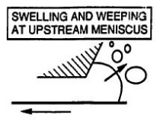
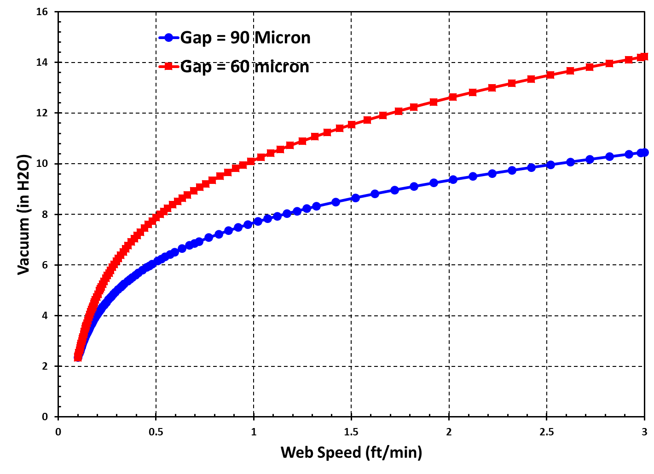

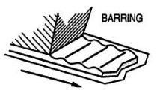
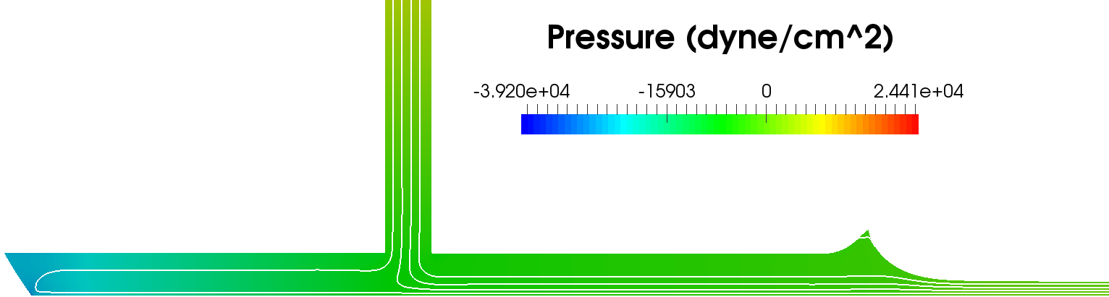
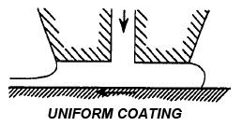
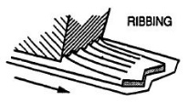
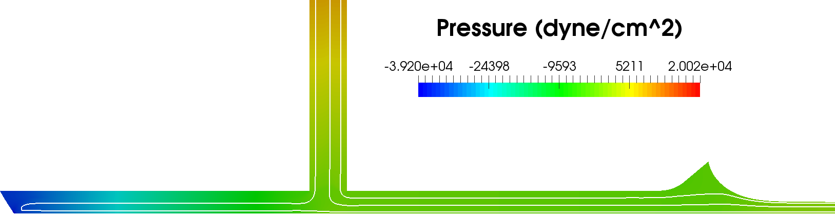
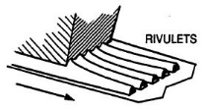
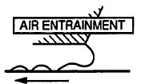
Technical Success: Coating Window Predictions for Single and Dual Slot-Die Methods
Process models of single-layer slot-die flow informed coating configuration changes for High-solids loading catalyst inks at ORNL
Vacuum Requirements for stable single-layer coating of 8 wt% Pt/C - Predicted
Typical operability window – from Sartor (1991)
Speed = 3 feet/min
Wet thickness = 30 µm
Gap = 90 µm
$$t=h/H$$
Gap = 60 µm
Vacuum
Web-speed

Slide 17
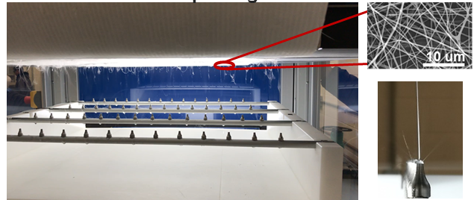
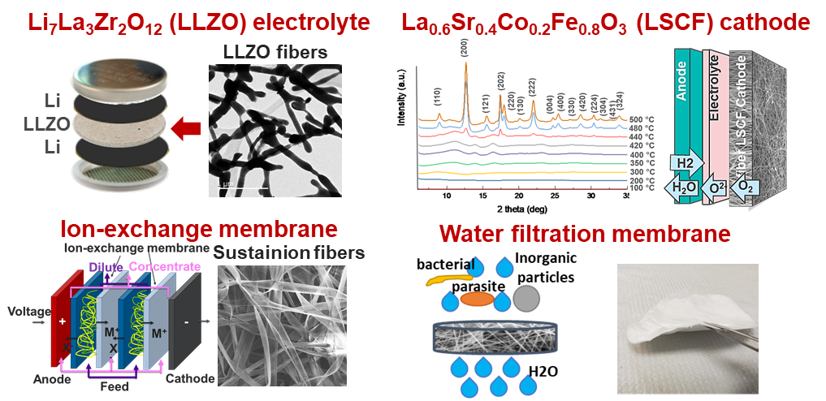
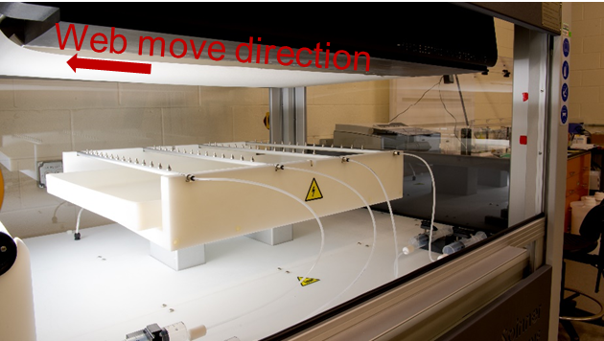
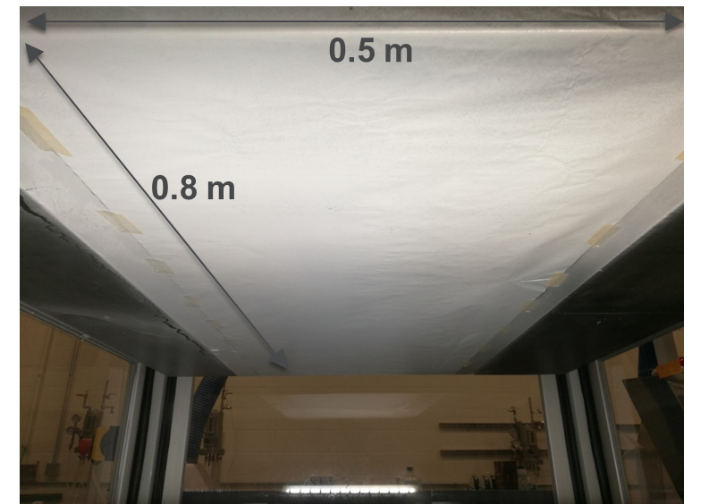
Technical Success: Scalable Nanofiber and Nonwoven Structure Production by Roll-to-Roll Electrospinning
High-rate R2R electrospinning capability expanded the application domains of electrospinning to energy storage, water purification, and energy conversation applications
56 nozzles driven by 4 separate voltage supplies enabling a deposition rate of 3 m/min
0.5 x 30 m² web size and 0.01-10 m/min web winding speed range
X-motion improved deposition homogeneity
Enabled a rapid development of nanofiber filter media for reusable N95 face masks, which addressed the medical PPE shortfalls at coronavirus pandemic
R2R Electrospinning Equipment
Demonstrated Applications
PVDF fiber mat

Slide 18
Special Thanks to …
All R2R Team Members at 5 Labs, and all industrial collaborators for all their contributions
David Wood, ORNL, currently leading and coordinating all Lab efforts
Claus Daniel, ORNL, initiating R2R Consortium and the Lab Partnership Lead until this year
Fred Crowson, Energetics, providing special guidance and support to ensure all technical objectives are met and documented
David Hardy, formerly of AMO, who led the R2R efforts from the DOE side from concept to inception through a completed 3-year Phase 1 industrial collaborative program.

