Slide 1
Wide-Bandgap Power Electronics
Al Hefner, Technology Manager
Advanced Manufacturing Office
AMO Peer Review
June 2020 | Washington, DC
manufacturing.energy.gov

Slide 2
Wide Bandgap (WBG) Power Electronics - Background
Why is topic of interest to AMO
Power Electronics is a key enabling technology for advancement of all electric power and energy systems.
Wide bandgap (WBG) power semiconductors operate at higher voltages, temperatures and switching frequencies than Silicon devices enabling better efficiency and more compact power electronics.
What is the opportunity space
US produced WBG power devices will replace off-shore produced Silicon power devices and will extend the application ranges to higher voltages and higher power (industrial and grid applications).
A strong US WBG power electronics supply chain ecosystem (material, device, package, and power electronics application) will provide US advantage for high-power equipment manufacturers.

Slide 3
WBG Power Electronics - Challenges and Barriers
Device reliability: variability in threshold voltages and low device reliability (perceived or actual) compared to silicon-based technologies; long term reliability data unavailable for wide bandgap devices.
High-voltage device/system reliability: reliability qualification of > 10 kV SiC die and power modules, and grid-scale laboratory testing of 13.8 kV WBG power electronics is needed to enable the technology adoption.
Process induced defects: a better understanding of the origin of defects induced in SiC during ion implantation and the ability to lower the SiC substrate temperature during ion implantation are needed to enable lower cost manufacturing.
Defect metrology for bulk GaN: wafer scan defect metrology and correlation to device performance and yield is needed to enable manufacturing of bulk GaN thick exitaxial layers suitable for high-voltage vertical GaN devices.

Slide 4
WBG Power Electronics - Objectives and Targets (MYPP)
OBJECTIVE
Advance economically viable wide bandgap semiconductor materials and devices, technologies, and applications that result in improvements in energy efficiency, enable cost-efficient integration of power systems, and accelerate the adoption of clean energy technologies.
TARGETS
Reduce volume and weight of targeted power electronic systems by 50% with respect to their silicon-based equivalent.
Increase the efficiency of targeted power electronic systems by 2%–3% (a reduction in losses of 28% or above) with respect to their silicon-based equivalents.
Validate a factor of 3 improvement in the reliability (failures reduced to one-third over 10 years) of targeted electrical devices produced at high volumes over their silicon-based equivalent.
Develop a 1 megawatt (MW) electric motor, operating at 15,000 rpm, driven by a WBG-based, medium voltage, variable speed drive, with a minimum system efficiency of 93%.

Slide 5
WBG Power Electronics – Current Portfolio
Power Electronics Traineeship Programs (FOA)
Virginia Tech – DOE Traineeship in WBG Power Electronics Engineering
University of Tennessee – DOE Traineeship in WBG Power Electronics Engineering
Lab Call – WBG Wafer Technology
NREL – Improving SiC Wafers and Processing for Lower Costs and Higher Reliability
LLNL – Rapid, non-destructive detection of defects in Thick-GaN bulk
Institute Cooperative Agreement (FOA)
North Carolina State University – Power America
FY
2012 | 2013 | 2014 | 2015 | 2016 | 2017 | 2018 | 2019 | 2020
Next Generation Electric Machines: NGEM 1 (FOA)
Calnetix Technologies - Medium Voltage Integrated Drive and Motor
Clemson University - Fully Integrated High Speed Megawatt Class Motor and High Frequency Variable Speed Drive System
Eaton Corporation - Integrated 10kV SiC VSD and High-Speed MW Motor for Gas Compression Systems
General Electric - SiC enabled High-Frequency Medium Voltage Drive for High-Speed Motors
The Ohio State University - Integrated Electric Drive with HV2 Modular Electric Machine and SiC Based Power Converters
Lab Call – MV SiC Application Analysis and Testbed
NREL - A Grid Application Development, Testbed and Analysis for MV SiC (GADTAMS)
Notes:
Al Hefner, Tech Manager for the AMO projects related to WBG Power Electronics.
Objective is to advance WBG semiconductor materials, devices, and applications that result in improvements in energy efficiency, enable cost-efficient integration of power systems, and accelerate the adoption of clean energy technologies.
In 2015, AMO competed a WBG PE manufacturing institute and awarded it to NCSU as the PA insititue. The institute addresses WBG power device manufacturing and supply chain integration as well as EWD to train the future workforce.
We also have two WBG PE traineeships; one at UTK and the other at VA Tech. This future workforce is very important since the WBG PE industry has grown exponentially in the last two years with a large portion of the device manufacturing and applications in the US.
The NGEM 1 program competed in 2017, addresses MV, MW class motors including a hybrid-electric aviation motor and three high speed compressor motors. Two of the projects are using 10 kV transistors for the motor drive. Many of these applications would not be practical without WBG semiconductors.
The most WBG PE compitition was for NL let projects. One of the awards was to NREL for testing analysis and applications of direct-grid-connected inverters using the new 10 kV transistors.
Finally, I wan to leave you with the thought that WBG PE will have important benefits for many other DOE programs including AMO CHP, EERE’s PV, EV, Wind offices as well as the office of electricity.

Slide 6
WBG Power Electronics – Projects Selected in FY 2020
FY 2019 Multi-topic FOA ($12M federal funds total): Topic 3.1 on “Medium-Voltage Power Conditioning Systems to enable Grid-Dispatchable and Resilient Manufacturing Facilities”
Virginia Tech University – High-Manufacturability 13.8 kV Grid-Interface Power Conditioning Converter with MVAC and MVDC Ports for Flexible Manufacturing Plants
University of Tennessee Knoxville – SiC Based Modular Transformer-less MW-Scale Power Conditioning System and Control for Flexible Manufacturing Plants
Eaton Corporation – Megawatt-Class, High-Voltage SiC Power Electronics Converters for Advanced Manufacturing with Grid Support Services
FY 2020 SBIR Phase 1 ($300k federal funds total): Joint topic with DOE EERE AMO/Wind/Water Offices on “Compact Power Conditioning Systems for High-Torque, Low-Speed Generators”
FastWatt – Compact power converter with high waveform quality for direct-drive renewable energy generators
RCT Systems – MV SiC-Based Power Conditioning Systems
Notes:
Al Hefner, Tech Manager for the AMO projects related to WBG Power Electronics.
Objective is to advance WBG semiconductor materials, devices, and applications that result in improvements in energy efficiency, enable cost-efficient integration of power systems, and accelerate the adoption of clean energy technologies.
In 2015, AMO competed a WBG PE manufacturing institute and awarded it to NCSU as the PA insititue. The institute addresses WBG power device manufacturing and supply chain integration as well as EWD to train the future workforce.
We also have two WBG PE traineeships; one at UTK and the other at VA Tech. This future workforce is very important since the WBG PE industry has grown exponentially in the last two years with a large portion of the device manufacturing and applications in the US.
The NGEM 1 program competed in 2017, addresses MV, MW class motors including a hybrid-electric aviation motor and three high speed compressor motors. Two of the projects are using 10 kV transistors for the motor drive. Many of these applications would not be practical without WBG semiconductors.
The most WBG PE compitition was for NL let projects. One of the awards was to NREL for testing analysis and applications of direct-grid-connected inverters using the new 10 kV transistors.
Finally, I wan to leave you with the thought that WBG PE will have important benefits for many other DOE programs including AMO CHP, EERE’s PV, EV, Wind offices as well as the office of electricity.

Slide 7

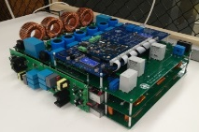
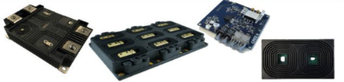
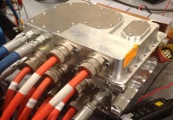
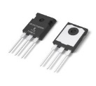

Technical Topic Activities – PowerAmerica
Launched: December 2014
Hub Location: Raleigh, NC North Carolina State University
Federal Funding: $70 Million
Cost share: $70 Million
STRATEGIC GOALS
Provide Energy Savings through higher voltage, speed and temperature capabilities of WBG power semiconductors:
Achieve comparable cost of WBG power devices (SiC and GaN) compared to Silicon within 5 years
Reduce volume and weight by 50% for targeted power electronics systems compared to Silicon equivalents
Enable grid-scale power electronics for resiliency
FOCUS AREAS
Assemblies
Enable Wide-Bandgap (WBG) Power Semiconductor Foundries in the U.S.
Establish supply chain from WBG semiconductor die and package to power electronic assemblies and applications
Enable advanced WBG Power Electronic Applications
Train U.S. workforce to ensure technical leadership and to create manufacturing jobs
Applications
Modules
Power
Devices
Die
Power
Device
WBG Foundry

Slide 8
Accomplishments – PowerAmerica
SiC Power Device Production
Multiple PowerAmerica members now produce SiC power devices from 700 V to 10 kV.
XFAB 6” SiC power device production foundry is used by over 10 SiC device venders and 9 PowerAmerica members have utilized XFAB.
CREE-Wolfspeed transitioned power device production to 6” wafers and announced construction of the worlds largest and most advanced SiC power device fab.
Microchip is also establishing high-volume low-cost SiC device manufacturing in its Silicon Fab5 in Colorado Springs, Co.
Module Package Assembly and Reliability
Wolfspeed and GE Aviation are producing numerous high performance SiC module package types used for converter demonstrations and product development.
Multiiple PowerAmerica member projects are demonstrating module reliability and developing advanced packaging technology.
Application Demonstration and Commercialization
PowerAmerica’s 19 SiC/GaN power electronics projects per year address all major applications including automotive and rail traction, on board chargers, aerospace, photovoltaic, flexible AC transmission systems, high voltage DC systems, microgrids, energy storage, motor drives, and data centers.
PowerAmerica trains over 100 students every year in addition to webinars, short courses, and hundreds of attendees at two annual member meetings.
Transitioning to a sustainable member run organization in November 2020.

Slide 9


Technical Topic Activities – Wide Bandgap Traineeships
$6M federal funds total for 5 Yrs
Purpose
Provide hands-on training of students in WBG power electronic devices and their application.
Benefits
Ensure a pipeline of well-trained professionals entering industry and academia
Enable a ‘chain reaction’ of higher education in WBG technology for decades
University of Tennessee
Knoxville
Virginia Tech.
Program Impact:
> 45 U.S. citizen M.S. and Ph.D. graduates in power engineering over 5 years
7 new graduate courses developed focusing on WBG
Converters, electrical systems packaging, WBG characterization and applications
Students involved with National Laboratory and Industrial Internships
Goal: Train at least 100 Graduate students in 5 years

Slide 10
Technical Topic Activities – Next Generation Electric Machines
Traditional
20-40% energy is wasted with
throttles, and mechanical devices
Big
60 Hz
Transformer
4.16 kV
3 phase
60 Hz
1-50 MW
60 Hz Motor
1800 RPM
Gear
Box
1:G(5-10)
Compressor
Fixed Speed
9 K-18 K RPM
13.8 kV
3 phase
60 Hz
NGEM: 1
Integrated
System
($22M)
New Approach
Delivered as
one box
Variable
Speed Drive
SiC Based
1-50 MW
Gx60 Hz Motor
G x smaller
Volume
13.8 kV
3 phase
60 Hz
Compressor
Variable Speed
9 K-18 K RPM
NGEM 2:
Enabling
Technologies
($25M)
Big 60 Hz Transformer replaced by small high frequency Transformer
Motor size reduced by 5x – cheaper, less magnets
20-40% energy per motor system is saved due to Variable Speed Drive – pay-back < 3 years
Gear Box eliminated
Smaller Foot-print (up to 5x)

Slide 11
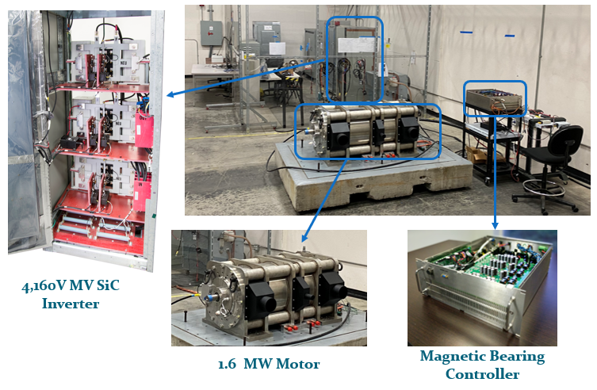
Accomplishments – Calnetix, Next Generation Electric Machine

Slide 12
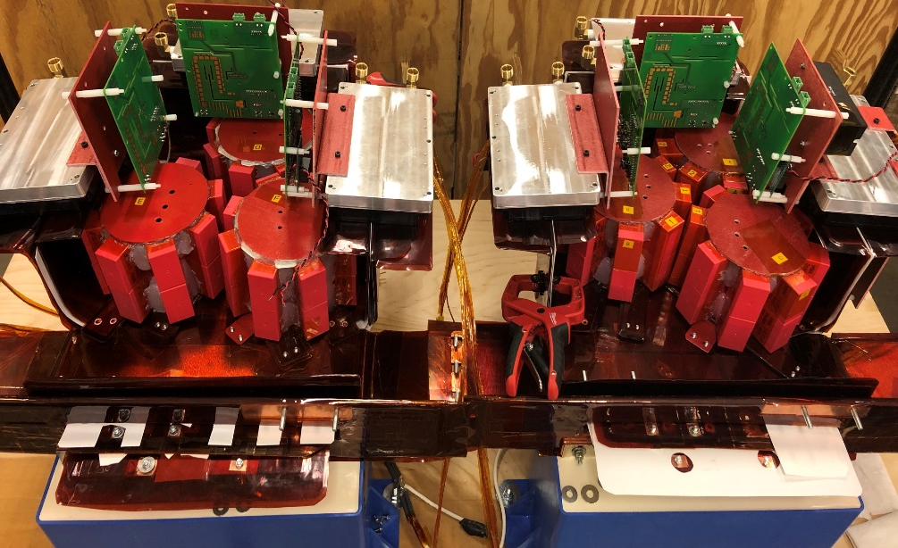
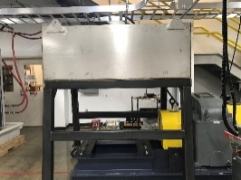
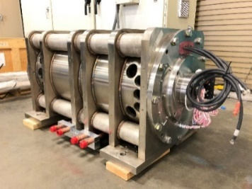
Accomplishments – Eaton, Next Generation Electric Machine
AFE and Inverter set assembled with modules and DC-link Snubbers
15,000rpm 1MW Dynamometer
3MW 5kV SiC VFD Enclosure
integrated with motor
(shared footprint)
(The motor goes here)
Motor Weight = ~4060 lbs. (1842 Kg)
Volume = 17.7 cubic feet (0.5 m³)
1MW 5kV 15,000rpm PMSM w/ Mag Bearings
“Smaller than your desk!!!”

Slide 13
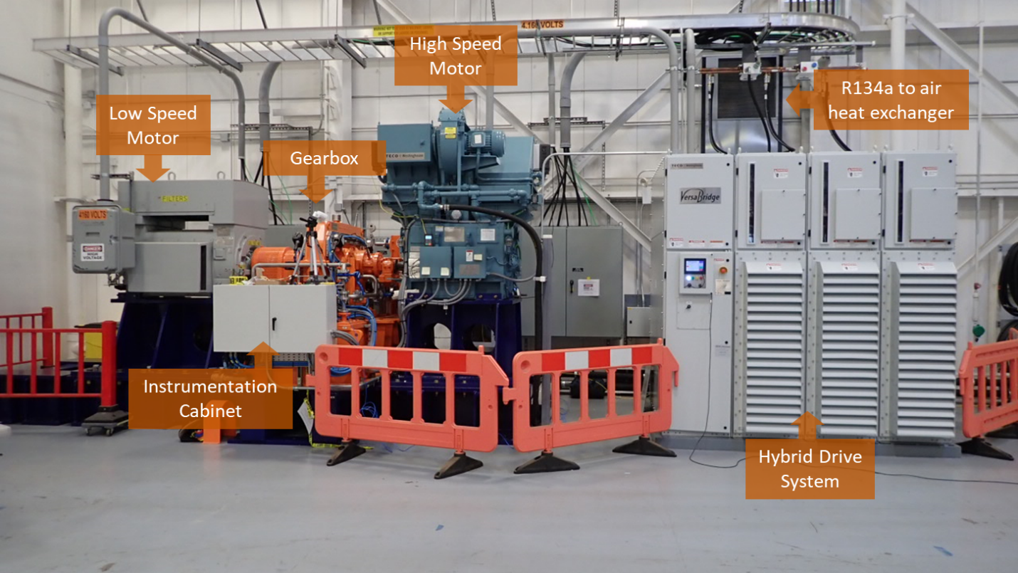
Accomplishments – Clemson, Next Generation Electric Machine

Slide 14
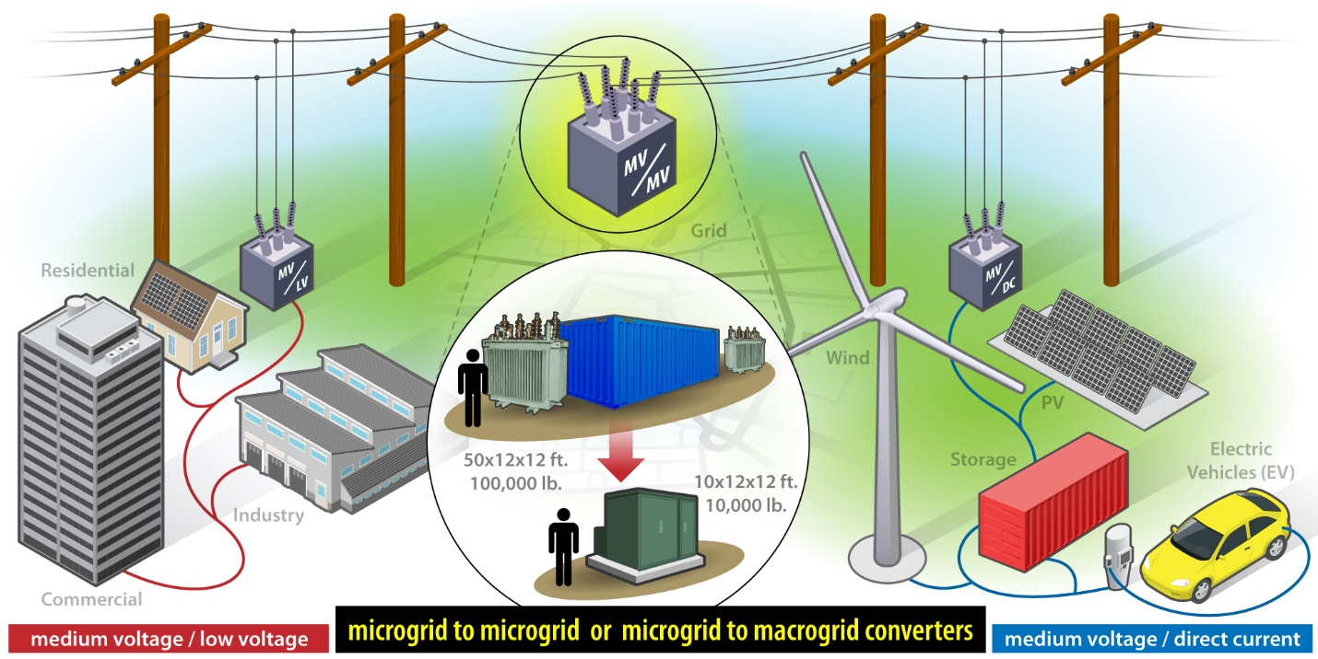
Technical Topic Activities – WBG Power Electronics Lab Call
NREL MV grid-scale power electronics ($7.5M federal funds for 3 Yrs) :
13.8 kV directly-connect grid inverters and AC-AC converters
MV directly-connected inverter testing facilities
application simulation and benefit analysis

Slide 15
WBG Power Electronics - Collaborations
US Navy, Army and Air Force programs on Wide-Bandgap Power Electronics
ARPA-E Power Electronics Programs
DOE EERE Power Electronics Programs:
Electric Vehicle (propulsion, converters, and chargers),
Solar,
Fuel Cell,
Wind and Water Power
AMO Flexible CHP Projects
DOE Energy Storage Grand Challenge
NREL Research for Integrated Energy Systems (ARIES) initiative
DOE Office of Electricity - Grid Modernization

