Slide 1


WEBINAR
CONSENT-BASED SITING
FUNDING OPPORTUNITY ANNOUNCEMENT
WE WILL BEGIN IN A FEW MINUTES
THIS SESSION WILL BE RECORDED
Please submit your questions via the Q&A feature

Slide 2
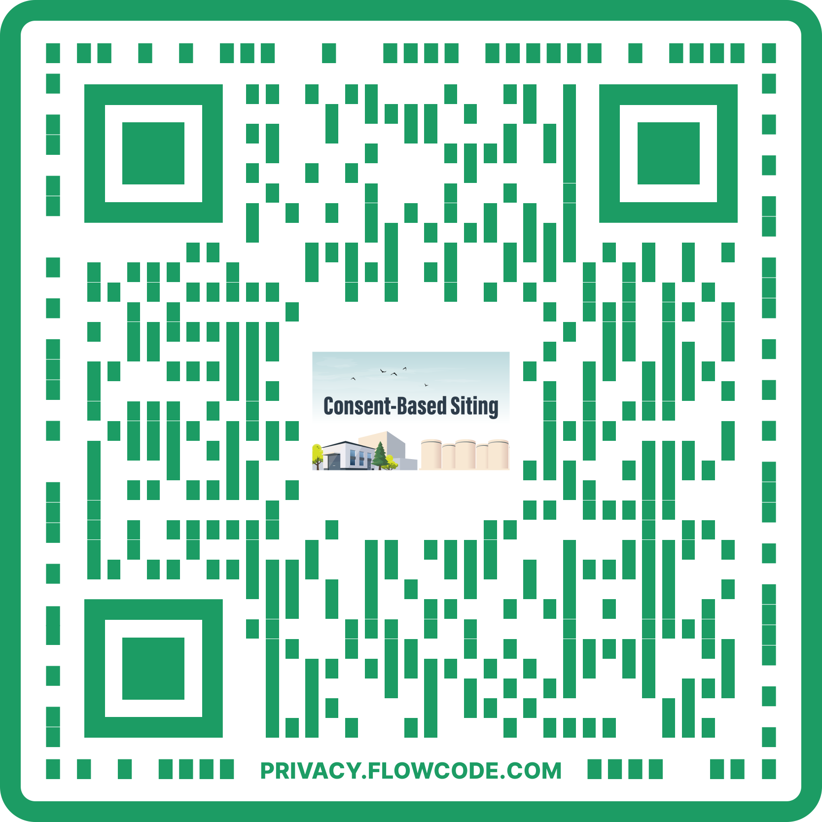
GUIDANCE FOR WEBINAR
This webinar will run for approximately 60 minutes
Attendees can submit their questions via the Q&A box prior to and during the Q&A session
If an attendee has a funding opportunity announcement (FOA)-specific question after the webinar, please submit it in email to
consent-based-siting-project@id.doe.gov
Please note that in fairness and respect to attendees, the U.S. Department of Energy (DOE) reserves the right to remove anyone who shows behavior that is unprofessional and/or disruptive during the webinar
This webinar is being recorded and will be made available at energy.gov/consentbasedsiting

Slide 3
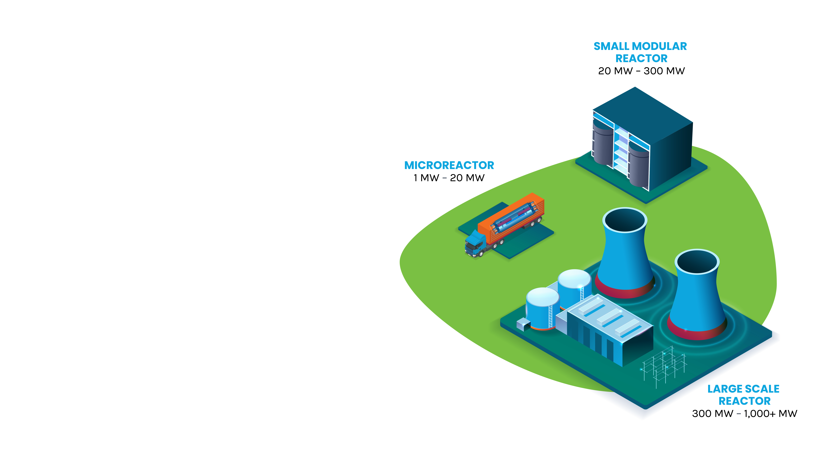
NUCLEAR ENERGY…
Is essential to tackling climate change
Currently makes up 19% of our nation's electricity
Provides half of our nation’s clean, emissions-free energy
We need nuclear to reach our ambitious goals of:
  50% reduction of carbon emission by the end of the decade
  100% clean electricity by 2035, and
  A net-zero economy by 2050

Slide 4

INTEGRATED WASTE MANAGMENT
The continued deployment of nuclear energy — as a solution for tackling climate change and meeting increasing energy demand — requires progress on the back-end of the fuel cycle
DOE is responsible for managing the nation’s spent nuclear fuel and high-level radioactive waste. This includes finding sites to store and dispose of the spent nuclear fuel
While spent nuclear fuel is safely stored across the country, the communities hosting this material never agreed to do so long term

Slide 5

INTERIM STORAGE
Is an important component of a waste management system
Allows for the removal of spent nuclear fuel from existing reactor sites
Provides useful research opportunities
Builds trust and confidence with stakeholders
Begins to address taxpayers' liability

Slide 6

CONSENT-BASED SITING
Consent-based siting is an approach to siting facilities that focuses on the needs and concerns of people and communities
    Special focus on ensuring issues of equity and environmental justice are built into the consent-based siting process
  By prioritizing communities and people, DOE believe it can find a solution to the decades-long stalemate on managing the nation’s spent nuclear fuel
A consent-based approach to siting, driven by each community’s well-being and needs, is both the right thing to do and our best chance for success

Slide 7

PUBLIC FEEDBACK
On December 1, 2021, DOE issued a request for information on using consent-based siting to identify sites for interim storage of spent nuclear fuel
DOE received 225 submissions from a wide variety of commenters
The Comment Summary and Analysis Report is available at energy.gov/consentbasedsiting
  Also includes comments received on the 2017 Draft Consent-Based Siting Process

Slide 8
PUBLIC FEEDBACK INFORMING NEXT STEPS IN
CONSENT-BASED SITING
1
2
3
Further developing
consent-based
siting process
Awarding cooperative agreements for interested groups and communities to learn more
Clarifying DOE’s broader strategy for an integrated waste management system

Slide 9
FUNDING OPPORTUNITY INFORMED BY PUBLIC FEEDBACK
“Funding to Participate: Funding and technical assistance should be provided to Tribes to participate in all stages of the CBS process. Tribes often do not have the same resources, staff capacity, or time as states, so DOE must take proactive steps to ensure that Tribes can participate in the process.”
– Tribal Representatives
“Extensive outreach activities and financial support for interested communities to learn for themselves. Funding should be provided as soon as possible.”
– Private Citizen
Quoted text from Responses to the Request for Information (86 FR 68244)
Available at energy.gov/consentbasedsiting

Slide 10

FUNDING OPPORTUNITY ANNOUNCEMENT
KEY FACTS
$16 million in funds to be awarded; 6-8 awards; period of performance is 18-24 months
Eligible awardees include:
  Higher-education institutions (colleges, universities, and other institutions of higher learning)
  Tribal, State, and local governments (municipalities, towns, cities, and counties)
  Community foundations
  Non-governmental organizations (trade associations, 501(c)(3) organizations, and other public groups)
Geographically and institutionally diverse awardees
  Across the continental United States
BUILDS CAPACITY FOR FUTURE ENGAGEMENT
Establishes a community of practice
Strengthens involvement and mutual learning aimed at building trust
Special focus on environmental justice

Slide 11
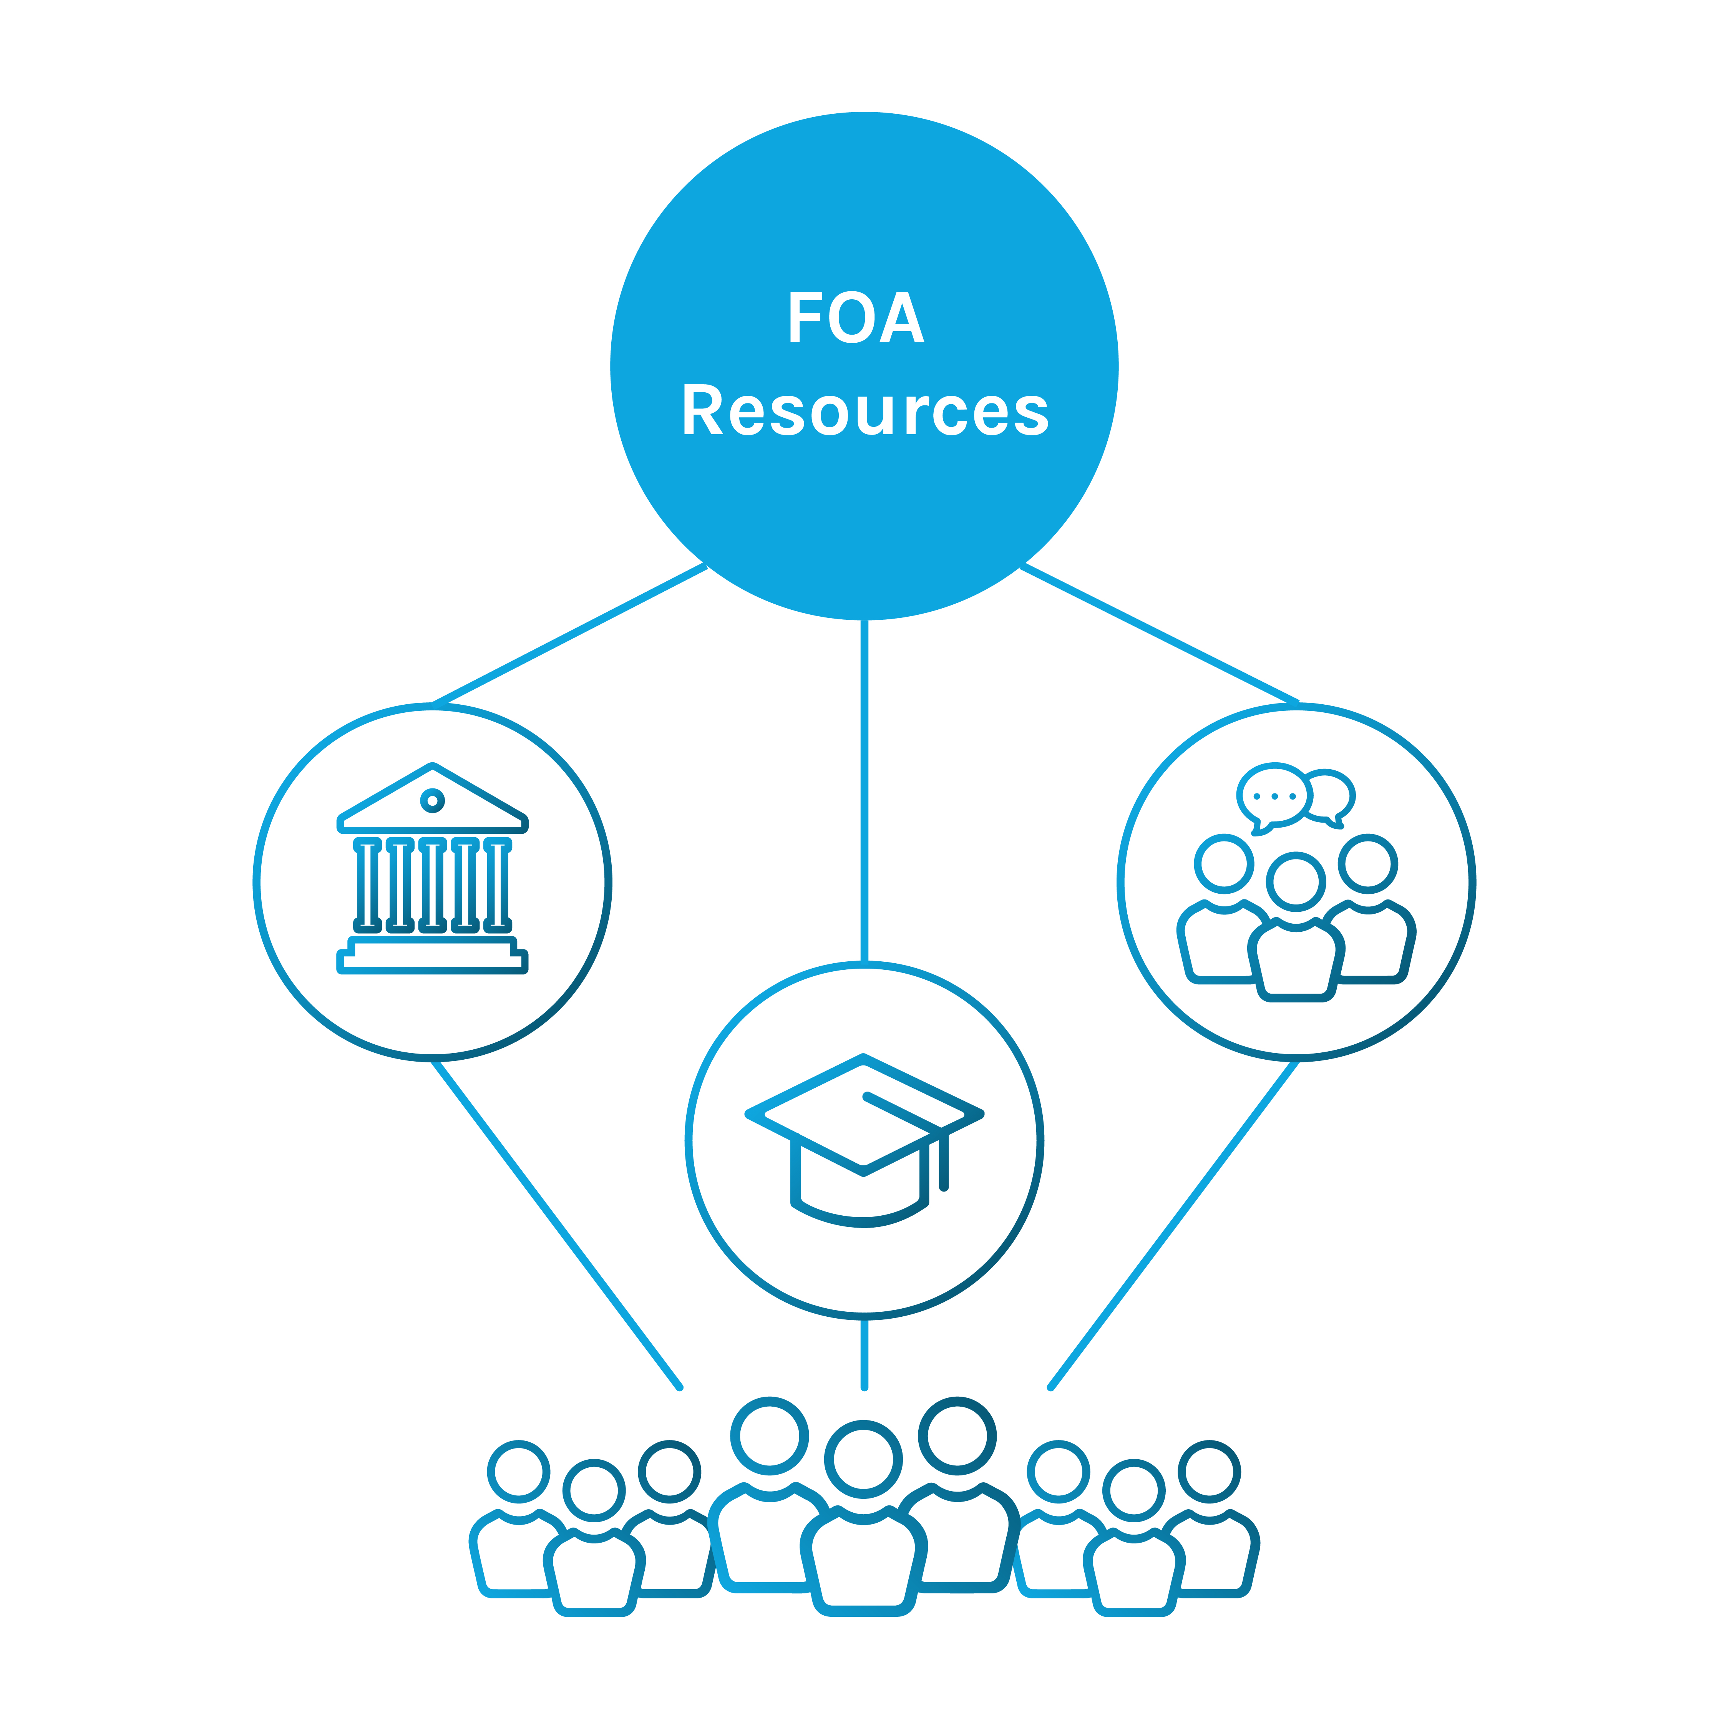
AWARD RECIPIENTS
WILL REPRESENT CONSENT-BASED SITING CONSORTIA
Award recipient is a hub for community engagement and resources
Reduce barriers for participation
Increase outreach (multiplication factor)
Allow for greater community engagement
Allow for cohort development/capacity

Slide 12
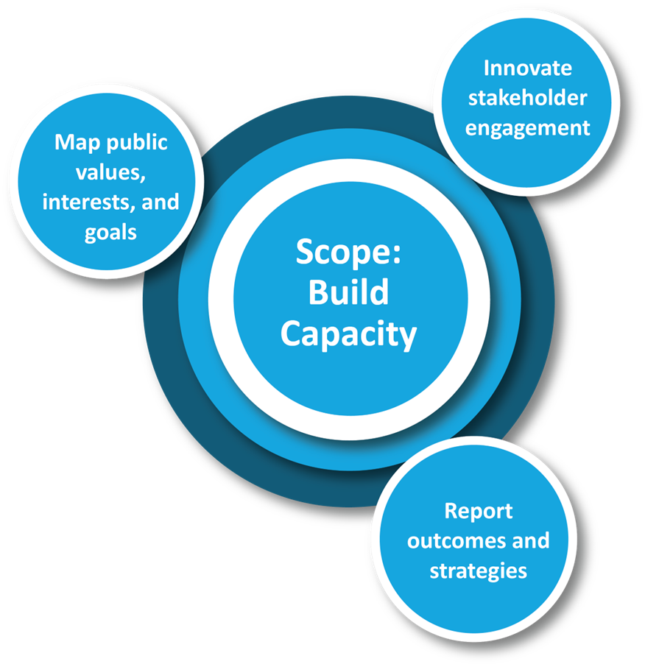
FUNDING OPPORTUNITY TASKS
Three main tasks are centered around consent-based siting and the role a federal consolidated interim storage facility may have in a community

Slide 13
APPLYING TO THE FUNDING OPPORTUNITY ANNOUNCEMENT
To access the FOA, visit energy.gov/consentbasedsiting
All interested applicants are encouraged, but not required, to submit a letter of intent
Submit applications and questions to
consent-based-siting-project@id.doe.gov
  This webinar summarizes key aspects of the FOA. Applicants must refer to, and comply with, all application requirements found in the complete FOA
  In the event that there is a discrepancy between this webinar and the FOA, the FOA shall take precedence
WHEN SHOULD YOU SUBMIT?
October 20, 2022
Optional letter of intent due
December 4, 2022
Optional FOA-specific questions due
December 19, 2022
Application due

Slide 14
GUIDANCE FOR WEBINAR Q&A
Attendees can type their questions via the Q&A box
DOE officials will try to answer as many questions as possible
After the webinar, remaining questions regarding the content of this FOA must be submitted in email to consent-based-siting-project@id.doe.gov
DOE will try to respond to emailed questions within five business days. If a similar question has already been asked and answered, it will appear in the amended portion of the online FOA
Please note that in fairness and respect to attendees, the DOE reserves the right to remove anyone who shows behavior that is unprofessional and/or disruptive during the webinar

Slide 15
THANK YOU
energy.gov/consentbasedsiting

