Slide 1

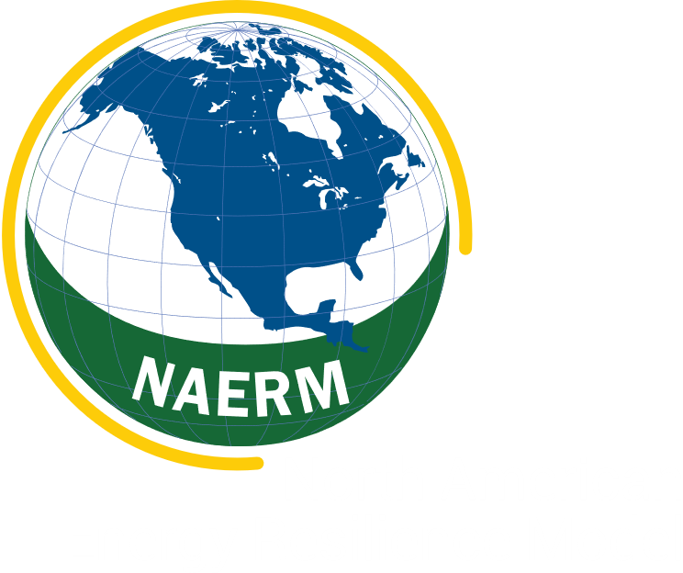
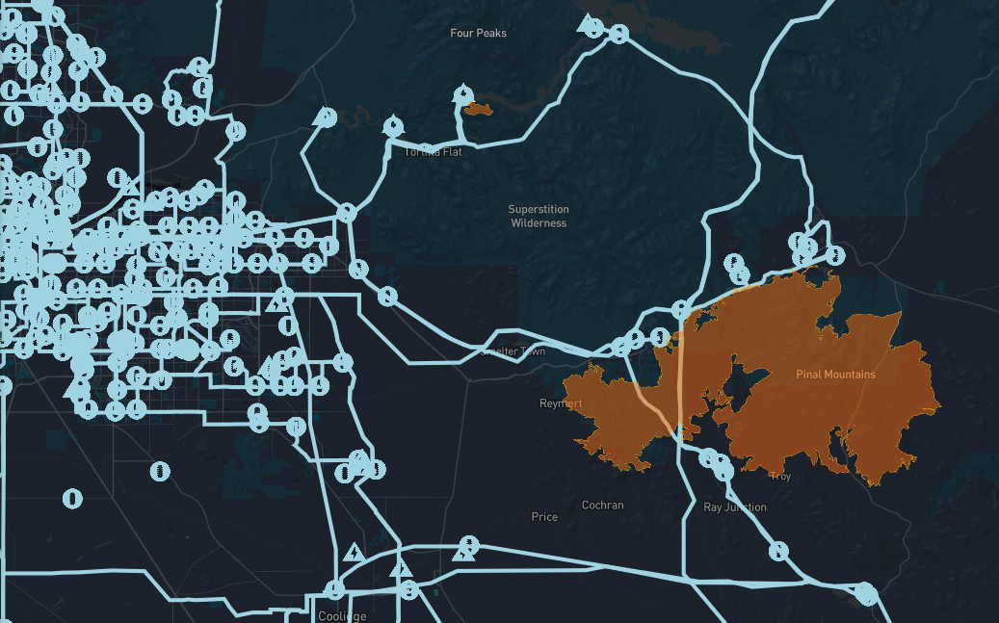
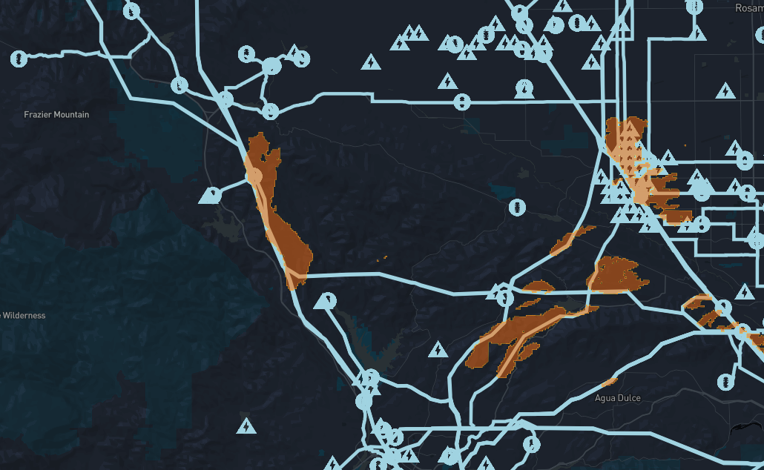
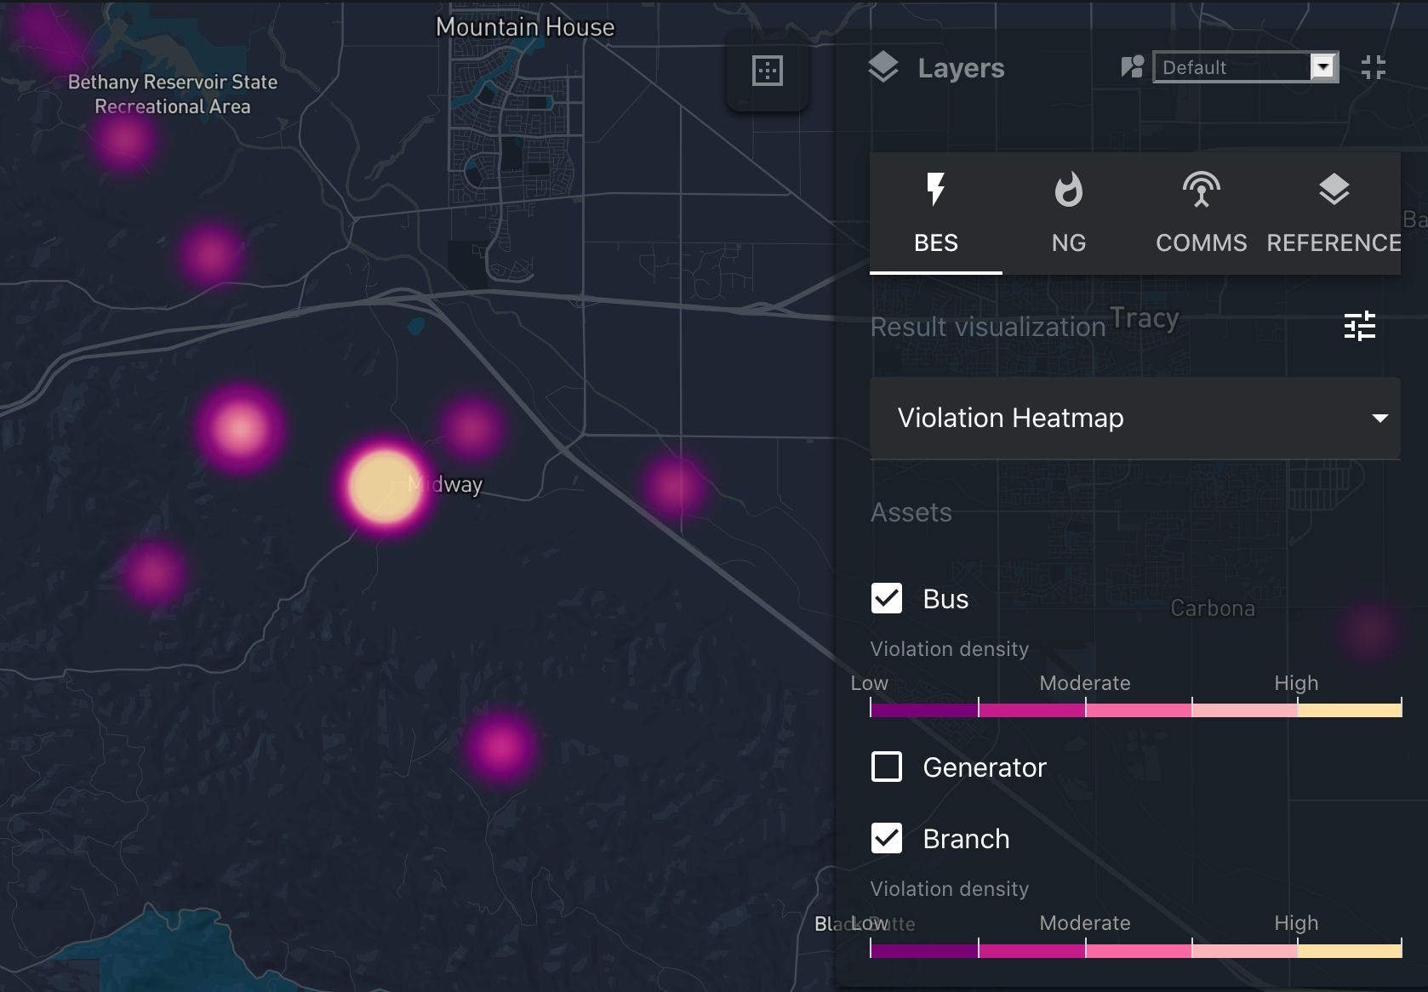
Version: July 27 2021
NAERM Wildfire
Analytic Capabilities
Modeling wildfire-induced disruptions to bulk electric, natural gas, communications, and transportation assets to provide situational awareness and support risk-informed planning
NAERM wildfire analytics seek to provide short-term planning awareness of what infrastructure components are at risk.
NAERM wildfire analytics allow users to determine the impacts of both active and forecasted wildfires on various critical infrastructures, including the bulk electric power system (BES), natural gas (NG), communication system (Comms), and transportation system (TR). We use computational models to translate wildfire activity into physical component outages, e.g., transmission lines, power plants, fiber cables, and railways. Such outages, referred to as contingencies, provide situational awareness concerning potential critical infrastructure impacted by wildfire. NAERM’s infrastructure co-simulation capabilities, can also be leveraged to provide higher-fidelity impact assessments, e.g., quantifying the loss of load associated with a joint loss of a natural gas pipeline and transmission infrastructure.
NAERM visualization capabilities allow users to interactively explore how both active and forecasted wildfires may directly impact BES, NG, Comms, and TR infrastructure. Figure 1 shows a region east of the Phoenix metro area in conjunction with a large, active wildfire as of July 6 2021. NAERM data layers indicate little critical infrastructure is at risk, isolated to two transmission lines crossing the fire perimeter. Co-simulations confirm no cross-infrastructure impacts associated with these line outages. Figure 2 shows an area with high forecasted wildfire ignition risk due to transmission component outage north of Los Angeles, CA on July 7 2021. NAERM data layers indicate the potential for wildfires to impact two large 230kV transmission lines. Subsequent co-simulation given the outage of these two lines yields minor system disturbances, which can be rapidly corrected. These two scenarios highlight the ability of NAERM to provide advanced situational awareness regarding wildfire risk to critical infrastructure, and to support risk-informed planning surrounding analysis of “what-if” situations.
NAERM can also be used to identify potential significant impacts to critical energy infrastructure. Figure 3 illustrates the results of a co-simulation following outages associated with a forecasted wildfire on transmission infrastructure for a region east of the California Bay Area. The forecasted wildfire impacts significant BES, NG, Comms, and TR infrastructure in the depicted region. Co-simulation results indicate the presence of significant voltage issues at transmission buses following the outages, which is suggestive of energy system risk in the form of potentially widespread loss of power.
The NAERM wildfire analytics capability is presently focused on providing insight into those infrastructure components are at risk given both active and forecasted wildfires, and rigorously quantifying potential impacts in terms of loss-of-load and related metrics.
Figure 1: Active wildfire perimeter (in orange) near Phoenix, AZ on July 6, 2021. Electric transmission network is overlayed in blue. The current wildfire perimeter intersects a low-voltage transmission corridor.
Figure 2: Areas with high wildfire risk due to transmission system failures (orange) north of Los Angeles, CA on July 7, 2021. Electric transmission network is overlayed in blue. Projections indicate two large 230kV lines leading into Los Angles are at potential risk from wildfire.
Figure 3: Transmission bus voltage violations following contingencies induced by a forecasted wildfire, east of the California Bay Area. White and bright violet indicate buses with significant voltage issues.

Slide 2

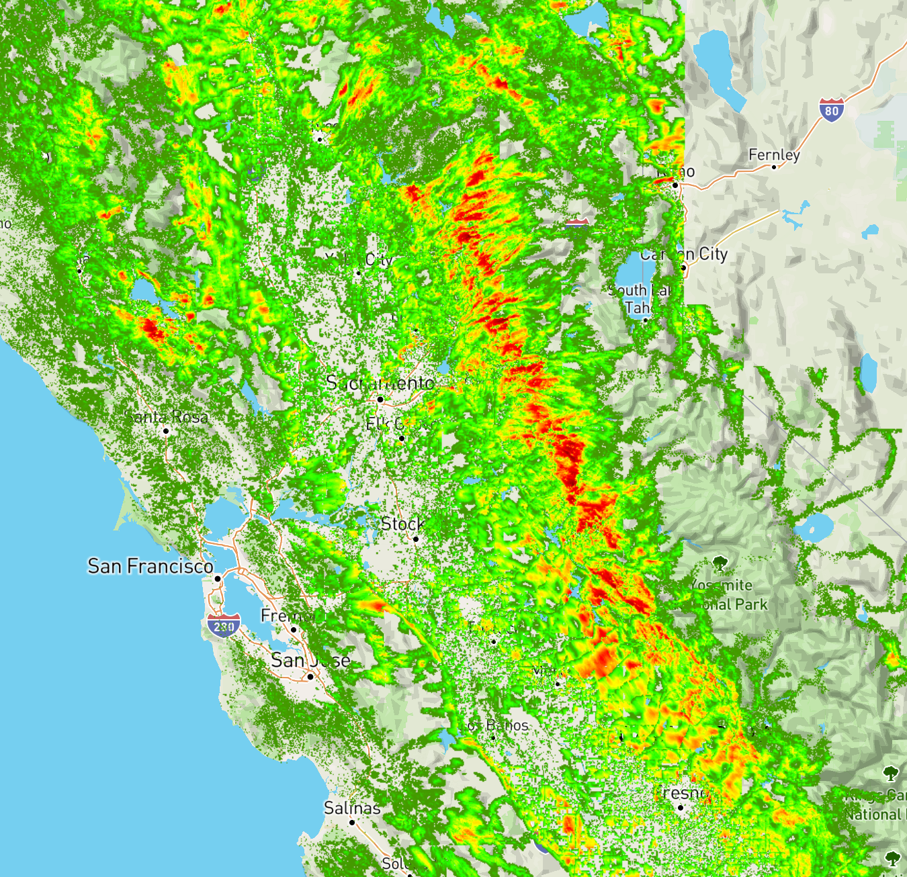
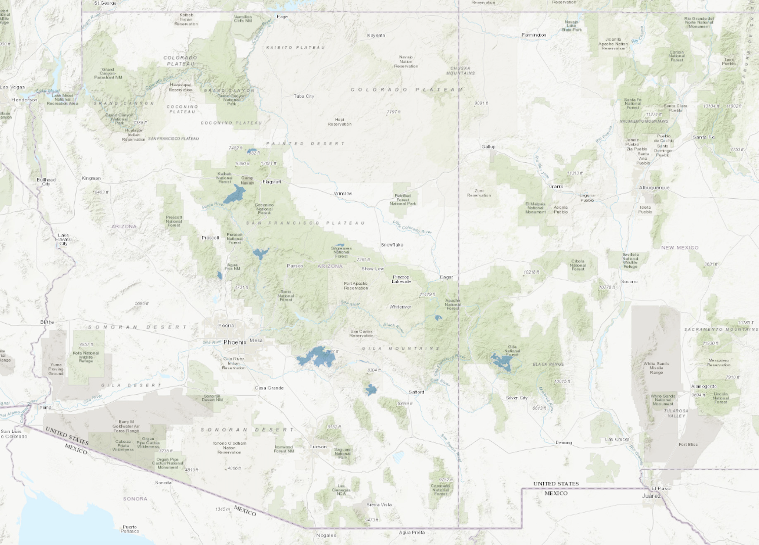
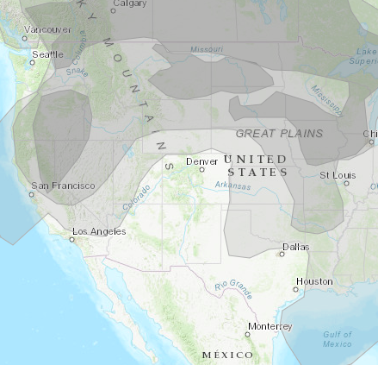

NAERM Analytic Methodology
We are currently pulling wildfire forecast data from wildfire risk forecasts generated daily by the Pyregence Consortium [1], a group of institutions collaborating to develop open-source wildfire models. Figure 4 shows an example of Pyregence wildfire risk data associated with anthropogenic causes. Pyregence data is currently limited to the state of California, but Pyregence is looking into expanding the range of their simulations, and we are separately looking into other data sources that span North America. We currently source our active wildfire data from the National Interagency Fire Center (NIFC) [2], a group representing several agencies providing support to wildland firefighting. Figure 2 shows a snapshot of active wildfires in the Southwestern US.
For the forecasted spread of active wildfires, we use two data sources. Pyregence releases active wildfire spread forecasts that give hourly forecasts for the projected expansions of active wildfire perimeters. We are also looking into a simpler method of predicting active wildfire spread based on wildfire hot spots and local wind direction.
We use smoke plume extent data from AirNow [4] to refine forecasts for renewable energy production.
Limitations and Extensions
Efforts are under way by the Pyregence Consortium to expand the geographic extent of the wildfire risk forecasts beyond California.
The NIFC active wildfire perimeter dataset does not provide forecasted change in active wildfire perimeters over time. Pyregence does separately provide forecasts for the spread of active wildfires, so we may leverage this data in the near future.
Add point on future renewable build out
Modeling ground-motion-induced failures in BES and NG assets
Figure 4: Pyregence risk forecast on July 10 2021 for wildfires due to anthropogenic causes (Northern California). Red indicates higher risk of ignition and burn.
Figure 5: NIFC active wildfire perimeters in the southwestern US, on July 7 2021. Burned regions are indicated in blue.
Figure 6: AirNow smoke plume extents, on July 27 2021.
References
Pyregence. “Near-term Wildfire Forecast.” https://pyregence.org/data
National Interagency Fire Center (NIFC). “Current Wildland Fire Perimeters.” https://data-nifc.opendata.arcgis.com/datasets/nifc::wfigs-current-wildland-fire-perimeters/about
Energy Visuals. “Transmission Atlas.” https://www.energyvisuals.com/products/ta.html
AirNow. “Fire and Smoke Map.” https://fire.airnow.gov/#

Slide 3
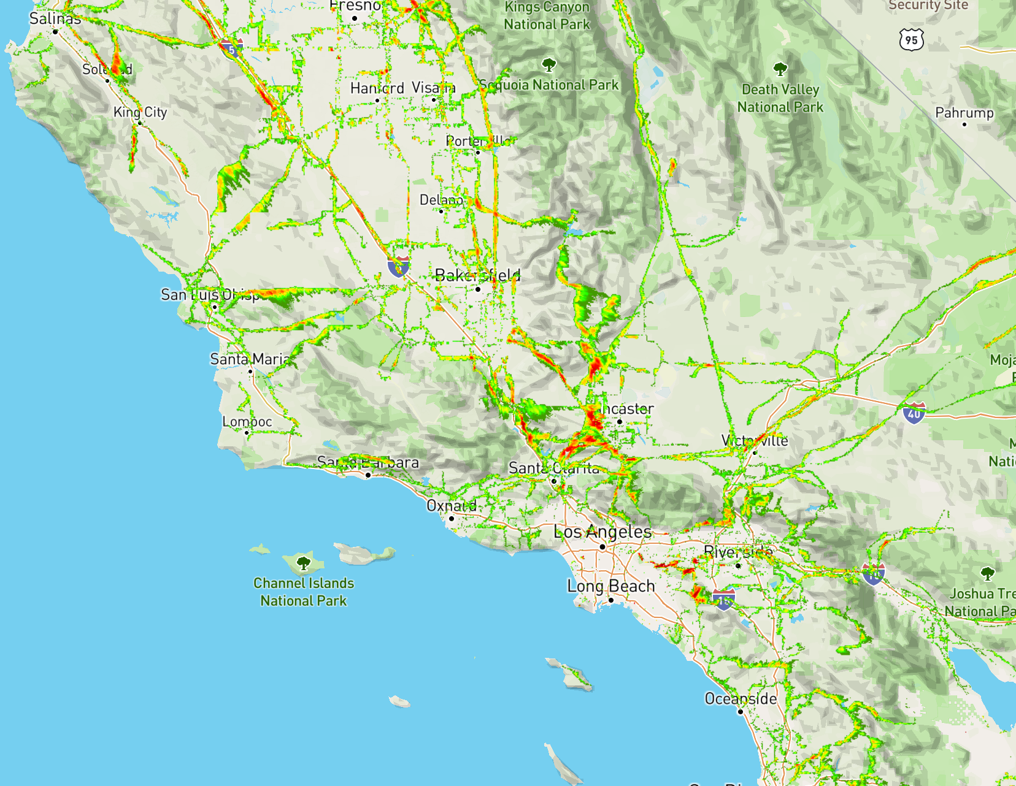
Version: July 27 2021
NAERM Wildfire
Analytic Capabilities
Modeling wildfire-induced failures in bulk electric, natural gas and communications assets to inform risk quantification and planning
NAERM wildfire analytic capabilities allow users to determine the impacts of both active and forecasted wildfires on various infrastructures, including bulk electric power, natural gas, and communication systems. We use computational models to translate wildfire activity into physical component outages, e.g., transmission lines, power plants, and fiber cables. A set of such outages is referred to as a contingency. The impacts of contingencies is then analyzed using NAERM’s infrastructure co-simulation capabilities.
We pull data for forecasted and active wildfires from distinct sources. We derive contingencies consistent with forecasted wildfires using data generated by the Pyregence Consortium [1], a group of institutions collaborating to develop open-source wildfire models. Pyregence releases wildfire risk forecasts twice a day for a five-day horizon, covering the state of California. Pyregence risk forecast data is computed by simulating hundreds of thousands of simulated wildfire ignitions, using a wide range of inputs including soil moisture and forecasted weather. Figure 1a shows an example of Pyregence wildfire risk data associated with anthropogenic causes; Figure 1b shows an analogous example for wildfire risk due to bulk transmission equipment failure. We derive contingencies consistent with active wildfires across the US using perimeters obtained daily from the National Interagency Fire Center (NIFC) [2], a group representing several agencies providing support to wildland firefighting. NIFC updates the active wildfire perimeters daily along with metadata such as size in acres and percent containment. Figure 2 shows a snapshot of active wildfires in the Southwestern US.
Risk quantification across BES, NG, and Comms assets
Wildfire Analytics using the North American Energy Resilience Model
Figure 1a: Pyregence risk forecast on July 10 2021 for wildfires due to anthropogenic causes (Northern California). Red indicates higher risk of ignition and burn.
Figure 1b: Pyregence risk forecast on July 10 2021 for wildfires due to transmission equipment failure (Southern California). Red indicates higher risk of ignition and burn.
Figure 2: NIFC active wildfire perimeters in the southwestern US, on July 7 2021. Burned regions are indicated in blue.

Slide 4
NAERM visualization capabilities allow users to interactively explore how both current and forecasted wildfires may impact bulk electric, natural gas, and communications infrastructure. Figure 3 shows an example of electric power infrastructure east of the Phoenix metro area in conjunction with a large, active wildfire as of July 6 2021. NAERM wildfire analytics can be leveraged to compute and outage the set of infrastructure components that are within a user-specified distance of the active wildfire perimeter. Co-simulation of the resulting contingency could then assess potential impacts of wildfire perimeter growth.
NAERM wildfire analytics additionally allows users to explore the impacts of forecasted wildfires – areas with high ignition risk – on bulk electric, natural gas, and communications infrastructure. Figure 4 shows an area with high wildfire ignition risk due to transmission component failure north of Los Angeles, CA on July 7 2021. The visualization indicates the potential for wildfires to impact two large 230kV lines. NAERM wildfire analytics can automatically compute impacted components, taking user-specified risk levels as input. As with active wildfires, we can co-simulate such contingencies using NAERM to determine potential impacts.
Infrastructure mapping shown in Figures 3 and 4 is derived from both Energy Visuals Inc. Transmission Atlas® product [3] and HIFLD data.
Figure 5 illustrates the results of a co-simulation following outages associated with a forecasted wildfire on transmission infrastructure for a region east of the California Bay Area. The forecasted wildfire impacts significant bulk electric, natural gas, and communications infrastructure in the depicted geographic region. Co-simulation results indicate the presence of significant voltage issues at transmission buses following the outages, which is suggestive of energy system risk or delivery failures.
Limitations and Extensions
Efforts are under way by the Pyregence Consortium to expand the geographic extent of the wildfire risk forecasts beyond California.
The Pyregence wildfire risk forecasts do not provide information on the specific dynamics of hypothetical wildfire spread over time. Wildfire risk projections should be viewed simply as regions that are most likely to be impacted by wildfires in the short term (days ahead).
The NIFC active wildfire perimeter dataset does not provide forecasted change in active wildfire perimeters over time. Pyregence does separately provide forecasts for the spread of active wildfires, so we may leverage this data in the near future.
Due to the nature of the Pyregence and NIFC data currently utilized, the NAERM wildfire analytics capability is presently focused on the ability to provide short-term planning awareness of what infrastructure components are at risk given wildfire impacts – as opposed to providing hours-ahead situational awareness associated with progression of a specific fire.
We are looking into improving the geolocations of infrastructure systems, e.g., more detailed routing paths for BES transmission lines.
Modeling ground-motion-induced failures in BES and NG assets
Figure 3: Active wildfire perimeter (in orange) near Phoenix, AZ on July 6, 2021. Electric transmission network is overlayed in blue. Fire is very near significant infrastructure to the north, and the current perimeter intersects a transmission corridor.
Figure 4: Areas with high wildfire risk due to transmission system failures (orange) north of Los Angeles, CA on July 7, 2021. Electric transmission network is overlayed in blue. Projections indicate two large 230kV lines leading into Los Angles are at potential risk from wildfire.
Figure 5: Transmission bus voltage violations following contingencies induced by a forecasted wildfire, east of the California Bay Area. White and bright violet indicate buses with significant voltage issues.
References
Pyregence. “Near-term Wildfire Forecast.” https://pyregence.org/data
National Interagency Fire Center (NIFC). “Current Wildland Fire Perimeters.” https://data-nifc.opendata.arcgis.com/datasets/nifc::wfigs-current-wildland-fire-perimeters/about
Energy Visuals. “Transmission Atlas.” https://www.energyvisuals.com/products/ta.html

