Slide 1
Machine Learning for Science
Prabhat
5/17/2018

Slide 2
Outline
Motivation
  Commercial Applications
What is ML?
  Problems / Tasks
  Solutions / Approaches
Machine Learning in Office of Science
Machine Learning in Office of Fossil Energy

Slide 3
Outline
Motivation
  Commercial Applications
What is ML?
  Problems / Tasks
  Solutions / Approaches
Machine Learning in Office of Science
Machine Learning in Office of Fossil Energy

Slide 4
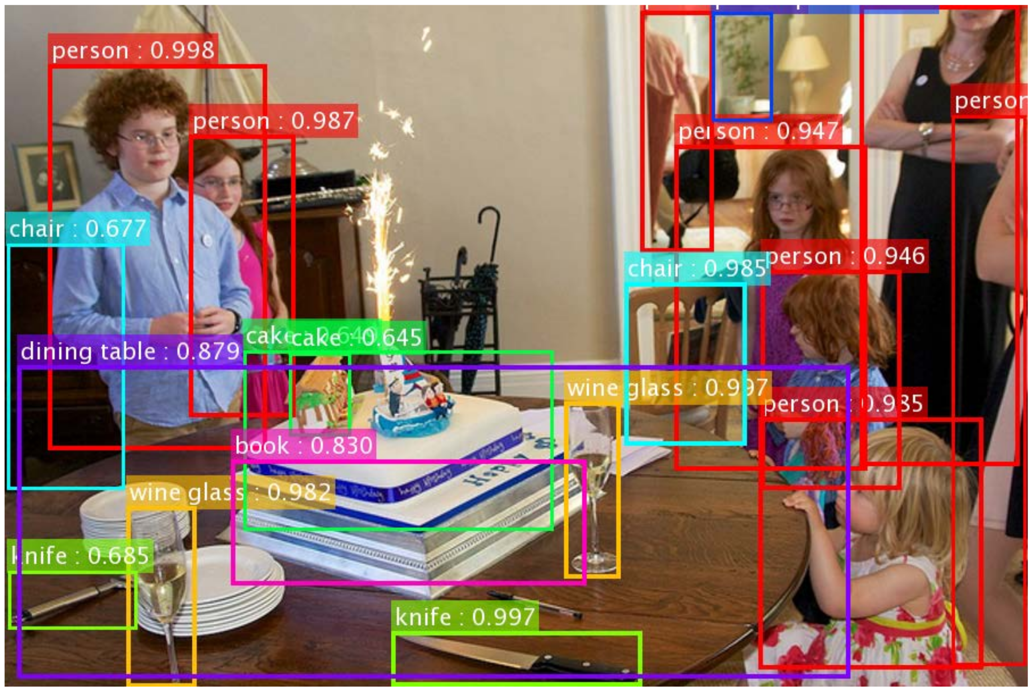

Slide 5
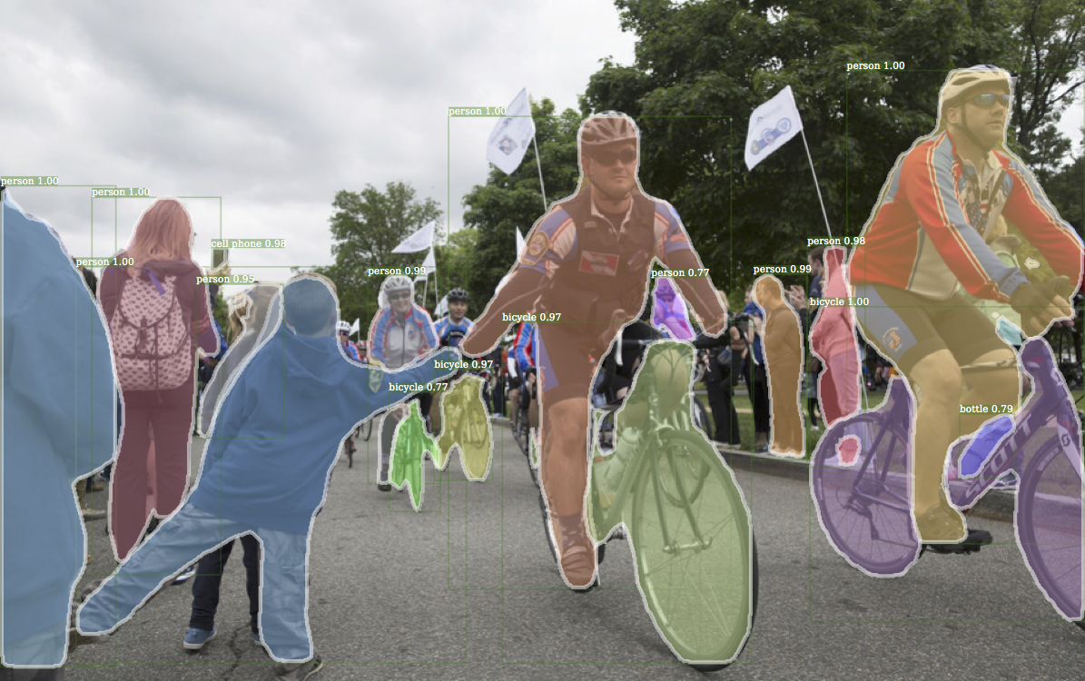

Slide 6
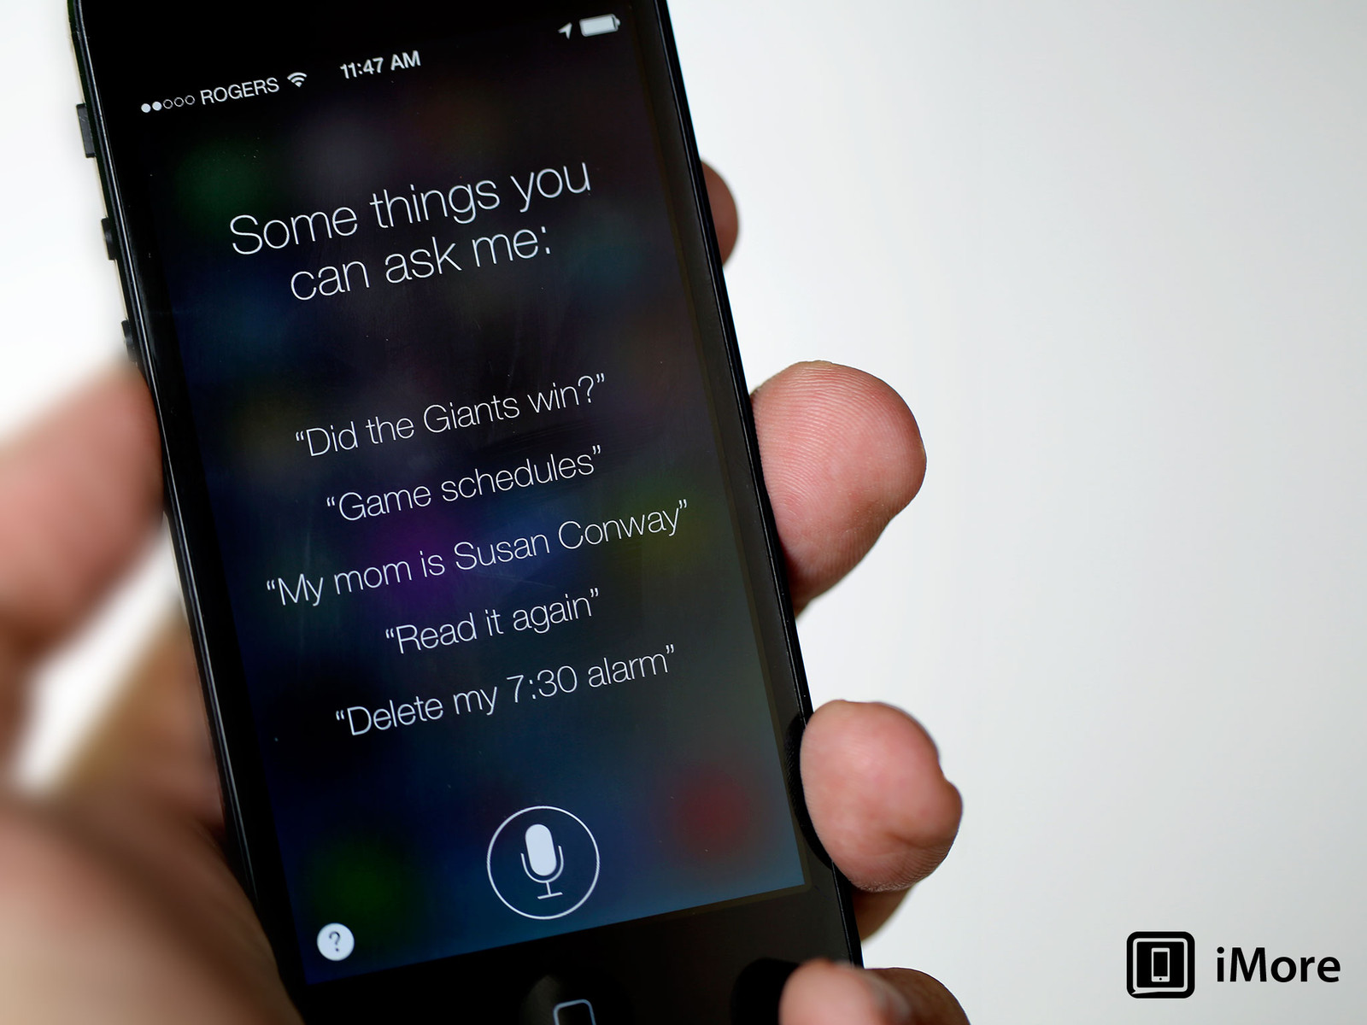

Slide 7
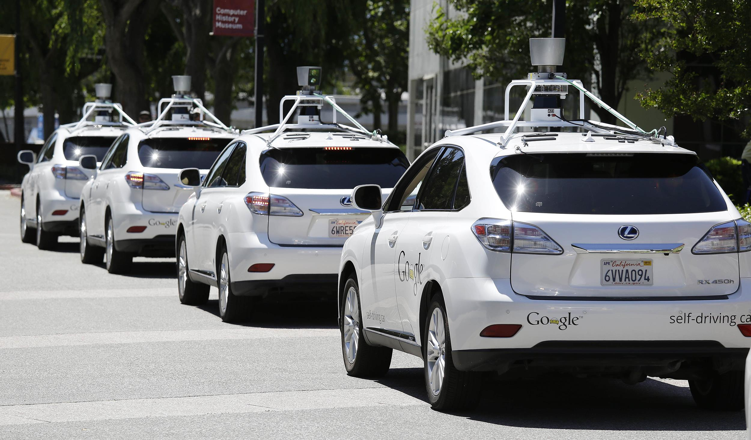

Slide 8
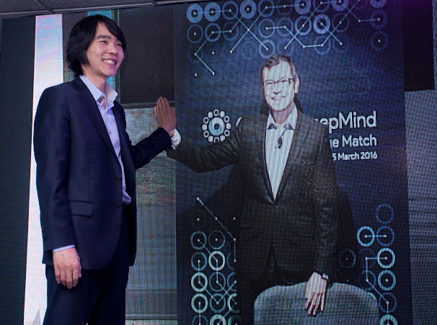

Slide 9
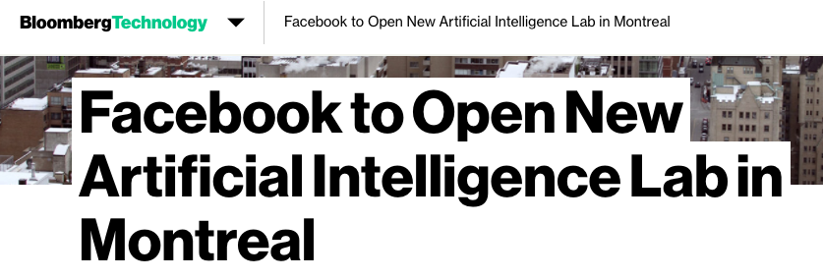

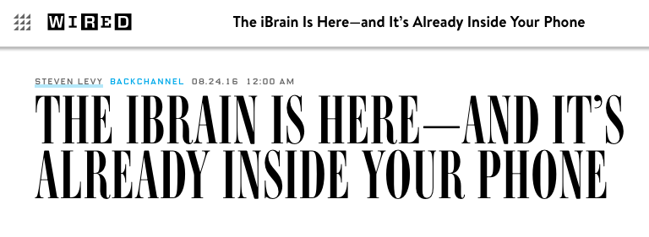

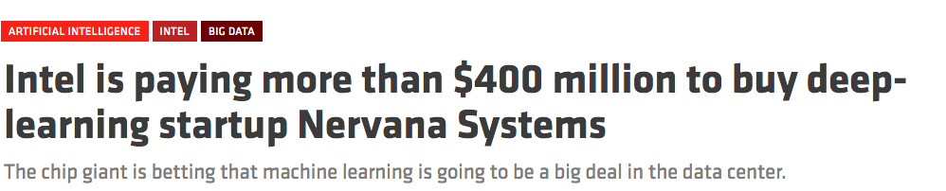
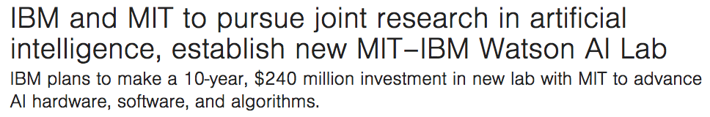

Slide 10
Outline
Motivation
  Commercial Applications
What is ML?
  Problems / Tasks
  Solutions / Approaches
Machine Learning in Office of Science
Machine Learning in Office of Fossil Energy

Slide 11
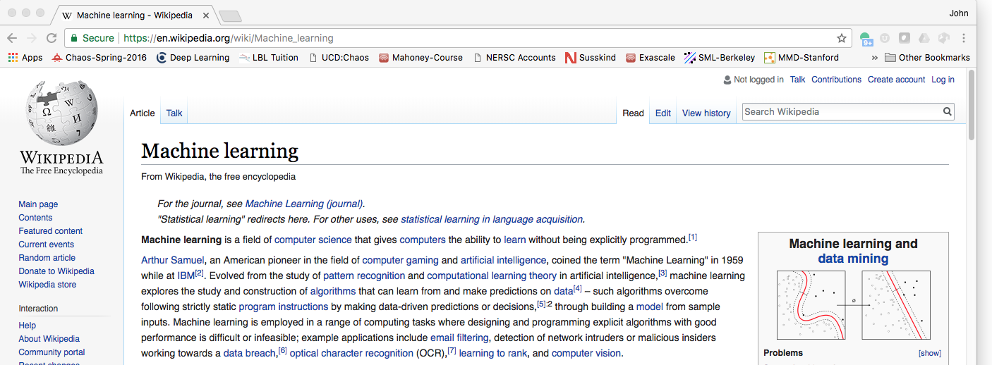

Slide 12
Classification Examples
Input | Output
Image (Cell phone) | Cat / Dog / Person
Check (ATM) | Characters / Digits
Video (Self-driving Car) | Road / Vehicle / Pedestrian Sun/Rain/Snow
E-mail | Spam/Ham

Slide 13
Regression Examples
Input | Output
User Profile (Google/NetFlix) | Likelihood of clicking on Ad Likelihood of watching Movie
Video (Drone) Image (Cell Phone) | Bounding Box of object Distance
Video + Radar (Self-driving Car) | Steering Wheel control Accelerate/Brake
Customer Profile (Bank) | Mortgage Rate Risk

Slide 14
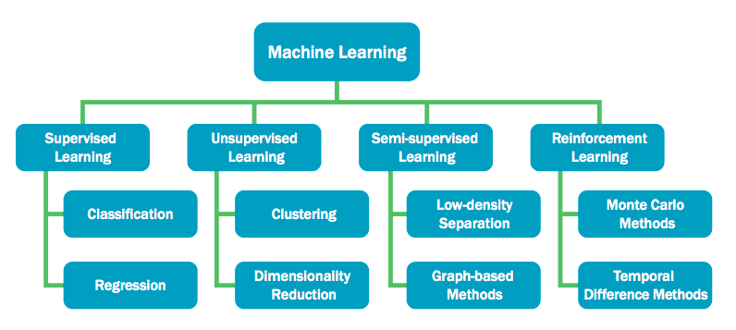
Flavors of Machine Learning
Image from http://web.eecs.utk.edu/~mberry/ascr/ML_DOE_Report_5.pdf

Slide 15
Buzzwords…
AI
Machine Learning
Deep Learning
Statistics

Slide 16
Algorithms
AI
Expert Systems
Knowledge Base
Machine Learning
Support Vector Machines
Kernel SVM
Convolutional Networks
Auto-encoders
Recurrent Neural Networks
Generative Adversarial Networks
Graph Convolutional Networks
Deep Learning
Logistic Regression
Decision Tree
Graphical Models
Random Forests
Nearest-Neighbor
Boosting
Statistics
Linear Regression
Principal Component Analysis

Slide 17

























Big Data Stack
Capabilities | Technologies
Data Transfer + Access
Workflows
Data Management
Data Analytics
Data Visualization
taskfarmer

Slide 18
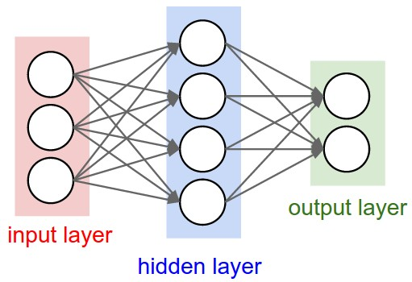
Neural Nets in 1960’s (1st Wave)
Single Layer networks

Slide 19
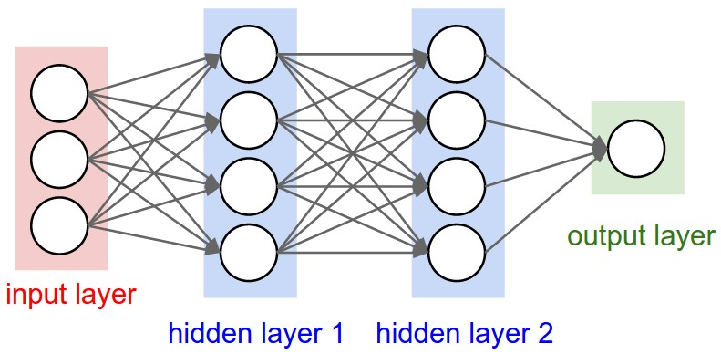
Neural Nets in Mid-1980s (2nd Wave)
Multi-layer networks
Backpropagation algorithm

Slide 20
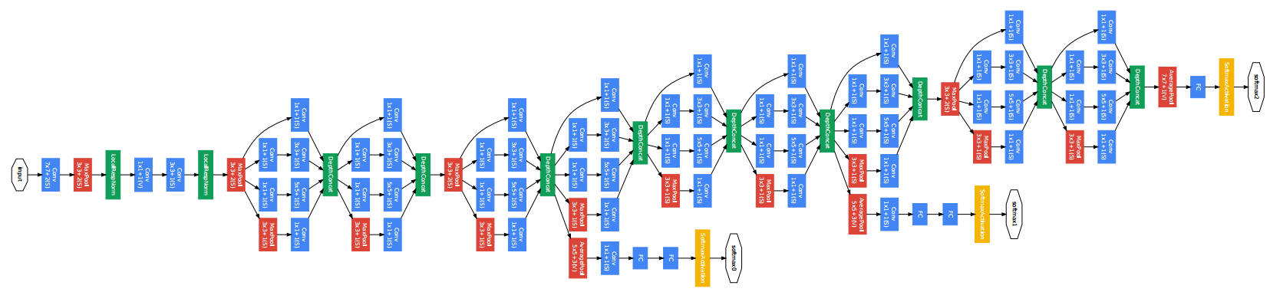
Neural Nets in 2010s (3rd Wave)

Slide 21
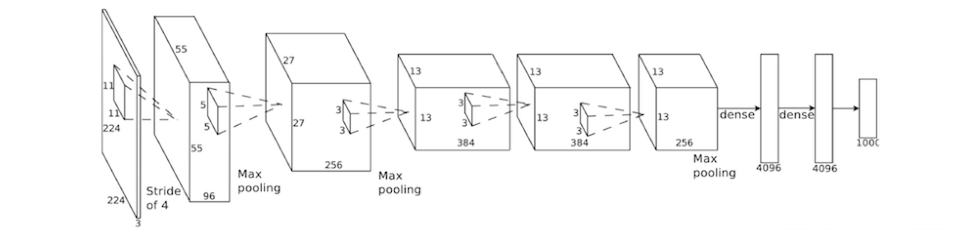
Training Convolutional Networks
Workflow:
  Identify training data (images + labels)
  Converge on hyper-parameters (architecture,…)
  Random parameter initialization
  Forward pass (filter images, make label prediction)
  Compute Error
  Backward pass (compute gradients, update parameters)

Slide 22
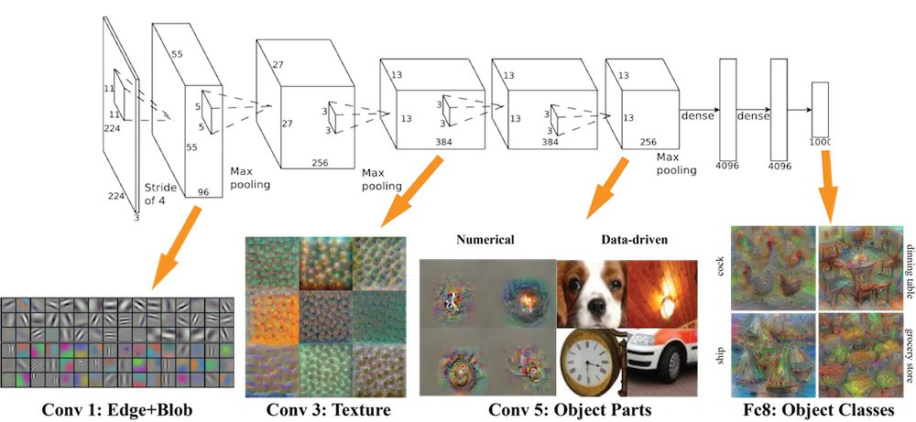
ImageNet Architecture

Slide 23
Outline
Motivation
  Commercial Applications
What is ML?
  Problems / Tasks
  Solutions / Approaches
Machine Learning in Office of Science
Machine Learning in Office of Fossil Energy

Slide 24
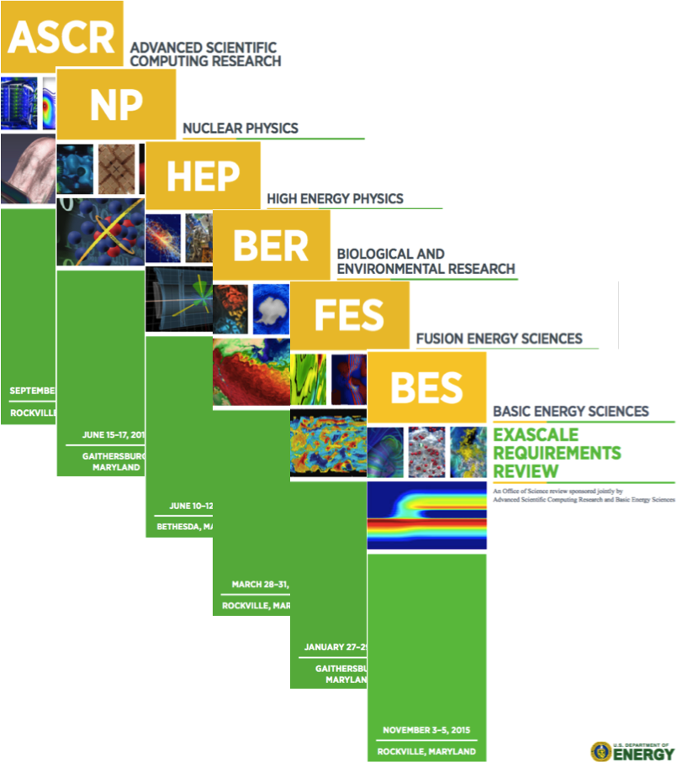
DOE Exascale Requirements Reviews
Broad input from DOE experimental facilities
Focused on the exascale ‘ecosystem’, beyond compute
Machine Learning called out as an important cross-cut theme

Slide 25
HEP |  |  | BER |  | BES |  | NP | FES
Astronomy | Cosmology | Particle Physics | Climate | Genomics | Light Sources | Materials | Particle Colliders | Plasma Physics
Classification
Regression
Clustering
Dimensionality Reduction
Surrogate Models
Design of Experiments
Feature Learning
Anomaly Detection
✗ |  | ✗ | ✗ | ✗ | ✗ | ✗ | ✗ | ✗
 | ✗ |  |  | ✗ | ✗ | ✗ | ✗ | ✗
 | ✗ | ✗ | ✗ | ✗ | ✗ | ✗ | ✗ | ✗
 |  |  | ✗ |  |  |  | ✗
✗ | ✗ | ✗ |  |  |  | ✗ | ✗ | ✗
 | ✗ |  | ✗ |  |  | ✗ |  | ✗
✗ | ✗ | ✗ | ✗ | ✗ | ✗ | ✗ | ✗ | ✗
✗ |  | ✗ | ✗ |  | ✗ |  | ✗
Notes:
This is a summary of various statistical and machine learning tasks across a number of scientific domains at LBL.

Slide 26
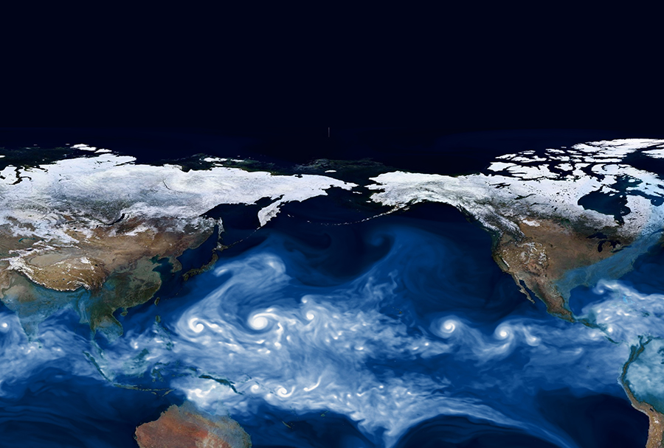
Characterizing Extreme Weather in a Changing Climate
1

Slide 27
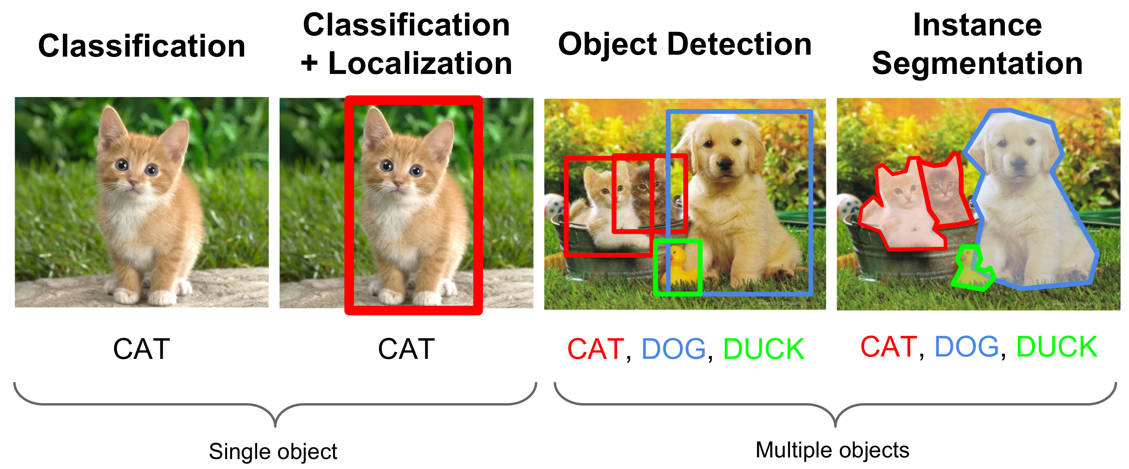
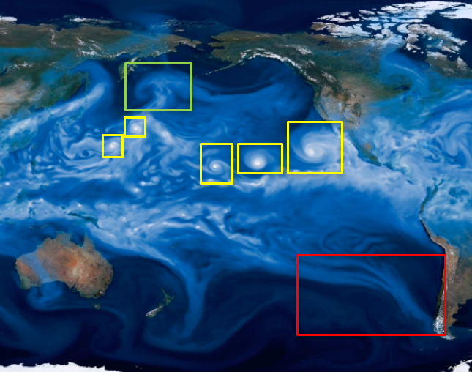
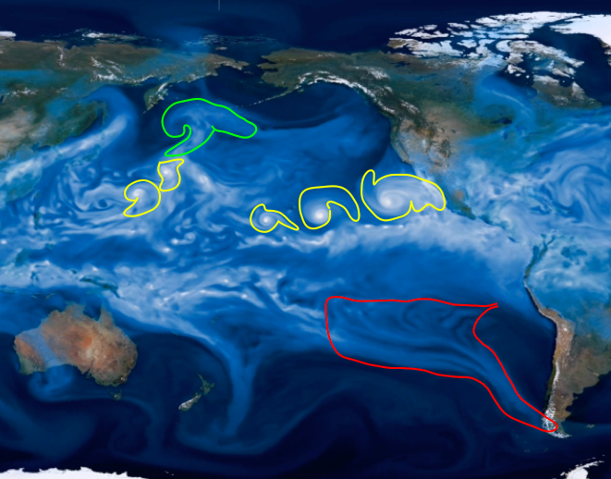


Climate Science Tasks

Slide 28
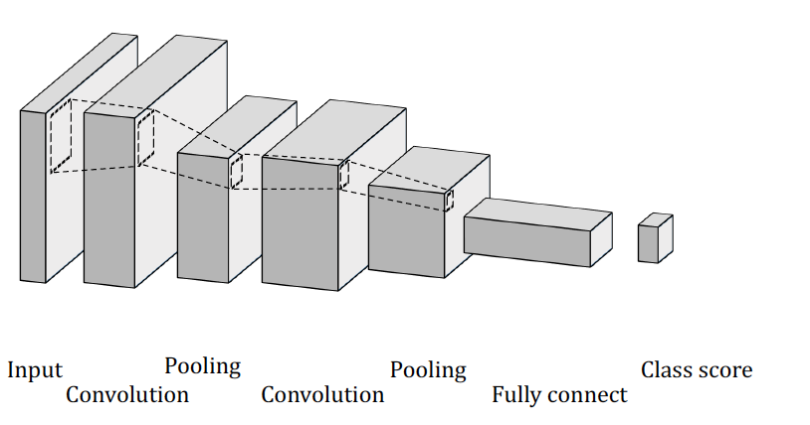
Supervised Convolutional Architecture
 | Logistic Regression | K-Nearest Neighbor | Support Vector Machine | Random Forest | ConvNet
 | Test | Test | Test | Test | Test
Tropical Cyclone | 95.85 | 97.85 | 95.85 | 99.4 | 99.1
Atmospheric Rivers | 82.65 | 81.7 | 83.0 | 88.4 | 90.0
Weather Fronts | 89.8 | 76.45 | 90.2 | 87.5 | 89.4
Notes:
ConvNet performs best in the classification task. Tropical cyclone is a comparatively easy problem. The features of tropical cyclone is quite clear and obvious.
ConvNet is trained well, no over fitting or under fitting. Mostly due to the small and shallow of network.
Classification results of weather front is interesting: none of the conventional classification model is trained well, as can be seen from the difference of training and testing accuracy. On the other hand, ConvNet is trained pretty well and generalized pretty well. Even though the testing accuracy of Logistic Regression and Support Vector Machine is comparable to that of ConvNet, I do not have much confidence that they are proper methods for this problem. Might need to put more regularization on them and train (hyper opt) again.
One significant draw backs of conventional classification methods is that: they are useless in localization scheme (while I guess it depends on how we process localization. If apply sliding window to a larger image and classify each window, these convention methods would still work. But in that sense, it is very computation expensive). However, it seems natural to use ConvNet for localization. Integrating localization and classification into one ConvNet is possible, therefore, detecting can be donw.

Slide 29
Semi-Supervised Convolutional Architecture (NIPS’17)
Encoder
Decoder
Classification + Bounding Box Regression
Contributors: Evan Racah, Chris Pal, Chris Beckham, Samira Kahou, Tegan Maharaj. MILA

Slide 30
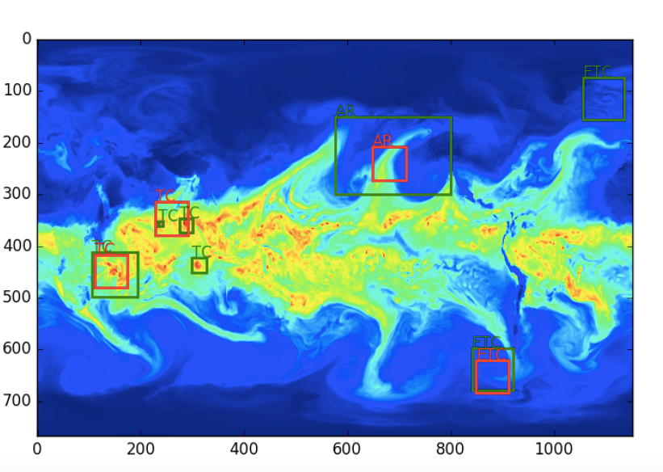
Classification + Regression Results
Ground Truth
Prediction
Contributors: Thorsten Kurth, Jian Yang, Ioannis Mitliagkas, Chris Pal, Nadathur Satish, Narayanan Sundaram, Amir Khosrowshahi, Michael Wehner, Bill Collins,
Intel, Stanford, LBL, MILA.

Slide 31
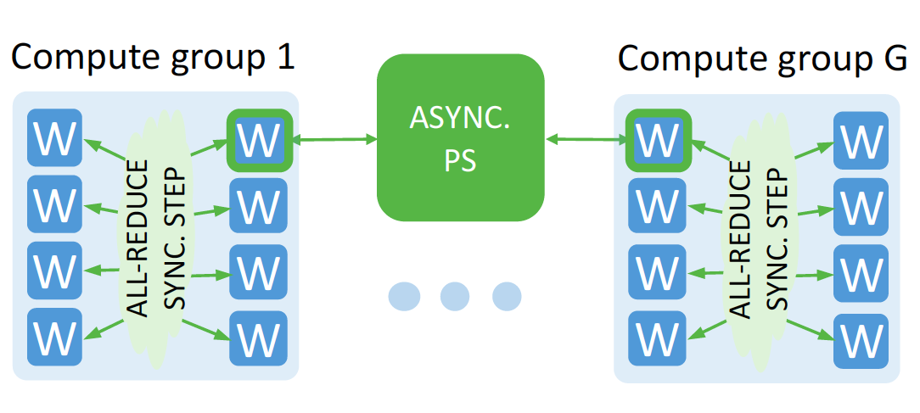
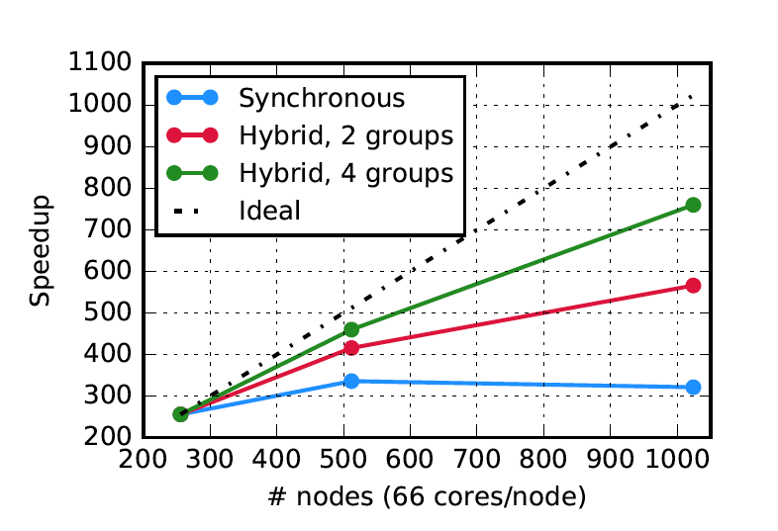
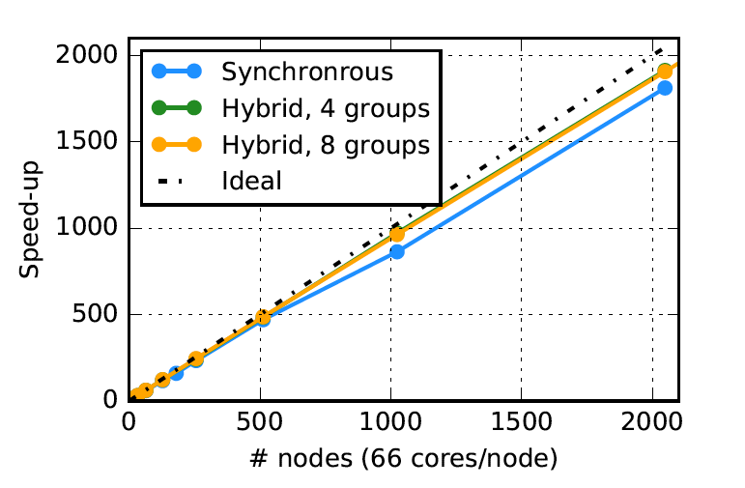
Deep Learning at 15PF (SC’17)

Slide 32
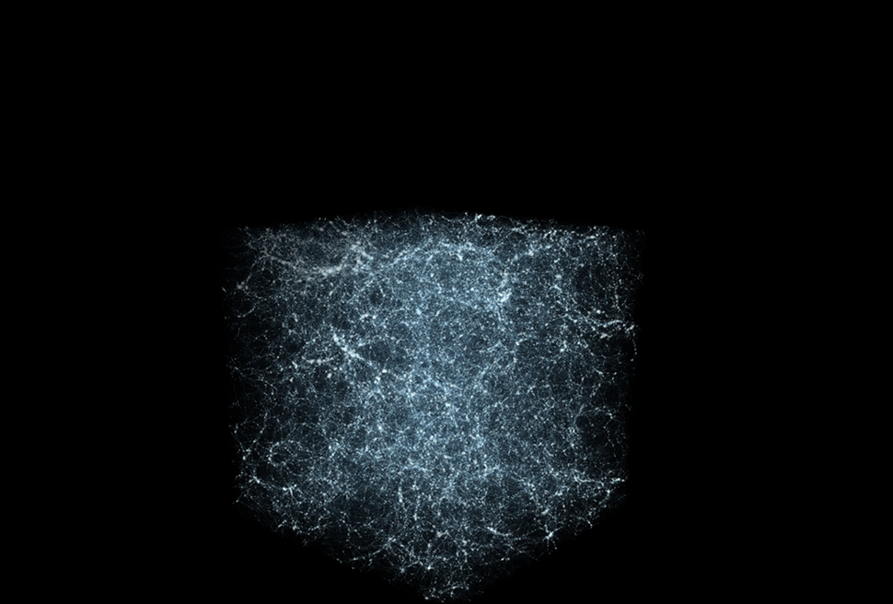
Determining the Fundamental Constants of Cosmology
2

Slide 33
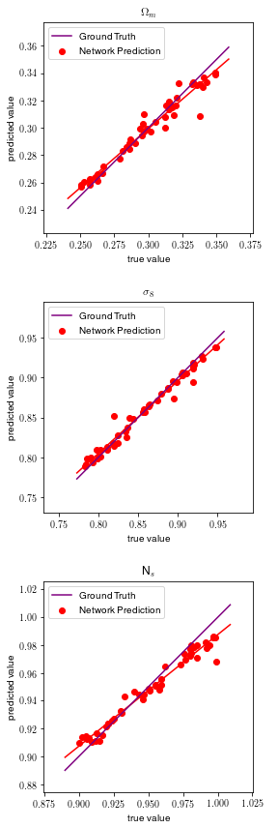
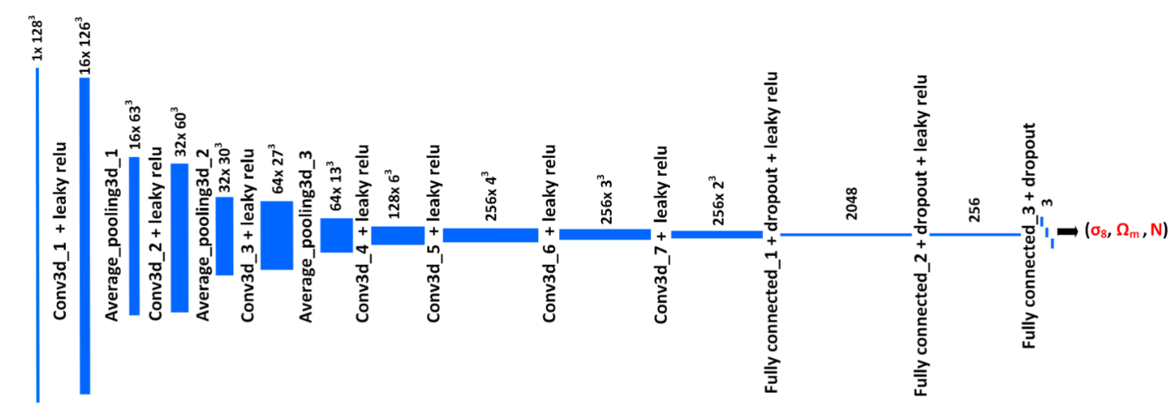
CosmoFlow:
3D Convolutional Network
Accurate prediction of (Ω_{M,} σ_{8,} N_{s} ) from simulated volumes
Scaling TensorFlow on 8192 Cori nodes
Contributors: Amrita Mathuriya, Debbie Bard, Pete Mendygral, et al. Intel, Cray, LBL.

Slide 34
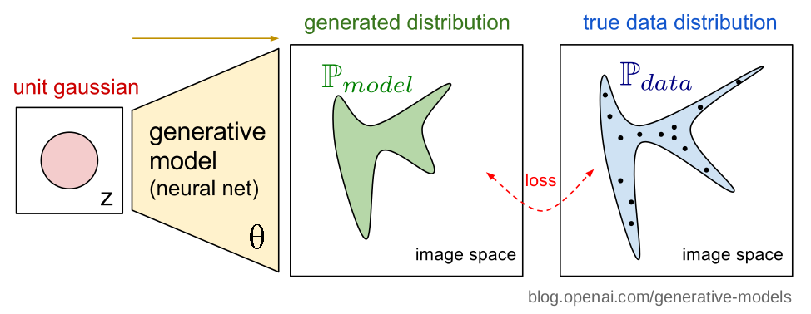
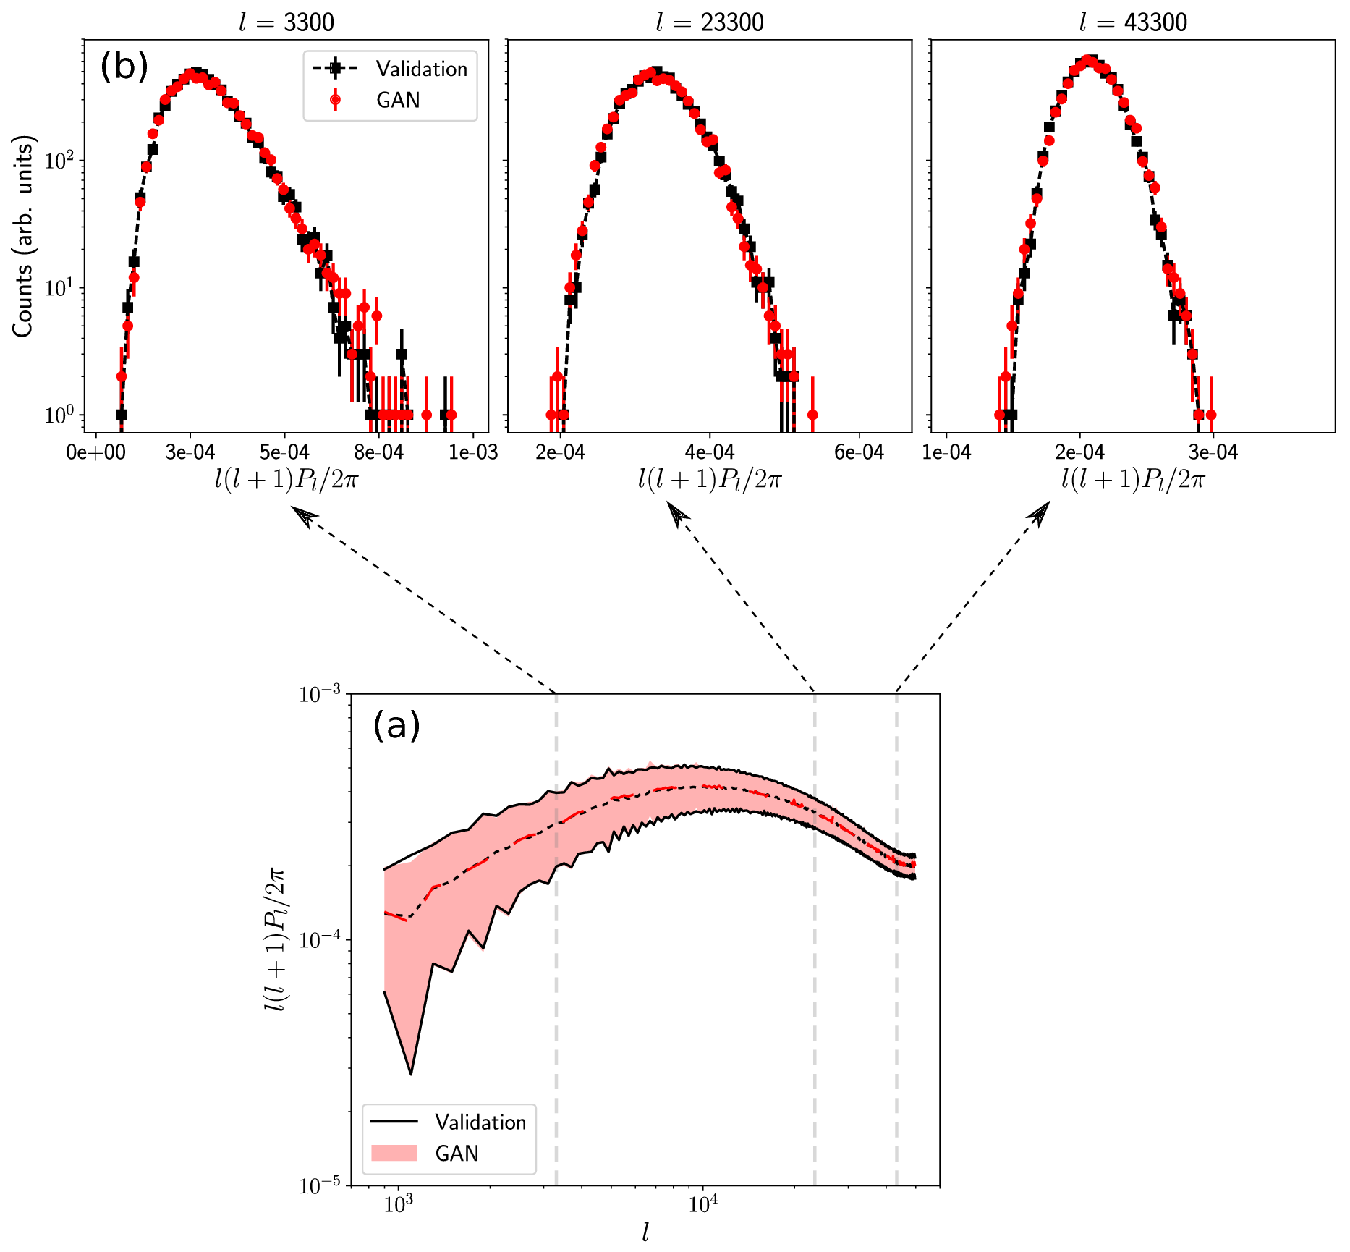
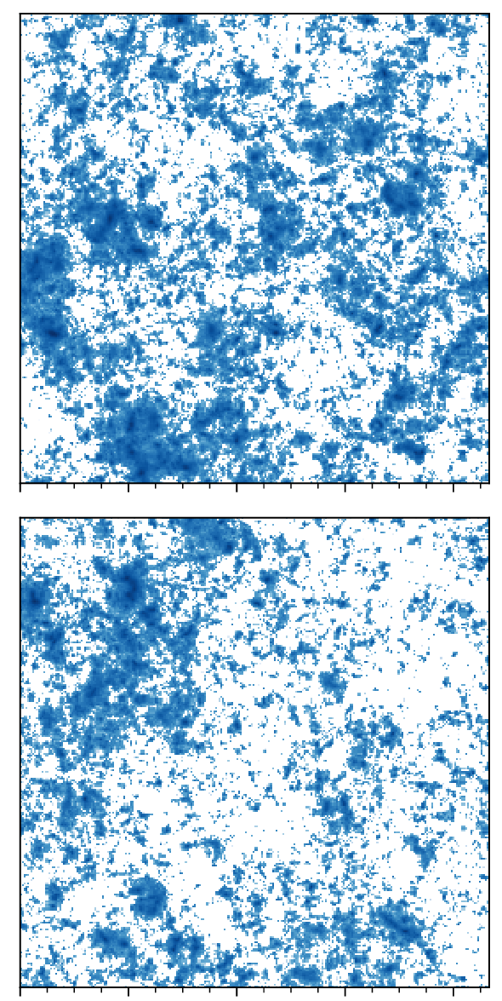
Generative Adversarial Networks
Power spectrum: fourier modes
Validation
Generated
GANs generated maps exhibit the same gaussian and non-gaussian structures as full simulations.
Contributors: Mustafa Mustafa, Debbie Bard, Wahid Bhimji, Rami Al-Rfou, Zarija Lukic. LBL, Google Research.

Slide 35
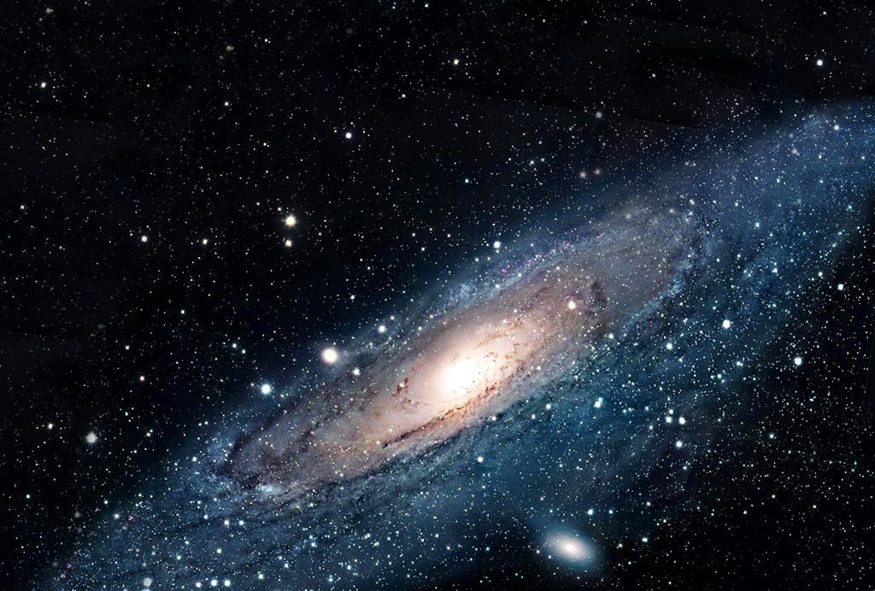
Creating a catalog of all objects in the Universe
3

Slide 36
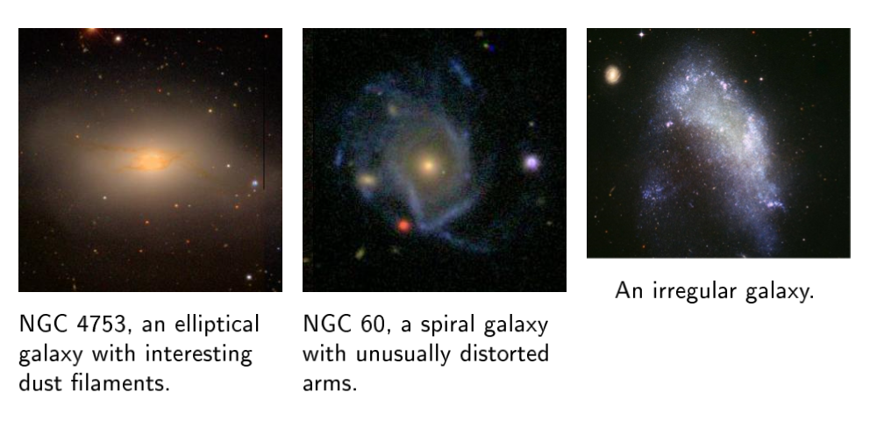
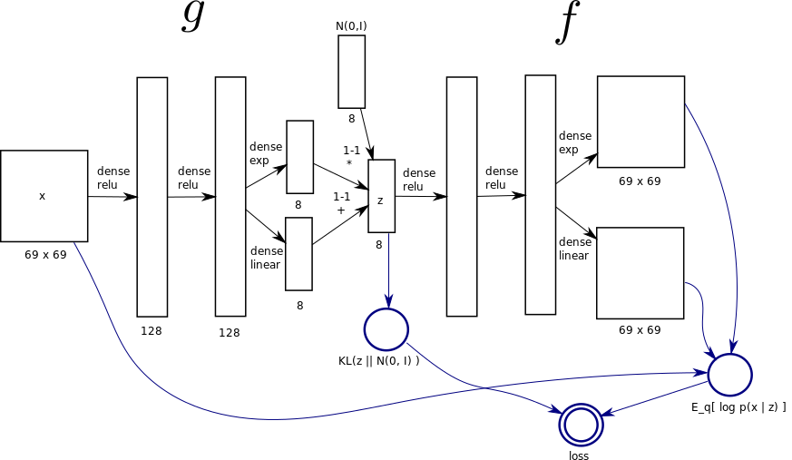
Variational Autoencoder Model
The Celeste galaxy model outperformed bivariate Gaussian densities for 99.3% of galaxy images.
Qualitative results from t-SNE indicate that the neural network learns a compact representation of galaxy shapes and orientation.
Contributors: Jeff Regier, Jon McAuliffe. UC Berkeley.

Slide 37
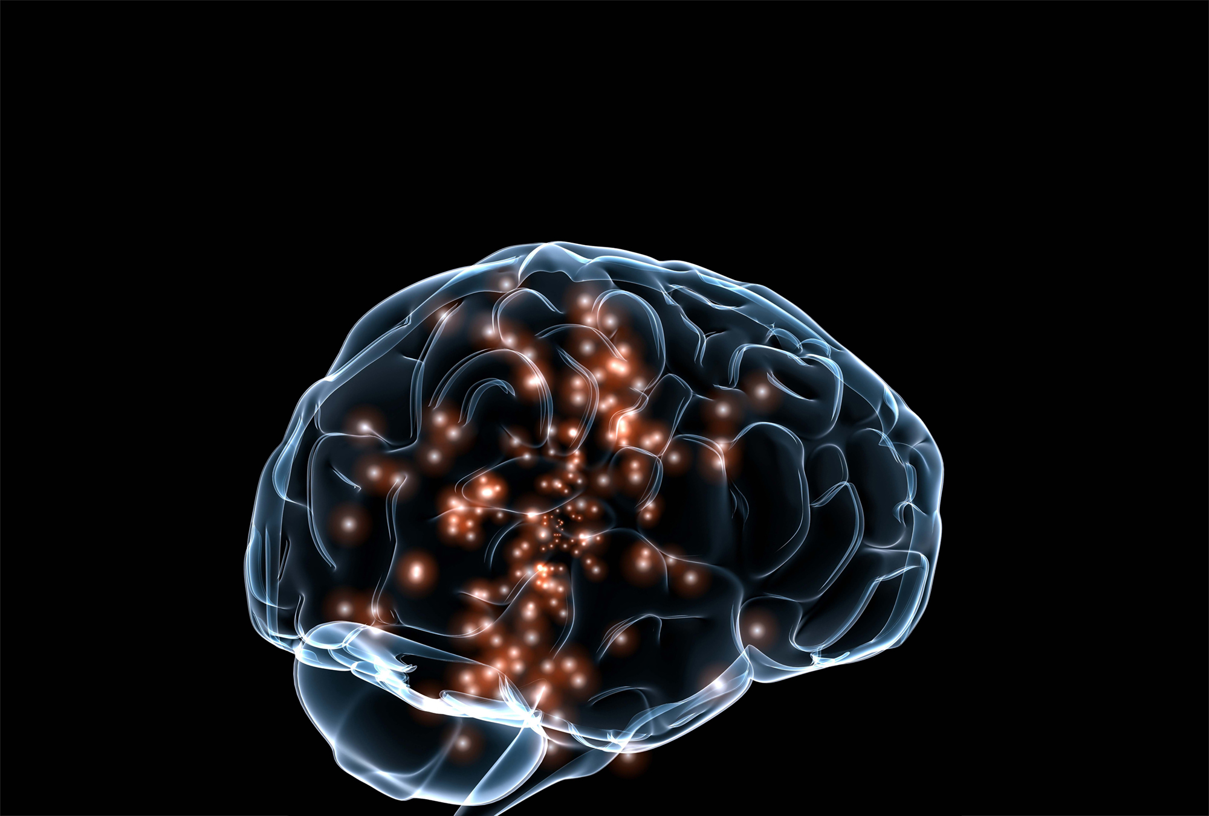
Understanding the Brain
4

Slide 38
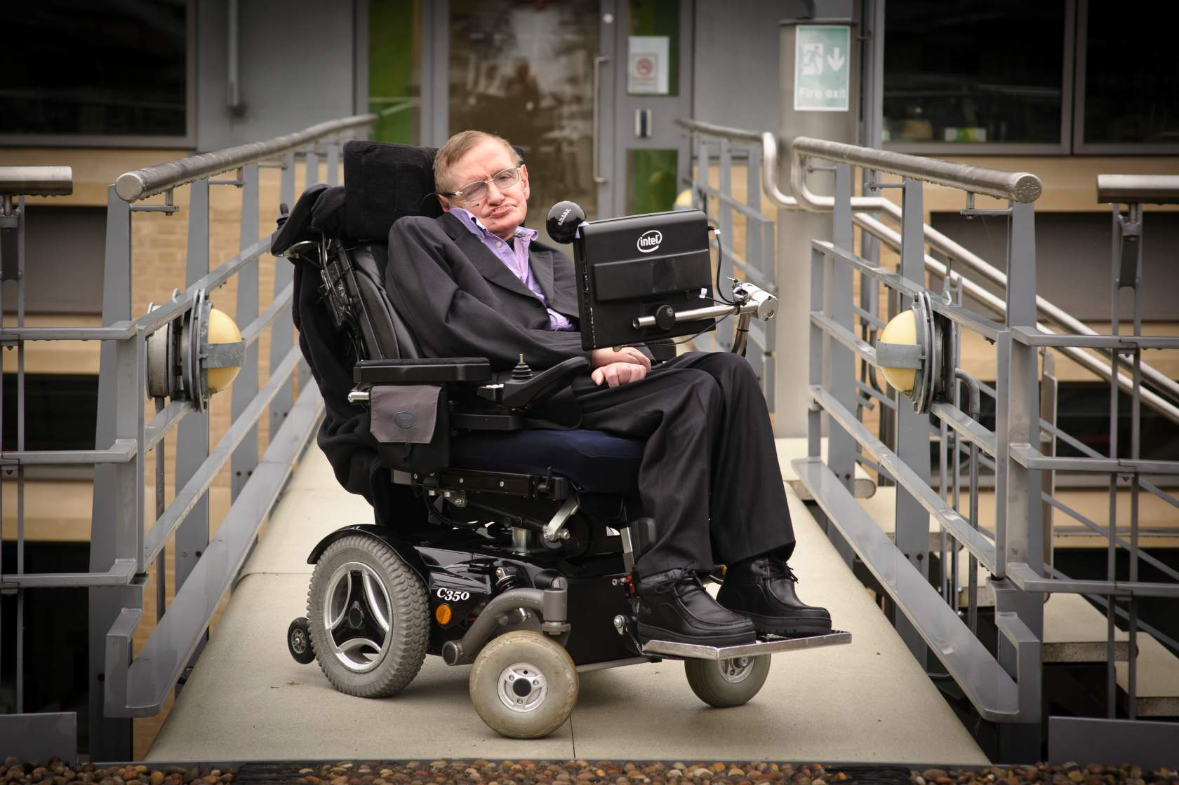
Speech Prosthesis

Slide 39
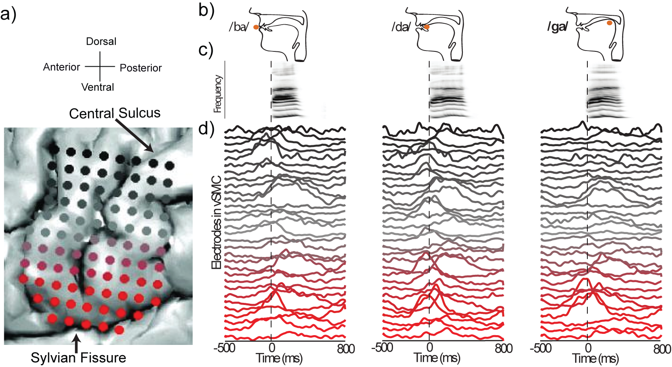
Decoding Speech
Contributors: Jesse Livezey, Kris Bouchard, E. Chang. UC Berkeley, UCSF.

Slide 40
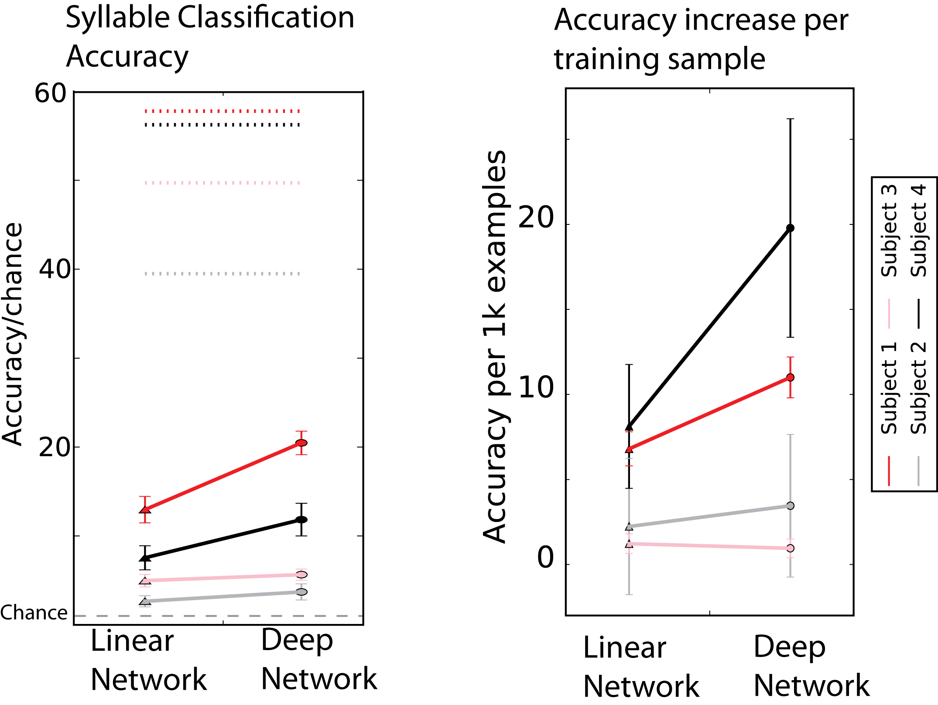
Fully Connected Architecture
Classify spoken syllable from spatiotemporal patterns of human neural recordings
Fully Connected, Feed-forward Network
All hyper-parameters optimized with Spearmint
L₂ regularization and dropout

Slide 41
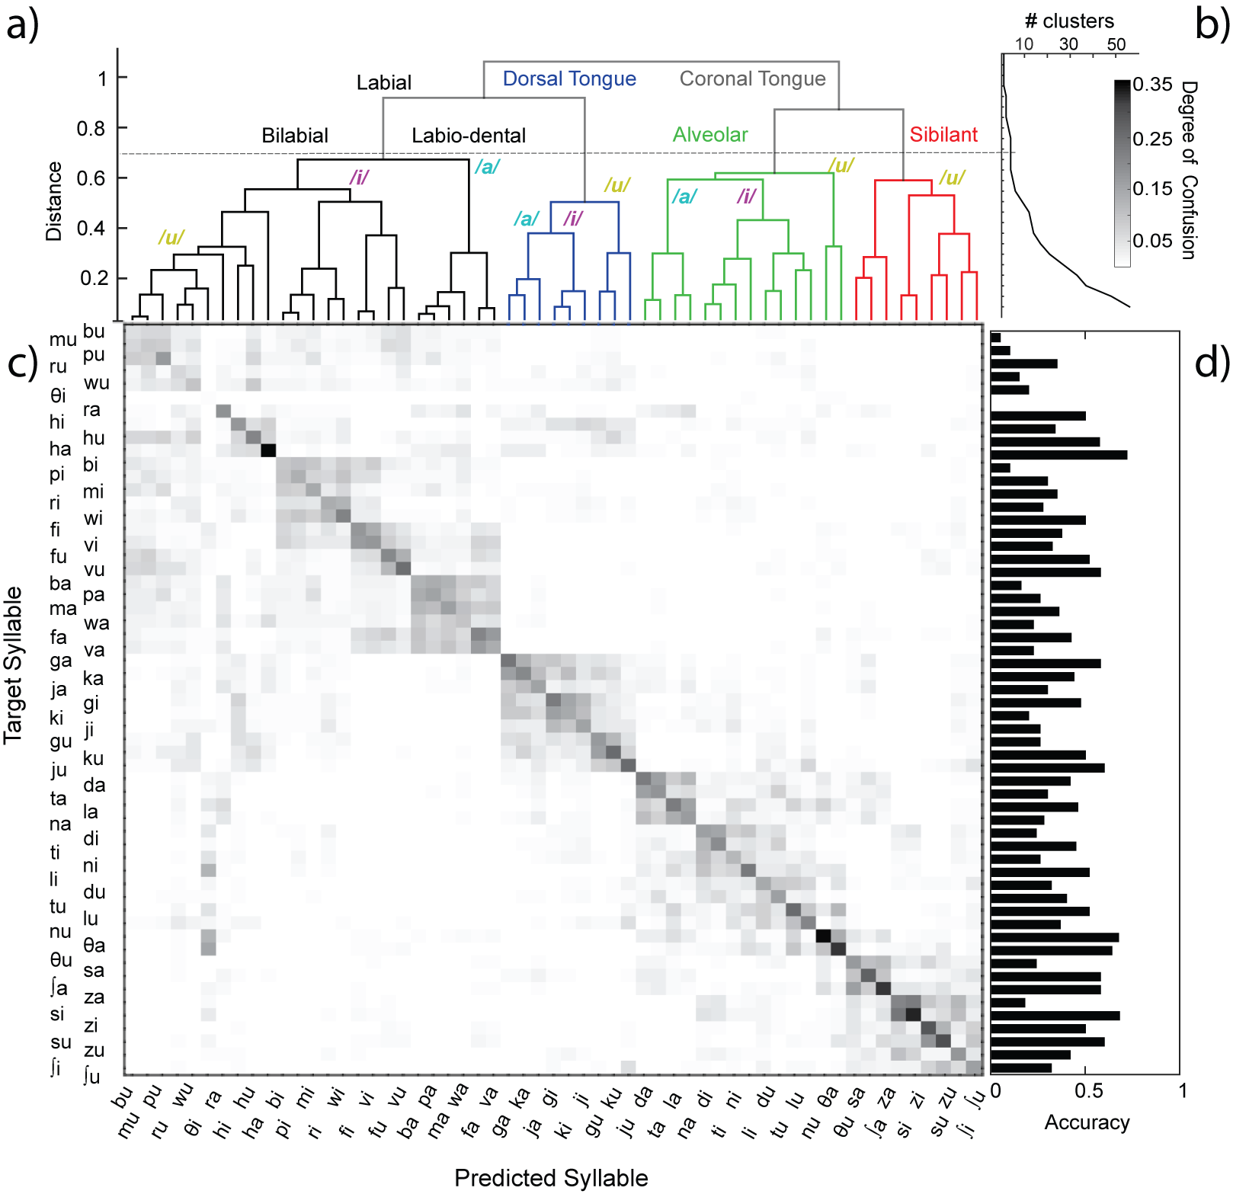
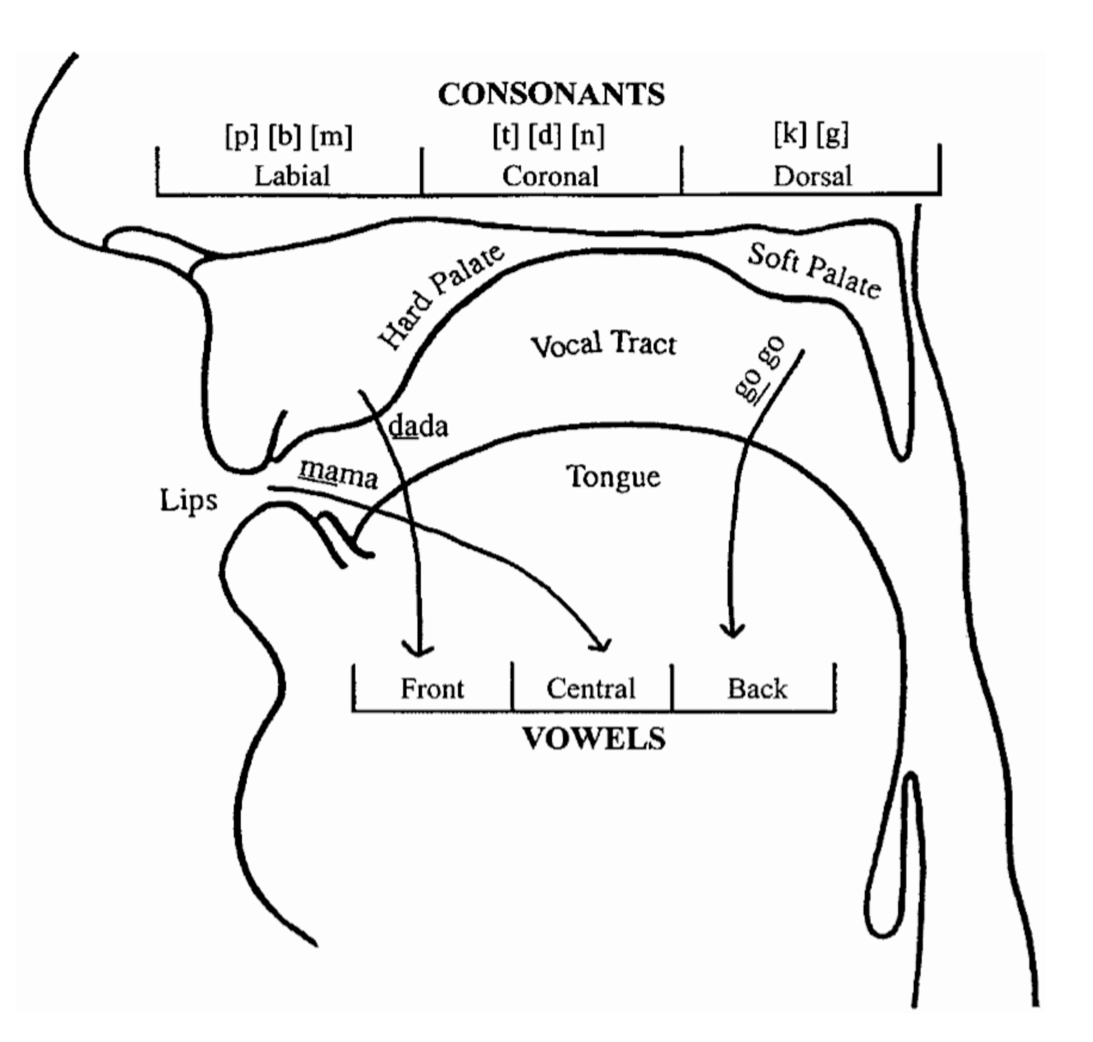
DNNs recover meaningful latent structure
Hierarchical clustering of confusion matrix reveals organization of speech control signals.

Slide 42
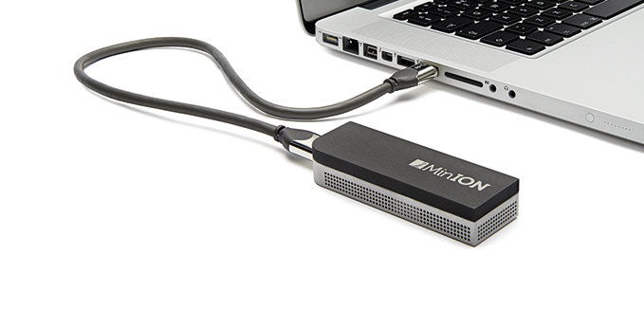
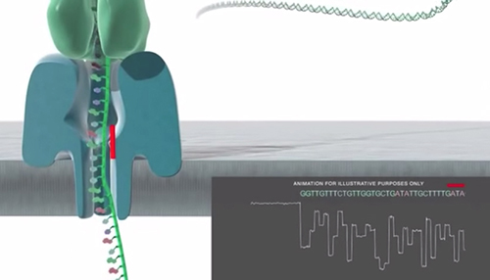
Oxford Nanopore Sequencing
5

Slide 43
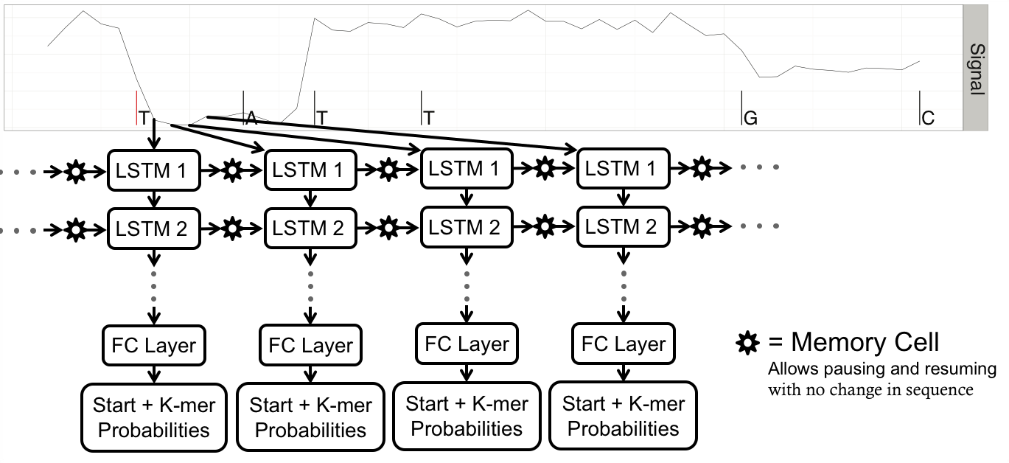
Long Short-Term Memory Architecture
Team: Ben Brown, Marcus Stoiber. LBL.

Slide 44
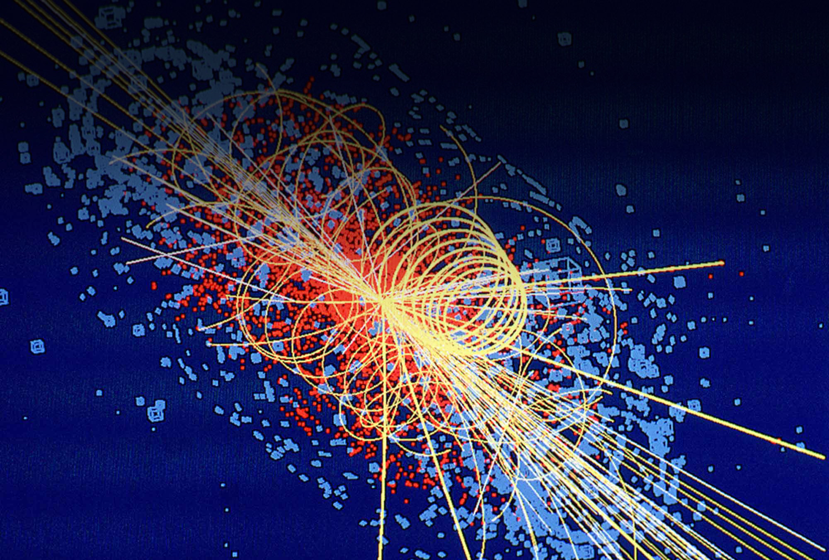
Fundamental Constituents of Matter
6

Slide 45
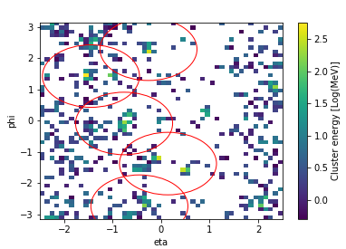
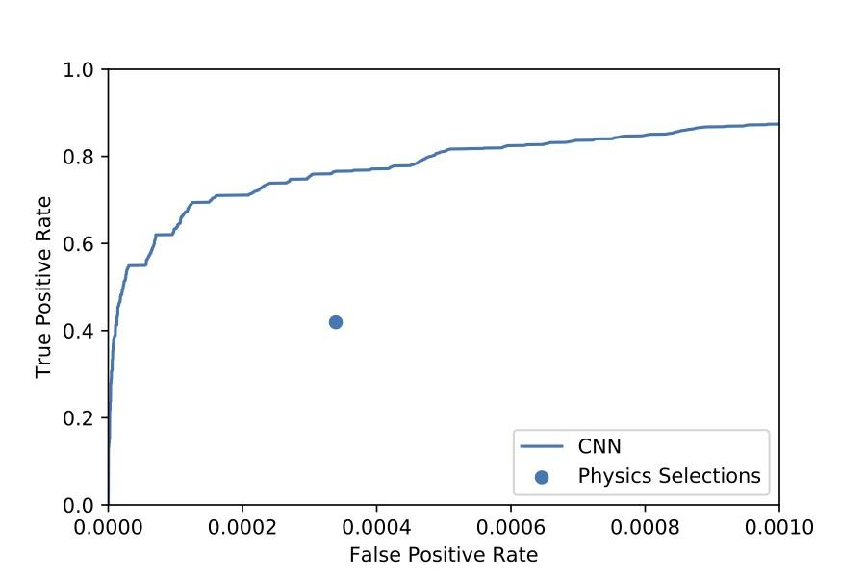
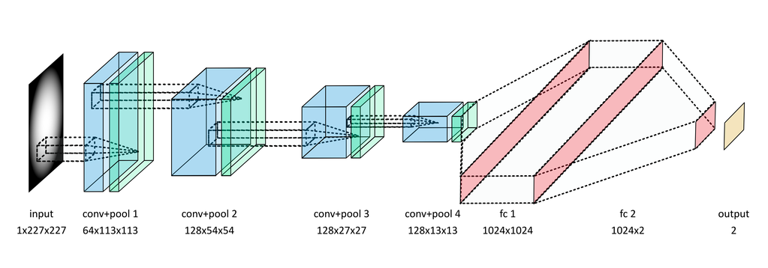
Supervised Convolutional Architecture
Bin energy from sub-detector (‘calorimeter’) and unroll cylinder to form 64x64 or 224x224 image
Train CNN on labelled data from full detector simulations to directly classify signal (‘Supersymmetry’) from background
Benchmark from existing analysis on high-level physics variables
Increased signal efficiency at same background rejection without using high-level physics variables
Input Conv+Pool(1) Conv+Pool(2) Conv+Pool(3) (Conv+Pool(4)) Fully Connected (FC) FC Output
1(or3)x64x64 64x32x32 128x8x8 256x4x4 4096 512 1

Slide 46
HEP |  |  | BER |  | BES |  | NP | FES
Astronomy | Cosmology | Particle Physics | Climate | Genomics | Light Sources | Materials | Particle Colliders | Plasma Physics
Classification
Regression
Clustering
Dimensionality Reduction
Surrogate Models
Design of Experiments
Feature Learning
Anomaly Detection
✗ |  | ✗ | ✗ | ✗ | ✗ | ✗ | ✗ | ✗
 | ✗ |  |  | ✗ | ✗ | ✗ | ✗ | ✗
 | ✗ | ✗ | ✗ | ✗ | ✗ | ✗ | ✗ | ✗
 |  |  | ✗ |  |  |  | ✗
✗ | ✗ | ✗ |  |  |  | ✗ | ✗ | ✗
 | ✗ |  | ✗ |  |  | ✗ |  | ✗
✗ | ✗ | ✗ | ✗ | ✗ | ✗ | ✗ | ✗ | ✗
✗ |  | ✗ | ✗ |  | ✗ |  | ✗
Notes:
This is a summary of various statistical and machine learning tasks across a number of scientific domains at LBL.

Slide 47
HEP |  |  | BER |  | BES |  | NP | FES
Astronomy | Cosmology | Particle Physics | Climate | Genomics | Light Sources | Materials | Particle Colliders | Plasma Physics
Classification
Regression
Clustering
Dimensionality Reduction
Surrogate Models
Design of Experiments
Feature Learning
Anomaly Detection
✗ |  | ✗ | ✗ | ✗ | ✗ | ✗ | ✗ | ✗
 | ✗ |  |  | ✗ | ✗ | ✗ | ✗ | ✗
 | ✗ | ✗ | ✗ | ✗ | ✗ | ✗ | ✗ | ✗
 |  |  | ✗ |  |  |  | ✗
✗ | ✗ | ✗ |  |  |  | ✗ | ✗ | ✗
 | ✗ |  | ✗ |  |  | ✗ |  | ✗
✗ | ✗ | ✗ | ✗ | ✗ | ✗ | ✗ | ✗ | ✗
✗ |  | ✗ | ✗ |  | ✗ |  | ✗
CNNs, LSTMs
Auto-encoders
GANs
RL
?
Notes:
This is a summary of various statistical and machine learning tasks across a number of scientific domains at LBL.

Slide 48
Outline
Motivation
  Commercial Applications
What is ML?
  Problems / Tasks
  Solutions / Approaches
Machine Learning in Office of Science
Machine Learning in Office of Fossil Energy

Slide 49
HEP |  |  | BER |  | BES |  | NP | Fossil Energy
Astronomy | Cosmology | Particle Physics | Climate | Genomics | Light Sources | Materials | Particle Colliders | Energy Geosciences
Classification
Regression
Clustering
Dimensionality Reduction
Surrogate Models
Design of Experiments
Feature Learning
Anomaly Detection
✗ |  | ✗ | ✗ | ✗ | ✗ | ✗ | ✗ | ✗
 | ✗ |  |  | ✗ | ✗ | ✗ | ✗ | ✗
 | ✗ | ✗ | ✗ | ✗ | ✗ | ✗ | ✗
 |  |  | ✗ |  |  |  | ✗
✗ | ✗ | ✗ |  |  |  | ✗ | ✗ | ✗
 | ✗ |  | ✗ |  |  | ✗ |  | ✗
✗ | ✗ | ✗ | ✗ | ✗ | ✗ | ✗ | ✗ | ✗
✗ |  | ✗ | ✗ |  | ✗ |  | ✗ | ✗
Notes:
This is a summary of various statistical and machine learning tasks across a number of scientific domains at LBL.

Slide 50
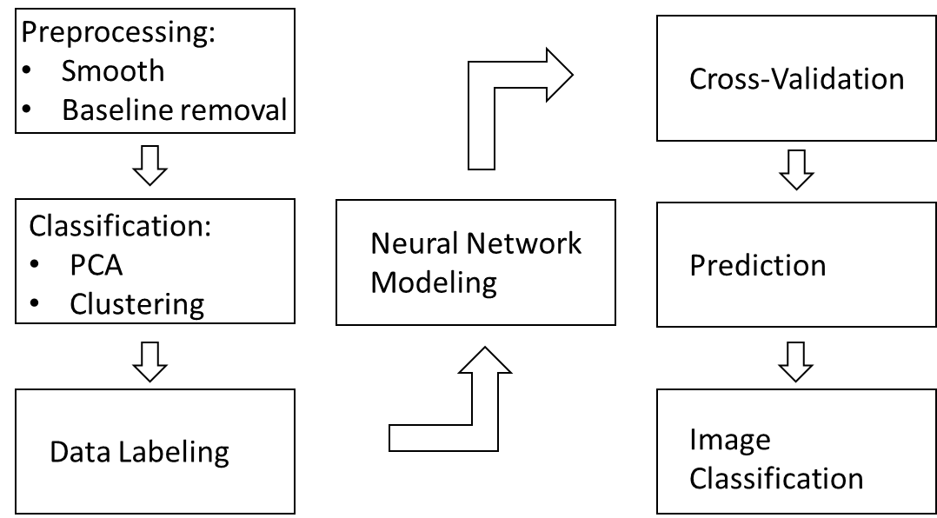
Imaging and scaling complex physical/mineralogical data
Background : Need to upscale properties measured in the lab to the appropriate scale.
Problem : Lab measurements of critical properties are needed for detailed process models, but the measurements are on a very different scale than in the model.
ML Challenge : Use ML to examine relationships between properties at a variety of scales to upscale properties.
1 μm
100 μm
Quartz
Clay
Carbonate
Pyrite
Organic-rich

Slide 51
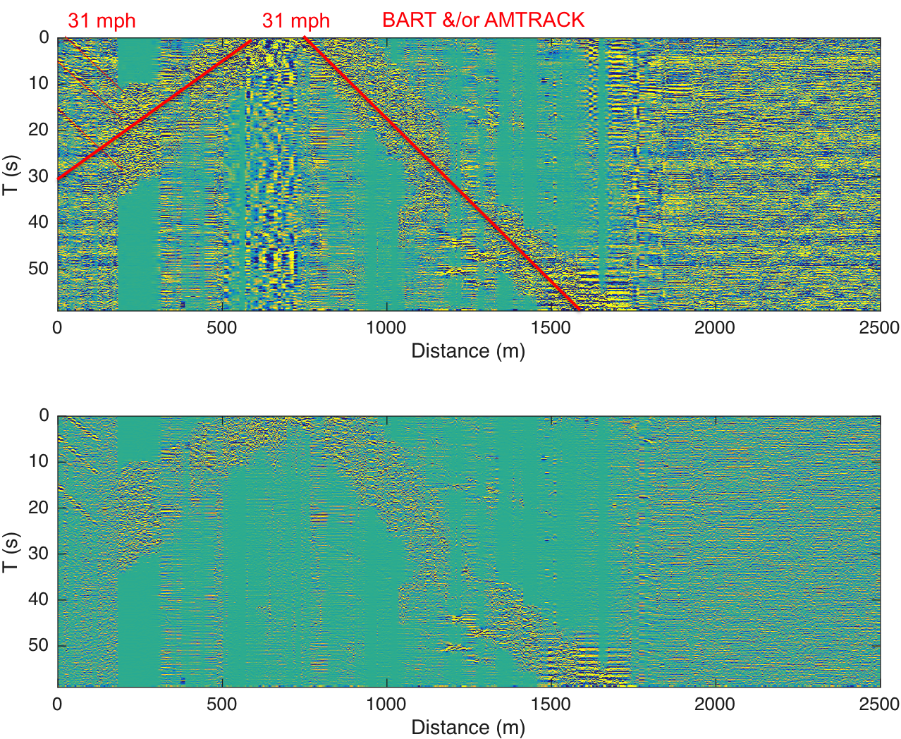

Making fast decisions with large, noisy data sets
Background : Rich, diverse, and noisy massive and streaming datasets are collected (e.g. seismic and remote sensing data) and need interpretation. These data are challenging to manually process (examples in seismology, remote sensing, environmental sensors). [sizes to low PB and growing].
Problem : Rapid evaluation of these large and streaming data will allow appropriate and timely decision making.
ML Challenge : Use ML techniques to aid in rapidly processing and interpreting these data sets.
Notes:
Jonathan Ajo Franklin : dark fibre; interrogation w/ laser

Slide 52


Finding Patterns in seismic datasets
Background : Natural and induced seismicity occurs, and induced seismicity can result from fluid injections (from carbon sequestration, enhanced geothermal systems, and produced water.
Problem : It is important to control conditions to reduce induced seismicity, and to be able to determine the difference between natural and induced seismicity.
ML Challenge : Use ML to examine seismic data and simple injection data to help manage induced events.
Notes:
Geophones and seismometers;

Slide 53
Short-Term Challenges
Complex Data
  2D/3D/4D, #channels, dense/sparse, graphs
Hyper-Parameter Optimization
  Tuning #layers, #filters, learning rates, schedule is a black art
Performance and Scaling
  Current networks take days to train on O(10) GB datasets, we have O(100) TB datasets on hand
Scarcity of Labeled Data
  Communities need to self-organize and run labeling campaigns

Slide 54
Long-Term Challenges
Lack of Theory
  Limits of supervised, unsupervised, semi-supervised learning
  Generalization limits of GANs
Interpretability: ‘Introspect It’ vs. ‘Build It’
  Black Box classifier; need to visualize representations
  Incorporate domain science principles (physical consistency, conservation laws, etc)
Uncertainty Quantification
Formal protocol for applying Deep Learning
  Applied Math has developed methodology over 30 years, no analog in DL

Slide 55

Questions?
prabhat@lbl.gov

Slide 56
Backup Slides

Slide 57
Typical ML Workflow
Problem Formulation
What's the task?
Data Preparation
Gather
Model Training
Develop Model
Is ML the right approach?
Success metrics?
Clean
Engineer features
Model Deployment
Explore
Pre-Process
Train
Validate
Hyper-parameter Tuning
Integration
Performance
Scaling
Monitoring
Refinement
Adapted from https://cloud.google.com/ml-engine/docs/ml-solutions-overview

Slide 58
Why Now?
Pattern Detection in Computer Vision
Neural Nets
Multi-layer perceptrons, Backpropagation
Eigenface
First principles Physics, Geometry
Random Forests
Hand-tuned features (SIFT, HOG, …)
Edge, Corner detectors
SVM
Kernel SVM
PASCAL VOC
ImageNet
ILSVRC
AlexNet
ResNet
…
1970
1980
1990
2000
2010
Moore’s Law, “Big Compute”, Commodity Sensors
“Big Data”
“AI/DL”

Slide 59
2018-2020
Broad deployment of DL tools at HPC centers and Cloud
Domain science communities will start self-organizing and conducting labeling campaigns
Researchers will exploit low-hanging fruit
  Classification, Regression, Clustering problems will be (nearly) completely solved

Slide 60
2020+
Entire data archives are segmented and classified
  Anomaly detection; Correlation; Causal Analysis
Long-term challenges are formulated and addressed
  Generalization limits, UQ
  Interpretability, incorporating domain science principles
What is the ‘value add’ of the scientist?

Slide 61



2020+ Workflow
Interactive Exploration
Semantic Labels
Mechanisms
Hypothesis
Observational Data
Simulation
Archives
Patterns
Clusters
Anomalies

