Slide 1
Journey of a Cost Estimate – W87-1 Modification Program
Dave Fong, Courtney Allen, Carla Jordan
(contributions by Pamela DiVito)
Sandia National Laboratories
August 13, 2026
SAND2026-24748PE P

Slide 2








Presentation Outline
1. Program & Replan Context
2. Peer Review Execution
3. Risk, Uncertainty & SCURA
4. Data & Future Roadmap
Background on W87-1 Mod Program timeline, lifecycle phases, and key transition from WDCR to the 2025 Replan.
Peer review framework replacing formal ICER, critical focus areas across technical/programmatic domains, and key results.
Early integration of risk management, Schedule and Cost Uncertainty Analysis (SCURA) timeline, and quantitative results.
Simplifying complex P6 data, LOE control accounts, GAO cost credibility standards, and path to FY27 Baseline Cost Report (BCR).

Slide 3
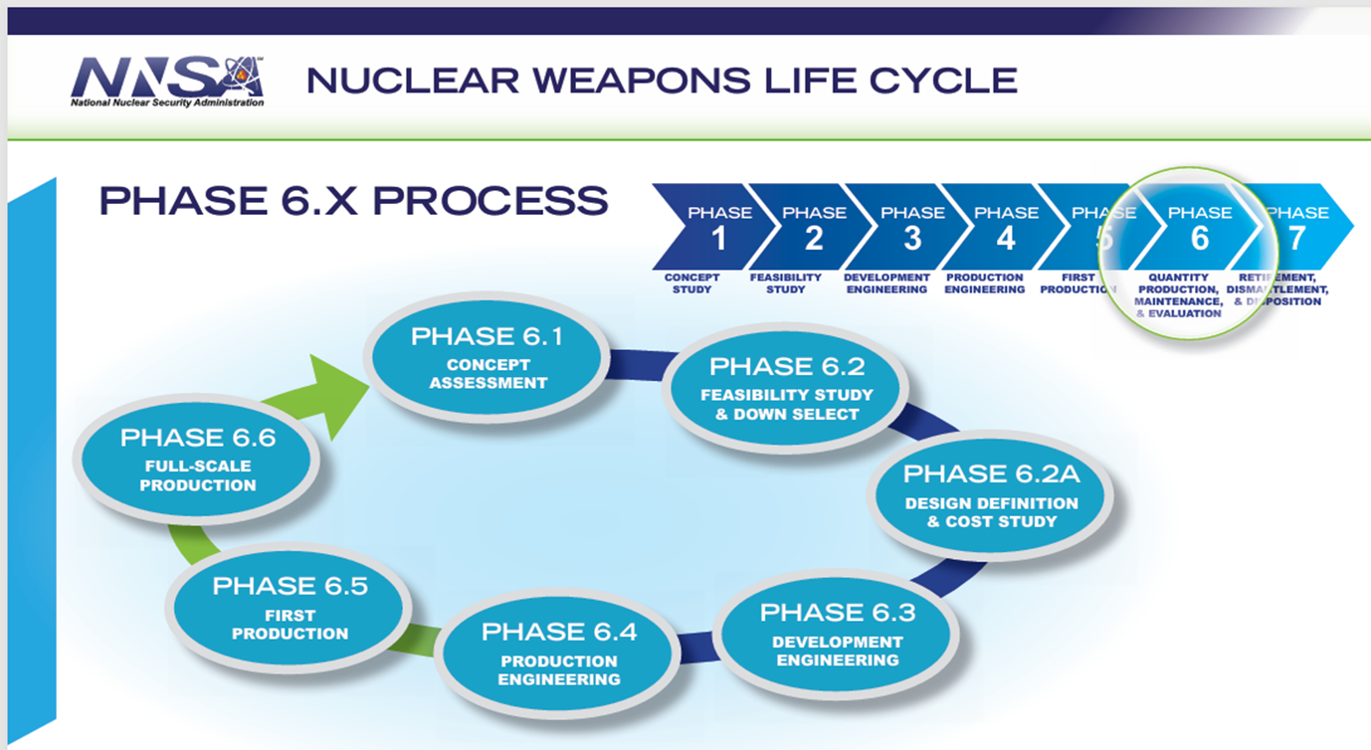







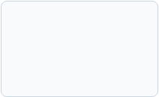

Product Lifecycle Review Timeline
2022 WDCR Phase
2025 Replan
2026-2027
Baseline Cost Report
2028-2033
Initial Weapon Design Cost Report estimate established.
Comprehensive scope, schedule, and cost alignment.
Formal BCR submittal for Phase 6.4 entry.
Future Replans/BCR updates

Slide 4


Lessons Learned: WDCR to Replan
Schedule & Logic Alignment
Cost, FYNSP Target Realism, Risk
LOE Percentages: Establish clear Level of Effort baselines across all key stakeholders.
Early Target Setting: Establish total program ROM/Target early to ensure cost reasonableness.
Schedule Constraints: Define explicit assumptions early (fixed target dates vs. range).
FYNSP Constraints: Directly factor in Future Years Nuclear Security Program funding limits.
Joint Milestones: Enforce mutually agreed-upon due dates between M&O, NNSA, and DoD Flight Tests.
Integrated Core Team: Maintain unified leadership spanning Cost, Schedule, and Risk/SCURA.
P6 Pipeline: Develop staff training pipeline to sustain specialized Primavera P6 expertise.
Early Peer Reviews: Shift peer reviews upstream rather than at final deliverable stages.
SCURA: Improve quantification of cost and schedule impacts in risk
Staff experience: Grow knowledge base across cost and risk

Slide 5



Replan Peer Review Strategy
Comprehensive Alternative to ICER
Review Architecture
Replaced the formal PMO Independent Cost Estimate Review (ICER) with a proactive internal peer review process to ensure readiness and technical rigor.
Benchmark Lessons: Analyzed peer review outcomes from preceding weapon programs.
SME Pairing: Paired technical Subject Matter Experts directly with Project Managers.
Targeted Focus: Defined clear criteria spanning technical scope, cost, and schedule elements.
Primary Review Objective:
Foster successful replan through early identification of programmatic and technical gaps. Positioned as collaborative assistance rather than an audit.
Structured Kickoff: Conducted aligned kickoff sessions for review teams.

Slide 6







Peer Review Process & Focus Areas
Process Flow:
Initial Evaluation
Kickoff
Technical & Programmatic
Reviewers Alignment with Feedback
Peer Review Feedback with Applicable Team
Follow-up on Progress Against Actions
Leadership Review/ ICER Summary Report
Programmatic Costs
Technical Readiness
Schedule Logic
Estimate Realism
FY26 target alignment
Critical path vs challenges
Activity durations & logic
Baseline variance analysis
Total Labor Equivalents (TLEs)
PRT hardware requirements
Key milestone alignment
LOE re-assessment
Design description fit
Target date feasibility
Outyear impact evaluation
Procurement commit timing
Critical path validity
Historical actuals check
Technical knowledge gaps
Air Force vs. NNSA sharing
Sandia National Laboratories

Slide 7
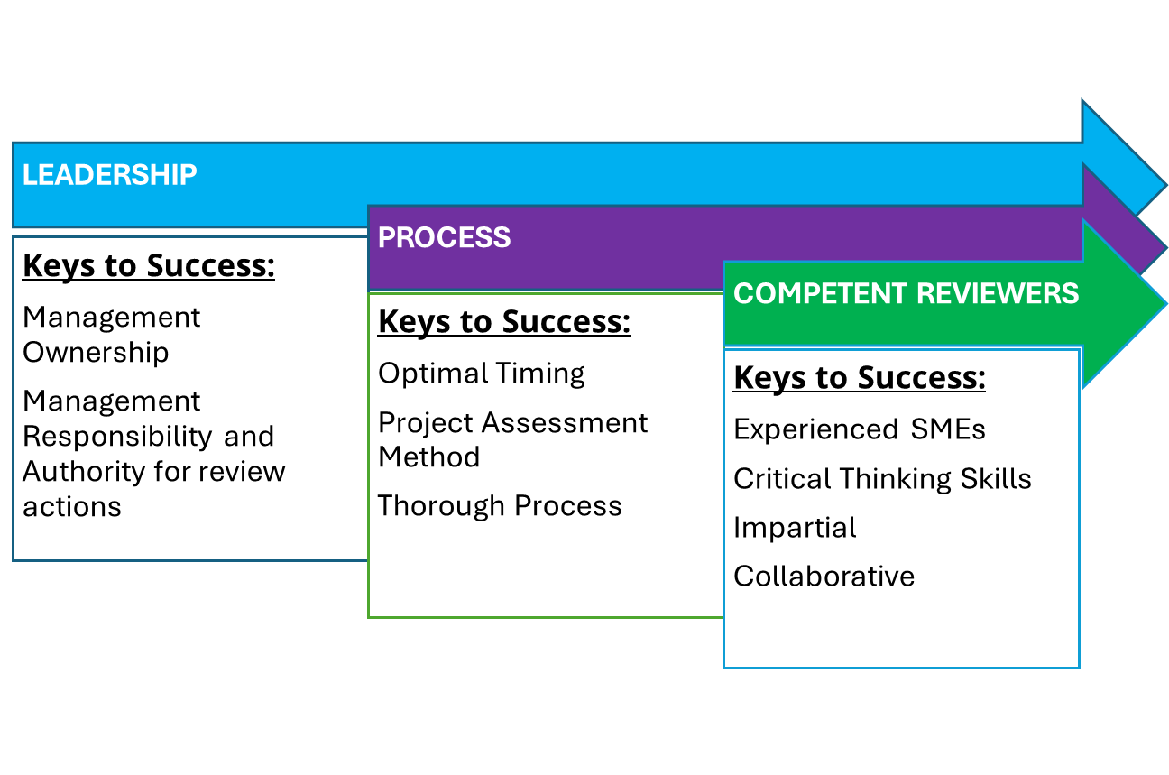
Peer Review Attributes

Slide 8



Peer Review Results
Successful Practices
Key Areas for Refinement
Outyear Targets: Target guidance was limited to Year 1, leading teams to assume unconstrained outyear growth.
Fiscal Year Assessment Tools: Newly created tools to evaluate estimates by FY were highly praised.
Communicating Limits: Total cost increase expectations were not conveyed early enough by management.
Systems-Level Iterations: Follow-up reviews with Systems and PMO successfully aligned costs to targets.
Overly High Ramp Down: Team ramp-down estimates were too conservative and required realistic recalibration.
Historical Actuals Integration: Program actuals to date provided essential sanity checks.
Structured Guidance & Lead Designation: Kickoff meetings require granular instructions. Teams lacked designated review leads, resulting in varying and inconsistent reviews
Actionable Feedback: Many good observations, recommendations, and actions were identified for scope, schedule, and cost
Action Item Verification Loop: While initial timelines were clear, follow-up procedures to verify that teams addressed corrective actions were undefined and infrequently validated.
SME Fit & Management Reinforcement: SME selection must prioritize technical expertise over availability. Active management enforcement of review standards is vital for consistent documentation.

Slide 9
Lessons Learned: Risk & SCURA Integration
Early Integration of Risk: Staffing changes throughout WDCR; Risk not integrated with other programmatic areas
Schedule and Cost Uncertainty Training: Lack of experience and limited training
Quality of SCURA Inputs: Dry run SCURA timed too late to address input data concerns

Slide 10


Risk & SCURA Integration
Early Integration Improvements
Targeted Training & Coaching
Unlike the WDCR process, the Risk Lead was fully embedded from day one of the Replan effort:
Addressed past training deficits with two comprehensive program-wide uncertainty workshops and individual engagement:
Uncertainty coding integrated into schedule timelines.
Demonstrated how uncertainty codes affect single-point estimates.
Internal SCURAs planned & pre-approved by leadership.
Held 1-on-1 risk/uncertainty deep dives with teams.
Monthly risk/uncertainty updates at check-ins.
Provided quantitative benchmarks (SPI/CPI, CEI, variance).

Slide 11
Re-Baseline SCURA Timeline (2025)
SCURA Cycle | Timing | Target Audience | Key Output & Value Proposition
Internal SCURA 1 | Jan 2025 | L1/L2 Mgmt, Programmatic Leads | First time assessing MR since Oct 2023.
Internal SCURA 2 | Mar 2025 | L1/L2 Mgmt, Programmatic Leads | Schedules, ETCs, and uncertainty coding still in development; learned that overlay needed refinement.
Internal SCURA 3 | May 2025 | L1/L2 Mgmt, Programmatic Leads | Just before "pencils-down"; learned risk burn down was optimistic.
Interim SCURA (Required) | Jun 2025 | SNL Senior Leadership, W87-1 FPO | MR supporting peer review; addressed previous learnings.
Final SCURA (Required) | Oct 2025 | SNL Senior Leadership, W87-1 FPO | Final MR & schedule contingency recommendations.

Slide 12


Impact: Risk & SCURA Integration
Key Achievements
8%
Clean Data Baseline: Successfully eliminated missing coding and missing justifications across all P6 tasks.
Recommended Management Reserve (MR)
Effective Overlay Method: Refined risk overlay methodology through iterative test runs.
Resulting from rigorous iterative SCURA runs and quantitative data validation
Reasonable Risk Burn Down: Reflected only approved and in-progress mitigations.

Slide 13
Lessons Learned: Cost & Funding
Affordability against FYNSP: Constrain or at least factor in FYNSP funding targets in earl
Understand Time Phasing of Costs: Hardware (HW) commitments & costing
Understand Level of Effort (LOE) percentages: LOE levels Pre and Post FPU across program
Establish Total program Target: Cost range needed early to ensure cost reasonableness

Slide 14


Data Optimization & Actuals
Leveraging Historical Data
Addressing Optimism Bias
Capitalized on 2.5 full years of actual execution data to inform future estimates:
Mitigated team tendencies to plan for "optimal" vs. "available" staffing:
Conducted deep dives into labor headcount increases.
Built custom template to "data dump" P6 schedules into Cobra.
Deployed external technical reviewers to validate resource spikes.
Combined historical actuals seamlessly with future ETCs.
Focused on alignment with FYNSP profile & FY26 targets.
Enabled teams to analyze time-phased costs by expenditure category.

Slide 15
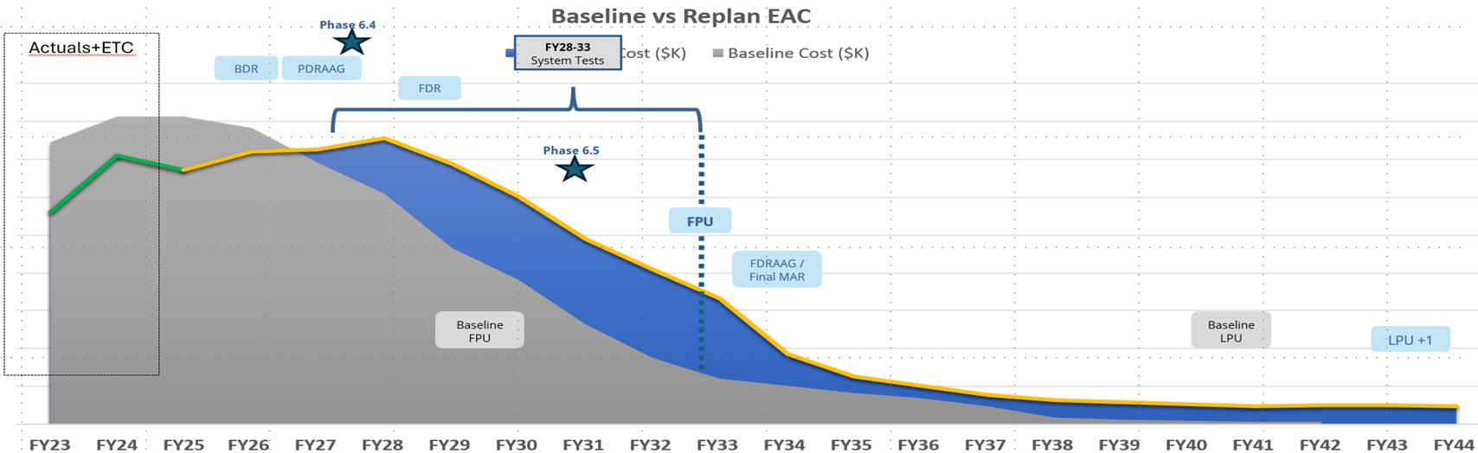
Cost & Resource Phasing
Expenditure Category | Hours (Labor) | Burdened Labor ($K) | Purchases ($K) | Travel & Chargebacks ($K) | Total EAC ($K)
Previous Baseline | Original Planned | $ --- | $ --- | $ --- | Baseline Ref
2025 Replan EAC | Recalibrated TLEs | Optimized | Phased Commits | Refined Rates | Updated Replan
Variance / Delta | Scope Extension | FYNSP Aligned | HW Schedule Shift | Efficiency Savings | Target Compliant
Simplicity Drives Results: Converting raw P6 schedule data into standardized cost categories enabled rapid executive decision-making and clear peer review validation.

Slide 16


LOE Account Simplification
Previous Challenge
Applied Solution
Level of Effort (LOE) accounts were fragmented across multiple work packages by engineer type and fiscal year, obscuring true long-term resource requirements.
Re-categorized and labeled LOE inputs (e.g., SEI_Elec_Desgn, SEI_Mech_Desgn) to provide management with direct visibility into multi-year TLE trends.

Slide 17





Cost Credibility & Path Forward
Our process included many iterative assessments of the cost estimate leading into the “pencils down” date and the refinement that occurs ahead of executive reviews
Previous lessons learned became the criteria we used in getting to a credible cost estimate
Comprehensive
Well-Documented
Accurate
Credible
Includes all direct and indirect lifecycle costs.
Clear ground rules, assumptions & replicate data.
Unbiased, stripped of overly optimistic assumptions, and continually updated.
Rigorous sensitivity, risk & uncertainty testing.
Looking Ahead to Phase 6.4 & FY27 BCR
The successful 2025 Replan positions the W87-1 program strongly to submit a defendable Baseline Cost Report (BCR) in FY27.
Continuous improvement of best practices, active change control, and close technical SME partnership will sustain cost credibility as scope evolves.

