Slide 1

Introducing the Schedule Community of Practice
Derrian Doblado, NA-181
Federal Lead

Slide 2
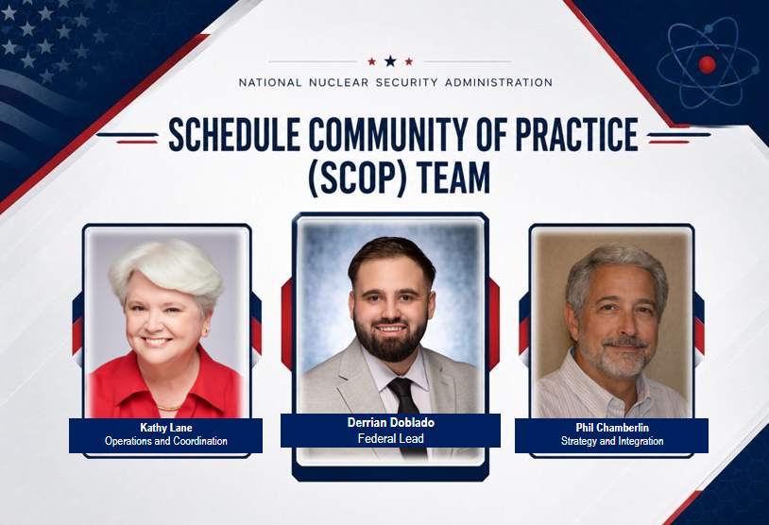
Meet the Team

Slide 3
What is Schedule?
Physical Work Being Performed
Feedback Loops
Bilateral Transfer of Information
Start
Raw Materials
Finish/FPU
Schedule
Initiating | Planning | Execution | Monitor & Control | Closeout

Slide 4
What is Schedule?
Risk
Physical Work Being Performed
Risk
Risk
Risk
Risk
Feedback Loops
Bilateral Transfer of Information
Risk
Start
Raw Materials
Finish/FPU
Schedule
Risk
Initiating | Planning | Execution | Monitor & Control | Closeout
Risk
Risk
Risk
Risk
Risk
Risk
Risk

Slide 5
What is Schedule?
Risk
Physical Work Being Performed
Risk
Cost
Feedback Loops
Bilateral Transfer of Information
Start
Raw Materials
Performance Measurement
Performance Measurement
Finish/FPU
Historical Data
Schedule
Risk
Initiating | Planning | Execution | Monitor & Control | Closeout
&
Cost
Risk
Lessons Learned
Risk

Slide 6
Why Schedule Matters
Schedules are models of the work can be performed
Schedules drive visibility into critical path, risk, and performance
Inconsistent practices lead to rework, confusion, and weak decision support.
Provides cost estimate time-phasing.

Slide 7
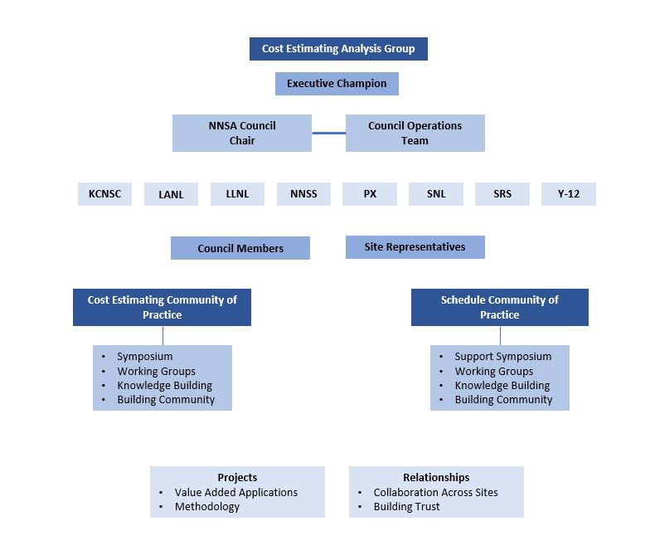
CEAG Governance Structure

Slide 8
SCOP Goals
Promote scheduling as a professional discipline across the NSE
Develop and encourage the application of consistent enterprise-wide scheduling framework
Improve scheduling collaboration across the NSE
Provide a forum for community members to share best practices and promote innovation
Bring together the scheduling community to define common needs and practices

Slide 9
SCOP Measures of Success
Active program office and site participation, knowledge sharing, and learning​
Regular growth of the scheduling body of knowledge​
NNSA and member sites value the SCOP contribution​
Activities supported by NNSA and M&O Sites management​

Slide 10
Engagement Forums
Quarterly Site Meetings
Monthly SCOP Meetings
Scheduling Track @ Risk Summit
  November 3-5 @ Y-12
CECOP Annual Symposium

Slide 11
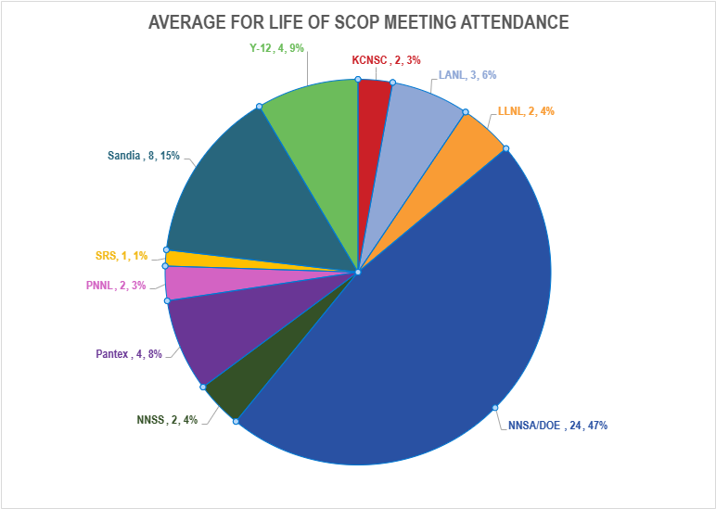
Participation
Participating Offices
NA-1.3 | NA-191
NA-125.2 | NA-192
NA-125.3 | NA-193.1
NA-125.4 | NA-90.1
NA-125.5 | NA-922
NA-152.32 | NA-MB-90
NA-18 | NA-MB-92
NA-181 | NA-MB-922
NA-182 | NA-MB-923
DOE PM-30
Average for Life of SCOP
Attended | Invited | % Attended
52 | 152 | 34%

Slide 12
SCOP Projects
E-SURA/SCORE
Training
CEAG Program Review Support

Slide 13
Contact Information
Contact information
  SCOP email scop@nnsa.doe.gov
  Connect.gov page https://community.connect.gov/x/5SHilw
  PowerPedia page https://powerpedia.energy.gov/wiki/Schedule_Community_of_Practice
Schedule Community of Practice (SCOP) | Department of Energy
Questions???

Slide 14
Backup Slides

Slide 15
Early Accomplishments
Establish initial SCOP representatives
Review existing CEAG charter and propose new language for SCOP
Set up Connect.gov page https://community.connect.gov/x/5SHilw
Set up PowerPedia page https://powerpedia.energy.gov/wiki/Schedule_Community_of_Practice
Create email entity for SCOP (scop@nnsa.doe.gov)
Kickoff meeting
Set up recurring meetings for SCOP (currently monthly – 2nd Wednesday of each month @ 2 pm ET )
Create an outward facing web page on energy.gov/NNSA (like CECOP at https://energy.gov/nnsa/cecop)
Join CECOP planning for potential scheduling focus area(s), a possible third symposium track, etc.

Slide 16
SCOP Projects
Common PCP Consolidation
  SCOP hosted a structured information session between NA-125 and stakeholders to collect and consolidate over 160 comments for formal review and submittal into SUMMT.
Digital Platforms
  External facing webpage, Connect.Gov, PowerPedia, NNSA Sharepoint
Resources and Training Materials
  GAO, NASA, EMDI, Lessons Learned, DOE Information,

Slide 17
Past Projects
Schedule Fundamentals for CAMs
  Training materials key scheduling principles within a project control environment, interpret and utilize Integrated Master Schedules NIMS and identify and manage schedule risks.
Common Construction Codes
  Develop a common “construction” summary schedule to eventually allow rolling up “construction” projects to a or multiple portfolio levels.
Schedule Estimating Workshop

