Slide 1
Independent Chain Analysis of Risk and Uncertainty for Schedules (ICARUS)
Schedule Estimating for Capital Acquisition Projects
Abby Schendt NA-BA-44
Stephen Colodner NA-BA-44
August 2026

Slide 2
Agenda
NNSA and Schedule Analysis
Icarus
Preliminary Model and Results
Conclusions
Future Work and Data Needs

Slide 3
NNSA’s Schedule History on Capital Acquisition Projects
"For example, two of the four projects are part of the Uranium Processing Facility family of projects (in Tennessee). They are a combined $2 billion over their cost baselines and 6.5 years behind their schedule baselines." -GAO-23-104402
“However, the baseline [LAP4-30B] project completion date of August 2030 is 4 years later than the high end of the preliminary date range approved at the alternative selection milestone in April 2021 and the statutory requirement to produce 30 pits per year in 2026.” -GAO-23-104402
"Too often project cost and schedule information are deficient and do not accurately reflect current project status or provide acceptable forecasts, so effective project management and oversight is impaired.“ - GAO-23-104402
To date, GAO's recommendation for NNSA to have an integrated master schedule consistent with best practices remains open. As the GAO has pointed out, without having a schedule, NNSA is 'increasing the likelihood of disruption and delay' for the program.^{[1]} The lack of a schedule also inhibits Congress's ability to provide responsible appropriations and policy...-Letter from Congress to Secretary Chris Wright
However, a May 2022 peer review, a September 2022 letter from the project's federal contracting officer... raised concerns about the [TA-55]project's ability to be completed within the schedule baseline…” - GAO-23-104402
"Facility recapitalization projects have been a continuing source of program schedule delays and cost overruns that...have significantly undermined NNSA’s credibility.“ - Letter from Congress to Secretary Chris Wright
Notes:
GAO-23-104402, National Nuclear Security Administration: Assessments of Major Projects
Letter to DOE & NNSA re Pit Production Mismanagement

Slide 4
What’s happening?
Analysis of NNSA Capital Acquisition Projects indicates some of the delays can be attributed scheduling practices
Program pressure to deliver on a specific date – Schedules are built backwards (forced) often resulting in negative float
Optimistic assessments of technical and design maturity- Leads to unplanned re-designs, testing, and validation
Logic loading – Misidentified critical paths
Resource loading issues- Misalignment in the schedule compounds the ability to maintain schedule in an uncertain budgetary environment

Slide 5
Impacts of project delays
Project risk mitigation is limited – Without an upfront, clear understanding of schedule risks, decisions are reactive and mitigation windows are missed
Resources are not optimized -Early warning works best if we can analyze schedule variance and allows us to reallocate resources or replan schedules
Loss of trust with stakeholders – Increased schedules often lead to increased costs (OMB/Appropriators) and increases risk to program deliveries (DoW)

Slide 6
Schedule Analysis Methodologies
Standard Methodologies
Milestone Analysis- uses historical data
Schedule Estimating Relationships- uses historical data
Bottoms Up- Relies on SME input
Newly Developed Methodologies for NNSA Projects
Independent Chain Analysis of Risk and Uncertainty in Scheduling (ICARUS)- Uses SME input and adds historical performance
TRL/MRL ¹ - Time to completion based on technology and manufacturing maturity; uses SME input and adds historical performance
NIMS adjusted earned value estimate (NAEVE) ² - uses historical data
Presented in in a different brief
Still in development

Slide 7
ICARUS
ICARUS utilizes both Markov Chain Analysis and Text Analysis
Markov Chain Analysis helps model the effect of delays, duration growth, and scope growth on the schedule
  This is used in current schedule uncertainty runs through P6
Text Analysis is used to look at task descriptions to measure to prior performance of similar tasks across prior projects
  This is the motor that forces historical performance into the Markov model

Slide 8
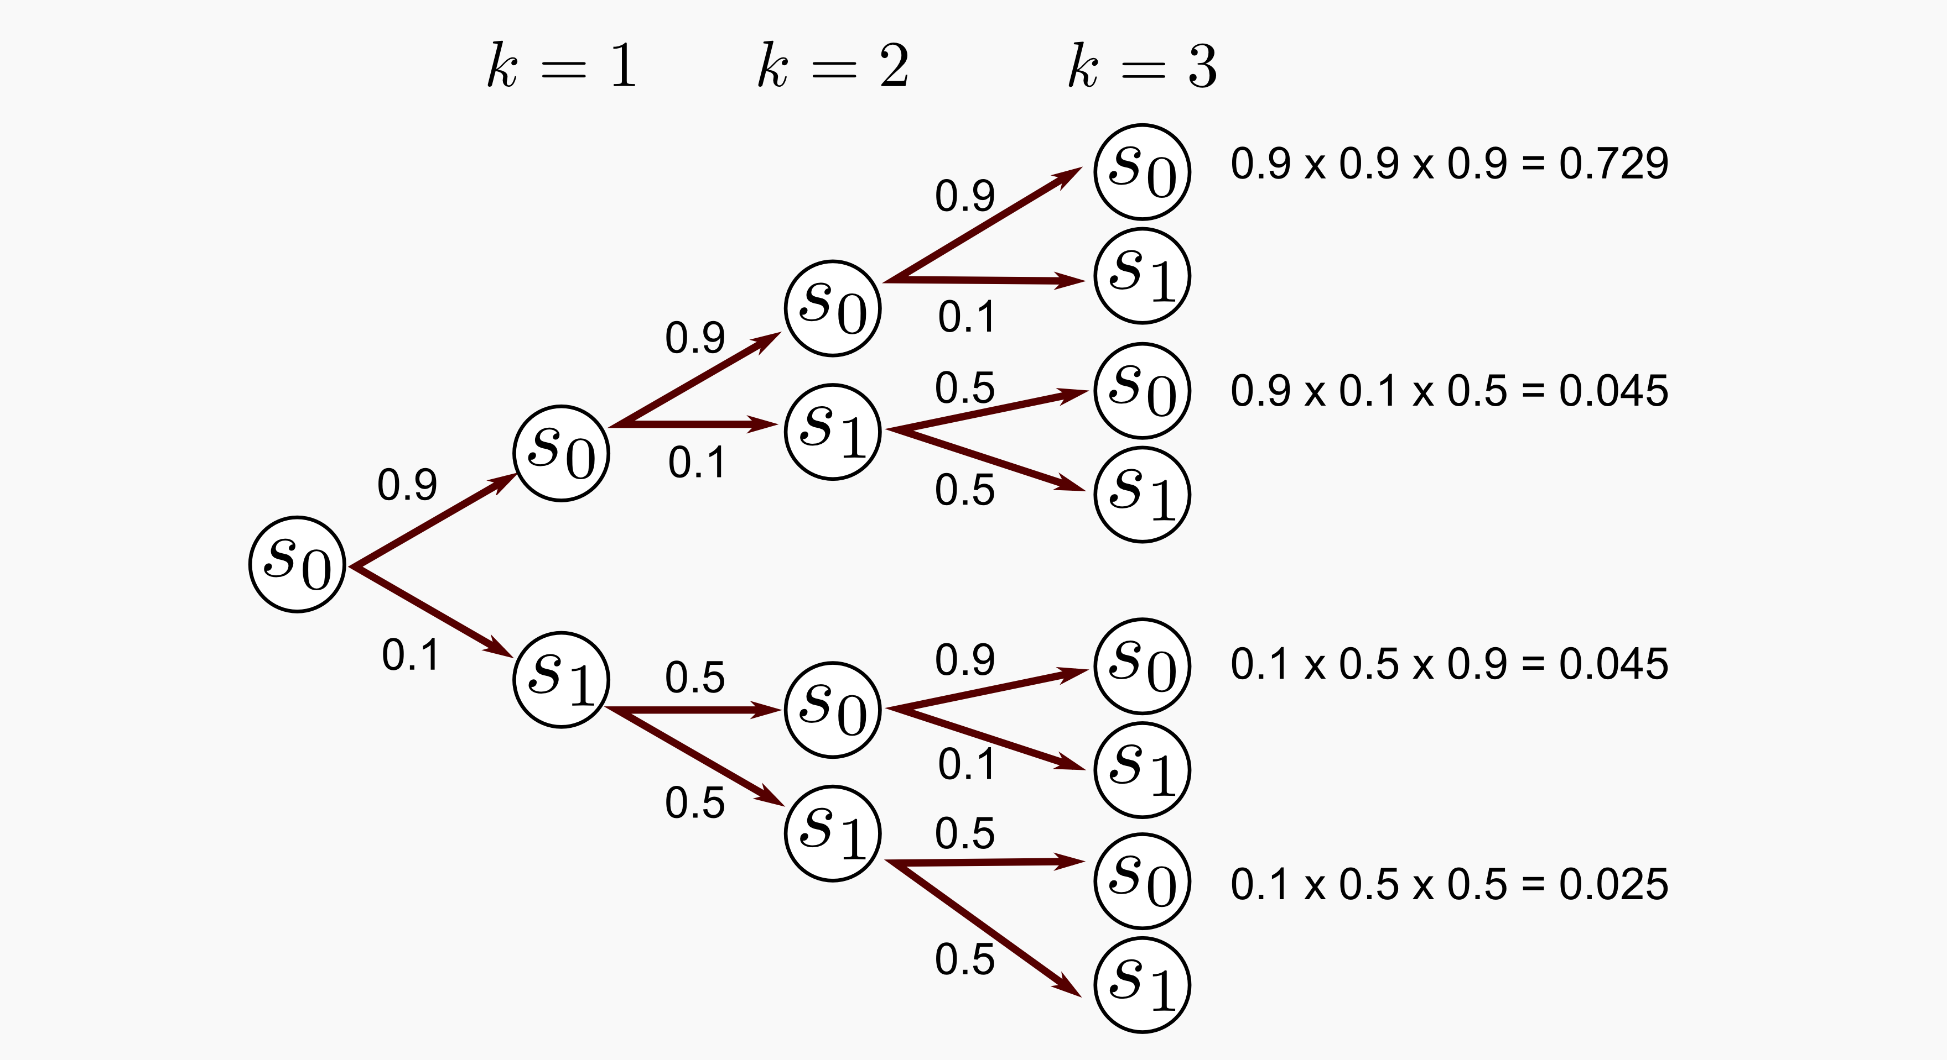
What is a Markov Chain Analysis?
Studies the movement of a process that moves between a set of states/events based only on the current point in the chain
Assumptions are that movement to the next state is only dependent on the current state
Analysis required calculating the probability of a future state based only on the current state
Allows for a structured way to model and predict the behavior in a stochastic system

Slide 9
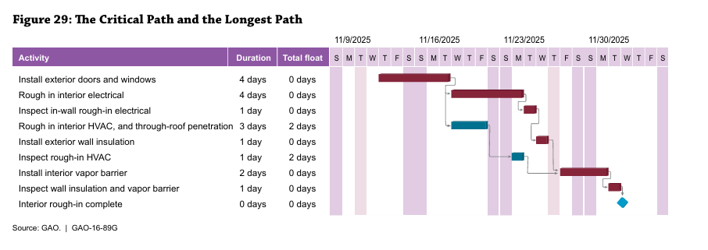
Markov Chain Analysis in Schedules
By establishing a probability of each task slipping and having predecessors/successors, the effects of task slippage can be measured at total program level
Probabilities can be established via SME input or via historical data

Slide 10
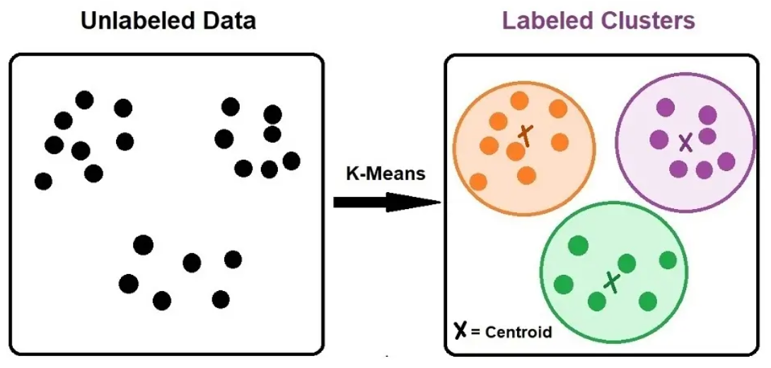
Introduction to Text Analysis
Uses statistical technique to interpret, classify, and model textual data
Takes unstructured data (like task descriptions) and turns it into structured data that can be analyzed for patterns
Currently we focus on keyword extraction, but we hope to be able to examine to include text classification and concordance analysis

Slide 11
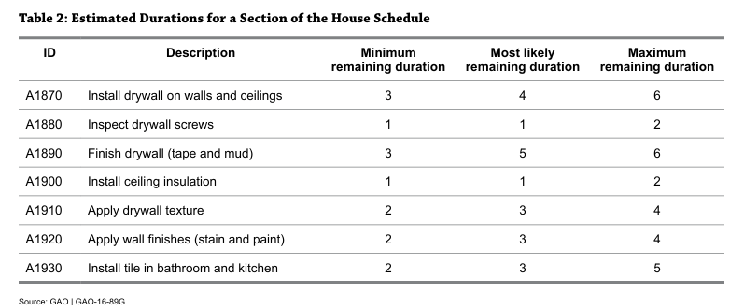
Text analysis for Schedules
Using text analysis we can utilize the larger data set provided by the NIMS across all projects to determine past task performance (probability of delays and distribution of delays)
We can look for key words, group tasks, or find common tasks to evaluate against a standardized baseline

Slide 12
First Version Model
Used pre-identified key words
NIMS data was mapped manually across 4 programs
  Utilized NIMS from program offices so contained pre-CD-2 data
Model existed across excel, R code, and python
Model was limited to reviewing schedule slip and not duration growth (compounding occurred in early attempt to combined)
Data limitations prevented fully chain analysis with predecessors and successors
Model was based on preselected key words (~100) to generate a logistic growth model (for probability of slip) and a parametric model (for size of slip)

Slide 13
First Version Model Results
Pre CD-2 Activities
Post CD-2 Activities
Pre-CD-2 activity delays are tied to design/engineering tasks (architecture, design) and milestone reviews (gate)
Post-CD-2 activity delays are often tied to equipment (procurement and instrumentation) and HVAC (ventilation)

Slide 14
Second/Third Version Model
Used a naïve 3 letter identifier (second version) and a cleaned text naïve identifier (third version)
Model relied on all PARS data
  Only post-CD-2 activities
Model utilizes automated mapping of schedules and allows for a greater intake of schedules
  Mapping depends on a perfect match of Task_ID and Task_Description
All steps are in python and utilize machine learning to predict likelihood of slip, size of slip, and duration growth
Data limitations prevented fully chain analysis with predecessors and successors

Slide 15
Understanding Historic Schedule Performance
Using large programmatic sets, we can look at project performance and benchmark to other projects’ performance
  Monitor project progress
  Check for schedule realism
  Understand historical performance on key tasks

Slide 16
Project Performance Cross Section

Slide 17
Conclusion
This methodology allows us to baseline project schedule performance on tasks against predictions based on historical tasks with similar names and to independently assess schedule realism at lower task items
Further work will also help us identify high risk/high cost schedule tasks to more efficiently identify areas for improvement
  Example 99% of all tasks associated with project reviews experience a slip

Slide 18
Future Work
Data Needs
Work to better look at the impact of task growth on schedule delays and model both impacts on tasks
  Right now we see tasks slipping but not the cause of those slips
Perform network analysis to identify high risk / high reward tasks to bring schedule to the left
Cluster tasks into groups for more robust analysis
NIMS directly from the program office
  Allows the capture of pre-CD-2 work
  NIMS with logic information still intact
Survey of tasks/keywords to feed into mapping for language model

Slide 19
Thank you!

Slide 20
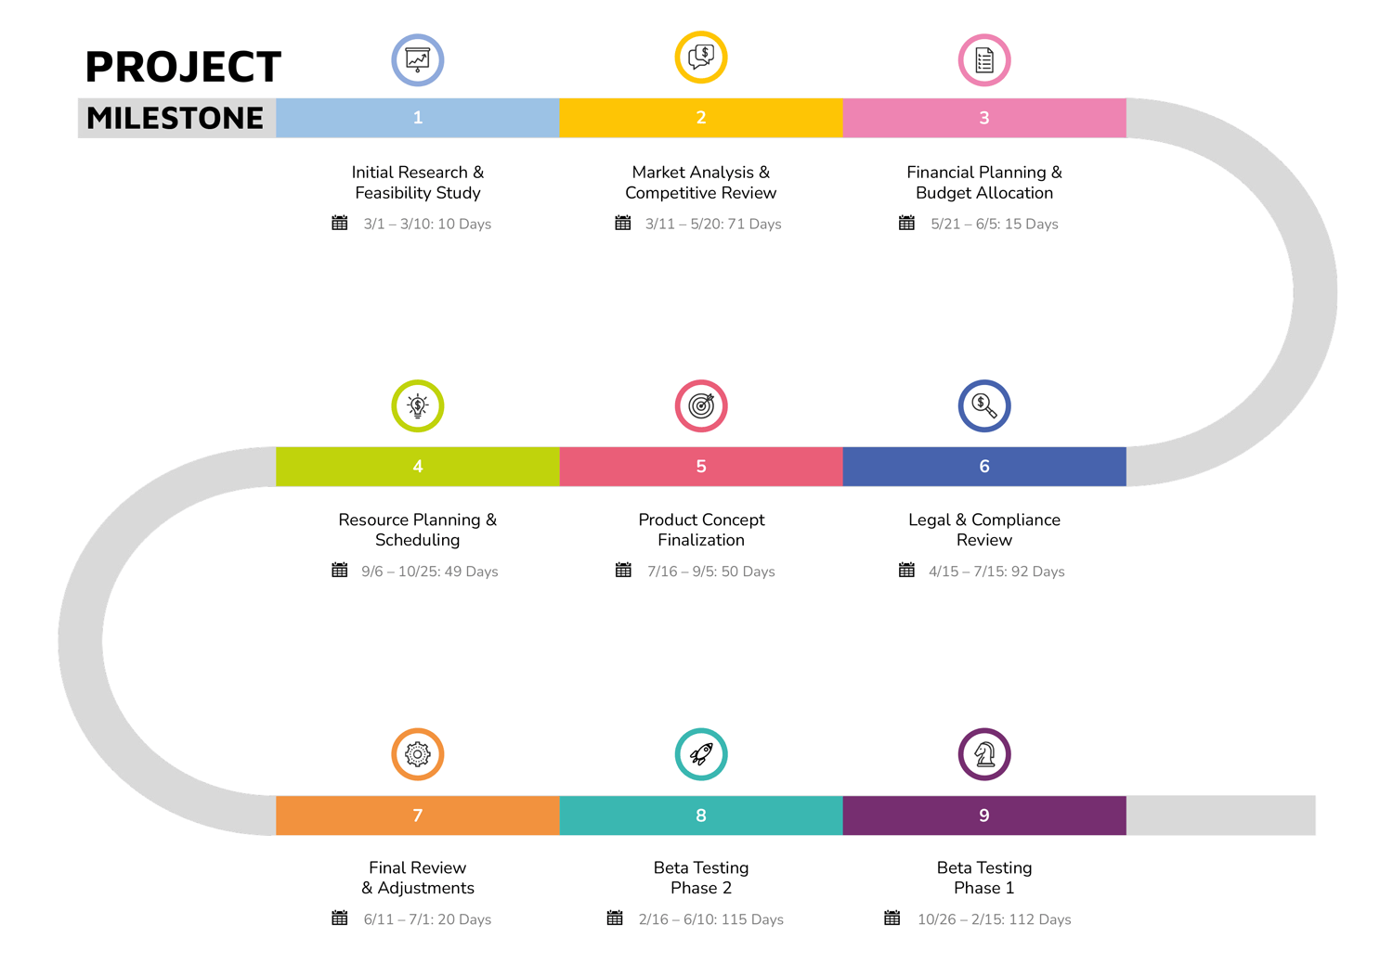
Milestone Analysis
Forecasts schedules using key project checkpoints over time
Pros
  Utilizes historical actuals to project future analysis
  Allows independent reviewers to assess schedule realism
  Easy to implement with very little data
Cons
  Is not scope adjusted, and depends heavily on nearly perfect analogies
  Milestone definitions change

Slide 21
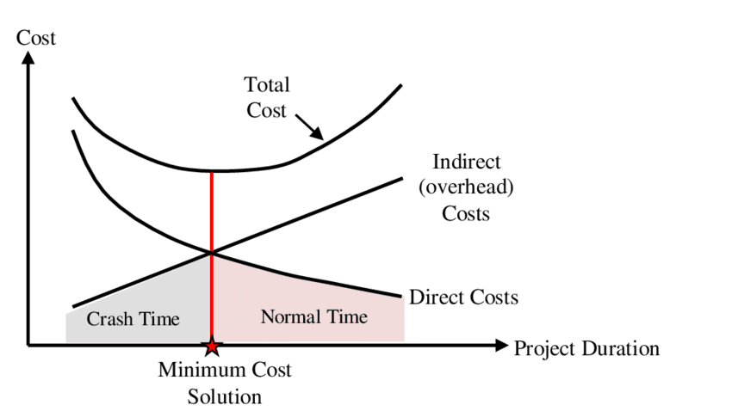
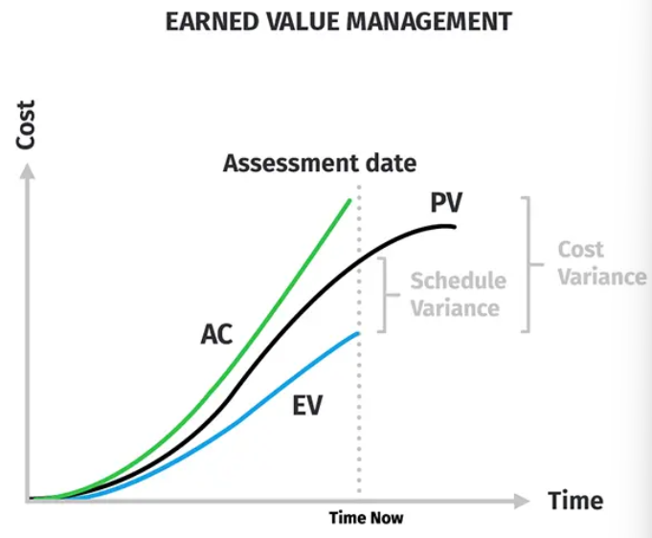
Schedule Estimating Relationship (SER)
Mathematical formula that calculates a projects duration based off a specific technical or cost parameter
Pros
  Utilizes historical actuals to project future analysis
  Repeatable and allows for some scope adjustment
  Allows independent reviewers to assess schedule realism
Cons
  In reality, schedule drives costs. In SERs, cost is often used as the driver of schedule
  Access to consistent, analogous technical data can be difficult, reducing accuracy

Slide 22
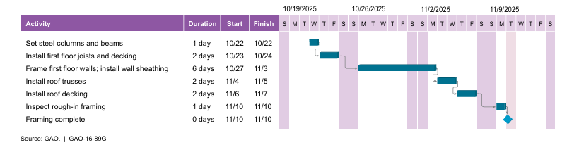
Bottoms-up Analysis
SME estimates are used to plan each task; Tasks are aggregated to determine total project duration
Pros
  Low-level schedule with a detailed list of tasks; allows for program management
  Well developed field with known best practices and health metrics
Cons
  Relies on SME input for duration and risks assessment (often leads to optimism bias)
  Difficult to verify accuracy of SME assessments
  Allows for negative float

