Slide 1
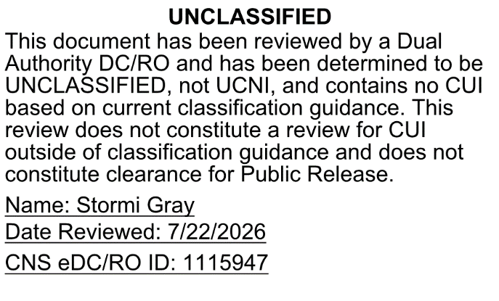
Improving Estimate Accuracy through Probability Calibration and Uncertainty Decomposition
Kimberly Scott, PMP, PMI-RMP
Consolidated Nuclear Security (CNS)
August 2026

Slide 2
Better Models Begin with Better Judgments
Today we will explore practical ways to improve the inputs that determine the quality of every estimate.
How?
Recognize overconfidence in estimate assumptions.
Break large uncertain estimate items into smaller drivers.
Calibrate confidence levels – your own and your team’s.

Slide 3
“That Estimate”
Think of an estimate that surprised you.
Not because someone was careless,
but because everyone genuinely thought that it was right.
What happened?
Scope growth
Productivity assumptions
Labor availability
Material pricing
Field conditions
Design maturity
Schedule compression
Vendor quotes aging out

Slide 4

Common Traps in Estimating
Anchoring
Story Building
Pattern Recognition
Associative
Substitution
Overconfidence
Confirmation Bias
Availability
Attribute Substitution

Slide 5

Quick Calibration Warm Up
How tall is the sphere in Las Vegas?
How many hotel rooms does the Bellagio have?
How long is the Las Vegas Strip?
What is the highest temperature ever officially recorded in Las Vegas?
How many working vintage signs at the Las Vegas Neon Museum?
Your Challenge:
Write down your single-point guess for each question. (How confident are you that your exact number is correct?)
Now, expand that guess into a low and high range where you are $90\%$ confident the true answer is captured.

Slide 6
Quick Calibration Warm Up
How many were right? Were you more overconfident, underconfident, or about right?
How tall is the sphere in Las Vegas? | 366 ft.
How many hotel rooms does the Bellagio have? | 3,933
How long is the Las Vegas Strip? | 4.2 mi
What is the highest temperature ever officially recorded in Las Vegas? | 120°F
How many working vintage signs at the Las Vegas Neon Museum? | 32

Slide 7

What Calibration Means
Calibration is the relationship between confidence and reality.
When you say you’re 80% confident, you should be right 8 out of 10 times.
Calibration isn’t about never missing.
It’s about knowing how likely you are to miss.

Slide 8
How Do We Get Better Calibrated?
Consider the opposite
Before defending the number, try to defeat the number.
Ask: What would make this estimate wrong?
Use the outside view
Look at historical actuals of similar projects first
Ask: What happened on similar work before?
Separate knowledge from confidence
Guard against false confidence on standard tasks
Ask: Do I know this or does it just feel familiar?

Slide 9

Technique 1: Consider the Opposite
What would make this estimate wrong?
Examples
  What would make labor productivity worse than assumed?
  Do overlaps or gaps exist between quotes?
  What scope is not fully mature?
  What field condition could change the install cost?
  What assumptions are we treating as fact?
Before Defending the Number
Try to Defeat the Number

Slide 10

Technique 2: Use the Outside View
Use:
Historical actuals.
Similar project overruns.
Prior productivity rates.
Change order history.
Quote aging patterns.
Rework trends.
Escalation history.
What happened on similar work before?
Instead of starting with:
  This project should be straightforward.
Start with:
  How often did similar work stay straightforward?
The inside view explains why this project is different. The outside view asks what usually happens before we make exceptions.

Slide 11

Technique 3: Separate Familiarity from Evidence
Familiar work can create false confidence, but …
familiar is not the same as known.
We’ve estimated this type of system before.
We know this vendor.
This looks just like the last one.
The factor is standard.
We always use that productivity assumption.

Slide 12

Technique 4: Name the Bet
What are we actually betting is true?
We are betting that…
  Quantities will not grow materially.
  There are no scope gaps between our contract packages.
  Labor productivity will hold.
  Access will be available.
  Design will not drive rework.
  Escalation will stay within assumptions.
  Schedule compression will not force overtime.
Every estimate contains hidden bets. Calibration means knowing which bets you are making.
The harder part is identifying the multiplicative factors that quietly make the estimate grow.

Slide 13
Final Calibration Challenge
Answer with a low and high range for each question.
How many performances did Elvis Presley give during his Las Vegas residency?
How many elevators are in the Eiffel Tower in Las Vegas?
How much concrete was used to build Hoover Dam?
How many visitors does Red Rock Canyon receive annually?
At full pool, what is the maximum depth of Lake Mead?

Slide 14

The Equivalent Bets Test
Would you bet your own money on your answers?
  Win $100 if the answer is inside your range.
  Lose $900 if it’s outside.
No? Adjust each answer to a range you’d be willing to make this bet.

Slide 15
Final Calibration Challenge
Did you beat your first score? Were you more overconfident, underconfident, or about right?
How many performances did Elvis Presley give during his Las Vegas residency? | 636
How many elevators are in the Eiffel Tower in Las Vegas? | 2
How much concrete was used to build Hoover Dam? | 3.25 million cubic yards
How many visitors does Red Rock Canyon receive annually? | > 3 million
At full pool, what is the maximum depth of Lake Mead? | ≈ 532 ft

Slide 16
Why Betting Works
A bet exposes whether confidence is real or decorative.
Estimate reviews often reward clean answers.
Real decisions require honest uncertainty.
Betting language forces us to separate
  what we know,
  what we assume,
  what we hope,
  and what we actually stand behind.
Notes:
Calibration tells us why we are uncertain.
Decomposition tells us why.

Slide 17
Calibration to Decomposition
Your bet didn’t feel safe – Why?
Calibration:
I’m less certain than I thought
It’s what assumptions are uncertain
Equivalent bet:
Would I risk my own money?
It isn’t necessarily about which number is wrong…
Calibration
identifies
uncertainty.
Decomposition
explains it.

Slide 18
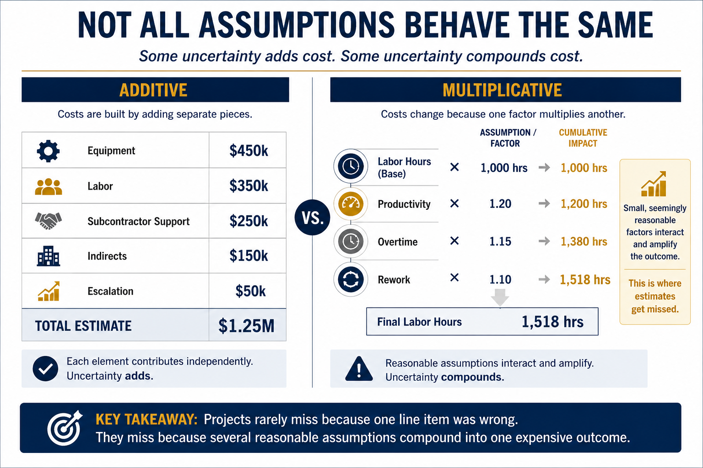

Slide 19
Local vs Structural Uncertainty
Local Uncertainty | Structural Uncertainty
Vendor Quote | Productivity
Equipment Cost | Design Maturity
Permit Fee | Congestion / Access
Material Price | Contract Constraints
One Work Package | Multiple Work Packages
Usually Additive | Often Multiplicative
Can we improve this estimate?
Structural assumptions deserve disproportionate attention.
Notes:
We already break costs into work packages
We Improve estimates by breaking structural uncertainty into discrete assumptions.

Slide 20
Uncertainty Lives in the Relationships
Access
Productivity
Labor Hours
Schedule
Escalation
Cost
Instead of asking
“What is labor?”
ask
“What affects labor?”
Most uncertainty propagates through relationships—not isolated variables.

Slide 21
The Real Goal – Make Structural Uncertainty Testable
How?
What are our hidden assumptions?
  Productivity?
  Access?
  Design?
  Learning curve?
What relationships are hidden?
We don’t always improve the estimate just by debating numbers.
We improve them by defining structural uncertainty.
Productivity
Schedule
Field Overhead
Cost
Quantities
Design Maturity

Slide 22

Follow Uncertainty Upstream
Isolate the variables.
  What are your high risk variables from the estimate circle?
Build a cross-impact matrix.
  If Variable A changes, does it directly force a change in Variable B?
Map inputs and outputs.
  What feeds you and what do you feed?
Define additive or multiplicative.
  What is a compounding path?
Identify the tipping points.
  Where does the original assumption break?
Which assumption started the chain?
The earlier we identify structural uncertainty, the fewer surprises remain downstream.

Slide 23
The Answer
42
“The Answer to the Ultimate Question of Life, the Universe, and Everything is 42.”
- The Hitchhiker’s Guide to the Galaxy
Notes:
n the story, a group of hyper-intelligent beings commissions the supercomputer Deep Thought to determine the Ultimate Answer to Life, the Universe, and Everything. After 7.5 million years, Deep Thought reveals the answer: 42. However, the beings realize that while they have the answer, they do not know the actual question, rendering the answer seemingly meaningless without context

Slide 24

Change the Question, Change the Outcome
Old Question
Is the quantity supported? |  | How do quantity changes affect labor?
Is the quote complete? |  | Where are the gaps between contract interfaces?
Is productivity realistic? |  | What site constraints degrade this rate?
Is the design mature enough? |  | What are the downstream impacts of a design change?
How do we close gaps? |  | What testable evidence narrows this uncertainty?
New Question

Slide 25
Reference Prompts
Labor & Productivity
What drives our baseline productivity?
Site & Systemic
What shared resources bottleneck the work?
Is labor tightly coupled to material delivery windows?
Is there a steep learning curve or skill gap?
Where do subcontractor hand-offs create idle
time?
How does congestion
scale field overhead
and indirects?
Contracts & Work Packages
Do contract terms incentivize collaboration or just shift risk?
Do overlapping work packages create scope gaps or double-counting?
Are subcontractor change-order terms additive or compounding?
Schedule Constraints
Which scheduling milestones are hard, inflexible gates?
How much schedule float exists before overhead costs begin to scale?
Are we relying on aggressive, unproven, or concurrent work schedules?
External & Macro Forces
What regulatory approvals or permits act as absolute schedule gates?
Are critical materials vulnerable to tariffs, trade rules, or geopolitical delays?
Is the local labor market experiencing high turnover or wage inflation?

Slide 26
Activity: Decompose the Uncertainty
Scenario: You are estimating the installed cost for a specialty equipment package. Design is not final. Vendor quotes are preliminary. Installation will occur during a constrained outage window.
As a team, identify:
1. The structural uncertainty
2. The hidden relationships
3. The multiplier
4. The best evidence to reduce uncertainty
Don't improve the estimate;
improve your understanding of the uncertainty behind it.

Slide 27
Changing the Estimate Review
Before Structural Decomposition | After Structural Decomposition
Adversarial & Subjective | Collaborative & Objective
Debates over safety margins, contingency, and individual line items | Jointly analyzing linkages, cascading impacts, and testing assumptions
Defensive, opinion-based debates | Proactive, evidence-based alignment

Slide 28

How do we help the team calibrate?
Technique 1: Separate confidence from the estimate.
Technique 2: Use the confidence ladder.
Technique 3: Ask, “What makes us wrong?”
Technique 4: Ask for the outside view.
Technique 5: Make hidden bets visible.
Technique 6: Use anonymous first votes.
Technique 7: Track estimates like forecasts.

Slide 29

Questions?

Slide 30
References & Additional Resources
Judgment, Calibration, and Forecasting
Hubbard, D. W. (2020). How to Measure Anything: Finding the Value of “Intangibles” in Business (4th ed.). Wiley.
Hubbard, D. W. (2020). The Failure of Risk Management: Why It’s Broken and How to Fix It. (2nd ed.). Wiley.
Kahneman, D. (2011). Thinking, Fast and Slow. Farrar, Straus and Giroux.
Kahneman, D., Sibony, O., & Sunstein, C. R. (2021). Noise: A Flaw in Human Judgment. Little, Brown Spark.
Tetlock, P. E., & Gardner, D. (2015). Superforecasting: The Art and Science of Prediction. Crown.
Tetlock, P. E. (2005). Expert Political Judgment. Princeton University Press.
Estimation and Uncertainty
Savage, S. L. (2012). The Flaw of Averages: Why We Underestimate Risk in the Face of Uncertainty. Wiley.
Taleb, N. N. (2007). The Black Swan: The Impact of the Highly Improbable. Random House.
Decision Making and Project Thinking
Klein, G. (2007). Performing a project premortem. Harvard Business Review, 85(9), 18–19.
Flyvbjerg, B., & Gardner, D. (2023). How Big Things Get Done. Currency.
This presentation builds on the work of researchers and practitioners who have spent decades studying judgment, forecasting, decision quality, and uncertainty. Any mistakes in interpretation are mine.

Slide 31
Thank you!
Kimberly Scott, PMP, PMI-RMP
Consolidated Nuclear Security (CNS)

