Slide 1
2026 CECOP SYMPOSIUM:
Implementing AACE Cost Estimating Frameworks on NNSA Capital Projects
Presenter: Michael Nosbisch, CCP PSP FAACE
Date: August 12, 2026

Slide 2
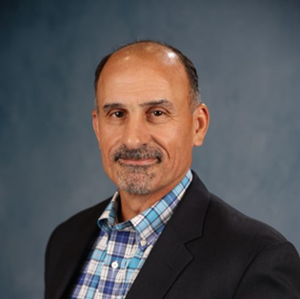

Speaker Introduction
More than 35 years of overall experience
  Currently Director of Project Controls Consulting Services at Strategic Management Solutions, LLC (SMSI)
  Visiting Senior Lecturer at Texas A&M (online Masters of Construction Management program)
Past President (2011-2012) and Fellow at AACE International
Former Vice Chair of EFCOG Project Delivery Working Group
2026 CECOP SYMPOSIUM

Slide 3
Presentation Overview
NNSA manages many of DOE's largest, most complex national security capital asset projects
Capital project landscape driven by modernization of nuclear infrastructure across multiple sites (e.g., Y-12, LANL, SRS)
NNSA is considered to be a semi-autonomous agency within DOE
Although it operates with degree of independent management, NNSA is subject to DOE policy and governance
2026 CECOP SYMPOSIUM

Slide 4
Presentation Overview (cont’d)
NNSA capital projects ≥ $50 million TPC ($300 million at National Labs) are subject to DOE Order 413.3B (Program and Project Management for Acquisition of Capital Assets)
Establishes framework for project planning, execution, and oversight
Defines Critical Decision (CD) milestones, baseline management, and project governance requirements
DOE/NNSA can supplement the order with mission-specific policies and guidance where appropriate
2026 CECOP SYMPOSIUM

Slide 5
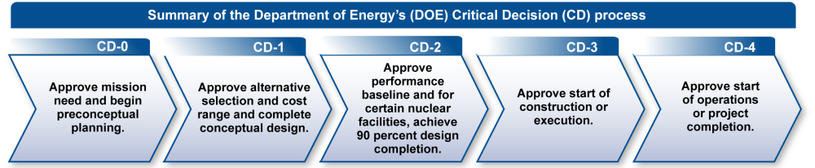
Presentation Overview (cont’d)
2026 CECOP SYMPOSIUM

Slide 6
Presentation Overview (cont’d)
DOE’s Estimating Guide (DOE G 413.3-21A) establishes a standard methodology for developing and maintaining capital project cost estimates
Defines characteristics of complete, accurate, credible, and well-documented estimates (per GAO)
Describes cost estimating process from planning through estimate development, review, and updates
Integrates scope, assumptions, risk, contingency, and estimate documentation
Provides guidance for estimate validation, independent reviews, and cost confidence
Supports consistent estimating throughout DOE Critical Decision (CD) process
Adopts AACE International's Recommended Practices as the basis for estimate classifications
2026 CECOP SYMPOSIUM

Slide 7
AACE International
Founded in 1956, AACE is the leading professional association for “cost engineering” (project controls)
Develops industry standards and best practices for Total Cost Management (TCM)
Offers globally-recognized certifications in cost management (CCP), estimating (CEP), scheduling (PSP), earned value (EVP), and risk management (DRMP)
Supports professional development through publications, training, and conferences
  Has published more than 120 Recommended Practices (RPs)
2026 CECOP SYMPOSIUM

Slide 8
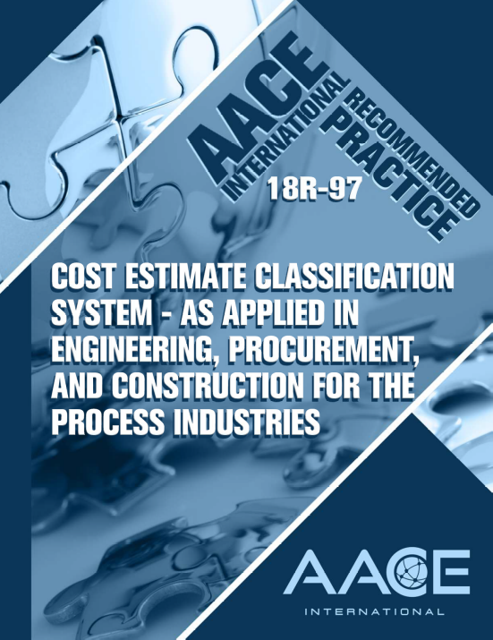
AACE RP 18R-97 (Cost Estimate Classification System as Applied in EPC for the Process Industries)
Classification system that defines estimate classes from 5 (least defined) to 1 (most defined)
  Based on level of scope definition, purpose, and methods used
  Accuracy range narrows as scope definition increases
  Meant as a guide (“recommended practice”), not a standard
  Included as appendix within DOE Estimating Guide
2026 CECOP SYMPOSIUM

Slide 9
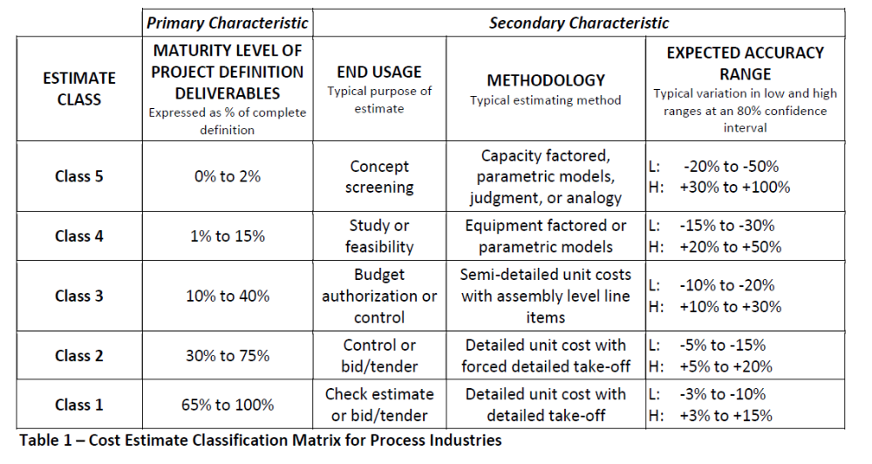
AACE RP 18R-97 (cont’d)
2026 CECOP SYMPOSIUM

Slide 10
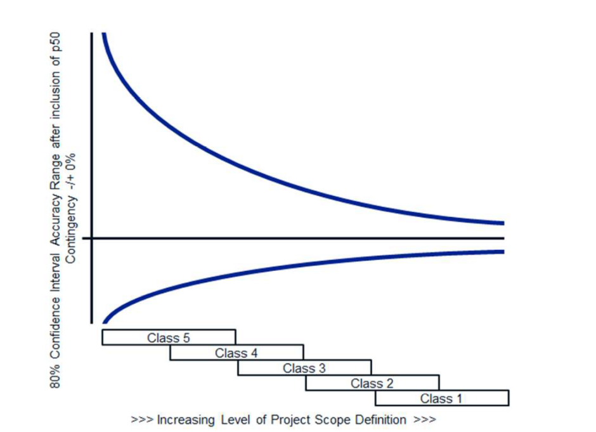
AACE RP 18R-97 (cont’d)
Estimate accuracy improves with project definition
  Depends on complexity, data, and contingency
Accuracy ranges overlap
  Lower-class estimates can match higher-class accuracy in some cases
  Accuracy must be set via project-specific risk analysis, not predetermined
~80% of outcomes should fall within ranges if contingency is sound
  High-risk projects may exceed them
2026 CECOP SYMPOSIUM

Slide 11
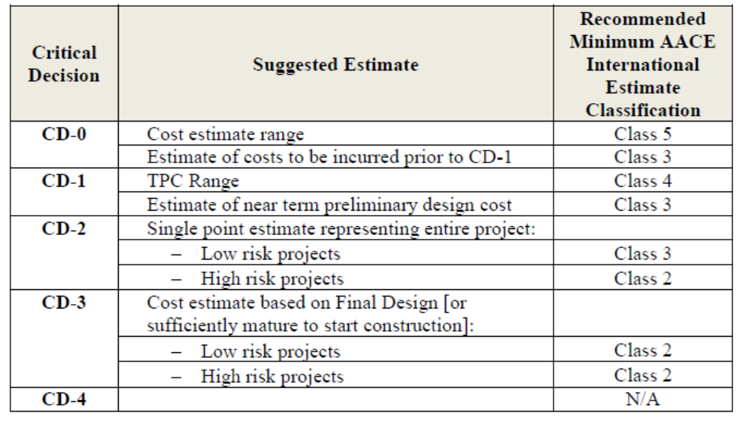
DOE Estimating Guide Application of AACE Estimate Classifications
2026 CECOP SYMPOSIUM

Slide 12
Class 5 Estimates at CD-0
Stage: Approve Mission Need
  Design maturity ~2% or less
  Typical accuracy: –50% to +100%
  ROM estimates for preconceptual or feasibility studies
  Deliverables: process flow diagrams, equipment lists, specifications
2026 CECOP SYMPOSIUM
Notes:
Example: Facility layout studies incorporating preliminary systems costs

Slide 13
Transition to Class 4 Estimates at CD-0/CD-1
Stage: Alternative Selection and Cost Range
  Design maturity: 1–15%
  Typical accuracy: –30% to +50%
  Estimate class determined by assessing project design deliverables
    As resources are invested, design matures
2026 CECOP SYMPOSIUM
Notes:
Example: Facility layout studies incorporating preliminary systems costs

Slide 14
Class 3 Estimates Toward CD-2
Stage: Approve Performance Baseline
  Design maturity: 10–40% for non-nuclear; 90% for nuclear
  Typical accuracy: –20% to +30%
  Estimate includes quantified contingency
    Provides foundation for Performance Baseline approval
  Class 2 for “high risk” projects
2026 CECOP SYMPOSIUM

Slide 15
Class 2 [Detailed] Estimates at CD-3
Stage: Approve Start of Construction/Execution
  AACE states design maturity: 30–75%
    DOE states based on final design/“sufficient to start construction”
  Typical accuracy: –15% to +20%
  Based on detailed quantity takeoffs (“forced”/derived if design not 100%)
  No differentiation between low and high risk projects
2026 CECOP SYMPOSIUM

Slide 16
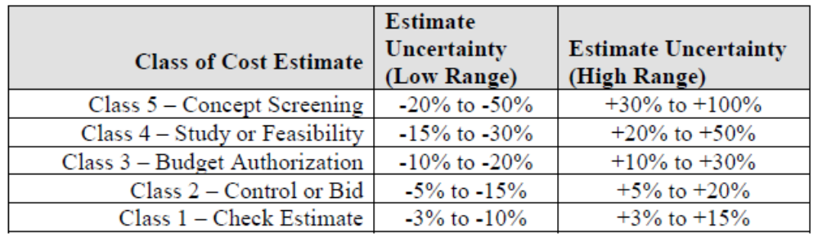
Role of Uncertainty and Risk
Risk and uncertainty ideally modeled with QRA
  One approach to account for estimate uncertainty is to use ranges established within classifications
  Provides DOE with decision-quality information
Contingency applied at P-50 during CD-1
  If large enough (≥ $100M TPC), ICE conducted at CD-2 to validate at P-80 to P-90
2026 CECOP SYMPOSIUM

Slide 17
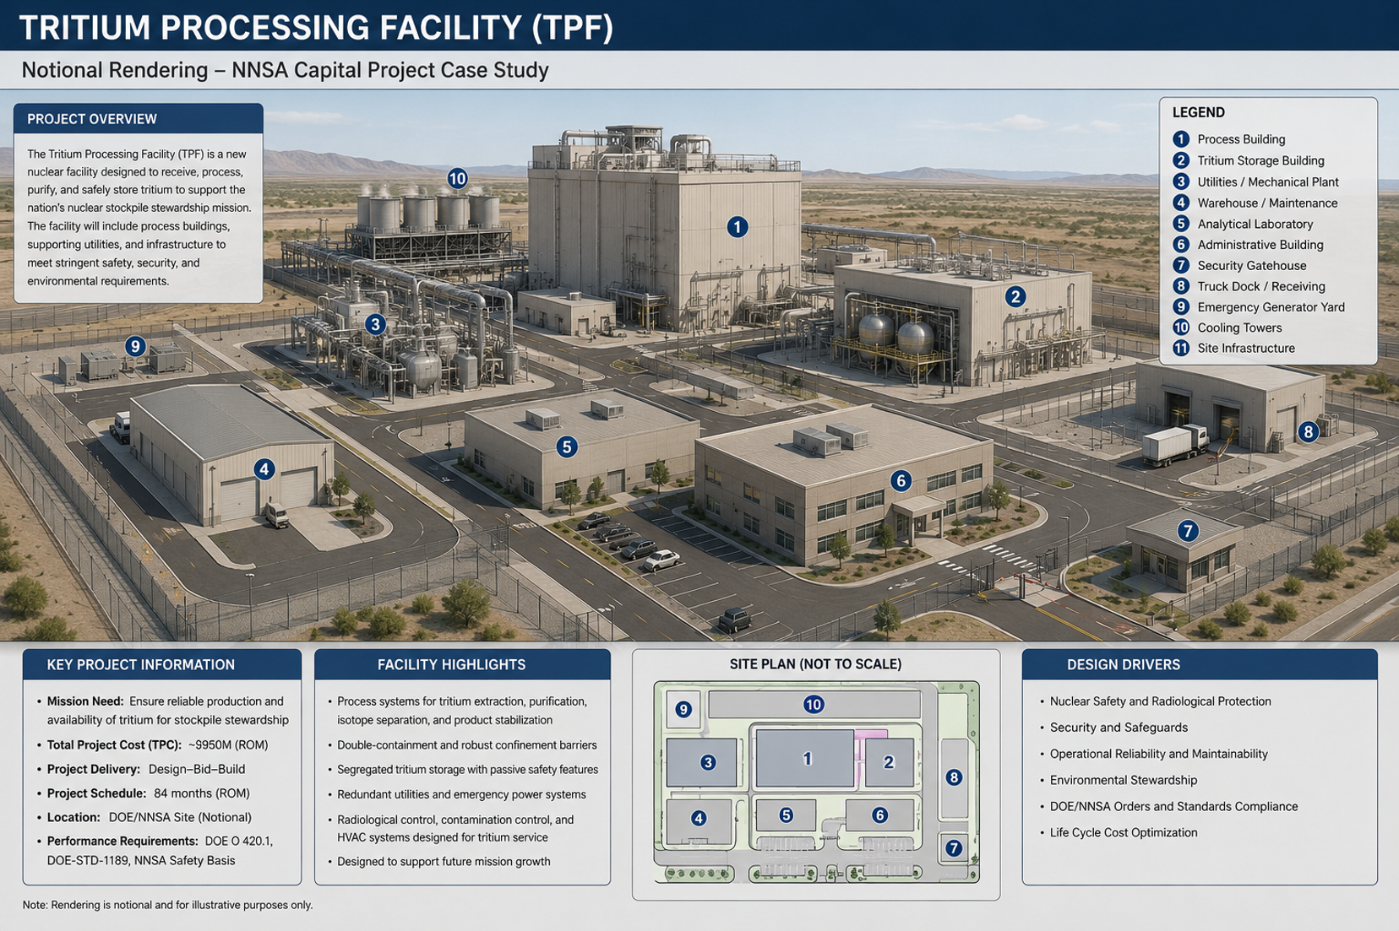
Case Study: Tritium Processing Facility (TPF)
2026 CECOP SYMPOSIUM

Slide 18
Case Study: Tritium Processing Facility (TPF)
NNSA Capital Projects present unique estimating challenges
Long project durations (10–20 years) with shifting design baselines and evolving mission requirements
Restricted access to historical cost data due to classification/security concerns
Market volatility
  Labor availability
  Specialty materials (e.g., nuclear-grade steel, high-density concrete)
  Inflation
2026 CECOP SYMPOSIUM

Slide 19
Case Study: Tritium Processing Facility (TPF)
Project Background
  The TPF is envisioned as a replacement or augmentation of aging tritium extraction and processing infrastructure, ensuring NNSA maintains the ability to support the nuclear stockpile
  Facility Scope:
    Secure processing lines for tritium handling, purification, and recycling
    Specialized gloveboxes and hot cells
    Integrated waste management systems
    Robust safety/security features
  Technical Complexity: Tritium is radioactive and requires specialized containment and monitoring systems
    Design must comply with stringent nuclear safety and environmental regulations
2026 CECOP SYMPOSIUM

Slide 20
Case Study: Tritium Processing Facility (TPF)
Project Background (cont’d)
  Schedule Challenges: Project spans multiple decades with phased CD approvals
    Escalation and workforce availability pose risks
  Estimating Challenges:
    Scarcity of comparable benchmark data due to unique tritium handling requirements
    Incorporation of evolving safety/security design criteria
    Uncertainties in long-lead equipment procurement and specialized vendor base
  Lifecycle Considerations: Beyond construction, estimates must account for 40+ years of operations, decontamination, and decommissioning costs
2026 CECOP SYMPOSIUM

Slide 21
Case Study: Tritium Processing Facility
Critical Decision (CD) | Estimate Class | Scope & Design Maturity | Estimating Methodology | Accuracy Range | Estimate Value (Hypothetical) | DOE Oversight & Notes
CD-0: Approve Mission Need | Class 5 | ~2% or less design maturity (preconceptual) | Parametric (e.g., $/SF, historical tritium facility factors) | –50% to +100% | $1.8B–$3.6B | ROM used to justify mission need; broad assumptions; minimal deliverables (e.g., process flow diagrams, equipment list)
CD-0/CD-1 Transition: Preconceptual → Conceptual Design | Class 4 | 5–10% design maturity (site layout, preliminary P&IDs) | Hybrid parametric with early unit rates | –30% to +50% | $2.2B–$3.0B | Supports CD-0 approval and informs CD-1 alternatives; DOE PM team begins review of methodology
CD-1: Approve Alternative Selection & Cost Range | Class 4–3 | 10–15% design maturity (conceptual design defined, process systems outlined) | Refined parametric, early vendor input | –20% to +30% | $2.4B–$2.9B | DOE PM validates methodology and estimate classification; uncertainty range applied; contingency via QRA at P-50
2026 CECOP SYMPOSIUM

Slide 22
Case Study: Tritium Processing Facility
Critical Decision (CD) | Estimate Class | Scope & Design Maturity | Estimating Methodology | Accuracy Range | Estimate Value (Hypothetical) | DOE Oversight & Notes
CD-2: Approve Performance Baseline | Class 3 | 30–40% for non-nuclear systems; 90% for nuclear safety systems | Detailed bottoms-up with vendor quotes and labor rates | –15% to +20% | $2.55B–$2.85B | Provides foundation for Performance Baseline approval; QRA contingency applied; Performance Baseline established
CD-3: Approve Execution Readiness | Class 2–1 | ≥90% design maturity (final design packages, construction ready) | Bottom-up takeoffs, firm vendor/subcontractor bids | –10% to +15% | $2.65B–$2.85B | DOE Independent Cost Estimate (ICE) validates TPC; point estimate with contingency & management reserve at 80–90% confidence
2026 CECOP SYMPOSIUM

Slide 23
Conclusion
DOE has historically applied AACE RP 18R-97 to establish consistency and traceability in relation to major capital projects
  Provides structured, risk-informed framework for capital project estimating
  Estimate class evolves with design maturity through critical decision milestones
NNSA appears to be moving away from DOE guidance in relation to capital projects
  Presenter’s recommendation is to maintain AACE classification system as key tenet of NNSA’s cost estimating practices and procedures moving forward
2026 CECOP SYMPOSIUM

Slide 24
Questions?
2026 CECOP SYMPOSIUM

