Slide 1
Supercharge Energy Storage Webinar
Technology Liftoff FOA
Demonstration and Validation FOA
August 29, 2023

Slide 2
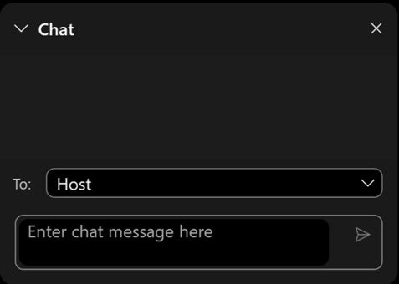
Housekeeping
Questions?
  Please submit all questions directly through the chat box and indicate which FOA your question is for.
  If you have technical questions – please put them in the chat box for the host.

Slide 3

Eric Hsieh
Eric Hsieh
Deputy Assistant Secretary for Energy Storage
Office of Electricity,
U.S. Department of Energy

Slide 4

Ben Shrager
Ben Shrager
Storage Strategy Engineer,
Office of Electricity,
U.S. Department of Energy

Slide 5
Storage Innovations 2030:
Technology Liftoff FOA
8/29/23

Slide 6

LONG DURATION STORAGE SHOT TARGET
Reduce storage costs by 90% from a 2020
Li-ion baseline...
…in storage systems that deliver 10+
hours of duration
…in 1 decade
Affordable grid storage for clean power – any time, anywhere
Notes:
Energy storage is one of the signature priorities of the department, and was the second energy Earthshot launched by DOE. The Long Duration Storage Shot seeks a 90% reduction in storage costs by the end of the decade for 10+ hour duration systems. This target, based on a LCOS of 5c, would make the combination of renewables and storage competitive, on both a cost and dispatchability basis, with combined cycle thermal units in many contexts.
It’s important to note that the LDES target is an ambitious, aspirational goal. Many of the applications highlighted earlier in the LDES liftoff report become financially viable before technologies fully achieve the LDES criteria.

Slide 7
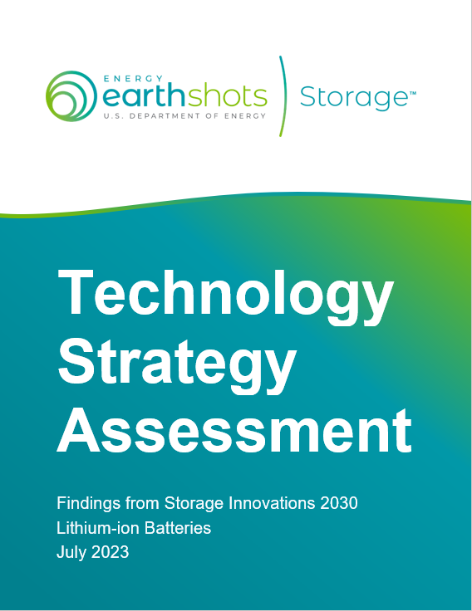
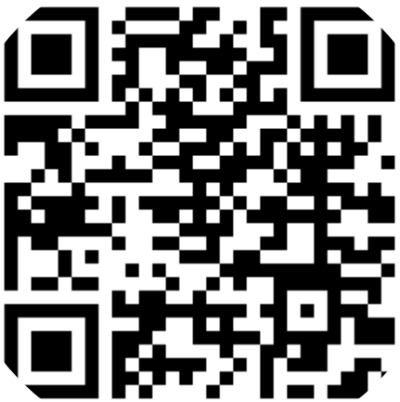
LDSS Technology Strategy Assessments
Released on July 19th, 2023
Results from the Storage Innovations 2030 Flight Paths and Framework stakeholder engagement and analysis efforts
Eleven Reports Released
Methodology
Lithium-ion Batteries
Lead-Acid Batteries
Flow Batteries
Zinc Batteries
Sodium Batteries
Pumped Storage Hydropower
Compressed Air Energy Storage
Thermal Energy Storage
Supercapacitors
Hydrogen Storage

Slide 8
SI 2030: Technology Liftoff Summary
$15 million Funding Opportunity Announcement (FOA) to tackle pre-competitive technology R&D barriers!
SI 2030 Technology Strategy
Structured Technology Partnerships
Pre-competitive R&D
$5 million awards
RFI Released
FOA Opens
RFI comments due
Concept Papers Due
Full Applications Due
Selections Made
March 8, 2023
April 3, 2023
July 25, 2023
September 15, 2023
December 4, 2023
Q1 2024

Slide 9
SI Technology Liftoff Objective 1
Partnership development: Entities will organize by coordinating with each other, engaging in meetings and discussions, and setting up durable channels of communication to effectively collaborate through this award period and afterwards. Such means of collaboration may include email, periodic meetings (virtual or in-person), collaborative online platforms, site visits, conference participation, polls, newsletters, websites, or knowledge sharing beyond the scope of the pre-competitive R&D project. Entities are encouraged to think creatively to develop lasting partnerships.
  Partnering List: DOE will make a partnering list available specific to this FOA that organizations can list their contact information in to facilitate forming potential project partnerships. Please email FOA3020@NETL.DOE.GOV to submit your information using the template at: https://netl.doe.gov/grid-resilience/FOA3020. You may find the most up to date partnering list at the same URL.

Slide 10
SI Technology Liftoff Objective 2
Pre-competitive R&D: Partnerships will receive funding to perform “pre-competitive” R&D projects at a research institution, such as (but not limited to) a DOE National Laboratory. “Pre-competitive R&D” includes activities that are of interest to multiple or all entities in the partnership. Such activities should propel an entire technology industry forward, and the outputs of this work should provide value to all participating members of the partnership. Further discussion of pre-competitive R&D is provided in the SI 2030 Technology Strategy Assessments. These assessments also provide themes and examples of activities consistent with DOE strategy. Applicants are strongly encouraged to leverage the Technology Strategy Assessments in identifying and proposing pre-competitive R&D.

Slide 11
Technical Elements that Must be Included in Applications
Partnership management and operation plan (should show durability or longevity after project award period)
If applicable, connection to the Storage Innovations 2030 strategy outlined in the LDSS Technology Strategy Assessments. Proposals should show connection to the R&D described in those reports, and connection to R&D activities with high potential to lower cost.
Technical outcomes from pre-competitive R&D
Detailed workplan to perform R&D

Slide 12
Eligible Applicants
Following domestic entities are eligible to participate as a prime or subrecipient:
  Institutions of higher education;
  For-profit entities;
  Non-profit entities; and
  State and local governmental entities, and Indian tribes.
FFRDCs (ex. National Labs) are eligible to apply as a subrecipient, but not as a prime recipient.
  FFRDC funds are expected to be awarded by the recipient to FFRDC.

Slide 13
Research Institutions
Each partnership must also connect with a participating research institution, such as a DOE National Laboratory, to perform the pre-competitive R&D. The research institution may or may not be considered a “member” of the partnership, but the R&D must have impact for all members of the project.
In this opportunity, a “research institution” is defined as a shared facility or capability made equitably available to all project partners for the purposes of advancing a technical barrier associated with a technology. Such a facility must be one of the following:
  DOE National Laboratory
  Other Federally Funded Research and Development Center (FFRDC)
  Institution of Higher Education
  Nonprofit institution with an R&D mission
Notes:
The definition of a non-profit research institution as defined in section 4 of the Stevenson-Wydler Technology Innovation Act of 1980 (15 U.S.C. 3703): “’Nonprofit institution’ means an organization owned and operated exclusively for scientific or educational purposes, no part of the net earnings of which inures to the benefit of any private shareholder or individual”

Slide 14
Applications Not of Interest
Submissions that fall outside the technical parameters specified in Section I, “Funding Opportunity Description; Objectives/Topic Areas/Areas of Interest” of the FOA, including but not limited to:
  Submissions for proposed technologies that are not based on sound scientific principles (e.g., violates the laws of thermodynamics).
  Submissions with fewer than two entities.
  Submissions that propose R&D that is not “pre-competitive” R&D. Projects under this announcement should benefit all members of the partnership and propel a whole technology industry (not just one specific entity or proprietary solution) forward.
  Submissions to enable technologies not capable of electricity-in/ electricity-out long-duration energy storage.
  Topics related to hydrogen storage. Proposed work related to hydrogen energy storage should be directed towards other DOE programs that focus on hydrogen (such as sections 40313, 40314, and 40315 of the Bipartisan Infrastructure Law).

Slide 15
Estimated Funding
Estimated project period of performance: between 2 and 4 years.

Slide 16
Concept Papers (6 pages maximum)
Cover Page (1 page max.)
Project Description
  Describe proposed R&D project, impact, risks, and alignment with DOE strategy
Project Team/ Addendum
  List of partnering organizations, team member experience, research institution, and equipment/ facilities
Full details listed in FOA document.
Due on September 15, 2023.

Slide 17
Full Application Merit Review Criteria
Criterion 1: Technical Merit, Innovation, and Impact (30%)
Criterion 2: Partnership Strength, Team, and Resources (30%)
Criterion 3: Project Execution and Management Approach (25%)
Criterion 4: Community Benefits Plan (15%)
Notes:
CRITERION 1: TECHNICAL MERIT, INNOVATION, AND IMPACT (30%)
This criterion will evaluate the technical merit and feasibility of the proposed pre-competitive R&D as detailed in the application. This criterion will also be used to gauge the degree of innovation of the proposed solution, along with the effectiveness of the proposal in addressing the technical requirements specified in the FOA.
CRITERION 2: PARTNERSHIP STRENGTH, TEAM, AND RESOURCES (30%)
This criterion will evaluate the strength, impact, and durability of the partnership developed under SI Liftoff. Criteria for evaluation include ensuring the management plan, project team, facilities and other resources are appropriate and sufficient to achieve the project’s proposed goals and objectives.
CRITERION 3: PROJECT EXECUTION AND MANAGEMENT APPROACH (25%)
This criterion will evaluate the level of the Applicant’s management skills and the adequacy, appropriateness, and reasonableness of the proposed management strategy to achieve the stated goals and objectives of both the FOA and the proposed technical concept/project as articulated through the Project Management Plan (PMP) and Statement of Project Objectives (SOPO).
Criterion 4: Community Benefits Plan (15%)
This criterion will ensure the project advances the following three (3) objectives: (1) advance diversity, equity, inclusion and accessibility (DEIA); (2) contribute to energy equity; and (3) invest in America’s workforce. See section IV.C.xix. R&D Community Benefits Plan (April 2023) for more in depth description of what is expected to be included in the CBP. Applicants must address all three (3) sections below:

Slide 18
Upcoming Deadlines
Concept Papers due on September 15, 2023
  Submit to FOA3020@NETL.DOE.GOV
Full applications due December 4, 2023
RFI Released
FOA Opens
RFI comments due
Concept Papers Due
Full Applications Due
Selections Made
March 8, 2023
April 3, 2023
July 25, 2023
September 15, 2023
December 4, 2023
Q1 2024

Slide 19
Ben Shrager
Storage Strategy Engineer
Energy Storage Division

Slide 20

Vinod Siberry
Vinod Siberry
Technology Manager,
Office of Electricity,
U.S. Department of Energy

Slide 21
Energy Storage Demonstration and Validation FOA Overview
August 29, 2023

Slide 22
Demonstration and Validation FOA
Background
2023 Appropriations Bill directs OE to establish:. “…a competitive pilot demonstration grant program, as authorized in section 3201 of the Energy Act of 2020, for energy storage projects that are U.S-controlled, U.S.-made, and North American sourced and supplied. The Department is directed to include in this program large scale commercial development and deployment of long cycle life, lithium-grid scale batteries and their components.”
Goals
Fund Innovative Energy Storage System (ESS) demonstration projects, host “Demo Day”
Will fulfill CDA and align with Long Duration Storage Shot and other relevant DOE goals
Demonstrations will support OE’s Rapid Operational Validation Initiative (ROVI)
Approach: $15 million FOA with three topic areas, 1 demo and $5 million per topic area

Slide 23
Demonstration and Validation FOA
Background
2023 Appropriations Bill directs OE to establish:. “…a competitive pilot demonstration grant program, as authorized in section 3201 of the Energy Act of 2020, for energy storage projects that are U.S-controlled, U.S.-made, and North American sourced and supplied. The Department is directed to include in this program large scale commercial development and deployment of long cycle life, lithium-grid scale batteries and their components.”
Goals
Fund Innovative Energy Storage System (ESS) demonstration projects, host “Demo Day”
Will fulfill CDA and align with Long Duration Storage Shot and other relevant DOE goals
Demonstrations will support OE’s Rapid Operational Validation Initiative (ROVI)
Approach: $15 million FOA with three topic areas, 1 demo and $5 million per topic area
Topic 1: Lithium Batteries
Topic 2: Flow Batteries
Topic 3: Innovative ESS
Other Innovative ESS

Slide 24
Demonstration and Validation FOA Requirements
Required Partnership Structure:
Storage System Requirements For All Topics:
Technology Providers | Host Site/Offtaker Organization
A private energy storage company An institution of higher education Other organizations involved in Engineering, Procurement, and Construction (EPC) of an ESS | Tribes/Tribal Organizations Electric Utility Political Subdivision of a State Facility or Campus Owner Other organization that would own, operate, use, or benefit from the ESS
Electricity-in, Electricity-out system
Capable of at least 100 kWe of output
Capable of at least 10+ hours of discharge duration*
LCOS < $.05/kWh*
“U.S.-controlled, U.S.-made, and North American sourced and supplied.”
Will operate and provide data to ROVI for at least 12 months
Targeted Use Cases/Applications:
Criteria for Innovative Demonstrations:
Use Case 1: Support the transmission or distribution (T&D) electric grid
Use Case 2: Improve resilience or efficiency for facilities or other critical infrastructure
Use Case 3: Integrate electric vehicle charging
Use Case 4: Used in microgrids, either grid-connected or islanded
Will consider: Any other new or innovative use case that ESS can be used for.
Advancing Innovative Technologies: Projects will help mature a storage technology that is pre-commercial for an intended use case or has not reached targeted scale for deployment (not in early-stage R&D, likely has had some previous demonstration)
Innovations for Use Case Applicability: Demonstration will help an ESS technology overcome a technical or commercialization barrier that prevents it from being used in specific use case(s).

Slide 25
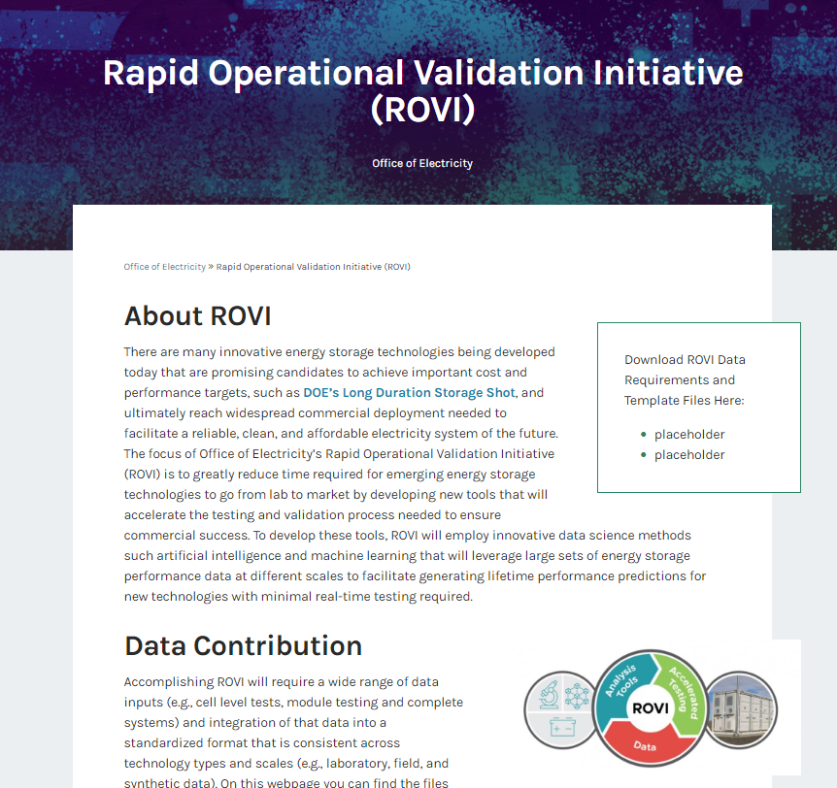

ROVI Integration
Demo Projects Supported by Demonstration & Validation FOA
Other Innovative ESS
Data Collection Requirements
Lithium Battery
Flow Battery
Data
ROVI Data Hub
Rapid Operational Validation Initiative (ROVI) | Department of Energy (doe.gov)

Slide 26
Areas Not of Interest
Submissions for proposed technologies that are not based on sound scientific principles (e.g., violates the laws of thermodynamics).
Submissions for basic research aimed solely at discovery and/or fundamental knowledge generation.
Submissions for large-scale demonstration projects of existing commercial technologies.
Mobile ESS (either onboard vehicles or relocatable systems)
Hydrogen based ESS concepts
ESS built to be used on a testbed or laboratory setting
New component or material development activities for ESS
Scaling up or expanding manufacturing capabilities

Slide 27
Cost Share Structure
Area of Interest | Estimated Federal Funding | Anticipated No. of Awards | Anticipated Individual Award Size |  |  | Maximum DOE Share of Award
 |  |  | DOE Share $/% | Cost Share $/% | Total $
1 – Lithium Batt. | $5,000,000 | 1 | $5,000,000/50% | $5,000,000/50% | $10,000,000 | $5,000,000
2 – Flow Batt. | $5,000,000 | 1 | $5,000,000/50% | $5,000,000/50% | $10,000,000 | $5,000,000
3 – Other | $5,000,000 | 1 | $5,000,000/50% | $5,000,000/50% | $10,000,000 | $5,000,000

Slide 28
Cost Share Structure
Area of Interest | Estimated Federal Funding | Anticipated No. of Awards | Anticipated Individual Award Size |  |  | Maximum DOE Share of Award
 |  |  | DOE Share $/% | Cost Share $/% | Total $
1 – Lithium Batt. | $5,000,000 | 1 | $5,000,000/50% | $5,000,000/50% | $10,000,000 | $5,000,000
2 – Flow Batt. | $5,000,000 | 1 | $5,000,000/50% | $5,000,000/50% | $10,000,000 | $5,000,000
3 – Other | $5,000,000 | 1 | $5,000,000/50% | $5,000,000/50% | $10,000,000 | $5,000,000
Awardee cost share amount can be reduced to 20% if the prime applicant is one of the following:
Tribe or Tribal Organization
Institution of Higher Education
Small Utility
Disadvantaged community
Small Business Technology Developer
Anticipated Individual Award Size |  |  | Maximum DOE Share of Award
DOE Share $/% | Cost Share $/% | Total $
$5,000,000/80% | $1,250,000/20% | $6,250,000 | $5,000,000
$5,000,000/80% | $1,250,000/20% | $6,250,000 | $5,000,000
$5,000,000/80% | $1,250,000/20% | $6,250,000 | $5,000,000

Slide 29
Concept Papers Requirements
Submissions Due September 15
Must not exceed 8 pages
Must be limited to a single area of interest
Content will include:
  A brief description of the proposed approach to achieve this FOA’s objectives.
  The proposed work, if successfully accomplished, would clearly meet the objectives as stated in the FOA.
  The applicant clearly describes the proposed technology, describes how the technology is unique and innovative, and how the technology will advance the current state-of-the-art
  The applicant has identified risks and challenges, including possible mitigation strategies, and has shown the impact that DOE funding and the proposed project would have on the relevant field and application; and
  The applicant has the qualifications, experience, capabilities, and other resources necessary to complete the proposed project
DOE will review concept papers and notify applicants that they either encourage or discourage a full application
Applicants must submit a concept paper to be eligible to submit a full application

Slide 30
Full Application Requirements
Submissions Due December 4
Review FOA Section C. Full Applications (Pg. 29 – 30) for entire list of required documents including Budget Justification, Community Benefits Plan, etc..
Project Narrative must not be more than 30 Pages, Sections Specific to this FOA Include:
  Description of Technology
  Description of the proposed Demonstration and Validation
  Cost and Performance Justification
  ROVI Data Collection Workplan

Slide 31
Full Application Evaluation Criteria
Description of Detailed Criteria Factors on Pages 61-65 of FOA
CRITERION 1: TECHNICAL MERIT AND EVALUATION (25%)
CRITERION 2: SIGNIFICANCE AND IMPACT (20%)
CRITERION 3: PROJECT EXECUTION AND MANAGEMENT APPROACH (15%)
CRITERION 4: TEAM AND RESOURCES (20%)
CRITERION 5: COMMUNITY BENEFITS PLAN (20%)

Slide 32
Demonstration and Validation FOA Timeline
Concept Papers Due
Full Applications Due
Expected Selection Notifications
September 15, 2023
December 4, 2023
Q1 2024
Concept Paper Responsiveness Feedback
October 10, 2023
Expected Award Date
  Q2 2024

Slide 33
Demonstration and Validation FOA Timeline
Concept Papers Due
Full Applications Due
Expected Selection Notifications
September 15, 2023
December 4, 2023
Q1 2024
Concept Paper Responsiveness Feedback
October 10, 2023
Expected Award Date
  Q2 2024
Questions? Email: FOA3036@netl.doe.gov
Important Links
Most up to date FOA version: FedConnect: Opportunity Summary
ROVI Requirements: Rapid Operational Validation Initiative (ROVI) | Department of Energy
Partnering List: Partnering List | NETL & Partnering List Submission | NETL

Slide 34
Vinod Siberry
Technology Manager
Energy Storage Division – Storage Validation Team

Slide 35
Questions?

Slide 36
Thank You
Storage Innovations 2030: Technology Liftoff - https://netl.doe.gov/grid-resilience/FOA3020
Energy Storage Demonstration and Validation - https://netl.doe.gov/grid-resilience/FOA3036

