Slide 1
Resilience and Wellbeing for Conflict Resolvers
Sarah R. Kith, MSOD COOP®
Dispute Resolution Convener, Library of Congress
September 20, 2016

Slide 2
Why Resilience and Well-Being?
Reflective Practice and Mastery of Practitioners’ Competence:
Sustain openness and curiosity to a life long learning journey
Return to a state of hope and enjoyment (quality of being)
Have compassion, empathy and connectedness with disputants
Practitioner’s Presence and quality of being - “be the calm”
Facilitate hope, optimism and self-reliance

Slide 3
Session Overview
Foundations of Well –Being and Resilience
Building Conflict Resilience and Reflective Practice
Facilitating Resilience

Slide 4
What inspired You to join the session?

Slide 5
About Inner Journey Institute
The Inner Journey Institute is an educational organization that’s been in operation since 1999 throughout the US and Canada. We are devoted to a world liberated from suffering, where all people experience themselves as fully alive, connected, self expressed and acknowledged for who they are.
The methodology of the Inner Journey Institute is based on two fundamental principles: Love and Awareness.

Slide 6
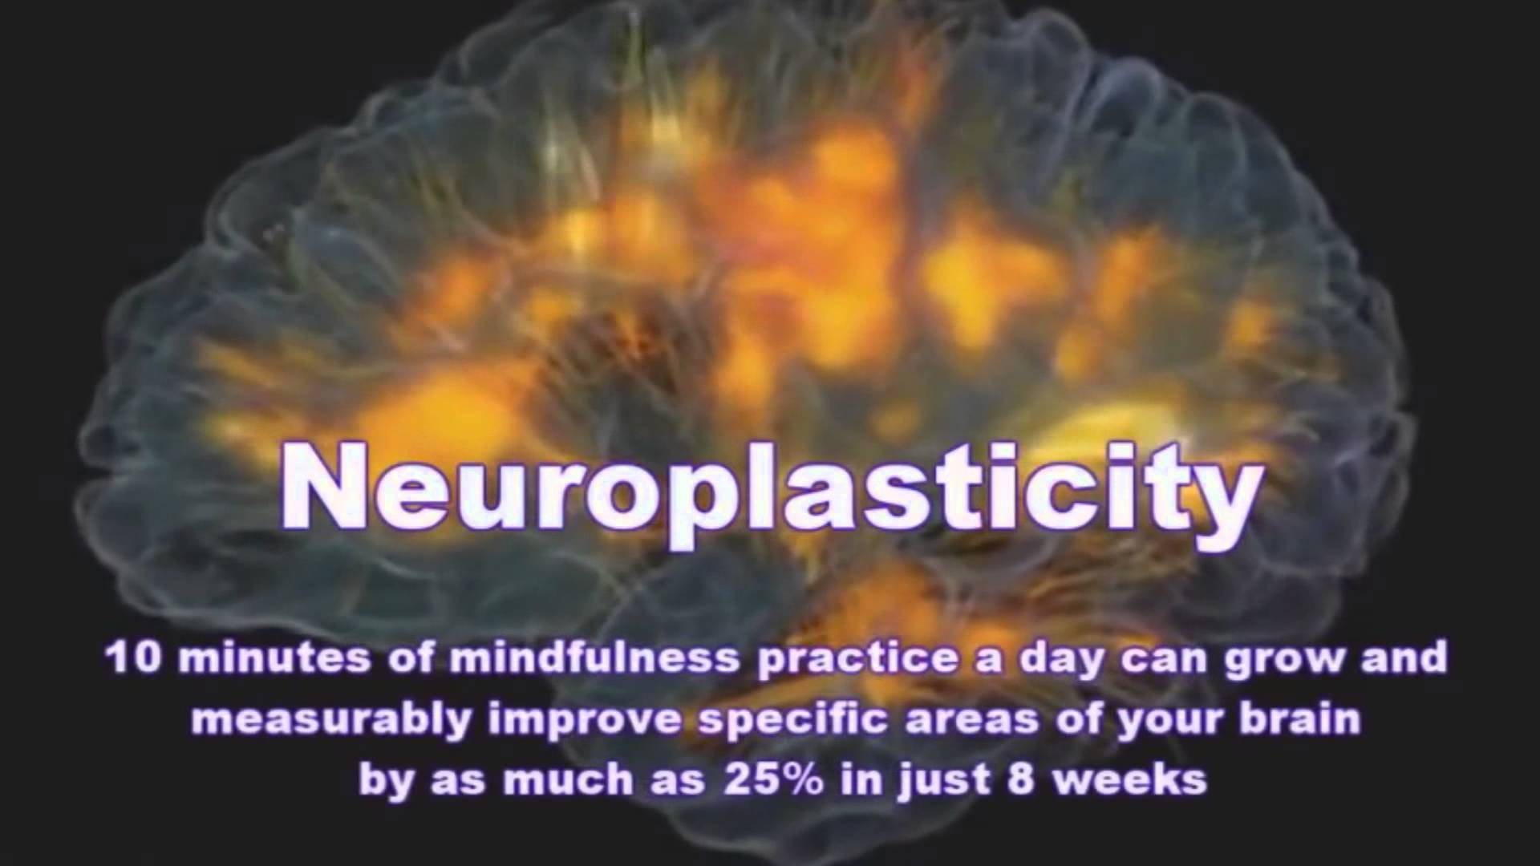

Slide 7
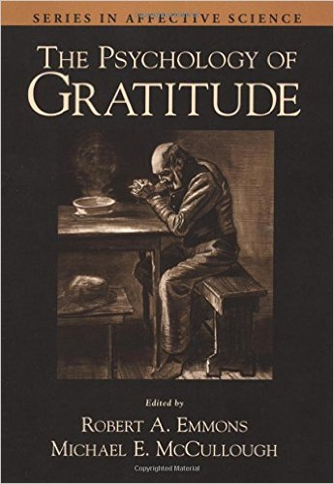
In an experimental comparison, those who kept gratitude journals on a weekly basis exercised more regularly, reported fewer physical symptoms, felt better about their lives as a whole, and were more optimistic about the upcoming week compared to those who recorded hassles or neutral life events (Emmons & McCullough, 2003)

Slide 8
Definition of Resilience
The ability to become strong, healthy, or successful again after something bad happens (Merriam-Webster Dictionary)
“The reactivity and rapidity of recovery following negative events.” (Davidson)
"Blessed are those who are flexible, for they shall never be bent out of shape." ~ Unknown.

Slide 9
“Why have you been using the tools of modern neuroscience just to study anxiety, stress, fear and depression? Why can’t you use them to study kindness and compassion?” – Dalai Lama
“Well-being is a skill”
Resilience
Positive Outlook
Mindfulness
Generosity
http://centerhealthyminds.org/about/why-well-being

Slide 10
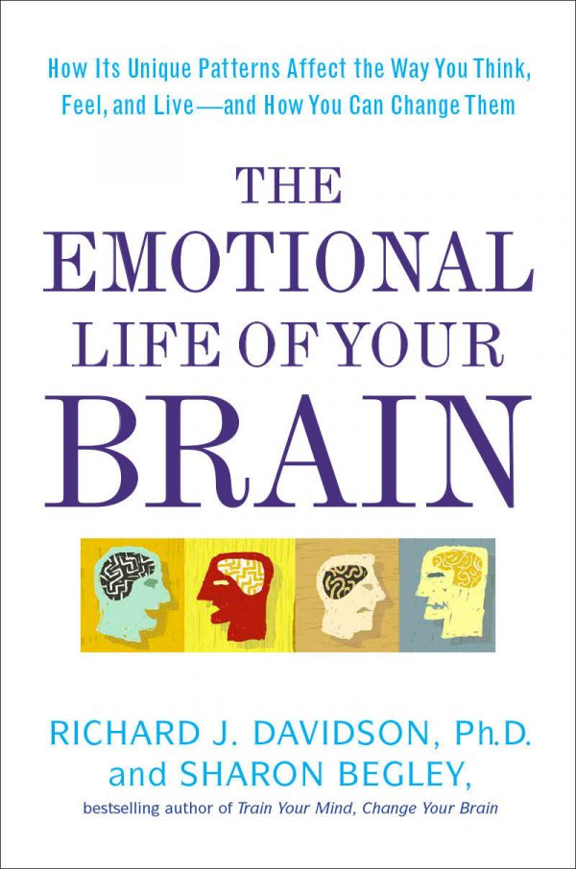
The emotional Brain
Resilience
Outlook
Social Intuition
Self-Awareness
Sensitivity to Context
Attention

Slide 11
You are what you think
If you change yourself you will change your world. If you change how you think then you will change how you feel and what actions you take. And so the world around you will change. Not only because you are now viewing your environment through new lenses of thoughts and emotions but also because the change within can allow you to take action in ways you wouldn’t have – or maybe even have thought about – while stuck in your old thought patterns. - Gandhi

Slide 12
Presence Kindness and Compassion
Picture someone who is close to you, someone that you feel a great amount of love towards.
Notice how this love feels in your heart… (Pauses between each question) Notice the sensations around your heart… Perhaps you feel a sensation of warmth, openness, and tenderness…
Compassion for Self: Contemplate a time when you have suffered yourself.
Notice how you feel when you think of your suffering… How does your heart feel? … (Pauses between each question) Do you continue to feel warmth, openness and tenderness?… Are there other sensations, perhaps an aching sensation?
Compassion for Others
Weng, Fox, Shackman, Stodola, Caldwell, Olson, Rogers & Davidson (in press) Psychological Science

Slide 13
Mindful Presence
At the same time, silently recite these phrases.
“May you have happiness.
May you be free from suffering.
May you experience joy and ease.”
http://centerhealthyminds.org/about/why-well-being

Slide 14
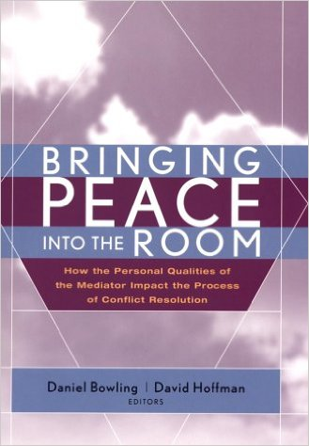
http://www.selfleadership.org
Richard Schwartz’s Internal Family System
Calmness
Clarity
Compassion
Creativity
Curiosity
Confidence
Courage
Connectedness
Building Conflict Resilience and Reflective Practice

Slide 15
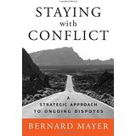
Facilitating Resilience in Disputants
“How can we help people prepare to engage with this issue over time?”
“It means learning to engage with both the conflict and the other disputants with respect for each person’s humanity…”
“…to accept conflict in their lives with courage, optimism, realism, and determination.”
Mayer (2009)
Notes:
Power of Choice
Role Playing with a long term perspective –
We sometimes ask disputants to role-play the way in which they might like to approach some one they are in conflict with or to try to reenact a problematic interaction. Sometimes we might ask people to play their own role in a situation, but at other times we might suggest they try someone else’s role – perhaps that of their adversary.

Slide 16
Georgia school shooting 911 call with Antoinette Tuff
https://www.youtube.com/watch?v=1kVpipSXRKA

Slide 17
What resonates with you from the Video?
How did She cultivate resilience?

Slide 18
Building Conflict Resilience and Reflective Practice
Stay engage with conflict
Practice letting go and forgiving
Reach out to others
Practice generosity and kindness
Have a routine mental and physical fitness
Keep a gratitude journal
Disentangling emotions that have disputants reacting from the lower part of their brain (fight or flight response)
Facilitate the negotiation of options
Contemplative practice - meditation
Physical activities - dancing, walking, yoga, running.
Reflective practice

Slide 19
Facilitating Resilience:
How does this apply to your ADR practice?
How could you incorporate the science of well-being and resilience in your day-to-day work? What intention will you set for yourself when working with disputants?

Slide 20
Reflective Practice – Shining the light on ourselves
What was going on for me while the interchange was happening?
What effect did my reaction have on the participants/disputants?
What did I set out to achieve?
What happened?
What went well?
What did not go the way it was intended?
What did I learn?
What will I do differently next time?
Approaches
Self-reflection – post case handling debrief with a peer (giving and receiving feedback
Individual’s journaling
Practitioners coming together
  Journal Club
  Case review –

Slide 21
Questions and Comments

Slide 22
Resources and Bibliography
Bring Peace into the Room: The Personal Qualities of the Mediator and Their Impact on Mediation, D. Bowling and D. Hoffman, 2000
Staying with Conflict, Mayer, 2009
Your Brain at Work, David Rock, 2009
The Psychology of Gratitude, Emmons & McCullough, 2003
The Making of a Mediator: Developing Artistry in Practice 1st Edition, Lang and Taylor, 2000
http://centerhealthyminds.org/about/why-well-being

Slide 23
Thank You!
May you have happiness.
May you be free from suffering.
May you experience joy and ease.

