Slide 1
How Fast Can We Burn Money and
When Do We Stop?
Compounding Uncertainties in Phasing Curve Shape and Duration
Stephen Colodner
Office of Program Analysis and Evaluation
(PA&E, NA-BA-40)
August 12, 2026

Slide 2
What’s in this talk
New methodology to simultaneously model uncertainty in cost, schedule, and phasing.
Relatively simple to implement; reading the output is where estimates can go wrong.
01
02
03
04
Why phasing needs a distribution
A five-number model
Coupling in Monte Carlo
Reading the results honestly
Historical projects disagree about when money is spent. A deterministic template picks one line out of that spread and bets the budget request on it.
Fit a Beta CDF to every historical project, then model the joint distribution of the fitted parameters. The whole model is one table row per cost type.
Draw cost, duration, and phasing shape together. Escalation exposure and outyear risk fall out of the same simulation.
Late fiscal years are mixture distributions. The P50 profile is not a plan, and annual quantiles aren’t additive
Notes:
Roadmap. Flag up front that section 4 is the part that changes what you put in a briefing package.

Slide 3
Why phasing should have a distribution
Motivation
Methodology
Monte Carlo Coupling
Interpreting Results
The questions phasing should answer — and what a fixed template cannot tell you

Slide 4
Questions phasing uncertainty should answer
Four questions
A total-cost S-curve answers none of them.
Budget formulation. What new budget authority is required in each fiscal year, and what happens to that profile if execution stretches?
Escalation exposure. Constant-year cost is silent about escalation. Then-year cost depends entirely on which years the money lands in.
Outyear planning. How much of the outyear request is contingent on the project still running — and how contingent?
Execution review. Is spend-to-date a warning sign, or ordinary shape variation? Without a distribution there is no way to say.
THE GAP
All four are temporal questions. Total cost and total duration distributions, however well built, do not answer any of them.
Notes:
Generally, we need to caveat our early estimates by saying they’re not budget-worthy, and the phasing is notional. Is there a way we could answer what budgeters really want to know? We currently answer them, usually with a deterministic spread inherited from a prior estimate. The point is not that we are doing it wrong — it is that the uncertainty is being dropped silently. The first 3 are important early for budgeting and decision making. The fourth is for active programs.

Slide 5
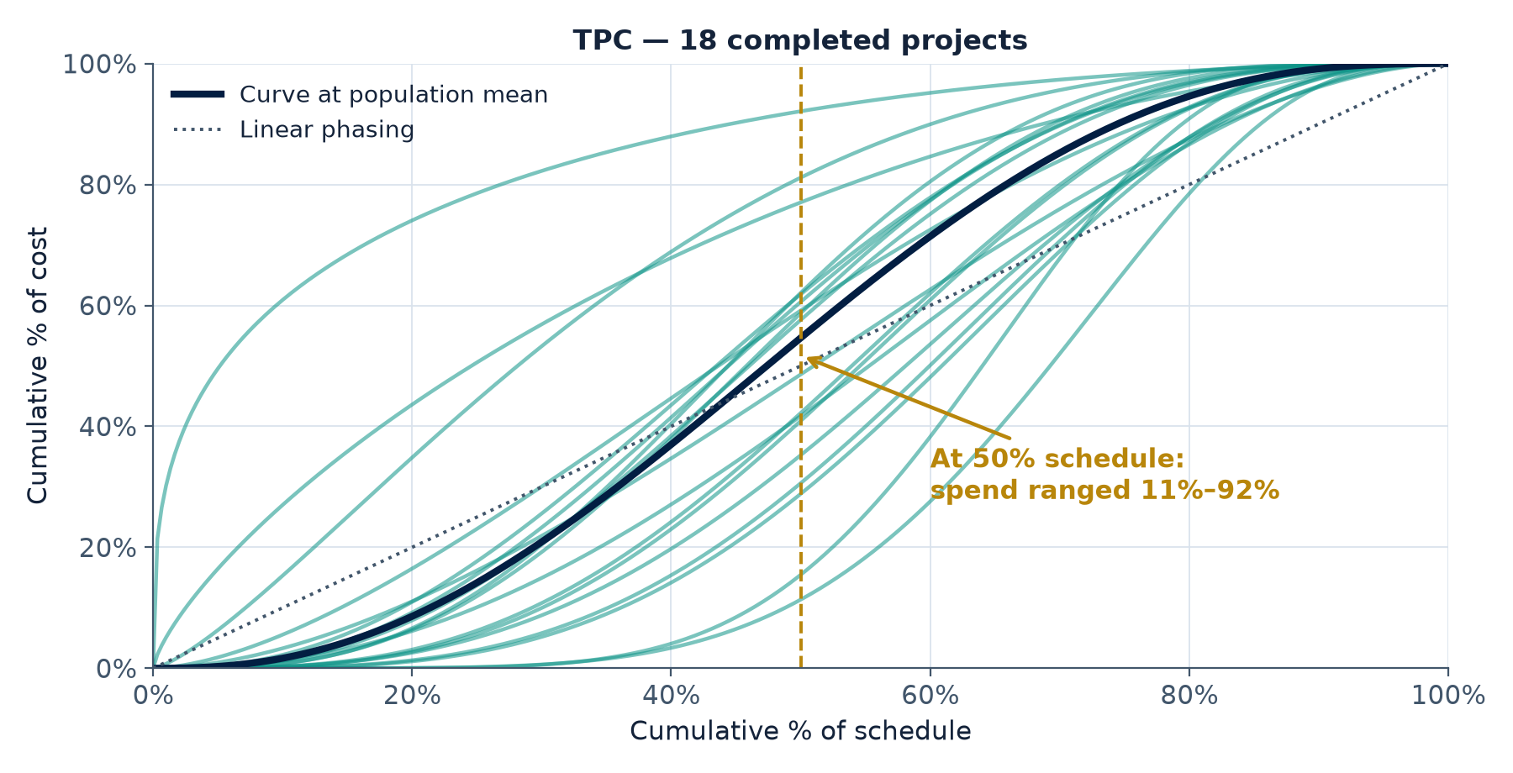
Historical phasing is not one shape
Completed projects, normalized to percent-schedule and percent-cost
WHAT THE DATA SAYS
At the halfway point of schedule, historical MIE upgrade projects had spent anywhere from about 12% to 92% of final cost. A deterministic profile replaces that 80-point spread with a single number.
Notes:
Point at the vertical spread at 50% schedule. This is the empirical motivation for the whole method: the shape is not a constant, so do not model it as one. Note these are illustrative curves drawn from the fitted population, not the 16 raw project curves — say so.

Slide 6
Three failure modes
Three ways a fixed phasing template produces a defensible-looking wrong answer
01
02
03
Under-programmed outyears
Under-escalated estimate
Misread execution
A template that finishes on the baseline schedule puts zero dollars in the years a slipped project would actually spend.
The request looks complete. The risk is invisible.
Back-loaded reality against a front-loaded plan pushes spend into later, more escalated years.
Then-year cost grows even if constant-year cost was exactly right.
A proposed PMB is just one phasing curve.
During execution, “Behind plan” has no statistical meaning without a distribution of plausible shapes.
Notes:
Baselining and EVM applications. A phasing distribution gives you control limits on percent-spent versus percent-complete, turning a judgment call into a statistical one. At IBR, we can say this is looking to execute at the 99th percentile of historical. More defensible than “that looks aggressive”. During execution, the same band makes “behind plan” into a testable claim looking at the existing data.

Slide 7
The coupling problem
The coupling problem — and why it concentrates in the outyears
1
Duration is uncertain, and we already model it
Schedule risk analysis is routine. We produce a duration distribution and report its percentiles.
2
Phasing shape is uncertain, and we usually do not
Shape is typically inherited from a template or an analogous project and treated as known.
3
Annual spend depends on both at once
“60% cumulative” is a different dollar figure in a 6-year execution than in a 8-year one. The percentage and the calendar interact.
4
The interaction compounds late
Early years are constrained by the start date. Late years inherit the full spread of both uncertainties — which is exactly where budget decisions live.
Notes:
This is the thesis slide. Everything after this builds machinery to do the compounding honestly, then to read the output correctly. Pause here.

Slide 8
Motivation
Methodology
Monte Carlo Coupling
Interpreting Results
Fit historical projects, then treat the fit parameters as the data

Slide 9
Study Design
What we built, in numbers
18
2
5
completed MIE projects with normalized expenditure histories
parameters per project curve, both interpretable
numbers define the entire phasing model per stratum
Fit a two-parameter curve to every completed project, model the joint distribution of the fitted parameters, then sample from it.
Sampling a curve costs one draw; evaluating it costs one function call.
The model is small enough to publish in a table and audit by hand — which matters more than sophistication when a reviewer asks where a number came from.
Notes:
Dataset: MIE projects. 2 Fit Parameters. R^2, RMSE, MAE, Bound Contact flag (whether alpha or beta pinned against the search bound), number of points fit.

Slide 10
Data and normalization
18 completed Major Item of Equipment projects, TPC by year.
Both axes normalized to the unit square. Cumulative percent of realized schedule against cumulative percent of realized cost.
Normalized by actuals, not baselines. The model’s job in simulation is to spread a total cost draw across a duration draw, so the historical shapes should describe how money actually moved across time that actually elapsed.
Consequence, stated openly. Phasing shape is modeled conditionally on the totals, so growth is handled by the companion cost and duration models — not here.
Completion convention matters. Where “100% of schedule” is defined (final invoice versus CD-4) drives tail behavior and must be stated.
Notes:
Field the normalization question before it is asked. Someone will say: if you normalize by actuals you have thrown away growth. Correct — and deliberate. Growth lives in the cost and duration models; this is shape given the totals. For this we set a spending cutoff for first and last years rather than look at critical decision/milestone dates.

Slide 11
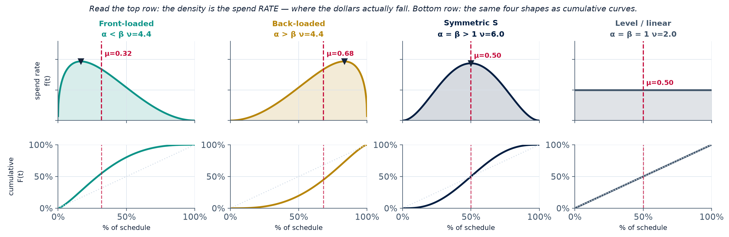
The Beta Distribution curve family
Bounded [0,1] support matches the problem exactly — and two parameters span every shape we see: front-loaded, back-loaded, symmetric-S, and level.
Notes:
If we normalize the budget into pct spend vs pct schedule, it resembles a probability mass function. We can extrapolate that to a probability density function. The density is the spend RATE -- where the dollars actually fall across the schedule -- and most people read that far faster than a cumulative curve. The bottom row is the same four shapes as the CDFs we actually fit, so the audience sees that a familiar S-curve and an intuitive burn-rate profile are two views of one object. Red dashed line is mean spend timing mu; the small triangle marks peak burn rate. Point at the fourth column: alpha=beta=1 gives a flat density, which is level spending and a straight cumulative line -- a useful sanity anchor. Beta phasing curves are established practice here, so cite the handbook lineage; the new contribution is two slides away.

Slide 12
Reading the parameters
The interpretation that makes the parameters talkable
f(t)
μ
↑
The density is a spend-timing distribution
Mean spend timing
μ = α/(α+β)
Peak rate
(α−1)/(α+β−2)
The Beta density is the distribution of when a dollar is spent across normalized schedule. Cost in any window is just F(t₂) − F(t₁).
One number for front- or back-loading. Below 0.50 is front-loaded, above is back-loaded. A program manager can argue with this number.
When both parameters exceed 1, this is where the monthly burn rate peaks — directly comparable to a staffing or procurement plan.
Notes:
This makes the method reviewable by non-statisticians. If you only get one methodology slide across, make it this one — it converts two abstract shape parameters into sentences about program behavior. The next slide gives this mean-timing quantity its formal name and supplies its missing companion.

Slide 13
Mean–precision transform
Same model, better-behaved coordinates
μ = α/(α+β)
ν = α + β
MEAN SPEND TIMING · where the money lands on the schedule
PRECISION · how tightly spend clusters around that point
It is a named parameterization, not a house convention. ν is called precision in the beta-regression literature, concentration in Bayesian usage, or equivalent prior sample size — a Beta(α,β) prior carries the weight of α+β pseudo-observations.
It separates the two questions we actually ask. Where the money lands is μ; how sharply it clusters is ν. The raw (α, β) pair confounds them, because moving either one moves both answers.
It partly dissolves a correlation artifact. The Beta information matrix has a negative off-diagonal everywhere, so fitted α̂ and β̂ are positively correlated by construction. Part of the ρ we measure is the estimator, not the portfolio.
Nothing about the fit changes. The map is bijective — same likelihood, same fitted curves, same predictions. What changes is what the numbers mean and how well conditioned they are.
Notes:
Worth 90 seconds. The reason to name it is citation defensibility: a reviewer who knows beta regression recognizes mean-precision immediately, whereas an unnamed sum-and-difference transform invites questions. Ferrari and Cribari-Neto (2004) is the usual reference for the mean-precision form. Two honest caveats if pressed: mu and nu are not exactly Fisher-orthogonal either, just better conditioned than alpha and beta; and the sum/difference rotation someone may propose instead is a rigid 45-degree motion of the parameter plane, which makes the axes perpendicular but does not make the coordinates uncorrelated unless the two variances happen to be equal.

Slide 14
Stage 1 · Fit every project
Stage 1 — fit every project individually
1
Fit the Beta CDF to each project’s interior points
Nonlinear least squares. Endpoints (0,0) and (1,1) are satisfied by the family identically, so they carry no information and are excluded.
2
Initialize by method of moments on the increments
Treat each period’s spend increment as probability mass at the interval midpoint, moment-match, and solve for α and β. CDF least squares is start-sensitive; this lands close to the optimum.
3
Record diagnostics per curve, not just parameters
R², RMSE, maximum absolute error, and a flag for any fit that reaches a parameter bound. The flags are the interesting part.
4
Read the failures before trusting the successes
A funding pause or a long closeout tail produces a shape the Beta family cannot express. Those curves announce themselves in max absolute error.
Notes:
Be honest that least squares on cumulative data gives autocorrelated residuals, so the reported standard errors are indicative rather than exact. A grouped-multinomial MLE on the increments is the cleaner estimator — mention it as a robustness check and move on unless someone digs.

Slide 15
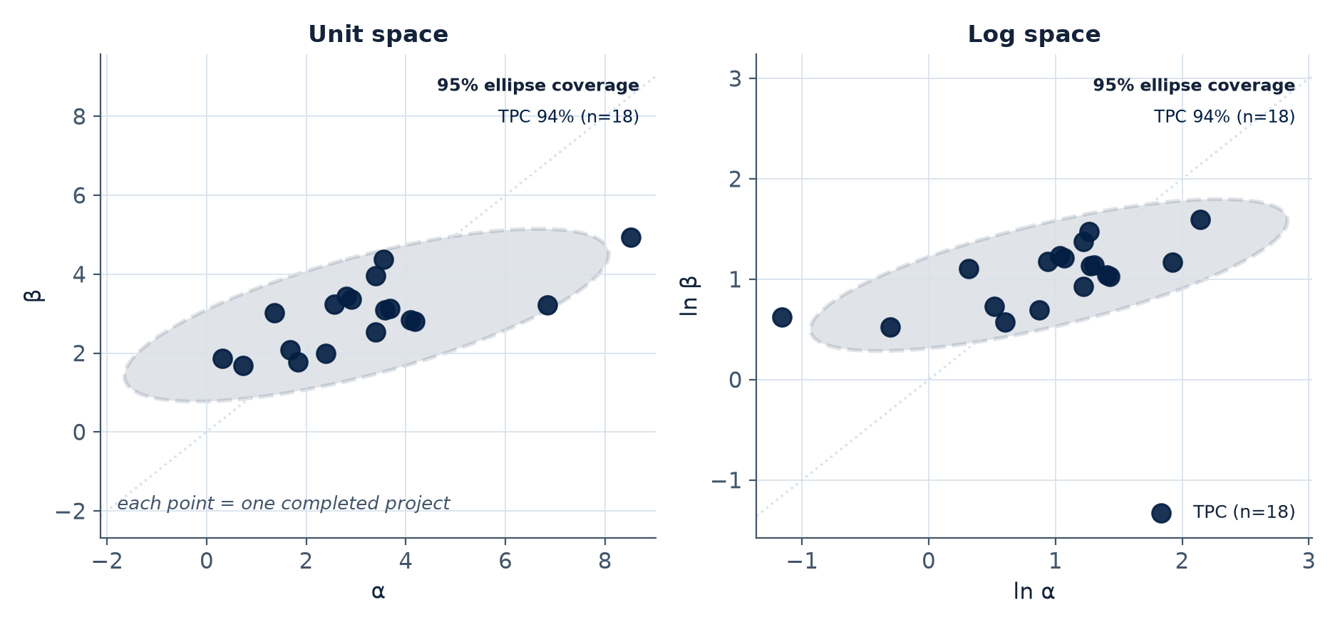
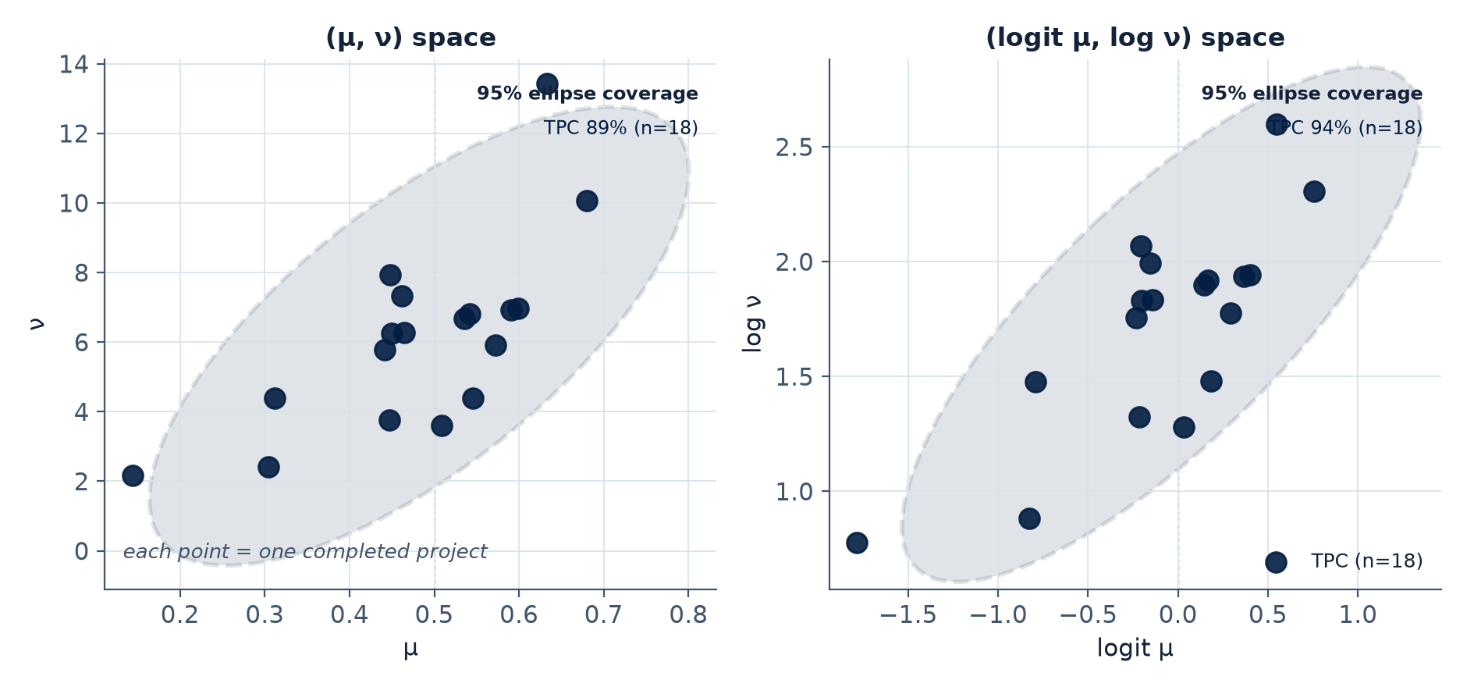
Stage 2 · Parameters as data
Stage 2 — the fitted parameters are the data
Each point is one completed project, reduced from a full expenditure history to two numbers.
The cloud is the empirical distribution of phasing behavior across the portfolio.
Stochastic, not deterministic. Instead of selecting one representative curve, characterize the population of curves and sample from it.
Mahalanobis Ellipses are 95% confidence regions under a bivariate normal approximation, shown in both unit and log space.
Notes:
This is the actual contribution — not the Beta family, which is standard practice. Say plainly: the object of inference is the joint distribution of the fitted parameters, and that is what makes the model generative rather than descriptive.

Slide 16
The complete model
The complete phasing model for TPC
μ₁
μ₂
σ₁
σ₂
ρ
mean of ln α
mean of ln β
standard deviation of ln α
standard deviation of ln β
correlation of ln α and ln β
Sample (ln α, ln β) from a bivariate normal, exponentiate, and evaluate the Beta CDF at t = month / duration for any duration draw.
One row per cost type, reproducible from the fits table and usable with any varying duration.
Notes:
Pause here and say it explicitly: this table IS the model. Everything in the next section consumes exactly these five numbers. Populate with the real fitted values before delivery. If asked why the log-alpha/log-beta pair rather than the mean-precision form from earlier: either works and the fit is identical, but the mean-precision version -- logit mu and log nu -- gives a covariance matrix whose entries you can describe in a sentence, so it is the better choice for the hierarchical layer. a vintage check across project start years supports pooling the full historical range rather than weighting recent projects.

Slide 17
Caveats
01
02
03
Small-sample optimism
Family adequacy
The principled upgrade
With n = 18, the estimated population mean and covariance carry sampling error the generator does not propagate.
The Beta CDF cannot represent multi-modal profiles — stop-work periods, split funding, restarts.
A hierarchical Bayesian formulation estimates curve-fit uncertainty, population dispersion, and population-parameter uncertainty jointly.
Notes:
#1 Sampled curves reflect project-to-project variation but treat the population itself as known, so forecast bands are modestly narrow.
#2 Those projects are visible in the diagnostics rather than silently absorbed, which is the best available outcome.
#3 This two-stage method is its front end, and its output initializes that model.

Slide 18
Motivation
Methodology
Monte Carlo Coupling
Interpreting Results
Drawing cost, duration, and phasing shape in the same simulation

Slide 19
The simulation recipe
The simulation recipe — five steps per iteration
1
Draw total cost and duration
From the existing cost and schedule risk models.
2
Draw a phasing shape
One draw of (ln α, ln β) from the fitted bivariate normal, exponentiated.
3
Evaluate the curve on normalized time
Cumulative spend at month m is total cost times the Beta CDF at t = m / duration. The same shape draw stretches over whatever duration was drawn.
4
Difference into periods and bin to fiscal years
First differences give period spend; binning against a start date gives the fiscal-year profile.
5
Escalate by year of execution
Each fiscal year’s spend meets its own index, so then-year cost emerges rather than being adjusted in.
Notes:
Emphasize separation of concerns. Because the phasing draw is on normalized time, it composes with any duration draw. Steps 1 through 3 can be independent or correlated — that is an explicit modeling choice, which is the next slide.

Slide 20
Testing independence
Independence is an assumption — so test it rather than inherit it
The default is independence between phasing shape, duration, and total cost. Convenient, and quite possibly wrong.
It is directly testable. Regress the fitted log parameters on log realized duration and on project size across the historical set. Either the relationship is there or it is not. MIE dataset showed no significant correlation between parameters and duration.
If long projects systematically back-load, introduce the dependence with a Gaussian copula over the log parameters and log duration. No structural change to the generator is required.
Report the test either way. A null result is affirmative evidence for the assumption, and it defuses the sharpest technical objection in the room before it is raised.
The same logic applies to growth. If projects that grow also back-load, that dependence belongs here rather than being lost in normalization.
Notes:
Report the correlation # verbally.

Slide 21
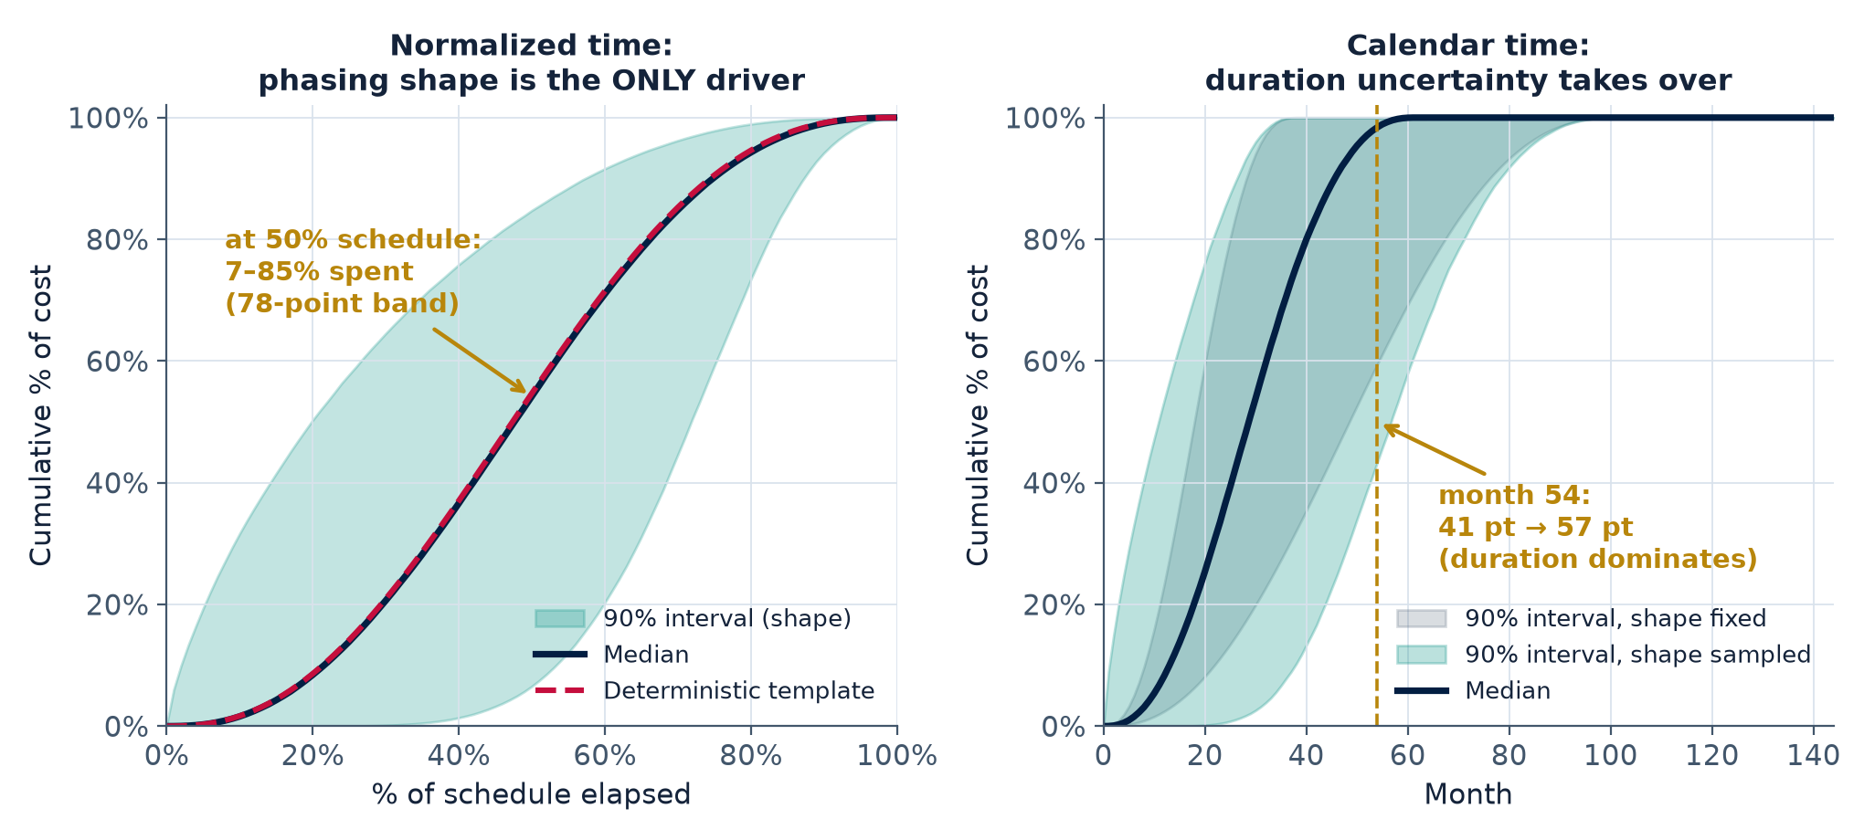
Where the uncertainty lives
Where each uncertainty actually lives
THE HONEST FINDING
In normalized time, phasing shape is the only driver — a 78-point band at the halfway point where a template would report one number. In calendar time, duration uncertainty dominates and shape contributes roughly a tenth of the variance. Both matter, in different places, for different questions.
Notes:
Resist the temptation to oversell. Phasing uncertainty does not blow up the calendar-time band — duration already dominates there. What it does do is give you a distribution at any percent-complete, which is what execution review and the conditional outyear reporting both need. Decomposition: phasing is about 10% of variance at mid-execution, and 100% of it in normalized time.

Slide 22
Months to fiscal years
From execution months to fiscal years — where the reporting problem is born
Each iteration produces a spend stream in execution time. Budget questions are asked in fiscal years, so every stream gets binned against a start date.
Duration uncertainty now decides which fiscal years exist at all. This is the step that changes the character of the output.
In a short draw, the late fiscal years contain exactly zero — not a small number, zero. The project was finished.
In a long draw, those same years carry substantial spend. Nothing is wrong with either iteration; they are different futures.
So a late fiscal year’s spend across iterations is not a smooth distribution. Hold that thought — it is the subject of the last section.
WHY IT MATTERS
Binning to fiscal years is where duration uncertainty stops widening a band and starts deciding whether a year is in the estimate at all.
Notes:
Plant the seed deliberately here. The mixture structure in section 4 should feel like a consequence the audience half-anticipated rather than a surprise.

Slide 23
Motivation
Methodology
Monte Carlo Coupling
Interpreting Results
Late fiscal years are mixture distributions — and three consequences that follow

Slide 24
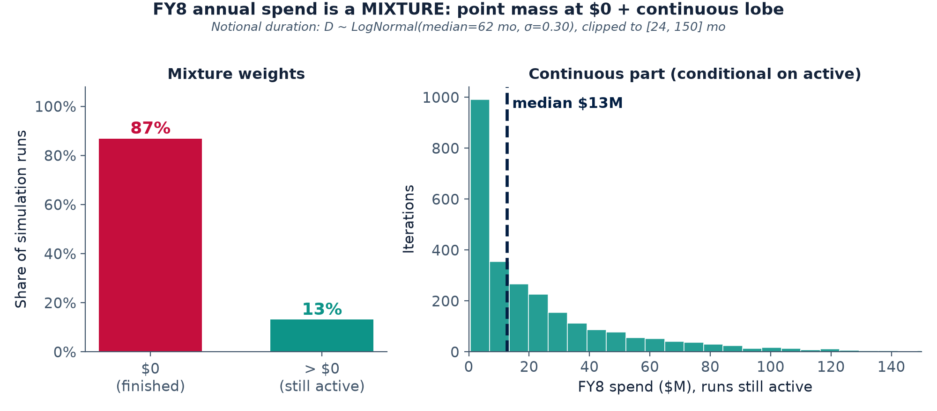
The outyear problem
THE CORE OBSERVATION
Annual spend in a late fiscal year is a point mass at zero — weight equal to the probability the project already finished — plus a continuous lobe. Ordinary percentiles behave strangely on mixtures, and every late fiscal year is one.
Notes:
So now you’ve got uncertainty distributions for these parameters, and it’s time to incorporate them into your Monte Carlo run. But what is going on with these results?
Walk it slowly: 87% of runs finished before this year and contribute exactly zero; the 13% still executing spend a median of about $13M. Those are two different facts and a single percentile cannot carry both.

Slide 25
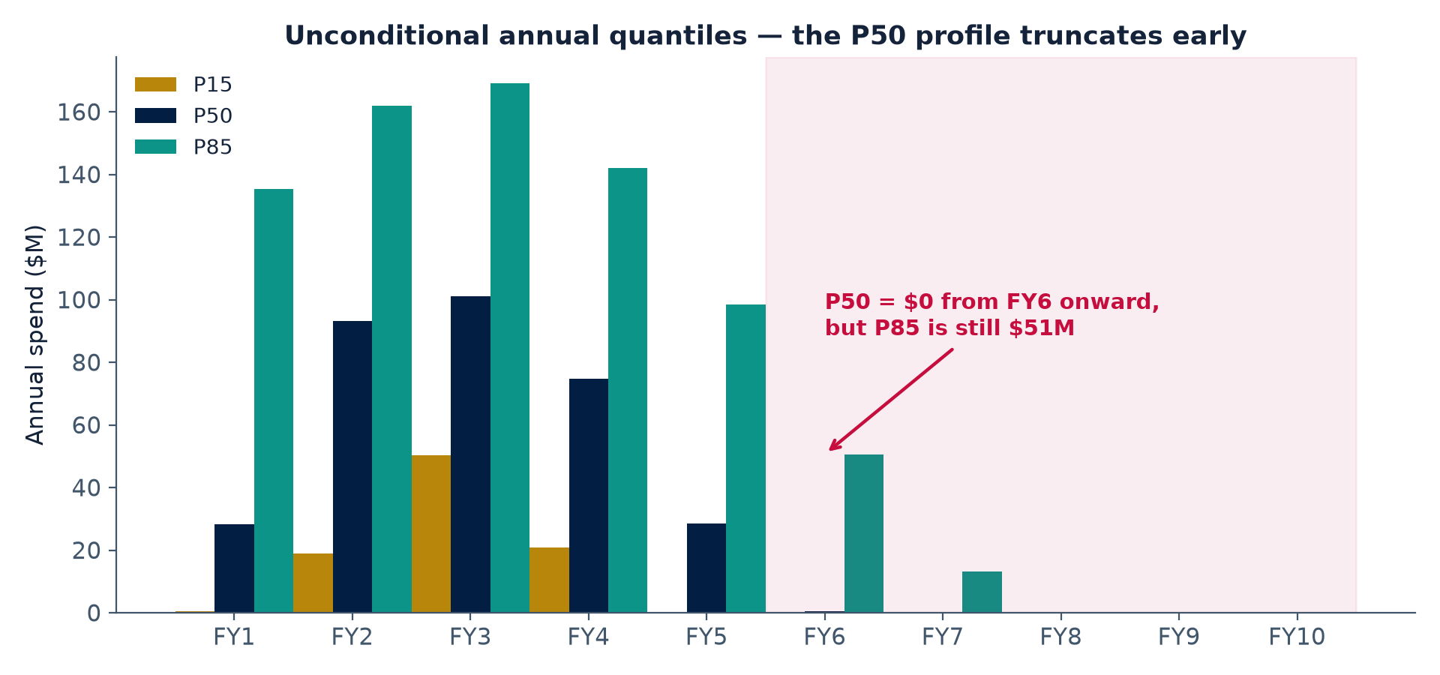
Consequence 1 · The median profile
Median profile ends too early
CONSEQUENCE 1
The P50 of annual spend is exactly zero in any year the project is more than 50% likely not to have finished, so the “P50 profile” silently truncates at the median completion date — while the P90 in that same year is still substantial. No single iteration looks like the P50 profile.
Notes:
Say the trap out loud: hand this chart to a budget office and they will read the P50 row as the realistic profile and conclude the outyears are free. They are not free — they are contingent. The P50 profile is not the median scenario; it is a collection of marginal medians that no execution path matches.

Slide 26
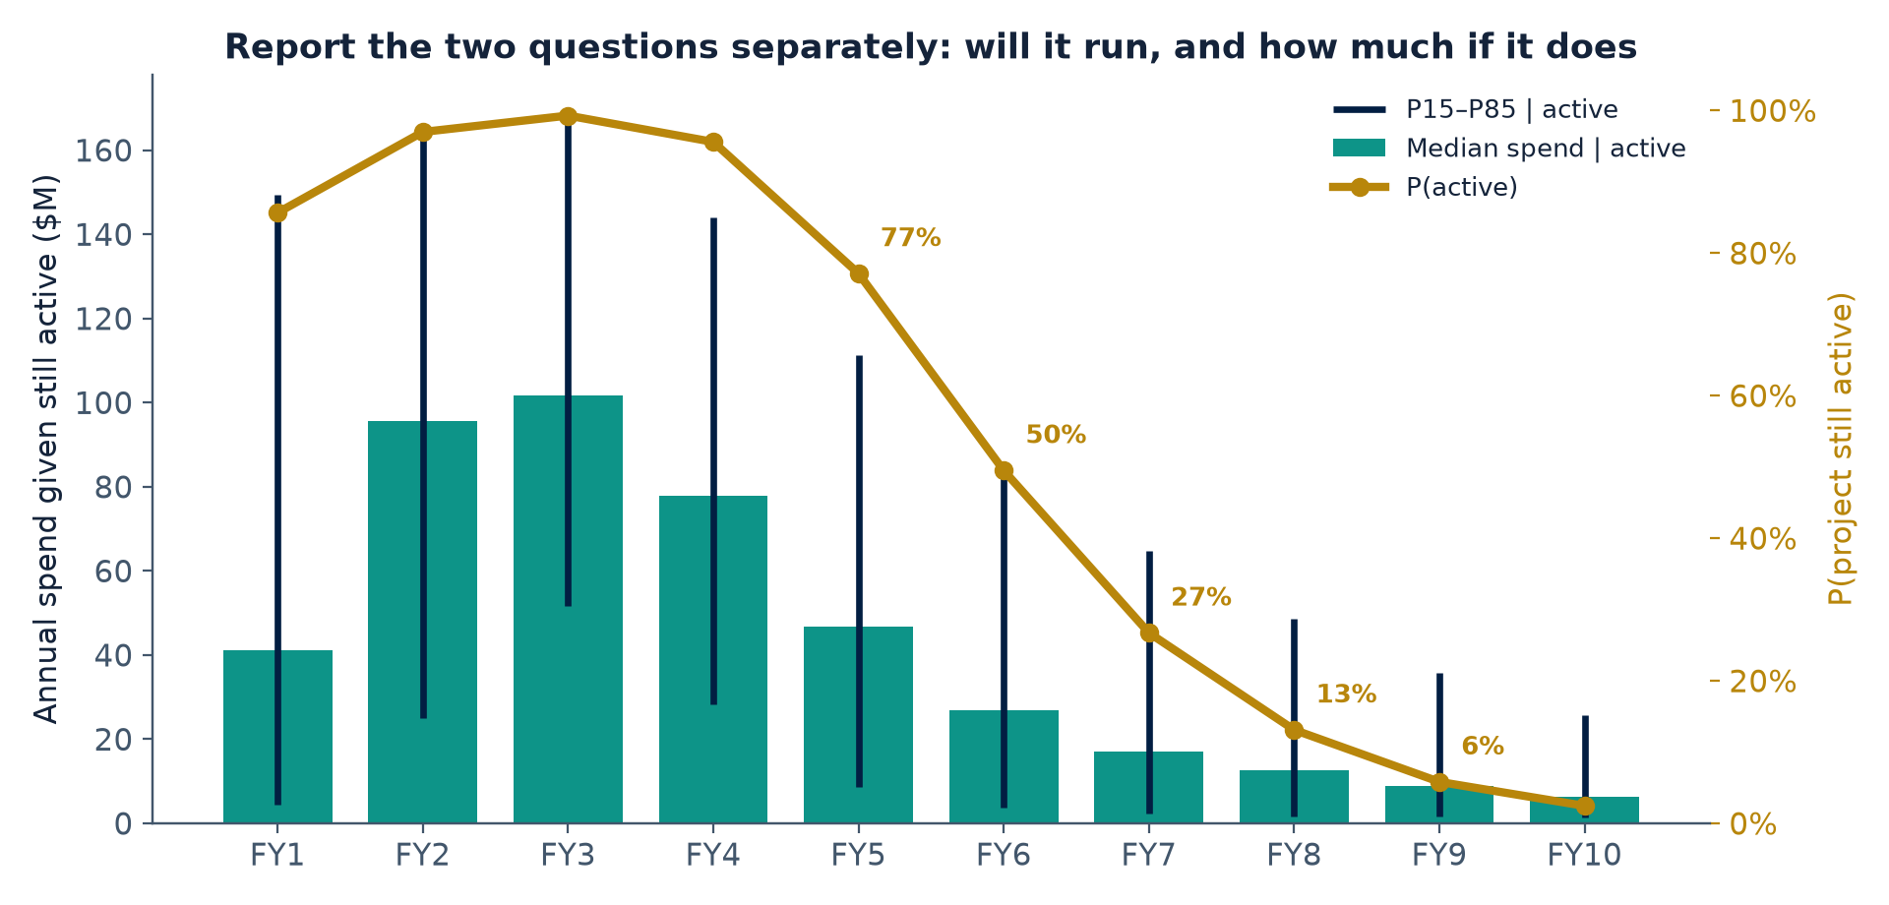
Consequence 2 · Conditional realities
Late-year quantiles hide two different questions
CONSEQUENCE 2
An unconditional P90 in a late year mixes “will the project still be running?” with “how much will it spend if it is?” Report those separately: probability of remaining active, and the conditional spend distribution given active.
Notes:
Here’s one possible visualization that we could provide that would give a better idea of how to budget. We can show the spend if active, and the probability that it’s active.
Walk one year end to end in the recommended language: in FY7, 27% of runs are still active, and those runs spend a median of about $15M.
Say it that way — never 'the FY8 P50 is zero,' which is true and useless.
The reason we see a P(active) below 100% in the first two years is an artifact of the fit on this dataset. I set a threshold for “active” at $1M, so some are eliminated. If we drop that to zero, you’d see a monotonically decreasing P curve.

Slide 27
Consequence 3 · Quantiles don’t add
Quantile profiles are not scenarios, and must not be summed
$627M
$489M
$138M
sum of the annual P80s across fiscal years
the actual P80 of total cost
over-programming introduced by adding quantiles
One duration draw cannot be simultaneously short (fat early years) and long (fat late years), but a table of marginal quantiles implicitly assumes it can. Early and late spend are negatively related through duration. Means are the exception — the mean annual profile sums exactly to the mean total, because expectation is linear and quantiles are not.
Notes:
Your MC results can leave you prone to a particular pitfall. The mechanism is simple once stated: see the mechanism rather than memorizing the rule. Then give them the one-line version they can carry: quantiles do not aggregate, means do.

Slide 28
What to report instead
A package that can survive review
1
Mean, not median annual profile
Additive, ties exactly to the mean total, and the right backbone for TOA planning.
2
Probability the project is still active, on every chart
This is the schedule-risk content of the outyears. Without it, an outyear number cannot be read.
3
Conditional annual distributions given active
Honest outyear magnitudes, uncontaminated by the zeros from iterations that already finished.
4
Cumulative fan chart in calendar time
The executive picture, and the one place the full uncertainty is visible at a glance.
5
Scenario profiles drawn from real iterations
For a P85 profile, condition the draws to the neighborhood of the P85 total cost and show their median phasing.
This represents a coherent, executable profile, unlike a vector of marginal quantiles.
Notes:
Item 5 is the practical replacement for 'the P80 profile' that people will keep asking for. Do not refuse the request — satisfy it correctly by conditioning on iterations near the P80 total. We can look at the subset of draws near that total and show the median phasing path.

Slide 29
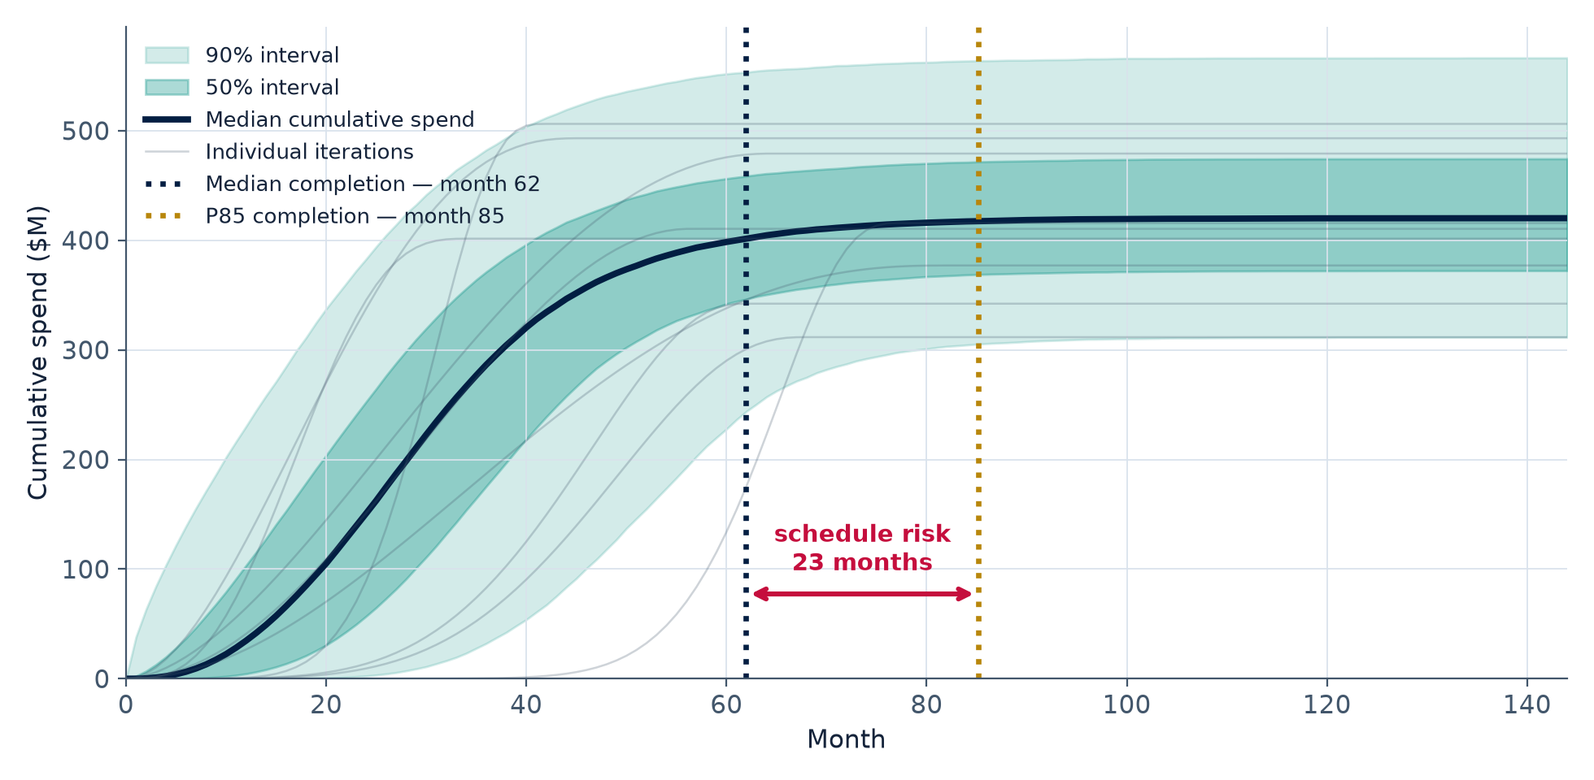
Reading the fan chart
Vertical is cost timing, horizontal is schedule
HOW TO BRIEF IT
Band width early reflects phasing shape; later, overall cost and duration dominates. Where the median flattens is median completion; where the upper band flattens is P85 completion. The horizontal gap between them is schedule risk made visible — the upper tail is “still spending because still executing,” not “spending more overall.”
Notes:
The vertical-versus-horizontal reading is the durable takeaway: vertical spread is when money moves, horizontal spread is how long the project runs.

Slide 30
Summary
1
2
3
Shape is variable, so model it as a distribution
Couple phasing with duration and cost
Report means, P(active), and conditionals
Completed projects disagree substantially about when money moves. Five numbers per stratum capture that, and the parameters are interpretable enough to defend.
Escalation exposure and outyear risk live in the interaction, not in any single marginal distribution. One simulation produces all three.
Never sum quantile profiles.
Never read the P50 profile as a plan.
Late fiscal years are mixtures and must be reported as two facts, not one number.
Notes:
Land on the interpretation rules. Even someone who never runs this model should leave able to read a stochastic phasing output correctly — that is the durable value of the talk.

Slide 31
BACKUP

Slide 32
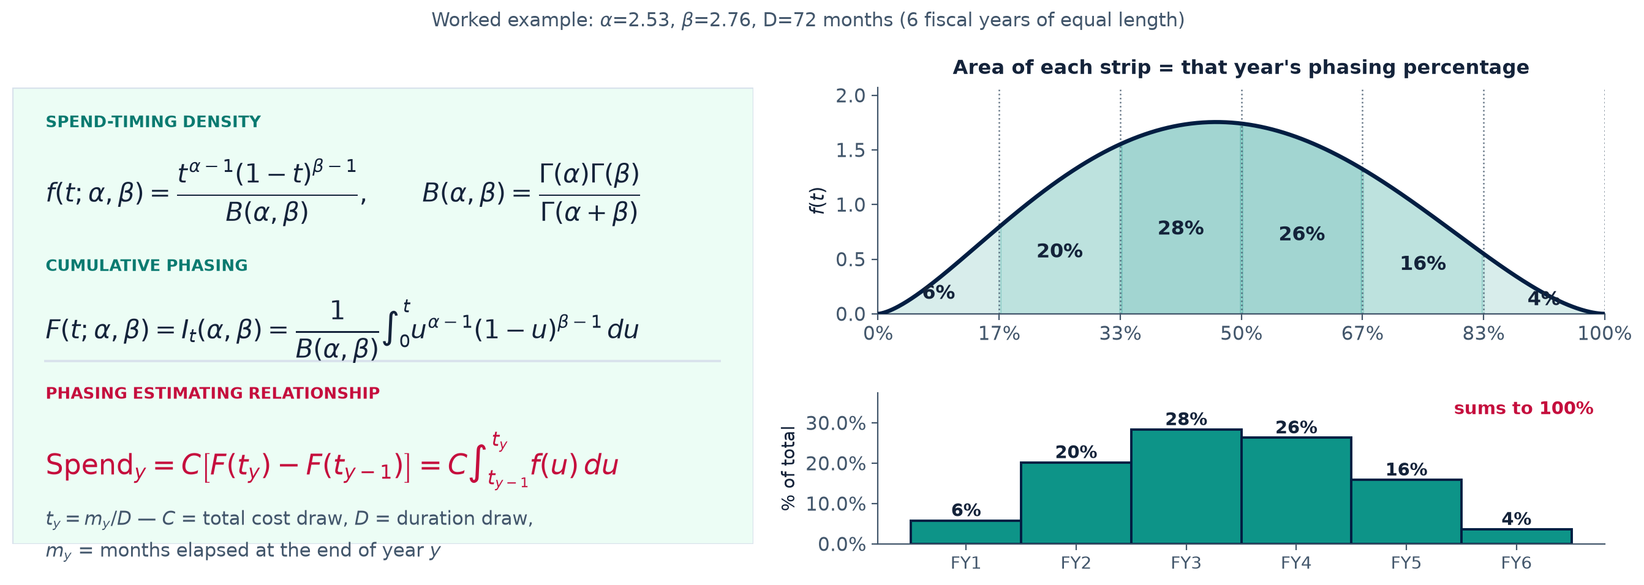
Beta Distribution Family Formulation

Slide 33
Choosing the population model
Choosing the population model — and testing the choice
A
B
✓
Bivariate normal in unit space
Bivariate normal in log space
Tested, not assumed
Direct and easy to explain, but nothing prevents a sampled parameter from going negative, and shape parameters of this kind are usually right-skewed.
Requires truncation or rejection to stay valid.
Sampling (ln α, ln β) guarantees positive parameters with no truncation, symmetrizes right skew, and treats parameter variation as multiplicative — the natural scale for a steepness quantity.
This is the recommended default.
Marginal normality checked in both spaces, plus Mahalanobis distance against chi-square quantiles for bivariate adequacy.
Backup carries the comparison; the choice is evidence-based, not stylistic.
Notes:
Keep this to about a minute. The message is 'we tested the assumption and here is the evidence,' not a statistics lecture. The Q-Q comparison lives in backup.

Slide 34
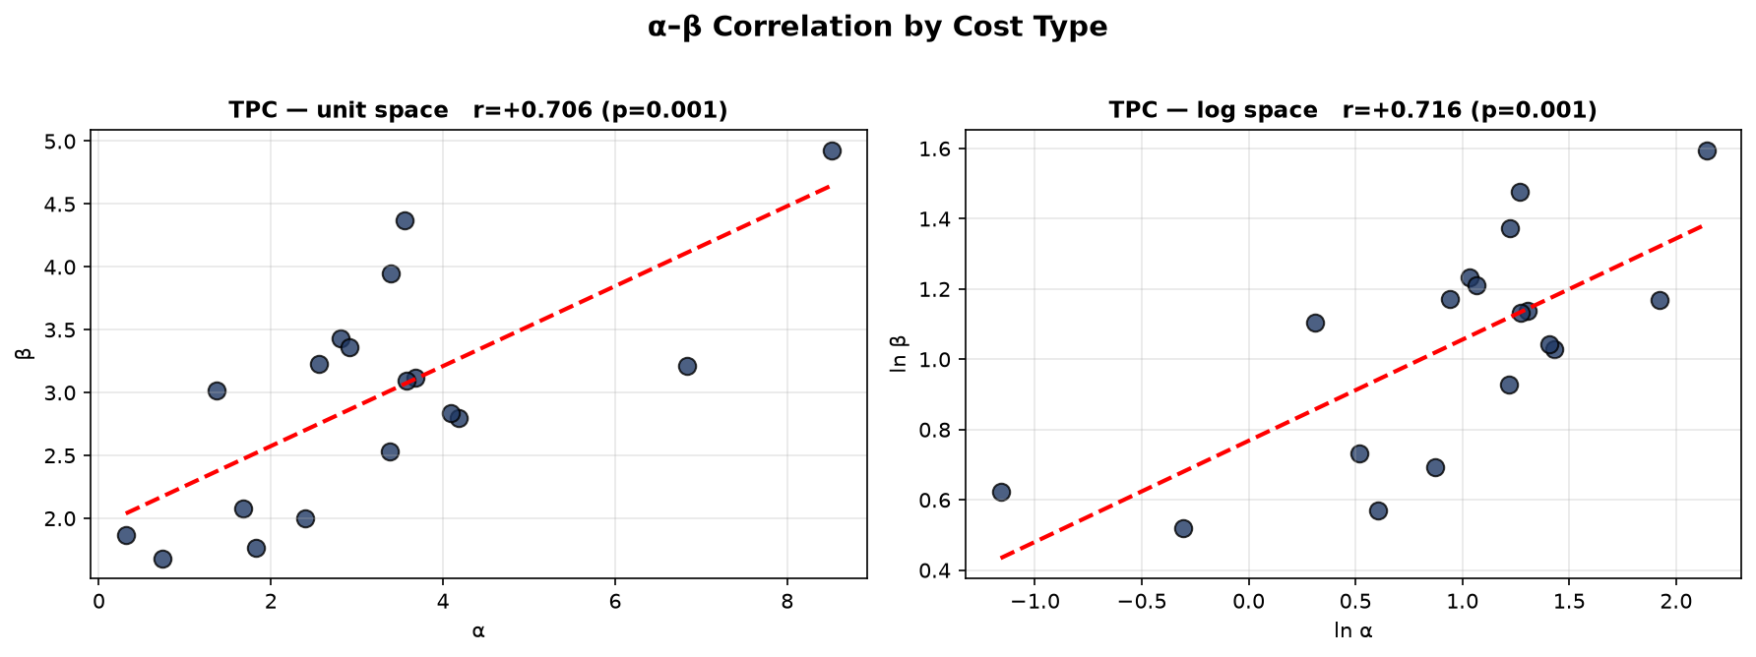
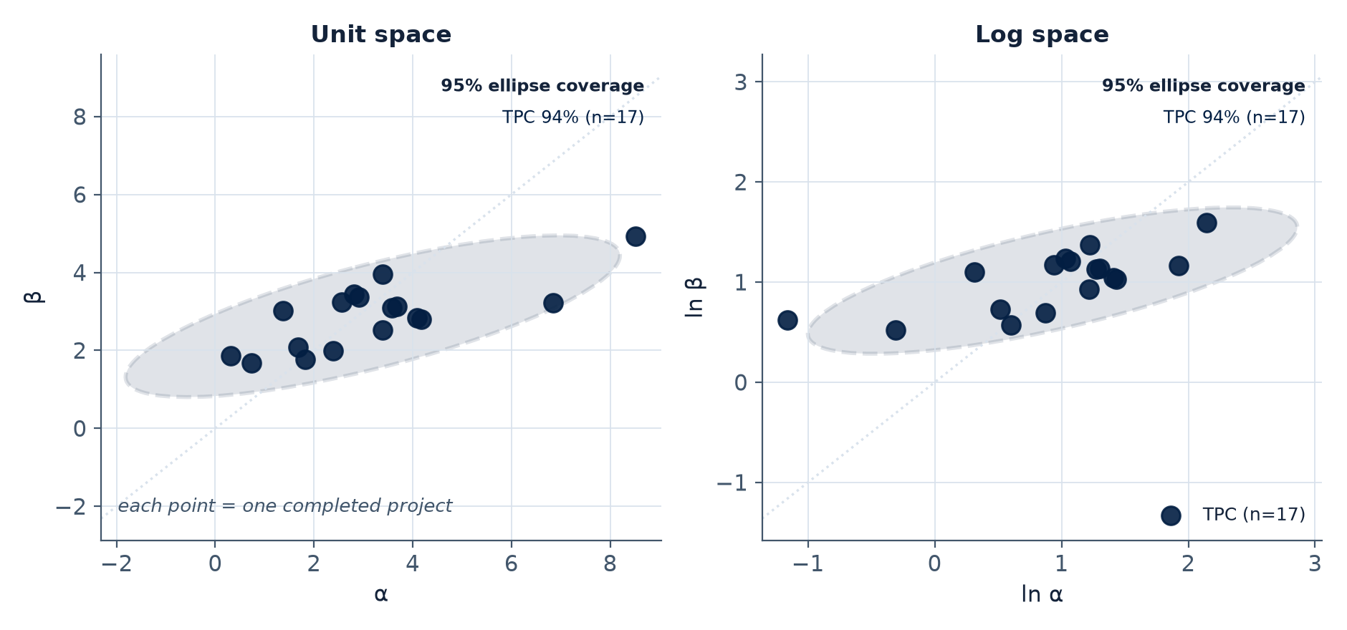
ln α, ln β Parameterization

Slide 35
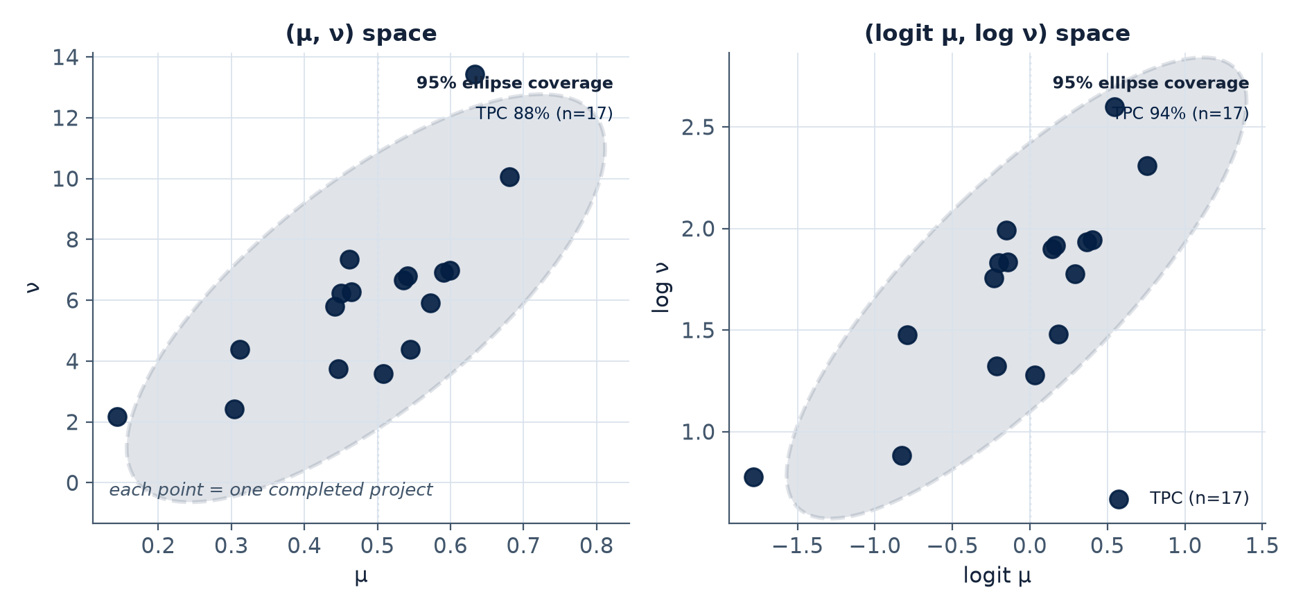
Mean-Precision Parameterization

Slide 36
The α–β correlation
The α–β correlation, and what it means substantively
Measured in both spaces, with Spearman rank correlation as a robustness check against the handful of extreme fits.
Moving along the α = β diagonal changes steepness. Both parameters rising together sharpens the S-curve while leaving mean spend timing roughly fixed.
Moving across the diagonal changes lean. That is the front-loaded versus back-loaded axis.
So a positive correlation is a finding you can state in plain language: our projects vary more in how sharply they ramp than in which direction they lean.
Retain the correlation regardless of significance. At n = 18 a non-significant estimate is not evidence of independence, and carrying the term costs nothing while dropping it discards structure.
Notes:
The plain-language translation in the fourth bullet is the whole point of this slide. If the correlation had come out negative, the sentence flips — projects vary more in lean than in steepness. Either way it is a portfolio characterization worth saying out loud.

Slide 37
Diagnostics that earned their keep
What the diagnostics caught — and why bound-contact is a finding, not a nuisance
Report RMSE as the headline, not maximum error. Maximum absolute error is the single worst period of the single worst project — useful as an honest worst case, misleading as a summary.
Parameters pinned at a bound mean weak identification, not a bound set too low. As α and β grow together at fixed ratio, the curve sharpens toward a step while mean timing barely moves. Raising the bound just moves the pin.
Check for the closeout tail first. Cost reaching 100% well before schedule does, followed by months of punch-list activity, inflates β without limit. That is a normalization convention problem, not a fitting problem.
Do not launder an artifact through the population model. Four extreme parameter pairs out of sixteen will inflate the fitted dispersion and produce implausibly spiky sampled profiles downstream.
Notes:
This slide exists because it happened during development. Being visibly willing to show the diagnostics that failed buys credibility for the fits that worked. If asked: the fix was upstream, in how schedule completion is defined.

Slide 38
Execution-phase use
Invert the model. Given percent-schedule today, the population of curves implies a distribution of percent-cost — a statistical expectation rather than a single planned value.
Actuals outside the P10–P90 band flag a shape anomaly worth investigating: funding disruption, procurement slip, or a genuinely different execution strategy.
Actuals inside the band are normal variation. Resist re-planning against noise; the band quantifies what “on plan” actually permits.
Natural extension: update the parameters as actuals arrive. Conditioning the phasing distribution on spend-to-date produces a refreshed forecast of when the remaining money moves — the timing analogue of an EAC.
Notes:
One slide, closes the loop for the EVM practitioners in the room. Flag the Bayesian update as future work rather than something already built.

Slide 39
Escalation exposure
Escalation exposure — a deliverable you get for free
+$99M
28%
difference between summing annual P80s and the P80 of the total, in the worked example
over-programming that a naive quantile profile would introduce
Longer duration draws push spend into later, more escalated years, so then-year cost is correlated with duration even when constant-year cost is held fixed. The simulation yields the full distribution of escalation dollars rather than a point adjustment applied after the fact — and it exposes the aggregation error on the right, which is the subject of the next section.
Notes:
For a DOE audience this alone can justify building the model. Ninety seconds. The 28% number is a preview of the aggregation trap — use it to set up section 4.

Slide 40
Backup material
Method-of-moments initializer — derivation, and behavior when early observations are sparse.
Unit-space versus log-space population fits — parameter tables, normality diagnostics, and the difference in sampled curves.
Fitted parameters versus realized duration and size — the scatter behind the independence assumption.
Sum-of-quantiles versus quantile-of-sum — the full numeric demonstration from the worked example.
Annual versus monthly granularity — effect on per-fit standard errors, and why Stage 2 pooling compensates.
Mean–precision versus (α, β) fits — the bijection, the conditioning comparison, and how much of the observed ρ survives correcting for estimator-induced correlation.
Hierarchical Bayesian formulation — model structure for the small-sample extension.
Reproducibility — single-script pipeline, fixed seed, fits table and distribution parameters as published artifacts.
Notes:
Do not walk this slide. It exists so that questions have somewhere to land and so the deck stands alone when forwarded.

