Slide 1
High Efficiency Waste Heat Harvesting Using Novel Thermal Oscillators Contract Number: DE-EE0008314 University of Pennsylvania; Rutgers University; Yale University 09/2018-08/2020
Chinedum Osuji, University of Pennsylvania
U.S. DOE Advanced Manufacturing Office Virtual Program Review
June 2-3, 2020
This presentation does not contain any proprietary, confidential, or otherwise restricted information.

Slide 2
Overview
Project Title: High Efficiency Waste Heat Harvesting Using Novel Thermal Oscillators
Project Budget and Costs:
Budget | DOE Share | Cost Share | Total | Cost Share %
Overall Budget | $960,000 | $240,000 | $1,200,000 | 20.0%
Approved Budget (BP-1&2) | $960,000 | $240,000 | $1,200,000 | 20.0%
Costs as of 3/31/20 | $575,335 | $98,964 | $674,299 | 14.7%
Timeline:
Project Start Date: 09/01/2018
Budget Period End Date: 04/30/2020
Project End Date: 08/30/2021
Barriers and Challenges:
High performance pyroelectric harvesting of low-grade waste heat requires efficient, simple thermal switching to control heat flows.
Suitable thermal switches have yet to be developed.
Project Team and Roles:
University of Pennsylvania (Lead)
Materials processing
Device fabrication and characterization
Yale University
Materials synthesis; Device modeling
Rutgers University
Device fabrication and characterization
AMO MYPP Connection:
Waste Heat Recovery Systems

Slide 3
Project Objective(s)
Pyroelectric (PE) waste heat harvesting is compelling:
Current PE materials are intrinsically capable of efficiencies that eclipse current thermoelectric materials.
PE harvesting requires periodic variation of the temperature of a generating device placed in contact with a steady heat source.
Efficient and sustained generation of such temperature variations in PE devices is the critical barrier to practical PE waste heat harvesting.
Objective: Enable practical energy recovery from low temperature waste heat with unprecedented efficiency using pyroelectric materials in manufacturing-relevant settings.
Approach: Develop and model switching technology relevant for manufacturing
Passive and active switching
Target: “Bolt-on” devices; $1/Watt, 35% efficiency (Carnot).
Target represents ~5X efficiency improvement.
(High Efficiency Waste Harvesting Using Novel Thermal Oscillators)

Slide 4
Technical Innovation
PE harvesting has been explored largely using MEMS devices and large-scale thermal cycling by pumped fluids.
Limitations:
MEMS devices: Complex; costly; not readily scalable.
Pumped fluids: Large frictional losses; not easily deployed.
Proposed Approach: Develop simple thin planar devices that can be “bolted on” to warm surfaces in manufacturing settings.
Thermal switching in planar devices by development of new, scalable thermal management solutions:
Shape memory contact switching (passive)
Electrohydrodynamic switching (active)
Critical Innovations:
Scalable fabrication.
Efficient bistable switching.
Geometry enables easy deployment/installation.
(High Efficiency Waste Harvesting Using Novel Thermal Oscillators)

Slide 5
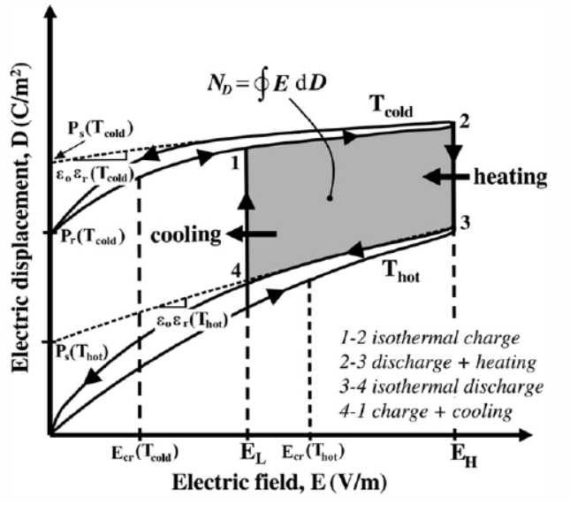
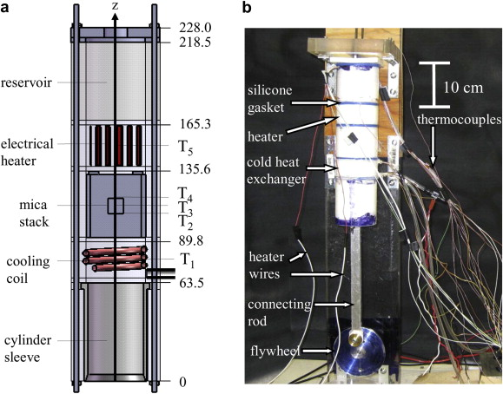
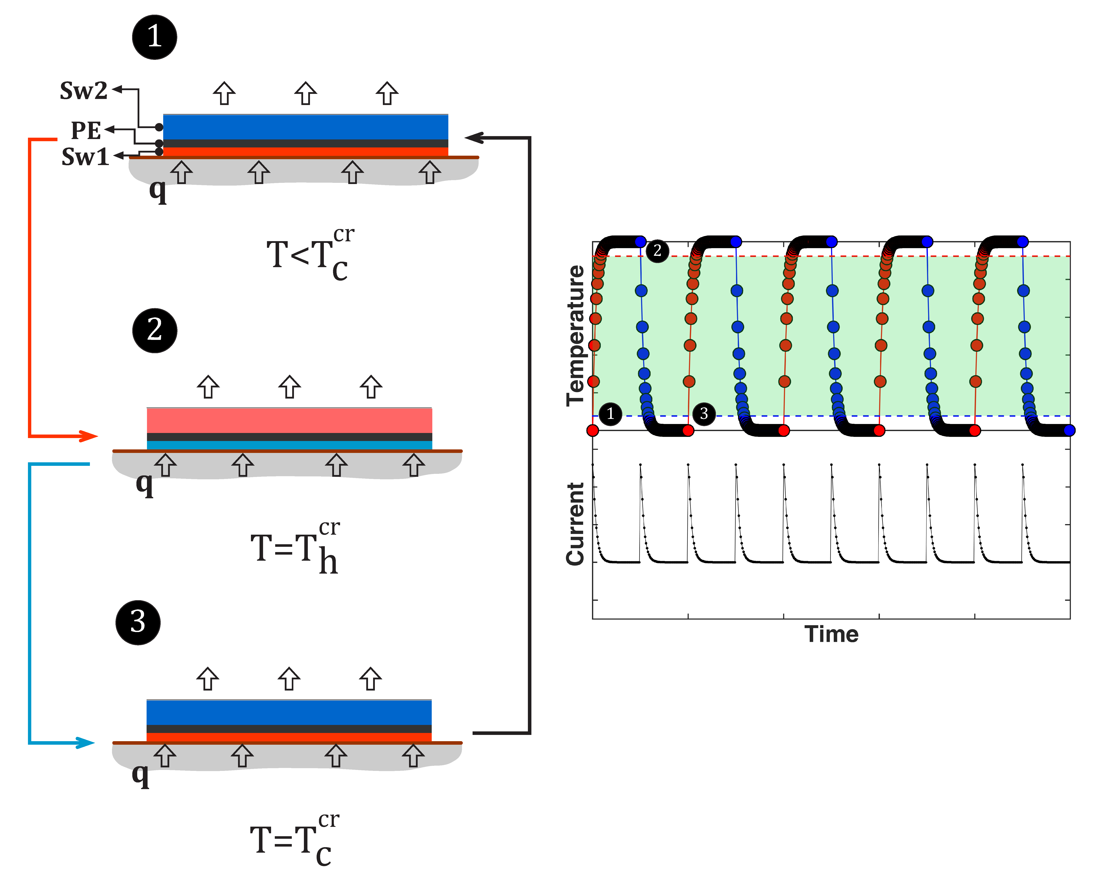
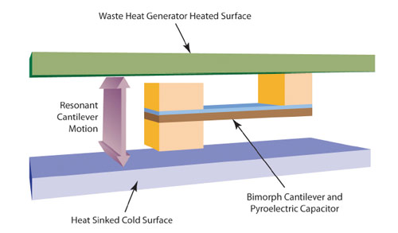
Technical Innovation
Pumped fluid device
Thermal oscillator planar device
Navid, A. et al. Int. J. of Heat and Mass Trans. (2010)
MEMS device
Pilon, L. et al. Applied thermal engineering, 30(14): p. 2127-2137 (2010)
Datskos, P. G. et al. International Society for Optics and Photonics (2011)
KEY CONCEPTS : Pyroelectric energy generation from waste heat is compelling due to impressive intrinsic efficiencies which far surpass thermoelectric conversion. The inability to readily generate sustained temperature cycles in compact systems represents the single biggest challenge to practical energy recovery using pyroelectric devices today. Prior research efforts have explored MEMS devices and fluid circulators for thermal switching. The proposed work will develop unique “thermal oscillator” switches to enable practical and efficient planar PE energy harvesting devices.
(High Efficiency Waste Harvesting Using Novel Thermal Oscillators)

Slide 6
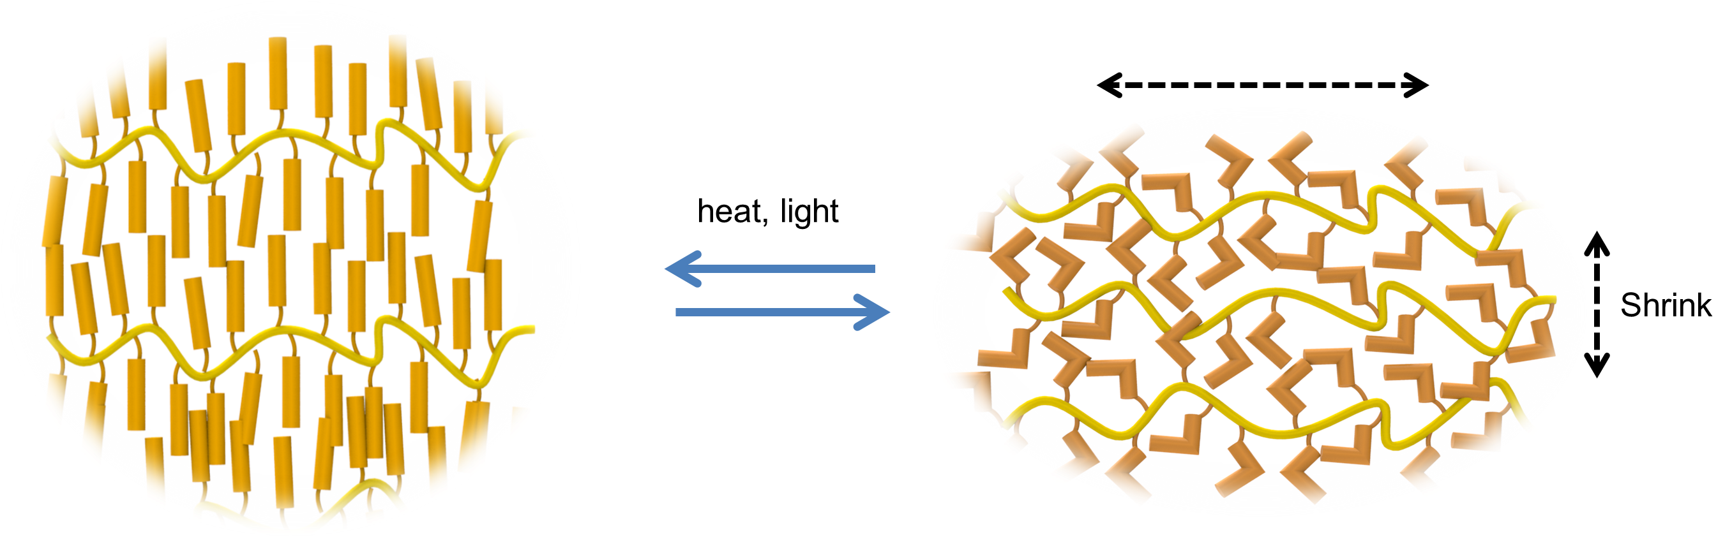
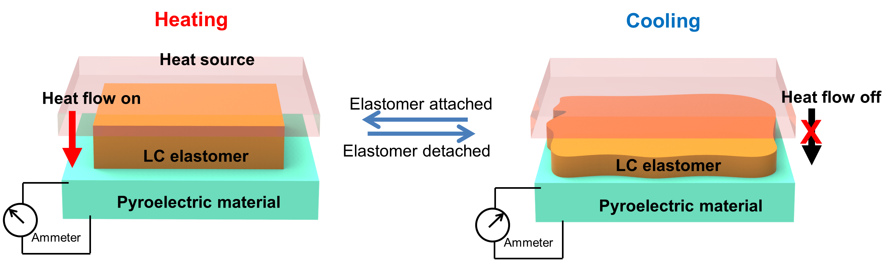
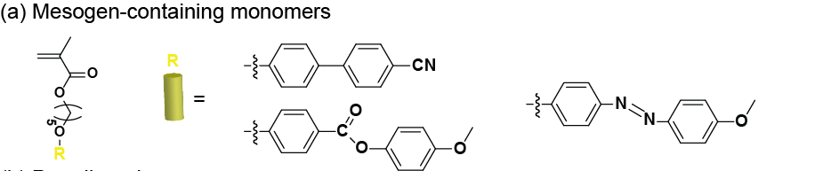
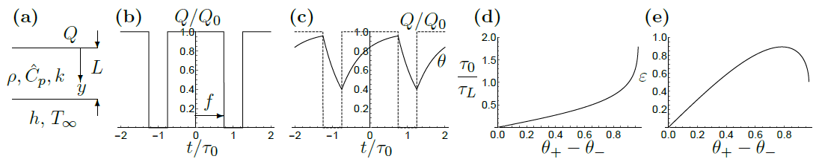
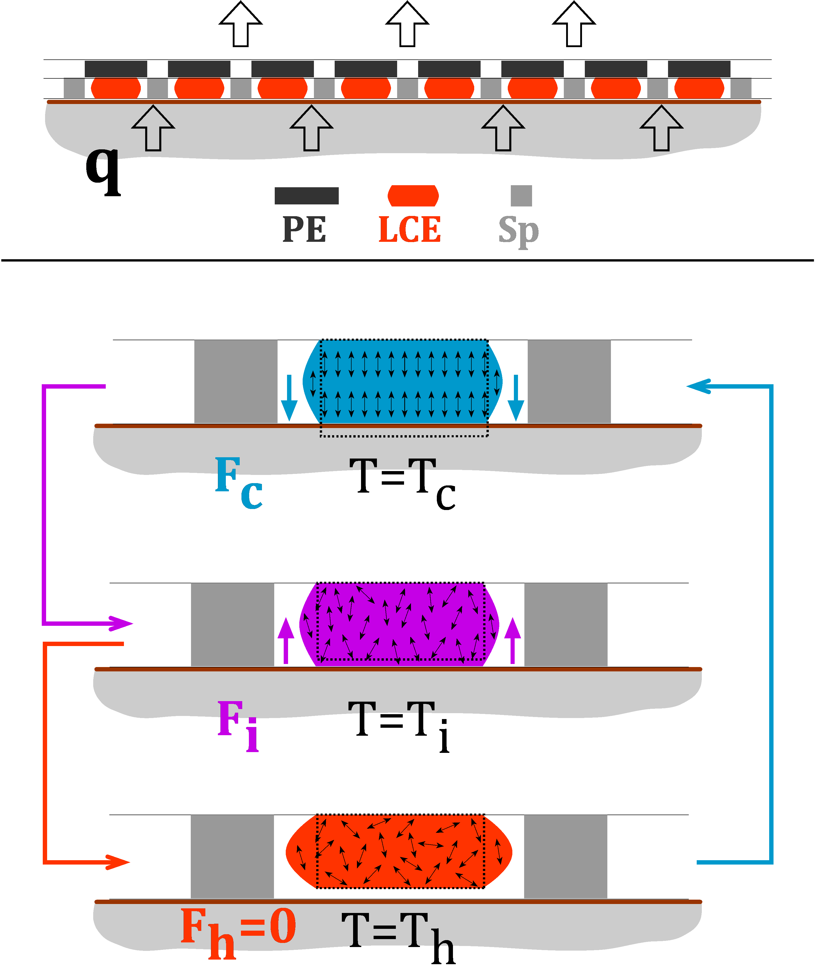
Technical Approach A
Thermally actuated shape memory switches
Modeling: Lumped, distributed parameter, and multiscale calculations.
Osuji: Processing of LCEs; Device fabrication and characterization; Thermophysical property optimization.
Zhong: Molecular engineering and synthesis of LCEs; Thermophysical property optimization.
Loewenberg: Modeling of transport properties
Singer: Materials property characterization.
Shape memory passive switching: Shape memory effect (SME) in aligned liquid crystalline elastomers (LCEs) produce reversible dimensional changes on heating and cooling above LC clearing temperatures. Materials and Methods: Acrylate LC polymers; cyanobiphenyl and azobenzene mesogens; mechanical and magnetic field alignment. P(VDF-TrFE) and other PEs. Transport modeling.
Shape Memory Thermal Oscillator (SMTO) Challenge: Engineering shape memory effects to reversibly make and break thermal contacts to control heat flow to a pyroelectric layer.
Notes:
LC elastomers exhibit thermomechanical actuation – they shrink along a well-defined direction on heating above a critical temperture, and return to their original dimensions when cooled below this critical temperature. This provides the basis for designign a thermal switch. The thermomechanical actuation must be combined with an adhesive instability to ensure that stationary points are avoided, i.e. that the switch can exhibit self-sustained cycling between two stable configurations.
Tc: Low temperature starting point
Ti: Clearing transition induces retractive force due to SME, but contact maintained by adhesion.
Th: Contact is broken as retractive force becomes sufficiently large to overcome adhesion.

Slide 7
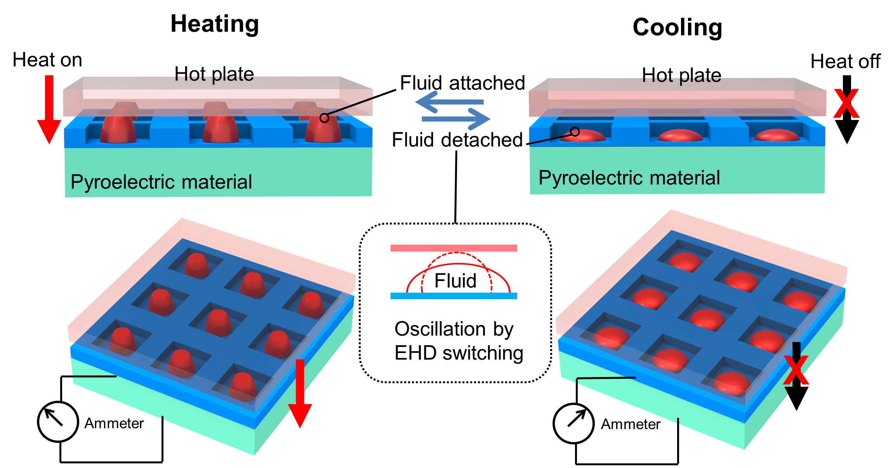
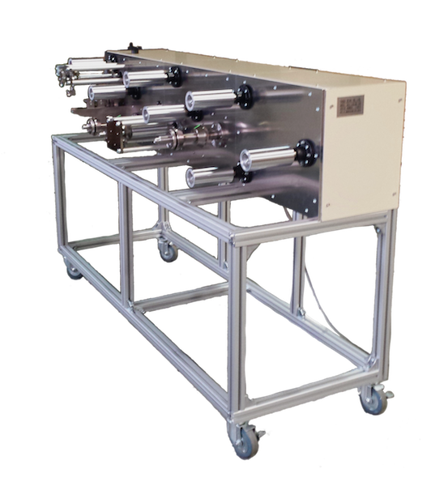




Technical Approach B
Electrically actuated thermal fluid switches
Thermocapillary
Dewetting
Heat Source
$$∇T$$
Composite
$$∇V$$
Pyroelectric
Electrohydrodynamic
Bridging
Singer: Formulation of thermal fluids; Device fabrication and characterization; R2R device fabrication; Optimization of thermophysical properties.
Osuji: Characterization of thermal transport.
Loewenberg: Modeling of transport properties.
Electrohydrodynamic active switches: Device utilizes field present in Olsen cycle. Field application drives electrohydrodynamic bridging to make thermal contact with the heat source. Field removal breaks thermal contact due to thermocapillary dewetting.
Materials and Methods: Nanoparticle filled silicone and other fluids for active thermal fluid. P(VDF-TrFE) and other PEs. Transport modeling.
Electrohydrodynamic Thermal Oscillator (EHTO) Challenge: Engineering thermal fluids for desired thermophysical properties and responsiveness.
Notes:
The EHD effect, characterized almost a century ago,[40] describes the elongation of fluid droplets along the direction of a strong electrical field due unbalanced surface charge and capillary forces. This can be utilized to generate liquid bridges between two surfaces. A related effect has been employed to create thermal switches for on demand heat regulation[41] but required complicated electronics specifically to avoid the use of a top electrode, which is demanded by the Olsen cycle. This research revealed both that a liquid bridge could be used effectively in this way, and, further, that the thermal conductivity of the bridge was enhanced by thermocapillary (TC) forces. These forces, as recently reviewed by co-PI Singer[42] create flows due to thermally induced surface tension gradients that force fluids down thermal gradients. The proposed EHD cell design will employ non-volatile, insulating fluid pockets as the source for thermal bridges, allowing for cyclable, long lasting dynamic thermal bridges. The challenges to such an approach are to find a geometry that is (i) readily-scalable, (ii) insensitive to gravity, and (iii) works in the context of the Olsen external field.

Slide 8
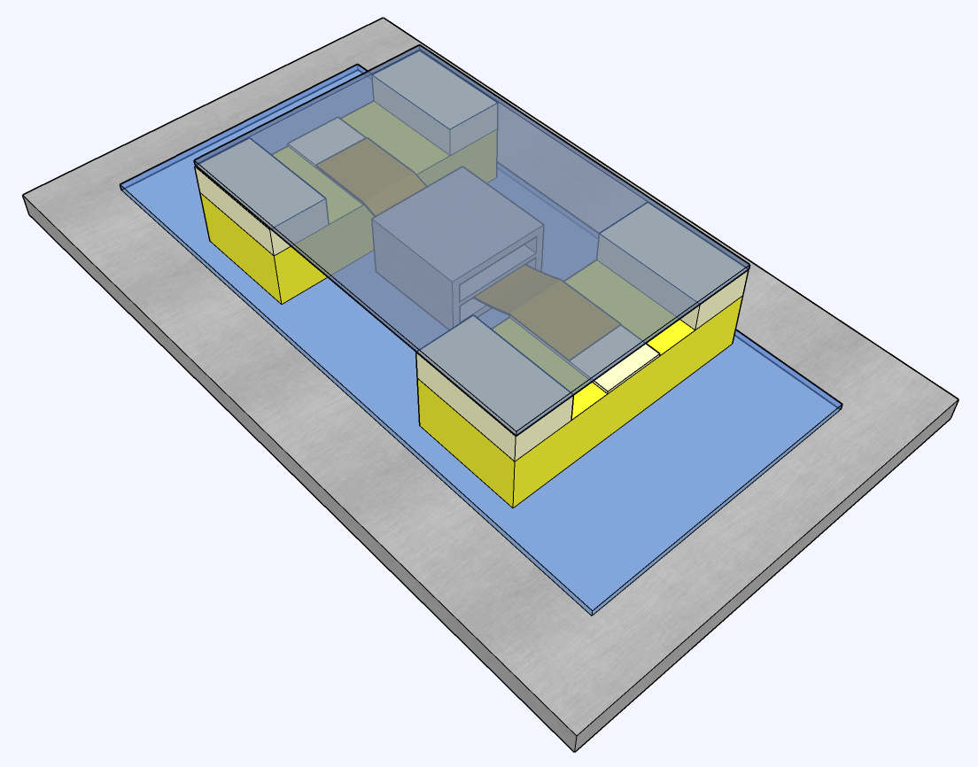
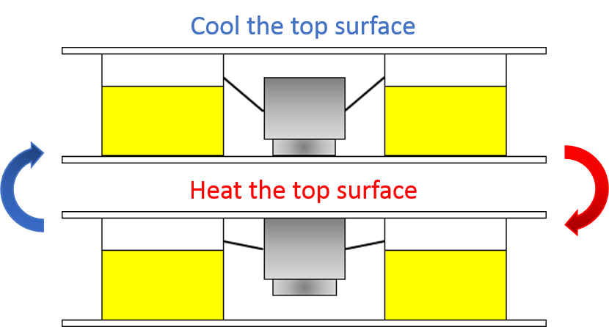
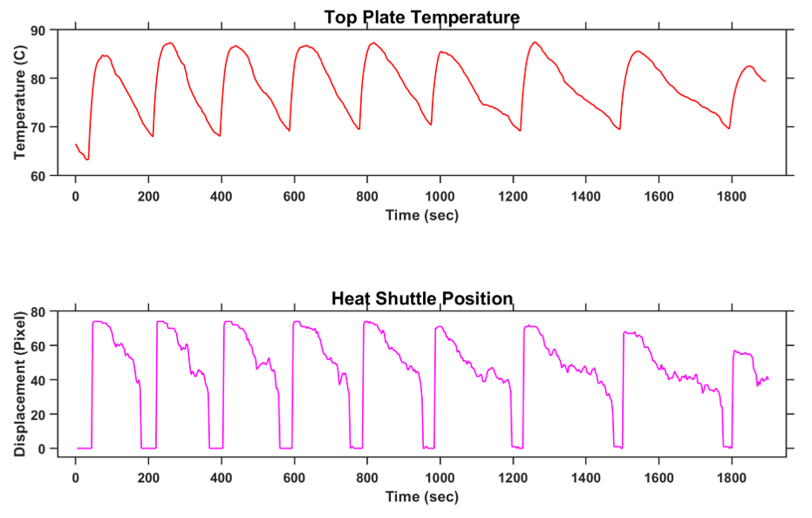
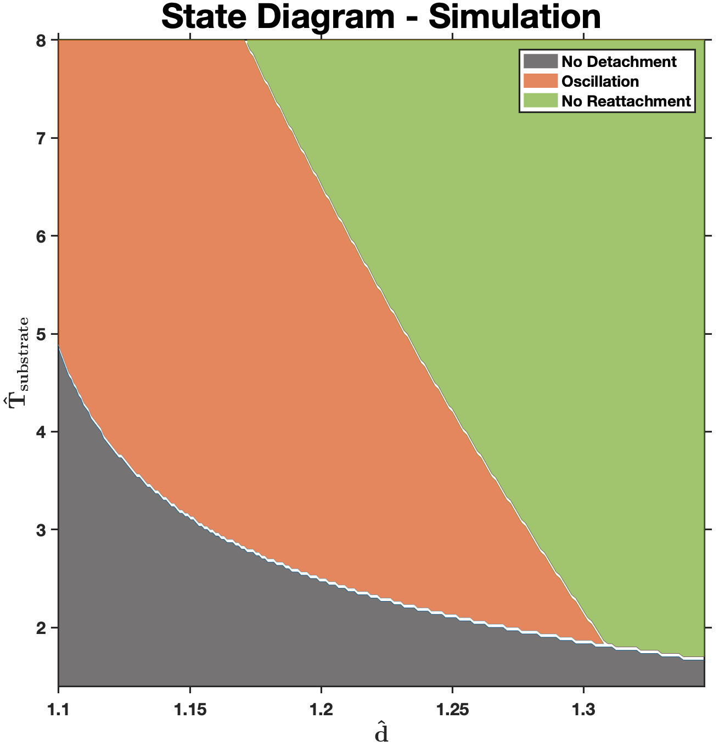
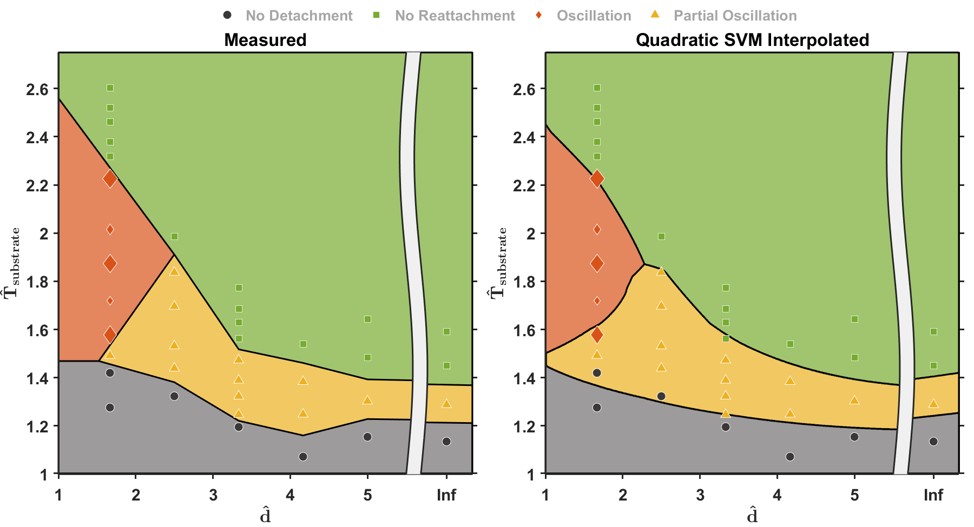
Results and Accomplishments A
Constant heat flux
or
Focused heat flux
Shape memory passive switching:
Bistable switching successfully achieved by thermally stimulated shape memory effects in designed polymers.
State diagram describing temperature oscillation cycles measured and simulated.
Device elements designed and optimized for manufacturability.
Custom apparatus for efficiency characterization designed and assembled.
High throughput fabrication and efficiency optimization remain to be completed.
Thermal transport Modeling:
Analytical results provided for heat transport in lumped and distributed parameter models.
Figure of merit has been generated that captures the magnitude and rate of temperature changes.
High efficiency “focused heat flux” operation regime identified.
Energy generation efficiency relative to Carnot is provided.
Numerical studies of multiscale model incorporating thermal transport coupled with switch motion remain.
Notes:
Plots show the figure of merit as a function of the fraction of the cycle that is spent heating the device. The top plot shows the constant flux case, while the bottom plot shows the “focused heat flux” case that arises in the limit of small heating rates relative to the heat capacity of the device and the switching time.

Slide 9
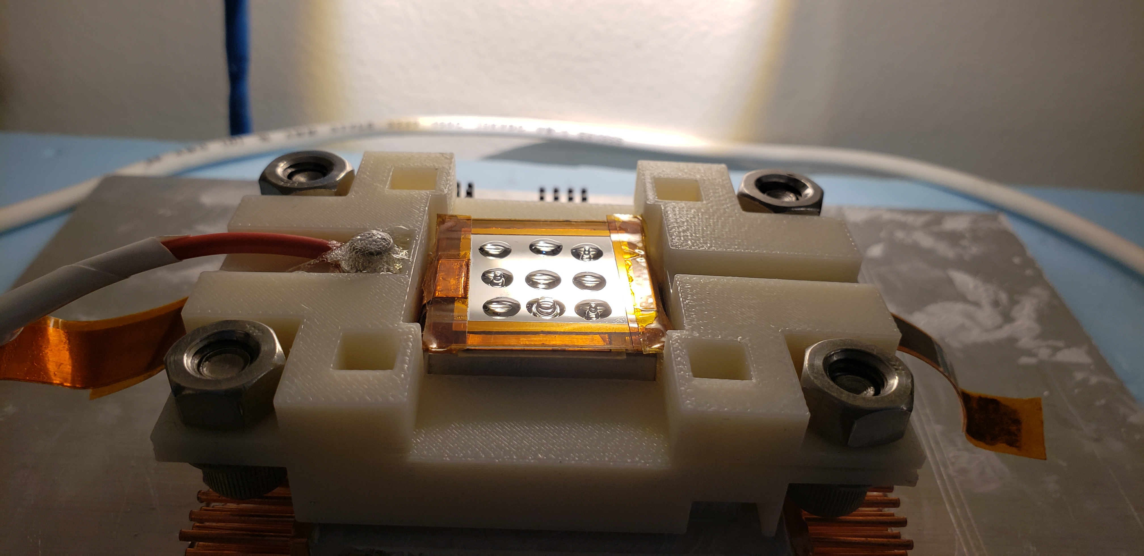
Results and Accomplishments B
Droplets of thermal fluid before switching
Capillary bridge providing thermal contact
Electrohydrodynamic switching
Development and optimization of thermal fluids that support EHD switching.
Developed inkjet based fabrication of arrays of droplets of thermal fluids.
Achieved successful voltage driven switching of thermal contact in custom designed devices.
Custom apparatus designed and verified for efficiency characterization.
Custom apparatus for efficiency characterization designed and assembled.
Implementation of high throughput fabrication using roll-to-roll instrument and optimization of device efficiency remain to be completed.

Slide 10
Results and Accomplishments
Milestone/Tasks | Status | Notes
Milestone 5.1.1 (M15/Q5): Fabrication of shape memory elements in a parallel production process from one or more polymers with the ability to bond and debond as a function of temperature. | Achieved
Milestone 5.2.1 (M21/Q7): Reliable measurement (normalized standard error less than 0.15) of device efficiency and achievement of minimum 20% efficiency using LCEs fabricated with the techniques detailed above. | In Progress
Milestone 5.2.2 (M24/Q8): Achievement of ultimate target efficiency (35%) using LCEs fabricated and optimized with the techniques detailed above. | In Progress
Milestone 6.2.1 (M18/Q6): Successful R2R generation of a sheet of droplets contained within insulating wells, with 1 droplet per well with size variation of <10% as determined by optical microscopy and no residue detectable on the surface of the insulating spacer. | Achieved
Milestone 6.3.1 (M21/Q7): Demonstrate parallel fabrication of EHD-PE devices with target efficiency of 20%. | In Progress
Milestone 6.3.2 (M24/Q8): Demonstrate parallel fabrication of EHD-PE devices with target efficiency of 35%. | In Progress
Milestone 6.4.1 (M24/Q8): Demonstration of EHD-PE device fabricated in part by R2R that possesses target efficiency of 25%. | In Progress
Milestone 7.1.1 (M18/Q6): Formulation and solution of the multiscale parameter model. | Partially achieved | Multiscale simulation of thermal transport coupled with switch motion remains.
(High Efficiency Waste Harvesting Using Novel Thermal Oscillators)

Slide 11
Transition (beyond DOE assistance)
Technology readiness (TR) level of 4-5 anticipated by project end.
Intellectual property licensing or recruitment of further development funding beyond 08/2020.
(High Efficiency Waste Harvesting Using Novel Thermal Oscillators)

