Slide 1
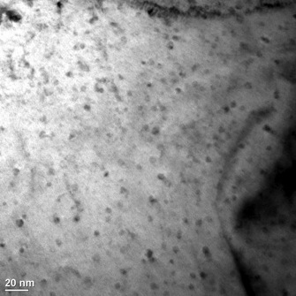

Scale-up Challenges for Materials in Harsh Service Conditions: Accelerating Industrial Adoption
Affordable
Reliable
Scalable
Predictable
Performance
Clean Energy Technologies
Materials Discovery
Grams /
Nano
Kilograms /
Macro
David F. Teter
Materials Science and Technology Division Leader
Los Alamos National Laboratory

Slide 2
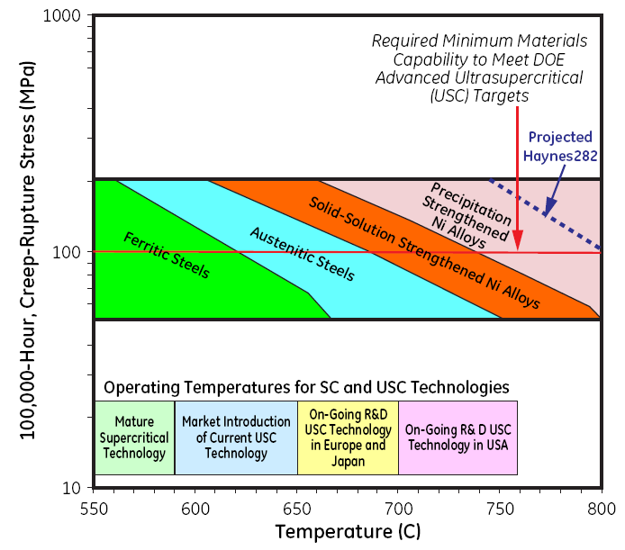

Low cost alloys for harsh environments will enable next generation heat exchanger technologies
Increase temperature capability
of low cost Fe alloys
Application | Benefit/Opportunity
A-USC Steam Plants¹ | 47% plant efficiency, 30% reduction in CO₂.
sCO₂ Power Cycles³ | 9 % increase in efficiency 20% lower LCOE near 100% carbon capture.
Concentrating Solar Power (CSP)⁴ | Receivers: ≤$150/kW_{th}; Thermal Efficiency ≥90%; HTF exit T>720ºC; ≥10,000 cycles
Transportation: turbochargers | Affordable, high efficiency (2025 CAFÉ)
Cross cutting: Affordable heat-resistant alloys 600-1000ºC
Ni: $13,950/ton
Steel billet: $370/ton
February 23, 2015
Notes:
DOE‐FE Clean Coal Research Program: Crosscutting Research Technology Program, 2013. (http://www.netl.doe.gov/research/coal/crosscutting)
DOE-EERE-AMO, Materials for Severe Service Conditions: Technology Assessment (Draft), 2015 (http://www.energy.gov/downloads/qtr-webinar-chapter-8-industry-and-manufacturing)
DOE--FE Clean Coal Research Program: Advanced Turbines Research Technology Program, 2013. (http://www.netl.doe.gov/research/coal/energy-systems/turbines)
DOE-EERE-Solar Energy Technology Office, Sunshot National Lab Multiyear Partnership Call for Proposals, 2015
Technology Roadmap Update for Generation IV Nuclear Energy Systems – 2014
For example, operation of pulverized coal plant at Advanced Ultrasupercritical (AUSC) conditions of up to 760°C and 5000 psi would increase plant efficiency and reduce carbon emissions by 25 percent per MW over current plants

Slide 3
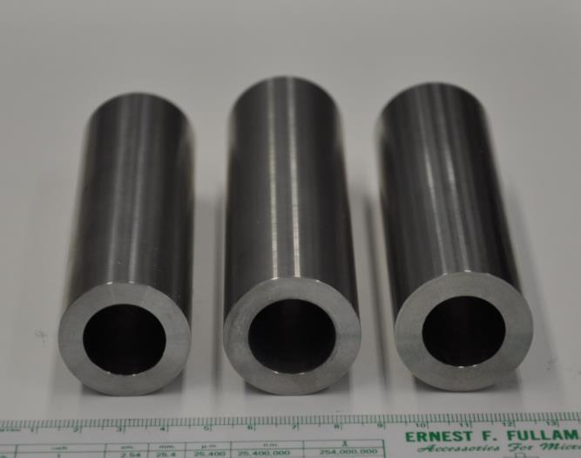
Retaining the nanostructure in nano-ferritic alloys while manufacturing at scale is challenging
Powder Synthesis
Mechanical Alloying
Consolidation
Atomization
Ceramic nanoparticles
Ball Milling
HIP
Hot Extrusion
Hydrostatic Extrusion
Pilger Mill
Post-processing
Cold Spray
Severe Plastic Deformation
Tube Drawing
Internal oxidation
Forming
Joining
Machining
High Energy Rod Milling
Attritor Mill
System integration
14YWT
CR6
14YWT
CR6b
9YWTV
PM2
ORNL, LANL
Consolidation at room temperature is difficult due to high strengths
Processes with elevated temperatures may coarsen the nanostructure
Need to consider cost and energy consumption of net manufacturing process from powder to final product.

Slide 4

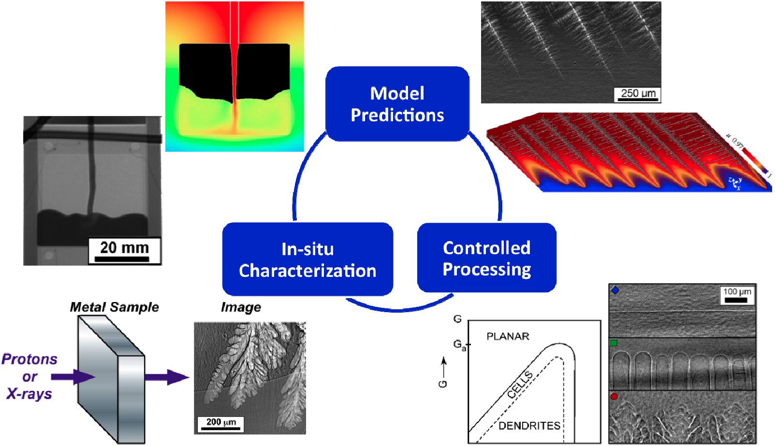
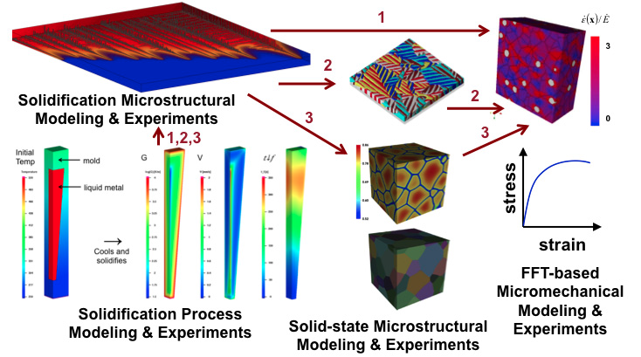

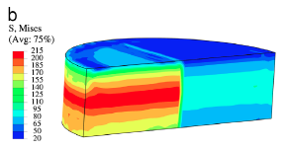
Science & Technology Gaps
Manufacturing processes that retain required nanostructure in final product application
ICME tools across large length scales that can forward predict process maps.
Characterization tools to rapidly understand materials formation and behavior as a function of process conditions and scale.
Rapid experimental validation of materials performance and service life.
Community-scale data infrastructure, management and informatics that enable fast convergence on the science or development pathways.
Casting / consolidation
solidification, segregation
performance – strength, ductilit, corrosion
evolution during thermo-mechanical processing

