Slide 1

Materials for Harsh
Service Conditions:
High Temperature Corrosion
Brian Gleeson
DOE-EERE Workshop
Pittsburgh, PA
November 19 & 20, 2015

Slide 2
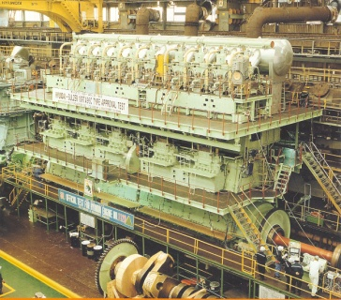
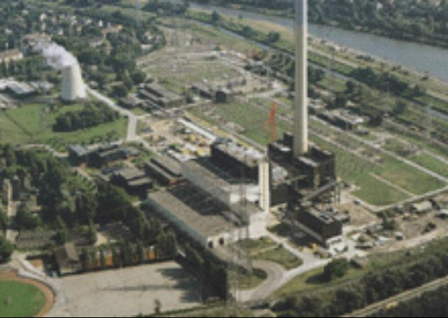
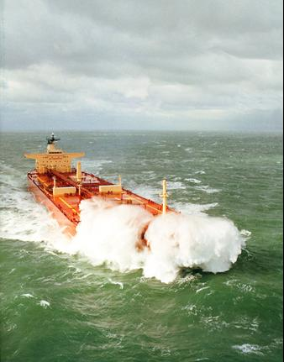
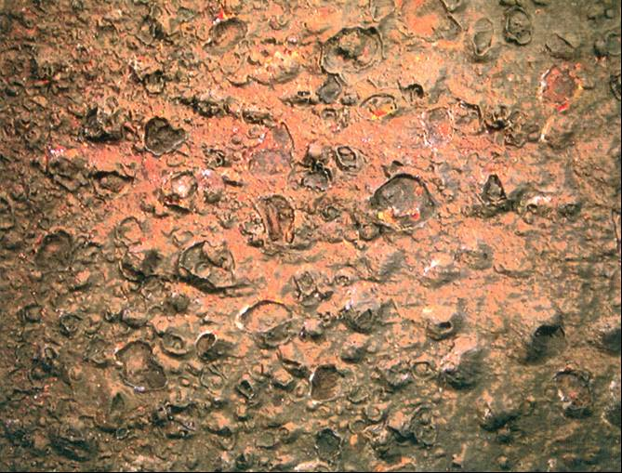
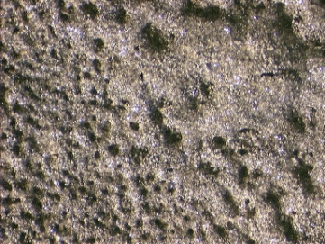
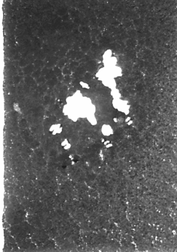
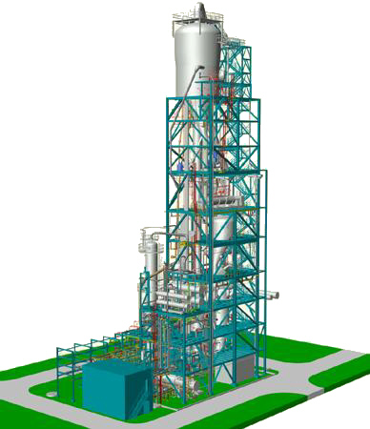
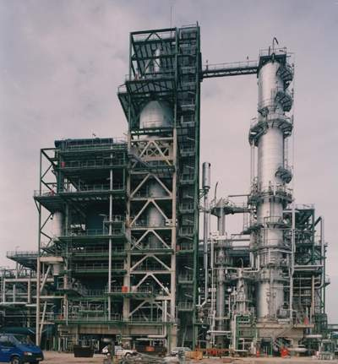
Harsh Environments
at High Temperatures
2-
SO4
Courtesy: Michael Schütze (DECHEMA)

Slide 3
Common Forms of High-Temperature Degradation
Oxidation (O₂, H₂O, CO₂ )
Sulfidation (S₂, H₂S)
Oxidation/Sulfidation (SO₂, SO₃)
Carburization (CO, CH₄)
Nitridation (N₂, NH₃)
Chloridation (Cl₂, HCl)
Hot Corrosion (Na₂SO₄)
Ash Deposit (fly ash)
volatilization contribution to attack
Deposit-induced attack
Many operating environments are multi-oxidant.
Even so, resistance to degradation often requires the
formation of a protective oxide.

Slide 4
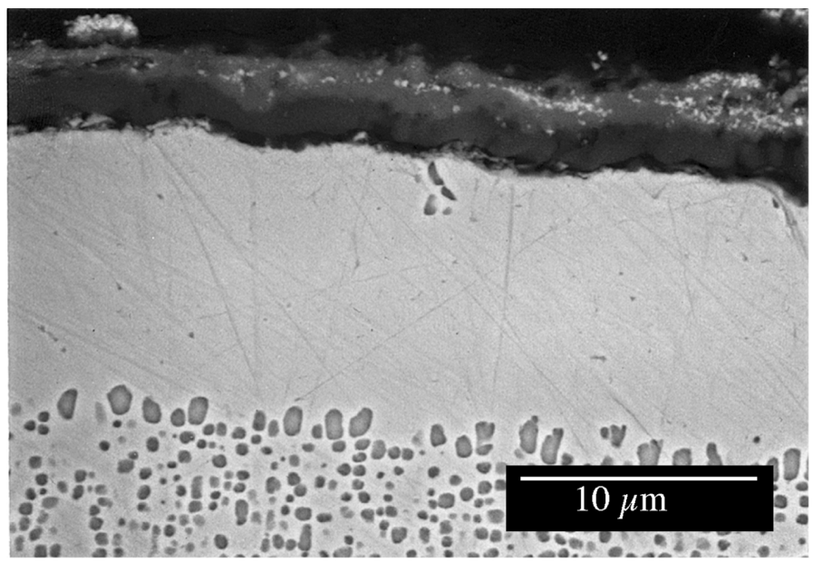
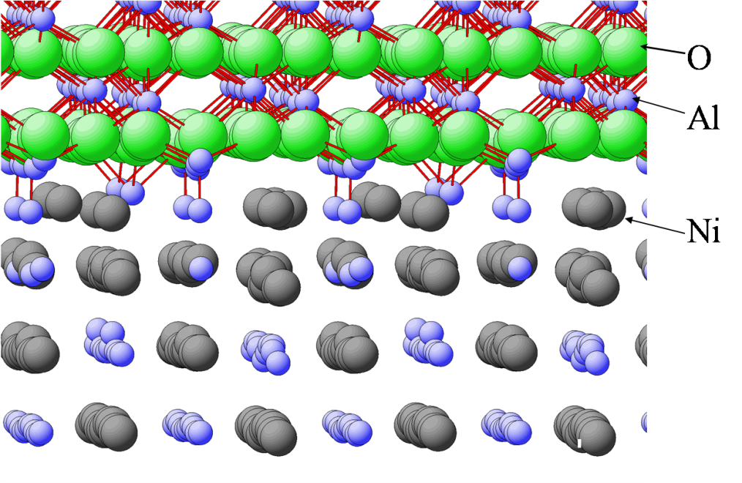
High-Temperature Materials
Important focus: Surface Degradation of Materials for Exposure to Harsh Environments
Assessment, development and modification of materials and surfaces for extended performance in many high-temperature applications, including advanced energy-generating systems.
Al₂O₃
Single Crystal Ni-base Superalloy

Slide 5
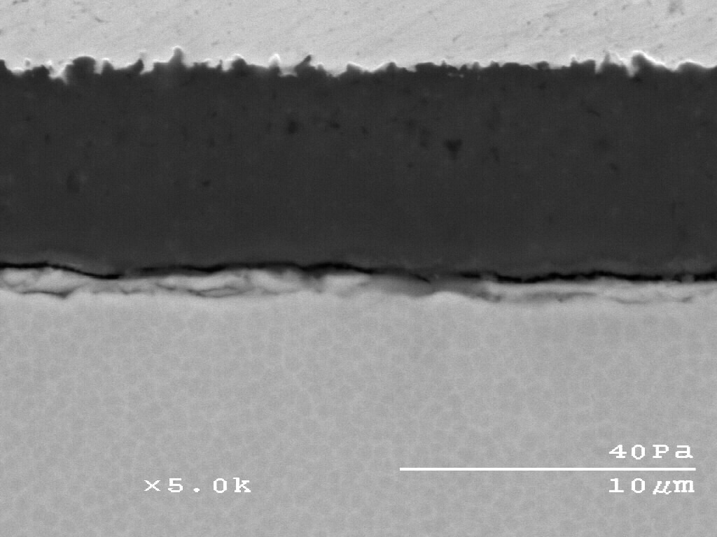
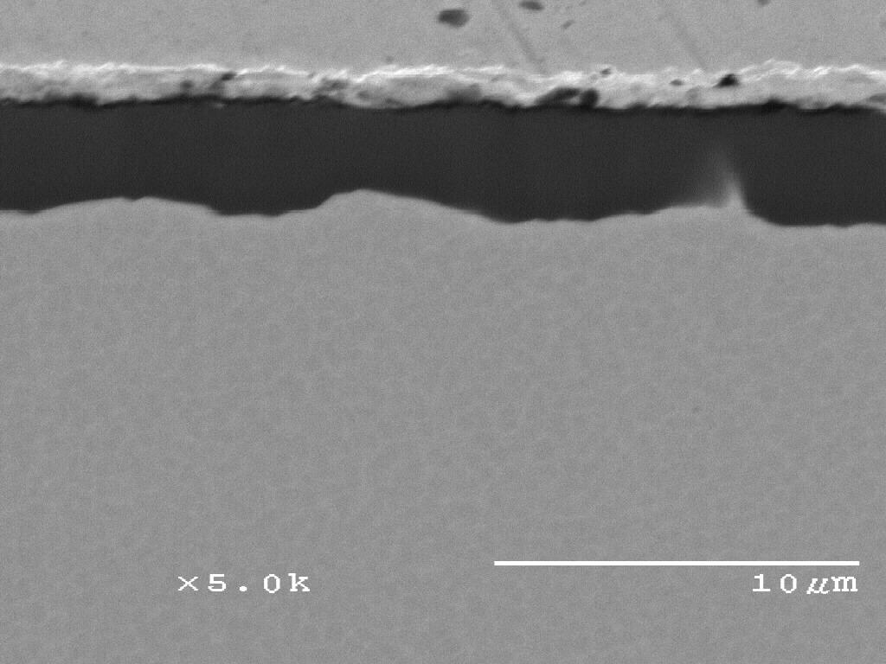
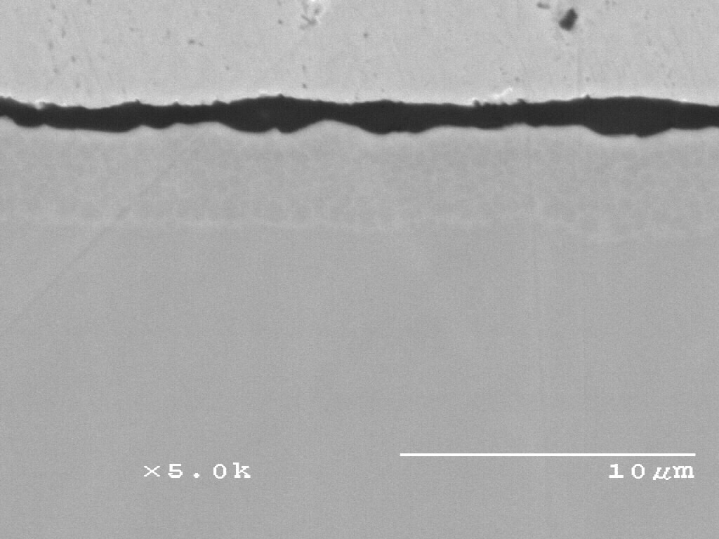
Isothermal Oxidation Kinetics at 1150˚C (2102˚F) in Air
Single Doped : Hf vs. Y
Base composition (at.%): Ni-20Al-5Cr
Al₂O₃ scale
Ni-20Al-5Cr
Al₂O₃ scale
-0.05Y
-0.05Hf

Slide 6
Effect of Minor Element Contents
Wrought 800 alloys from two different producers
Measured compositions in wt.%
Alloys | C | Mn | Si | Cr | Ni | Fe | Ti | Al | Cu
A800 | 0.02 | 0.78 | 0.13 | 20.05 | 33.64 | 44.46 | 0.41 | 0.30 | 0.21
B800 | 0.06 | 0.70 | 0.38 | 20.50 | 30.30 | 47.15 | 0.32 | 0.25 | 0.07
1000ºC, 1-day cycles
0
B800
-20
Weight Change(mg/cm² )
-40
A800
-60
-80
-100
0
20
40
60
80
100
120
Oxidation cycles
Oxidation behavior is often significantly influenced by minor alloying additions

Slide 7
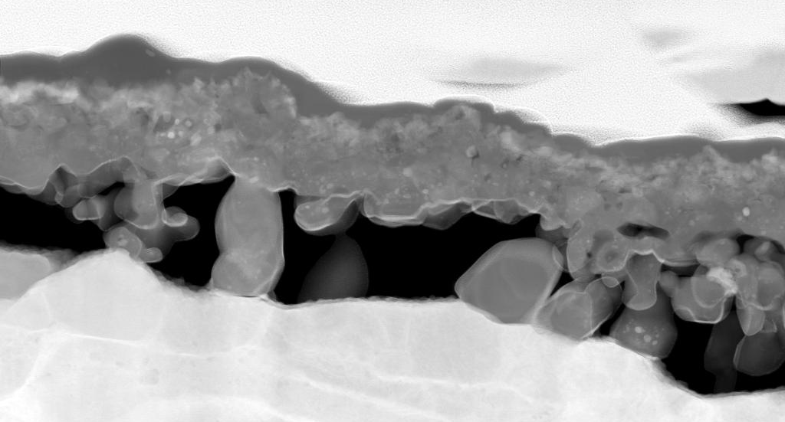
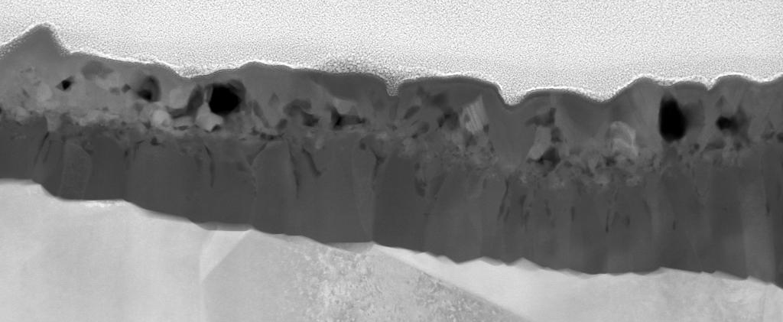
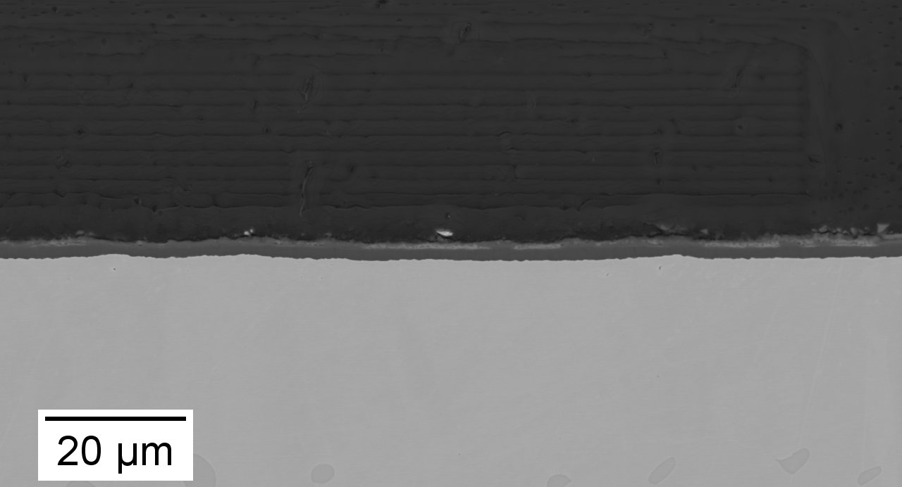
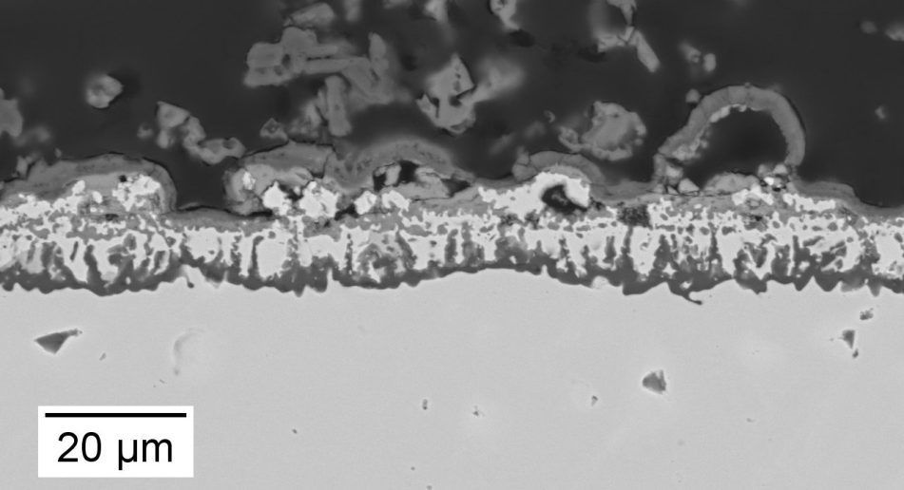
Al₂O₃-Scale Formation on an NiCoCrAlY System
Ni-30Co-30Cr-12Al-0.1Y in CO₂-20H₂O-1.6O₂ at 1100 °C in air
After 20 minutes
No deposit
SiO₂-Al₂O₃-CaO-Na₂SO₄ deposit
STEM images
deposit
Al, Cr oxide
Al₂O₃
500 nm
500 nm
After 50 hours

Slide 8
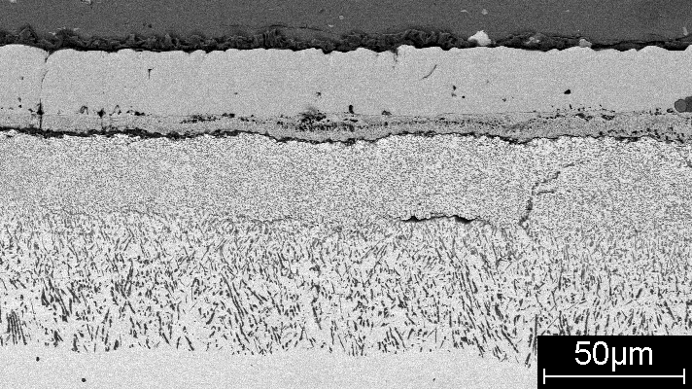
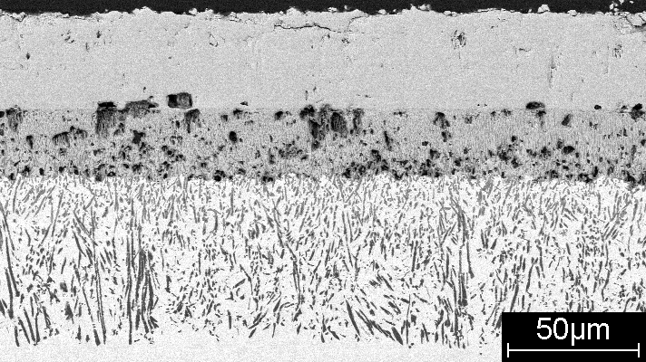
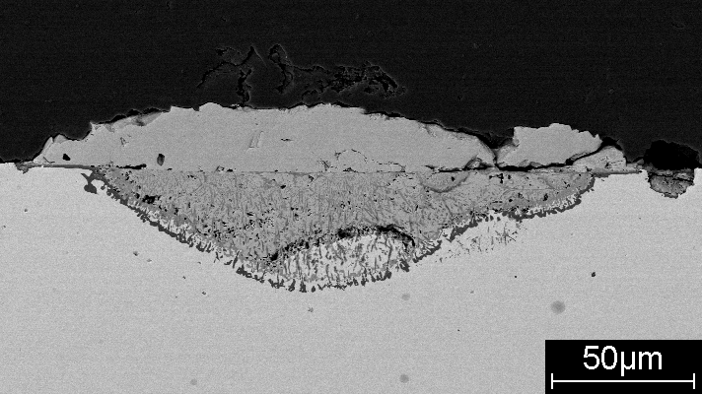
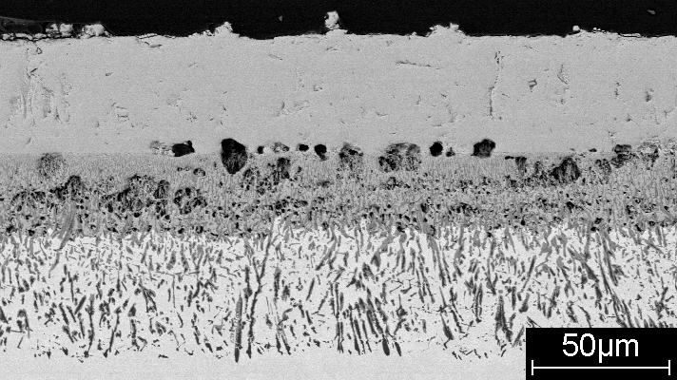
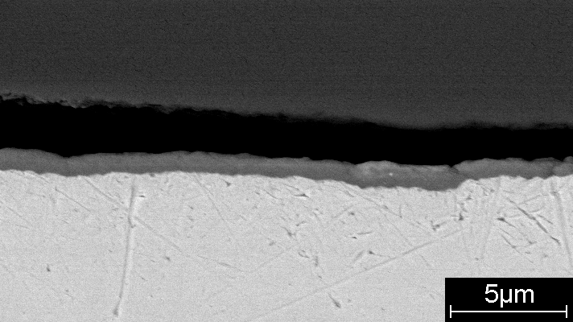
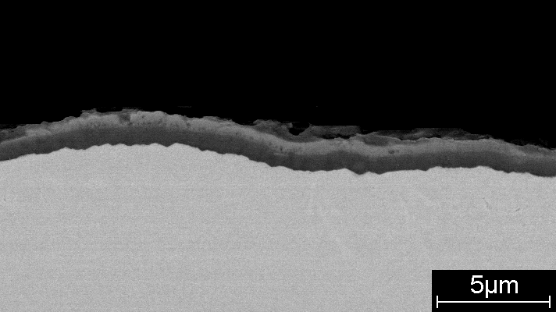
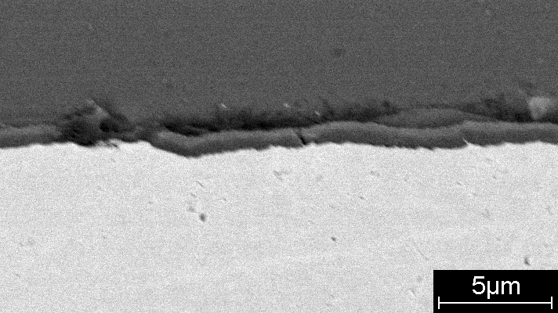
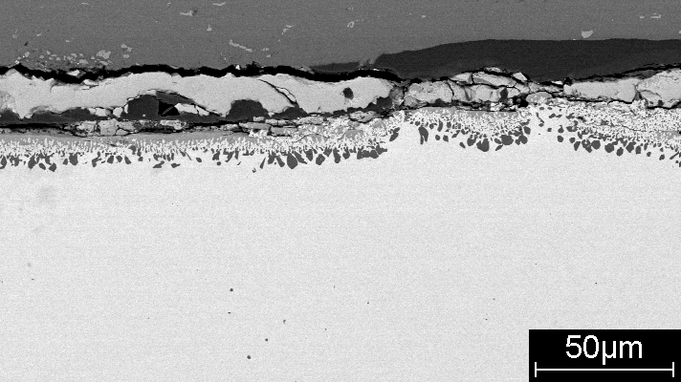
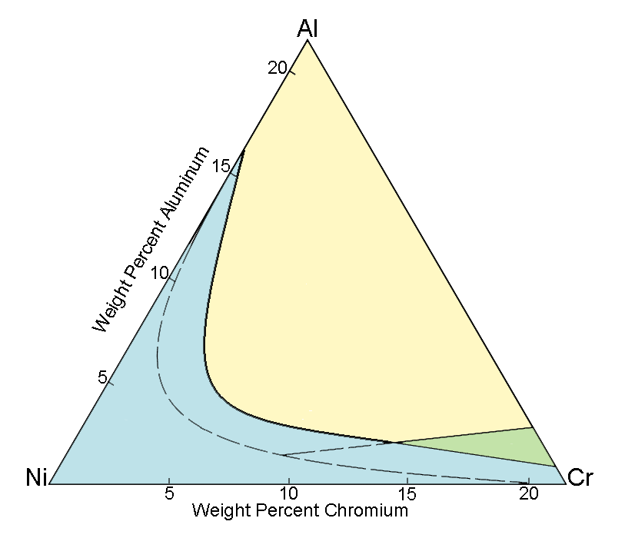
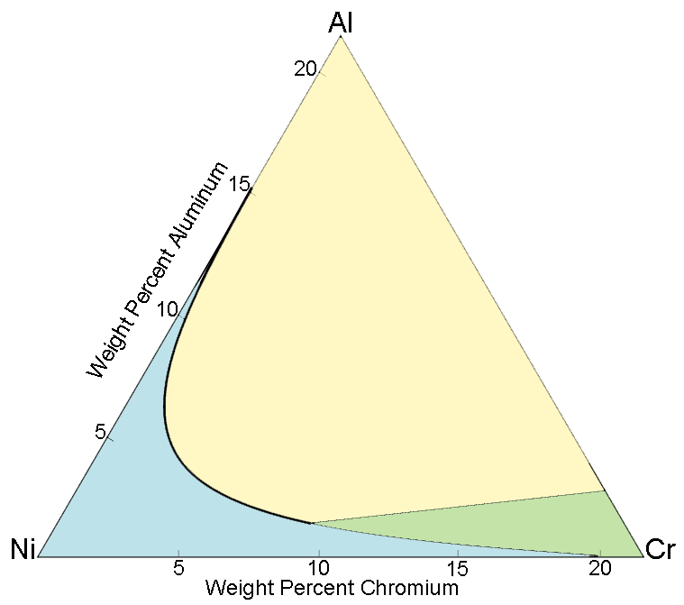
A Steam-Containing Environment can be Harsh
Giggins and Pettit* established the following oxidation map for rolled Ni-Cr-Al alloys in 0.1atm O₂ at 1000ºC.
Dry
Wet (30% steam)
#1
#1
Wet
Al₂O₃
#2
#2
Al₂O₃
N_{Al}*
#1
#2
#3
N_{Al}*
#4
Cr₂O₃
#1
#2
#3
#3
#3
NiO+Int.Oxi.
#4
Cr₂O₃
NiO+Int.Oxi.
*Giggins and Pettit, J. Electrochem. Soc.,118 (1971) 1782
#4
#4
8

Slide 9
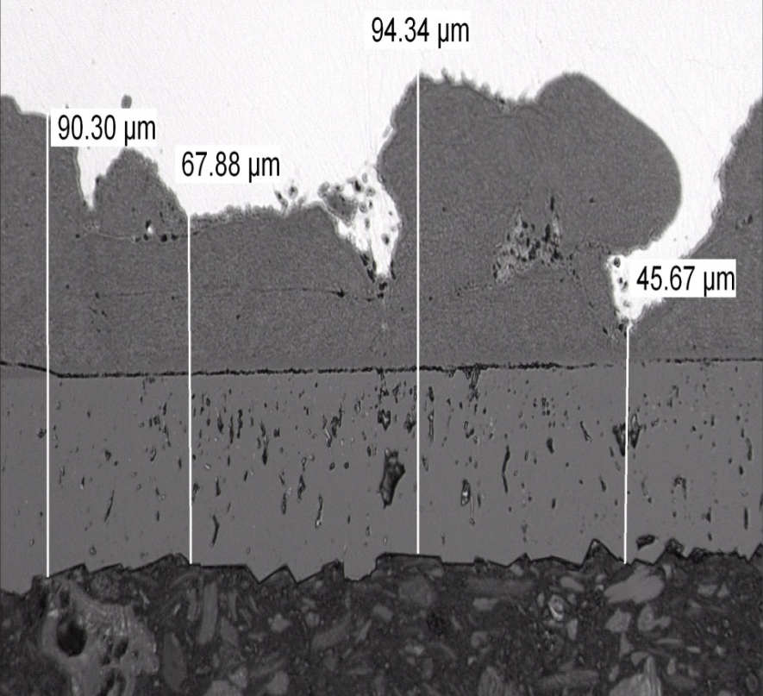
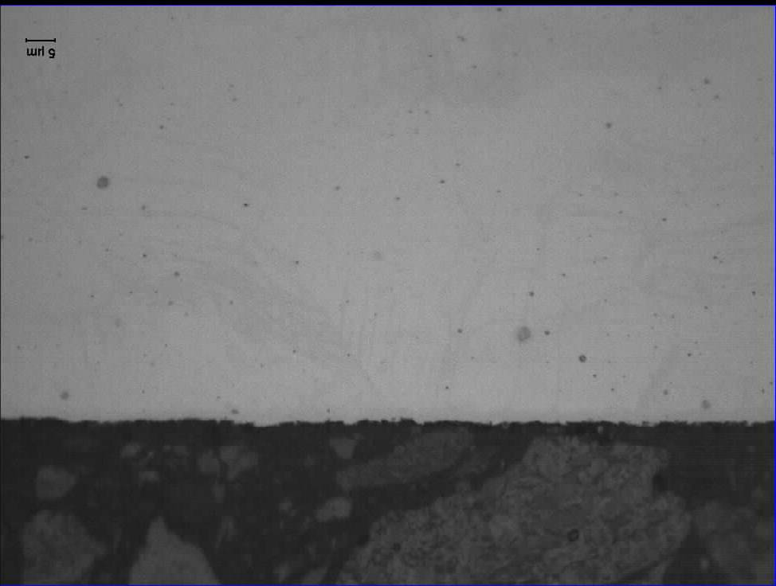
Effect of Steam Pressure
316 Stainless Steel (18.6 wt % Cr) 650º C for 1500 h
50 µm
50 µm
300 bar 1 bar
Extensive attack
Minimal attack
Courtesy: Alina Aguero (INTA, Spain)

Slide 10
Oxidation of Fe-15Cr in O₂ vs. CO₂ at 900°C
Predictability of the bi-oxidant CO₂ result currently does not exist.
From F. Pettit and G. Meier, Univ. Pitt.

Slide 11
High-Temperature Degradation
Gaps/Opportunities to be Discussed
Environments and materials are typically much more complex than what is treated experimentally or theoretically.
multi-component materials comprised of more than one phase
Multi-oxidant environments
There is a continual push for higher temperatures.
There is often a superpositioning of degradation modes (e.g., mechanical fatigue together with oxidation) in practical applications.
Significant opportunities exist to exploit advanced computation, simulation and characterization techniques.
There is a significant need for improved testing procedures and capabilities.
There is a strong push to develop new materials at a faster pace with reduced risk.

Slide 12
Cyclic Oxidation of Ni-20Al-(5-10)Cr-0.05Hf
Alloys at 1150°C
Predicted alloy phase
equilibria

Slide 13
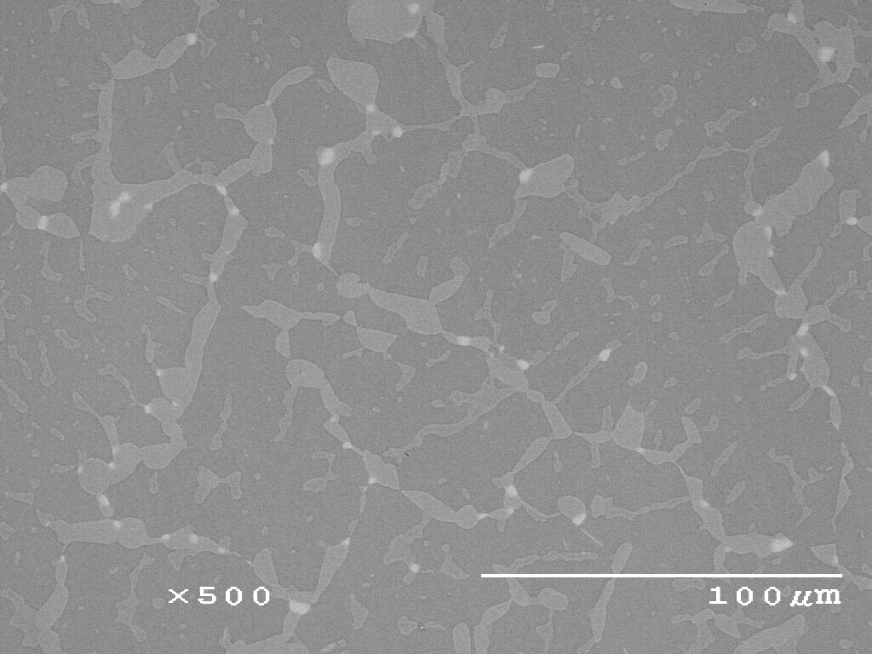
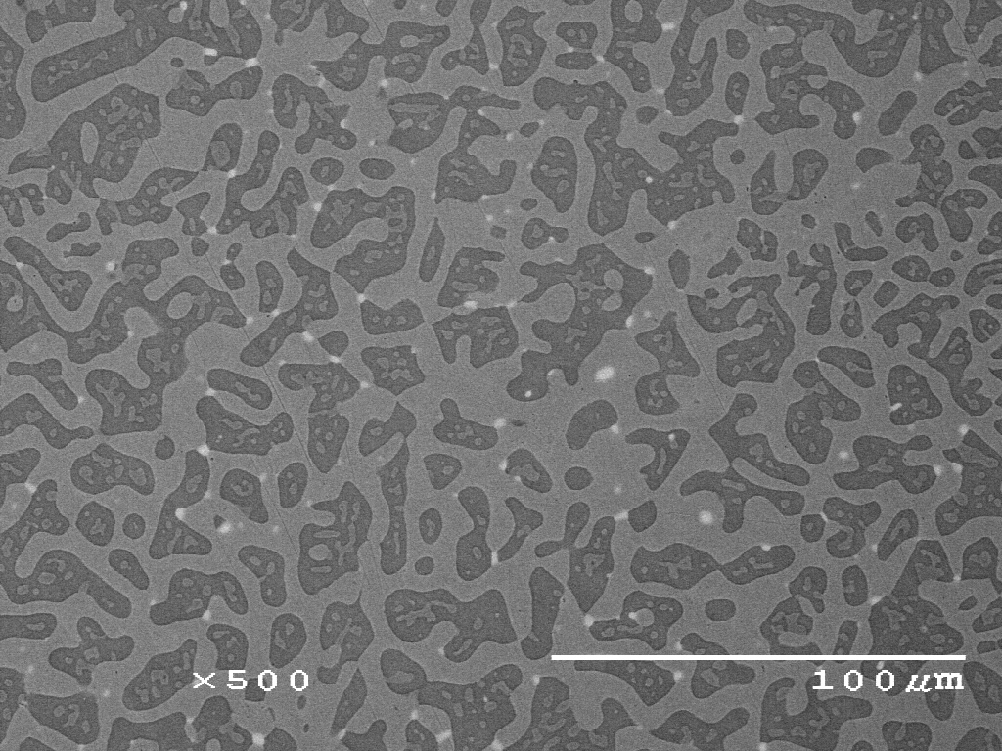
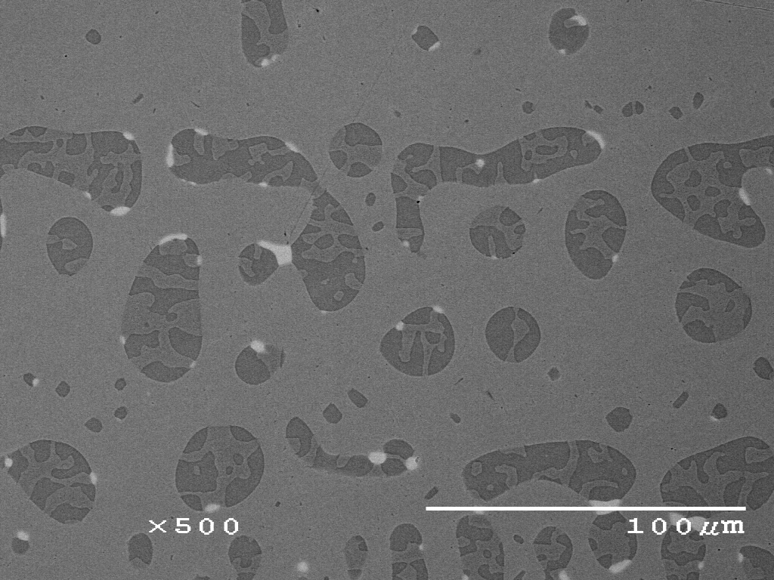
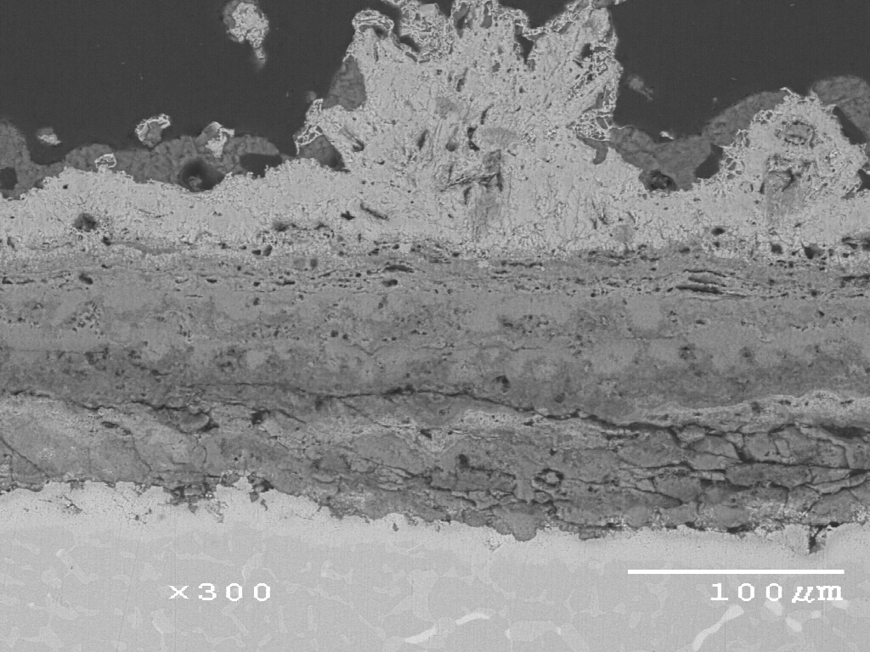
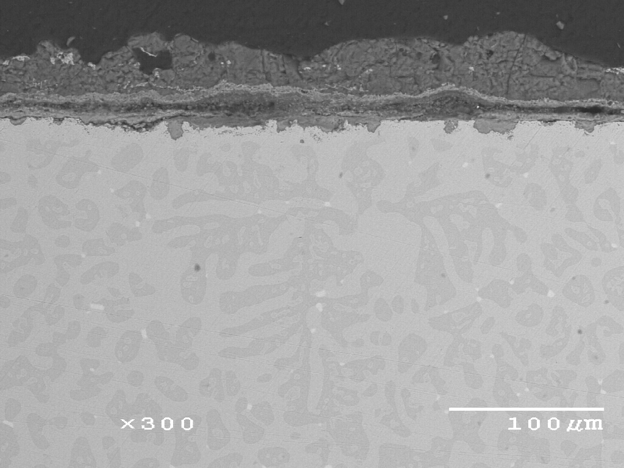
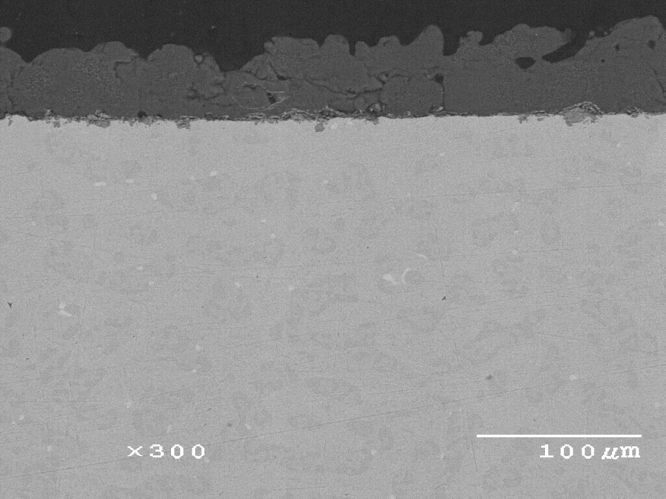
700ºC Hot Corrosion-Volume Fraction of β-NiAl, V_{f}(β)
Na₂SO₄ Deposit, O₂-1000ppmSO₂, 5×20h cycles
Ni-18Co-26Al-20Cr-0.1Y
V_{f} (β)=77%
Ni-18Co-18Al-28Cr-0.1Y
V_{f} (β)=46%
Ni-20Co-12Al-35Cr-0.1Y
V_{f} (β)=18%
Na₂SO₄ Salt
Na₂SO₄ Salt
(Ni,Co)O
Corrosion product
Poor resistance
∆m = 33 mg/cm²
Good resistance
∆m = 4.85 mg/cm²
Excellent resistance
∆m = 0.19 mg/cm²

Slide 14
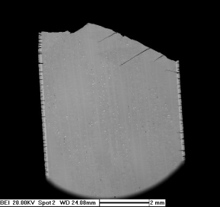
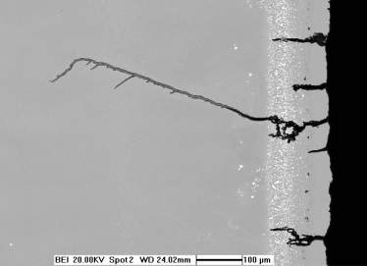
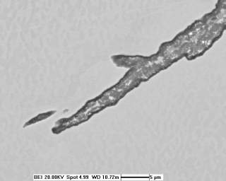
Example of concurrent degradation modes
Oxidation-Fatigue Damage
Multiple crack origins at coating surface
γ’-depleted zone around crack
Oxide-filled crack
crack branching
Courtesy: Ram Darolia (GE)

Slide 15
Priority Future Research Directions Include:
Understanding the surface-reaction behavior of multiphase materials exposed to multi-component reactive gases …. with and without the inclusion of deposits
Accounting for concurrent degradation processes (e.g., surface reactions during mechanical loading).
Developing lab-scale testing procedures that accurately represent what is found in practice.
Addressing these priorities can be facilitated by the use of advanced computation and characterization techniques.
Probing different temporal and spatial scales

Slide 16

Thank you for your attention

Slide 18
Forming and Sustaining a Protective Scale
A systems approach is required:
Spallation Behavior Scale Adherence Diffusion Behavior in Alloy
Scale
Oxidant Supply
Deposit
Alloy
- Composition
- Strength
- CTE, E
- Microstructure
There are important fundamental aspects to each component of this system.

Slide 19
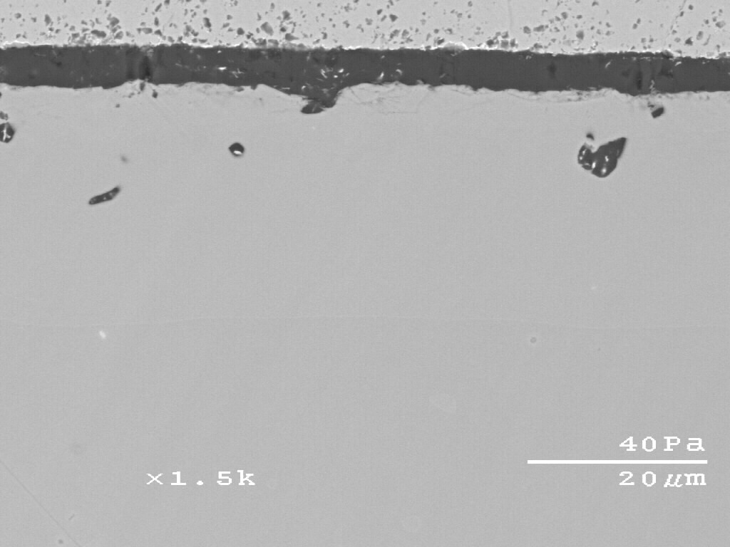
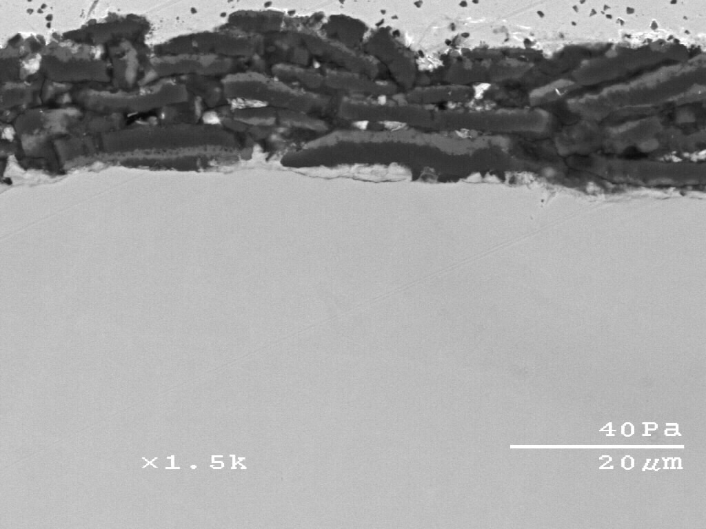
Cyclic Oxidation Kinetics at 1150˚C (2102˚F) in Air
Single doped with Hf or Y vs. Co-doped with Hf+Y
Base composition (at.%): Ni-20Al-5Cr
0.1Hf-0.05Y
-0.05Hf

Slide 20
Factors Affecting Oxidation
It is well established that oxide formation on an alloy surface is a function of numerous variables, including:
structure and crystallographic orientation of the surface
material microstructure (phases, defects, etc)
the principal oxidizing species (i.e., O₂, CO₂, or H₂O) and its partial pressure
alloy composition and, in particular, surface composition
oxide stabilities and competitive nucleation/growth processes
Compounding factors such as an imposed stress, thermal cycling, erosion, etc.
Many of these factors are well established, but are poorly understood
from a fundamental standpoint

Slide 21
Fundamental Questions Related to Surface Reactions Include:
To what extent does oxidation behavior change when complexities like loading (cyclic or static), deposits and/or or additional oxidants are imposed?
Can steady-state scaling kinetics be influenced in a controllable manner by the product formed in the very early stages of exposure?
Can reaction behavior be effectively modeled for multi-component systems exposed to multi-oxidant conditions?

Slide 22
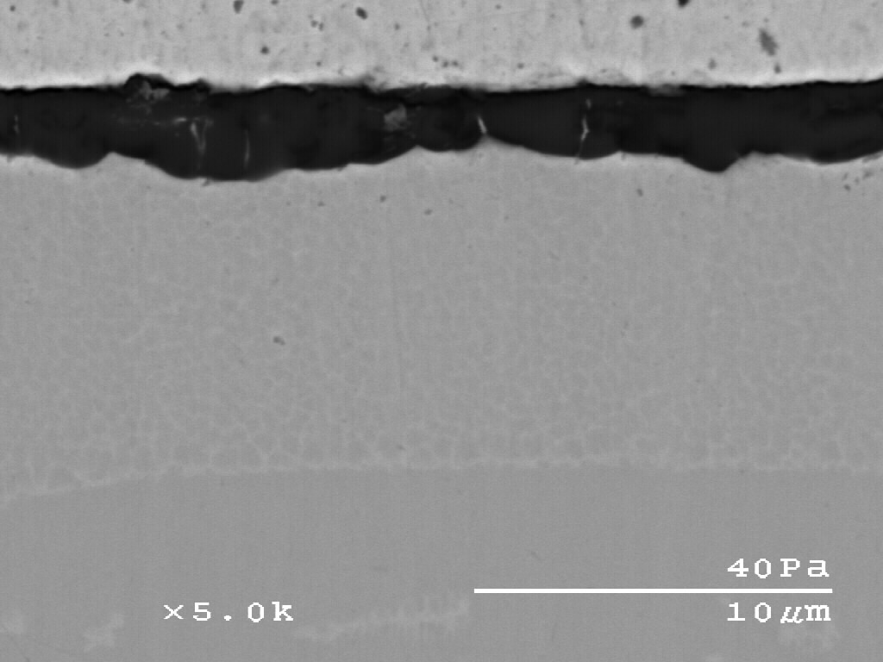
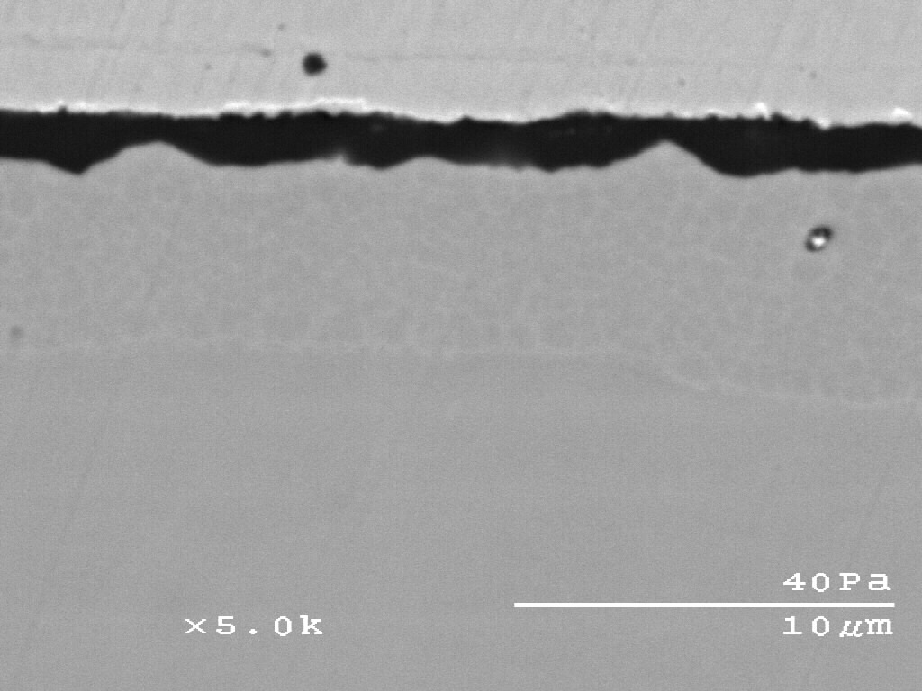
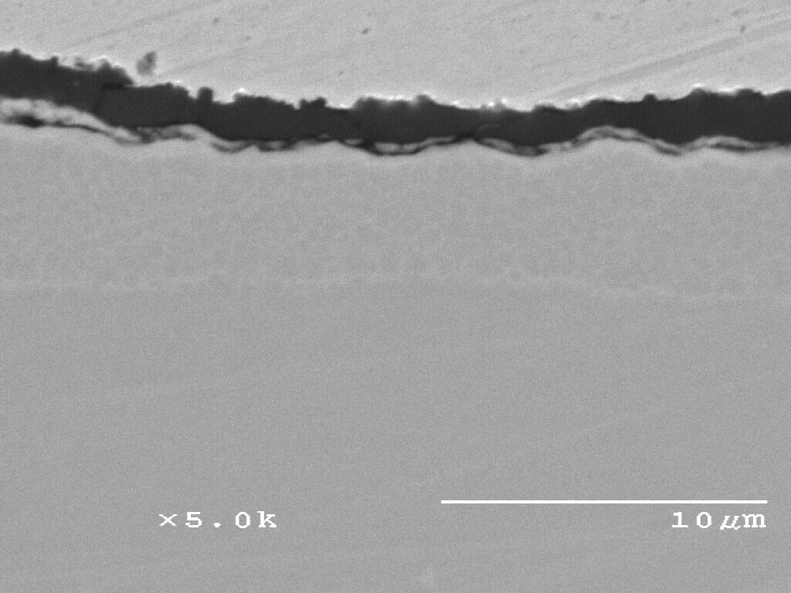
Isothermal oxidation behavior of
Ni-20Al-5Cr-based γ-Ni+γ′-Ni₃Al alloys single vs. co-doping
-0.05Y
-0.05Hf-0.05Y
-0.1Hf-0.05Y
The oxidation rates of co-doped alloys are between those of Hf- and Y-doped alloys
-0.05Hf

