Slide 1
Thank you for participating in today’s session:
Tribal Listening Session for the Draft Environmental Impact Statement for Department of Energy Activities in Support of Commercial Production of High-Assay Low-Enriched Uranium (HALEU)
This meeting will begin shortly.

Slide 2

Wendy Green Lowe
P-2 Solutions
Tribal Listening Session Facilitator

Slide 3
Session Information
A copy of this presentation is currently available online.
A recording will be available on the project website within 1 week.
Please hold questions and comments until the end of the presentation.
This meeting is closed to the press and the public
For a copy of the presentation, please visit: https://www.energy.gov/ne/haleu-environmental-impact-statement

Slide 4
Tribal Listening Session for the Draft Environmental Impact Statement for Department of Energy Activities in Support of Commercial Production of High-Assay Low-Enriched Uranium (HALEU)
Michael Reim April 10, 11, and 16, 2024
Program Manager
U.S. Department of Energy (DOE)
Office of Nuclear Energy (NE)
Office of Advanced Fuels Technologies

Slide 5



DOE Participants
Michael Reim
Program Manager
U.S. Department of Energy
Office of Nuclear Energy
Office of Advanced Fuels Technologies
Dr. Jon Carmack
U.S. Department of Energy
Deputy Assistant Secretary for Nuclear Fuel Cycle and Supply Chain
Jason Anderson
U.S. Department of Energy National Environmental Policy Act (NEPA) Compliance Office

Slide 6
Presentation Overview
High-Assay Low-Enriched Uranium (HALEU)
What is HALEU?
Why is HALEU needed?
  Purpose and Need
HALEU Request for Proposals (RFPs)
National Environmental Policy Act (NEPA)
Proposed Action and Alternatives
Activities Covered in the HALEU Environmental Impact Statement (EIS)
Approach to Impact Analysis
Summary of Potential Impacts

Slide 7
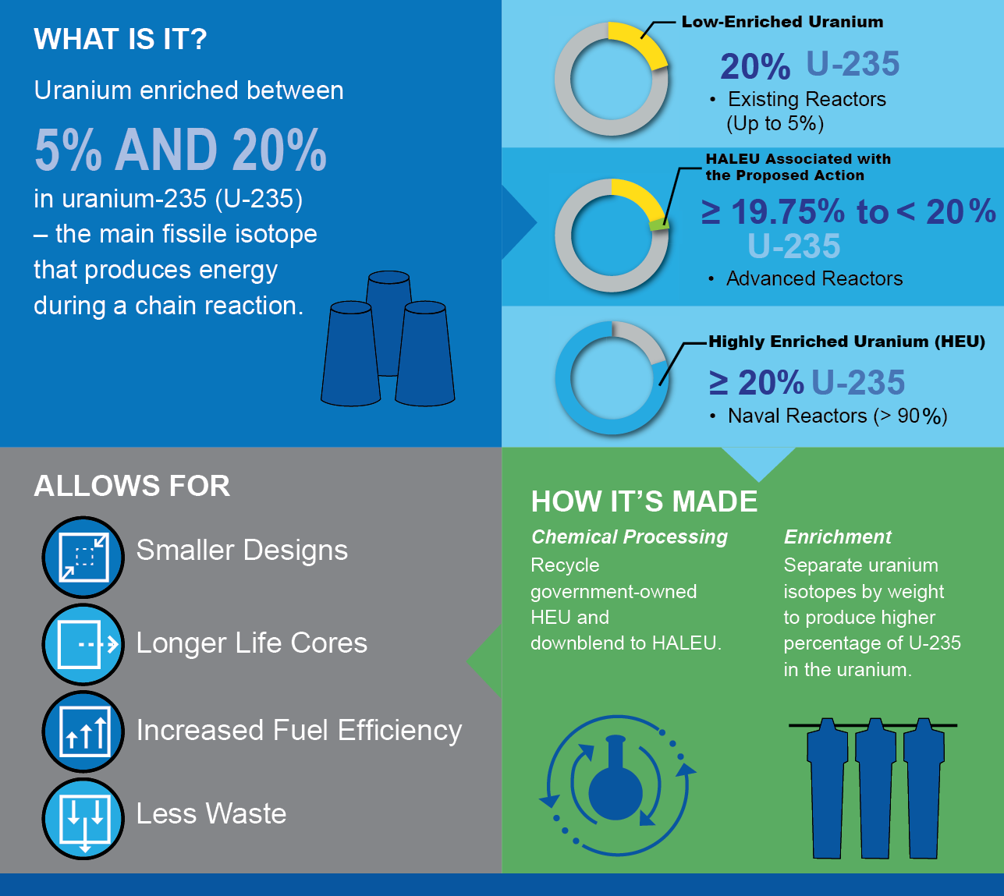
What is HALEU?
High-Assay Low-Enriched Uranium
7

Slide 8
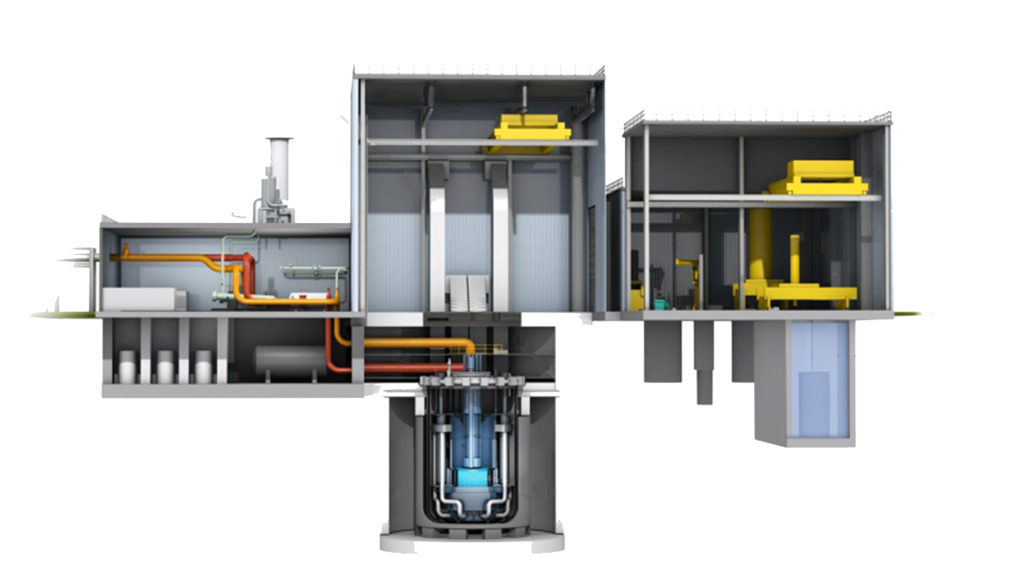
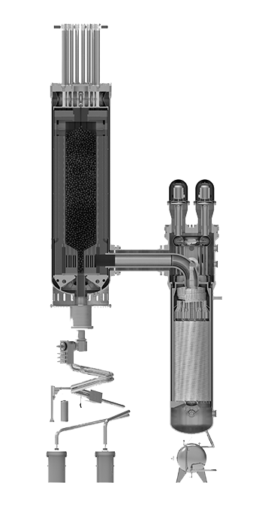
Why is HALEU needed?
Natrium Reactor
Sodium-cooled fast reactor + molten salt energy storage system
TERRAPOWER
Kemmerer, Wyoming
XE-100
High-temperature gas-cooled reactor
X-Energy
Seadrift, Texas
A next generation fuel for
next-generation nuclear reactors.

Slide 9
Purpose and Need
Section 3131 of the Nuclear Fuel Security Act of 2023
  Among other things, seeks
  to expeditiously increase domestic production of HALEU to meet the needs
  of advanced nuclear
  reactor developers and
  the consortium
  established under Section 2001(a) of the Energy Act
  of 2020.
Section 2001(a) of the Energy Act of 2020
  “The Secretary shall establish and carry out, through the Office of Nuclear Energy, a program to support the availability of
  HA–LEU for civilian domestic research, development, demonstration, and commercial use...”
(42 U.S.C. 16281; 134 Stat. 2453; Pub. L. 116-260 Div Z)
The Energy Act of 2020 and Nuclear Fuel Security Act of 2023

Slide 10
HALEU Enrichment RFP
RFP was issued in January 2024
Read more:
  https://www.energy.gov/ne/haleu-enrichment-services
HALEU Deconversion RFP
RFP was issued in November 2023
Read more:
  https://www.energy.gov/ne/haleu-deconversion-services
HALEU Requests for Proposals (RFPs)
Enrichment and Deconversion RFPs

Slide 11
National Environmental Policy Act (NEPA)
HALEU Environmental Impact Statement (EIS) (HALEU EIS)

Slide 12
Proposed Action Alternative
The Proposed Action is to acquire, through procurement from commercial sources, HALEU enriched to at least 19.75 and less than 20 weight percent uranium-235 (U-235) over a 10-year period of performance, and to facilitate the establishment of commercial HALEU fuel production.
No Action Alternative:
The No Action Alternative is the status quo, where DOE would not implement the Proposed Action.
Proposed Action & Alternatives

Slide 13
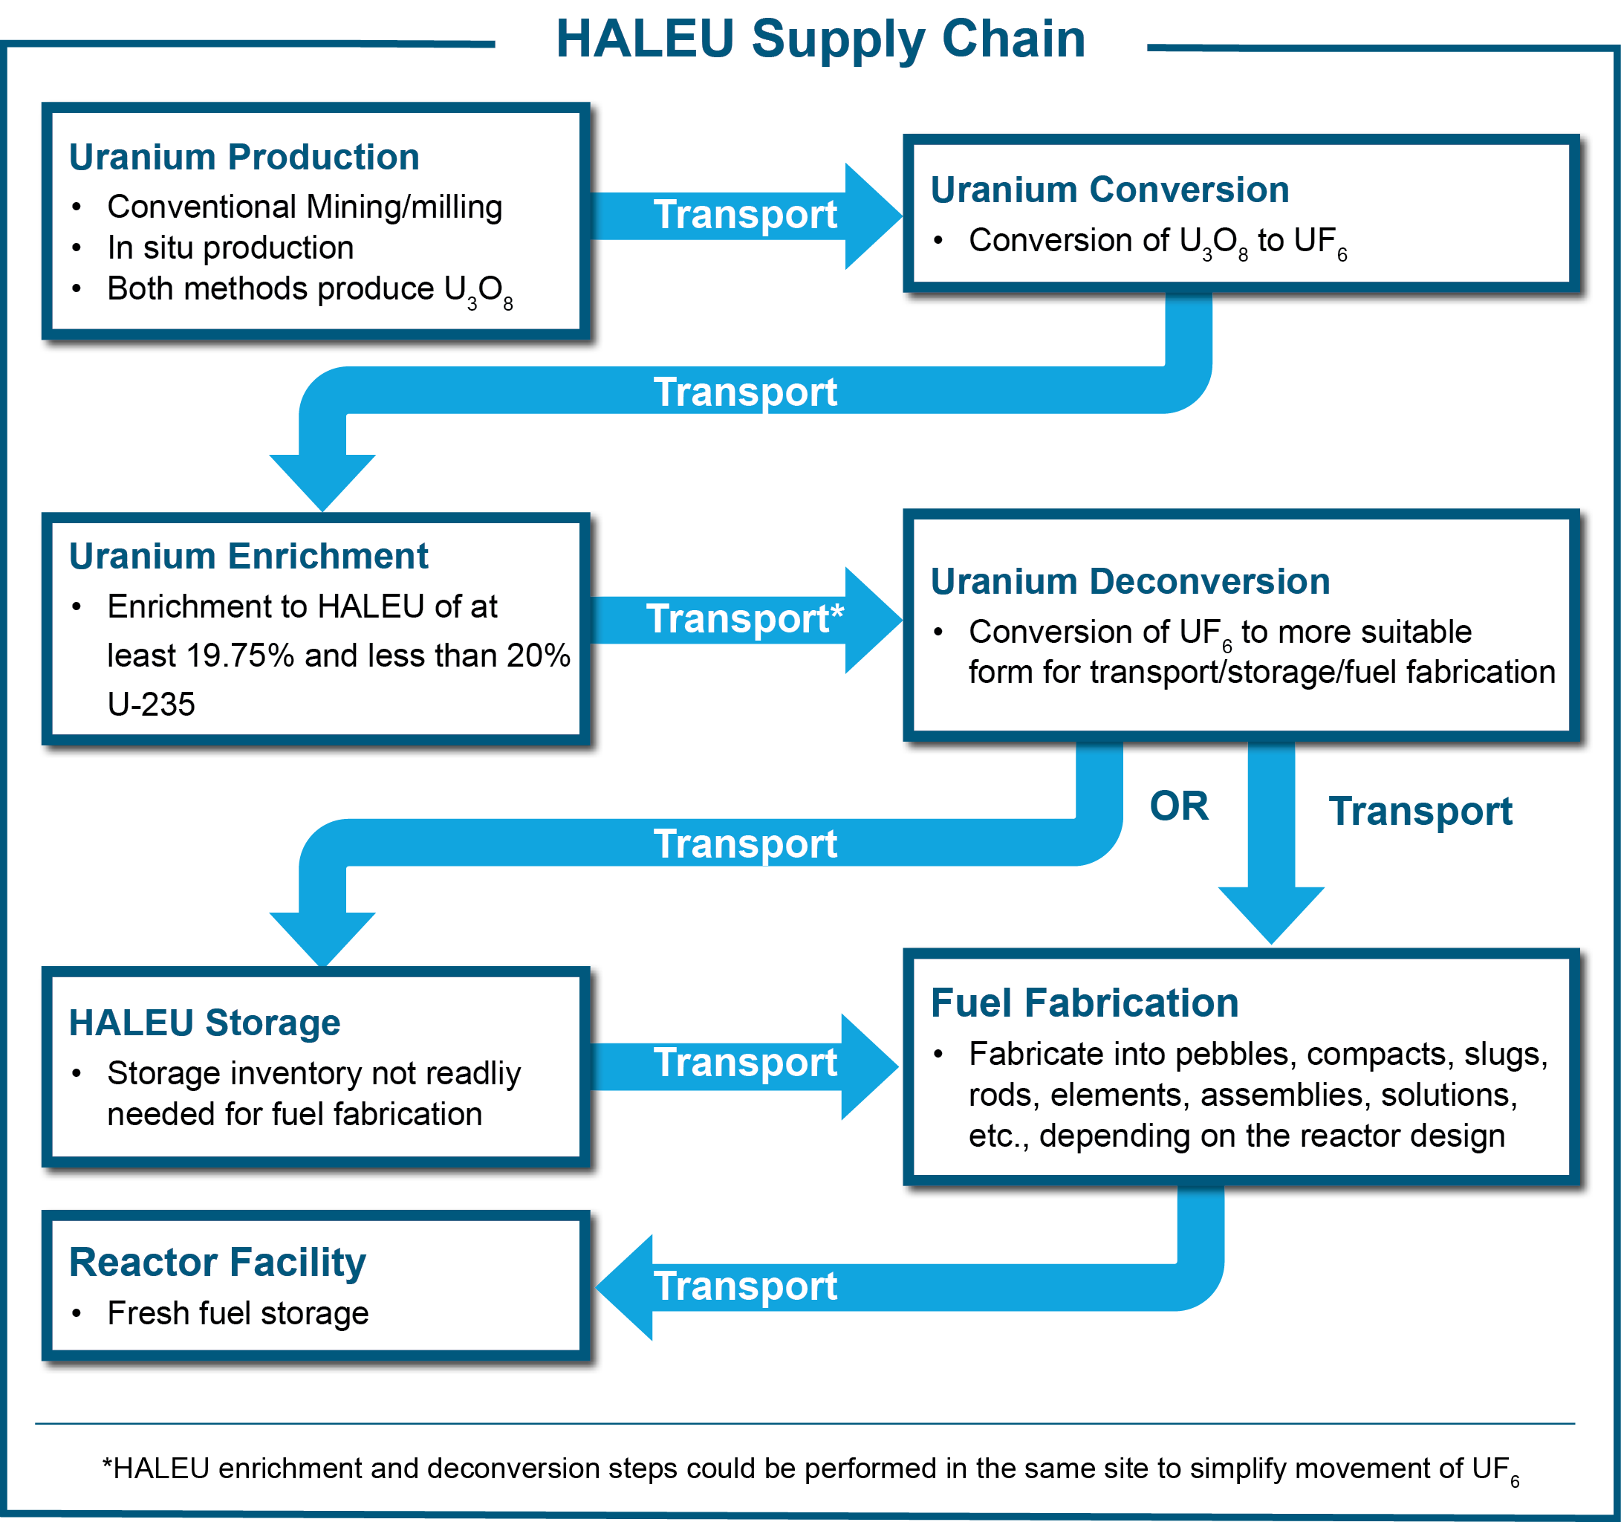
HALEU EIS
Activities Covered in the EIS

Slide 14
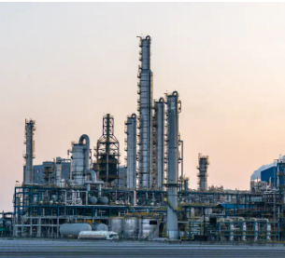
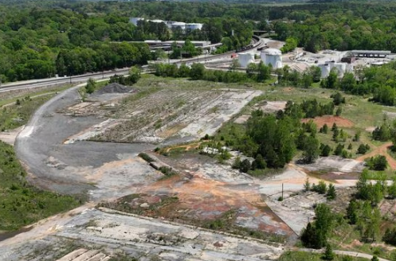

Approach to Impact Analysis
  Existing uranium fuel cycle facilities
  Other industrial (brownfield)
  sites
Existing NEPA evaluations were used to assess similar facility construction and operation located at the following:
  Previously undeveloped (greenfield) sites

Slide 15
Summary of Potential Impacts
  Existing uranium fuel cycle facilities: Most impacts would be SMALL
  Other industrial (brownfield) sites: Impacts generally range from SMALL to MODERATE
This slide summarizes the potential impacts of siting at the three location scenarios.
  Previously undeveloped (greenfield) sites: Impacts generally range from SMALL to MODERATE

Slide 16
Thank you for your participation.

Slide 17
Questions?
Request Government-to-Government Consultation
Email: HALEU-EIS@nuclear.energy.gov
Please include “Consultation” in the
subject line
U.S. Mail:
Mr. James Lovejoy
HALEU EIS Document Manager
U.S. Department of Energy
Idaho Operations Office
1955 Fremont Avenue, MS 1235
Idaho Falls, ID 83415*
* The Idaho address does not indicate a preference for the use of facilities located in Idaho
To ask a question, please use Zoom’s “raise hand” feature. When called, please introduce yourself and your Tribal affiliation.

Slide 18
How to Submit Formal Comments
Provide comments TODAY by:
Providing an oral comment during this broadcast
Submitting a comment into the chat
Submit comments LATER via:
Email (with “HALEU EIS” in the subject line):
HALEU-EIS@nuclear.energy.gov
Or U.S. Mail:
ATTN: Mr. James Lovejoy,
HALEU EIS Document Manager,
U.S. Department of Energy,
Idaho Operations Office,
1955 Fremont Avenue, MS 1235
Idaho Falls, Idaho 83415
Comments should be postmarked by April 22, 2024, to ensure consideration in the Final EIS.
45-day Public Comment Period Begins
March 8, 2024
Tribal Listening Sessions
April 10, 11, and 16, 2024
45-day Public Comment Period Ends
April 22, 2024
Final EIS Issued
Fall 2024
For more project information, please visit: https://www.energy.gov/ne/haleu-environmental-impact-statement

Slide 19
Oral Comment Period
DOE respectfully requests feedback and comments on the Draft EIS. All comments received, whether spoken, written, or electronic, will be given equal consideration.
To submit a comment, please use Zoom’s “raise hand” feature. When called, please introduce yourself and your Tribal affiliation.

Slide 20
Thank you for your participation.

Slide 21
Comments Received During Scoping
Comment Topics
Tribal Consultation
Transportation
Support
Storage
Spent Fuel Management
Regulatory Concern
Reactor Technologies
Purpose and Need
Out of Scope
Opposition
Nuclear Waste Management
Nonproliferation
NEPA
Fuel Fabrication
Environmental Impacts
Enrichment
EJ & Justice40
Deconversion
Cost Analysis
Conversion
Climate Change
Alternatives
Accidents & Human
Health
The scoping period for the
HALEU EIS took place from
June 5, 2023, to July 20, 2023.
All comments were considered in developing
the Draft EIS.

